Slide 1

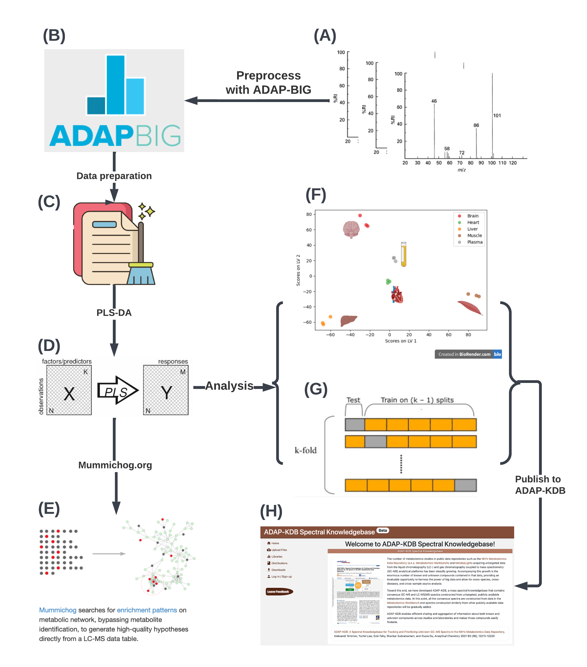
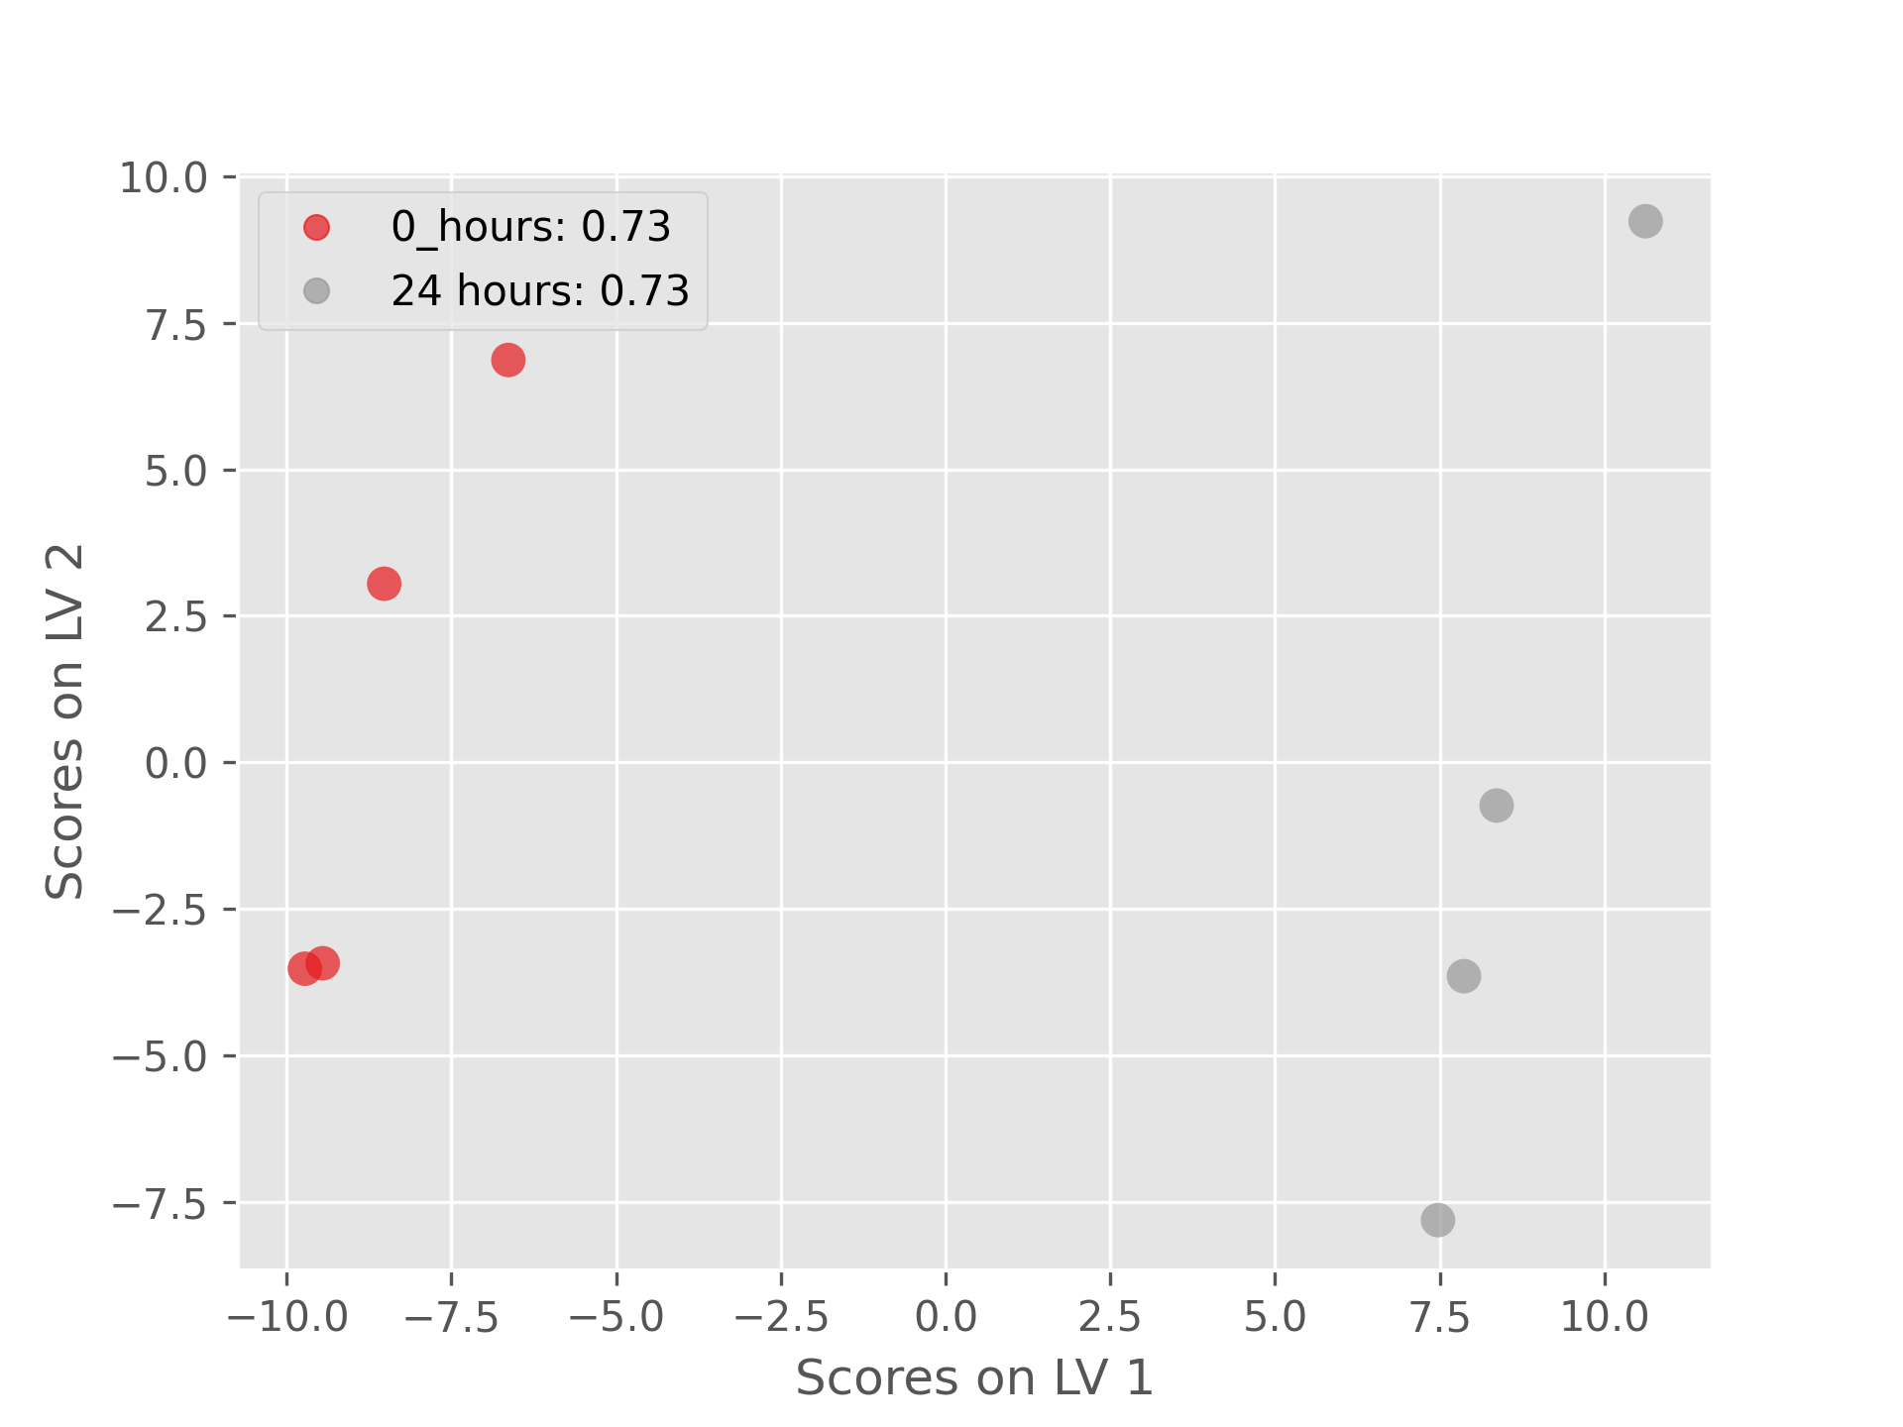
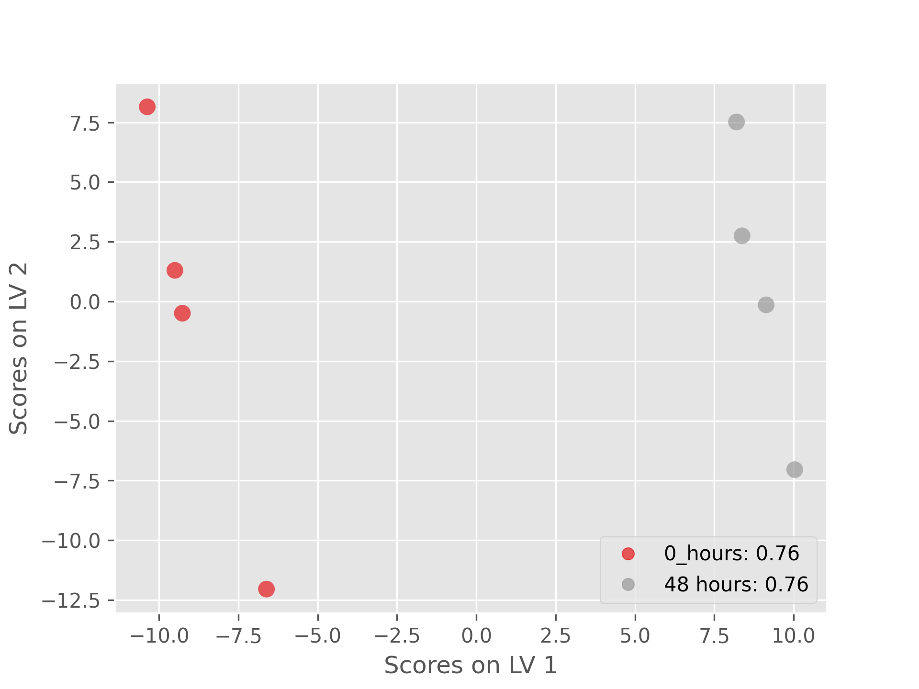
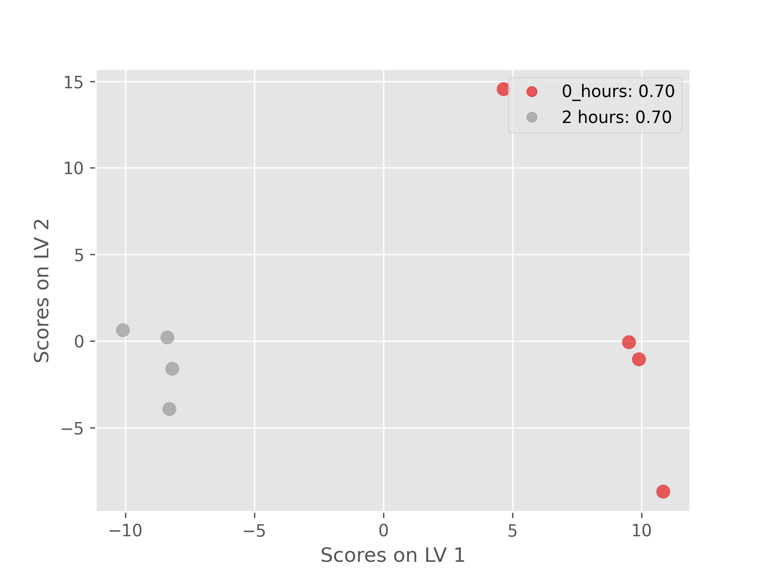
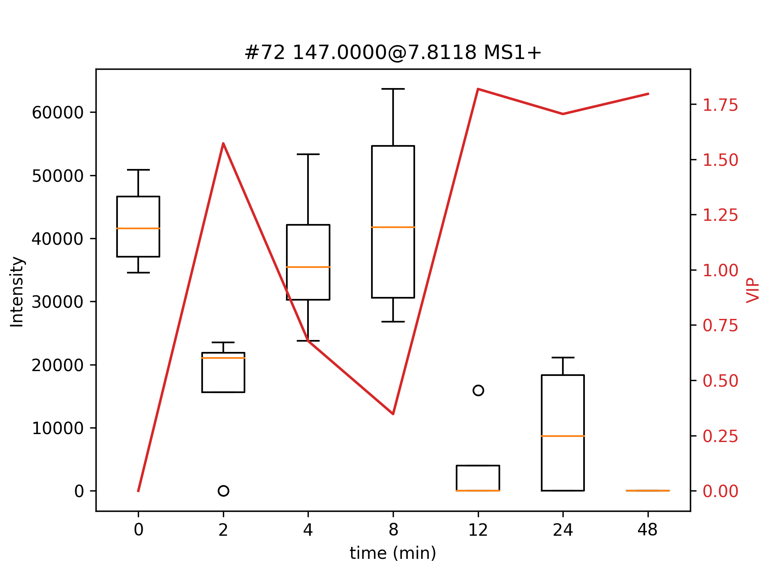
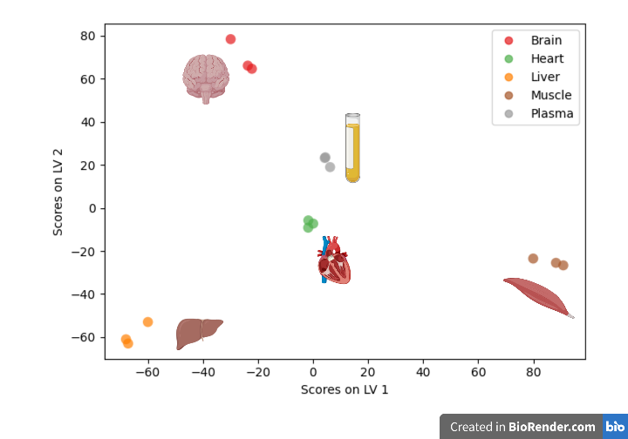
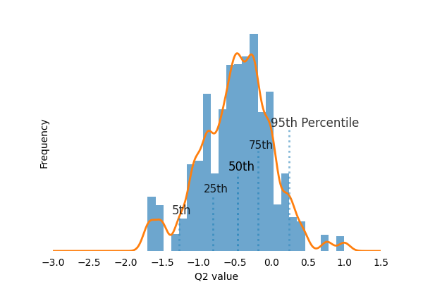
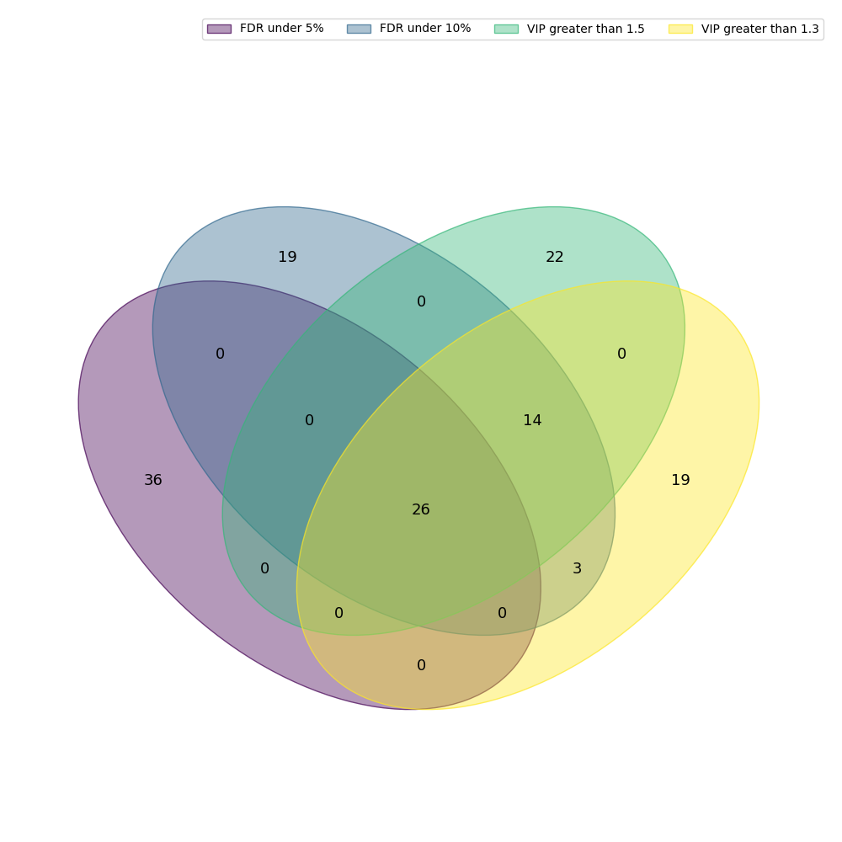
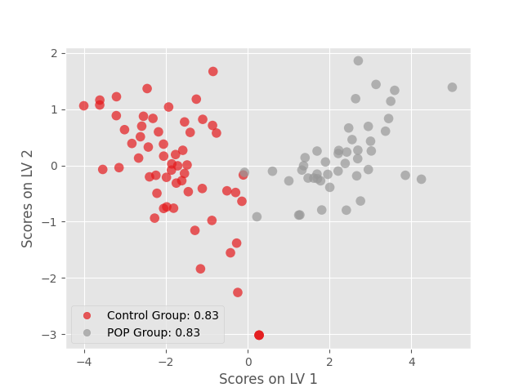
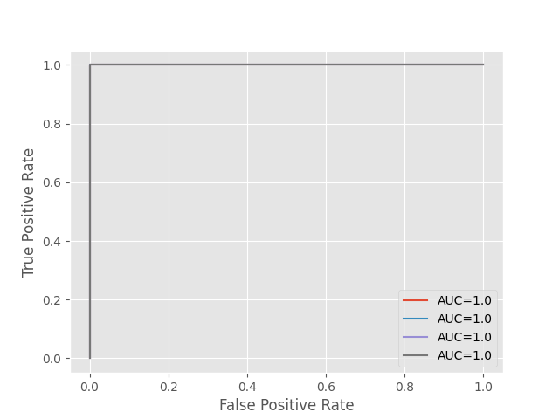
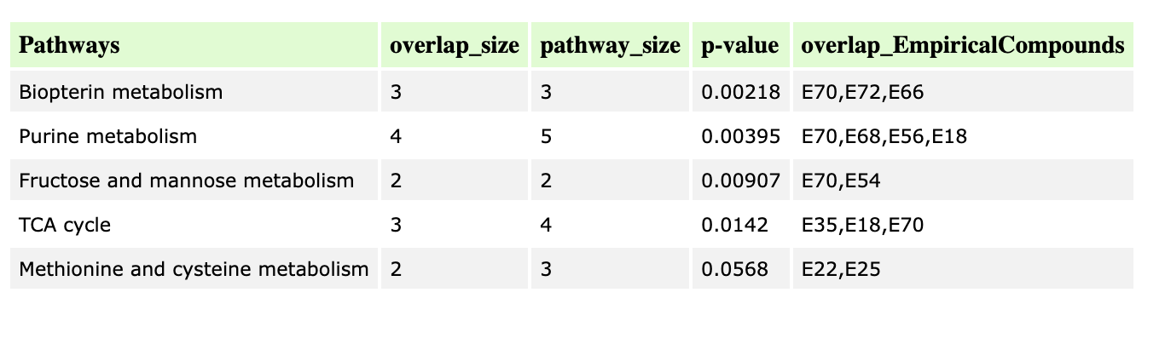
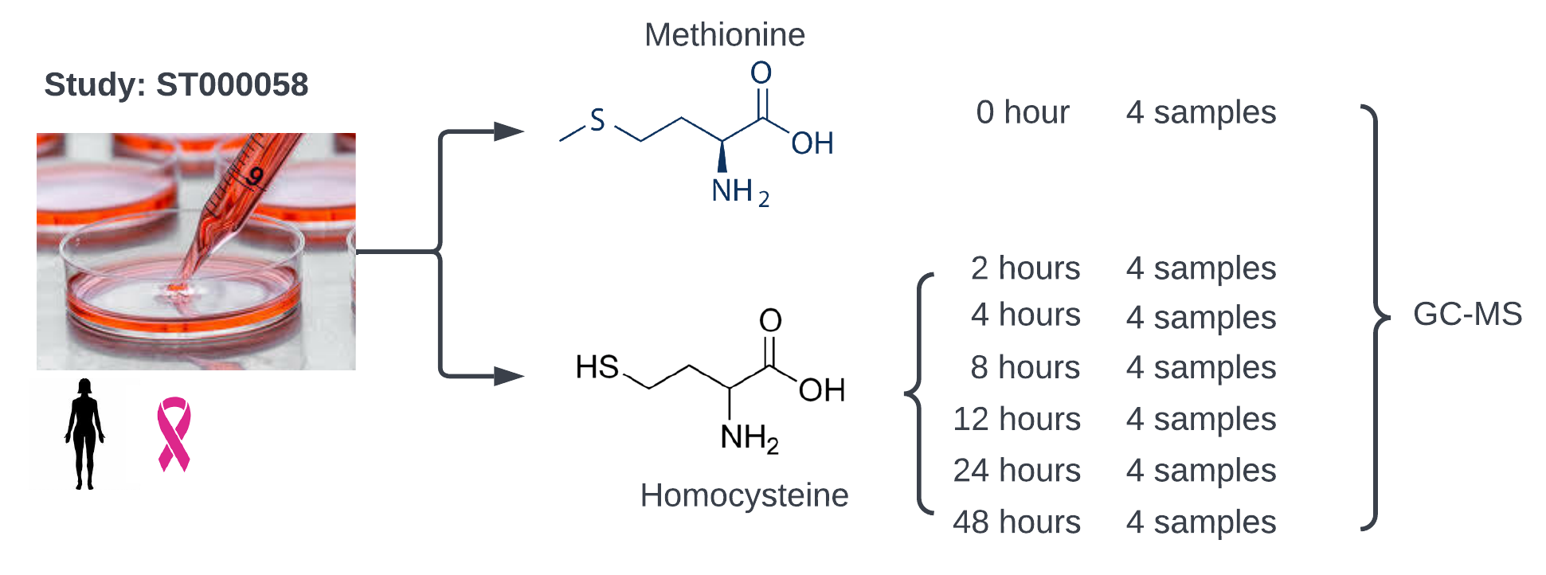


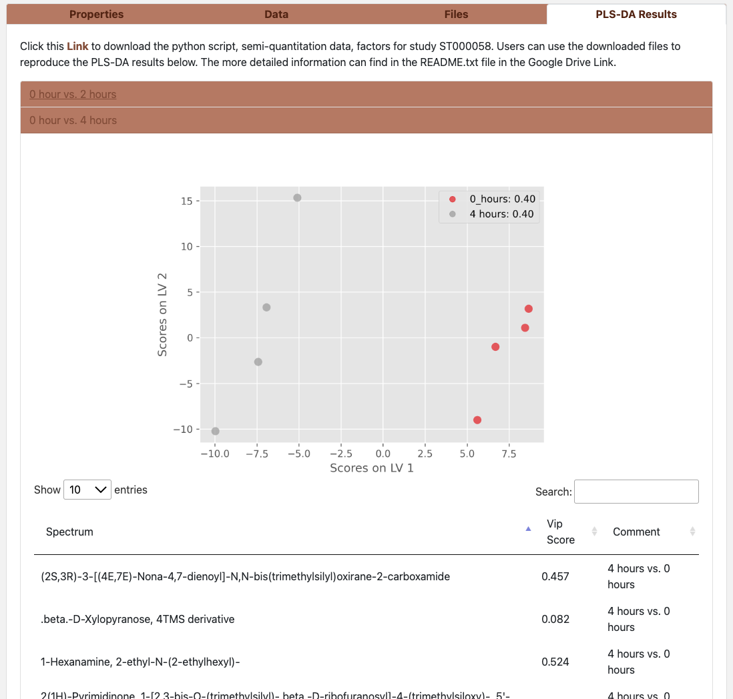
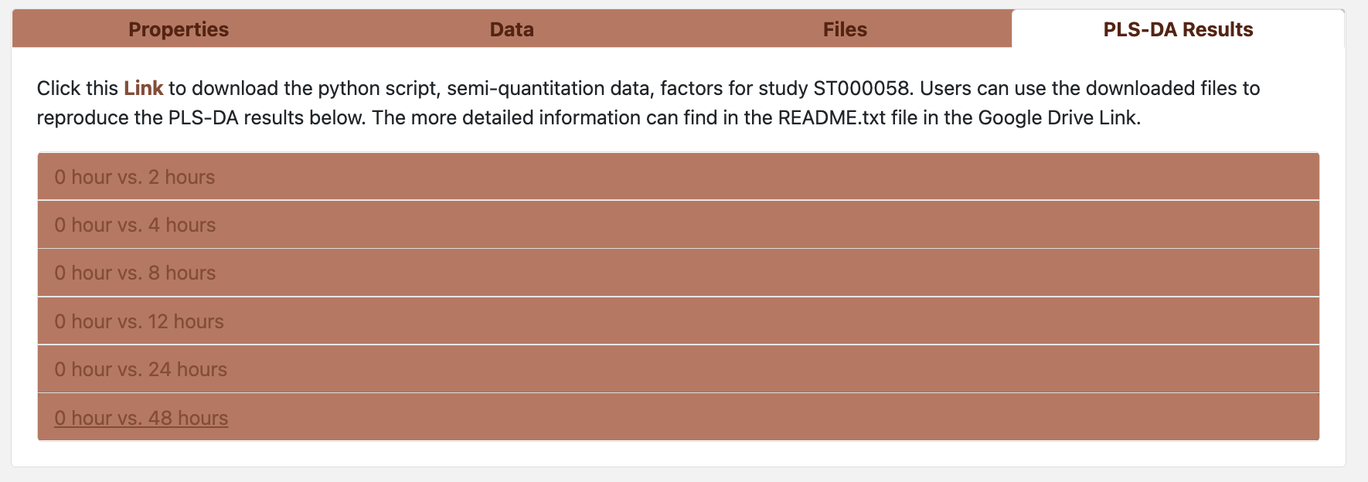
Extraction of Metabolic Signatures from Untargeted Metabolomics Data in Public Data repositories
Yunfei Liao; Aleksandr Smirnov; Xiuxia Du
University of North Carolina at Charlotte, Charlotte, NC
Introduction
Methods
Results
(A)
(C)
(D)
(B)
(C)
(D)
Biomarkers are indicative of diseases or abnormalities in human bodies and are invaluable in early disease diagnosis. Mass spectrometry-based untargeted metabolomics is a discovery tool and allows researchers to look for a set of metabolites that together can serve as disease biomarkers that are generally more applicable than a single metabolite in diagnosing diseases.
(B)
(E)
(F)
Figure.2 Figures (A) – (D) are for ST000058. From (A) – (C) are the PLS-DA score plots between Methionine treatment and Homocysteine treatment under 2 hours, 24 hours and 48 hours, respectively. (D) is the plot for average intensity and VIP scores changing over the different PLS-DA analysis for one metabolite. (E)
The numbers showing in the legend is Q² score for measuring the PLS-DA models.
(E)
(F)
Figure.2 Figures (A) – (D) are for ST000058. From (A) – (C) are the PLS-DA score plots between Methionine treatment and Homocysteine treatment under 2 hours, 24 hours and 48 hours, respectively. (D) is the plot for average intensity and VIP scores changing over the different PLS-DA analysis for one metabolite. (E)
The numbers showing in the legend is Q² score for measuring the PLS-DA models.
Data
(A)
(B)
(C)
Study ST000058 in the Metabolomics Workbench shows metabolites changes associated with methionine stress sensitivity of cancer using GC-MS analysis.
Studies MTBLS1033 in the Metabolights study metabolic pathway and biomarkers associated with pelvic organ prolapse. (Control samples: 59, POP disease samples: 45, and Pooled Quality Control samples: 14)
Figure.1 Informatics workflow for extracting metabolic signatures. (A) Raw mass spec data; (B) Data preprocessing using ADAP-BIG software tool; (C) Data preparation(data cleaning such as handling null values and targets identification.); (D) PLS-DA analysis; (E) Pathway analysis using Mummichog [1]; (F) PLS-DA scores plot; (G) Leave-one-out cross validation; (H) Publish results to the cloud resource ADAP-KDB at https://www.adap.cloud/ [2].
95% Confidence Intervals (1.0, 1.0)
Figure.2 Figures (A) – (D) are for ST000058. From (A) – (C) are the PLS-DA score plots between Methionine treatment and Homocysteine treatment under 2 hours, 24 hours and 48 hours, respectively. (D) is the plot for average intensity and VIP scores changing over the different PLS-DA analysis for one metabolite. (E)
The numbers showing in the legend is Q² score for measuring the PLS-DA models.
Figure.3 Figures (A) – (C) are for MTBLS1033. (A) is the PLS-DA score plots between Control group and POP Disease group; (B) is the ROC-AUC result of k-folder validation (k=4) using 20% of the whole sample as testing data and 80% for training and feature selections. (C) The pathway enrichment analysis results from Mummichog
Conclusion
References
Acknowledgement
A total of 12 studies from Metabolomics Workbench have been processed using this pipeline and the results will be uploaded to ADAP-KDB. Among these 12 studies, 2 are LC-MS studies and the rest are GC-MS studies.
[1] Li et al. Predicting Network Activity from High Throughput Metabolomics. PLoS Computational Biology 9.7 (2013): e1003123.
[2] Aleksandr Smirnov, Yunfei Liao, et al. ADAP-KDB: A Spectral Knowledgebase for Tracking and Prioritizing Unknown GC–MS Spectra in the NIH’s Metabolomics Data Repository, Analytical Chemistry 2021 93 (36), 12213-12220
We thank the funding support under the National Institutes of Health/National Cancer Institute grant U01CA235507 (PI: Xiuxia Du).
Figure. 4 ADAP-KDB design to display metabolic signatures
The link to download code and data of the processed studies can be found in the QR code.
Figure. 4 ADAP-KDB design to display metabolic signatures

