Slide 1



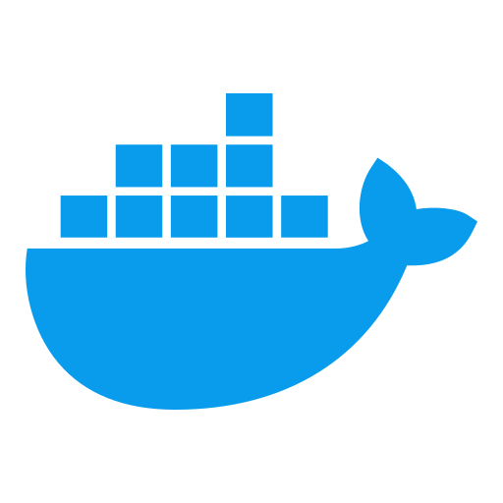

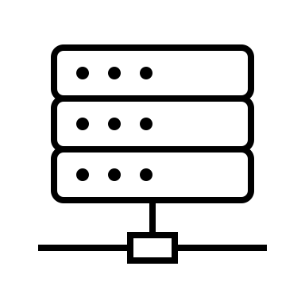


Local PC
Docker Daemon
Bind Mount
DuckDB File
Send command through socket
to launch DBT
Bind Mount
Run DBT
Docker Container
Docker Container
Open-meteo API
Apache Airflow
DBT

