Slide 1
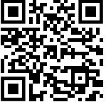
Sign In

Slide 2

Phishing Scams
Presented by: Aidan Fetter

Slide 3
What is a phishing scam?
Social Engineering attack used to steal a person’s data (login information, credit card number(s), etc.)
Malicious links
Installs malware
Freezes systems
Unauthorized purchases
Identity theft
Small or large scale

Slide 4

Types of Phishing Scams
Email Phishing (Ex: Yesterday)
Fake domains
Bad grammar
Forceful language
Don’t know → Don’t click
Spear Phishing
Targets specific individuals (IT, higher-ups)
Whaling- Targets CEO/Highest ranks
Vishing
Voice fishing (phone calls; Ex: “Fraud investigator” calling a victim)

Slide 5

Types of Phishing Scams (Continued)
Smishing
SMS messages (similar to Email Phishing)
Clone Phishing
Copies legitimate emails sent by trusted entities
Ex: Intercepts before reaching victim or re-sends email (“updated”)
Pharming
Hijacks Domain Name System (DNS) to redirect upon click

Slide 6

Types of Phishing Scams (Part 3)
HTTPS Phishing
“More secure” link due to encrypted connection
Seems legitimate
Pop-Up Phishing
Pop-up notifications upon entering
Ex: “Allow” button when prompted for notifications from website
Evil-Twin Phishing
Fake Wi-Fi hotspots
Steals data over connection (Man-in-the-middle attack)

Slide 7
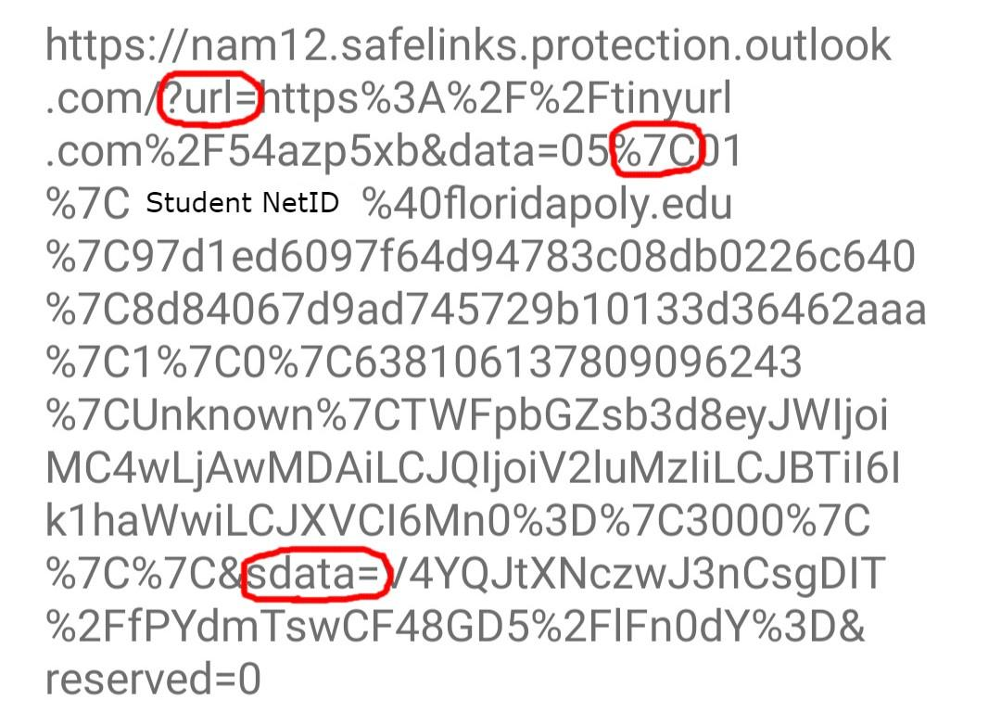
Pipe
? = Query
%2F = “/”
%3D = “=”
sdata = Data encoded in base64

Slide 8

Victims of Phishing Attack
Vishing scam example:
https://www.youtube.com/watch?v=55caoAtaLlw
Email phishing scam example:
https://www.checkpoint.com/cyber-hub/threat-prevention/what-is-phishing/the-top-5-phishing-scams-of-all-times/
Facebook and Google were scammed out of $100 million through a series of invoices sent by Quanta (a Taiwanese vendor company that both tech giants collaborate with)

Slide 9

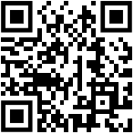
Practice Problems
Please enter the link to join the practice!
https://PollEv.com/aidanfetter870
Notes:
Answers:
1) b
2) d

Slide 10

Practice Problems- TryHackMe (Optional)
TryHackMe link to learn more about Phishing scams: https://tryhackme.com/module/phishing
Notes:
Answers:
1) b
2) d

Slide 11
References
https://www.bluevoyant.com/knowledge-center/8-phishing-types-and-how-to-prevent-them
https://www.imperva.com/learn/application-security/phishing-attack-scam/
https://www.checkpoint.com/cyber-hub/threat-prevention/what-is-phishing/the-top-5-phishing-scams-of-all-times/
Special Thanks to Jacob Zukas

