Slide 1
Subnetting
Created by: Aidan Fetter

Slide 2
What are IP addresses
IPv4
Ex: 192.168.19.22
Classes: A, B, C, D, and E
Link
IPv6
Ex: 2001:0df8:00f2:0000:0000:06ee:0000:0f11 → 2001:0df8:00f2::06ee:0000:0f11 (compression can only appear once)
Ex: 2001:0df8:00f2:0000:0000:0000:0000:0f11 → 2001:df8:f2:0:0:0:0:f11 (Omit leading 0s)
Final address: 2001:0df8:00f2:0000:0000:0000:0000:0f11 → 2001:df0:f2::f10

Slide 3
What is Subnetting?
Subnet/Subnetworks - A separate and identifiable portion of a network (Printer example)
Subnet Masks (Ex: 255.255.0.0 and 192.154.220.20/16)
Number of subnets = 2^{x}, where x = number of 1s in subnet mask
Based on subnets z, take z bits from the host portion
Number of hosts in each subnet = 2^{y} - 2, where y = number of 0s in subnet mask
Ex: We need to subnet 192.168.0.0/24 (Class C address) → 11000000.10101000.00000000.00000000 into two subnets with 50 hosts each.
How do we solve this?

Slide 4
Calculations
Two subnets = 1 bit (2¹)
Subnet mask = 255.255.255.0 = 11111111.11111111.11111111.00000000
New Subnet mask = 255.255.255.128 = 11111111.11111111.11111111.10000000
Number of hosts?
Subnet 1 (Keep original IP address but change mask): 192.168.0.0/25
IP address range: 192.168.0.0 - 192.168.0.127
Subnet 1 (New IP address with new mask): 192.168.0.128/25
IP address range: 192.168.0.128 - 192.168.0.255

Slide 5
IPV6 Subnetting
Subnet mask is called a “Prefix Length” (or “Prefix) and can be any number between 0 and 128
Denotes how many bits of the address define the network
/64 is the standard size of IPv6 subnets
Link

Slide 6
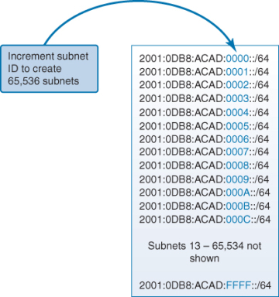

Slide 7
Practice
I want to create 4 subnets with 25 hosts each using the IP address 172.26.85.242 and a subnet mask of 255.255.255.224. Is this possible? If so, what would these subnets look like?
I want to create 2 subnets with 5 hosts each using the IP address 172.26.85.242 and a subnet mask of 255.255.255.224. Is this possible? If so, what would these subnets look like?
Extra Practice

Slide 8
Extra Resources
https://www.cloudflare.com/learning/network-layer/what-is-a-subnet/#:~:text=A%20subnet%2C%20or%20subnetwork%2C%20is,routers%20to%20reach%20its%20destination
https://www.cloudaccess.net/cloud-control-panel-ccp/157-dns-management/322-subnet-masks-reference-table.html
https://www.solarwinds.com/resources/it-glossary/subnetting
https://www.dnsstuff.com/subnet-ip-subnetting-guide
https://www.subnetting.net/Start.aspx

