Slide 1
Embedded Softwares
for the
Internet of Things
SmartSense
Members:
Giovanni Vitiello (Group leader)
Trisha Agrawal
Christian Li Sivertsen
Frederico Gasperi
Group number 13

Slide 2
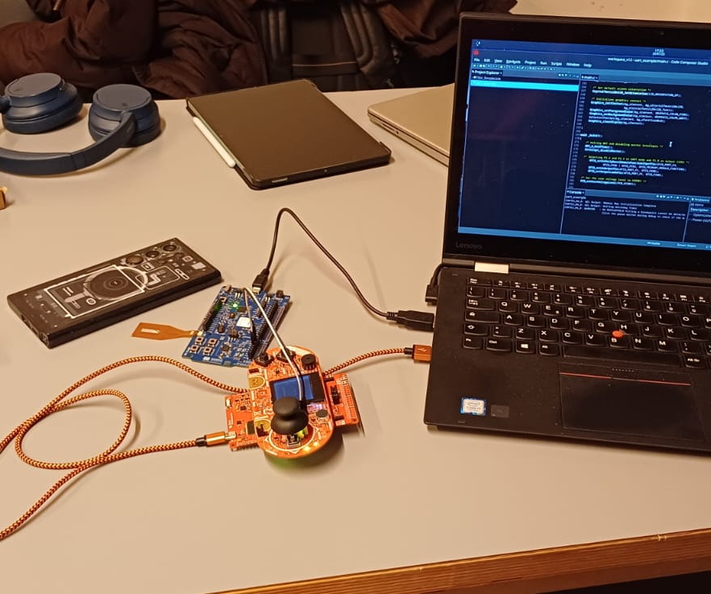
Purpose

Slide 3
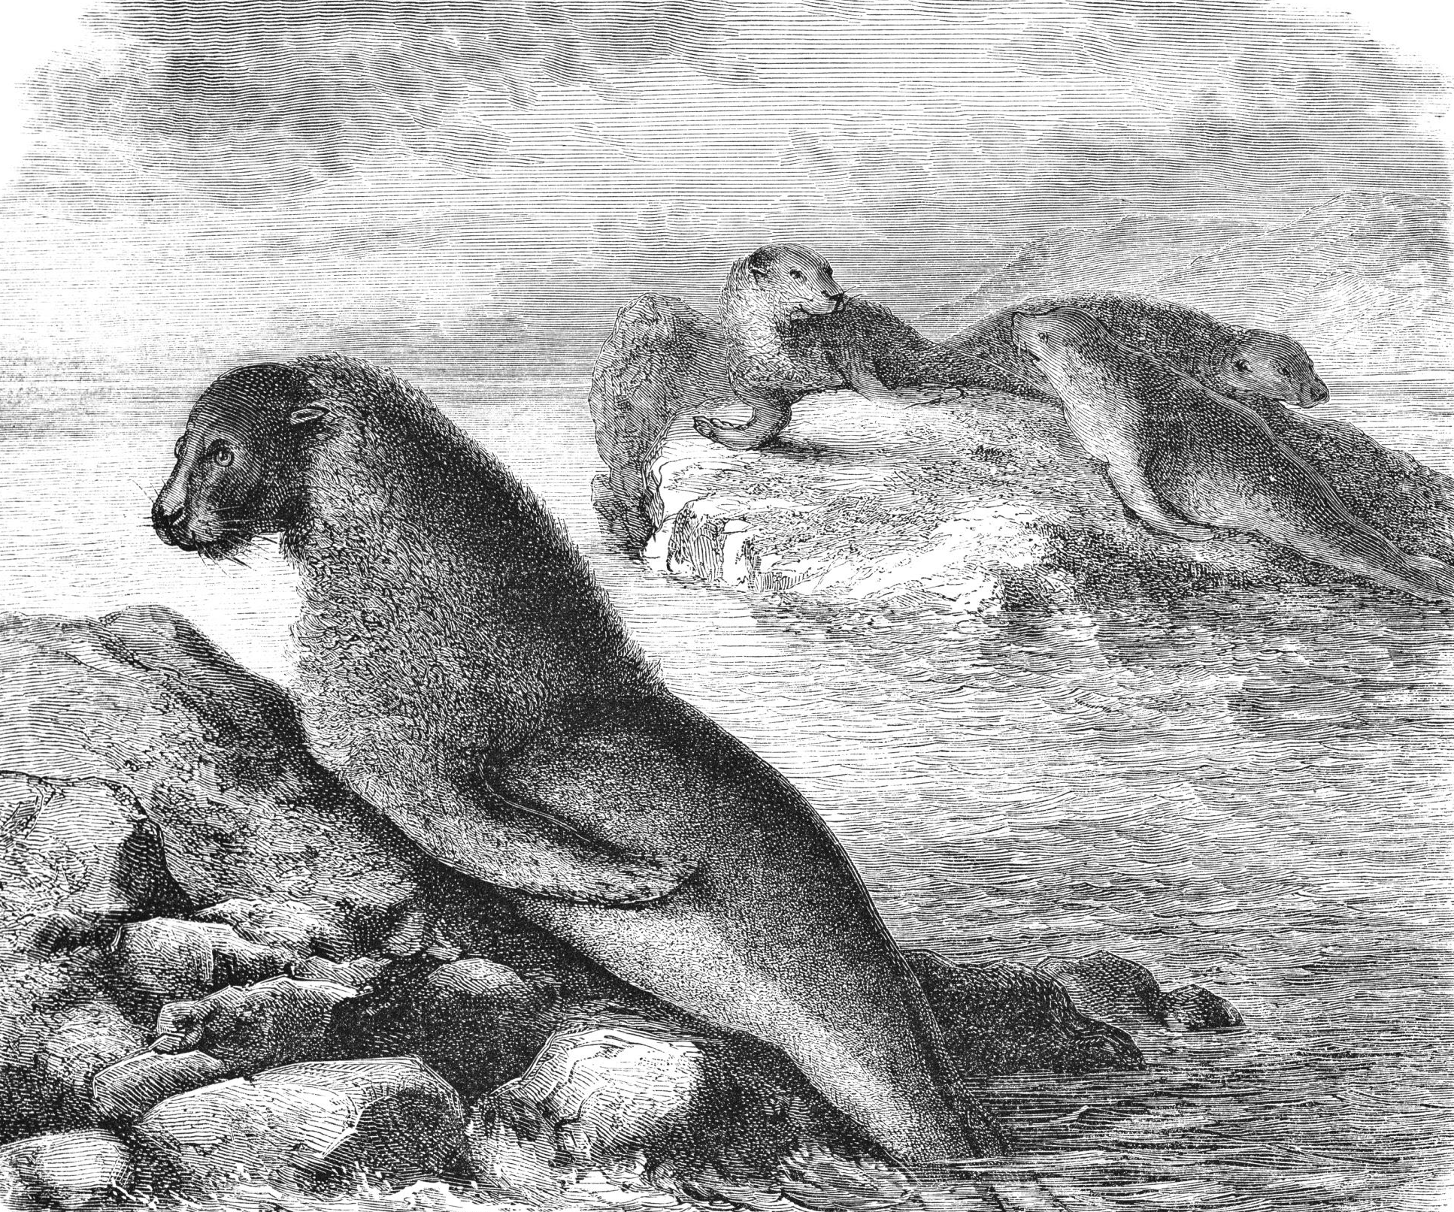
Working Scheme
FSM diagram next to this text

Slide 4
Software Architecture

Slide 5
Member Contribution
Trisha
Giovanni
Christian
Frederico

Slide 6
Future Works

Slide 7
Thank You
Breathe fresh, be ahead

