Slide 1
Embedded Softwares
for the
Internet of Things
SmartSense
Members:
Giovanni Vitiello (Group leader)
Trisha Agrawal
Christian Li Sivertsen
Frederico Gasperi
Group number 13

Slide 2
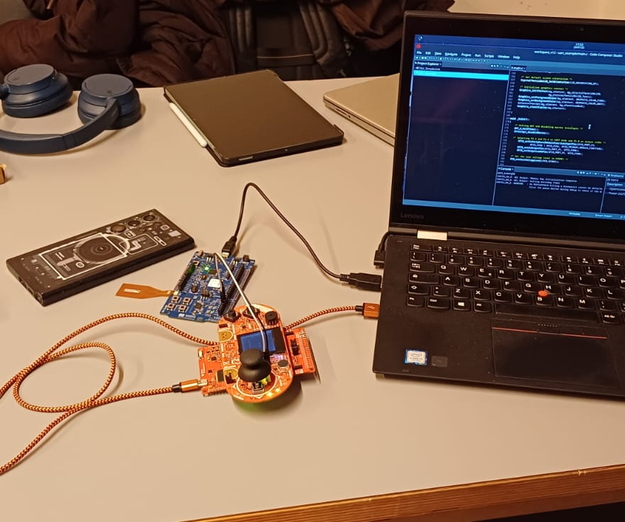
Purpose
To monitor air quality, humidity and temperature of environment
To promote healthy lifestyle
To prevent diseases s.a. flu
To keep updates on current state of air

Slide 3
Software Architecture
Nordicthing 52 is bluetooth setup
Assigning ports to sensor
Uses interrupt every time joystick is given a command
Sends data
Nordic nrf52 requests specific data
Processes it and sends to UART ports
MSP 324 BoosterPack displays request

Slide 4
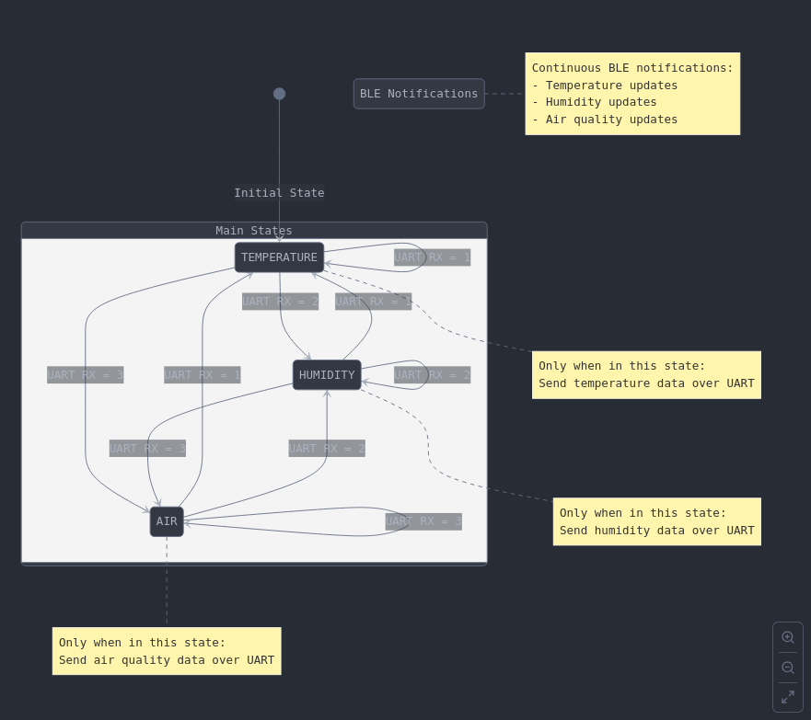
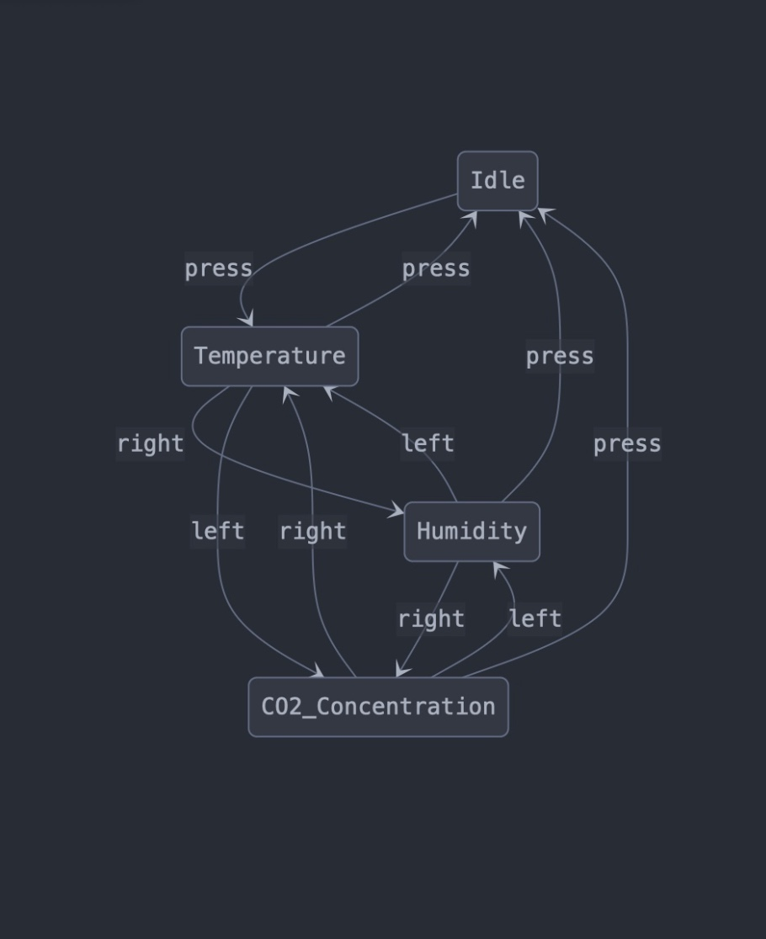
Working Scheme
NordicThingy52 and Nordic nrf52
Boosterpack

Slide 5
Member Contribution
Trisha Agrawal
Giovanni Vitiello
Testing
ReadMe (GitHub)
Project Presentation Slides
Project Presentation Video
Bluetooth
Christian Li Sivertsen
Frederico Gasperi
Finite State Machine
Joystick
Graphics
UART

Slide 6
Future Works
Addition of Audio Feedback
  Making a buzz sound for excessive Carbon Dioxide particles in environment
  On NordicThingy 52
Additional pressure measurements
And many more…

Slide 7
Thank You
Breathe fresh, be ahead

