Slide 1

CAN Bus implementation Embedded lab
Muhammad Affan Ul Haq Khan
Syed Arslan
Zukran Khan

Slide 2

Outline
What is CAN Bus?
CAN Frame
Code

Slide 3
What is CAN Bus
Vehicle bus standard[1]
Message based protocol[1]

Slide 4
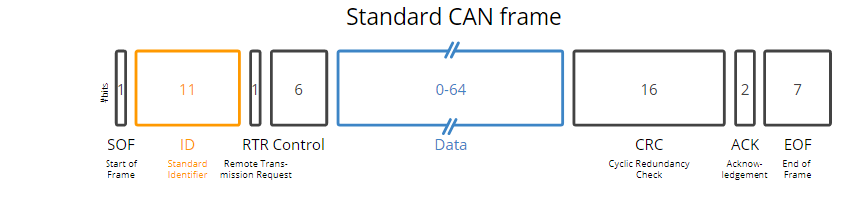
CAN Frame [2]

Slide 5
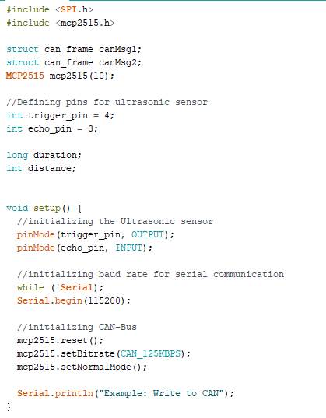
Code(transmitter)

Slide 6
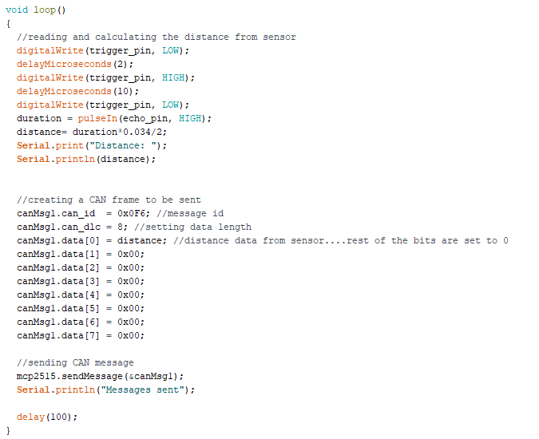
Code(transmitter)

Slide 7
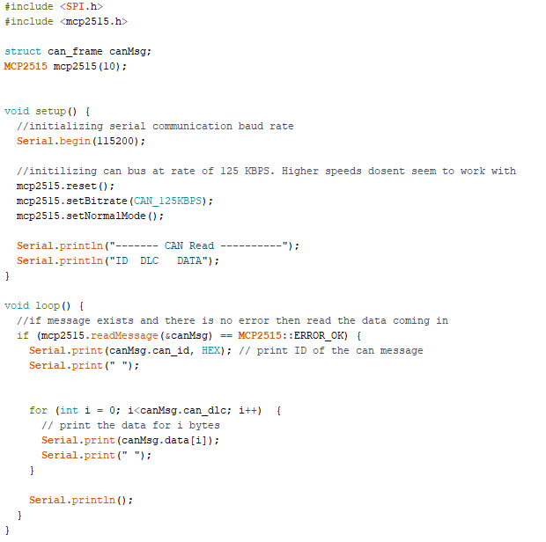
Code(receiver)

Slide 8
References
[1] CAN bus (https://en.wikipedia.org/wiki/CAN_bus)
[2] CAN Bus Explained - A Simple Intro [2022] (https://www.csselectronics.com/pages/can-bus-simple-intro-tutorial

