Slide 1
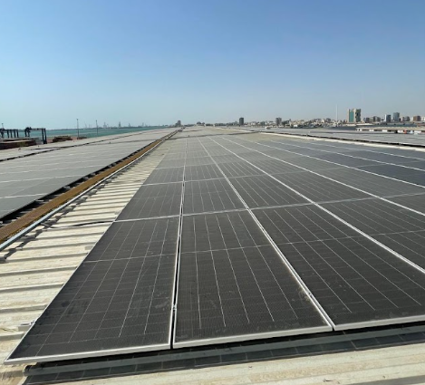
PROJECT 01
Amazon Jeddah Solar PV
2.0 MWp · Jeddah, Saudi Arabia
PROJECT DESCRIPTION
A Rooftop Solar PV project at Amazon, Jeddah, Saudi Arabia. Delivered as a Turnkey EPC project to support clean and renewable energy generation.
Add project image here
KEY FACTS
Capacity
2.06 MWp
Location
Jeddah, Saudi Arabia
Scope
Turnkey EPC
Status
Completed

Slide 2
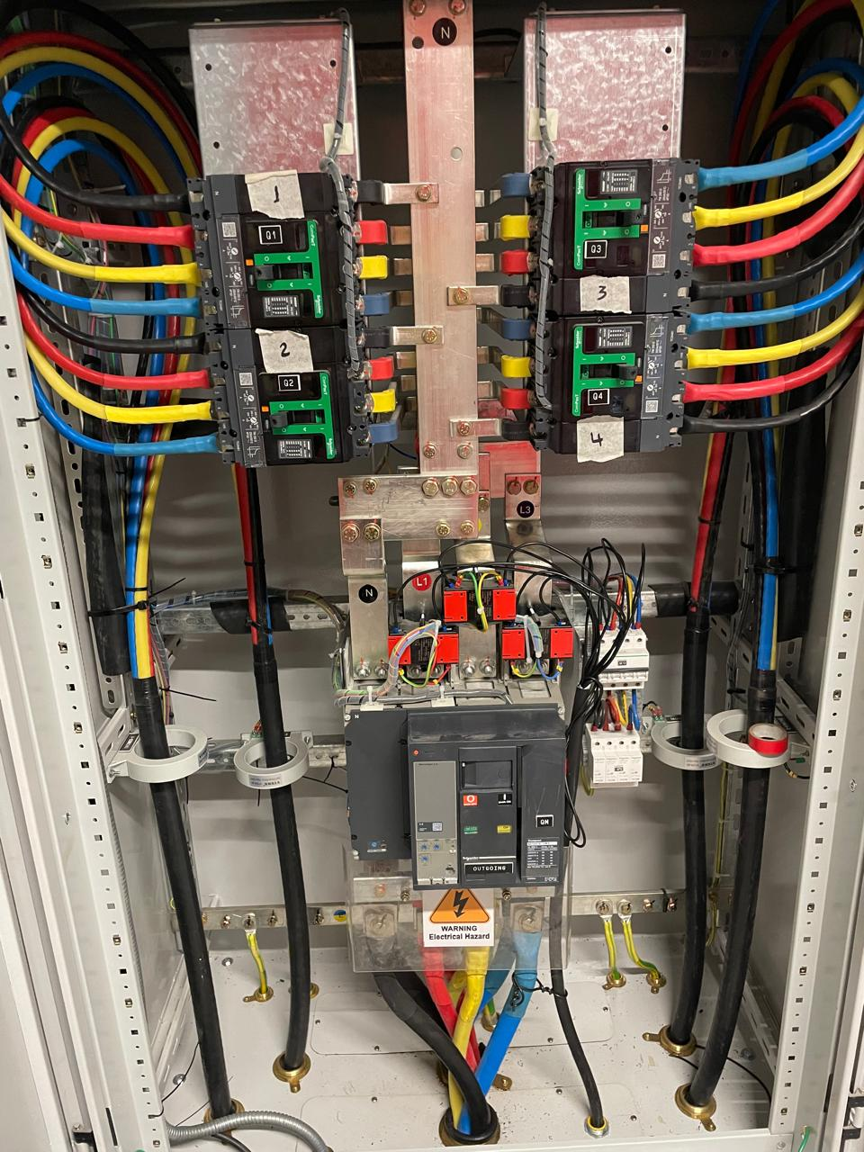
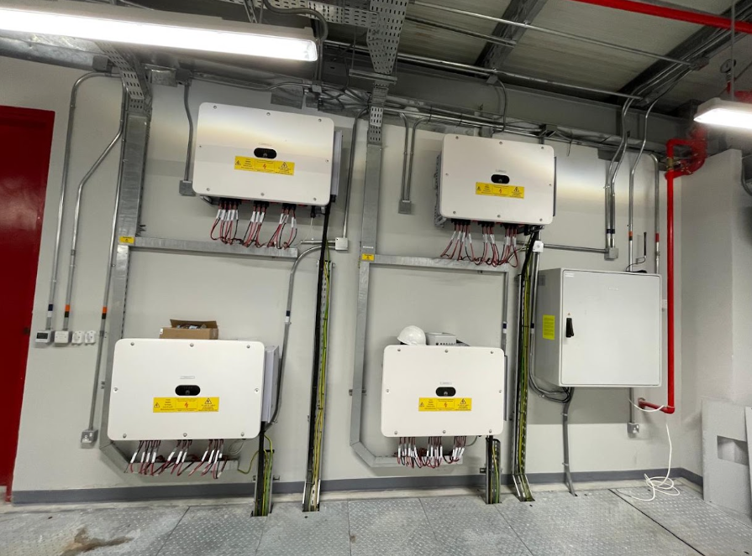
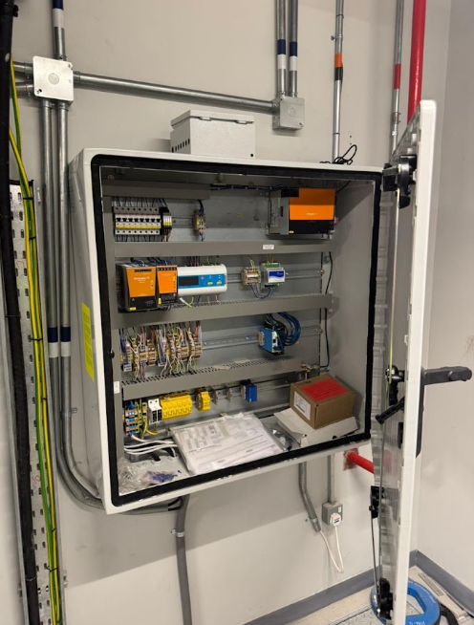
PROJECT 01 · SITE GALLERY
Amazon Jeddah Solar PV
Images & delivery notes
Add image
Add image
Add image
DELIVERY NOTES
Successfully delivered and Supported the installation of the Solar PV Project, ensuring safe, timely, and efficient project execution in line with required quality and safety standards

