Slide 1
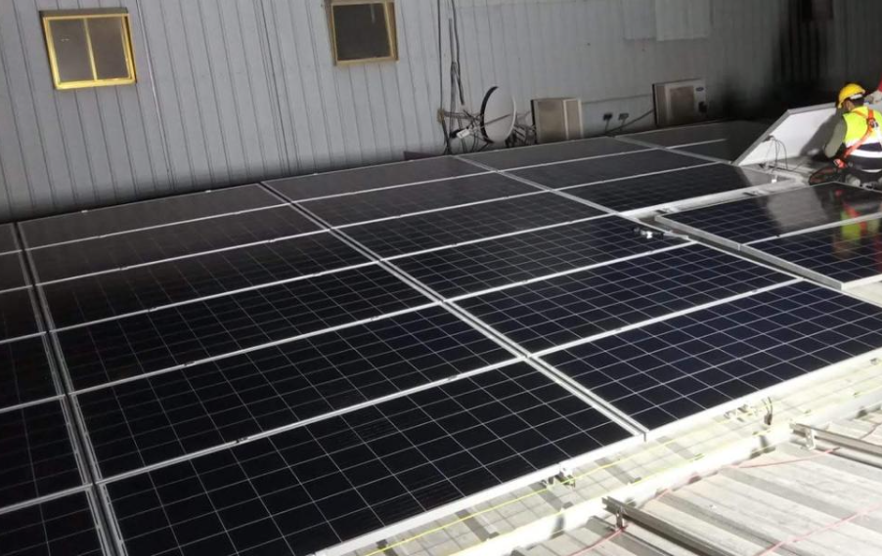
PROJECT 04
Al Jomaih Shell Lubricant Factory
Completed project
PROJECT DESCRIPTION
Solar PV installation for an industrial lubricant manufacturing factory, Designed to maximize on-site renewable energy generation and improve energy efficiency.
Add project image here
KEY FACTS
Capacity
500 KW
Location
Saudi Arabia
Scope
Turnkey EPC
Status
Completed

Slide 2
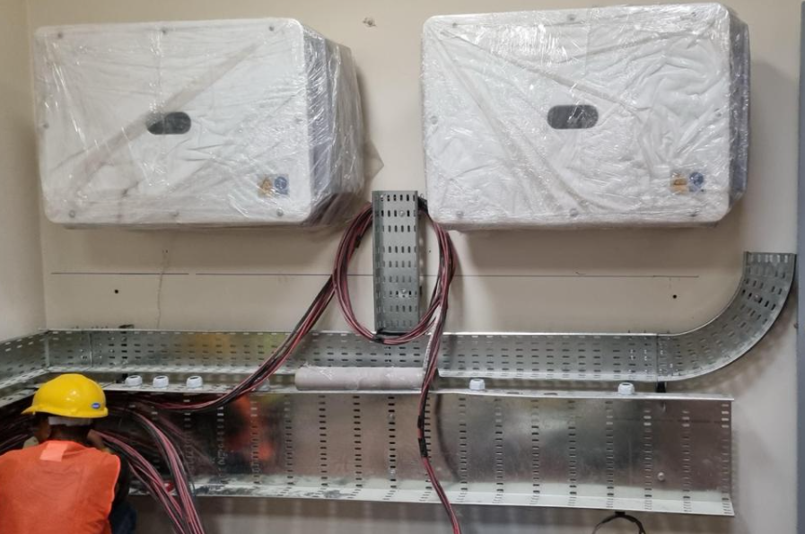
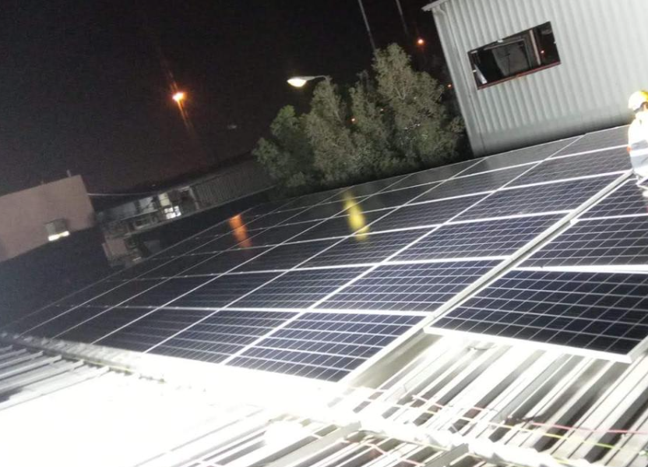
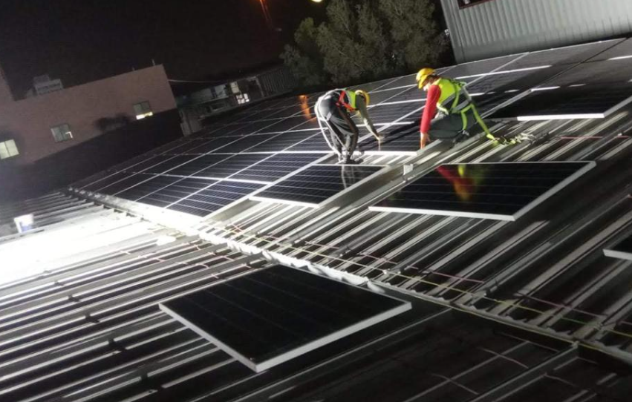
PROJECT 04 · SITE GALLERY
Images & delivery notes
Al Jomaih Shell Lubricant Factory
Add image
Add image
Add image
DELIVERY NOTES
Successfully completed and delivered with a focus on safe installation, quality workmanship and reliable system.

