Slide 1
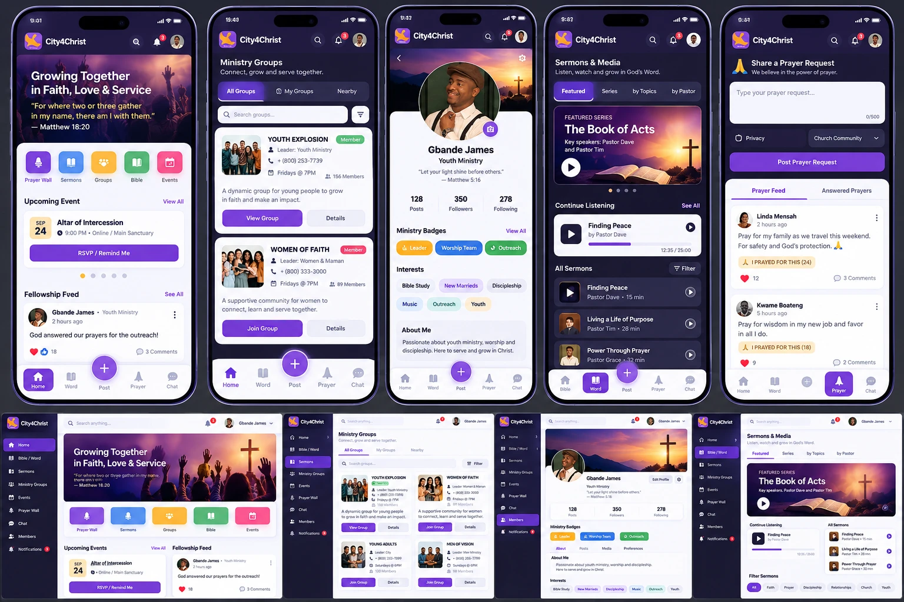
UI/UX REDESIGN · MOBILE & DESKTOP
City4Christ
Member App
One unified church community platform for the Bible, fellowship, prayer, ministry groups, sermons, events and member relationships.
Dashboard
Ministry Groups
Profile
Sermons & Media
Prayer Wall
City4Christ · Design Presentation
Notes:
Title slide. The redesign turns separate feature mockups into one unified church community platform across mobile and desktop.

Slide 2
01 · DESIGN VISION
From separate feature mockups to one platform
The original screens read as individual feature mockups. The redesign should feel like one church social and community platform. It should be as easy to use as a modern social app, but built around faith and fellowship.
1
2
3
4
Unified
Participatory
Word-centred
Device-native
One design system, one navigation model and shared components across every module.
Members pray, post, join and RSVP, not only read. Actions like “I Prayed For This” record real participation.
Scripture, devotionals and sermons appear everywhere, starting with the verse on the home screen.
Mobile and desktop are separate layouts built on one design system. Desktop is not a stretched phone screen.
The five core modules
1 · Home / Member Dashboard
2 · Ministry Groups
3 · Member Profile
4 · Sermons & Media
5 · Prayer Wall
Each one has a mobile composition and a desktop counterpart.
City4Christ UI/UX Redesign
2

Slide 3
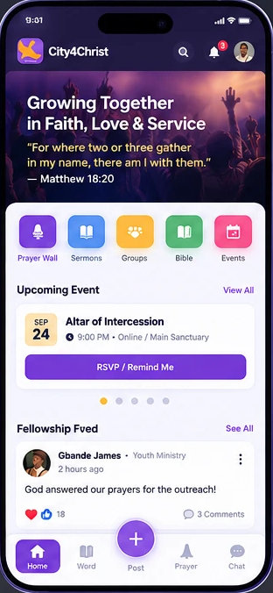
02 · HOME / MEMBER DASHBOARD
A daily starting point
Header
City4Christ logo · Search · Notifications · Member avatar
Hero / Daily Scripture
Scripture of the day, Bible reference, a Listen button and a Daily Devotional button
Quick Actions
🙏 Prayer Wall
🎙 Sermons
👥 Groups
📖 Bible
📅 Events
Upcoming Events
Date · Title · Time · Location or Online · RSVP / Remind Me
Fellowship Feed
Member posts with reactions, comments, share and a more menu
MOBILE
City4Christ UI/UX Redesign
3

Slide 4
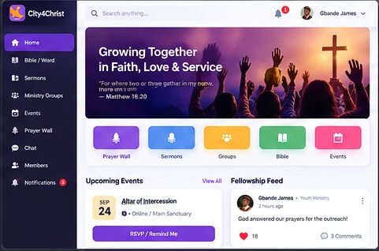
02 · HOME / MEMBER DASHBOARD, DESKTOP
Three-column dashboard
Left · Sidebar
Center · Content
Right · Context
Home · Bible / Word · Sermons · Ministry Groups · Events · Prayer Wall · Chat · Members · Notifications
Scripture hero · Events · Fellowship feed
Upcoming events · Prayer activity · Suggested groups · Online members
City4Christ UI/UX Redesign
4

Slide 5
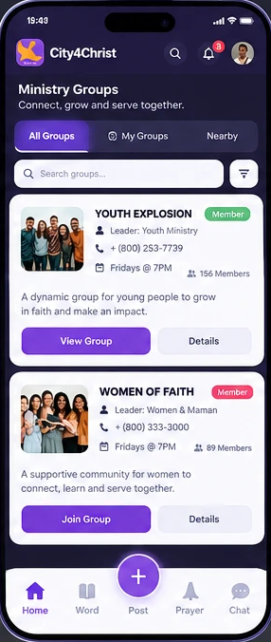
03 · MINISTRY GROUPS
Search, filter, compact cards
Replace the original large cards with a cleaner layout built on search, filters and compact cards.
Tabs & search
Filters
All Groups | My Groups | Nearby
🔍 Search groups...
Ministry
Age group
Gender
Location
Meeting day
Online / physical
Group card, for example Youth Explosion
Group image
Leader
Phone / contact
Meeting day & time
Member count
Short description
View Group · Join Group
Desktop
A two-column card grid. A right panel shows group information: leader, meeting schedule, location, members and upcoming activities.
MOBILE
City4Christ UI/UX Redesign
5

Slide 6
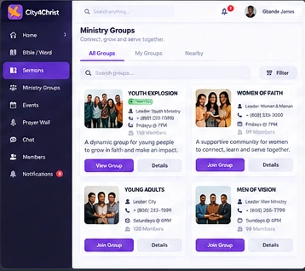
03 · MINISTRY GROUPS, DETAIL & DESKTOP
Every group gets a home
Group detail page (mobile)
[ Cover Image ]
Youth Explosion
Youth Ministry
Leader: Youth Minister
Friday • 7:00 PM
156 Members
[ Join Group ]
About · Group Feed · Members
Events · Discussion · Media
City4Christ UI/UX Redesign
6
DESKTOP · TWO-COLUMN GROUP GRID

Slide 7
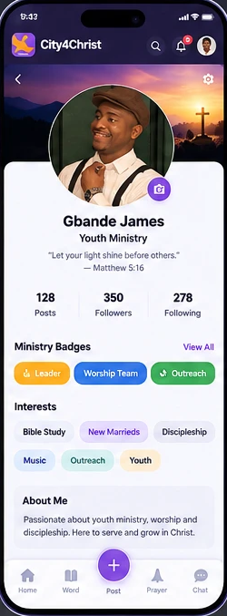
04 · MEMBER PROFILE
A professional community profile
Identity
Ministry badges
Cover photo, profile photo, name, ministry and a personal verse. Counts for posts, followers and following. Edit Profile
🏅 Leader
🎵 Worship Team
🌍 Outreach
Interests
Profile tabs
Bible Study
New Marrieds
Discipleship
Posts | Media | Groups | Events
Music
Youth
Desktop layout
┌──────────────────────────────────────────────┐
│ Cover Image │
├───────┬───────────────────┬──────────────────┤
│ Photo │ Name · Ministry │ Edit Profile │
├───────┴───────────────────┴──────────────────┤
│ Posts · Followers · Following │
├──────────────┬───────────────────────────────┤
│ Badges │ About │
│ Interests │ Recent Posts │
│ Groups │ Media │
└──────────────┴───────────────────────────────┘
MOBILE
City4Christ UI/UX Redesign
7

Slide 8
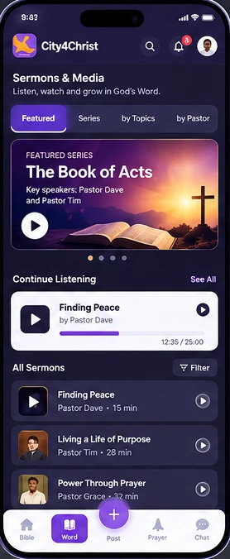
05 · SERMONS & MEDIA / WORD HUB
A complete Christian media library
Navigation
Library filters
Featured | Series | Topics | Pastors
Topic
Pastor
Date
Series
Featured series
Continue listening
A large promotional card, for example The Book of Acts with Pastor Dave and Pastor Tim, and a Play Series button.
▶ Finding Peace · Pastor Dave
████████░░░░ 12:35 / 25:00
Recommended features
Audio player
Video player
Download
Share
Save
Personal notes
Bible references
Transcript
Related sermons
Desktop: full media dashboard with a fixed player
Featured Series → Continue Listening → Latest → Popular → Series → Topics
▶ Finding Peace · Pastor Dave
00:12:35 ━━━━━━━━━━━━━━ 00:25:00 ↶ 10s ▶ 10s ↷
MOBILE
City4Christ UI/UX Redesign
8

Slide 9
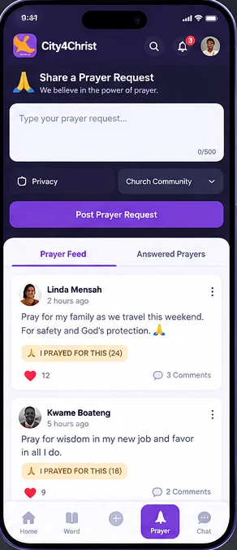
06 · PRAYER WALL
A major feature, not just another feed
Prayer composer
Privacy options
“Share a Prayer Request. We believe in the power of prayer.” A text field (500 characters), a privacy selector and a Post Prayer Request button.
Public
Church Community
My Ministry Group
Pastor Only
Anonymous
The key interaction: 🙏 I PRAYED FOR THIS
Members don’t just like a prayer. They record that they actually prayed. The count shows the requester how many people are praying for them.
Prayer card
Tabs
Linda Mensah · 2 hours ago
Pray for my family as we travel
this weekend. 🙏
🙏 I PRAYED FOR THIS (24)
❤️ 12 💬 3
Prayer Feed | Answered Prayers
Answered prayer
🙏 Prayer Answered
“God answered our prayer...”
❤️ 24 people prayed · 💬 8
MOBILE
City4Christ UI/UX Redesign
9
Notes:
The key improvement is "I Prayed For This": members record that they actually prayed, rather than simply liking a request.

Slide 10
07 · NAVIGATION & INTERACTION MODEL
One creation button, two navigation patterns
Mobile · 5-item bottom navigation
Desktop · persistent left sidebar
🏠 Home
📖 Word
+
🙏 Prayer
💬 Chat
Desktop does not use the mobile bottom navigation.
CITY4CHRIST
🔍 Search anything…
🏠 Home
The center + is the main creation button. It opens a bottom sheet:
📖 Bible / Word
Top bar: search, notifications 🔔 and the member avatar 👤 with name.
Create
🎙 Sermons
📝 Post
🙏 Prayer Request
👥 Ministry Groups
📅 Events
📸 Photo
🎥 Video
🙏 Prayer Wall
💬 Chat
📅 Event
💬 Testimony
👤 Members
🔔 Notifications
⚙ Settings
Creation stays one tap away, so the rest of the interface stays clean.
City4Christ UI/UX Redesign
10

Slide 11
08 · DESIGN SYSTEM
One system for every screen
Color
Components
RSVP / Remind Me
Details
🙏 I PRAYED FOR THIS (24)
Member
Deep Navy
Royal Purple
Gold
Shape
Touch
#160D2E · primary
#6B3FE0 · actions
#F4B73B · highlights
16–24px border radius · soft shadows · rounded avatars
Large touch targets (44px minimum) · pill badges
Feedback
Overlays
Soft Lavender
Light Lavender
Purple 2
Skeleton loading states · toast notifications
Modal dialogs on desktop · bottom sheets on mobile
#E6DEFB · pills
#F3EFFD · desktop bg
#8A5CF6 · gradients
Use very light lavender or white for desktop content areas, and deep navy or purple for selected dark sections.
Use one icon set with a consistent stroke weight everywhere.
City4Christ UI/UX Redesign
11

Slide 12
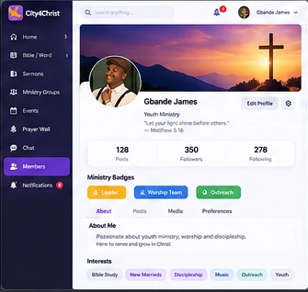
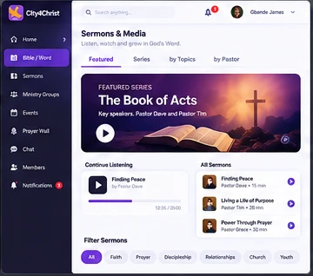
09 · RESPONSIVE STRATEGY
Mobile vs. tablet vs. desktop
Mobile and desktop should not be scaled versions of each other. Each breakpoint gets its own composition.
MOBILE
TABLET
DESKTOP
390–430px
768–1024px
1280px+
Bottom navigation
Single-column cards
Swipeable sections
Bottom sheets
Center + create button
Two-column layouts
Collapsible sidebar
Group grid with two cards per row
Media player docked at the bottom
Persistent sidebar
Two- to three-column dashboard
Large content areas
Fixed media player
Right-hand context panel
City4Christ UI/UX Redesign
12

Slide 13
10 · APPLICATION STRUCTURE
Recommended information architecture
CITY4CHRIST
├── Dashboard
│ ├── Daily Scripture
│ ├── Devotional
│ ├── Quick Actions
│ ├── Events
│ └── Fellowship Feed
├── Bible / Word
│ ├── Bible
│ ├── Devotionals
│ ├── Reading Plans
│ └── Bookmarks
└── Sermons & Media
├── Featured · Sermons
├── Series · Topics
├── Pastors
└── Audio Player
├── Ministry Groups
│ ├── All Groups
│ ├── My Groups
│ ├── Group Details
│ ├── Group Feed
│ ├── Group Events
│ └── Members
├── Prayer Wall
│ ├── Prayer Feed
│ ├── Submit Prayer
│ ├── My Prayers
│ └── Answered Prayers
└── Events
├── Upcoming · Calendar
└── RSVP · Reminders
├── Community
│ ├── Posts
│ ├── Testimonies
│ ├── Members
│ └── Chat
└── Profile
├── Profile
├── Badges
├── Interests
├── Posts
├── Groups
└── Settings
City4Christ UI/UX Redesign
13

Slide 14
11 · IMPLEMENTATION APPROACH
Build the system first, then the screens
STEP 1
STEP 2
STEP 3
STEP 4
Design tokens
Component library
Mobile compositions
Desktop compositions
Color, type scale, spacing, radius, shadow and motion, defined once and shared by every platform.
Buttons, pills, cards, avatars, feed items, prayer cards, media player, sheets, modals, toasts and skeletons.
Dashboard, Groups, Profile, Sermons and Prayer Wall with bottom navigation and the Create sheet.
Sidebar shell, multi-column dashboards, a fixed media player and context panels, as separate layouts.
The key redesign
Turn separate feature mockups into one church community platform. It should be as easy to use as a modern social app, and centered on the Bible, fellowship, prayer, ministry groups, sermons, events and member relationships.
City4Christ UI/UX Redesign
14

