Slide 1

Automated Loan Approval System:
Enhancing Banking Efficiency through Data Science Jasper Umoffia

Slide 2
Problem & Solution
Challenges:
Traditional loan approval processes are time-consuming and prone to human error, leading to inefficiencies and delays.
Solution:
Implementing automation improves efficiency by streamlining workflows and enhances accuracy through advanced data science techniques, revolutionizing the loan approval paradigm.
Reduce Turnaround Time

Slide 3
Data Source
Source: The dataset was sourced from Kaggle (LOAN PREDICTION DATASET ).
Description: With 614 entries and 13 columns, including the target variable "Loan_Status," our goal is to predict whether a loan should be approved or declined based on diverse attributes like gender, income, and credit history.

Slide 4
Methodology
Dependencies & Tools:
Will employ essential data science tools, including Pandas, Scikit-learn, Matplotlib, Seaborn, and XGBoost for data handling, visualization, and machine learning.
Machine Learning Methods:
Will utilize a variety of algorithms:
GaussianNB
SVC with Grid Search CV
XGBoost classifier
Decision Tree using Randomized Search
Random Forest using Randomized Search
Model Evaluation:
Will incorporate loss functions to assess model performance during development (Accuracy, Recall, Precision).

Slide 5
Expected Outcome
Expectations:
Anticipate a transformative impact on the loan approval process through automation, leading to enhanced efficiency and reduced processing time.
Envision improved accuracy in decision-making, resulting in a more reliable and fair system for applicants.
Enthusiasm:
Excited about the opportunity to apply data science methodologies to real-world challenges in the financial sector.
Eager to contribute to the advancement of automated systems that can positively influence business operations and customer experiences.

Slide 6
Data Exploration
Loan_ID | Gender | Married | Dependents | Education | Self_Employed | ApplicantIncome | CoapplicantIncome | LoanAmount | Loan_Amount_Term | Credit_History | Property_Area | Loan_Status
0 | LP001002 | Male | No | 0 | Graduate | No | 5849 | 0.0 | NaN | 360.0 | 1.0 | Urban | Y
1 | LP001003 | Male | Yes | 1 | Graduate | No | 4583 | 1508.0 | 128.0 | 360.0 | 1.0 | Rural | N
2 | LP001005 | Male | Yes | 0 | Graduate | Yes | 3000 | 0.0 | 66.0 | 360.0 | 1.0 | Urban | Y
3 | LP001006 | Male | Yes | 0 | Not Graduate | No | 2583 | 2358.0 | 120.0 | 360.0 | 1.0 | Urban | Y
4 | LP001008 | Male | No | 0 | Graduate | No | 6000 | 0.0 | 141.0 | 360.0 | 1.0 | Urban | Y
Data columns (total 13 columns):
# Column Non-Null Count
--- ------ --------------
0 Loan_ID 614 non-null
1 Gender 601 non-null
2 Married 611 non-null
3 Dependents 599 non-null
4 Education 614 non-null
5 Self_Employed 582 non-null
6 ApplicantIncome 614 non-null
7 CoapplicantIncome 614 non-null
8 LoanAmount 592 non-null
9 Loan_Amount_Term 600 non-null
10 Credit_History 564 non-null
11 Property_Area 614 non-null
12 Loan_Status 614 non-null

Slide 7
Data Exploration Cont.: Overview of Key Financial Statistics
ApplicantIncome CoapplicantIncome LoanAmount Loan_Amount_Term Credit_History
count 614.000000 614.000000 592.000000 600.00000 564.000000
mean 5403.459283 1621.245798 146.412162 342.00000 0.842199
std 6109.041673 2926.248369 85.587325 65.12041 0.364878
min 150.000000 0.000000 9.000000 12.00000 0.000000
25% 2877.500000 0.000000 100.000000 360.00000 1.000000
50% 3812.500000 1188.500000 128.000000 360.00000 1.000000
75% 5795.000000 2297.250000 168.000000 360.00000 1.000000
max 81000.000000 41667.000000 700.000000 480.00000 1.000000

Slide 8
Data Exploration Cont.: Handling missing values
Imputation of Missing Values:
Selected columns: LoanAmount, Loan_Amount_Term, Credit_History
Imputation Method: Mean imputation
Result: Missing values replaced with respective column means, ensuring dataset completeness and preserving statistical characteristics.

Slide 9
Data Exploration Cont.: Check for missing values
Loan_ID 0
Gender 13
Married 3
Dependents 15
Education 0
Self_Employed 32
ApplicantIncome 0
CoapplicantIncome 0
LoanAmount 22
Loan_Amount_Term 14
Credit_History 50
Property_Area 0
Loan_Status 0

Slide 10
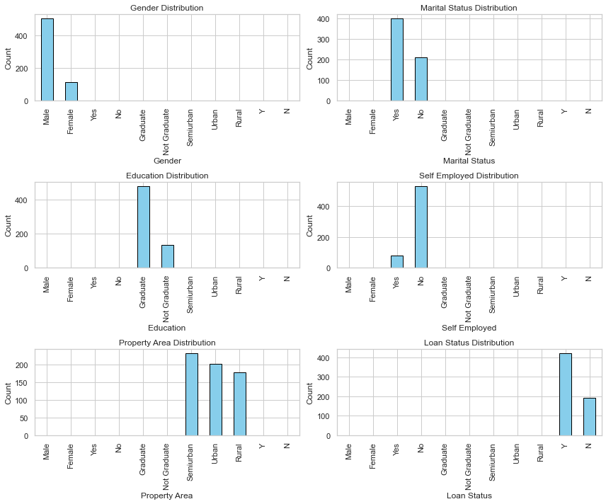
Data Exploration Cont.: Feature Classification

Slide 11
Data Exploration Cont.: Feature Classification
Gender counts:
Male 502
Female 112
Marital Status counts:
Yes 401
No 213
Education Status counts:
Graduate 480
Not Graduate 134
Self Employed Status counts:
No 532
Yes 82

Slide 12
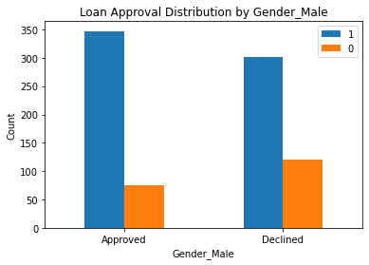

Slide 13
Data Exploration Cont.: Balancing Imbalanced Features: Encoding and SMOTE
Achieve balance in imbalanced features through encoding and SMOTE.
1. Ordinal encoding for 'Dependents' (non-binary classes).
2. One-hot encoding for other categorical features (binary classes).
Why Ordinal Encoding?
Maintains order for non-binary classes like 'Dependents' ('1', '2', '3+').
Next Step:
Apply Synthetic Minority Over-sampling Technique (SMOTE) for overall balance.

Slide 14
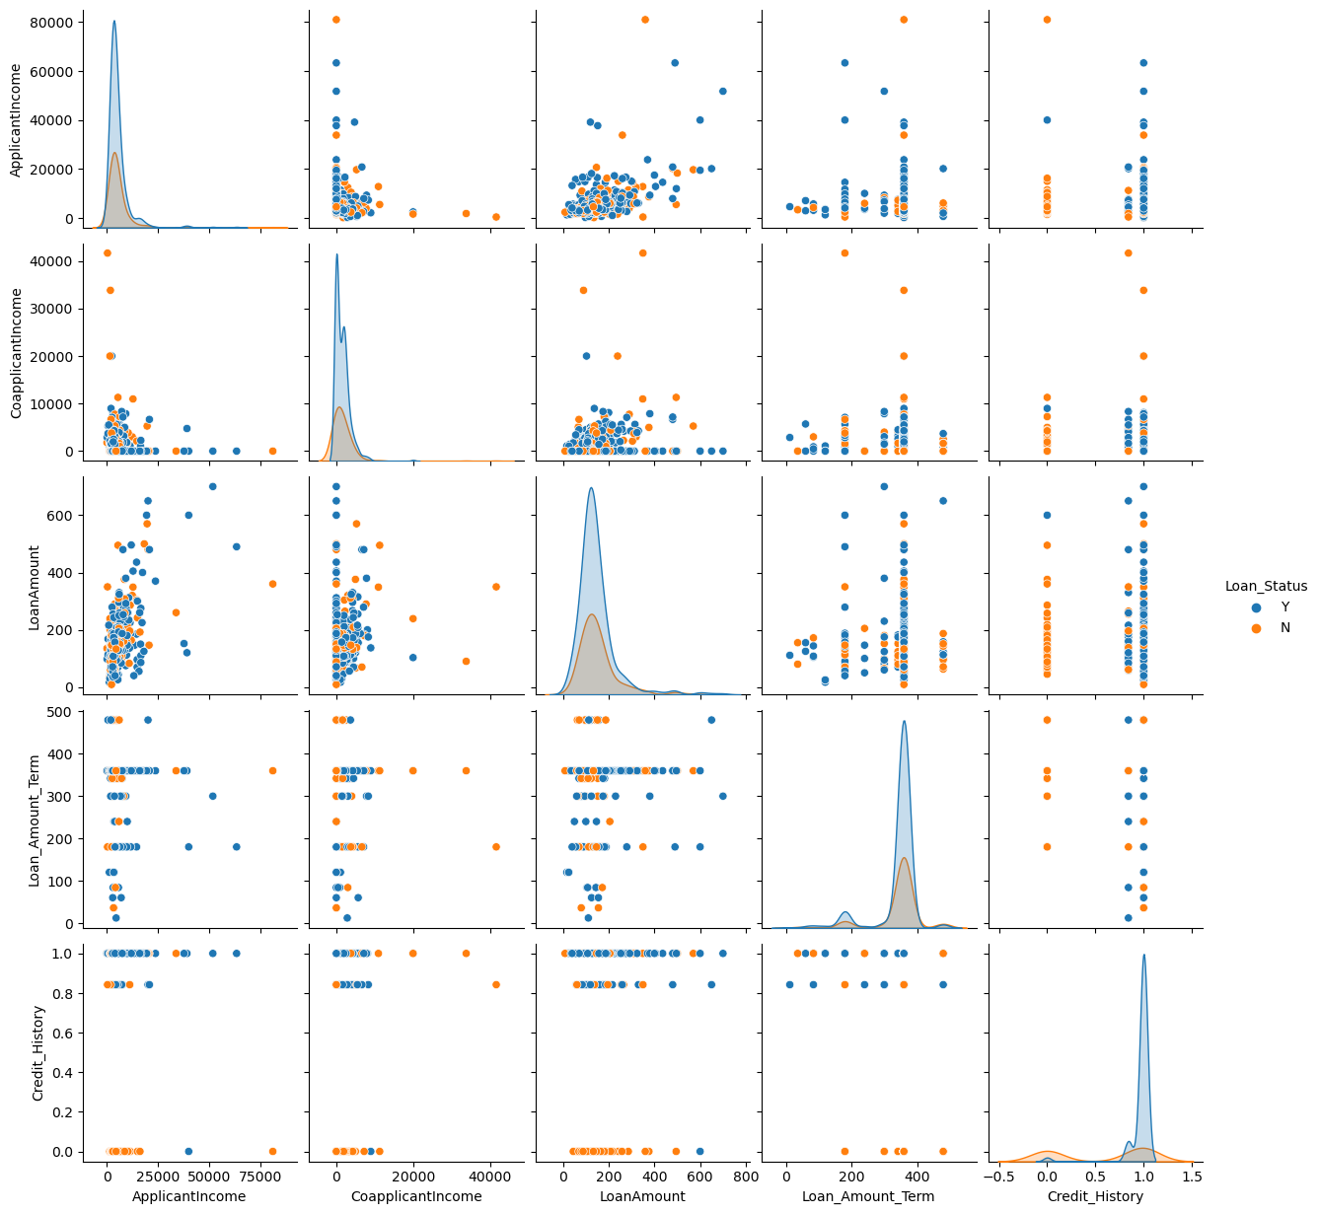
Visualize relationships between predictor variables and the outcome variable

Slide 15
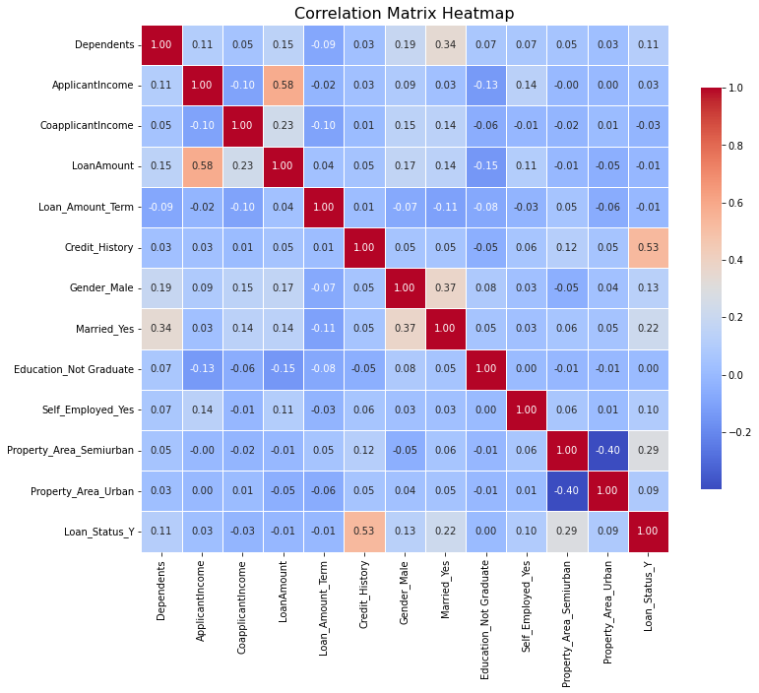
Display the correlation matrix

Slide 16
Feature Exploration in our Loan Approval Model
Exploring feature relationships goes beyond data analysis; it is a pivotal step guiding the selection of machine learning algorithms.
This exploration aids in assessing algorithm assumptions, ensuring model interpretability.
It is crucial for selecting algorithms that handle this aspect effectively, contributing to the overall reliability of the predictive model.
The strategic alignment of chosen algorithms with dataset characteristics enhances the project's success in meeting loan approval goals.

Slide 17
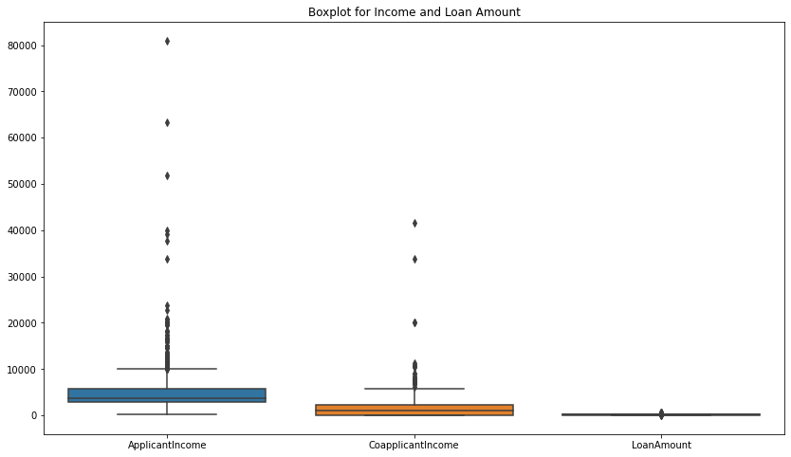
Preprocessing Check for outliers

Slide 18
Preprocessing: Addressing Outliers: Capping Values at the 95th Percentile
Ensure robustness in data preprocessing by addressing outliers.
Why Cap Outliers at 95th Percentile?
1. Maintaining Data Integrity:
Preserves most of the dataset, avoiding extreme values' influence.
Mitigates the impact of outliers on statistical measures.
2. Balancing Outlier Handling:
A balance between outlier removal and data preservation.
Allows for a more nuanced approach, retaining valuable information.
3. Statistical Significance:
The 95th percentile is a common threshold in statistical practice.
Strikes a balance between extreme values and overall data distribution.

Slide 19
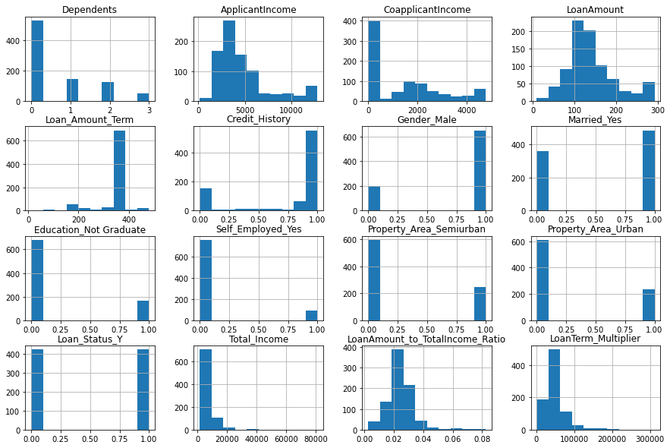
Feature Distribution

Slide 20
Preprocessing: Model Selection and Scaling Strategy
Model Selection:
Linear regression deemed unsuitable due to non-normal distribution and lack of linearity.
Chosen models: XGBoost, Decision Trees, and Random Forests for capturing complex patterns.
Hyperparameter Tuning:
Techniques: Grid Search Cross-Validation and Randomized Search.
Optimizes model parameters, tailoring algorithms to dataset characteristics.
Scaling Consideration:
Algos (XGBoost, Decision Trees, Random Forest) handle scaling internally.
Evaluation of model performance with and without scaling for optimization.

Slide 21
Machine learning method
This task is a classification problem because it involves predicting a discrete output variable, specifically the 'Loan_Status,' which appears to be a binary variable with values 0 and 1. In classification problems, the goal is to assign input data points to predefined categories or classes.
In this scenario, the objective is to categorize loan applications into either approved (1) or declined (0) based on various input features such as 'Gender,' 'Married,' 'Education,' and others.
The nature of the 'Loan_Status' variable, representing distinct classes indicating loan approval outcomes, aligns with the characteristics of a classification problem, where the aim is to build a model that can learn and generalize patterns from historical data to make predictions on new, unseen instances.

Slide 22
Model Performance Analysis Gaussian Naïve Bayes
Precision (0.69):
Approximately 69.1% accurate identification of approved loans out of predicted approvals.
Enhances the precision of loan approval predictions.
Recall (0.80):
Captures about 79.8% of actual loan approvals.
Improved ability to identify most actual loan approvals, reducing missed opportunities.
Accuracy (0.72):
Overall accuracy of approximately 72.2%.
While providing an overall measure of correct predictions, precision and recall considerations are crucial, especially in imbalanced datasets.
Demonstrates reasonable overall accuracy.

Slide 23
Model Performance Analysis GridSearchCV
Precision (0.50):
Only about 50.3% accurate identification of approved loans out of predicted approvals.
Precision is crucial in loan approval, reflecting the accuracy of positive predictions.
A higher precision minimizes false positives, ensuring fewer incorrectly approved loans.
Recall (0.98):
Captures about 97.6% of actual loan approvals.
Crucial in loan approval, indicating the model's ability to identify most actual loan approvals.
Higher recall reduces missed opportunities to approve legitimate loan requests.
Accuracy (0.51):
Overall accuracy of approximately 50.9%.
While providing an overall measure of correct predictions, accuracy may be insufficient in imbalanced datasets.
In the context of loan approval, accuracy alone might not fully assess model performance due to imbalanced classes.

Slide 24
Model Performance Analysis XGBoostClassifier
Precision (0.82):
Approximately 81.7% accurate identification of approved loans out of predicted approvals.
Higher precision effectively reduces false positives, ensuring more accurate loan approval predictions.
Recall (0.90):
Captures about 90.5% of actual loan approvals.
Higher recall signifies an excellent ability to identify the majority of actual loan approvals, minimizing missed opportunities.
Accuracy (0.85):
Overall accuracy of approximately 85.2%.
High overall accuracy indicates correct predictions for the majority of instances.
Considering precision and recall alongside accuracy is crucial in imbalanced datasets

Slide 25
Model Performance Analysis Random Forest with RandomizedSearch
Precision (0.79):
Approximately 79.2% accurate identification of approved loans out of predicted approvals.
Represents a good balance between precision, recall, and accuracy.
Recall (0.90):
Captures about 90.5% of actual loan approvals.
Indicates an effective ability to identify the majority of actual loan approvals.
Accuracy (0.83):
Overall accuracy of approximately 83.4%.
Demonstrates a good balance between correct predictions for the majority of instances.

Slide 26
Model Performance Analysis Random Forest model with hyper-parameter tunning
Accuracy (83.4%):
Reflects an improved performance compared to the default configuration.
Demonstrates the overall correctness of predictions.
Precision (79.2%):
Approximately 79.2% accurate identification of approved loans out of predicted approvals.
Indicates the accuracy of positive predictions.
Recall (90.5%):
Captures about 90.5% of actual loan approvals.
Highlights effective identification of the majority of actual loan approvals.

Slide 27
Model Performance Analysis Stacking Random Forest, SVC, Naive Bayes, and Decision Tree
Accuracy (75.7%):
Represents the overall correctness of predictions.
Indicates a reasonable level of accuracy in predicting loan approvals.
Precision (73.1%):
Approximately 73.1% accurate identification of approved loans out of predicted approvals.
Demonstrates the accuracy of positive predictions.
Recall (80.9%):
Captures about 80.9% of actual loan approvals.
Highlights effective identification of the majority of actual loan approvals.

Slide 28
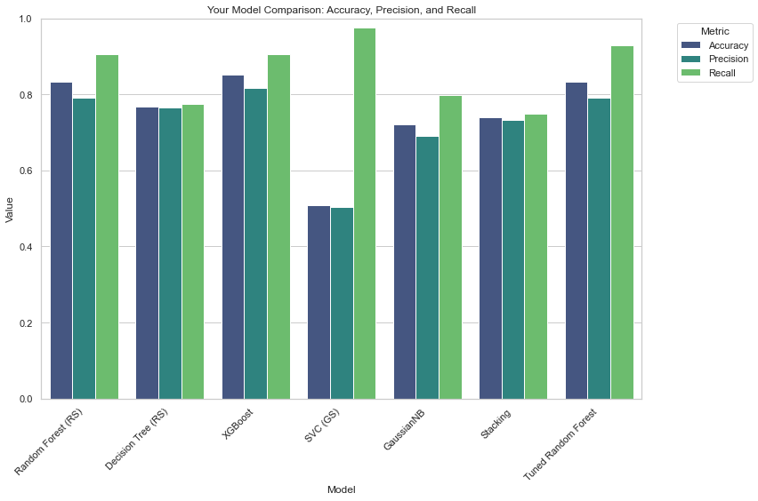

Slide 29
Recommendation
Based on the evaluation of the models, the XGBoost Classifier consistently demonstrated superior performance with a high accuracy of 85.2%, precision of 81.7%, and recall of 90.5%.
Considering the significance of both minimizing false positives and false negatives in loan approval decisions, and the well-balanced trade-off provided by XGBoost, it emerges as the recommended algorithm for loan approval automation.
XGBoost provides a robust solution that effectively identifies approved loans and captures the majority of actual loan approvals, making it a strong candidate for automating loan approval decisions.

Slide 30

Thank you

