Slide 1
Running Duke DP Recon
Afia’s computer Feb 28, 2024
Tip: DO NOT put this xenon gas exchange folder on One drive at your PC.
The one drive folder has spaces. For example,
C:\Users\usc9q\OneDrive - University of Missouri\xenon-gas-exchange-consortium-main
Linux gets angry when seeing a space in the specified path.
Instead, I had to put my files here
C:\Users\usc9q\Documents\Afia\xenon-gas-exchange-consortium-main

Slide 2
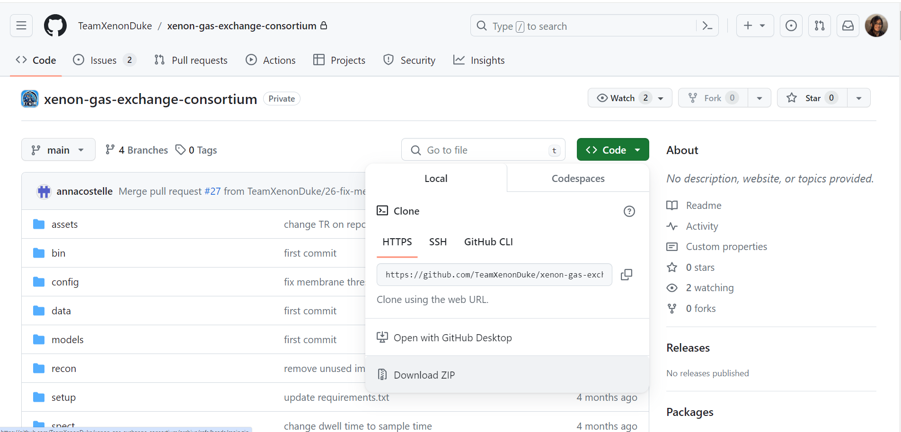
Download duke’s recon codes from Github
https://github.com/TeamXenonDuke/xenon-gas-exchange-consortium.git

Slide 3
I tried to run the code on MS Visual Studio. Didn’t work as it requires Linux system for CNN segmentation and Bias correction

Slide 4
Running the code on Ubuntu with WSL
I am following the ReadMe file from Duke Group Github

Slide 5

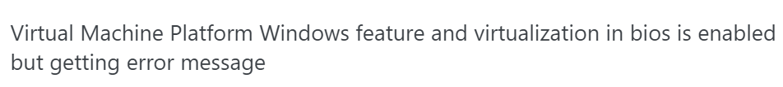
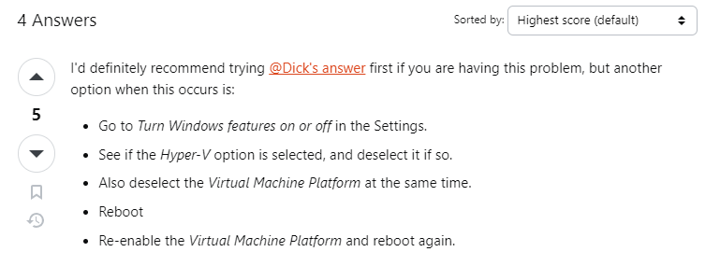
https://www.youtube.com/watch?v=X-DHaQLrBi8&t=385s&ab_channel=ProgrammingKnowledge2
If you could do exactly as the youtube video, then you are done.
But I tried to follow this but my Ubuntu was showing error.
To get rid of this, I follows these, https://askubuntu.com/questions/1459065/virtual-machine-platform-windows-feature-and-virtualization-in-bios-is-enabled-b/1459070#1459070
My Ubuntu worked after following these steps

Slide 6
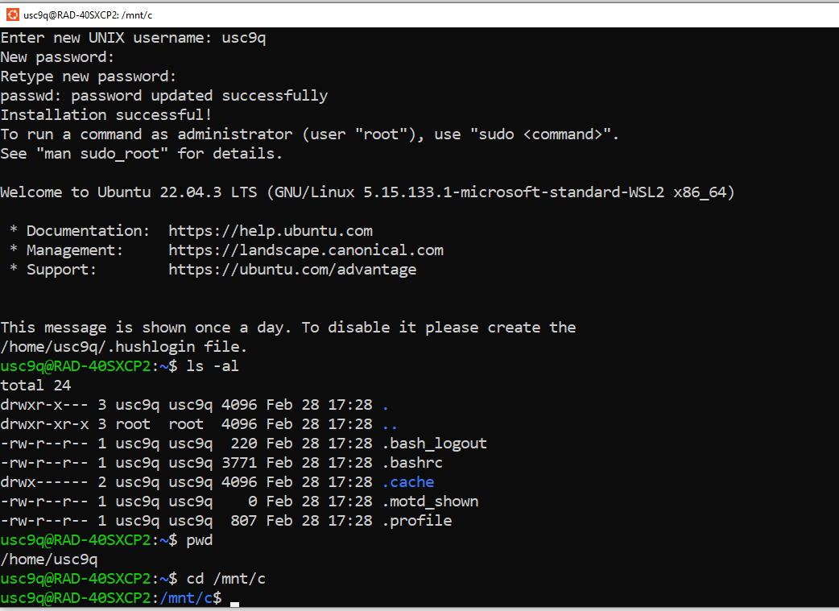
Ubuntu is working

Slide 7

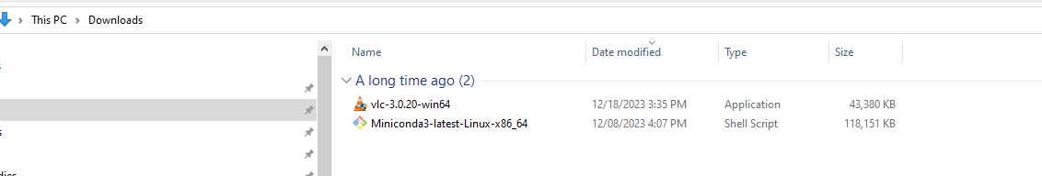
I have downloaded Miniconda and put it in my ‘Downloads’ folder

Slide 8
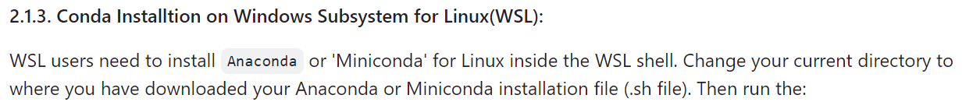
Write the following
cd /mnt/c/Users/usc9q/Downloads
chmod +x Miniconda3-latest-Linux-x86_64.sh
bash Miniconda3-latest-Linux-x86_64.sh
Had to do this. Otherwise, miniconda3 was not getting installed

Slide 9
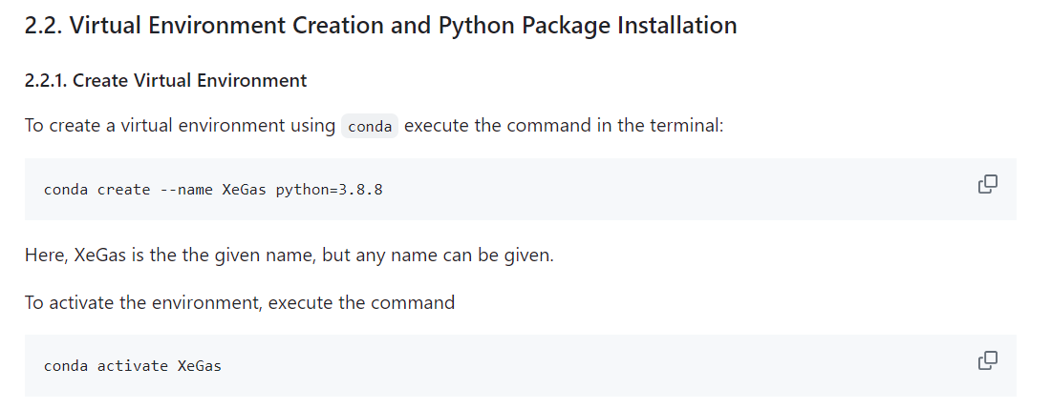
conda create --name XeGas python=3.8.8
conda activate XeGas
Close your ubuntu terminal and re-open it. Hit:
conda list [it should show a list]

Slide 10
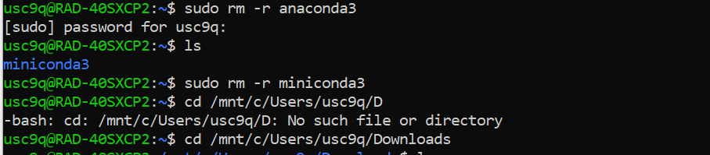
Off topic: Removing a directory on ubuntu terminal
I installed both anaconda &and miniconda. So, had to delete one of them. This is how you can remove a directory

Slide 11
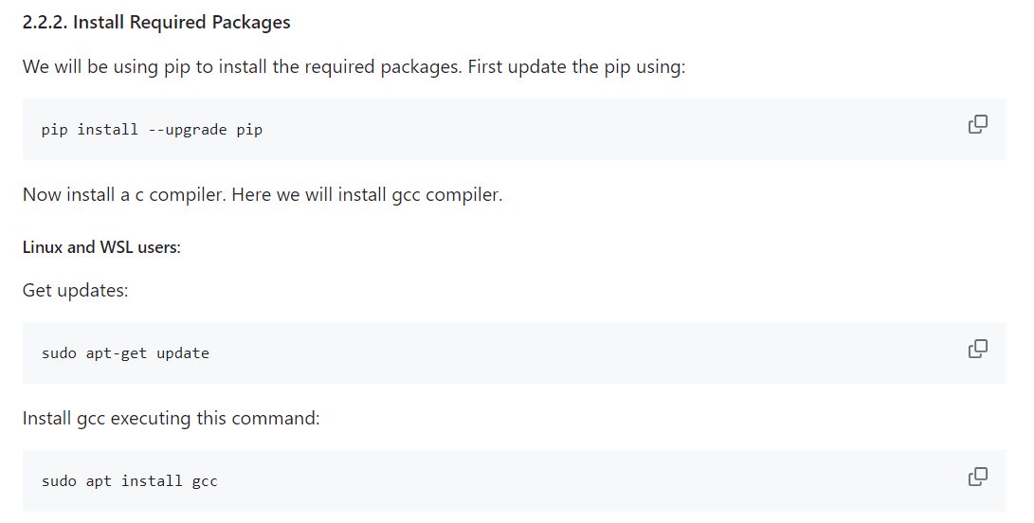
I ran these exact command on my ubuntu
These worked
pip install --upgrade pip
sudo apt-get update
sudo apt install gcc
Notes:
pip install --upgrade pip
sudo apt-get update
sudo apt install gcc

Slide 12
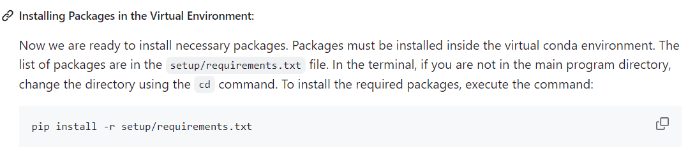
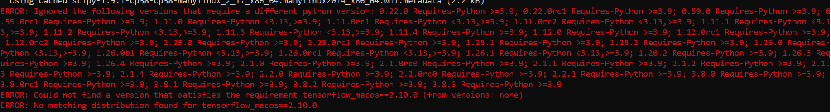
This gave error

Slide 13
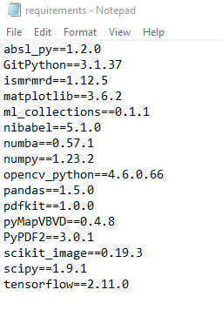
Go to this path first
cd /mnt/c/Users/usc9q/Documents/Afia/xenon-gas-exchange-consortium-main/
On the requirement file, I manually edited it.
And then installed requirement file.
pip install -r setup/requirements.txt
It worked !!!
Notes:
cd /mnt/c/Users/usc9q/Documents/Afia/xenon-gas-exchange-consortium-main/

Slide 14
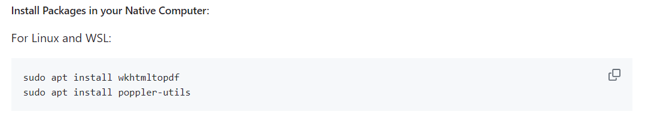
These worked
sudo apt install wkhtmltopdf
sudo apt install poppler-utils

Slide 15
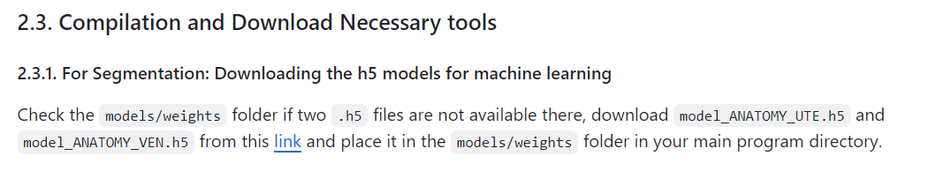
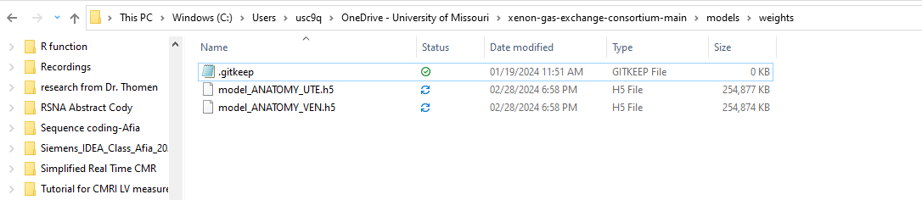
These worked
I downloaded these files and put it in models/weights

Slide 16
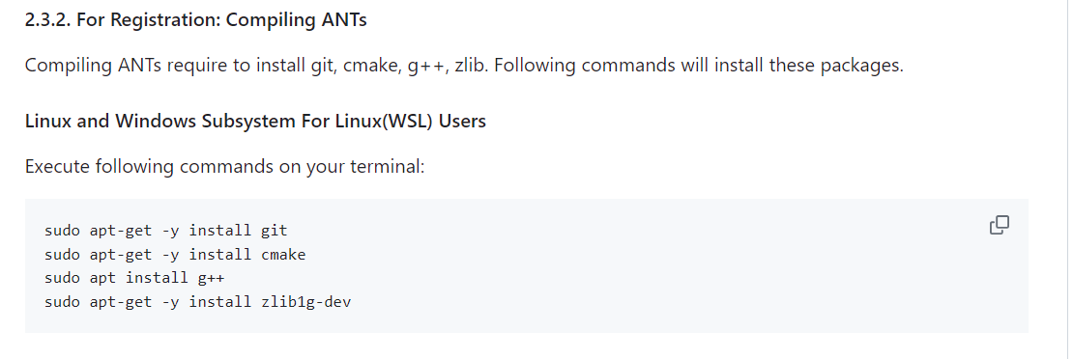
These worked
sudo apt-get -y install git
sudo apt-get -y install cmake
sudo apt install g++
sudo apt-get -y install zlib1g-dev
Notes:
sudo apt-get -y install git
sudo apt-get -y install cmake
sudo apt install g++
sudo apt-get -y install zlib1g-dev

Slide 17
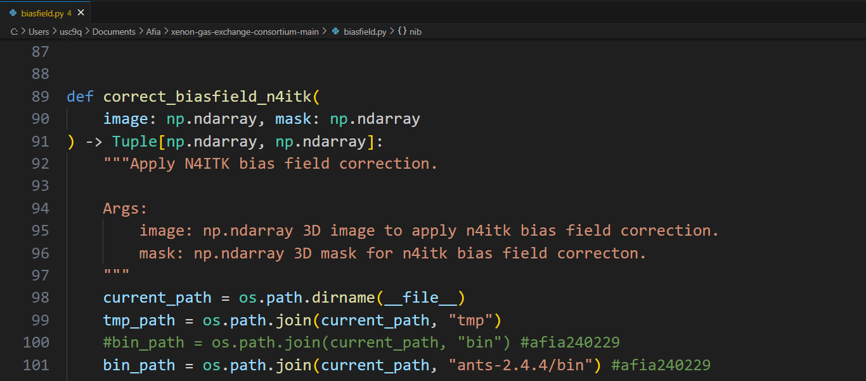
In order to perform the bias correction, you need to do the following
1.Download ants-2.4.4 from Here
And place it in the parent folder (E.g, C:\Users\usc9q\Documents\Afia\xenon-gas-exchange-consortium-main\ants-2.4.4)
2. In ubuntu, write the following to grant access
chmod +r ants-2.4.4/bin/N4BiasFieldCorrection
3. Edit Line 100 in the biasfield.py code (see picture below),
Notes:
cd /mnt/c/Users/usc9q/Documents/Afia/xenon-gas-exchange-consortium-main/

Slide 18
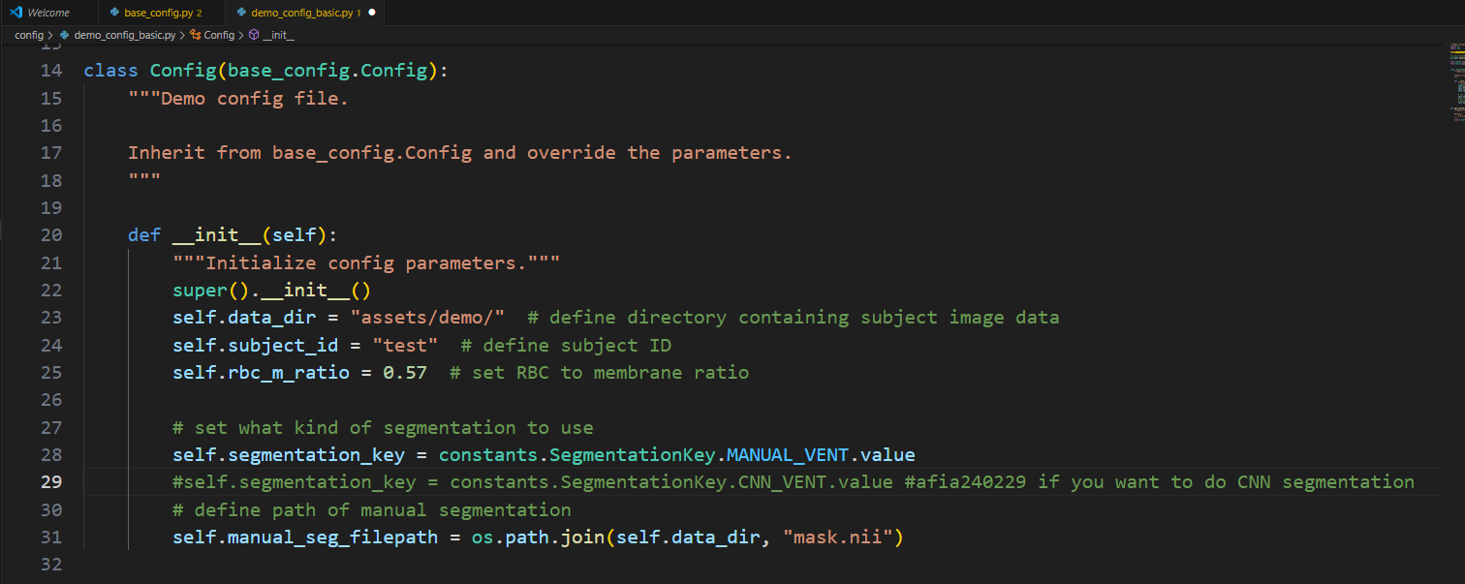
Make your own config file -it should be similar to config/demo_config_basic.py file
This should be the path to your subject data, Edit it as necessary
Put it from the Matlab flipCal code
Do you want to upload your manual segmentation or automated CNN segmentation? Select either Line 28 or 29 based on your preference
If you want to upload your manual mask, then upload it here (./assets/demo/mask.nii)

Slide 19
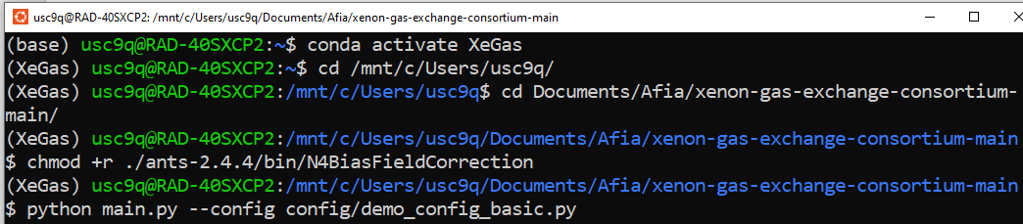
Run your config file like this.
You will find all the analysis saved in ./tmp folder
conda activate XeGas
cd /mnt/c/Users/usc9q/Documents/Afia/xenon-gas-exchange-consortium-main/
chmod +r ants-2.4.4/bin/N4BiasFieldCorrection
python main.py --config config/XeClinical2.py
Notes:
cd /mnt/c/Users/usc9q/Documents/Afia/xenon-gas-exchange-consortium-main/

Slide 20
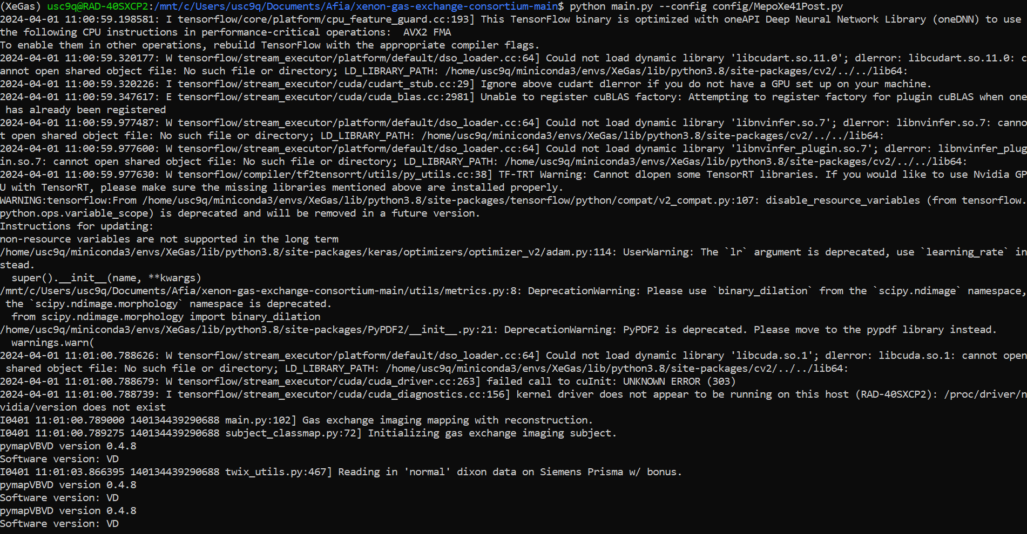
The code should run. But it may show the following errors/warnings anyway

Slide 21
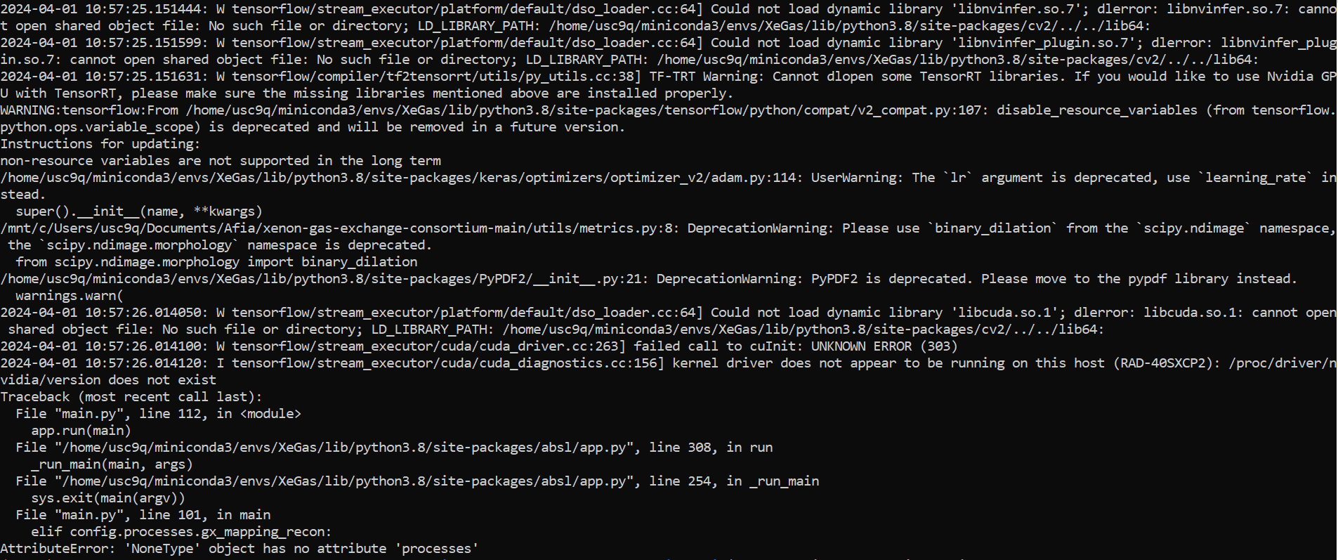
Troubleshooting
If you see the following error
Check if you are declaring the config file properly.
Steps for trouble shooting,
While you run the code, check if the following command is correct or not
python main.py --config config/XeClinical2.py
2. Check if you have the config file in config/ folder
3. If it still doesn’t work, Go to main.py and manually declare the config file like this
_CONFIG = config_flags.DEFINE_config_file("config", "config/MepoXe41Pre.py", "config file.")
Double dash

Slide 23
Failed attempt to run it on MS Visual studio

Slide 24
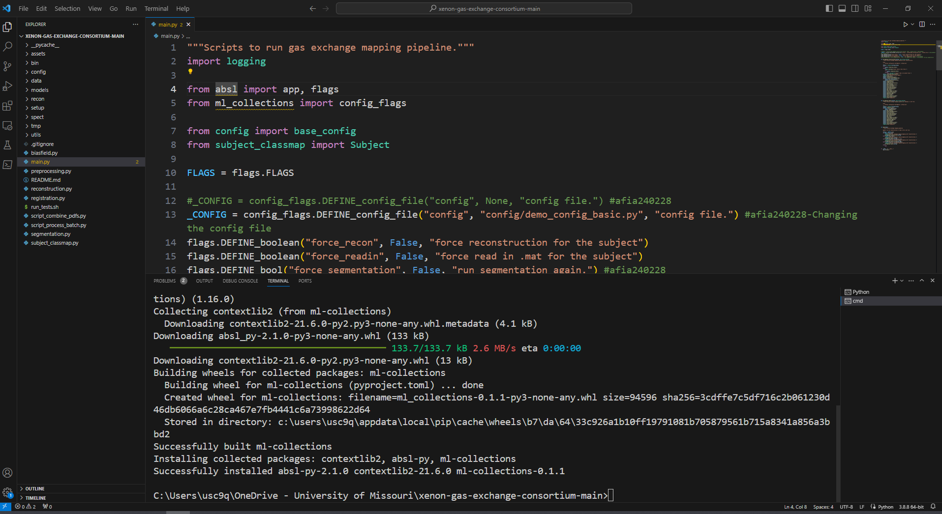
Duke pipeline runs on 3.8.8
Change your python to 3.8.8 version

Slide 25
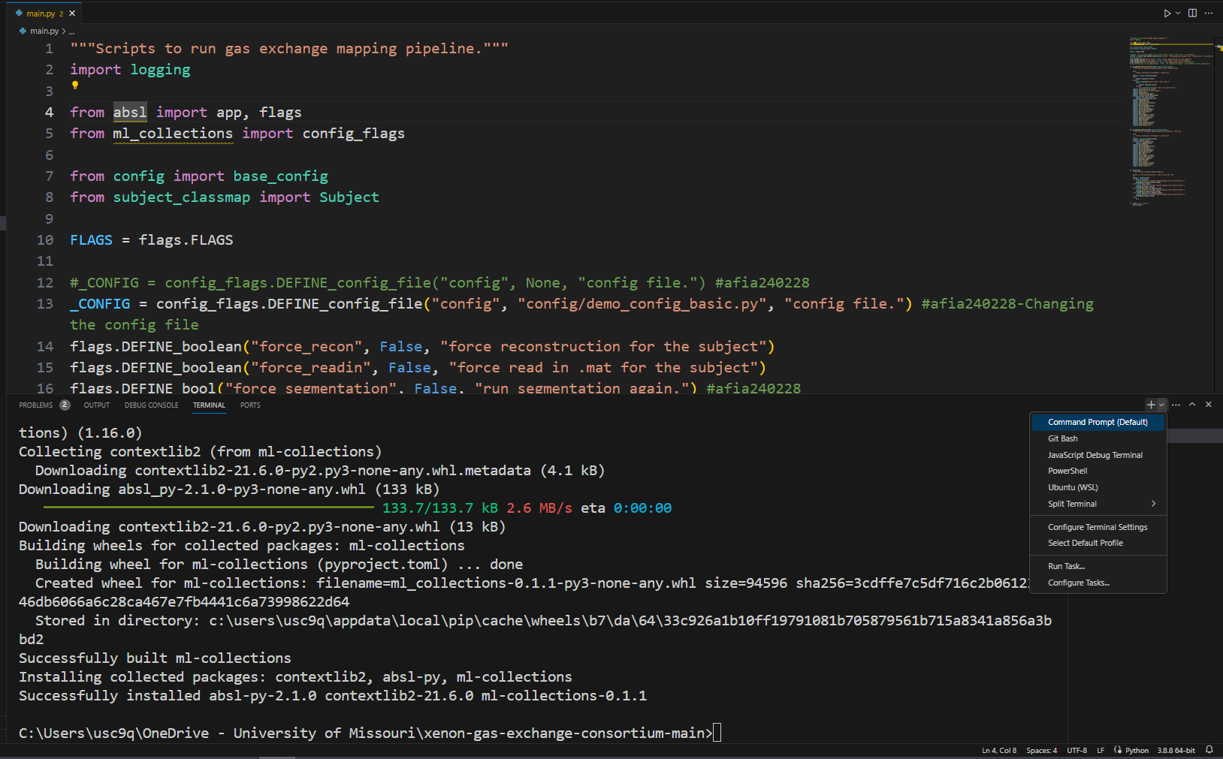
Go to Command prompt and install all the uninstall things

Slide 26
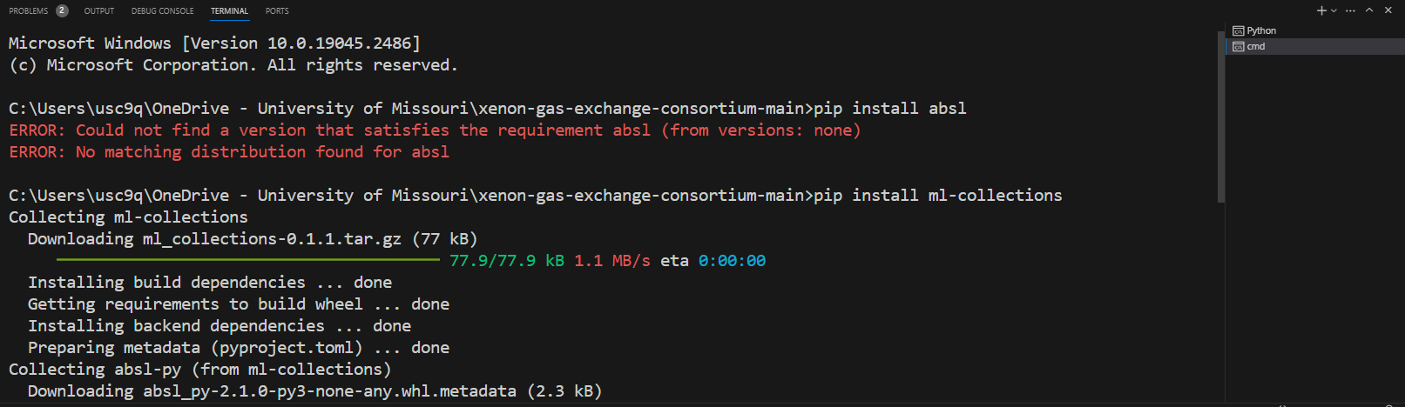
I had to install the following
pip install ml-collections
pip install opencv-python
pip install ismrmrd
pip install numba
pip install tensorflow
pip install PyPDF2
pip install gitpython
pip install -r setup/requirements.txt

Slide 27
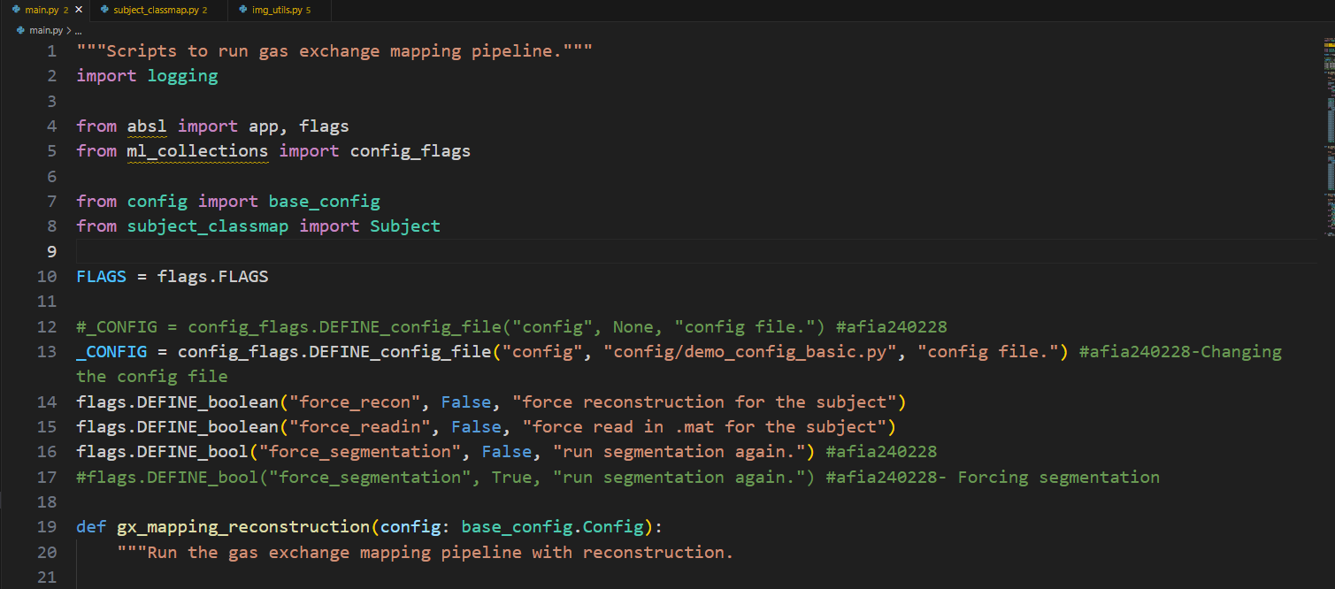
Declare the demo file

Slide 28
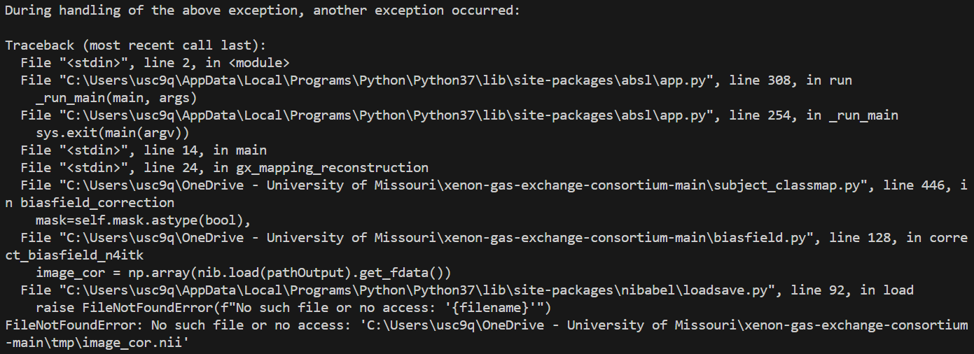
This error showed up. Since I didn’t run/install the ANT stuff.
Those requires Linux

