Slide 1
Running Duke DP Recon
Afia’s computer Feb 28, 2024
Tip: DO NOT put this xenon gas exchange folder on One drive at your PC.
The one drive folder has spaces. For example,
C:\Users\usc9q\OneDrive - University of Missouri\xenon-gas-exchange-consortium-main
Linux gets angry when seeing a space in the specified path.
Instead, I had to put my files here
C:\Users\usc9q\Documents\Afia\xenon-gas-exchange-consortium-main

Slide 2
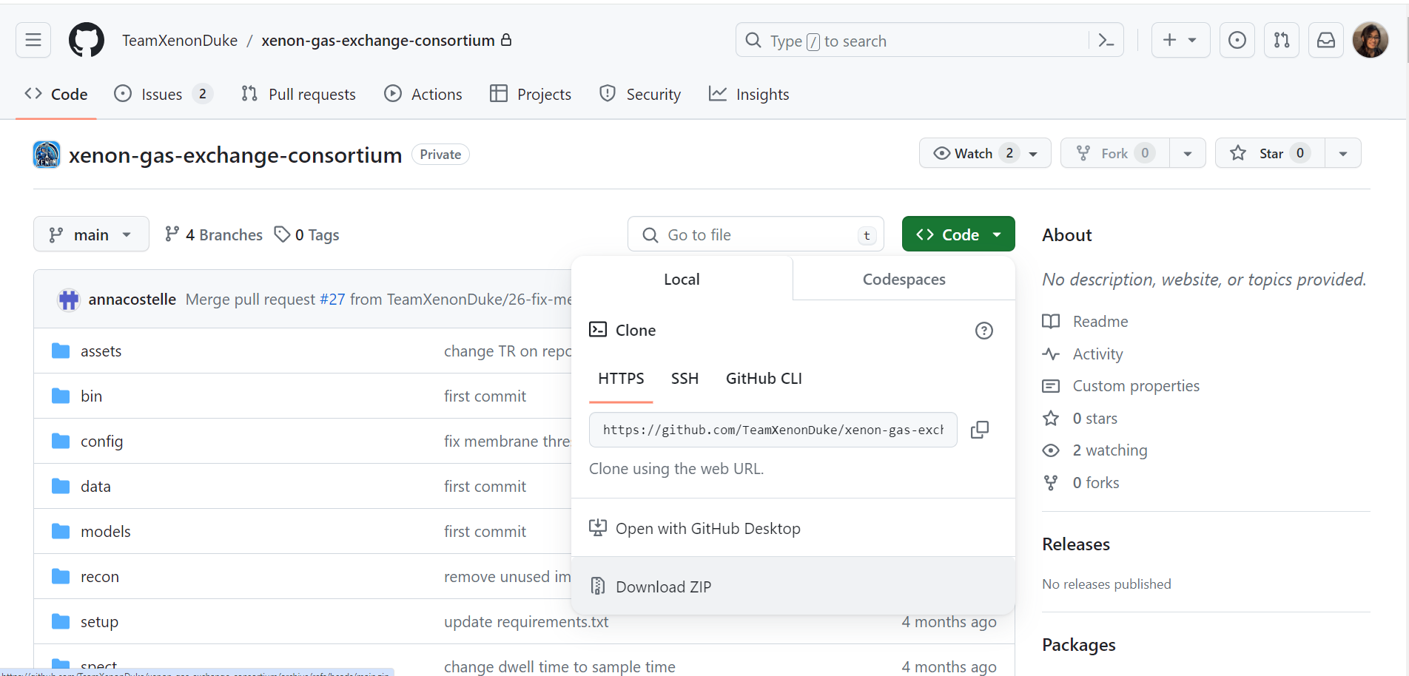
Download duke’s recon codes from Github
https://github.com/TeamXenonDuke/xenon-gas-exchange-consortium.git

Slide 3
I tried to run the code on MS Visual Studio. Didn’t work as it requires Linux system for CNN segmentation and Bias correction

Slide 4
Running the code on Ubuntu with WSL
I am following the ReadMe file from Duke Group Github

Slide 5

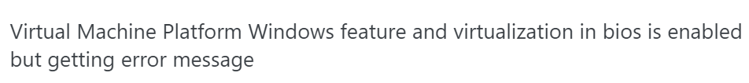
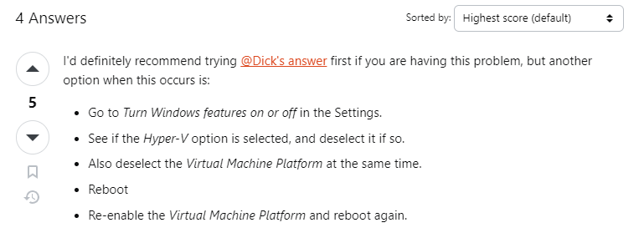
https://www.youtube.com/watch?v=X-DHaQLrBi8&t=385s&ab_channel=ProgrammingKnowledge2
If you could do exactly as the youtube video, then you are done.
But I tried to follow this but my Ubuntu was showing error.
To get rid of this, I follows these, https://askubuntu.com/questions/1459065/virtual-machine-platform-windows-feature-and-virtualization-in-bios-is-enabled-b/1459070#1459070
My Ubuntu worked after following these steps

Slide 6
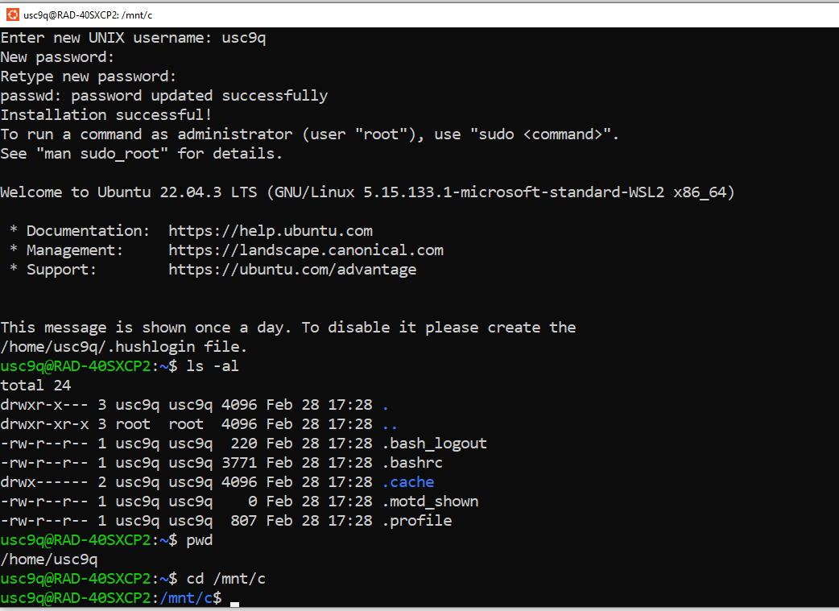
Ubuntu is working

Slide 7

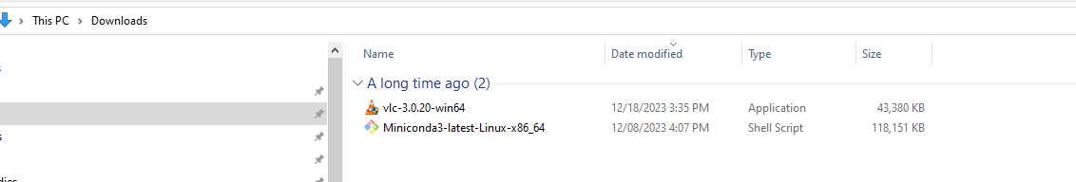
I have downloaded Miniconda and put it in my ‘Downloads’ folder

Slide 8
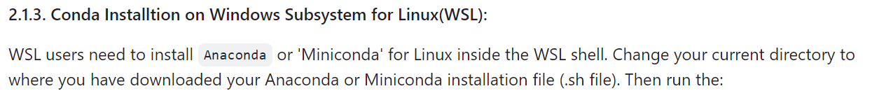
Write the following
cd /mnt/c/Users/usc9q/Downloads
chmod +x Miniconda3-latest-Linux-x86_64.sh
bash Miniconda3-latest-Linux-x86_64.sh
Close your ubuntu terminal and re-open it. Hit:
Conda list [it should show a list]
Had to do this. Otherwise, miniconda3 was not getting installed

Slide 9
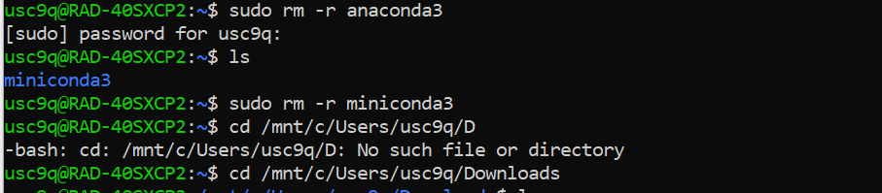
Off topic: Removing a directory on ubuntu terminal
I installed both anaconda &and miniconda. So, had to delete one of them. This is how you can remove a directory

Slide 10
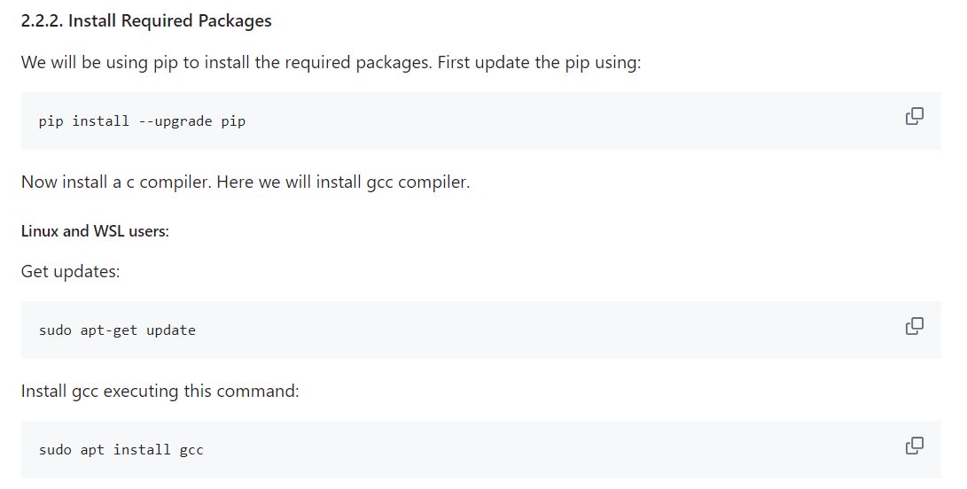
I ran these exact command on my ubuntu
These worked

Slide 11
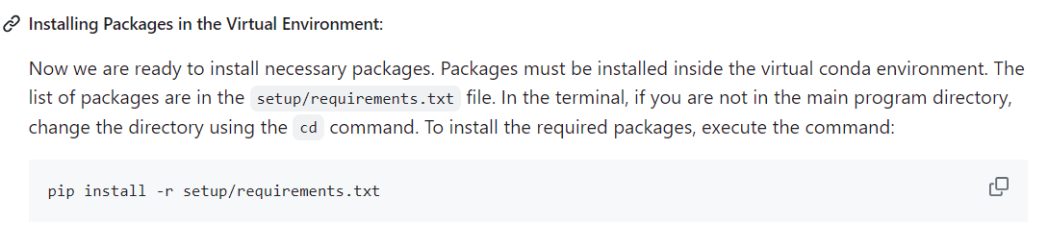
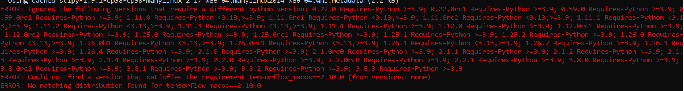
This gave error

Slide 12
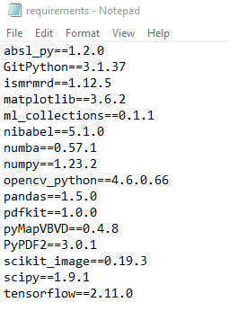
On the requirement file, I manually edited it.
And then installed requirement file.
pip install -r setup/requirements.txt
It worked !!!

Slide 13
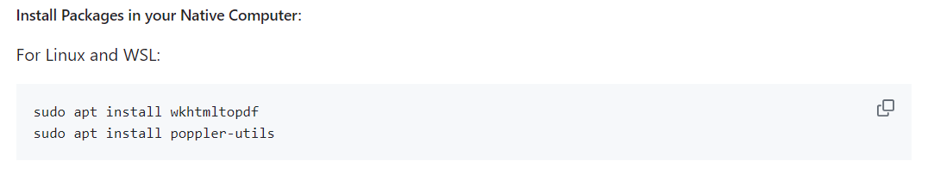
These worked

Slide 14
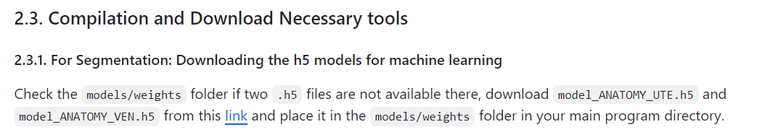
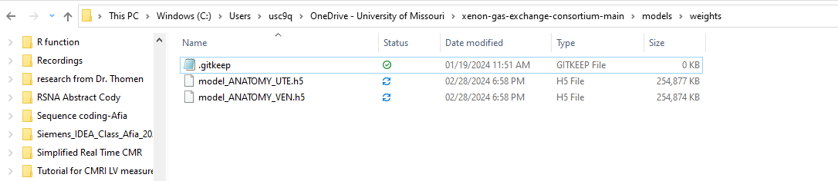
These worked
I downloaded these files and put it in models/weights

Slide 15
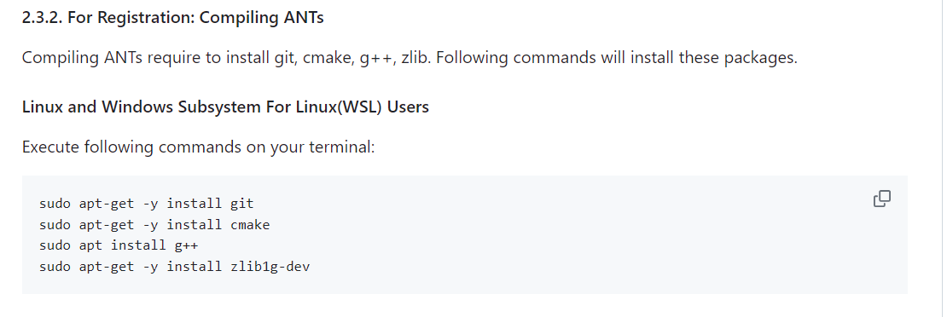
These worked

Slide 16
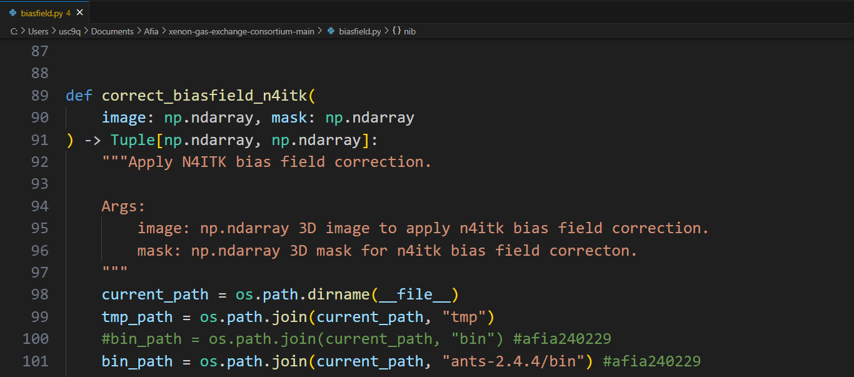
In order to perform the bias correction, you need to do the following
1.Download ants-2.4.4 from Here
And place it in the parent folder (E.g, C:\Users\usc9q\Documents\Afia\xenon-gas-exchange-consortium-main\ants-2.4.4)
2. In ubuntu, write the following to grant access
chmod +r ants-2.4.4/bin/N4BiasFieldCorrection
3. Edit Line 100 in the biasfield.py code (see picture below),

Slide 17
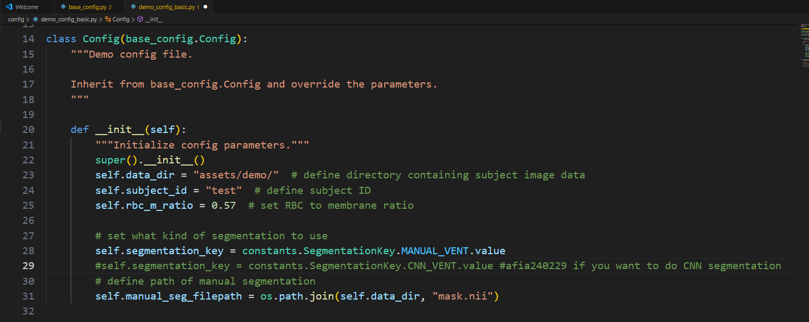
Make your own config file -it should be similar to config/demo_config_basic.py file
This should be the path to your subject data, Edit it as necessary
Put it from the Matlab flipCal code
Do you want to upload your manual segmentation or automated CNN segmentation? Select either Line 28 or 29 based on your preference
If you want to upload your manual mask, then upload it here (./assets/demo/mask.nii)

Slide 18
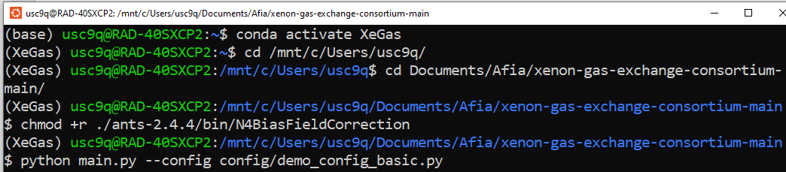
Run your config file like this.
You will find all the analysis saved in ./tmp folder

Slide 20
Failed attempt to run it on MS Visual studio

Slide 21
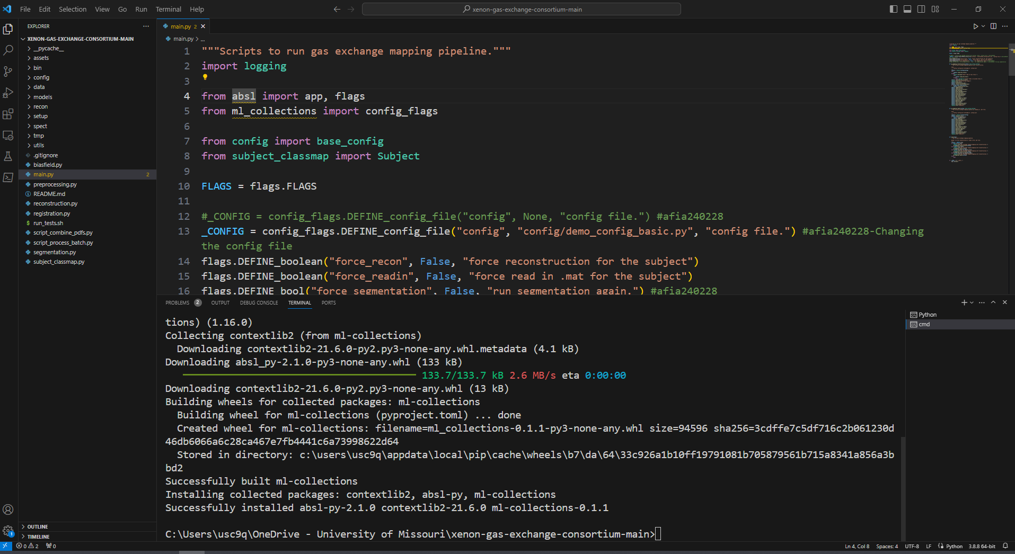
Duke pipeline runs on 3.8.8
Change your python to 3.8.8 version

Slide 22
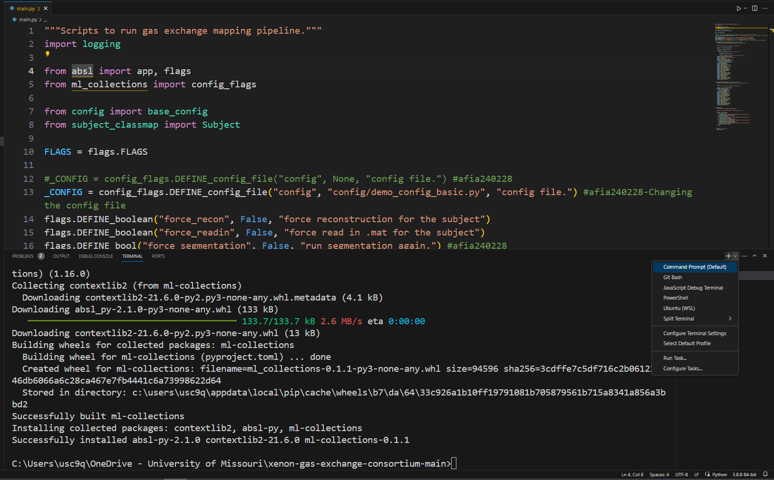
Go to Command prompt and install all the uninstall things

Slide 23
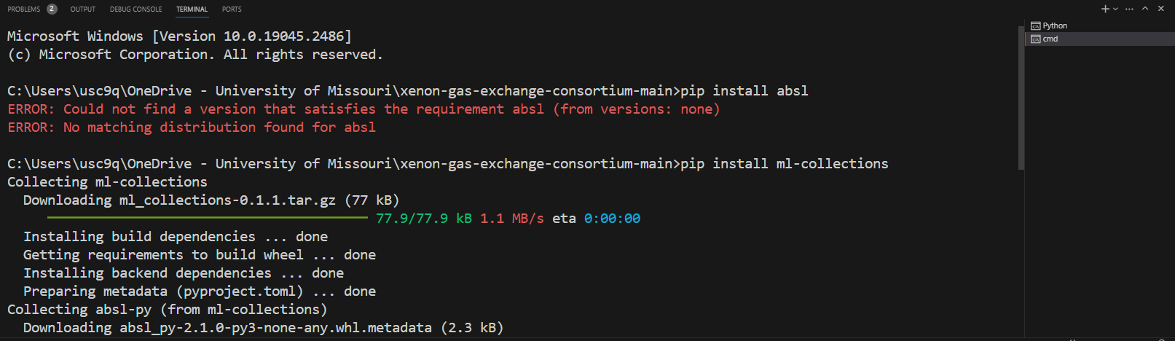
I had to install the following
pip install ml-collections
pip install opencv-python
pip install ismrmrd
pip install numba
pip install tensorflow
pip install PyPDF2
pip install gitpython
pip install -r setup/requirements.txt

Slide 24
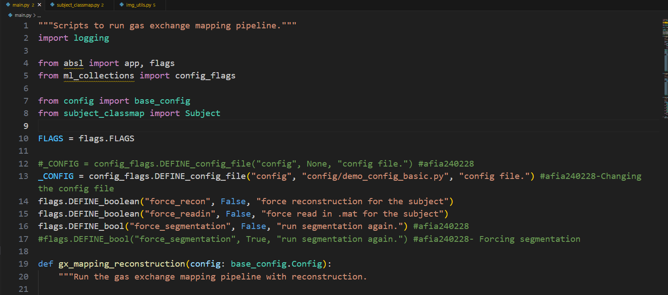
Declare the demo file

Slide 25
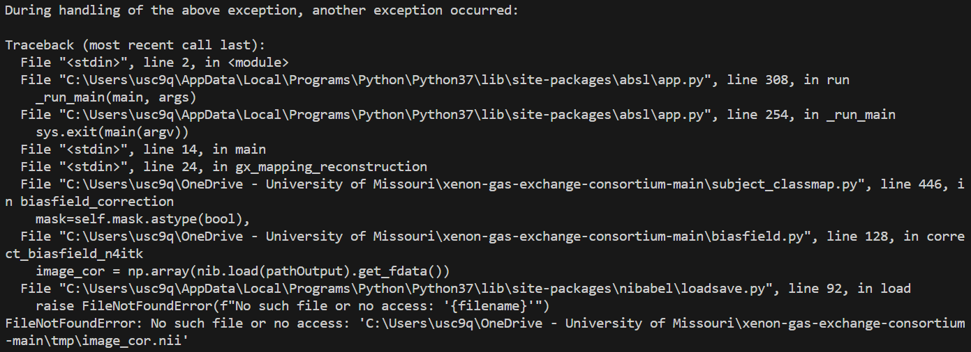
This error showed up. Since I didn’t run/install the ANT stuff.
Those requires Linux

