Slide 1
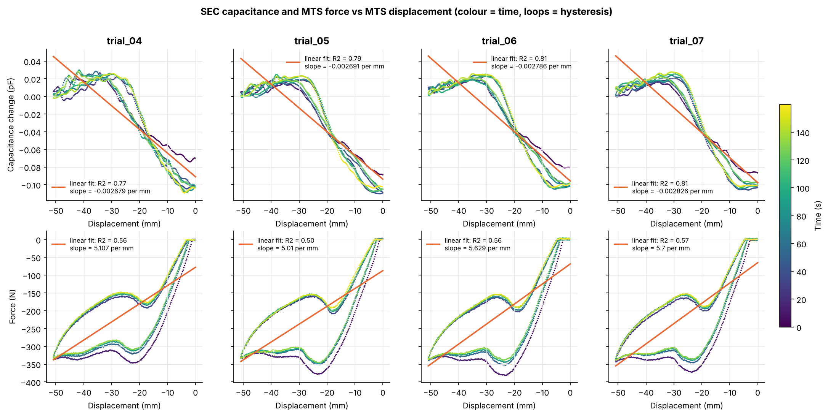
SEC capacitance tracks how far the tire is pressed
Can the SEC sensor stand in for the MTS load frame? The MTS presses 0 → −50.8 mm in a 40 s triangle cycle (force to ≈ −350 N) while SEC records capacitance C1.
6 of 9
trials usable (04–09); 01–03 are 60 s single ramps that will not align
R² 0.77–0.81
capacitance vs displacement, straight-line fit per trial
≈150 N
Top: S-shaped capacitance curve, flat beyond −30 mm. Bottom: force loops with a snap-through near −20 mm.
force hysteresis loop; capacitance shows very little
Notes:
Problem: replace or complement the MTS load frame with the SEC capacitive sensor. Target = MTS displacement and force. Trials 04–09 are 160 s of 40 s triangle loading, aligned to SEC by cross-correlation (offset 8.9–10.1 s, |r| 0.86–0.90). Trials 01–03 are short single ramps with alignment |r| 0.30–0.58, so they are reported but not trusted. Capacitance is zeroed per trial (trial 04 baseline sits ≈0.15 pF higher).

Slide 2
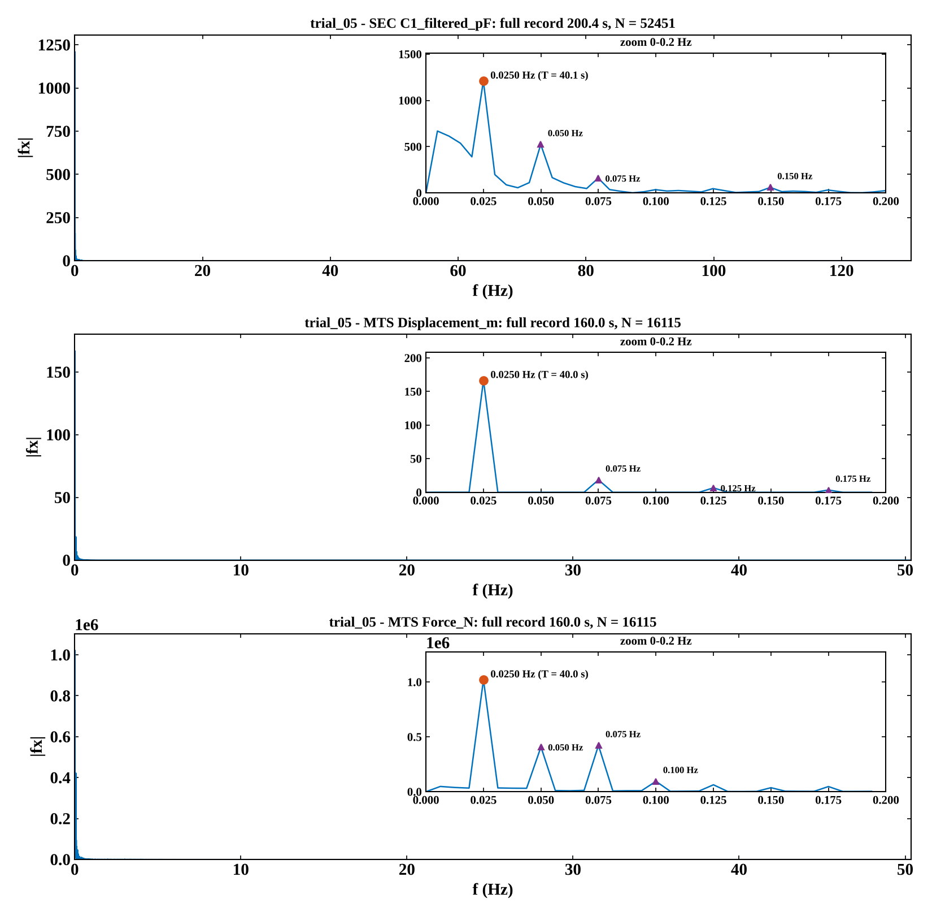
One frequency drives the system: 0.025 Hz
Same 40 s peak in SEC, displacement and force in every trial 04–09
Harmonics: displacement odd only (triangle wave); force and SEC add 0.05 Hz
Over 99% of energy lies below 0.5 Hz, so the test is quasi-static with no resonances
Trials 01–03 have no dominant peak
Notes:
Full-record FFT (Python port of the MATLAB code, mean removed, |fft| over 0..Nyquist). A peak counts as dominant if it holds at least 20% of spectral power and fits at least 3 cycles in the record. SEC carries less of its power at 0.025 Hz (32–49%) because of its 0.05 Hz harmonic and low-frequency drift; trial 09 SEC reads 0.0254 Hz only because of bin resolution. This 40 s period sets the TDA window: 1 period = 40 s window, ¼ period = 10 s Takens delay.

Slide 3
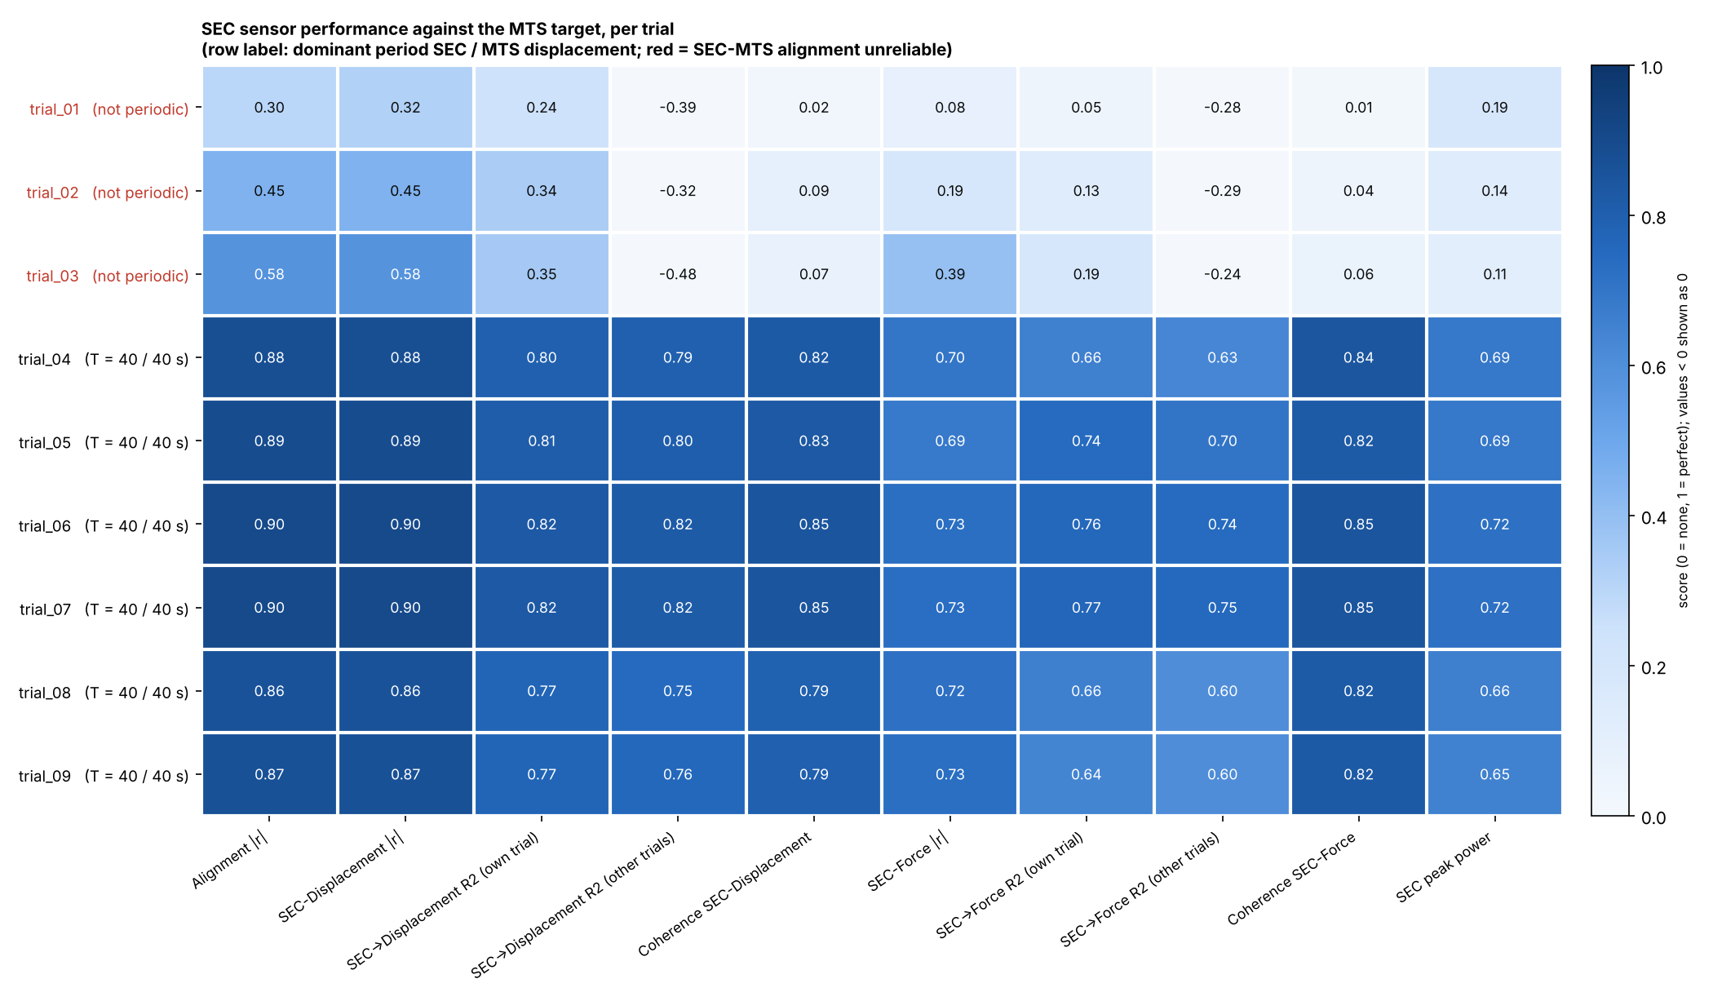
SEC predicts displacement with R² ≈ 0.8 across trials
0.86–0.90
|r| with displacement, trials 04–09
0.75–0.82
R² when calibrated on the other trials
0.60–0.75
R² for force (other trials): weaker
Notes:
Cubic SEC-to-target calibration. Own-trial R² for displacement 0.77–0.82 and other-trial R² 0.75–0.82: the calibration transfers between trials with almost no loss. Coherence with displacement 0.79–0.85 and with force 0.82–0.85. Force is harder because of its hysteresis and snap-through, which a one-to-one capacitance curve cannot represent. Trials 01–03 (red rows) fail: other-trial R² is negative.

Slide 4
FastTDA adds loop shape that capacitance misses
What TDA contributes
Displacement R² 0.88 → 0.91 on held-out trials
Direction accuracy 0.90 → 0.96 alongside the capacitance slope
Window set by physics: one 40 s loading period, 10 s delay
About 100× faster than VR or Alpha persistence
Limits
Blind to level and direction: alone it is at chance
Force gain did not replicate (0.691 → 0.693)
Ellipse fit fails on 25–48% of short windows
6 usable trials, one amplitude: preliminary
Notes:
FastTDA: Takens embedding (dim 2), SVD least-squares ellipse fit, feature = minor axis 2b. Validation uses non-overlapping windows, leave-one-trial-out linear models, circular-shift permutation tests and partial Spearman given capacitance. FastTDA alone scores 0.59 on loading vs unloading (chance 0.60), because the loop shape is time-reversal invariant and min-max scaled. Its value is as a complement. FastTDA tracks the 40 s displacement profile well in trials 04–07 (rho 0.84–0.93) but only 0.50–0.55 in 08–09. Next steps: more trials, more load amplitudes, and testing the force gain on new data.

