Slide 1


Slide 2
“Predicting Coupon Acceptance On E-Commerce Platforms”
“The goal of this project is to leverage machine learning techniques to analyze driving scenarios and user attributes collected from an e-commerce website. Predicting whether users will accept coupons accurately during their journeys. The survey describes different driving scenarios including the user’s destination, Current time, Weather, Passenger, Coupon attributes, user Attributes, and Contextual Attributes, Then asks the user whether he/she will accept the coupon or not.”

Slide 3

Data Overview
1
Dataset size:
12684 Rows and 24 Columns
Key Features:
Destination, Passenger, Weather, Coupon, Gender, Bar, Marital Status, Expiration Hours, Directions, Occupation, Coffee House, Carry Away, Restaurant Less Than 20, Restaurant 20 To 50, Temperature, Age, Income.
Target Variable:
Coupon Acceptance or Not Acceptance by He/She
2
3

Slide 4
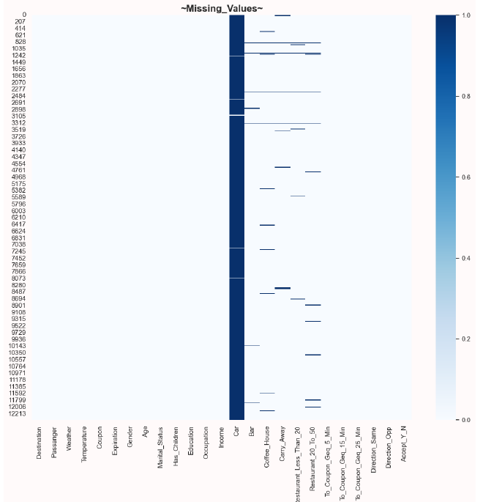
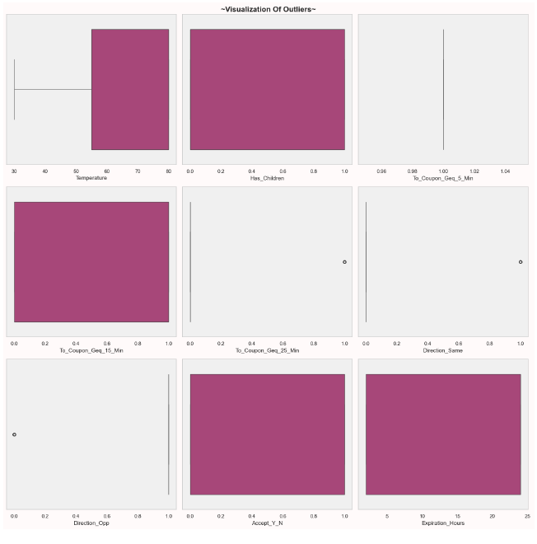
Data Preprocessing
1
Handling Duplicates:
Dropping the duplicates values.
Handling Missing Values:
SimpleImputer for categorical variables with most frequent argument & there is no missing values in numerical variable.
Outliers Treatment:
Applied the Z-Score Method, IQR Method and Boxplot to check & Handle Outliers.
Data Manipulation:
Binning some of the columns like Age, Income, etc.
2
3
4

Slide 5
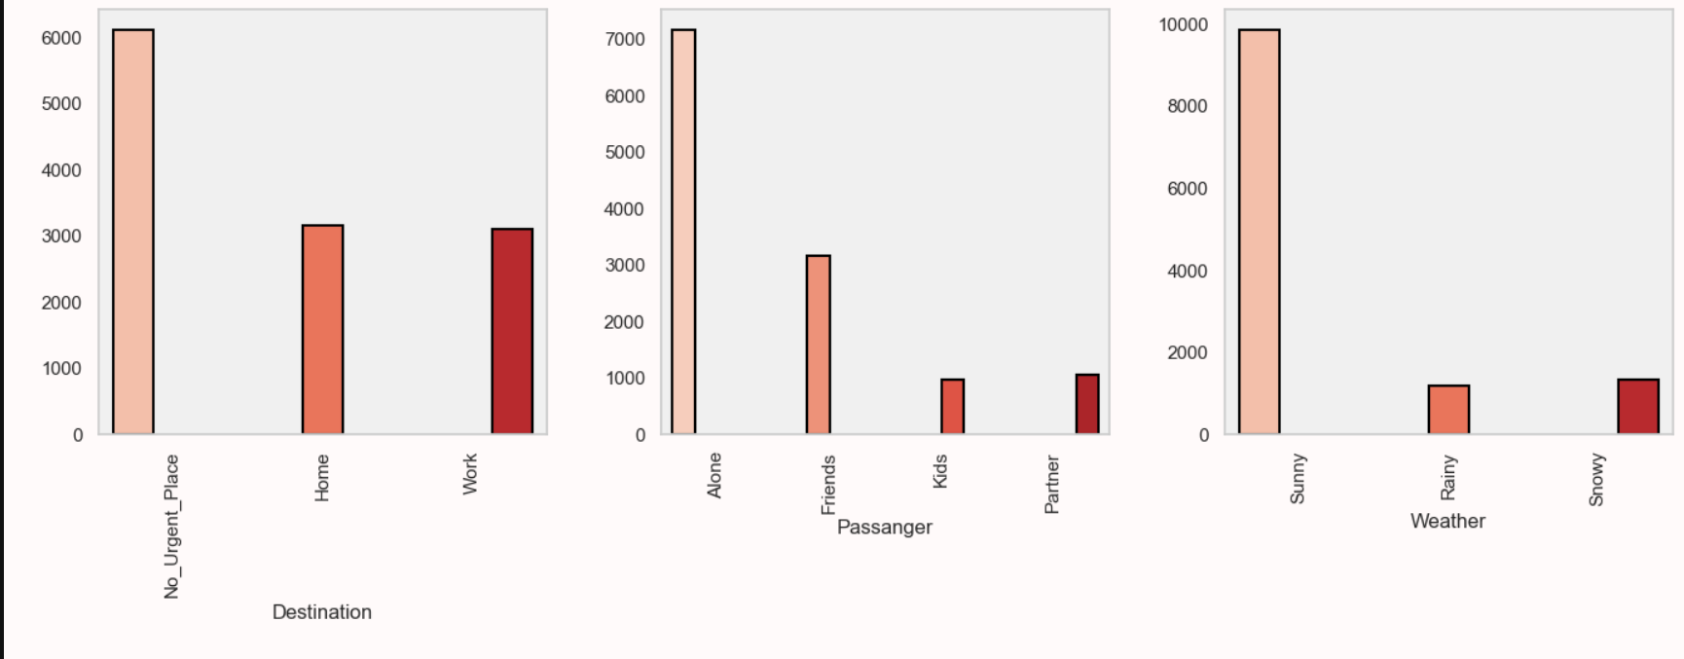
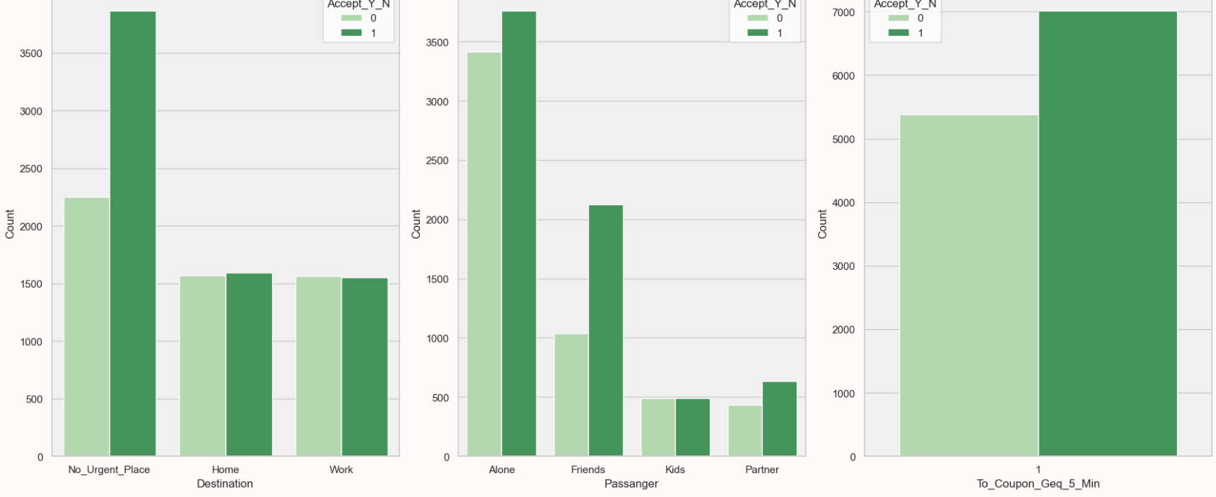
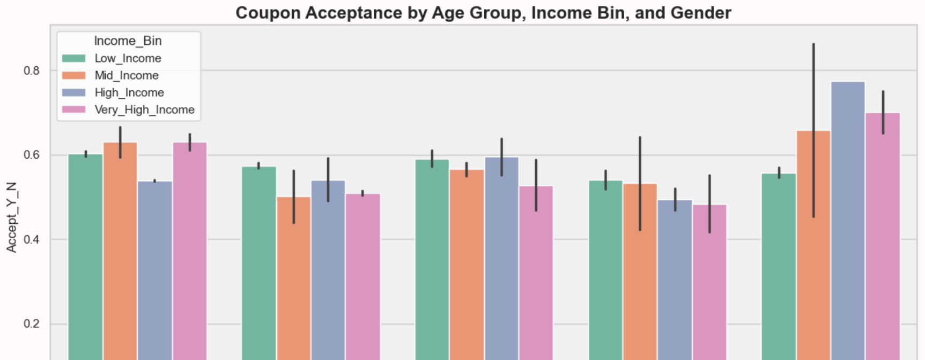
Exploratory Data Analysis
Multivariate Analysis
Demographics
Travel Behavior
Coupon Usage
Univariate Analysis
Bivariate Analysis
Numerical columns
Categorical columns
Target Variables
Customer demographics & Acceptance
Travel Behavior & Coupon Accessibility
Coupon type & Past Purchase Behavior

Slide 6
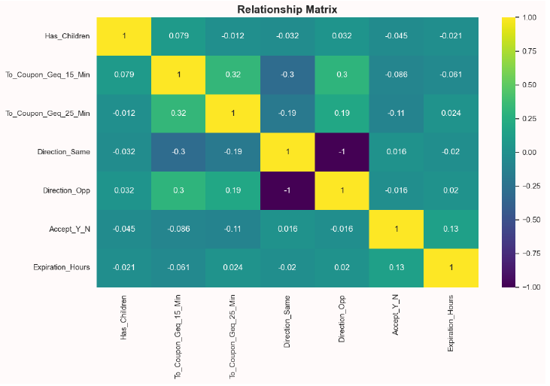
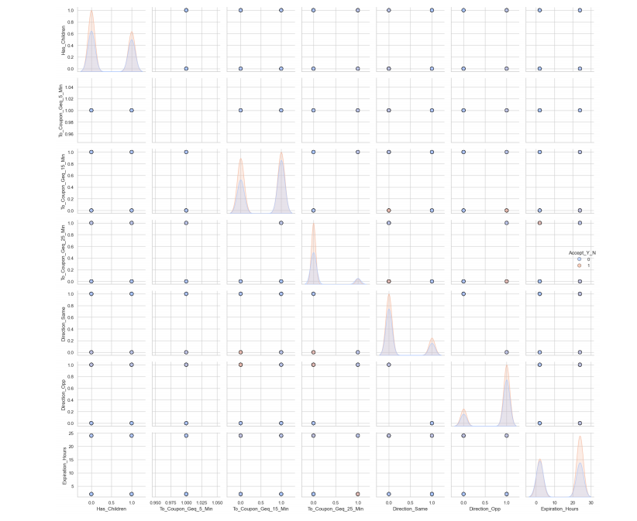
Correlation Matrix
Pair Plot
Displays the relationships between variables, guiding feature selection & helps to identified importance features for prediction.
Pairwise relationships between all the numerical features allowing us to understand the data before building a models.

Slide 7
Feature Engineering
1
Feature Encoding
4
Multicollinearity
Features encoded using one hot encoding
& ordinal encoding.
Checking Multicollinearity using VIF &
dropping highly correlated features.
2
Data Imbalanced
5
Feature Scaling
Balanced the data using SMOTE technique.
Standarized the data using Standard Scalar.
3
Correlation Matrix
6
Feature Selection
For understanding the linear relationships between the variables.
Used RFE & Mutual Info Classif for selecting relevant features.

Slide 8
Model Selection
Baseline Classifier Models
Logistic Regression, KNN and Naive Bayes are Standard classification models for baseline performance.
Advanced Models
Support Vector Classifier, XGBoost for more complex classification & for best accuracy.
Tree-Based Models
Decision Trees, Random Forest, Gradient Boosting, AdaBoost to enhanced the classification accuracy.

Slide 9
Model Training and Evaluation
1
Data Splitting
3
Cross Validation
80% training, 20% testing split for model evaluation.
K-Fold & Stratified K-Fold to improved model performance & generalization.
2
Hyperparameter Tuning
4
Performance Metrics
Used GridSearchCV & RandomizedSearchCV for fine-tuning & to optimized models parameters.
Evaluated models using classification metrics like Accuracy Score, Precision, Recall, F1Score, Confusion matrix, Roc Auc and classification report.

Slide 10
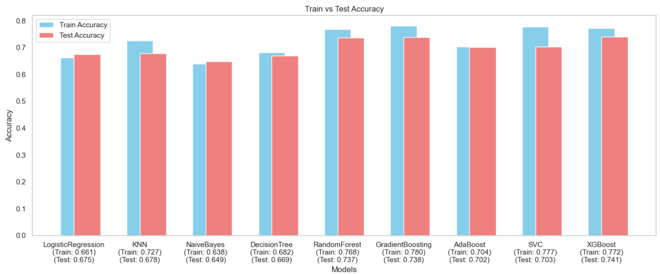
Model Performance Comparison
Best Performer
XGBoost Classifier achieved highest accuracy score of 74.1% out performing other models indicating superior ability to generalize.
Runner Up
Gradient Boosting Classifier and Random Forest came 2nd with accuracy score of 73.8% which slightly lower than XGBoost.
Baseline Models
Logistic Regression and KNN performs similarly around 67.5% accuracy score offering a good baseline model for classified.

Slide 11
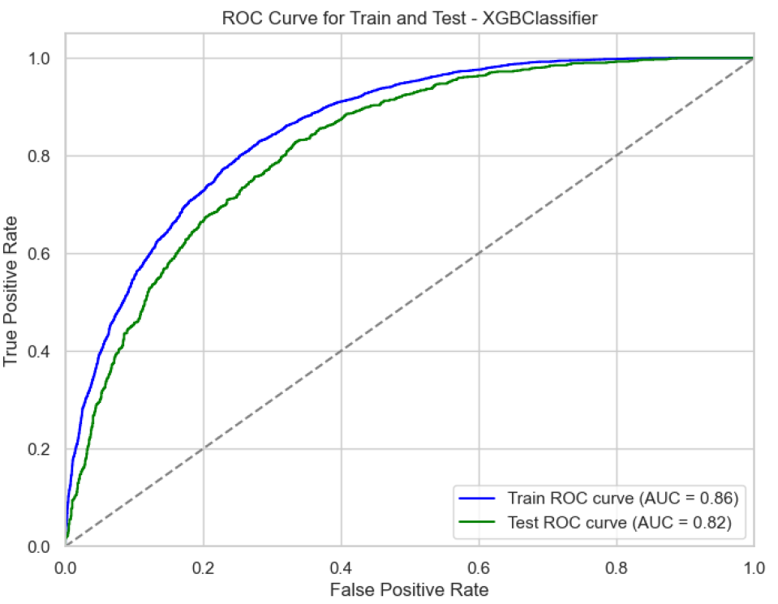
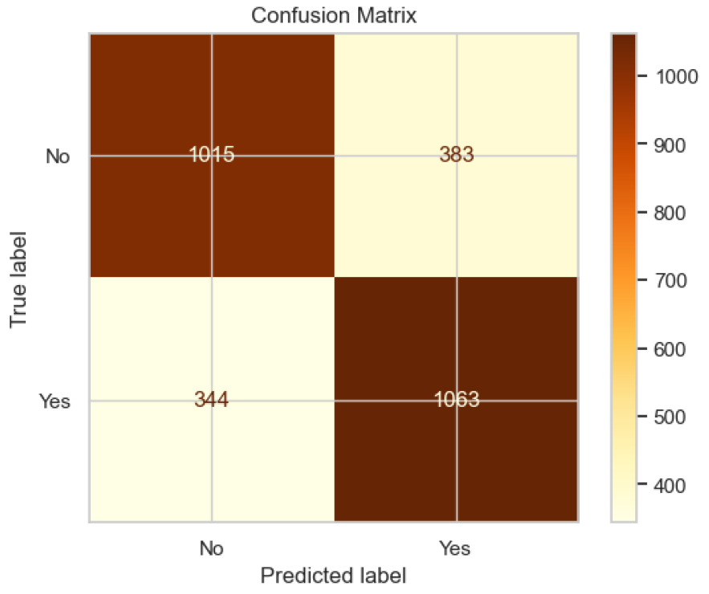
Best Model XGBoostClassifier
The XGBoostClassifier demonstrated strong performance with a True Positive count of 1,063 and a True Negative count of 1,015. However, the model misclassified 344 instances as False Positives and 383 as False Negatives. These results align with the model's recall of 75.5% and precision of 73.5%, indicating a balanced trade-off between sensitivity and specificity.
Also XGBoostClassifier achieved a training accuracy of 77.2% and a testing accuracy of 74.1%, with a precision of 73.5%, recall of 75.5%, and an F1 score of 74.5%. The best cross-validation score was 75.0%, while the ROC-AUC scores were 86.0% for training and 82.0% for testing, indicating strong model performance and generalization capability to predict coupon acceptance.

Slide 12
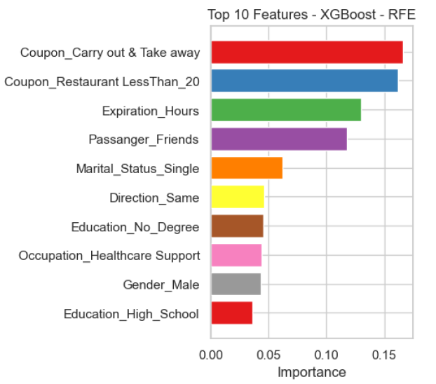
Feature Importance
1
Coupon
Carry out & take away / restaurant < 20 are most Important features which holds 33.0% importance.
2
Expiration Hours
Second most important feature with 13.0% importance.
3
Passengers
Third most important feature with 12.0% importance.
4
Other Features
Rest all the features contributed with 42.0%.

Slide 13

Key Findings
1
Best Model
XGBoost outperformed all other models, achieving the highest accuracy and robust predictive performance, making it the best choice for this classification task.
2
Important Factor
Features like Coupon, Expiration, Gender, Occupation, Passengers, Directions, Destination, Weather, Marital Status are significantly influence coupon acceptance.
3
Model Accuracy
Achieved 74.1% accuracy in predicting Coupon Acceptance.

Slide 14
THANK YOU

