Slide 1
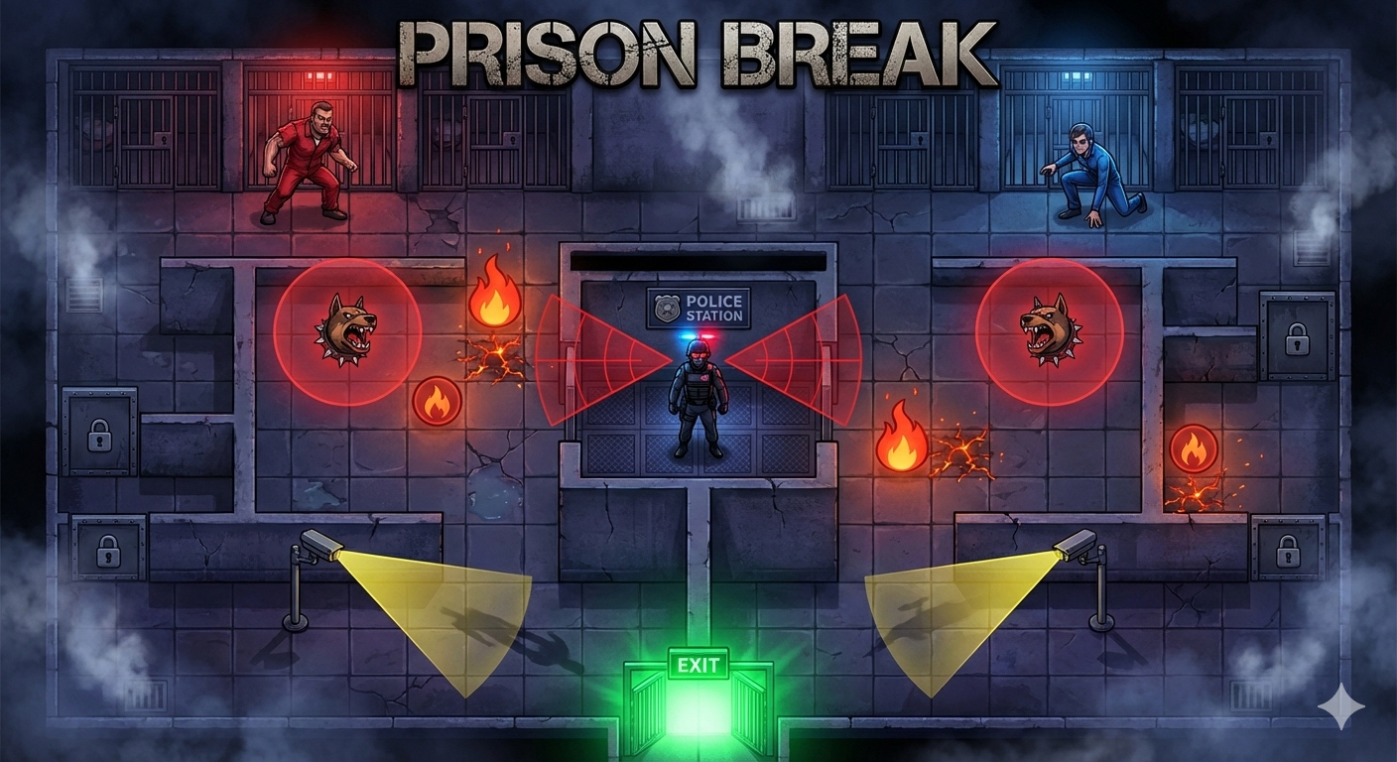



CSE 3209 · Artificial Intelligence Laboratory
Presented By
2107067 | 2107078 | 2107087
1
Notes:
1.7.2013
1
‹#›

Slide 2




Objectives
01
Grid-based prison escape simulation in Godot Engine
05
Compare three AI techniques in one shared adversarial environment
02
Police/Hunter agent using Fuzzy Logic Inference System
06
Design prison map with walls, CCTV, fire hazards, and exits
03
Red Prisoner controlled by Minimax + Alpha-Beta Pruning
07
Implement capture, escape, scoring & danger-map systems
04
Blue Prisoner controlled by Monte Carlo Tree Search
08
Visualize AI reasoning through HUD, overlays & analysis screens
2
Notes:
1.7.2013
2
‹#›

Slide 3





Introduction
Prison Break is a Godot-based multi-agent AI simulation set inside a prison escape scenario. It shows how different AI techniques behave against each other in the same environment — not as isolated algorithms, but as competing decision-makers.
Police
Red Prisoner
Blue Prisoner
Fuzzy Logic
Minimax + Alpha-Beta
Monte Carlo Tree Search
Defensive agent — reacts to uncertain signals: distance, alert, CCTV, dog, exit threat.
Rusher — treats police as adversary, plans optimal escape move strategically.
Stealth agent — estimates future outcomes through rollout simulations.
3
Notes:
1.7.2013
3
‹#›

Slide 4
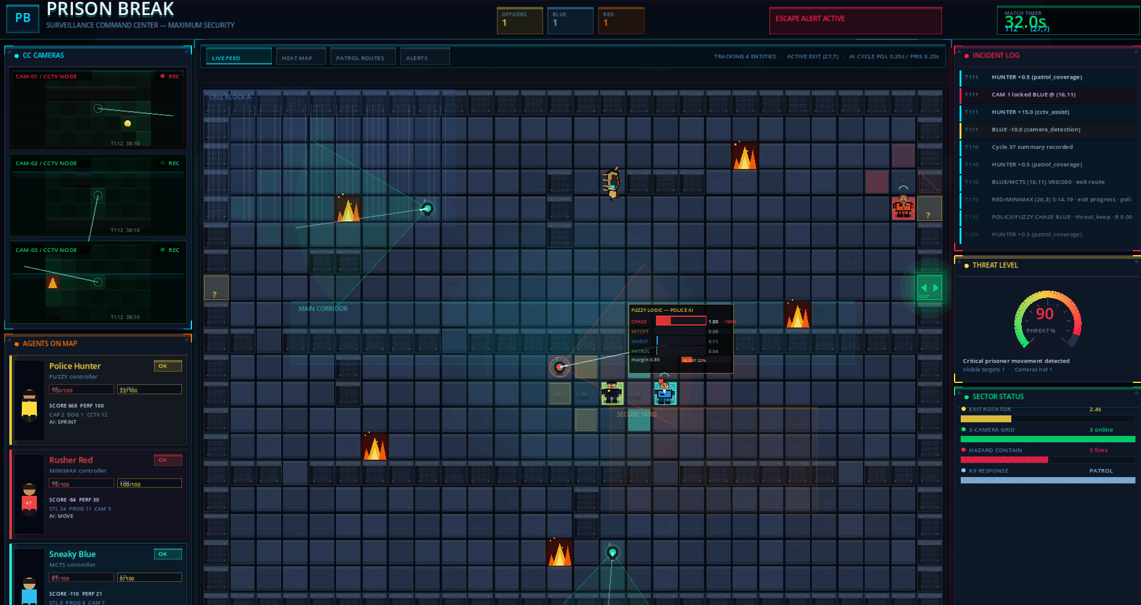
4
Figure -1 : Whole game scene

Slide 5







System Architecture
Centralized signal event-driven simulation. EventBus coordinates all agent decisions, scoring, replay snapshots, and HUD updates.
GAME SCENE
Simulation Loop · Tick Clock · EventBus
Police/Hunter
Fuzzy Logic
Red Prisoner
Minimax
Blue Prisoner
MCTS
Dog NPC
+ CCTV
OUTPUT LAYER
Grid/Cost/
Danger Maps
Scoring
System
HUD +
Overlays
Replay +
Benchmark
AI Analysis
Screen
5
Notes:
1.7.2013
4
‹#›

Slide 6



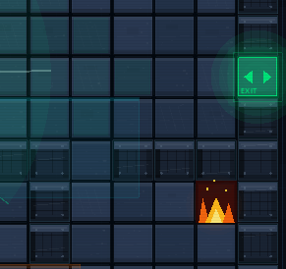




Game Environment Design
Grid-Based Map
Walls & Barriers
Discrete tile grid — all agents share same coordinate model for pathfinding, MCTS rollouts, Minimax, CCTV visibility.
Block movement, force route planning. Doors/barriers restrict paths, adding strategic depth.
Fire Hazards
CCTV Cameras
Seed the danger map. Create penalties and elimination pressure, narrowing safe routes.
Monitor zones using range/visibility. Detection raises Police/Hunter alert and triggers fuzzy behaviour changes.
Active Exit
Dog NPC
Figure -2 : Active exit and fire fazards in the game
Dynamic objective with rotation and decoy exits. Police uses exit threat to choose chase vs. intercept.
Mobile state-machine threat. Patrols, detects, sniffs, chases, latches — boosting danger map pressure.
6
Notes:
1.7.2013
5
‹#›

Slide 7
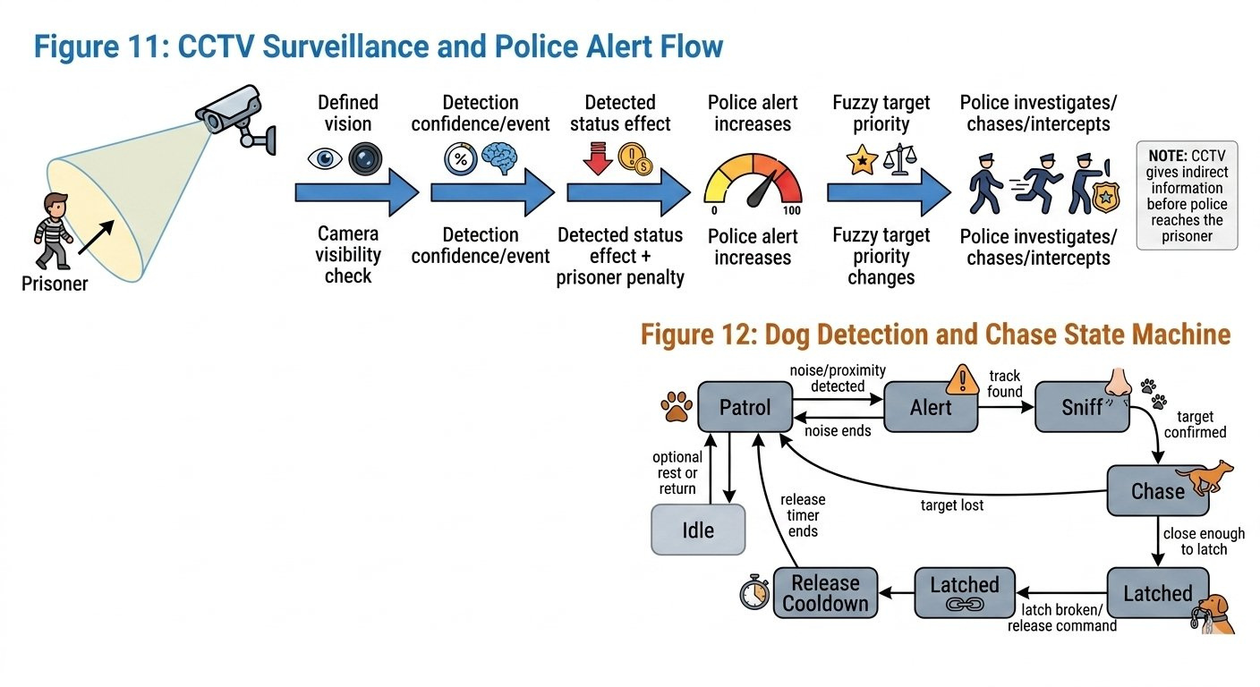
7
Figure -3 : CCTV surveillance and Police Alert Flow

Slide 8





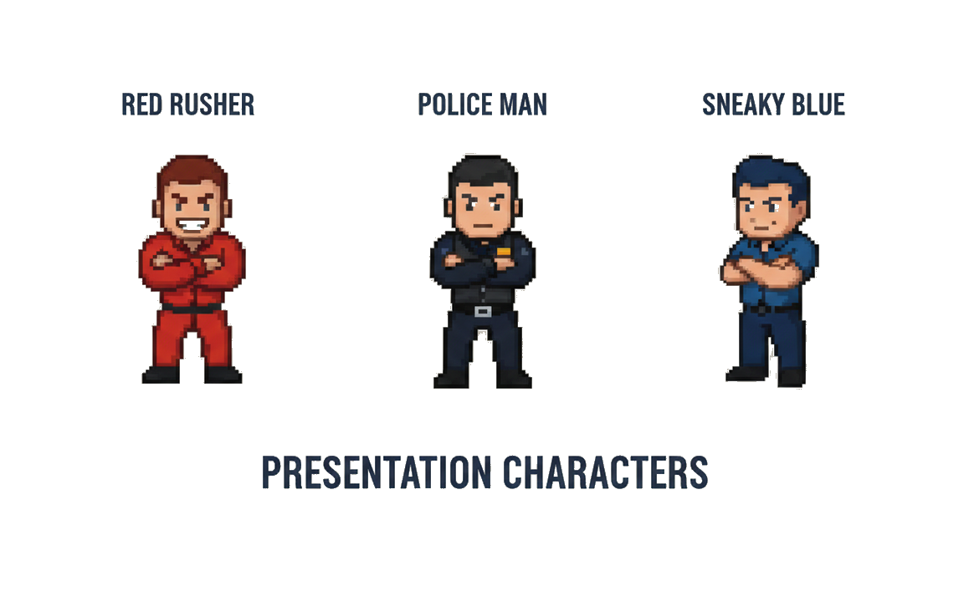




AI Agent 1: Police
Fuzzy Logic Inference System
Why Fuzzy Logic?
FUZZY INPUTS
Police receives partial, uncertain signals. Fuzzy logic converts them into graded behaviour scores — reacting like a human guard, not a rigid rule engine.
▸ Distance to prisoner
▸ Dog signal
▸ Distance to active exit
▸ Prisoner stealth
BEHAVIOUR OUTPUTS
▸ Alert level
▸ Capture opportunity
Move toward selected prisoner or capture tile
CHASE
▸ CCTV confidence
▸ Target priority
INTERCEPT
Move toward exit-side or predicted escape tile
INVESTIGATE
Move toward CCTV hint or last known position
PATROL
Guard patrol targets when threat is low
8
Notes:
1.7.2013
6
‹#›

Slide 9
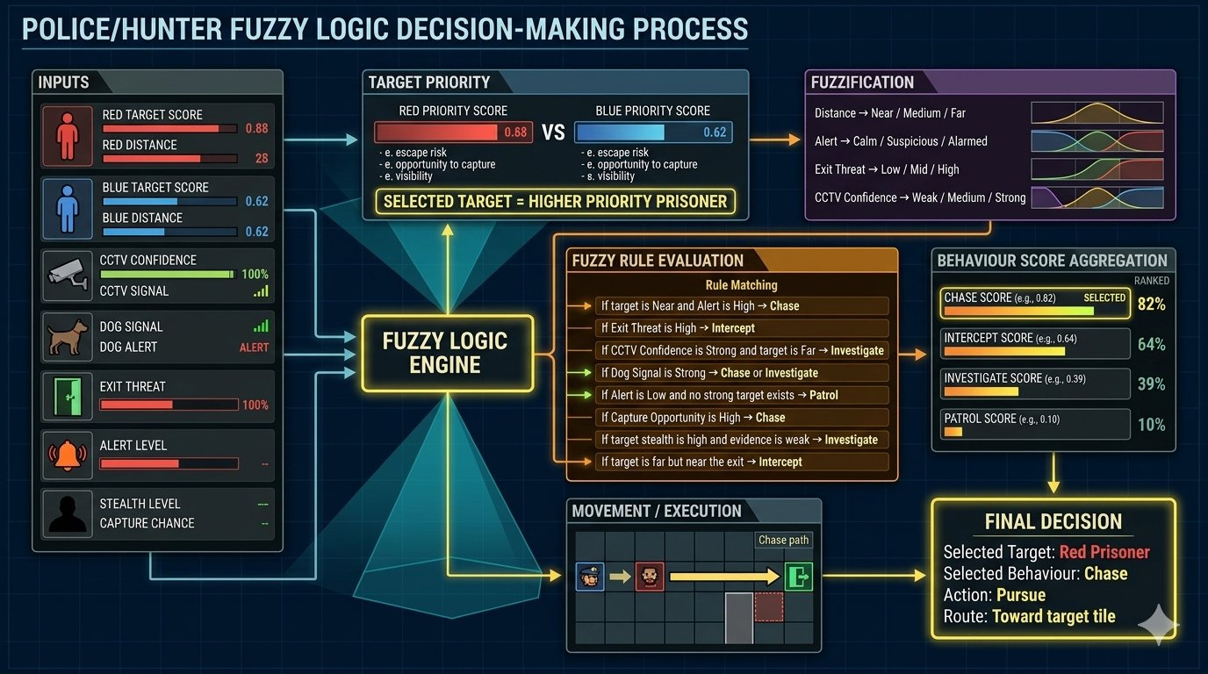
9

Slide 10






Fuzzy Rule Base
Police/Hunter Decision Logic
Rule
Condition
Output
R1
Prisoner is near AND alert is high
CHASE
R2
Prisoner is close to active exit
INTERCEPT
R3
CCTV confidence is high BUT target is far
INVESTIGATE
R4
Dog detected or chased a prisoner
CHASE / INVESTIGATE
R5
No strong target AND alert is low
PATROL
R6
Capture opportunity is high
CHASE
R7
Stealth is high AND signal is weak
INVESTIGATE
R8
Target is far BUT exit threat is high
INTERCEPT
10
Notes:
1.7.2013
7
‹#›

Slide 11
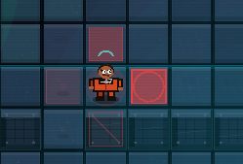




AI Agent 2: Red Prisoner
Minimax with Alpha-Beta Pruning
Algorithm
Minimax with Alpha-Beta Pruning
ALPHA-BETA PRUNING
Style
Rusher — treats Police as adversarial opponent
Red Root (MAX)
Goal
Escape through the active exit
Strength
Strategic planning against an opponent model
Move A
Move B ✓
Move C
Weakness
Depends on search depth and heuristic quality
Police resp.
Score: +8
PRUNED ✕
Evaluation Function
Score =
+ exit-progress reward
− danger penalty
− guard pressure
− fire/wall penalty
+ stamina value
11
Notes:
1.7.2013
8
‹#›

Slide 12
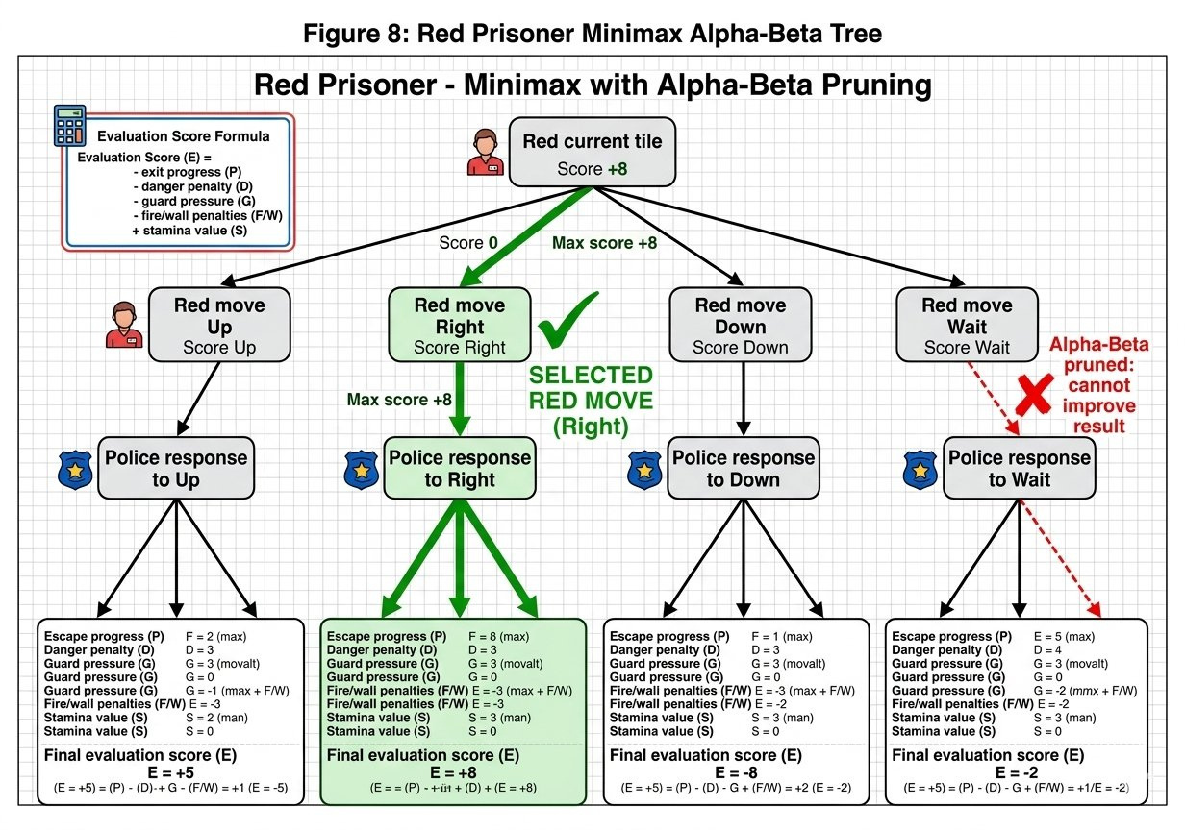
12

Slide 13








AI Agent 3: Blue Prisoner
Monte Carlo Tree Search (MCTS)
1
2
3
4
SELECTION
EXPANSION
SIMULATION
BACKPROP.
Choose promising nodes using UCT formula, balancing exploration vs exploitation
Add one or more child nodes (new moves) to the selected node
Play a complete rollout from expanded node using heuristic or random moves
Update visit counts and simulation rewards up through path to root node
ROLLOUT SCORING FACTORS:
◆ Escape progress
◆ Stamina cost
◆ Distance to exit
◆ Exit rotation
◆ Police safety
◆ Survival
◆ Dog/CCTV/fire danger
13
Notes:
1.7.2013
9
‹#›

Slide 14
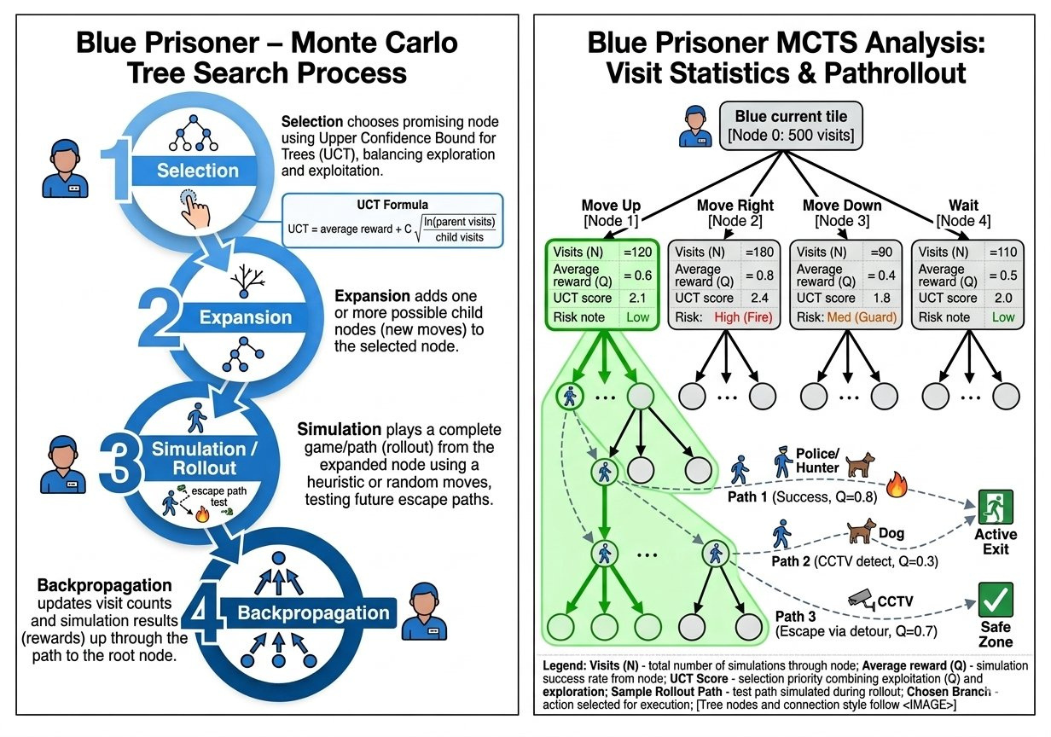
14

Slide 15










Simulation Loop & Scoring
01
Update perception, CCTV hints, alert decay
SCORING EVENTS
02
Rebuild danger & cost maps
Event
Police Effect
Prisoner Effect
03
Ask Police/Hunter fuzzy AI for decision
Prisoner escapes
Escape penalty
Large bonus
04
Ask Red Minimax AI for decision
Police captures
Capture bonus
Capture penalty
05
Ask Blue MCTS AI for decision
CCTV detects
CCTV assist
Detection penalty
06
Resolve actions & movement
Dog engages
Dog assist
Zone penalty
07
Update dog NPC & fire hazards
Fire contact
Fire assist
Fire penalty
08
Check capture / escape / timeout / elimination
Timeout
Containment
Timeout penalty
09
Update scoring & performance metrics
Patrol coverage
Coverage bonus
N/A
10
Record AI analysis & replay snapshot → Update HUD
15
Notes:
1.7.2013
10
‹#›

Slide 16




Capture, Escape & Outcome Logic
PRISONERS WIN
POLICE WINS
Both prisoners successfully reach the active exit
All prisoners are captured, eliminated, or fail to escape
PARTIAL ESCAPE
TIMEOUT
At least one prisoner escapes but not all escape within time
60-second timer expires — remaining prisoners timed out
Capture:
Police within tile range + cooldown expired → updates counters, scoring, state. Repeated captures → elimination/respawn.
Escape:
Prisoner reaches active exit → becomes inactive, receives escape bonus. Police receives escape-allowed penalty.
16
Notes:
1.7.2013
11
‹#›

Slide 17




AI Decision Visualization
Live HUD
AI Analysis Page
• Timer, score events, agent status
• Police Fuzzy: target priority + behaviour scores
• Fuzzy behaviour bars (Chase/Intercept/Investigate/Patrol)
• Red Minimax: candidate moves + police response branches
• Threat level gauge & incident log
• Blue MCTS: visit counts, rewards, UCT values + Decision Timeline
Decision Overlays
Result Screen
• Candidate path highlights on grid
• Final ranking (Police / Blue / Red) with scores & %
• Danger heatmap & CCTV vision cone
• Captures, escapes, timeout summary
• Dog patrol route & AI cycle label per tick
17
Notes:
1.7.2013
12
‹#›

Slide 18

Tools & Technologies
Game Engine
Godot
AI Technique 3
Monte Carlo Tree Search (MCTS)
Language
GDScript
Environment
Grid-based tile simulation
AI Technique 1
Fuzzy Logic Inference System
Architecture
Signal/Event-driven (EventBus autoload)
AI Technique 2
Minimax + Alpha-Beta Pruning
18
Notes:
1.7.2013
13
‹#›

Slide 19




Conclusion
Prison Break demonstrates a complete multi-agent AI simulation where three different AI paradigms compete in the same dynamic prison environment.
Fuzzy Logic gives the Police/Hunter human-like, uncertainty-aware behaviour
Minimax provides deterministic adversarial planning for the Red prisoner
MCTS enables simulation-based exploration for the stealthy Blue prisoner
Strongest Contribution
Visible AI Reasoning — supporting systems (CCTV, dog, fire, exits, danger maps, replay, AI analysis) make the environment explainable and suitable for AI Lab demonstration.
19
Notes:
1.7.2013
14
‹#›

Slide 20
References
KEY REFERENCES
[1] Russell & Norvig — Artificial Intelligence: A Modern Approach
[2] Browne et al. — A Survey of Monte Carlo Tree Search Methods (IEEE, 2012)
[3] Knuth & Moore — An Analysis of Alpha-Beta Pruning (Artificial Intelligence, 1975)
[4] Zadeh, L.A. — Fuzzy Sets (Information and Control, 1965)
[5] Hart, Nilsson & Raphael — A* Pathfinding (IEEE, 1968)
20

Slide 21
Thank You
Do you have any questions ?
21

Slide 22
22
Notes:
1.7.2013
15
‹#›

