Slide 1
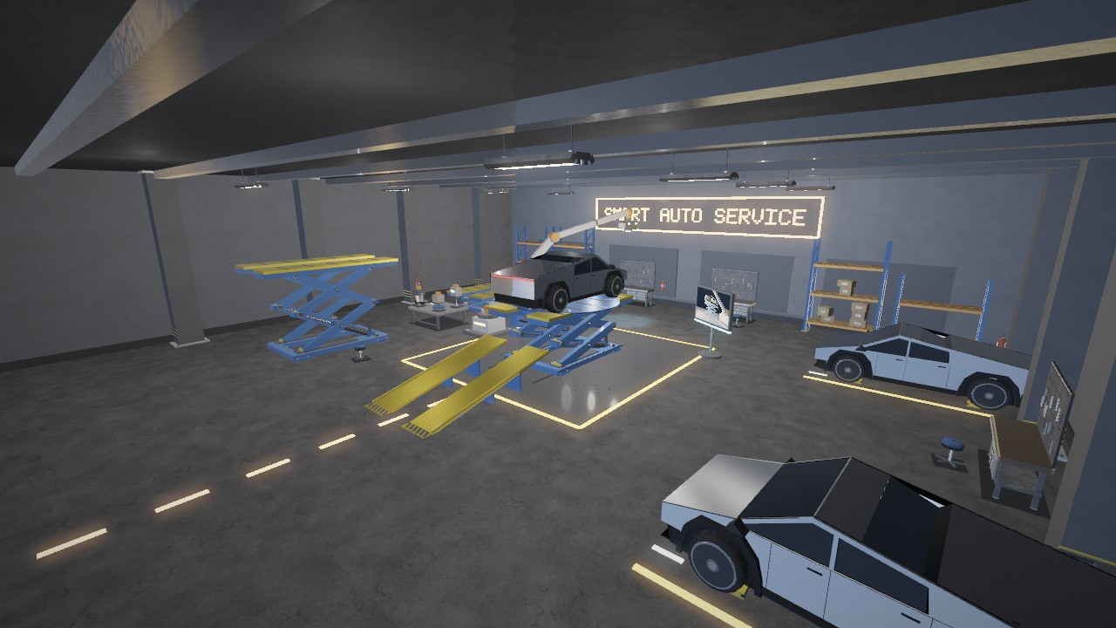
CSE 4102: Computer Graphics and Image Processing
SMARTGARAGE
Automatic Vehicle Inspection and Service System Using OpenGL
SUBMITTED BY
SUBMITTED TO
Afifa Sultana Offa
Md. Tajmilur Rahman
Roll: 2107087
Lecturer
Md. Mubtashim Abrar Nihal
Lecturer
Department of Computer Science and Engineering
Khulna University of Engineering & Technology, Khulna 9203, Bangladesh
Date of Submission: October 7, 2026
Notes:
SmartGarage: automatic vehicle inspection and service bay. CSE 4102 project. OpenGL 3.3 core, C++, GLSL.

Slide 2
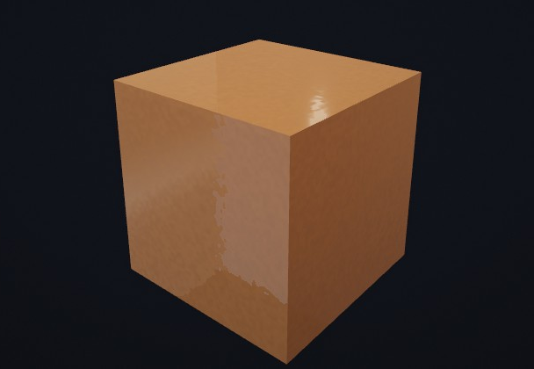
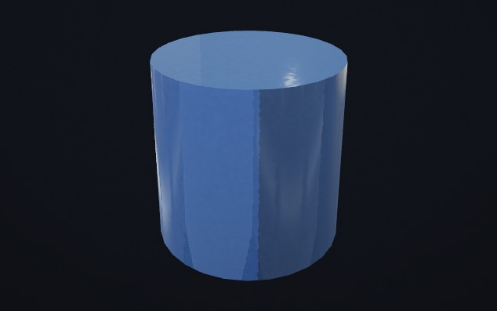
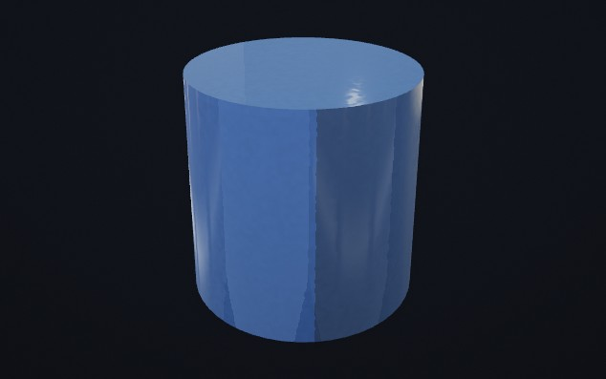
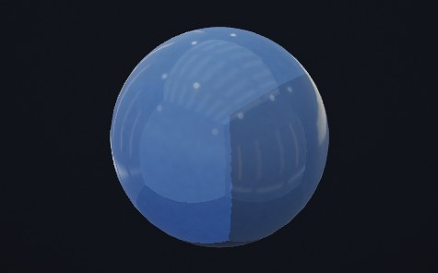
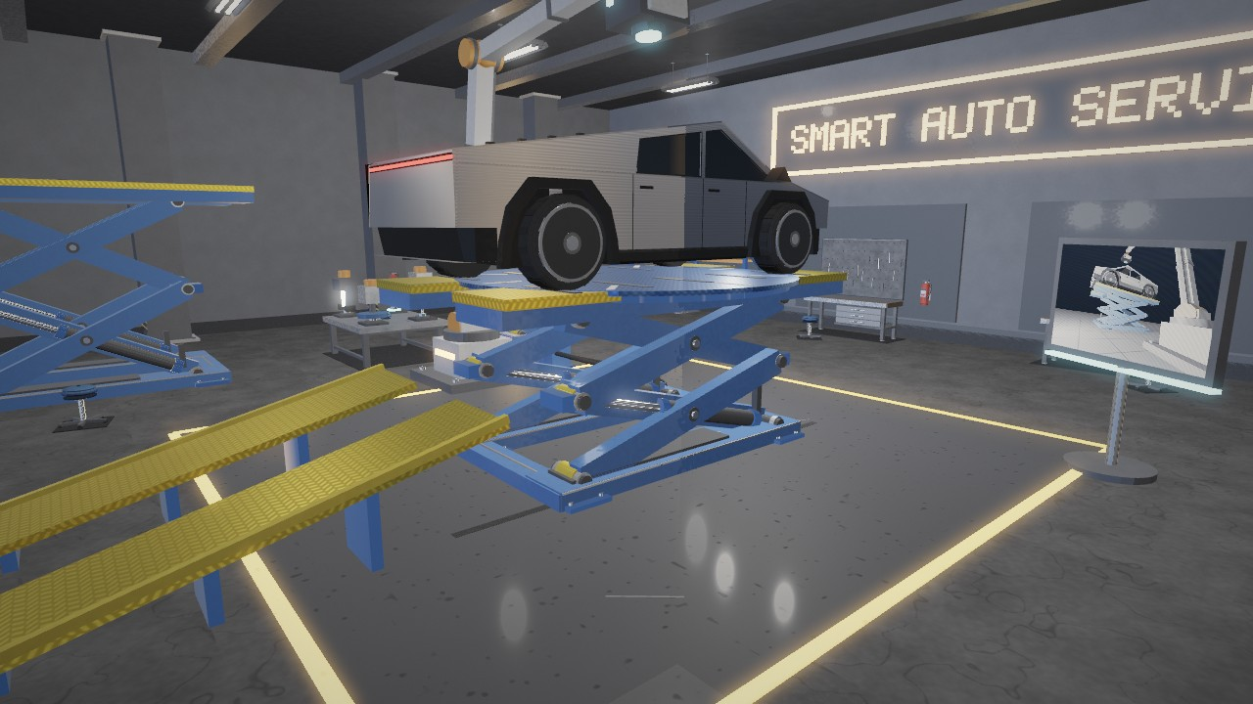
SMARTGARAGE AT A GLANCE
Fig. 2 Cube
Fig. 3 Cylinder
Fig. 4 Smooth cylinder
Fig. 5 Sphere
Fig. 1 SmartGarage workshop overview
KEY EQUATIONS
Model matrix: M = T · R_{y} · R_{x} · R_{z} · S
Hierarchy: M_{child} = M_{parent} · M_{local}
Unit cube → scissor arm: S(0.20, 0.32, 3.30), then R_{x}(−14.75°), then T
21 / 21 proposal items implemented, plus a ray-traced inspection monitor
Fig. 6 Scissor arm in the lift
Notes:
Overview: the garage and its main parts, the four reusable primitives with the model matrix and hierarchy that build every object, the proposal completion, the six mandatory requirements and the complete service workflow.

Slide 3
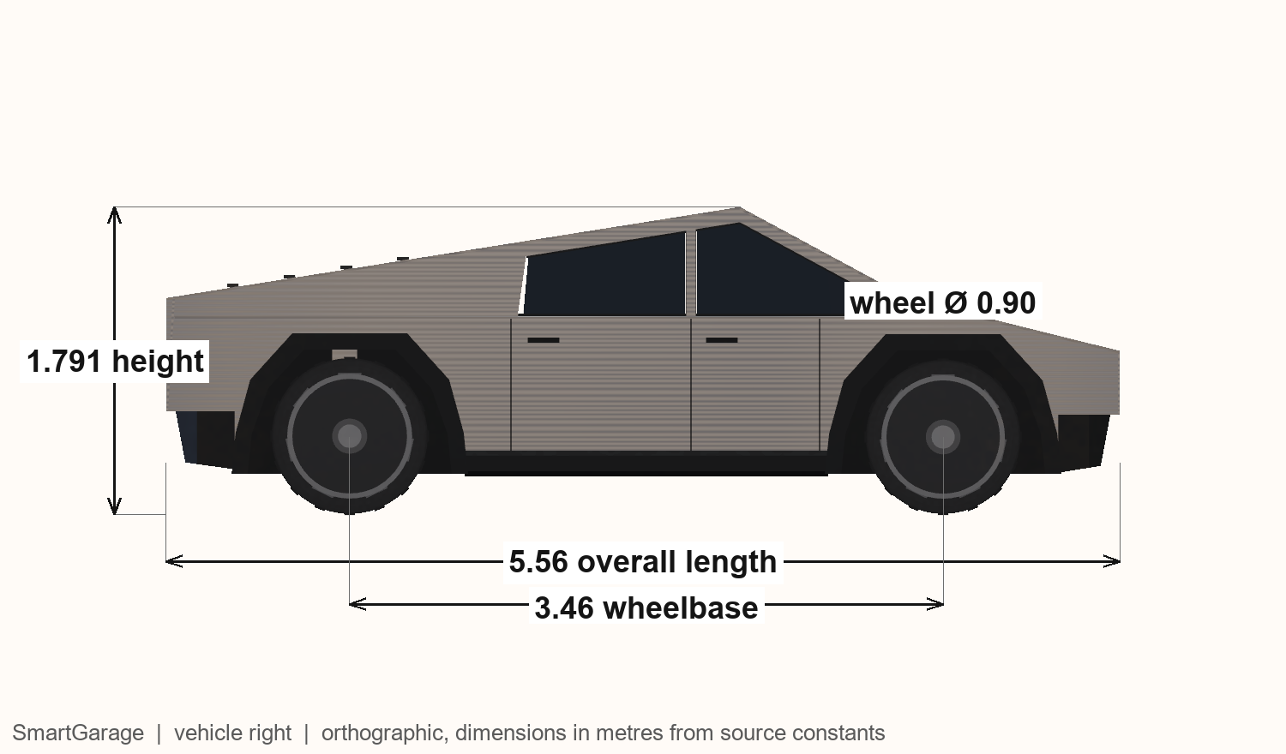
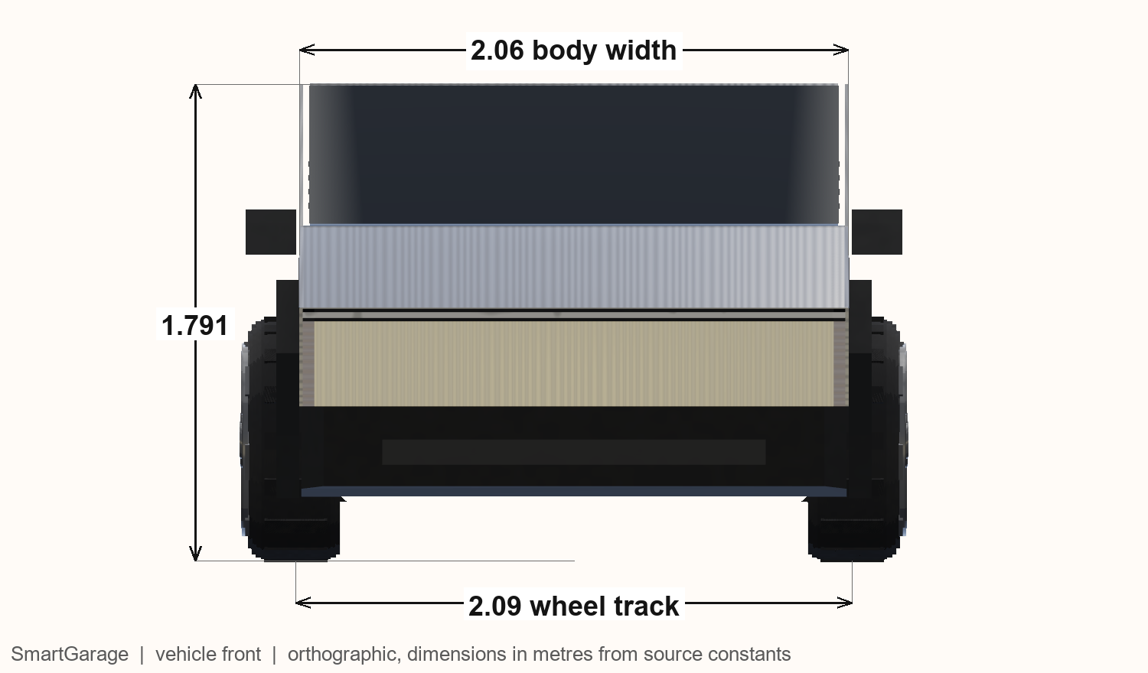
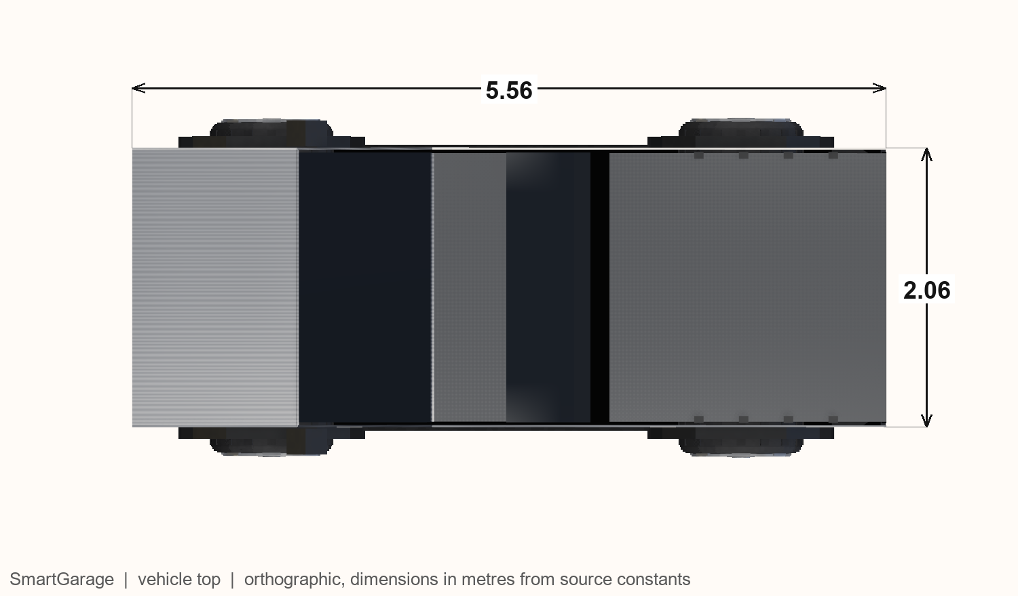
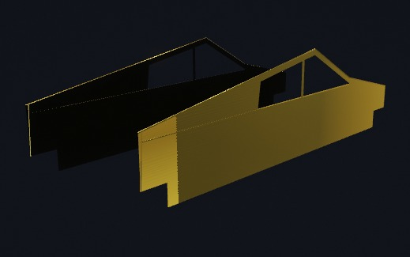
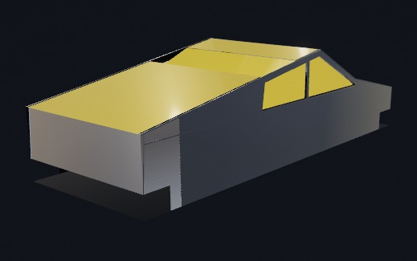
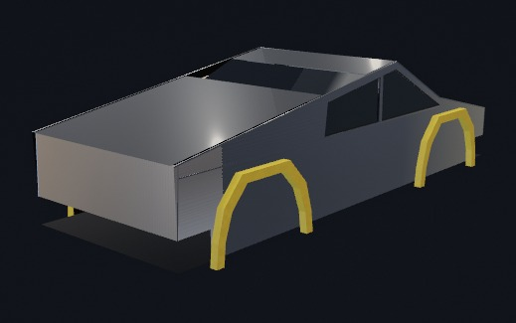
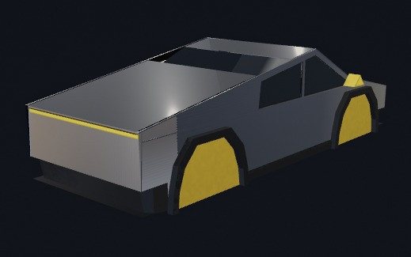
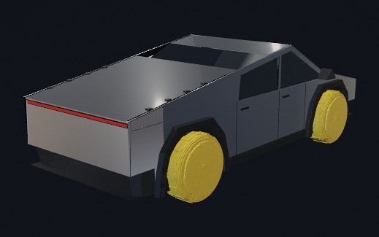
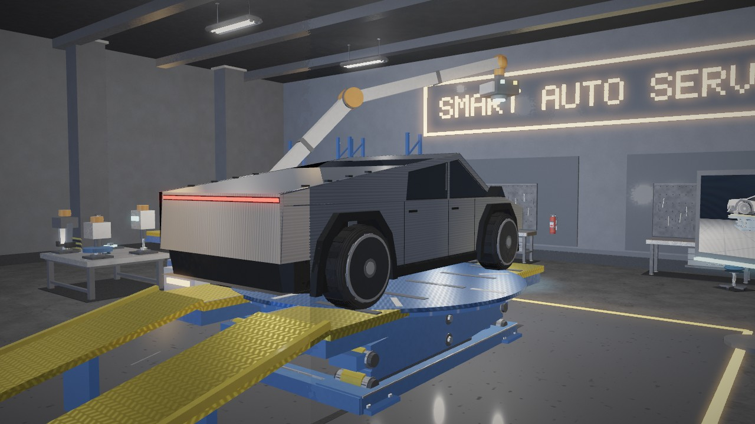
VEHICLE CONSTRUCTION
Fig. 7 Right view with dimensions
Fig. 8 Front view with dimensions
Fig. 9 Top view with dimensions
Fig. 10 Stage 1: side skin
Fig. 11 Stage 3: roof + glass
Fig. 12 Stage 5: wheel arches
Fig. 13 Stage 7: lights
Fig. 14 Stage 10: wheels
Fig. 15 Final vehicle
KEY EQUATIONS
Flat face normal: n = (P₂ − P₁) × (P₃ − P₁) / ‖(P₂ − P₁) × (P₃ − P₁)‖
Wheel: M_{wheel} = M_{car} · T · R_{z}(90°) · R_{y}(φ), φ = s / r, r = 0.450 m
Size: L 5.56 m · W 2.06 m · H 1.79 m · wheelbase 3.46 m; 13 shell batches, 10 stages
Notes:
Vehicle: three orthographic views, ten construction stages, a custom hood quad with its face normal, and the rolling wheel transform.

Slide 4
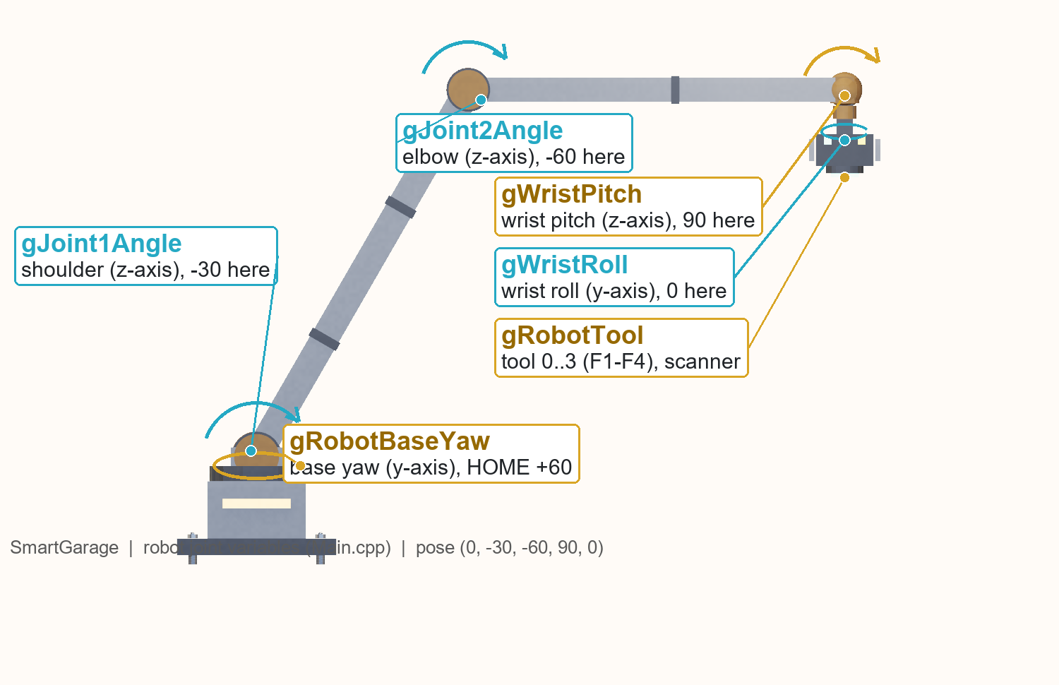
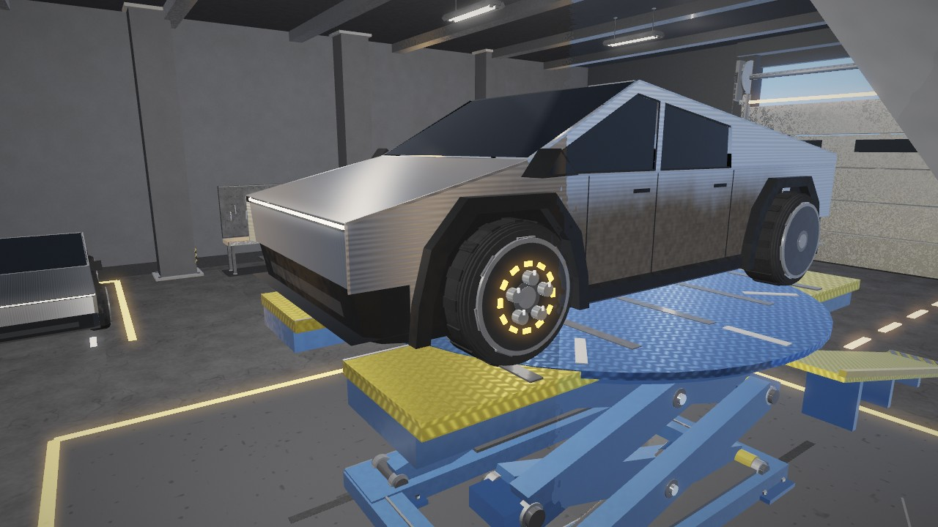
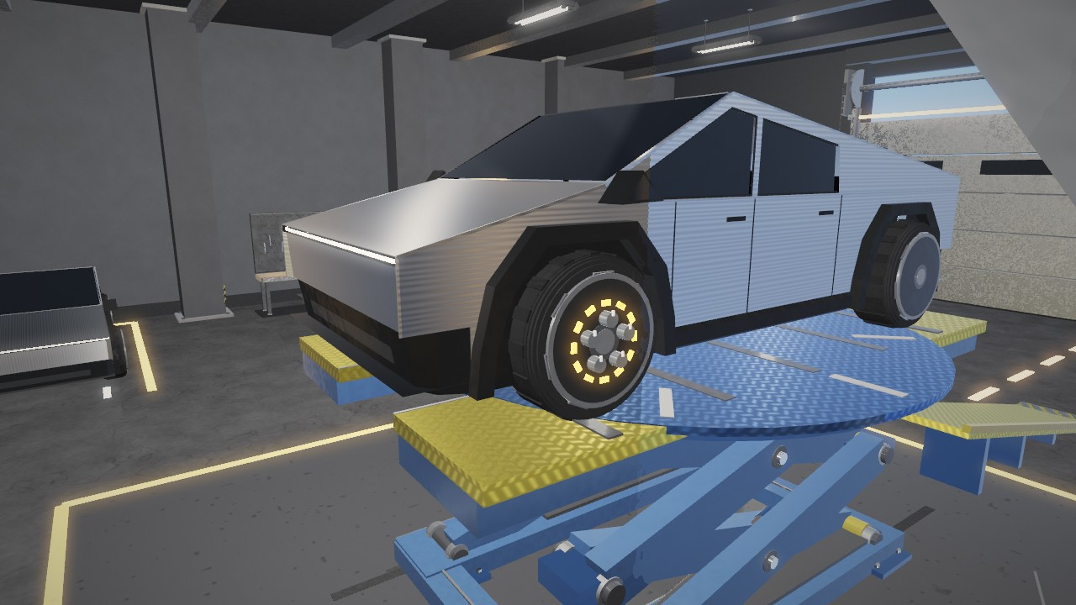
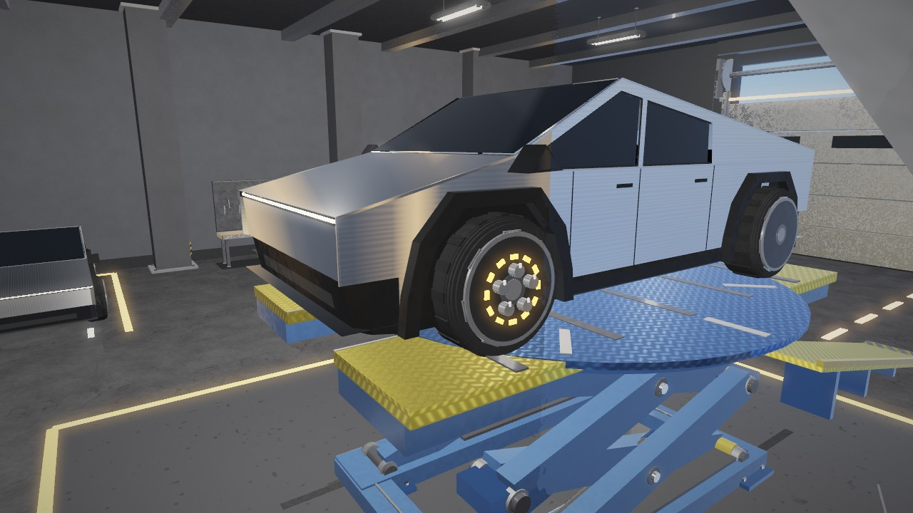
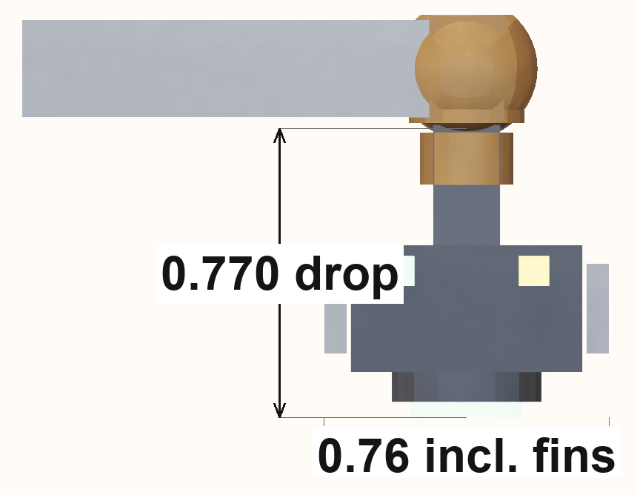
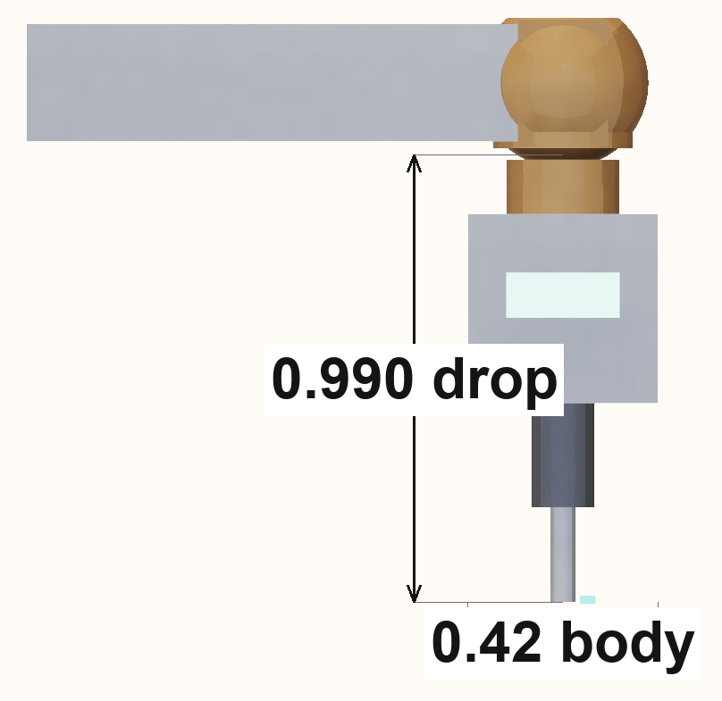
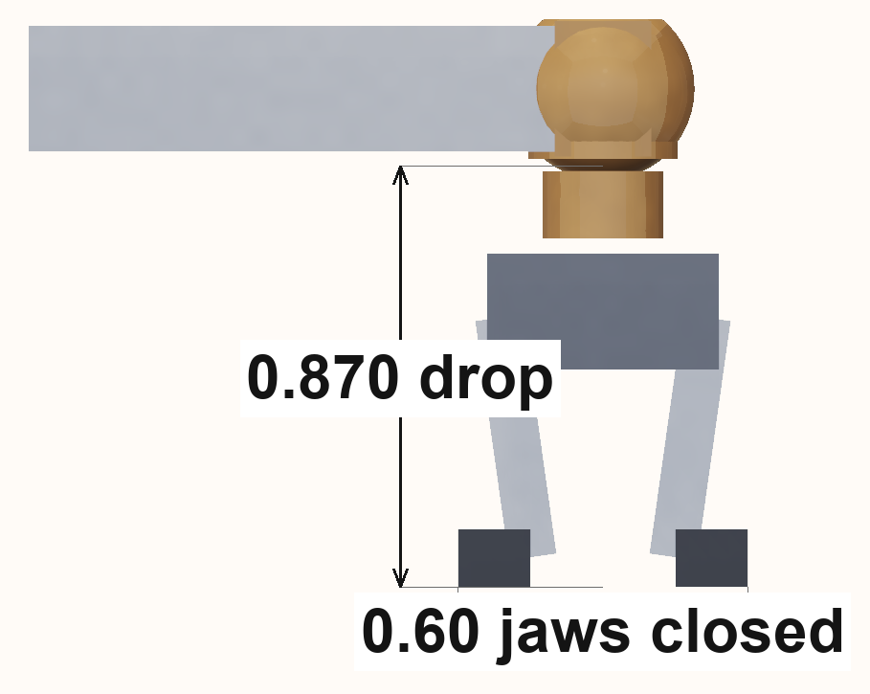
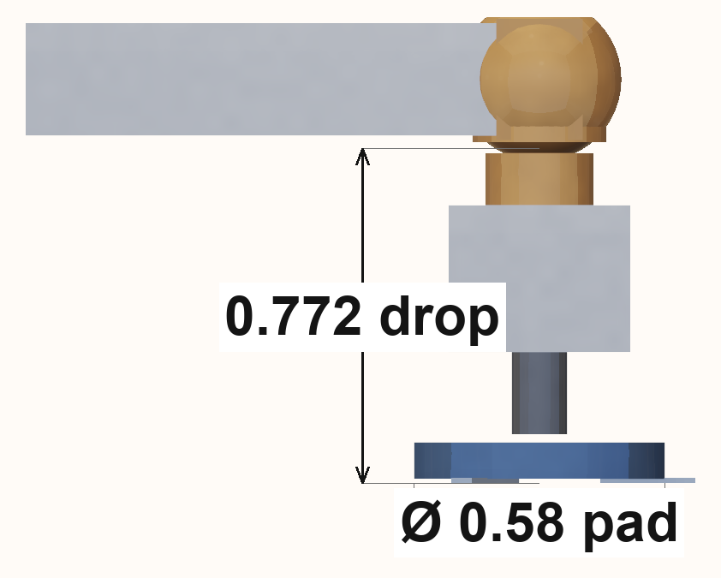
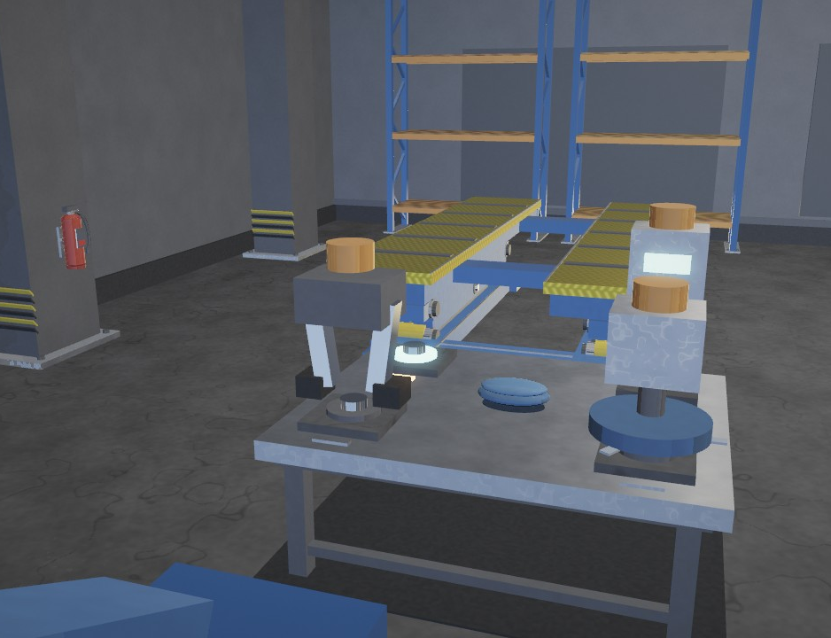
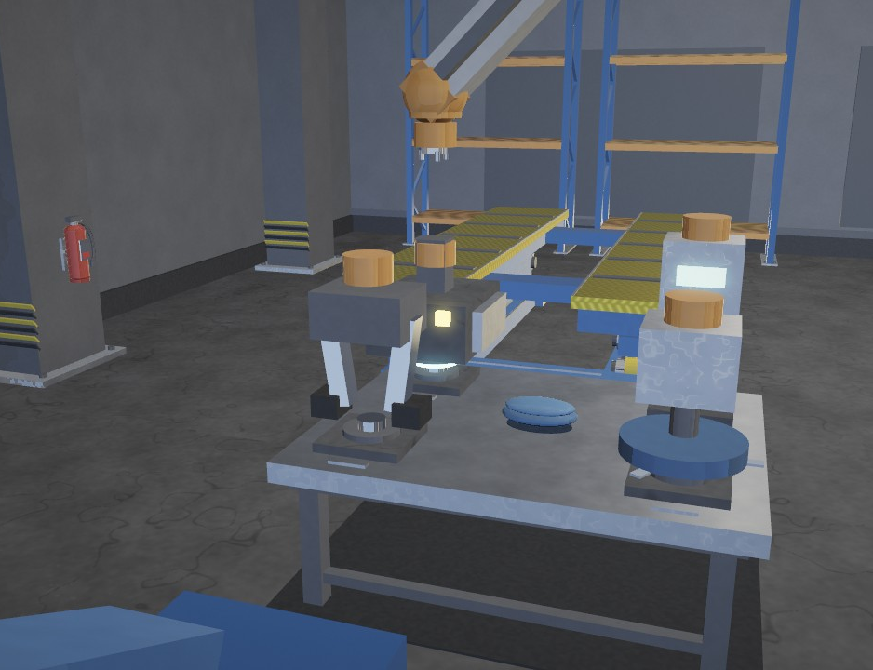
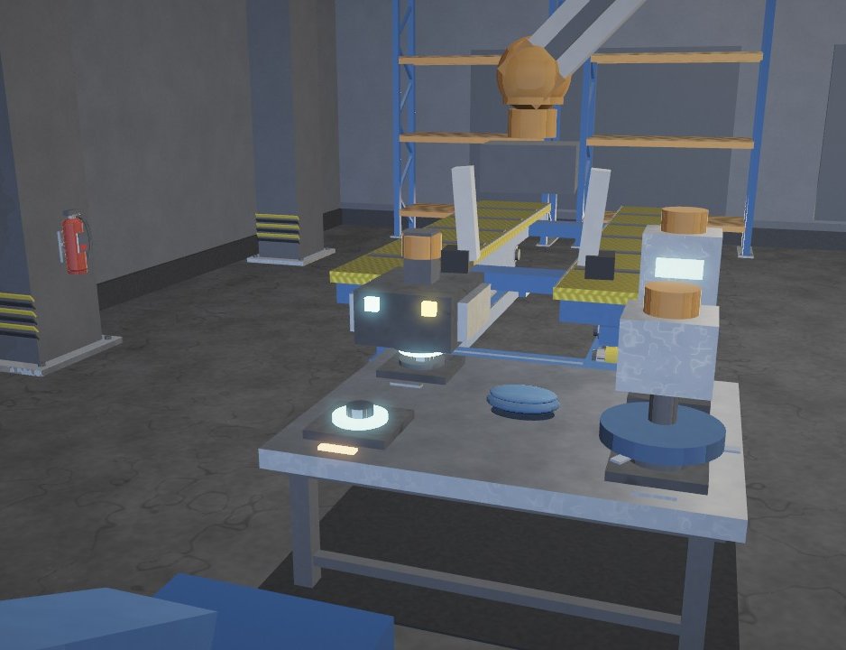
ROBOT, TOOLS & POLISHING
Fig. 17 Sponge: grime
Fig. 18 Clean surface
Fig. 19 Polisher: shine
Fig. 20 Scanner
Fig. 21 Driver
Fig. 22 Gripper
Fig. 23 Polisher
Fig. 16 Robot arm joints and current pose
KEY EQUATIONS
M_{child} = M_{parent} · M_{local}
End point: E = (−L₁ sinθ₁, 1.05 + L₁ cosθ₁)
L₁ = 4.5, L₂ = 4.0
Polish: r′ = mix(r, 0.34r + 0.03, p), 0.40 → 0.166
Keys: U/J shoulder · I/K elbow · Y/H wrist
Fig. 24 Tool docked
Fig. 25 Tool bare
Fig. 26 New tool
Notes:
Robot: five joints as a parent-child chain, four exchangeable tools, and the polishing stage. The sponge removes the grime band by band; the polisher lowers the roughness from 0.40 to 0.166, so highlights get about 34 times sharper and the reflection of the room becomes clearer.

Slide 5
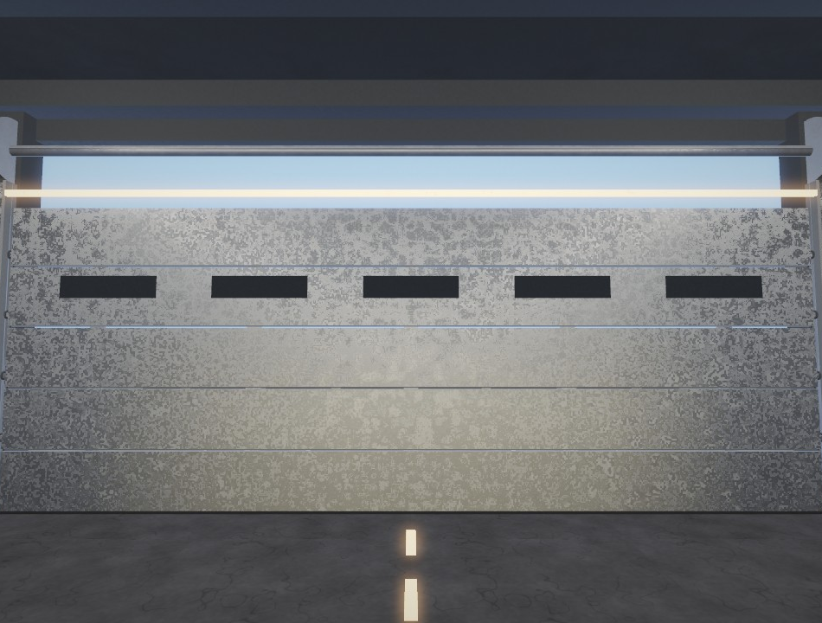
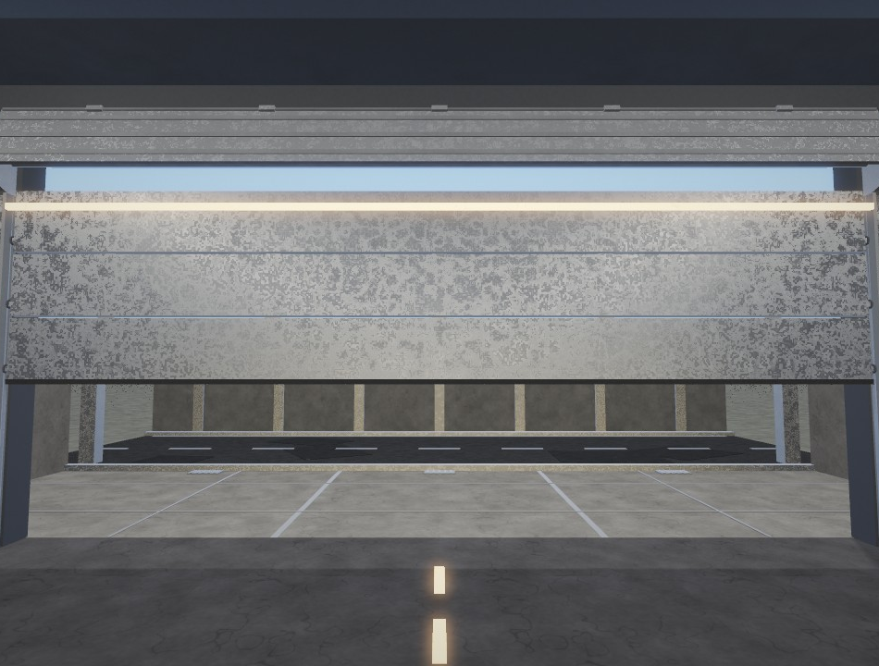
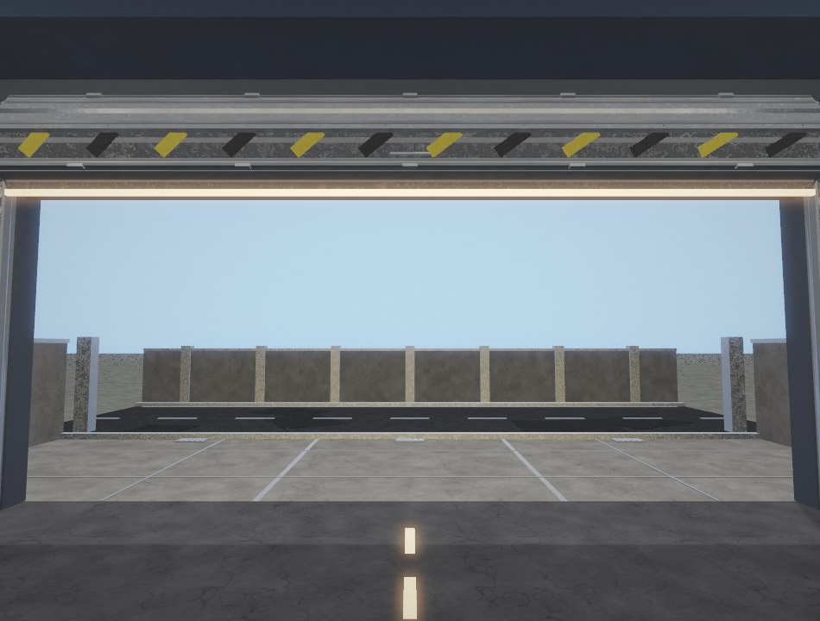
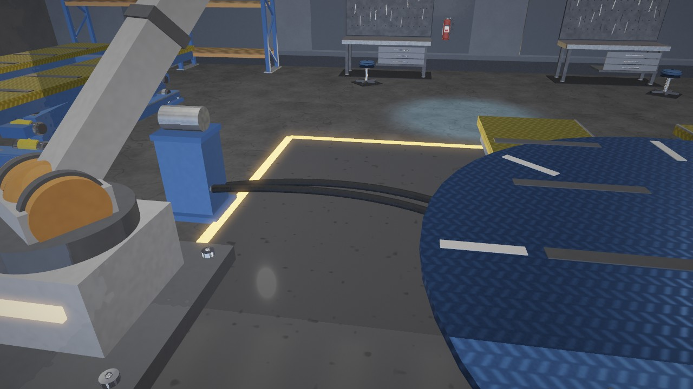
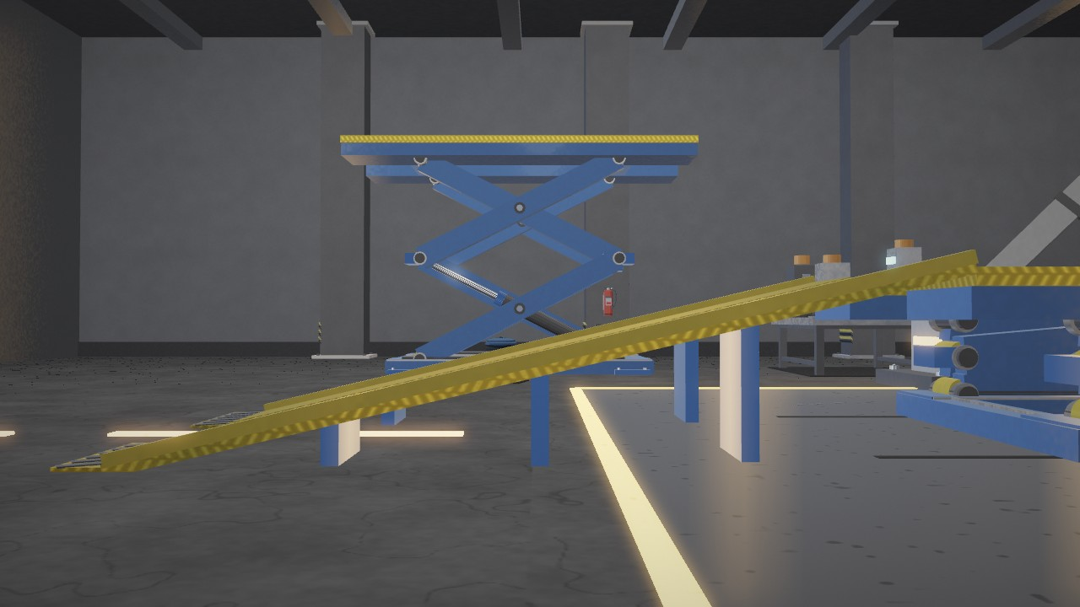
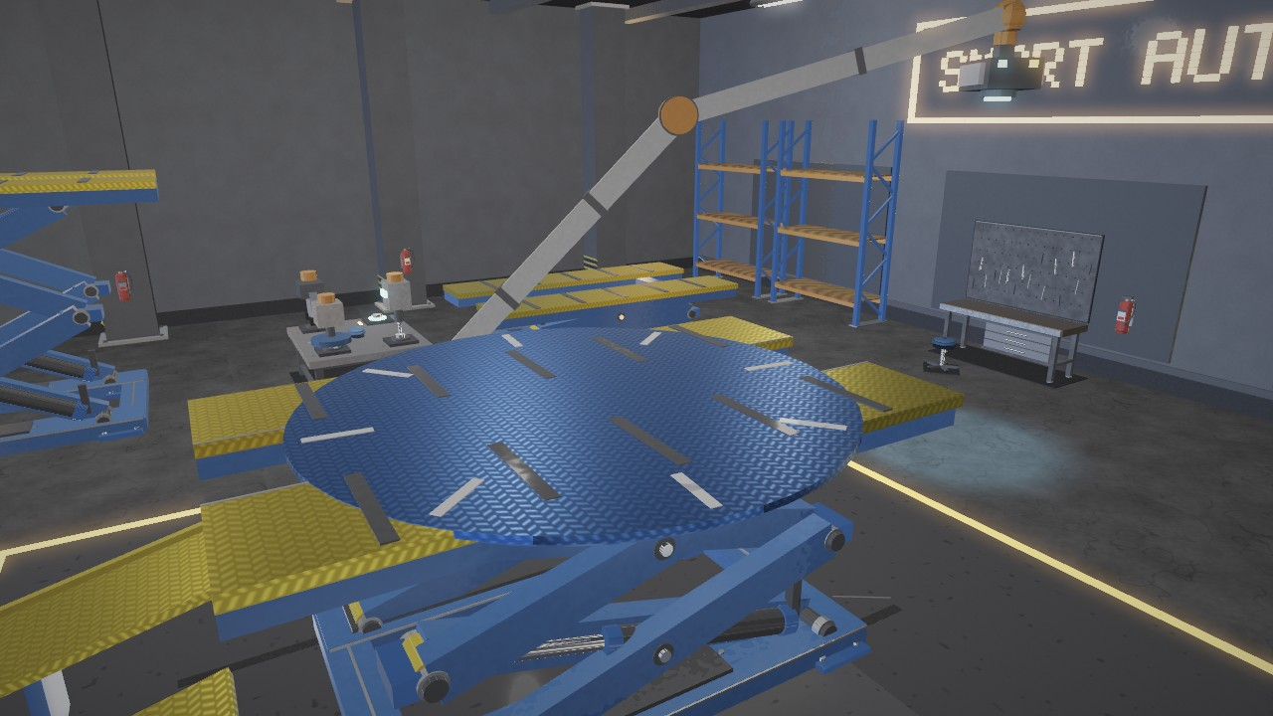
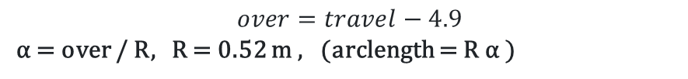
LIFT, DOOR, RAMP & CURVES
Fig. 27 Scissor lift
Fig. 28 Roller door closed
Fig. 29 Roller door winding
Fig. 30 Roller door open
Fig. 31 Bézier hose
Fig. 32 Entry ramp
Fig. 33 Turntable
LIFT & DOOR
θ = asin((0.58 + h) / 2L), L = 3.30 m, h = 1.10 m → 14.75°
Door: α = over / R, R = 0.52 m, offset 0 … 4.9 m
HOSE & RAMP
B(t) = (1−t)³ P₀ + 3(1−t)² t P₁ + 3(1−t)t² P₂ + t³ P₃
Ramp: α = atan(1.08 / 4.60) = 13.21°, turntable D = 4.20 m
Notes:
Four motion and curve examples: scissor lift angle, roller door winding, cubic Bezier hose and ramp plus turntable rotation.

Slide 6
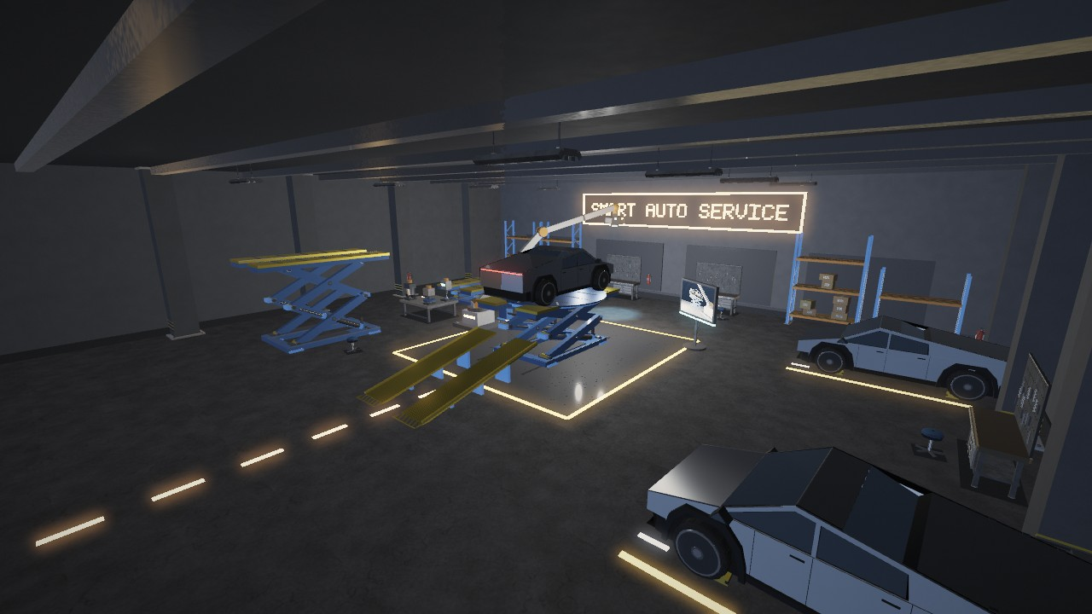
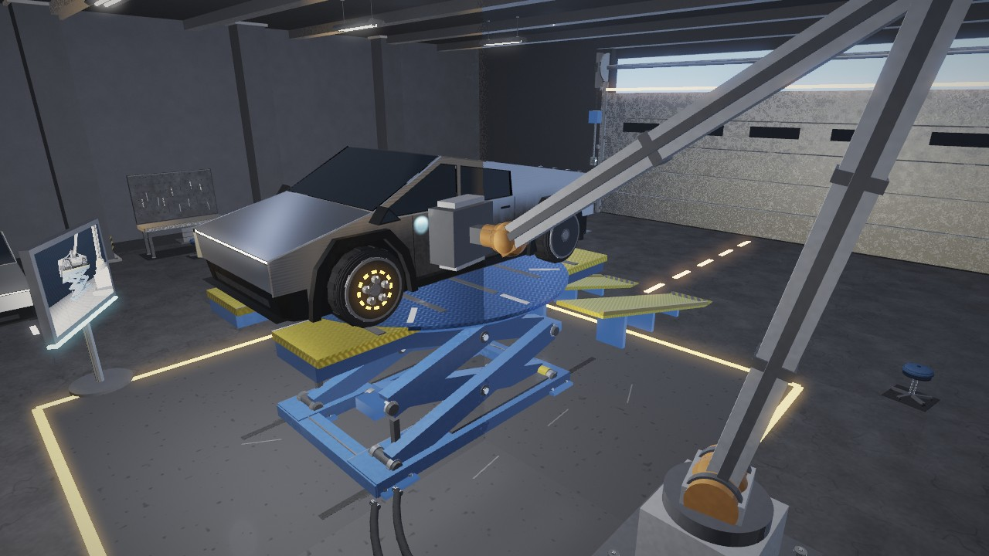
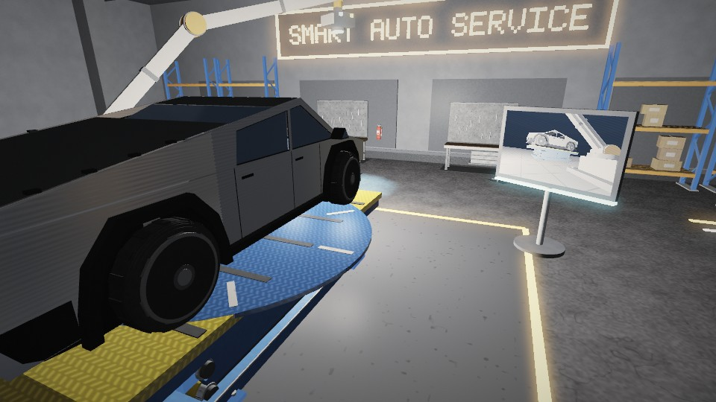
LIGHTING SYSTEM
PHONG REFLECTION
I = I_{a} + I_{d} + I_{s}
Ambient: I_{a} = k_{a} L_{a}
Diffuse: I_{d} = k_{d} L_{d} max(N·L, 0)
Specular: I_{s} = k_{s} L_{s} max(R·V, 0)^{n}
n = mix(180, 10, roughness)
Attenuation:
A(d) = 1 / (1 + 0.075d + 0.018d²)
Fig. 34 Directional light
Fig. 35 Ceiling point lights
Fig. 36 Moving spotlight (scanner tip)
Fig. 37 Headlight point lights
Notes:
Lighting: directional, point, moving spot and headlight point lights, evaluated with the classical Phong reflection model.

Slide 7
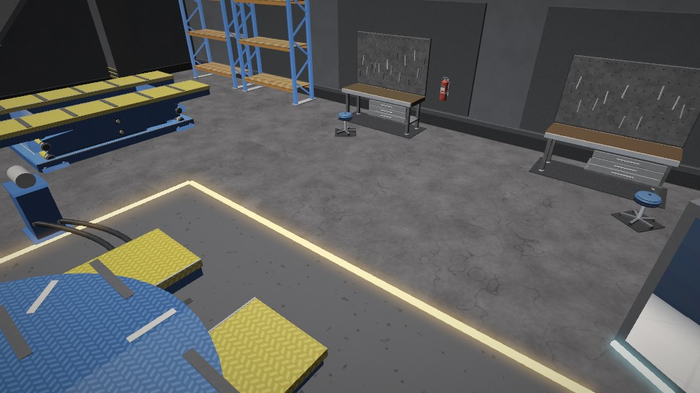
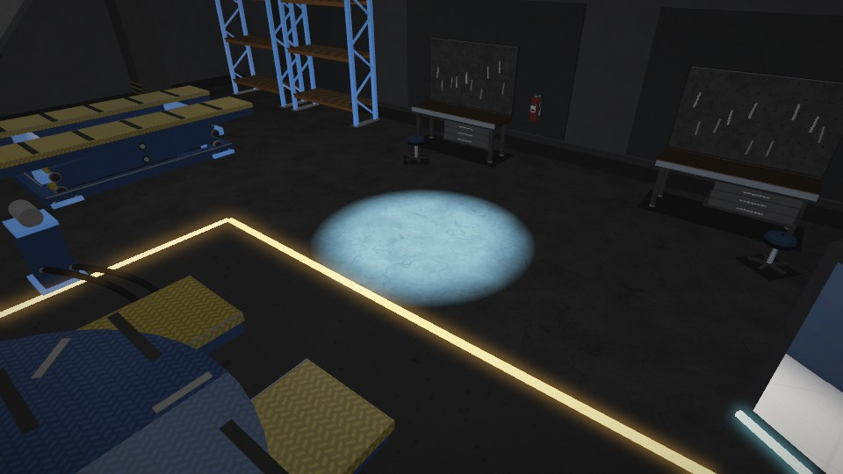
GOURAUD VS PHONG
Fig. 38 Gouraud shading: lighting per vertex, spotlight lost
Fig. 39 Phong shading: lighting per fragment, crisp spotlight
INTERPOLATE COLOUR
C_{f} = α C₁ + β C₂ + γ C₃
INTERPOLATE NORMAL, THEN LIGHT
I(n_{f}) = I_{a} + I_{d} + I_{s} at every pixel
BEYOND THE REQUIREMENTS
PBR | GGX | PCF shadows | Triplanar textures | HDR | MSAA | Bloom
Notes:
Gouraud evaluates the Phong model per vertex and interpolates colour; Phong interpolates the normal and evaluates per fragment. Same scene, same lights.

Slide 8
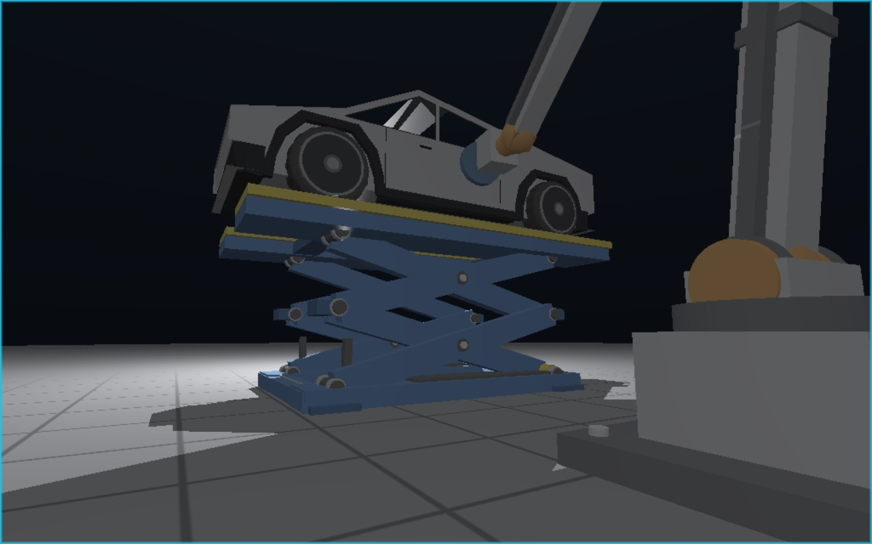
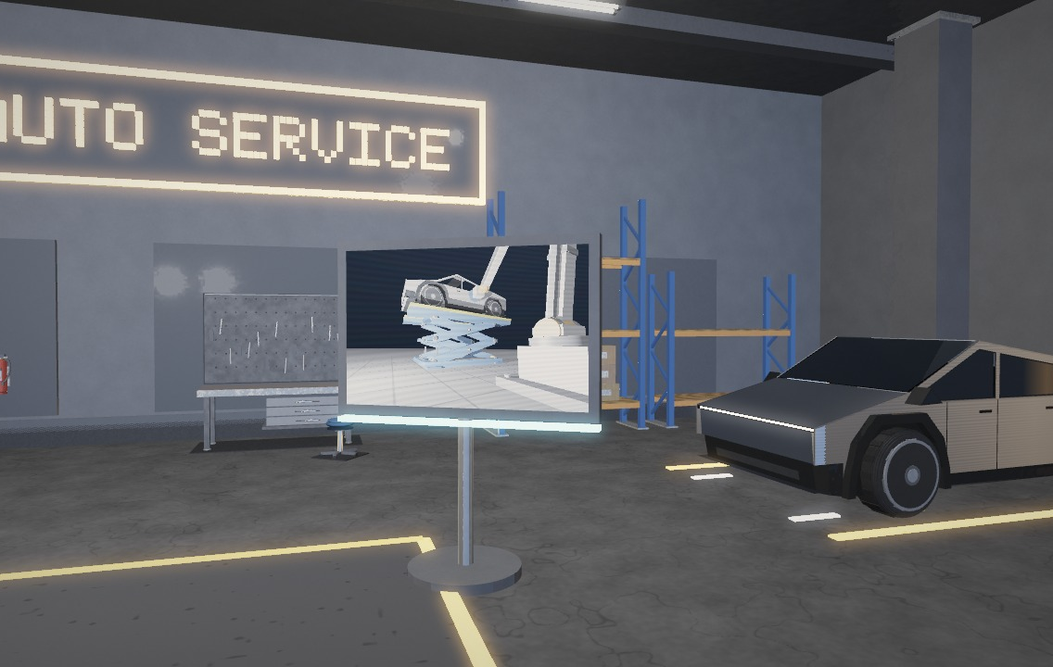
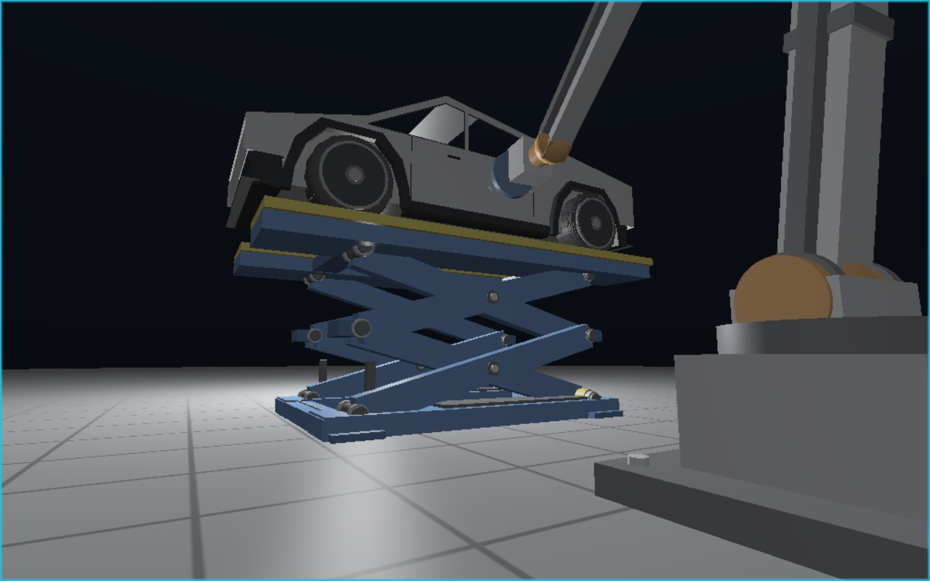
RAY-TRACED INSPECTION MONITOR
Fig. 41 Monitor beside the lift
Fig. 40 Ray-traced inspection monitor: 1 ray + 1 shadow ray per pixel
RAY & SHADOW RAY
d = normalize(f + u·a·tan(φ/2)·r + v·tan(φ/2)·u), nearest t > 0 wins
t_{max} = |L − P| − 0.03, origin P + 0.012 n; 793 items, no RTX (OpenGL 3.3)
Fig. 42 Same view, shadow rays off
Notes:
Bonus: ray tracing. A physical inspection monitor beside the lift shows the underside of the raised vehicle, the wheels, the lift supports and the robot tool. Its picture comes from a separate GLSL ray-tracing pass: one camera ray per pixel, nearest hit, a shadow ray toward the inspection light. The rest of the garage is rasterised. The scene is the same lift, car and robot transforms the garage uses, recorded every frame. Default camera: the live robot-side view. Keys: 9 enlarge, minus shadows, equals camera preset, Insert/Delete orbit, PageDown light, numpad moves the light.

Slide 9
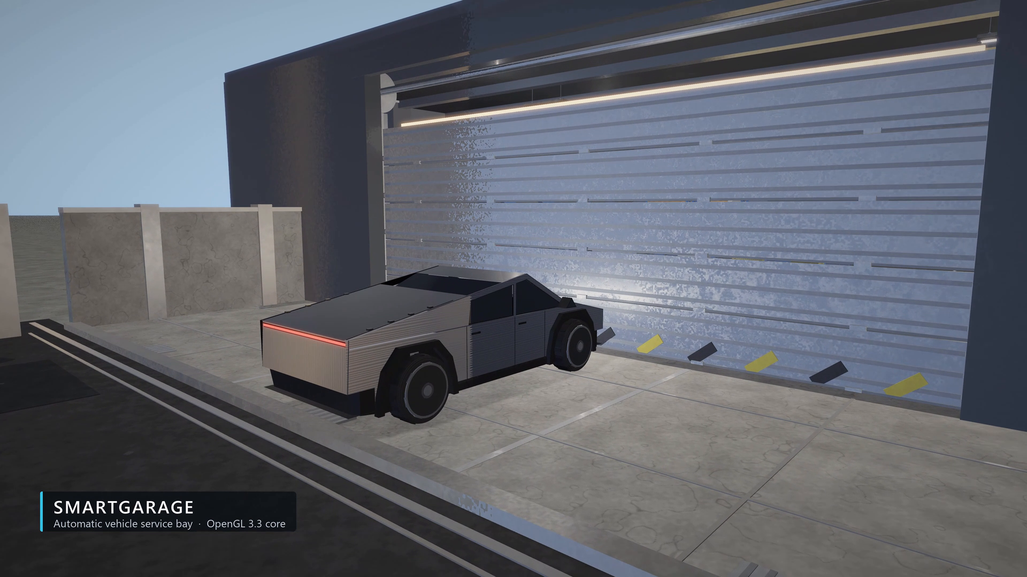
Notes:
Demonstration video (2.5x speed, 2:41). Click to play. Full-speed 4K60 master: Demo_Video/SmartGarage_Demo_4K60.mp4

Slide 10
THANK YOU
Afifa Sultana Offa
Roll 2107087
SmartGarage
Automatic Vehicle Inspection
and Service System Using OpenGL
Notes:
Thank you.

