Slide 1
Data Collection Pipeline for XYZ Company
Done by: Abdulrahman Afifi

Slide 2
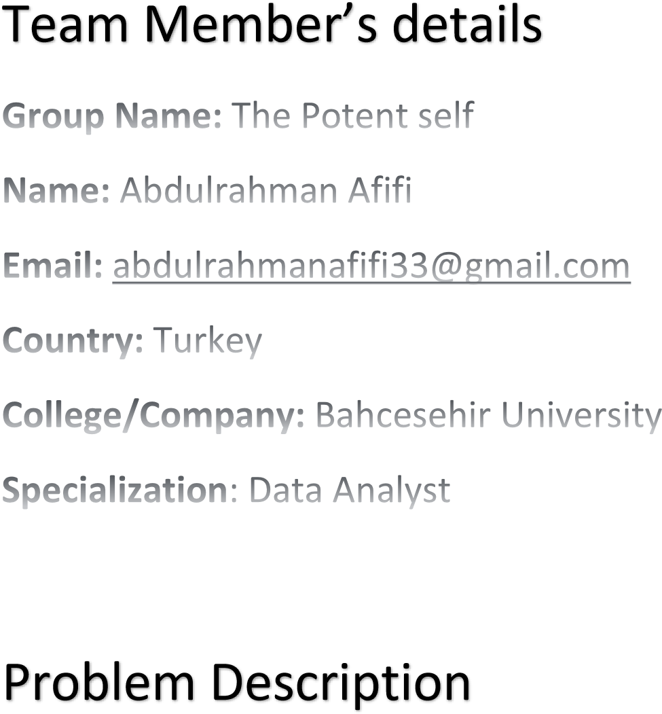

Slide 3
AGENDA
Problem Description​
Data Cleansing and Transformation
​Visual Aids for EDA
Recommended models for this data set
​Summary​

Slide 4

Problem Description
XYZ firm is gathering client data using Google Forms/Survey Monkey and has published a variety of n forms on the web.
The company want to build a pipeline that would collect all of the data from these Google forms/survey surveys and visualise it on the dashboard.
The company needs clean data, and if there are any data issues in the data, they should be addressed via this process (duplicate data or junk data). A dedup check should be run on the customer's email address.

Slide 5
GitHub repo link
DataCollectionPipelineProject/Week11 at main · AfifiGhost2000/DataCollectionPipelineProject (github.com)

Slide 6
Data Cleansing &Transformation

Slide 7
After collecting our data from google forms using specific API, we stored it into a pandas dataframe object to apply some data cleansing and transformation. The first step in this procedure is that I renamed and shortened long questions available in the form to make it easier for data analysis. Moreover, I added the +sign missing from phone numbers provided by the customers. I also extracted day,month,hour,min, and seconds from the timestamps available to be able to analyse and forecast our data.
Email Id is being extracted from the email to avoid duplicated emails from same user. Also machine learning could be applied to emailId to identify username.
The dollar sign has been deleted from the average monthly income to be able to analyse our data properly.
Also Satisfaction rate has been segregated into 3 categories ‘Low’, ‘Medium’, and ‘High’. This can provide some useful insights for the company.

Slide 8
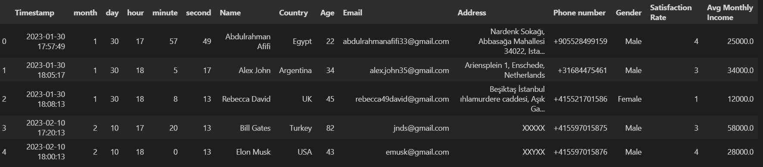
Final Representation of our data

Slide 9
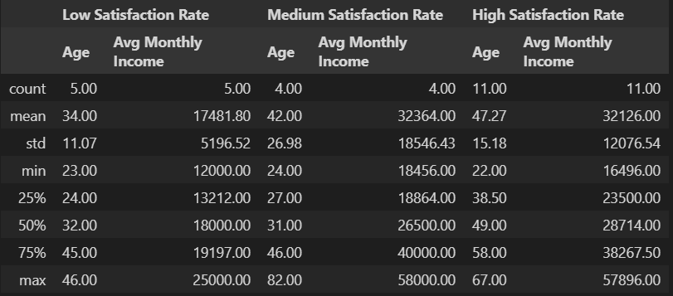
Data Description

Slide 10
Visual Aids for EDA

Slide 11
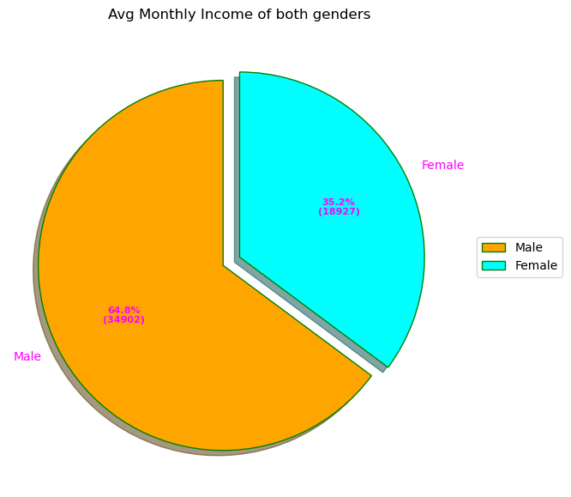
GenderWise Avg Monthly Income Percentage

Slide 12
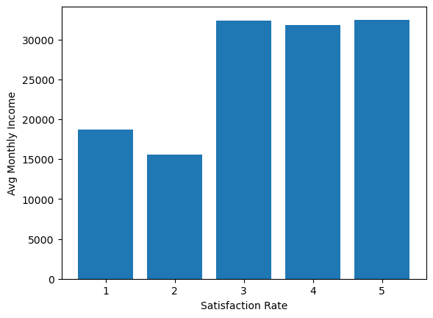
Avg Monthly Income Per satisfaction Rate for all customers who responded

Slide 13
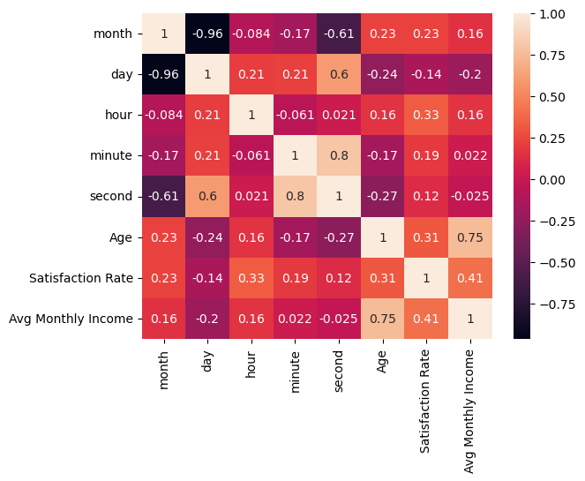
Heatmap representation

Slide 14
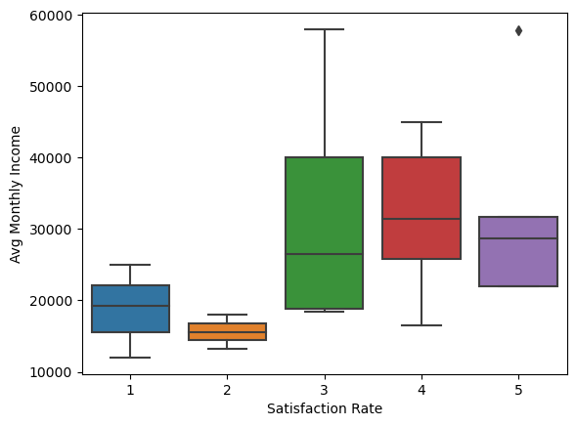
Box Plot for Satisfaction rate vs Avg Monthly Income

Slide 15
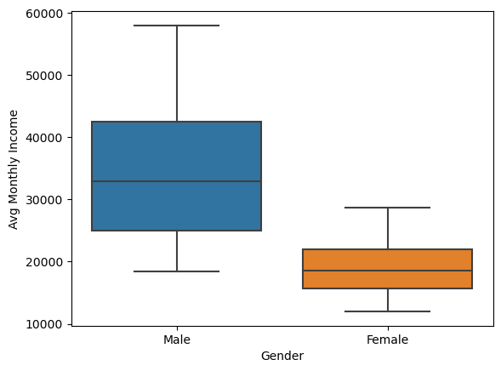
Box Plot for Gender vs Avg Monthly Income

Slide 16
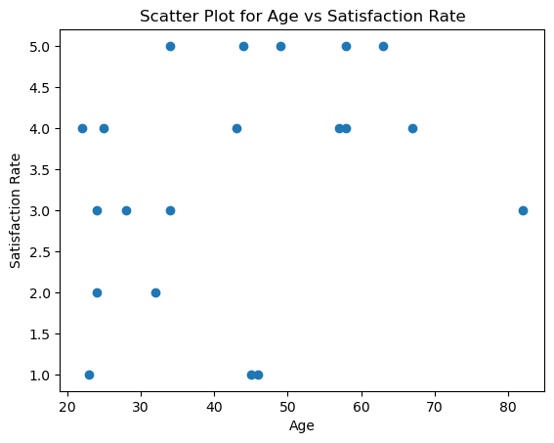
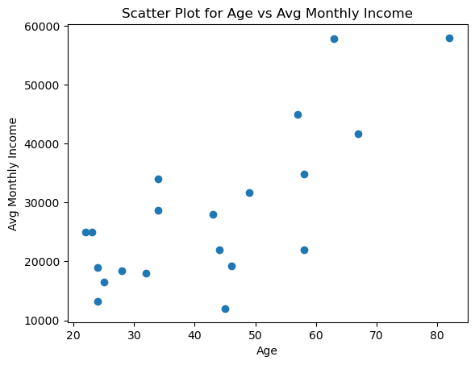
Scatter plot

Slide 17
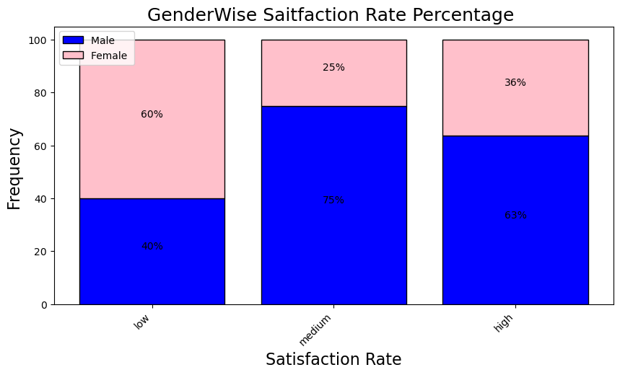
Gender-Wise satisfaction rate percentage

Slide 18
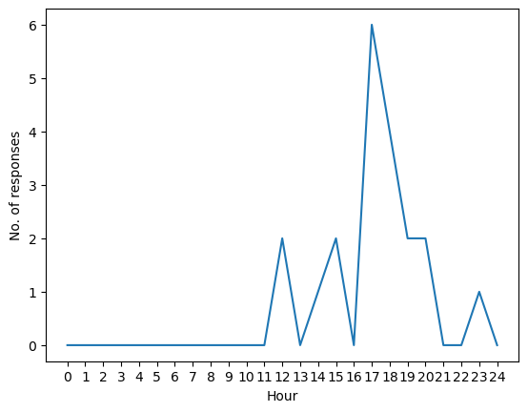
Hourly no. of responses

Slide 19
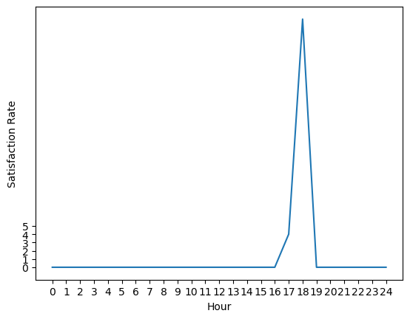
Satisfaction rate per time slot(In decimals)

Slide 20
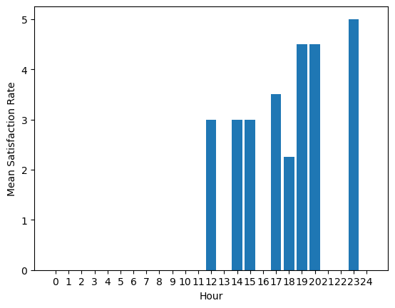
Mean satisfaction rate per hour

Slide 21
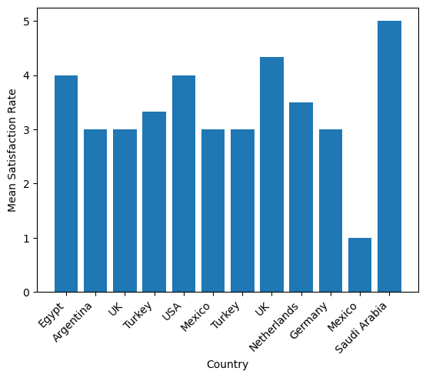
Mean satisfaction rate per Country

Slide 22
Recommended Models for This Dataset

Slide 23
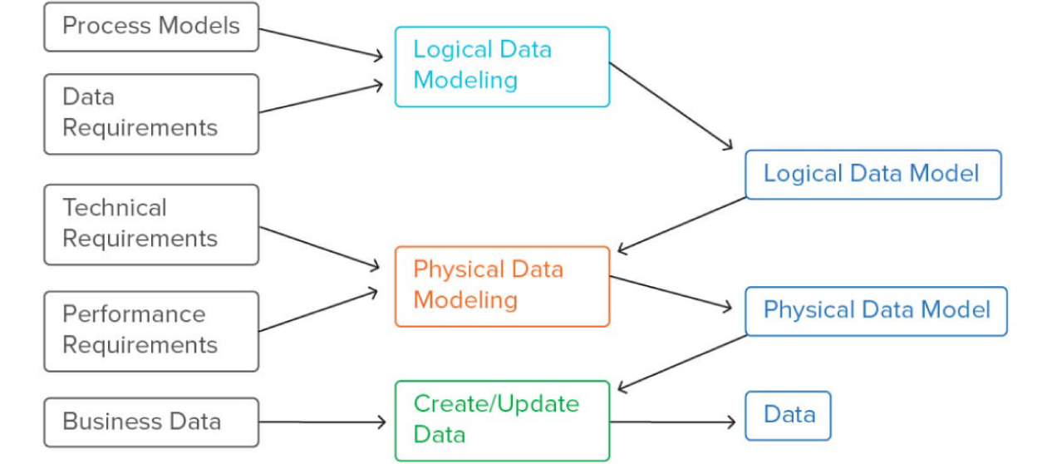
Fundamental understanding

Slide 24
Benefits
Data models can help us emphasize on what data is needed and how it can be organised into our database.
The obvious primary key found in our database is Timestamp field.
After visualising our data model we must choose a suitable machine learning model for efficient data analysis and model prediction. Because, as the data grows exponentially we need a machine learning model to predict values instantly.
Some of well know machine learning model techniques are: Supervised/Unsupervised learning and reinforcement learning. Can be classified as linear, ensemble, boosting, and stacking.

Slide 25
Feature selection
The primary key can be excluded from our feature set. Then, we begin exploring other features. I decided to choose only Country, Gender, Age, and Satisfaction Rate label as X feature set. Because they are easier to analyse and encode. Avg Monthly Income is being selected as the Y feature set. This is is the value we would like to predict.

Slide 26
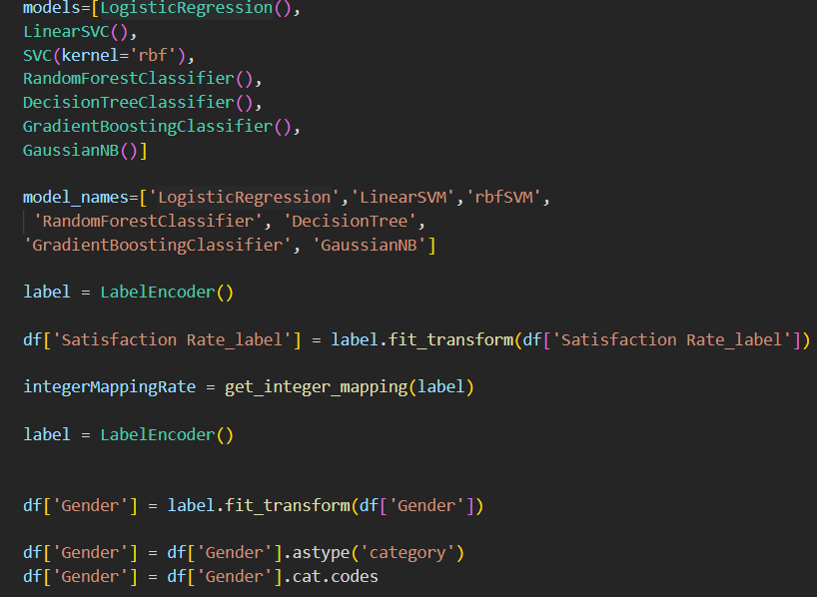
Model preparation
I encoded categorical or non-float values to be able to fit it in our machine learning models.

Slide 27
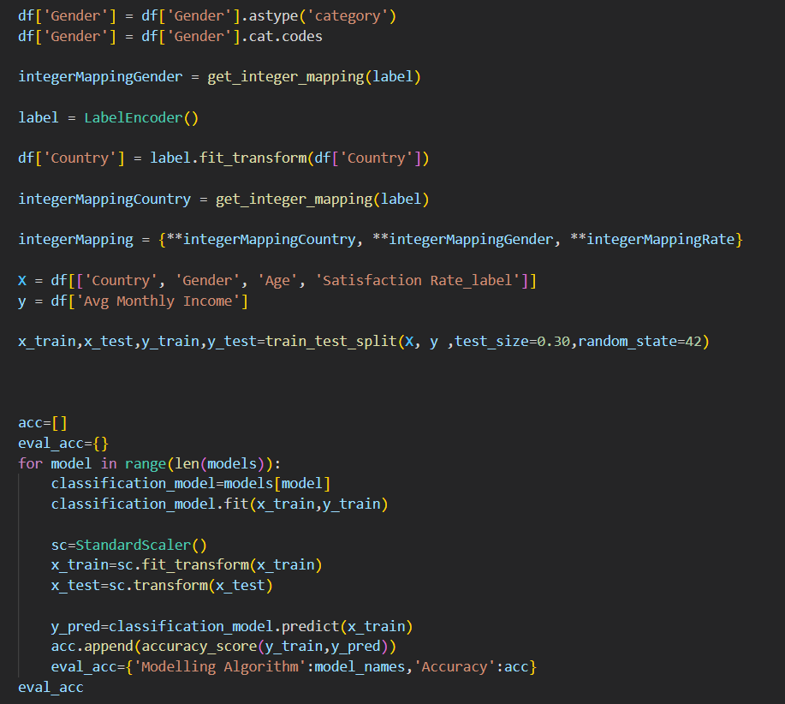
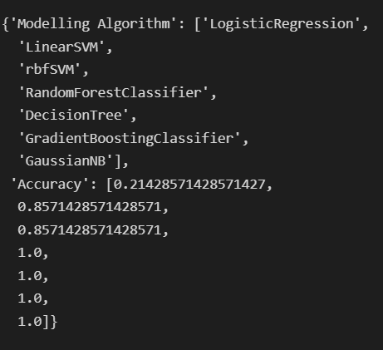
Explanation
Data is split into 30% test and 70% train. Then we fit our data into all possible models and evaluate accuracy. Output of code is below!
***I used the train model for prediction since we have a small dataset!

Slide 28
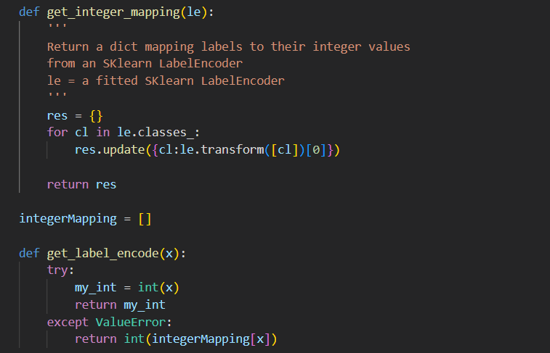
Some useful functions needed

Slide 29

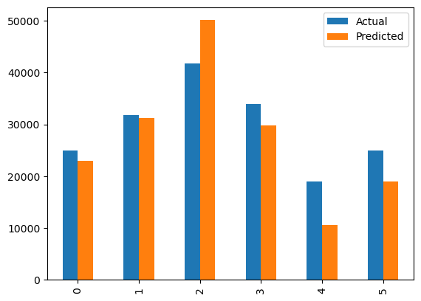
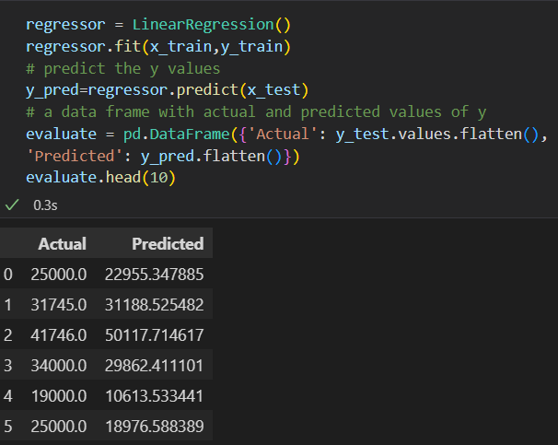
Actual vs predicted values from Linear Regression model

Slide 30
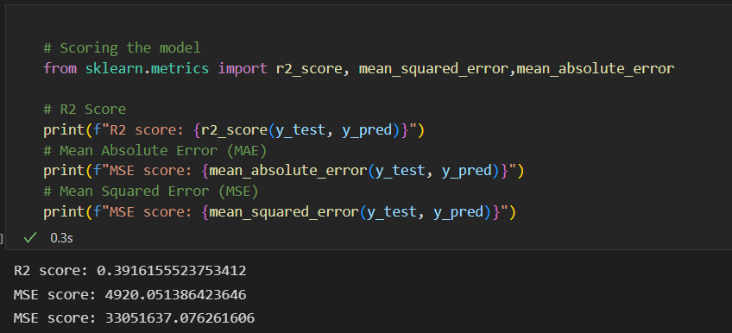
Calculate accuracy

Slide 31
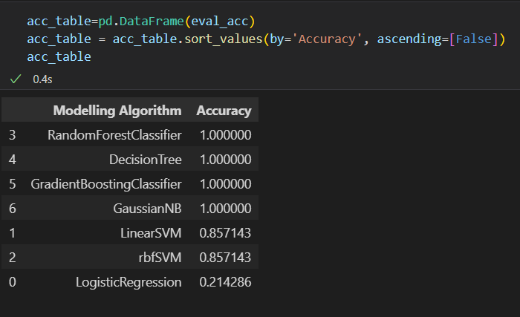
Results

Slide 32
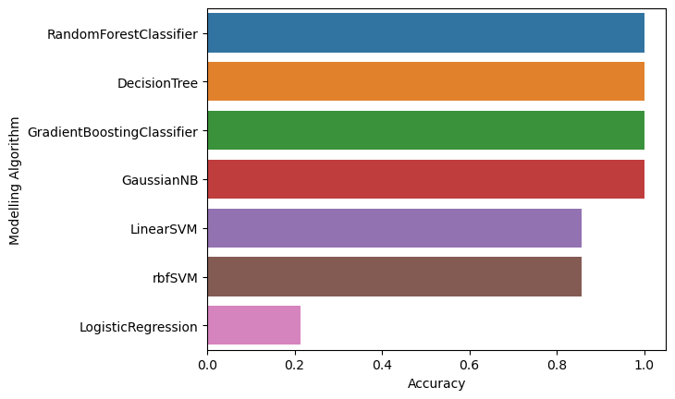

Slide 33
Conclusion
Based on the results, we can choose any one of the 4 models with 100% accuracy. I recommend using GradientBoosting Classifier or Gaussian NB. GradientBoosting classifier can perform better than RandomForest. A RandomForest Classifier can reduce overfitting when training when compared to Decision Trees. Gaussian NB is also good since it easy to implement and doesn’t require much training data.

Slide 34
THANK YOU
Done by: Abdulrahman Afifi
Don’t forget to visit my:
LinkedIn Profile

