Slide 1

Exploratory Data Analysis
<G2M insight for Cab Investment firm>
<14/12/2022>

Slide 2

Agenda
Executive Summary
Problem Statement
Approach
EDA
EDA Summary
Recommendations

Slide 3

Executive Summary
This project aims to help XYZ’s Executive team analyse and inspect how is the market is going before taking the final decision on identifying the right company to invest in the foreseeable future.

Slide 4
Problem Statement
XYZ is a private firm in US. Due to remarkable growth in the Cab Industry in last few years and multiple key players in the market, it is planning for an investment in Cab industry and as per their Go-to-Market(G2M) strategy they want to understand the market before taking final decision.

Slide 5
Approach
I used some Explanatory Data Analysis(EDA) and statistical techniques to analyse and forecast profit for each Pink and Yellow cab companies in the US industry using the 4 provided csv files
The 4 csv files are combined into one dataframe that contains all relations of all files together. Transaction_ID and Customer_ID csv files are merged using the surrogate key Customer_ID. Cab_Data csv file is merged with merged table above using the Customer_ID. Then, it is merged with the city attribute in the City_csv file.
I created 3 csv files: ProfitAnalysis, YearlyProfitAnalysis, CityWiseProfitAnalysis to inspect data extracted from original datasets clearly.
There are total of: 15 columns/features(including 8 derived features),
359,392 total data points, Timeframe of the data: 2016-01-31 to 2018-12-31

Slide 6
Assumptions
Outliers are present in the Profit feature but due to unavailability of trip duration details, we can neglect this as an outlier.
Outliers are calculated using the Interquartile range formula. Anything below or below upper and lower bounds is considered as an outlier.
Profit is calculated using Cost of Trip and Price Charged features keeping all other factors constant.
We assumed that the users feature includes total number of users from all cab companies(including yellow and pink cab) per city.

Slide 7
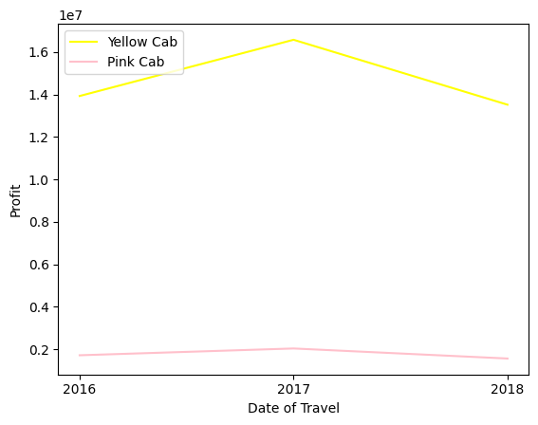
EDA: 1.Yearly Profit Analysis of Yellow and Pink Cab Company
Both companies reached their peak profit at the year of 2017, however Yellow Cab company has a higher peak and overall profit than Pink Cab in all years.

Slide 8
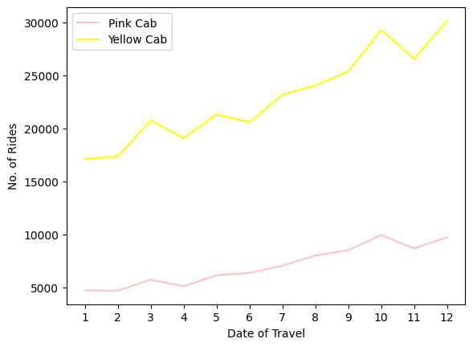
EDA: 2.Monthly No. of Rides Analysis
As we can see both companies have roughly the same pattern . There is an exponential rise in number of rides conducted by both companies between the months 2-3 and 9-10 in all years between the time data frame. This concludes that there is a high customer demand during these months. It could be due to start of new academic semester and people need more transportation during these specific times. Pink Cab has retained roughly same no. of rides for 4 consecutive months.

Slide 9
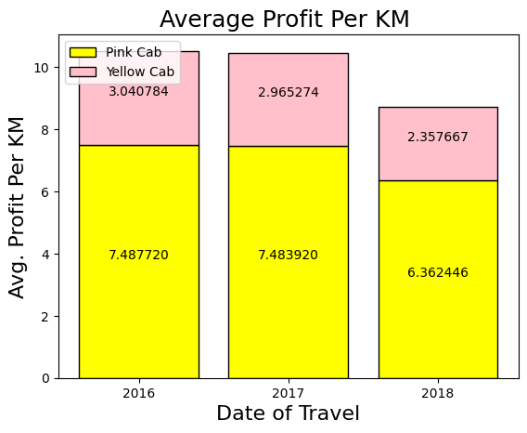
EDA: 3.Average Profit per KM Analysis
The average Profit per km of Yellow cab is higher than Pink Cab( roughly 2-3 times). Both companies experience a decline in the avg profit per km as years pass by. This could be due to the riding distance increases much faster than the profit attained by each company.

Slide 10
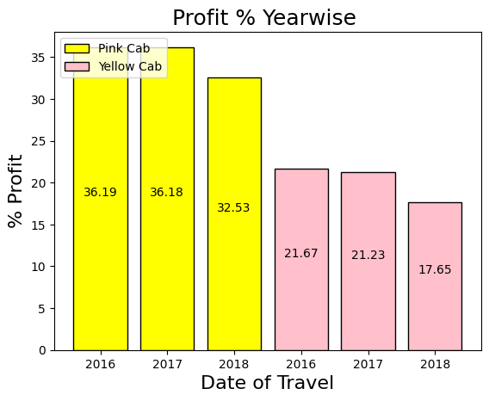
EDA: 4. Profit Percentage Year-wise Analysis
Both companies experience roughly the same decline rate in profit percentage yearly. The Yellow Cab company again is obviouly higher!

Slide 11
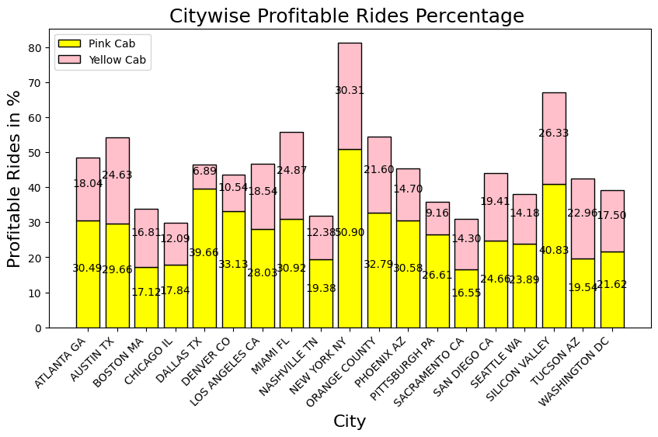
EDA: 5. City-Wise Profitable Rides Percentage Analysis
Pink Cab outperforms Yellow Cab company in only 1 city out of 19 served cities. Pink Cab has roughly same profitable rides as that of its competent in 7 cities(difference is <=5%). This indicates that Pink Cab company is trying to increase its profit in some cities. Yellow Cab has astonishgly exceeded profit % by more than 6 times that of Pink Cab.

Slide 12
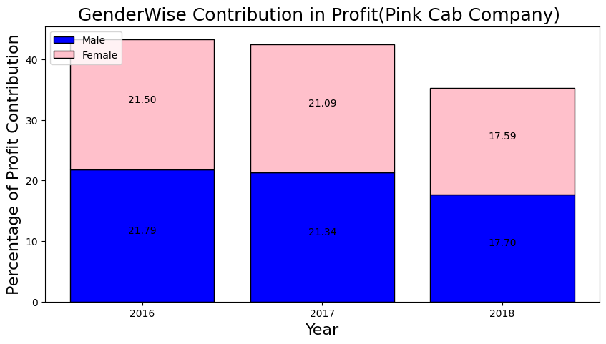
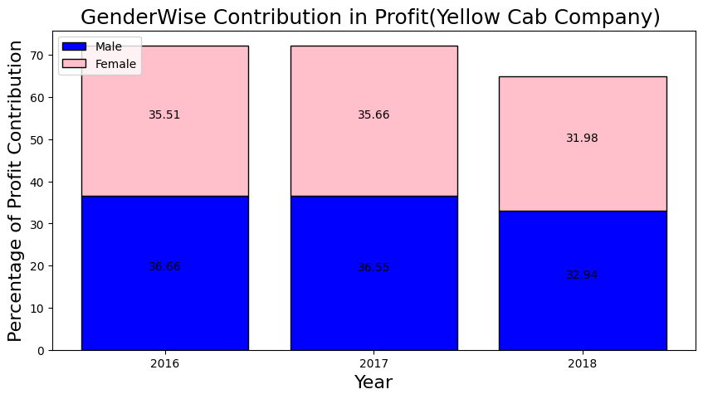
EDA: 6. Gender-wise Contribution in Profit
The Male users has slightly higher contribution in profit in both companies. Overall, there is no significant difference in profit contribution between both genders.

Slide 13
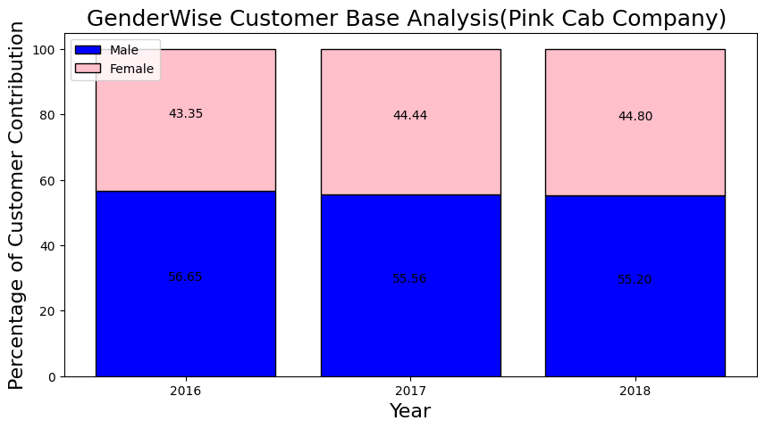

EDA: 7. Gender-wise Customer base Analysis
This shows the percentage of male and female customers served by both companies. Also, we can see that percentage of male customers are slightly higher than the other gender. Overall, there is no significant differences. This could be reason why male customers contribute to greater portion of profit in both companies.

Slide 14
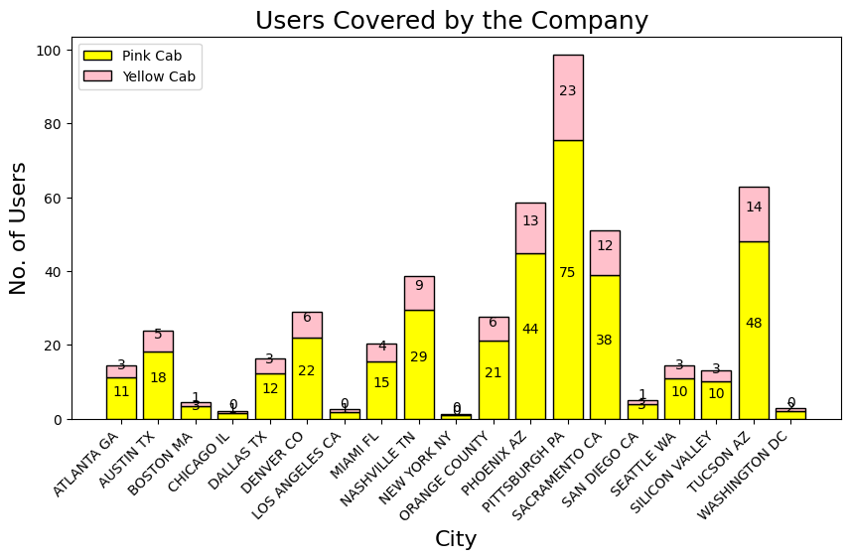
EDA: 8. Users Covered by both company per city
This shows ratio of users served by both companies in all cities against all other users present in the city.
We can see that there is a huge difference in customer reach from both companies. Yellow Cab has approximately the same low customer reach as Pink Cab in only 6 cities.

Slide 15
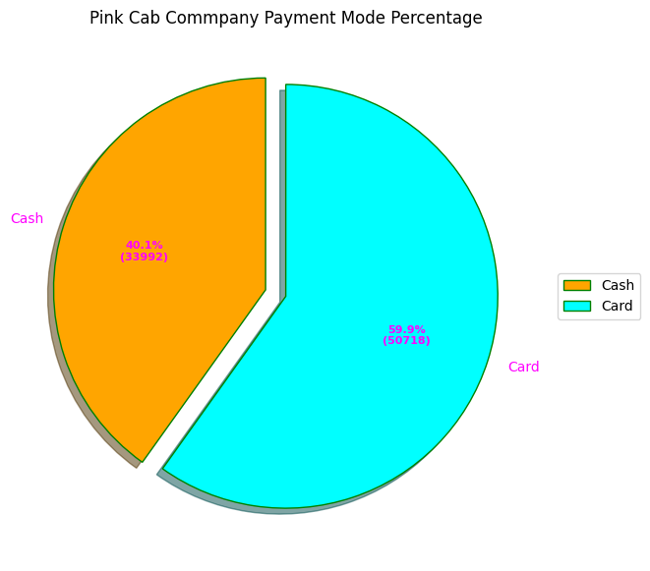

EDA: 9. Payment mode percentage Analysis
There are greater number of users paying by card in both companies as compared to other payment methods. There is no significant difference between card and cash users in both companies this indicates that payment mode has no effect on company’s profit.

Slide 16
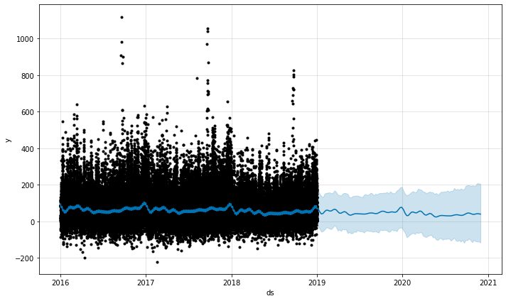
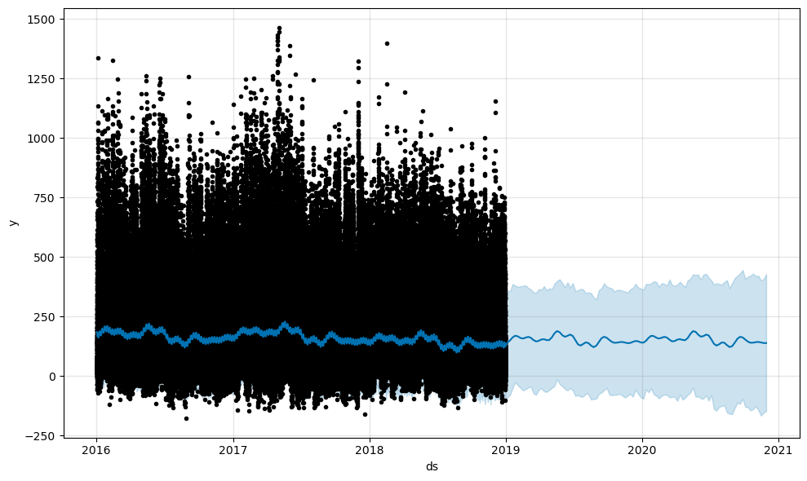
EDA: 10. Profit Forecasting
Yellow Cab
Pink Cab

Slide 17
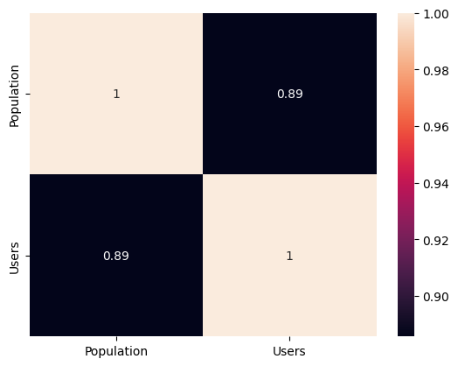

Heat Map Correlation between users and Population
Pink Cab Yellow Cab

Slide 18
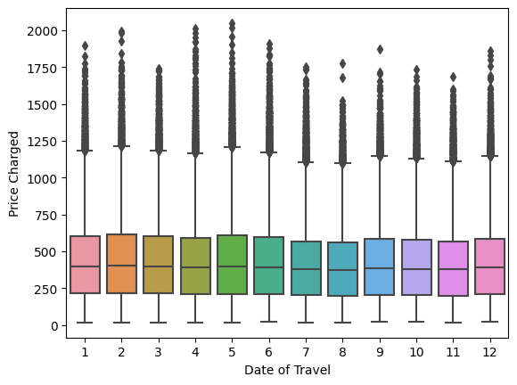
Outliers Box plot

Slide 19
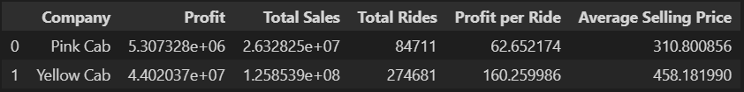
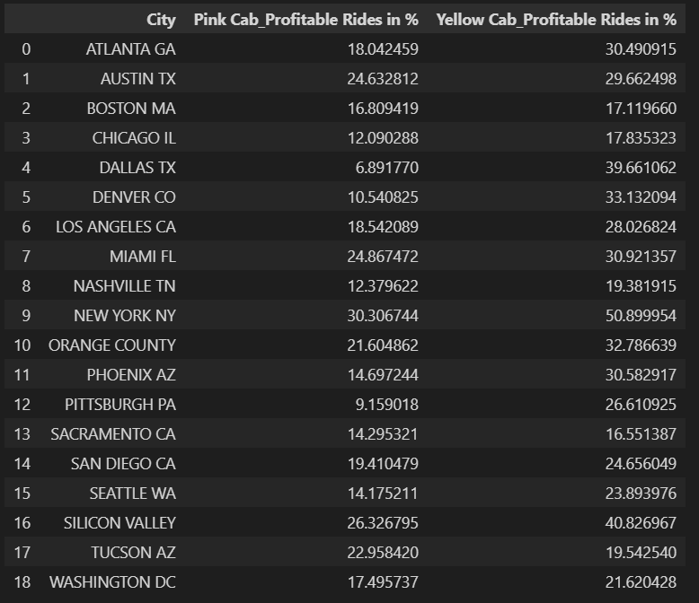
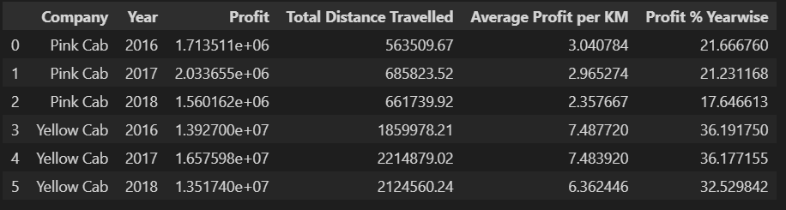
Created CSV Files

Slide 20
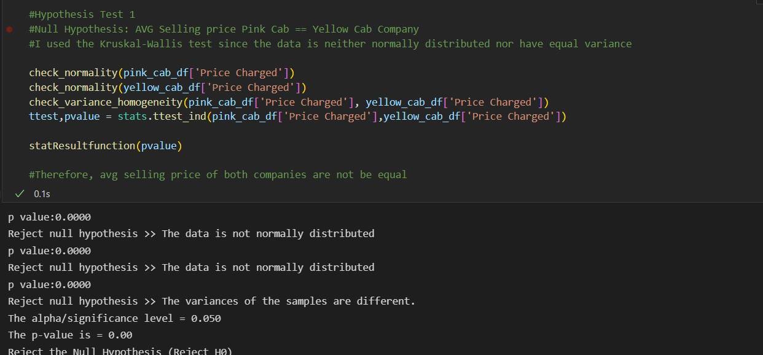
Hypothesis Tests
Test1, Is there difference between Avg. Selling Price of both cabs?

Slide 21

Test2, Is there difference between Avg. user income of both cabs?

Slide 22

Test3, Is there any relation between users and population per city?

Slide 23
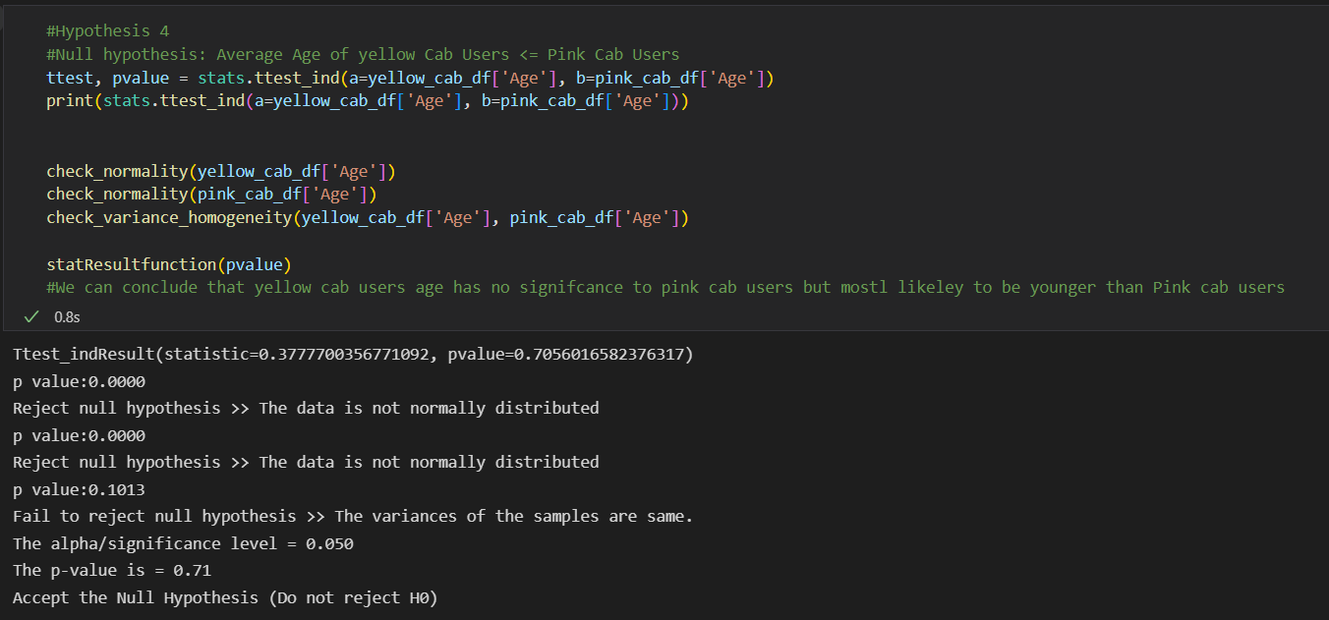
Test4, Is there difference between Avg. user age of both cabs?

Slide 24
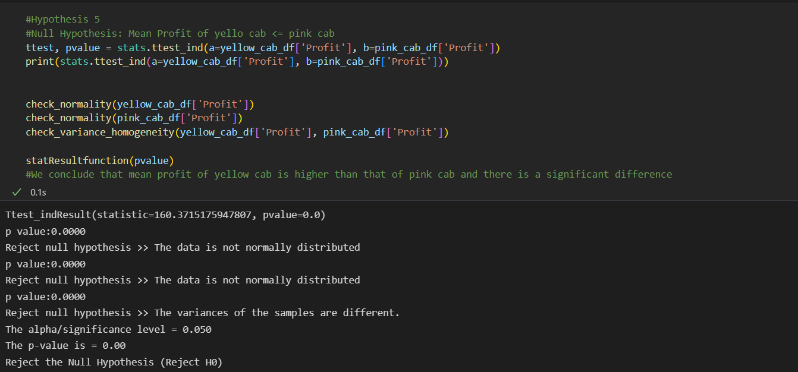
Test5, Is there difference between the Mean Profit of both cabs?

Slide 25

Is there any seasonality in number of customers using the cab service?
Yes, the answer is visualised in slide no.8

Slide 26
Recommendations
Customer Reach: Yellow Cab company has a high customer reach in 13 cities as compared to Pink Cab
Average Profit per KM: It can be concluded that Yellow Cab has outperformed Pink Cab by approx. 3 times average Profit per km after the time range.
Ride count and Profit Forecasting: Both companies are facing loss in profit; however, after the year 2019 yellow cab experiences profit rise unlike the other cab . Pink Cab experienced a constant un-change per year in ride count for a long period of time as compared to other cab.
City-wise profit analysis: Yellow Cab has higher profit percentage that is covered from larger portion of cities in the US as compared to other cab.
Average Selling Price: Yellow Cab has higher average selling price as compared to Pink Cab due to its widely availability.
Therefore, based on the above points we can conclude that Yellow Cab company is the best recommended option to invest in for the foreseeable future.

Slide 27
Thank You

