Slide 1
Customer Segmentation and Targeted Marketing Plan
Prepared by: Afinu Mansoor NK
Tools Used: Python, Pandas, Matplotlib, Seaborn, Scikit-learn
Dataset: Online Retail Dataset (Kaggle)

Slide 2
Business Problem
An online retail company wants to improve marketing ROI by segmenting its customers.
Treating all customers the same reduces marketing ROI.
Objective: Identify customer segments and create targeted marketing plans.

Slide 3
Dataset Overview
Dataset: Online Retail II (2010–2011)
Source:Kaggle
Key columns: InvoiceNo, StockCode, Quantity, InvoiceDate, UnitPrice, CustomerID, Country

Slide 4
Data Profiling
df.head() / df.tail() / df.sample() – to understand sample records.
df.shape – dataset size.
df.columns – all feature names.
df.dtypes – to identify data types (noticed “TotalCharges” as object).
df.info() – overall summary with non-null values.
df.nunique(), df.count() – to check unique entries and completeness.
df.describe() – basic statistical summary.
df.duplicated().sum() – checked and found no duplicates.
df.isnull().sum() – found missing values in TotalCharges.

Slide 5
Data Cleaning and Preparation
Removed missing customer IDs and Descriptions.
Removed negative or canceled transactions.
Created total amount = Quantity × Unit Price.
Combined data from both years.
Convert InvoiceDate to datetime.

Slide 6
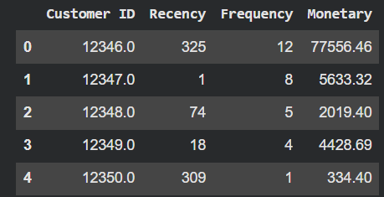
Feature Engineering
Calculated RFM values:
  Recency: Days since last purchase
  Frequency: Number of transactions
  Monetary: Total spending
Created an RFM table per customer

Slide 7
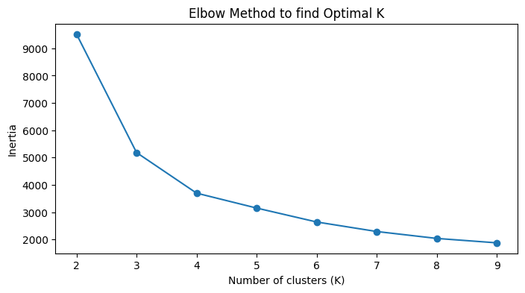
Model Building – K-Means Clustering
Used K-Means clustering
Scaled RFM features
Chose 4 clusters using Elbow Method

Slide 8
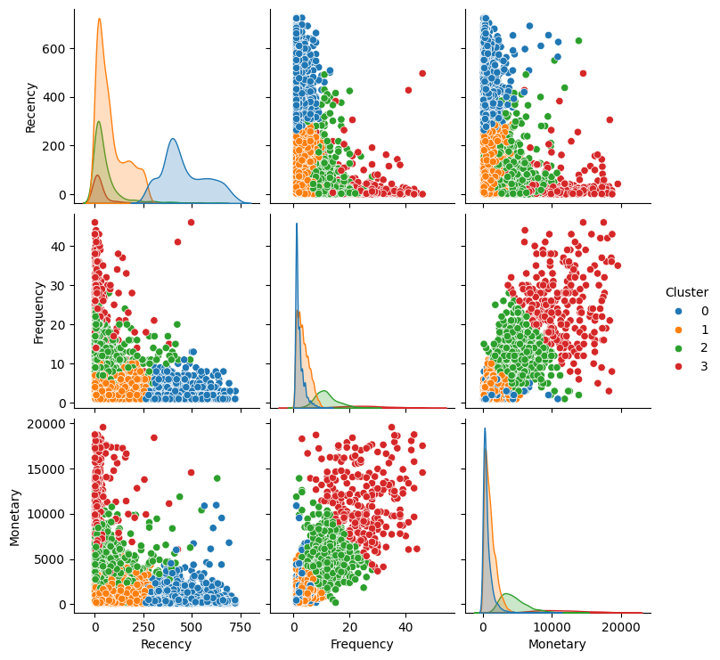
4 clear groups identified
Differences in spending and frequency

Slide 9
Cluster Interpretation
Cluster | Description | Behavior
0 | Occasional Buyers | Rarely buy, low spend
1 | Inactive Customers | Haven’t bought recently
2 | Regular Customers | Buy frequently, medium spend
3 | Loyal / High-Value Customers | High frequency and high spend

Slide 10
Customer Personas
Loyal Customers: Frequent, high spenders, brand promoters
Regular Shoppers: Consistent buyers, price sensitive
Occasional Buyers: Irregular shopping habits
Inactive Customers: Need re-engagement

Slide 11
Targeted Marketing Strategies
Segment | Marketing Action | Goal
Loyal Customers | VIP programs, early access | Retention
Regular Customers | Reward points, discounts | Upsell
Occasional Buyers | Reminder emails, offers | Increase frequency
Inactive Customers | Win-back campaigns | Reactivation

Slide 12
Marketing ROI Benefits
Better targeting = higher conversion
Reduced marketing cost
Stronger customer loyalty
Improved overall ROI

Slide 13
Conclusion
4 customer groups identified using K-Means
Created data-driven marketing strategies
Improves ROI and customer relationships

