Slide 1

Exploratory Data Analysis & Customer Insights
Prepared by: Afinu Mansoor NK
Tools Used: Python, Pandas, Matplotlib, Seaborn Dataset: Kaggle – Online Retail II Dataset (UCI)

Slide 2
Business Problem
A small e-commerce business looking to better understand their sales data to make informed decisions. They’ve shared raw transaction data including order IDs, product categories, customer IDs, sales amounts, and order dates. They want clear insights into top-selling products, seasonal trends, and customer buying patterns and they need actionable, easy-to-understand recommendations to help them grow their business.
Objectives:
Clean and preprocess the dataset
Perform detailed Exploratory Data Analysis (EDA)
Identify key trends and sales patterns
Segment customers based on their purchase behavior
Provide clear and actionable business insights

Slide 3
Dataset Overview
Total Rows: 541,909
Feature | Description
InvoiceNo | Unique order ID
StockCode | Product code
Description | Product name
Quantity | Number of items sold
Price | Price per unit
InvoiceDate | Date of transaction
CustomerID | Unique customer identifier
Country | Country of customer

Slide 4
Data Profiling
df.head() / df.tail() / df.sample() – to understand sample records.
df.shape – dataset size.
df.columns – all feature names.
df.dtypes – to identify data types.
df.info() – overall summary with non-null values.
df.nunique(), df.count() – to check unique entries and completeness.
df.describe() – basic statistical summary.
df.duplicated().sum() – checked and found 6865 duplicates.
df.isnull().sum() – found missing values in Customer ID and Description.
IQR method – Outlier check done. Found Outliers in Quantity and Price

Slide 5
Data Cleaning & Preprocessing
Removed duplicate entries
Dropped rows with missing Customer IDs (for customer-based analysis)
Created new features:
TotalSales = Quantity × Price
Month, Year, Weekday extracted from InvoiceDate
Outliers in Quantity and Price kept for realistic analysis

Slide 6
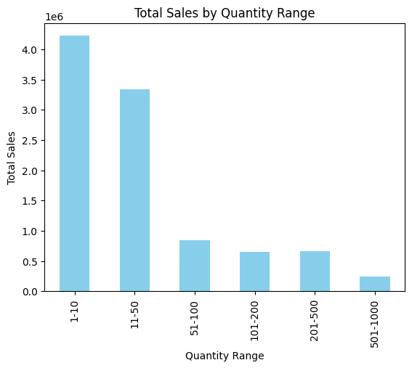
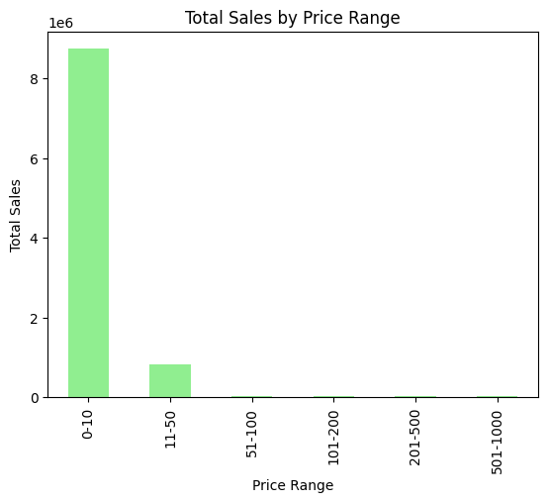
Exploratory Data Analysis (EDA)
Sales by Quantity & Price
Bar charts show most sales occur in moderate Quantity and Price ranges.
Very high Quantity and Price values are rare

Slide 7
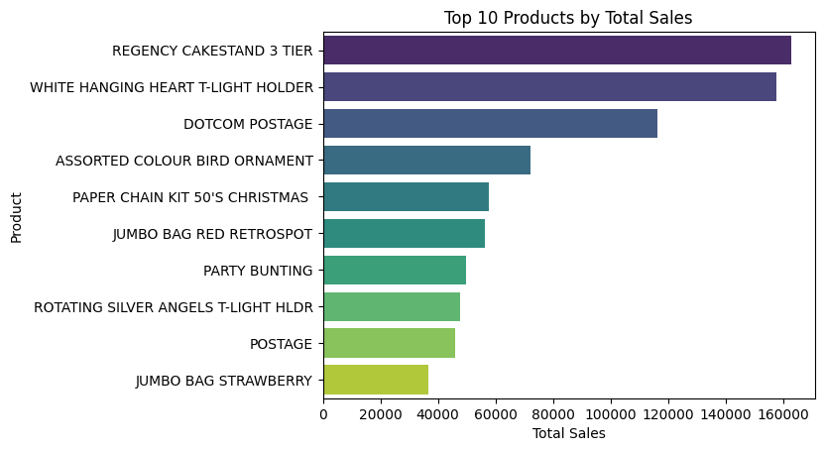
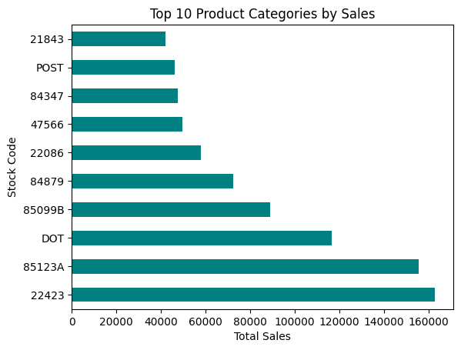
2. Top Products and Categories
Certain products and categories generate the majority of revenue.
Insights can guide inventory stocking and marketing promotions.

Slide 8
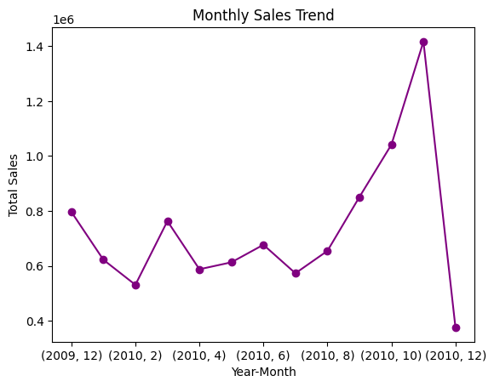
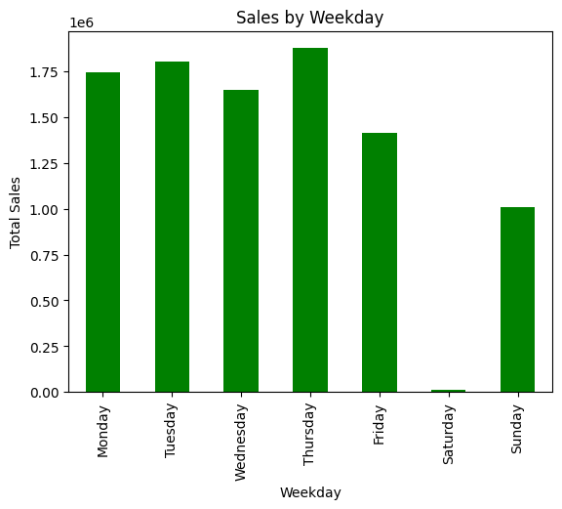
3. Sales Trends
Monthly and weekly analysis reveals peak sales periods.
Helps plan seasonal promotions and manage stock levels.

Slide 9
3.Sales by Country
Majority of revenue comes from the top 10 countries.
These countries are key markets for the business.

Slide 10
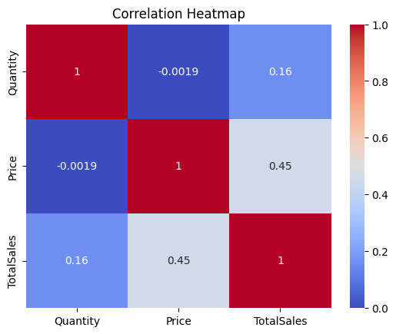
5.Correlation Analysis
Shows relationships between Quantity, Price, and Total Sales.
Quantity and Price have the strongest influence on total revenue.

Slide 11
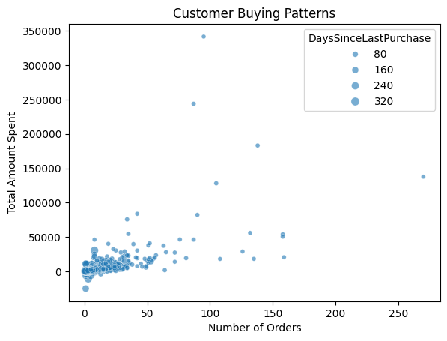
4.Customer Buying Patterns
Customers differ in how often they buy and how much they spend.
Frequent and high-spending customers can be targeted for loyalty programs.

Slide 12
Key Conclusions
Most sales come from moderate quantity and price ranges.
Specific products and countries dominate overall revenue.
Sales peak during certain months and weekdays.
A small group of customers buy frequently and spend more.
Quantity and Price directly impact total sales volume.

Slide 13
Business Recommendations
Focus marketing on top-selling products and countries.
Offer rewards for frequent and high-spending customers.
Use sales trend insights for better stock and promotion planning.
Monitor Quantity–Price balance to optimize profitability.

