Slide 1
NOISE OUT PRUNING
NURUL AFIQAH MOHD HASBULLAH
(17065831)
Bachelor of Engineering(Hons): Electronics and Computer

Slide 2
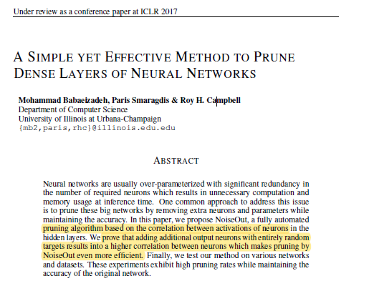

Founder
Mohammad Babaeizadeh aka MBZ
PhD Candidate University of Illinois at Urbana-Champaign Computer Science Department
Paper: “A Simple yet Effective Method to Prune Dense Layers of Neural Networks”(2017)
Source:
http://mb2.web.engr.illinois.edu/

Slide 3
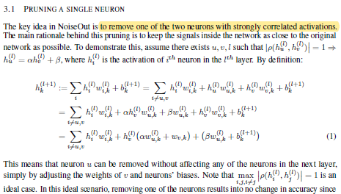
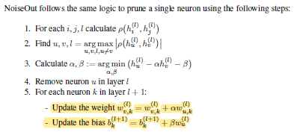
Algorithm Key Point - 1
Remove a single neuron with the highest correlation of activations value

Slide 4
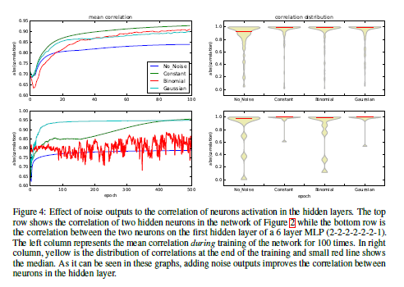
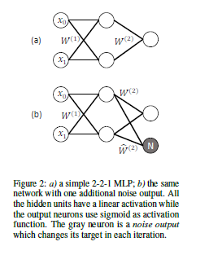
Algorithm Key Point - 2
Add a noise neuron to build correlations between neuron
Noise neuron apply sigmoid rule
Noise neuron is independent from input neurons

Slide 5
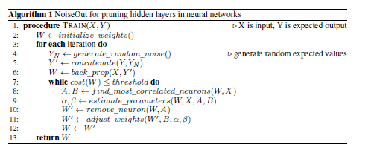
Noise Out Final Algorithm
Apply during Training Neural Networks only

Slide 6
Noise Out Pruning Type
Remove Neuron with the Highest Correlation of Activation Value
Add Noise Neuron to Increase Correlations in Hidden Layers
Initial Pruning
Final Pruning
Remove Neuron with the Highest Correlation of Activation Value
Remove Neuron with the Highest Correlation of Activation Value
Add Noise Neuron to Increase Correlations in Hidden Layers

Slide 7
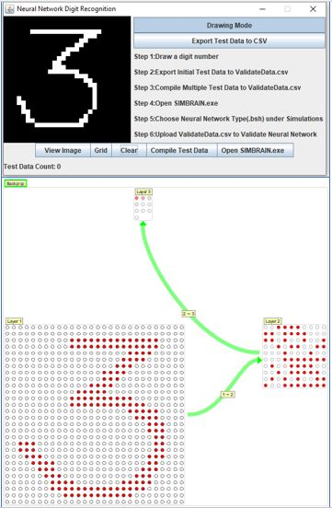
228.798 – Individual Research Project

Slide 8
Backpropagation Neural Networks with Two Hidden Layers & Noise Out Initial Pruning has the lowest Training MSE

Slide 9
Backpropagation Neural Networks with Two Hidden Layers & Noise Out Initial Pruning has the lowest Testing MSE

Slide 10
Backpropagation Neural Networks with Two Hidden Layers & Noise Out Final Pruning has the lowest Testing MSE

Slide 11
DISCUSSION
The founder of Noise Out apply the algorithm with Python and Keras Library
There is no implementation on Simbrain framework(Java and BeanShell script) yet
Regularly discuss with the founder of Simbrain

Slide 12
Code Implementation for Initial Pruning
Constant Variables:
Learning Rate
Learning Momentum
Number of Neurons in First Layer(200 Neurons)
Backpropagation
Number of Iterations(100)

Slide 13
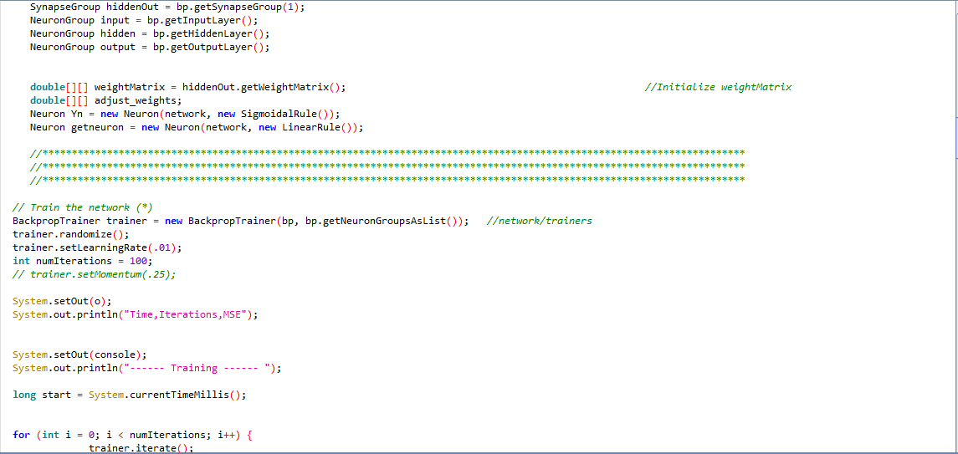

Slide 14
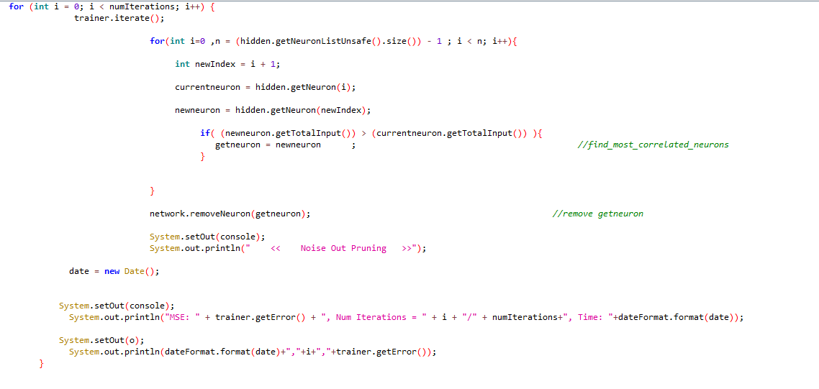

Slide 15
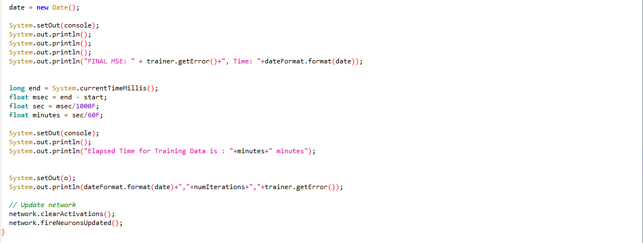

Slide 16
Code Implementation for Final Pruning
Constant Variables:
Learning Rate
Learning Momentum
Number of Neurons in First Layer(200 Neurons)
Backpropagation
Number of Iterations(100)

Slide 17
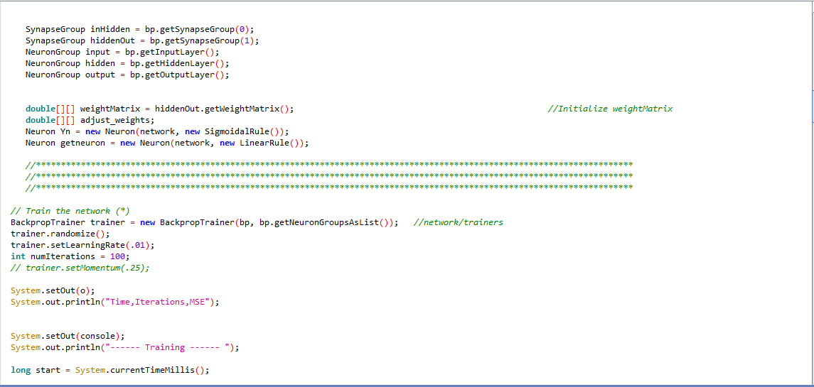

Slide 18
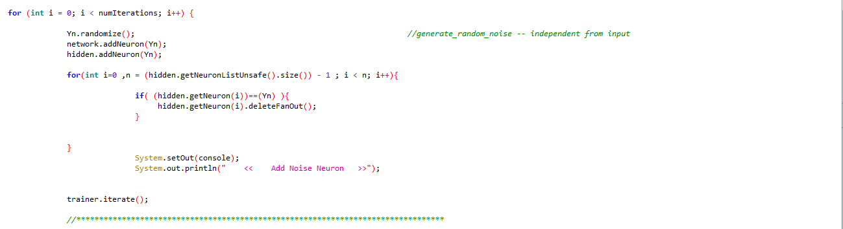
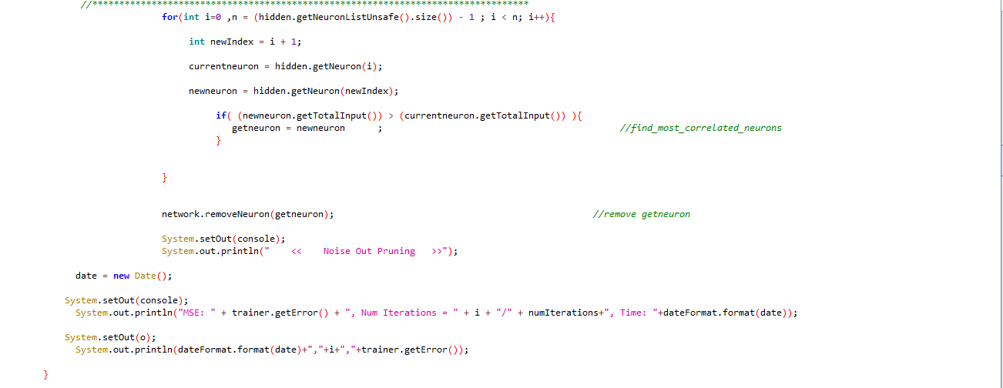

Slide 20
