Slide 1

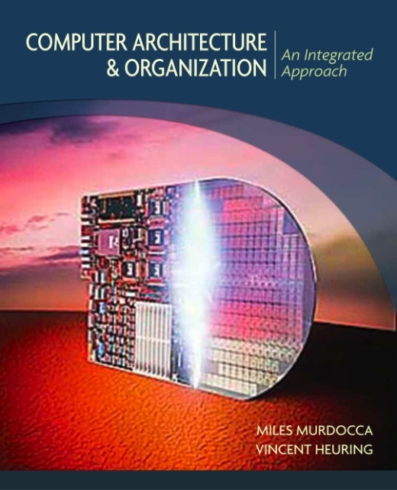
Computer Organisation and Architecture
Chapter 10 – Buses and Peripherals

Slide 2
Chapter Contents
    Simple Bus Architecture
    Simplified Illustration of a Bus
    Concept of Bus
    Bus Clocking

Slide 3
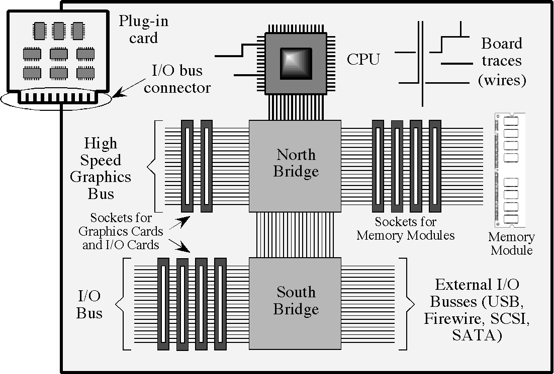
Simple Bus Architecture
  • A simplified motherboard of a personal computer (top view):

Slide 4
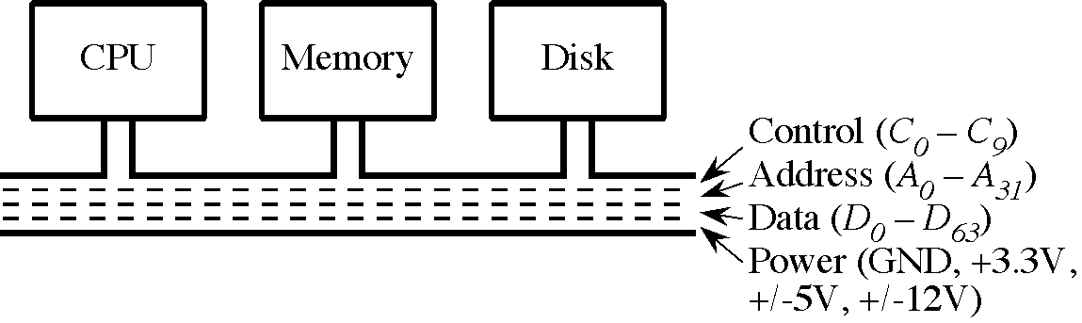
Simplified Illustration of a Bus

Slide 5
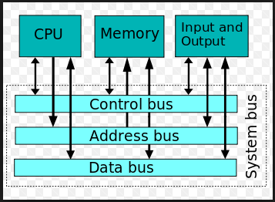
Concept of Bus
A system bus is a single computer bus that connects the major components of a computer system, combining the functions of a data bus to carry information, an address bus to determine where it should be sent, and a control bus to determine its operation. The technique was developed to reduce costs and improve modularity, and although popular in the 1970s and 1980s, more modern computers use a variety of separate buses adapted to more specific needs.

Slide 6
Concept of Bus
A bus consist of the physical parts, like connectors and wires and a bus protocol.
The wires can be partitioned into separate groups for control, data and power.
A bus that connects major computer components (processor, memory, I/O) is called a system bus. The most common computer interconnection structures are based on the use of one or more system buses.
The devices share a common set of wires, and only one device may send data at any one time.
All devices simultaneously listen, but normally only one device receives.
Only one devices can be a bus master, and the remaining devices are then considered to be slaves.
A bus can be classified as one of two types: synchronous and asynchronous.
Synchronous: One of the devices that is connected contain an oscillator (a clock) that send out sequence of 1s and 0s at time intervals.
Asynchronous: there is no bus clock

Slide 7
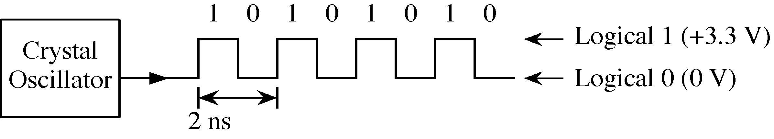
Bus Clocking
A 500 MHz Bus Clock

Slide 8
Bus Clocking
The machine cycle is the amount of cycles needed to do either a fetch, read or write operation. more here. The read or write may be more than a single bus cycle if the transaction between the CPU and memory is longer than the data width fetched or written. For example, on an 8080 machine, the data width is 8 bits.
The bus cycle is the cycle or time required to make a single read or write transaction between the cpu and the external memory. The machine cycle is the amount of cycles needed to do either a fetch, read or write operation.
The speed of a computer processor, or CPU, is determined by the clock cycle, which is the amount of time between two pulses of an oscillator. ... The clock speed is measured in Hz, typically either megahertz (MHz) or gigahertz (GHz). For example, a 4 GHz processor performs 4,000,000,000 clock cycles per second.

Slide 9
Data transfer rate across the bus
A 64-bit microprocessor, with a 24-bit external data bus, driven by an 10-MHz input clock. This microprocessor has a bus cycle whose minimum duration equals to 4 (four) input clock cycles. Calculate the maximum data transfer rate across the bus that this microprocessor in bytes/sec.
Min bus cycle duration = 4 clock cycles
Bus clock = 10 MHz
Maximum bus cycle rate = Bus clock/Clock cycles = 10/4 = 2.5 M/s
Data transferred per bus cycle = 24 bit = 3 bytes
Data transfer rate per second = bus cycle rate * data per bus cycle= 2.5 M * 3 = 7.5 Mbytes/sec

Slide 10
Data transfer rate across the bus
A 16-bit microprocessor, with a 24-bit external data bus, driven by an 5-MHz input clock. This microprocessor has a bus cycle whose minimum duration equals to 4 (four) input clock cycles. Calculate the maximum data transfer rate across the bus that this microprocessor in bytes/sec.
A 128-bit microprocessor, with a 32-bit external data bus, driven by an 7-MHz input clock. This microprocessor has a bus cycle whose minimum duration equals to 4 (four) input clock cycles. What is the maximum data transfer rate across the bus that this microprocessor can sustain in bytes/sec.

Slide 11
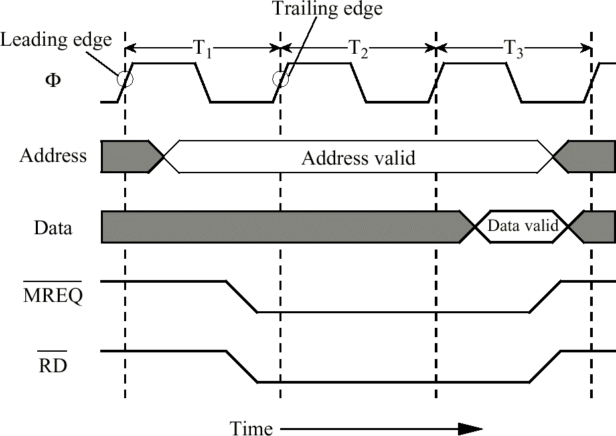
The Synchronous Bus
  • Timing diagram for a synchronous memory read (adapted from [Tanenbaum, 1999]).

Slide 12
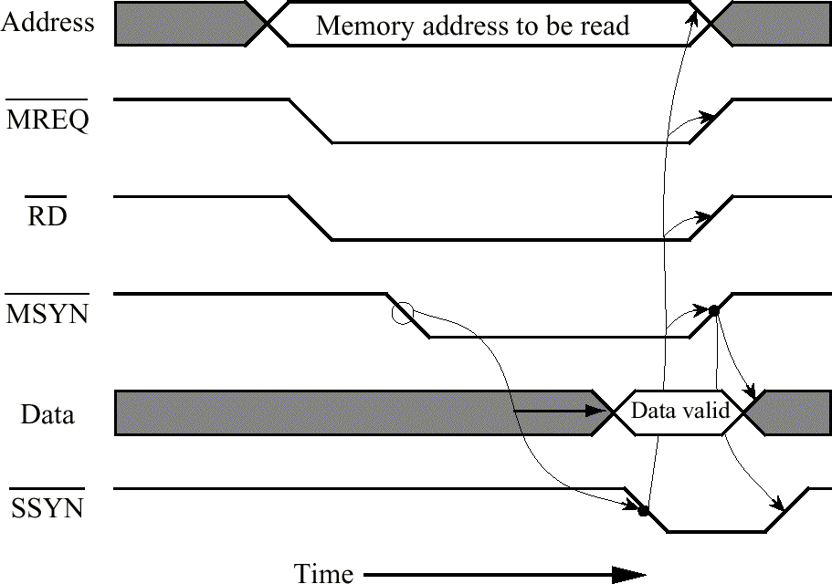
The Asynchronous Bus
  • Timing diagram for asynchronous memory read (adapted from [Tanenbaum, 1999]).

Slide 13
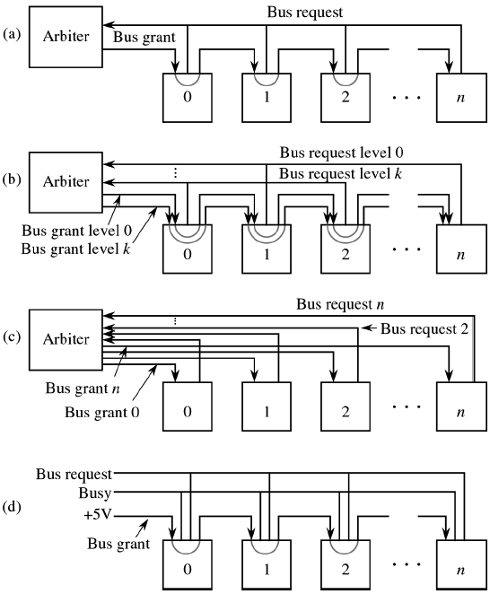
Bus Arbitration
Simple centralized bus arbitration;
Centralized arbitration with priority levels;
Fully centralized bus arbitration;
Decentralized bus arbitration. (Source: adapted from [Tanenbaum, 1999].)

Slide 14
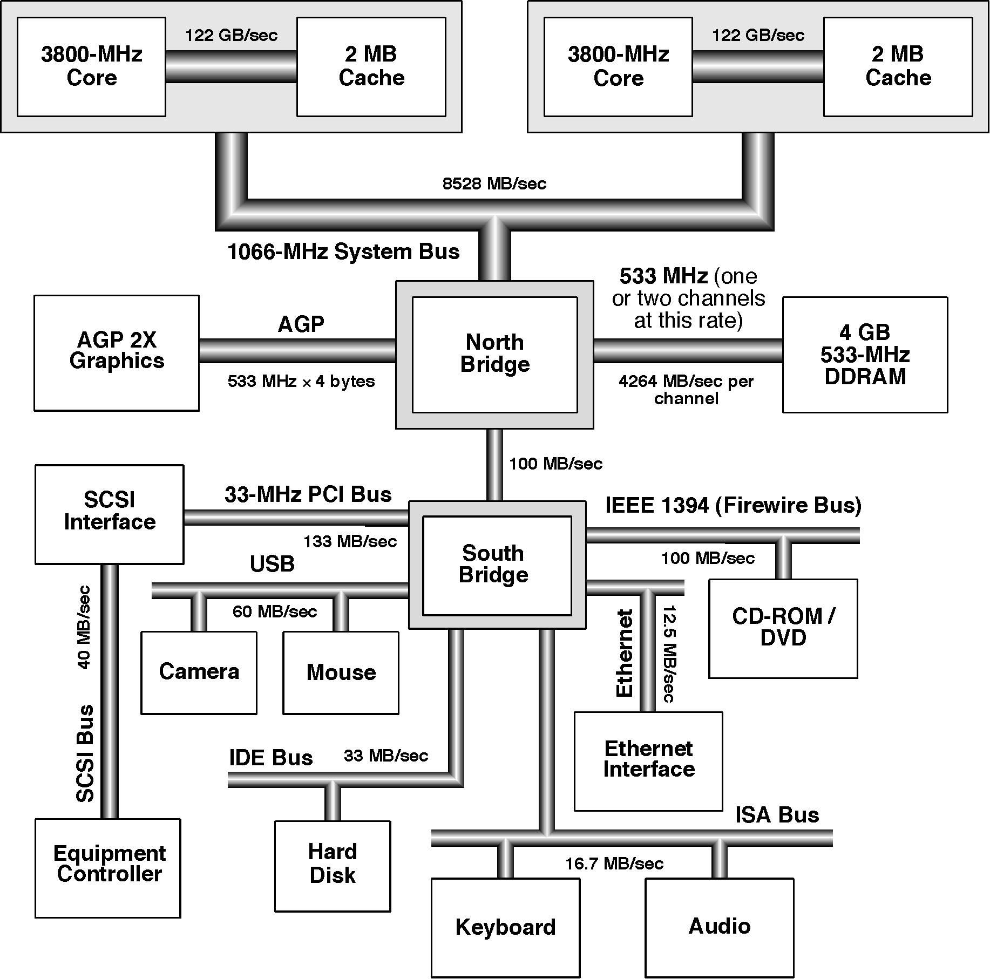
Bridge Based Bus Arch-itecture
Bridging with dual Pentium processors.
Source: http://www.intel.com.

Slide 15
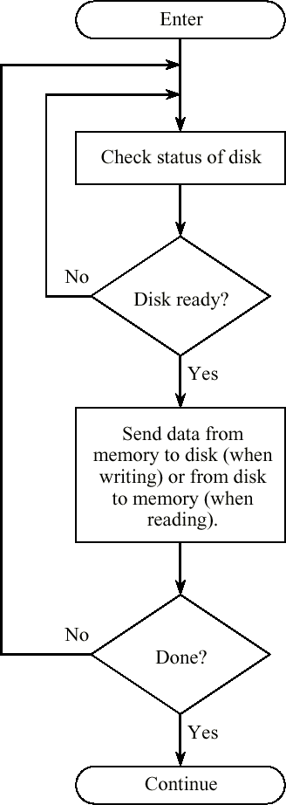
Programmed I/O Flowchart for a Disk Transfer

Slide 16
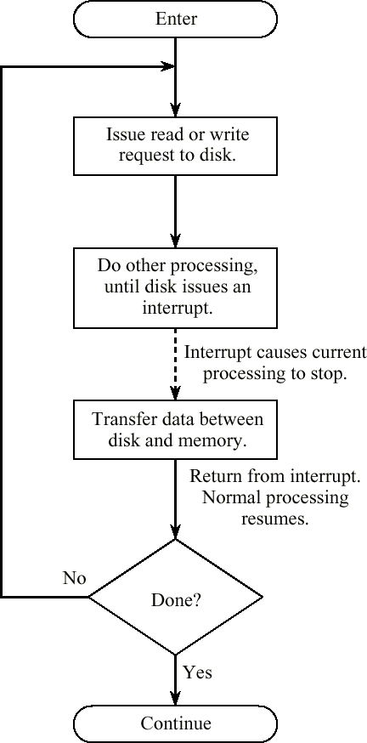
Interrupt Driven I/O Flowchart for a Disk Transfer

Slide 17
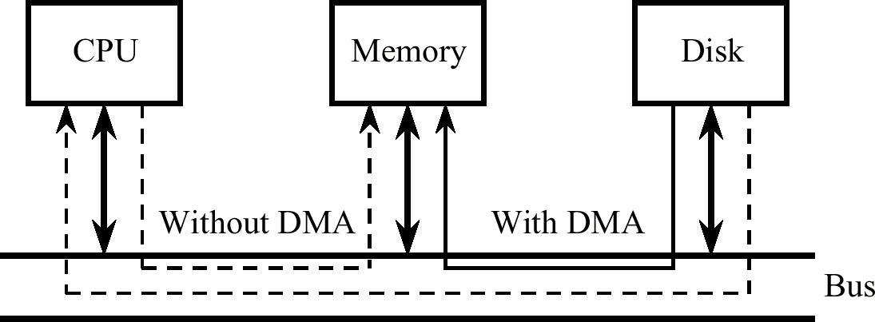
DMA Transfer from Disk to Memory Bypasses the CPU

Slide 18
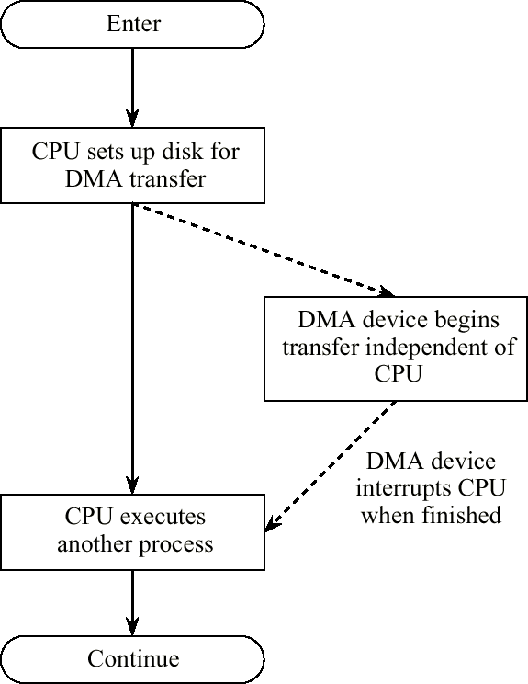
DMA Flowchart for a Disk Transfer

Slide 19
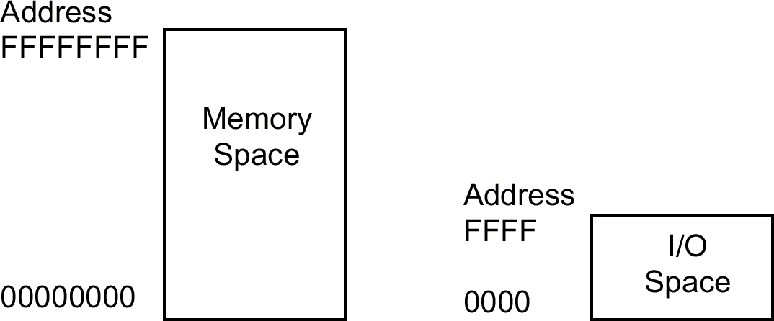
Intel Memory and I/O Address Spaces

Slide 20
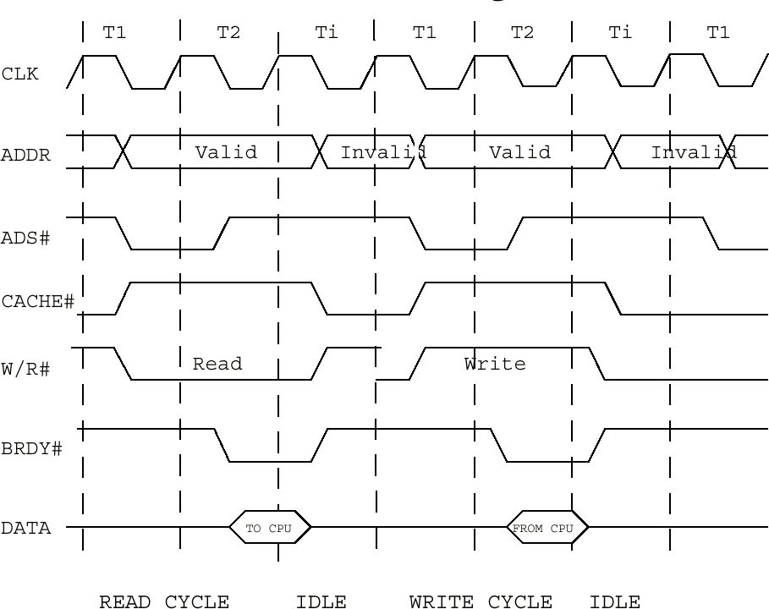
Standard Intel Pentium Read and Write Bus Cycles

Slide 21
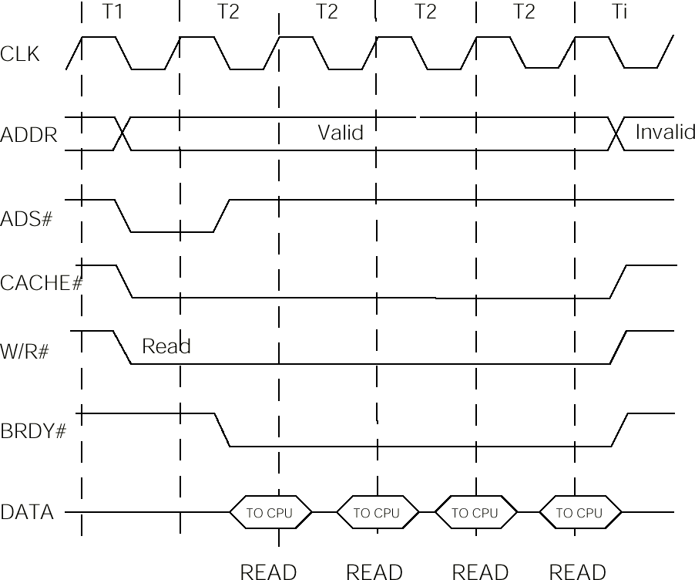
Intel Pentium Burst Read Bus Cycle

Slide 22
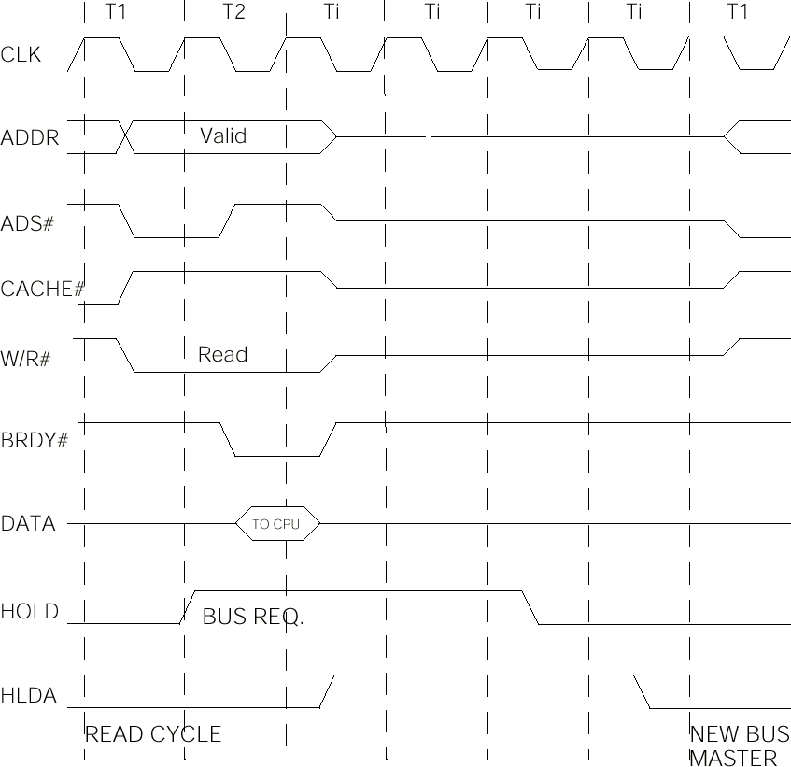
Intel Pentium Hold-Hold Acknow-ledge Bus Cycle

Slide 23
Data Encoding
Encoding is the process of using various patterns of voltage or current levels to represent 1s and 0s of the digital signals on the transmission link. The common types of line encoding are Unipolar, Polar, Bipolar, and Manchester.
Only the transitions between magnetized areas are sensed when reading a disk, and so runs of 1s or 0s may not be accuracy detected unless a method of encoding is used that embeds timing information into the data to identify the breaks between bits.

Slide 24
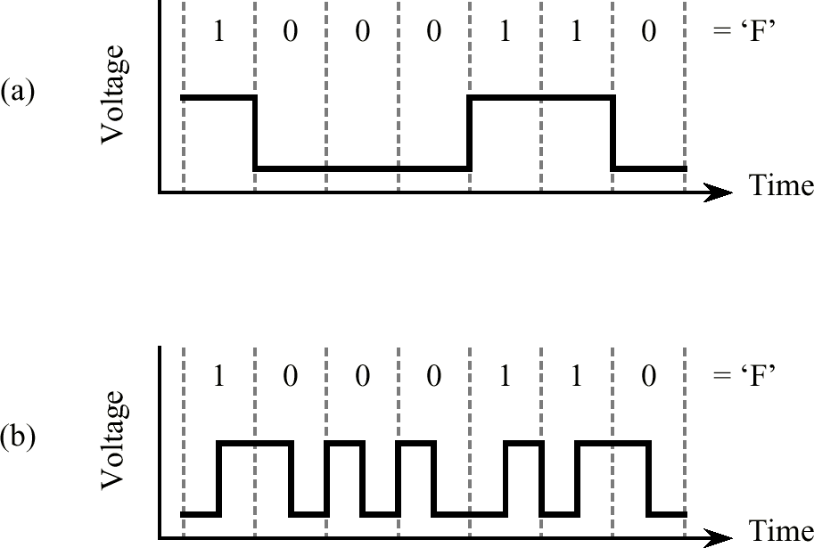
Manchester Encoding
  • (a) Straight amplitude (NRZ) encoding of ASCII ‘F’;
(b) Manchester encoding of ASCII ‘F’.

Slide 25
Problem
Given the value of ASCII ‘L’ character as 4C₁₆, encode it using these methods:-
  (a) Straight Amplitude (NRZ) Encoding
  (b) Manchester Encoding
    4C₁₆
    4D₁₆
    4F₁₆
    5A₁₆
    4A₁₆
    4E₁₆

Slide 26
Problem
Given the value of ASCII ‘L’ character as 4C₁₆, encode it using these methods:-
  (a) Straight Amplitude (NRZ) Encoding
  (b) Manchester Encoding
    4C₁₆
    7A₁₆
    32₁₆
    5A₁₆
    2A₁₆
    25₁₆

Slide 27
Problem
Given the value of ASCII ‘L’ character as 4C₁₆, encode it using these methods:-
  (a) Straight Amplitude (NRZ) Encoding
  (b) Manchester Encoding
    K
    Z
    g
    e
    x
    (

Slide 28
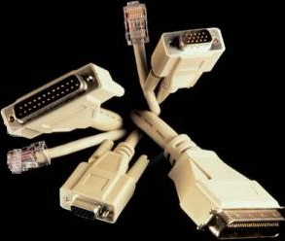
RS-232
  • The RS-232 standard commonly uses 9-pin and 25-pin connectors, but uses others as well (see the figure).
  • RS-232 is used for slow-bit-rate devices such as mice, keyboards, and non-graphics terminals.

Slide 29
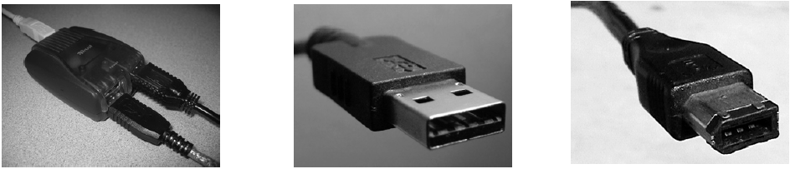
USB and Firewire
Universal Serial Bus (USB) and IEEE 1394 (Firewire) are groups of standards for interconnecting peripheral devices. USB 2.0 supports data transfer rates up to 480 Mbps, with as many as 127 devices connected to a single host controller through special hub devices in a tree-like manner.
Firewire is similar to USB but has traditionally been faster, up to 800 Mbps. A key advantage of Firewire is isochronous data transfer, in which a continuous, guaranteed data transfer is supported at a predetermined rate. This makes Firewire attractive for digital video and digital audio.
(left) USB hub; (middle) USB cable; (right) Firewire cable.

Slide 30
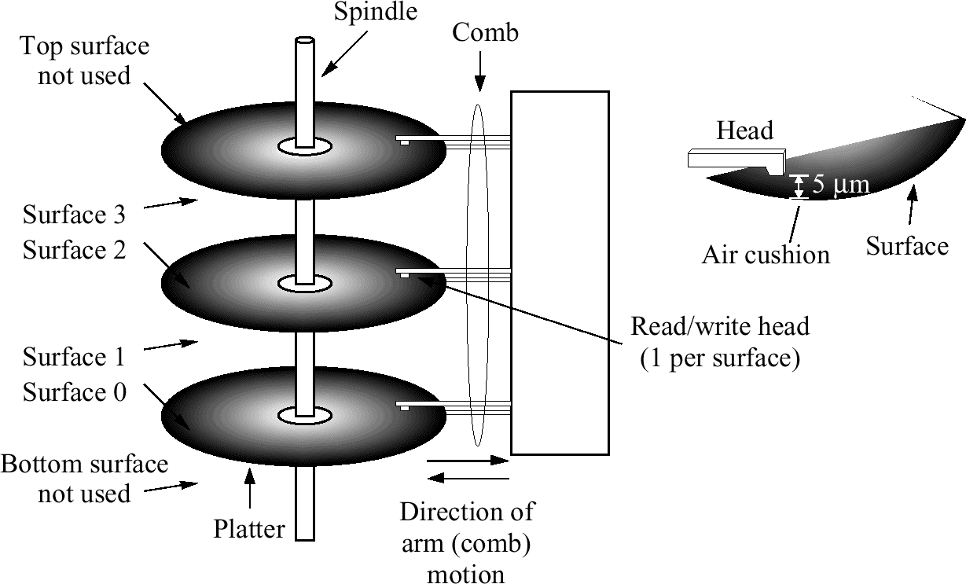
A Magnetic Disk with Three Platters

Slide 31
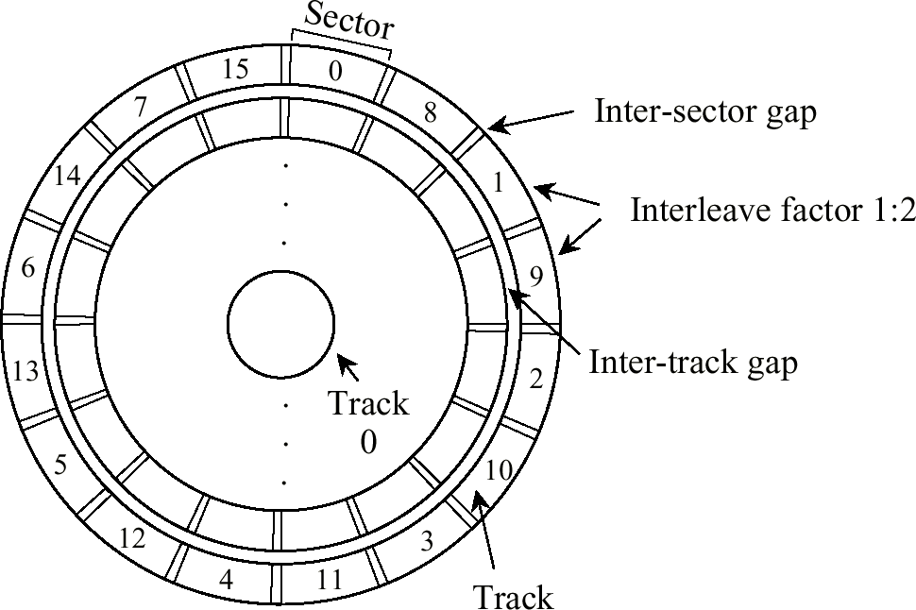
Organization of a Disk Platter with a 1:2 Interleave Factor

Slide 32
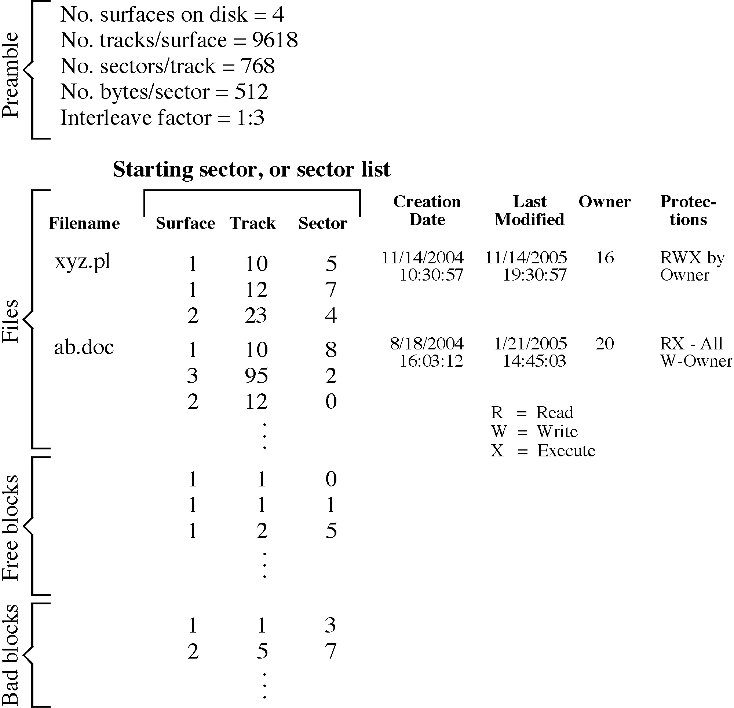
Master Control Block

Slide 33
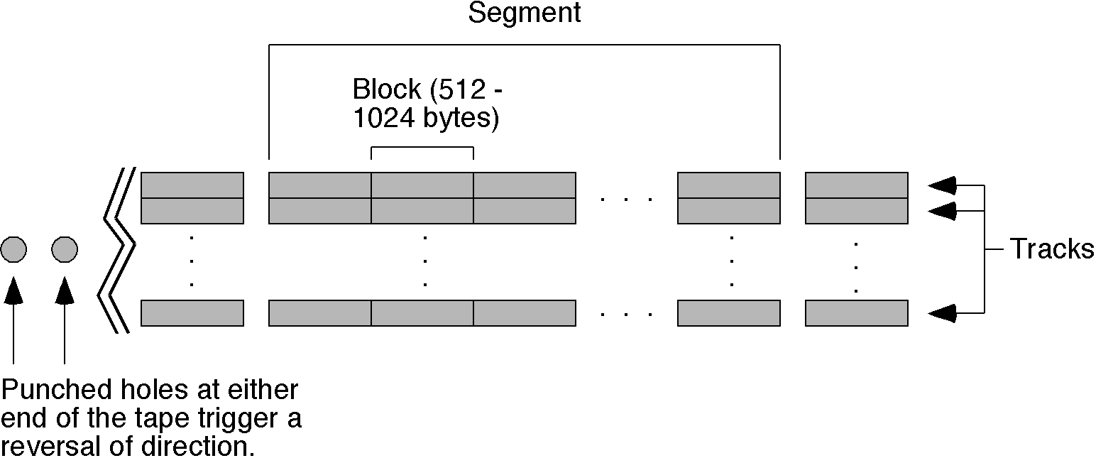
Magnetic Tape
  • A portion of a magnetic tape.

Slide 34
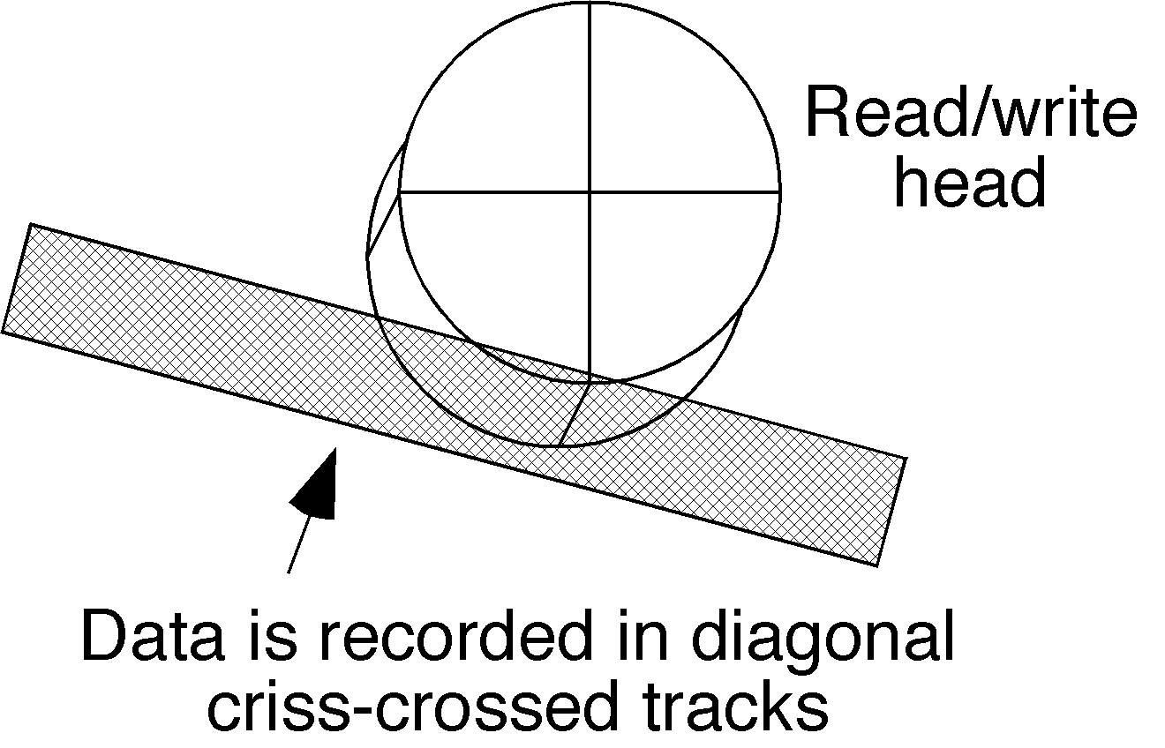
Digital Audio Tape (DAT)
  • Digital audio tape (DAT) formatting supports high densities, on the order of 72 GB for a small 73 mm × 54 mm profile. The read / write head is placed at an angle to the tape as shown in the figure, allowing data to be criss-crossed over the same area, using opposite polarities which maintains separation of the bits.

Slide 35

Spiral Format for Compact Disk
  • Unlike a magnetic disk in which all of the sectors on concentric tracks are lined up like a sliced pie (where the disk rotation uses constant angular velocity), a CD is arranged in a spiral format (using constant linear velocity). The speed of rotation is adjusted so that the disk moves more slowly when the head is at the edge than when it is at the center.

Slide 36
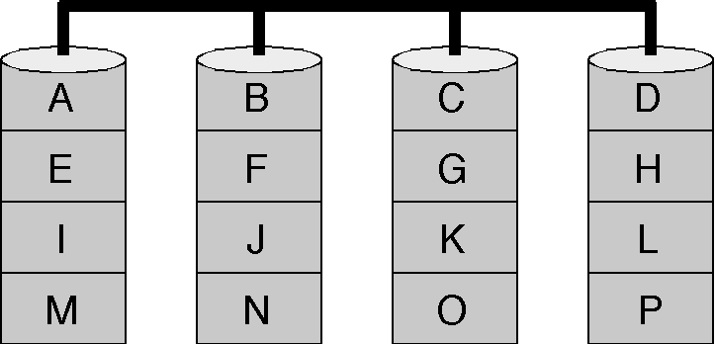
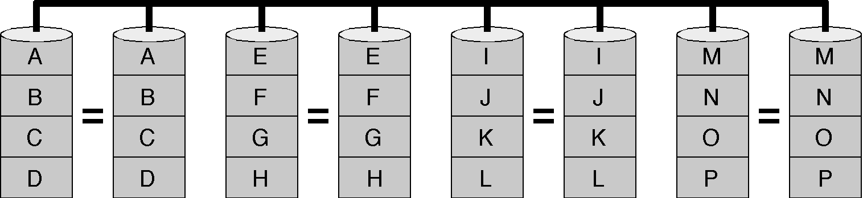
Redundant Arrays of Inexpensive Disks (RAID)
  • RAID level 0 – striped disk array without fault tolerance.
  • RAID level 1 – mirroring and duplexing.

Slide 37
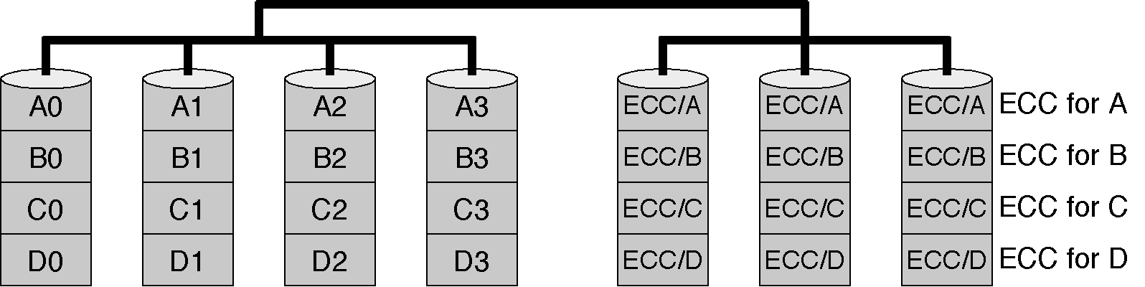
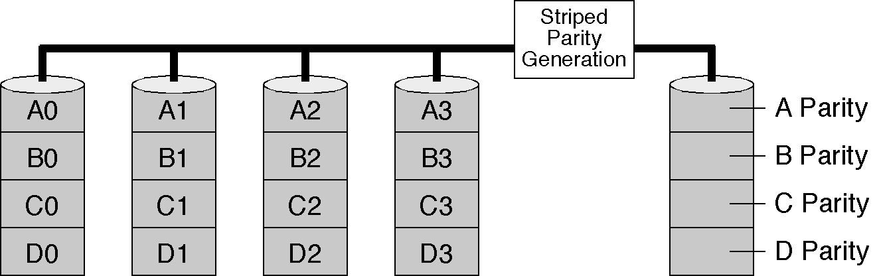
RAID (Continued)
  • RAID level 2 – bit-level striping with Hamming Code ECC.
  • RAID level 3 – parallel transfer with parity.

Slide 38

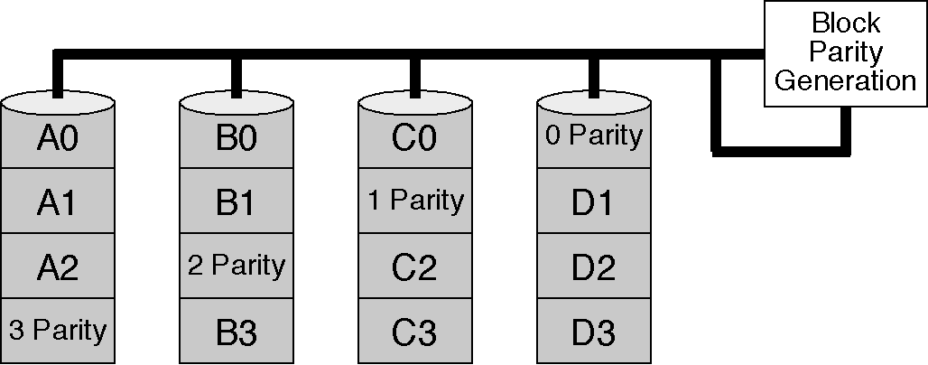
RAID (Continued)
  • RAID level 4 – independent data disks with shared parity disk.
  • RAID level 5 – independent data disks with distributed parity blocks.

Slide 39
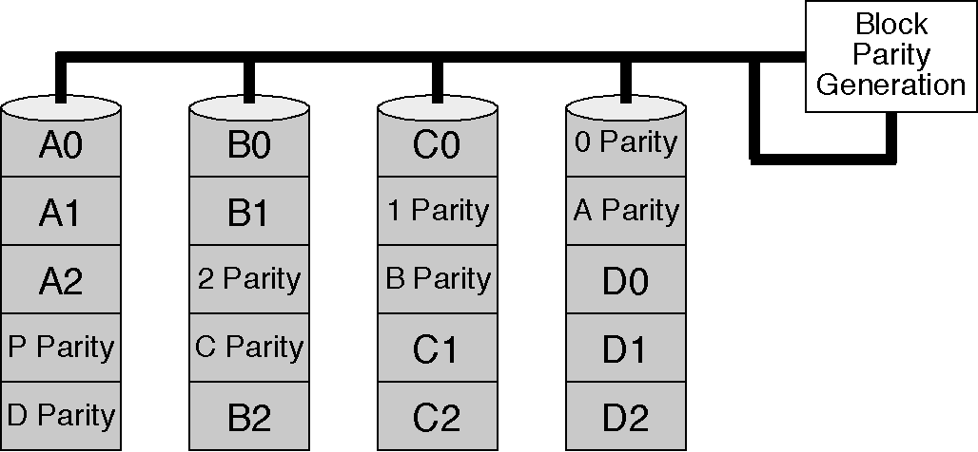
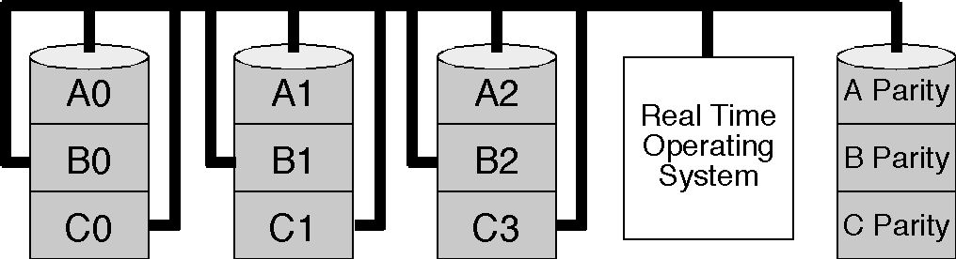
RAID (Continued)
  • RAID level 6 – independent data disks with two independent distributed parity schemes.
  • RAID level 7 – asynchronous cached striping with dedicated parity.

Slide 40
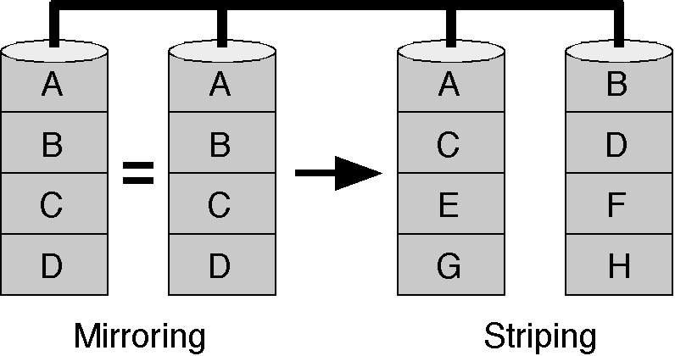
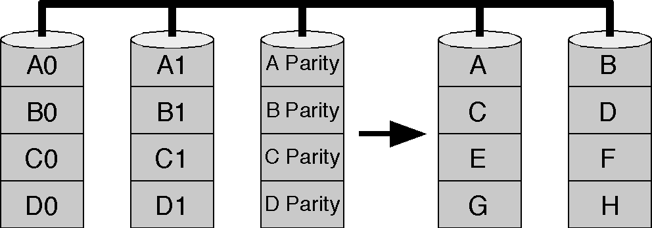
RAID (Continued)
  • RAID level 10 – very high reliability combined with high performance.
  • RAID level 53 – high I/O rates and data transfer performance.

Slide 41
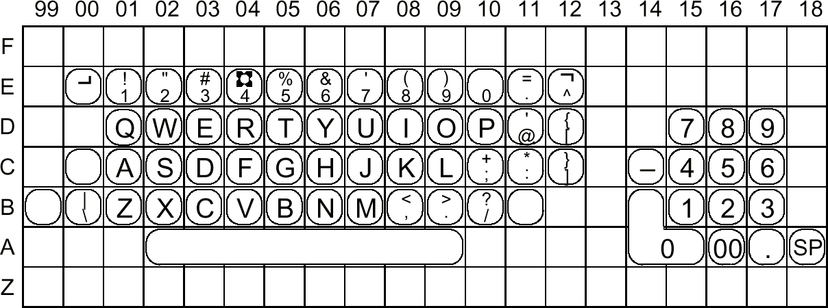
ECMA-23 Keyboard Layout
  • Keyboard layout for the ECMA-23 Standard (2nd ed.). Shift keys are frequently placed in the B row.

Slide 42
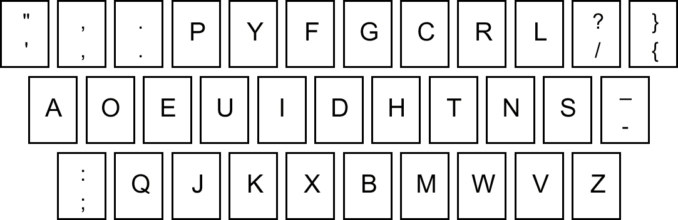
The Dvorak Keyboard Layout

Slide 43
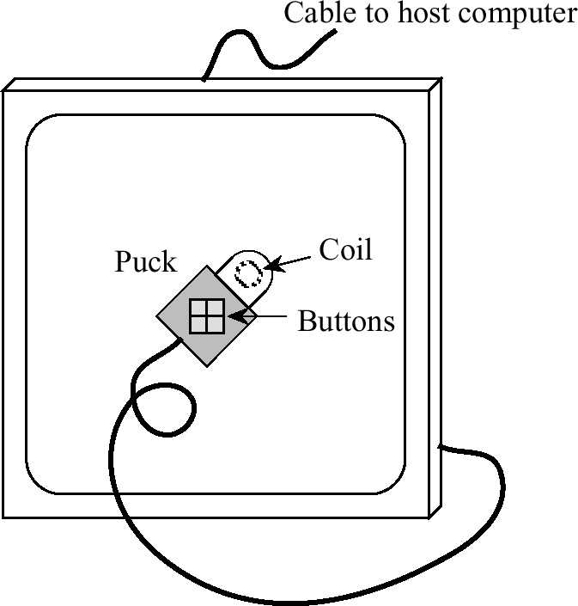
Tablet with Puck

Slide 44
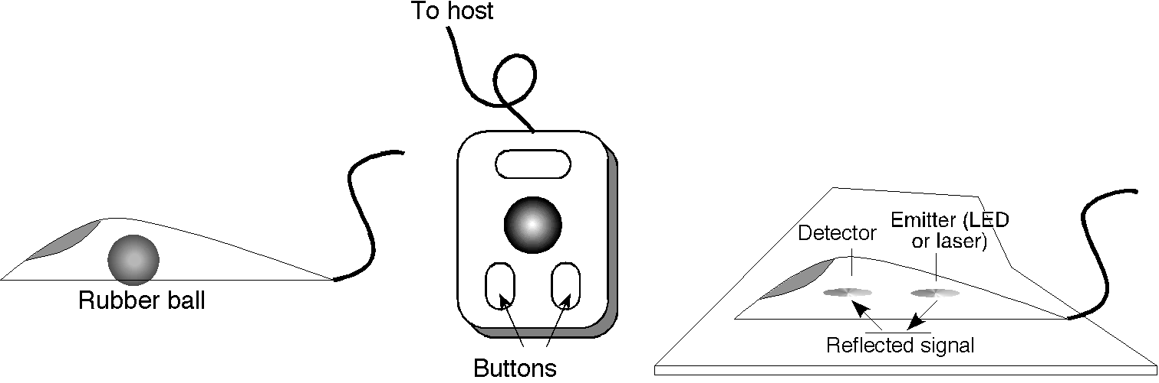
Mouse and Trackball
  A mechanical mouse (left), a three-button trackball (center), and an optical mouse (right).

Slide 45
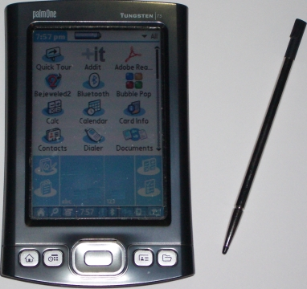
Touch Sensitive Pen-based Display
  • Pen-based personal digital assistants (PDAs) use a passive matrix in which the pen can be anything that induces pressure on the screen.
  • Two transparent conducting layers are placed on the screen, separated by spacer dots. When the user applies pressure to the top layer, as with a stylus or simply a finger, the top and bottom layers make contact. The induced voltage at the edges varies according to the position of the stylus.

Slide 46
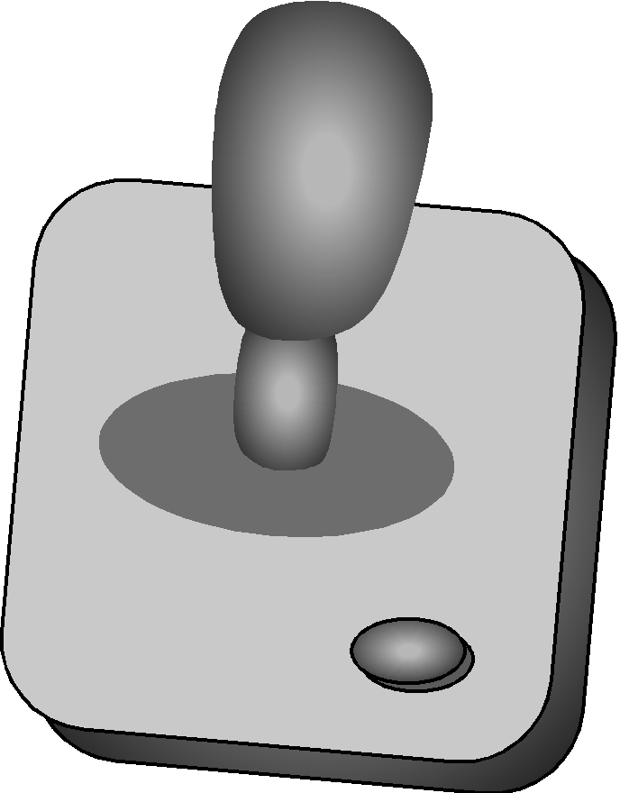
Joystick
  • A joystick with a selection button and a rotatable rod:

Slide 47
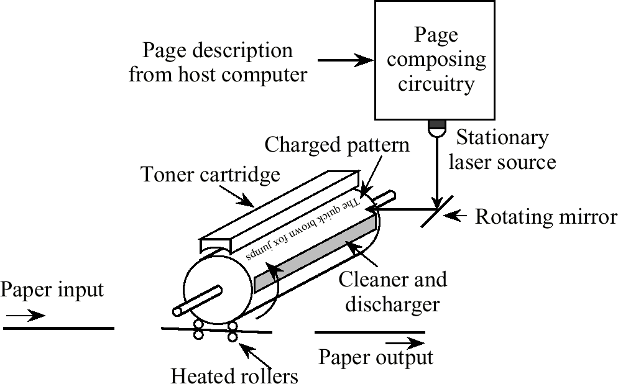
Laser Printer
  • Schematic of a laser printer (adapted from [Tanenbaum, 1999]).

Slide 48
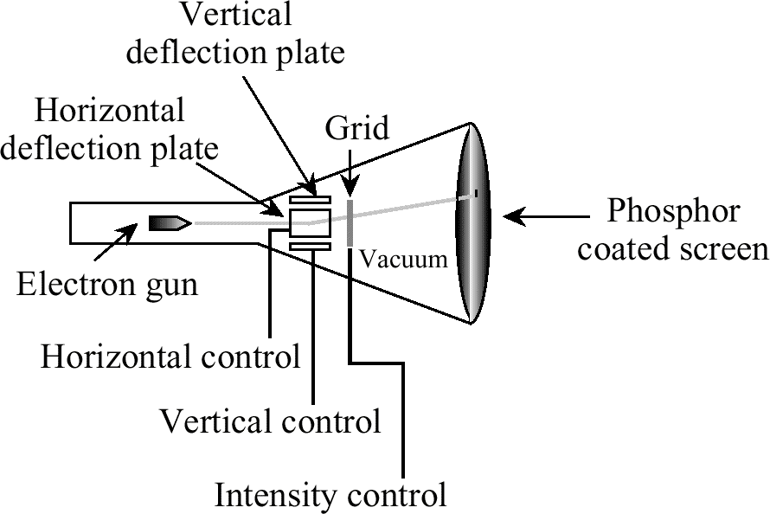
Cathode Ray Tube
  • A CRT with a single electron gun:

Slide 49
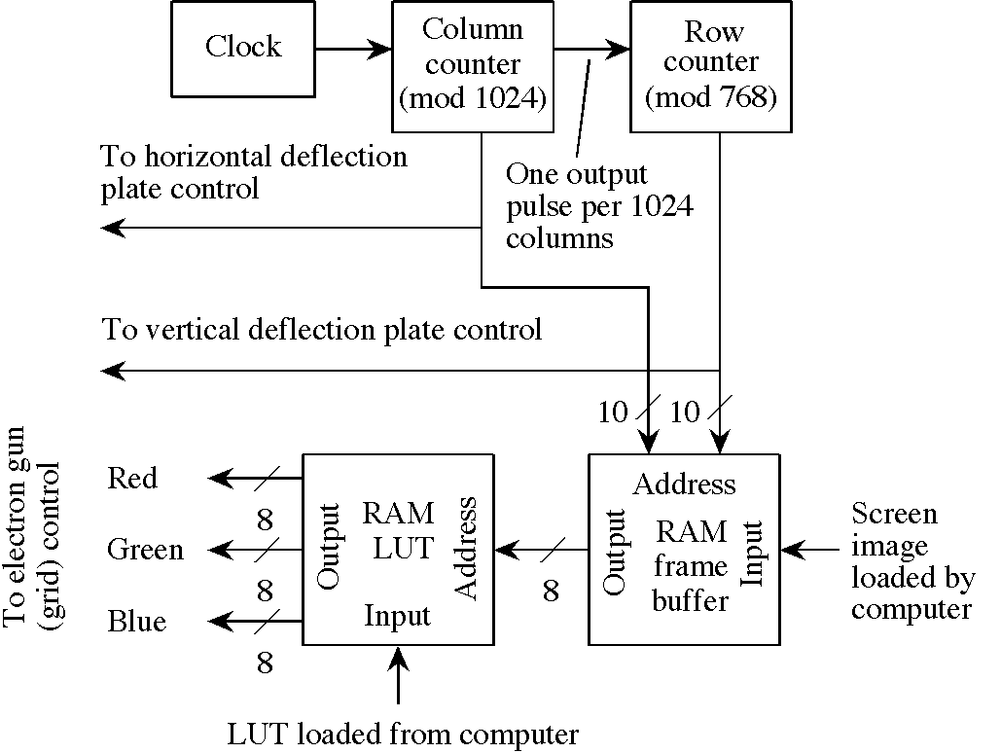
Display Controller
  • Display controller for a 1024×768 color monitor (adapted from [Hamacher et al., 1990]).

Slide 50
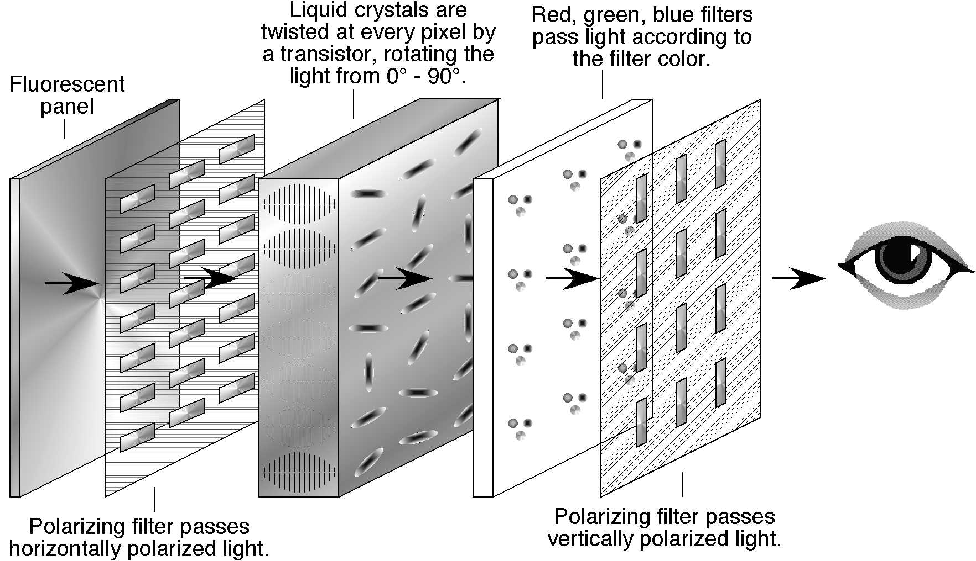
Active Matrix Color Liquid Crystal Display

Slide 51
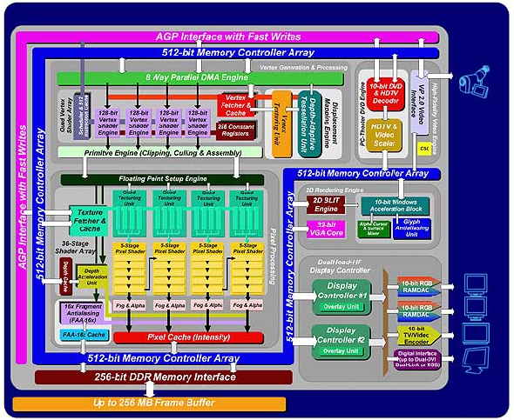
Matrix Parhelia-512 GPU

