Slide 1





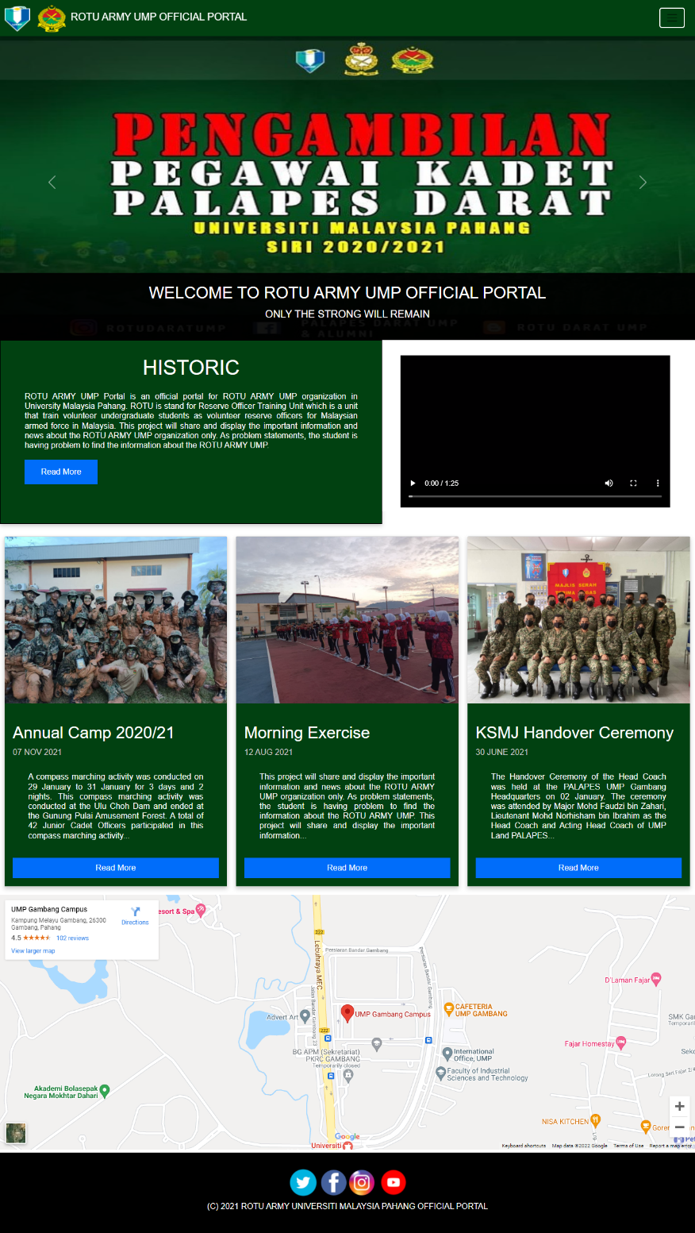
ROTU ARMY UMP Official Portal
SCOPE
INTRODUCTION
The portal only serves ROTU ARMY UMP information and news placed in University Malaysia Pahang.
The portal focuses on the UMP undergraduate students who having problem in finding information about the ROTU ARMY UMP only.
The portal includes five user which is admin, staffs, current student, public user and new students.
BCC3024
UNDERGRADUATE PROJECT II
ROTU ARMY UMP Portal is an authority entrance for ROTU ARMY UMP association in University Malaysia Pahang. ROTU is represent Pasukan Latihan Pegawai Simpanan which is a unit that train volunteer college understudies as volunteer reserve officers for Malaysian equipped power in Malaysia. ROTU ARMY UMP Official Portal is a portal that shared all the information about the organization.
METHODOLOGY
PROBLEM STATEMENT
They are having issue in finding and get the information about the organization because they need to attend the ROTU ARMY UMP kiosk during the orientation event only.
The information about the ROTU ARMY UMP in official UMP Portal or in internet is too concise.
SDLC
Waterfall Model
REQUIREMENT
Ahmad Afiq Ahnaf Bin Harudin
CD19013
DESIGN
EXECUTION
TESTING
Dr. Salwana Binti Mohamad @ Asmara
SUPERVISOR
RELEASE
CONCLUSION
OBJECTIVE
This portal development will be focused to show and clarifying the data about the ROTU ARMY UMP for the UMP understudies. This task will be creating to confirm bugs of ROTU ARMY UMP Portal. The extent of the portal is the entryway just serves ROTU ARMY UMP data and news put in University Malaysia Pahang. . Likewise, the project focuses on the UMP understudies who having issue in discovering data about the ROTU ARMY UMP as it were.
USER INTERFACE
To design a ROTU ARMY UMP Portal system.
To develop a portal that display and explaining the information and news about the ROTU ARMY UMP for the UMP students.
To develop a portal that ease the student and staff to manage the ROTU ARMY UMP organization.
To verify bugs of the ROTU ARMY UMP Portal.
Home Page

