Slide 1
Pretend
A fair about the demon world

Slide 2

Something about the origin
When Puri’s consciousness became clear, he just found himself in a place where was full of unaccustomed atmosphere. Emmmmm, concretely, the ar was more turbid than his hometown’s.

Slide 3
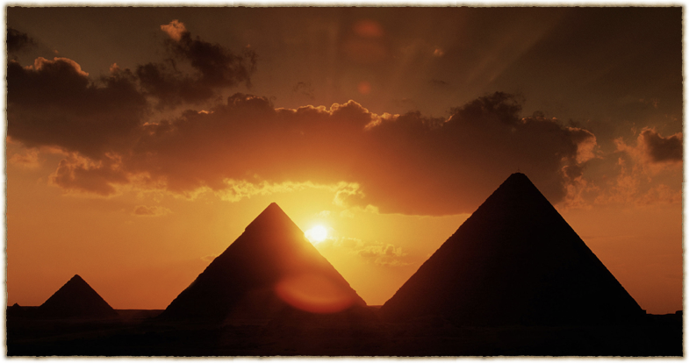
First devil
When Puri found the special castle,
he was aware of that there must be not his customary world.
There was not the second choice for Puri but enter the castle,
and now the situation looks like not so bad.

Slide 4
Communication
When there is a condition that Puri can provide something that the devils want him to do, and this world is not dangerous enough for Puri to deal with, So this story will continue…

Slide 5
What Puri has to do is to please the devils and find why he fall into this world, and what he can do to go back the customary world.
This part is mainly show through the communication with the devils to make the reasonable choice.

Slide 6
Reverse party
Four year later, Puri come along with one of the devil that he choose, join the most wonderful party— liberty craft.

Slide 7
Liberty craft
Every five years, there are some things contains asmodians friends, rare treasures, magic that demons own. This will be transferred to cards for this party. Obey the rules, defeat the competitor, and get the glory!

Slide 8
Betray or keep sincere
Win the party, and get the glory. All seems to be improved, but the message that Puri got from the party makes him shaky.

Slide 9
Devil’s Room
"The gate to the human’s world is exist, and the key is charged by the devil who comes along with you". When the advanced demon with blue flame told Puri this message, Puri hesitates.

Slide 10
Puri wonder why the devil don’t tell him about the key and the gate, and even the others don’t mention it yet.
Betray or keep sincere, what should Puri do?

Slide 11
Pretend
Go back the customary world, or get the truth under the mist.
Wish all things are your best suits!

