Slide 1
R3.04 - English
Strategy & State Pattern
{ Presented by Sacha and Theo }
02/12/2024

Slide 2
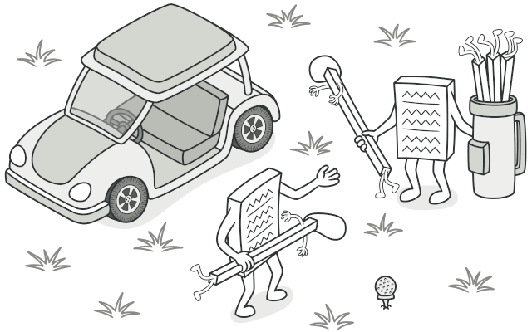
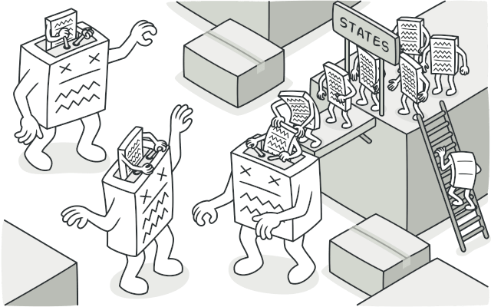
R3.04 - English
{ Presented by Sacha and Theo }
02/12/2024
Summary
Strategy Pattern
State Pattern
Differences

Slide 3
Strategy Pattern
Encapsulates interchangeable behaviors into separate classes, allowing the behavior of a class to be dynamically changed at runtime
State Pattern
Differences

Slide 4
Strategy Pattern
Encapsulates interchangeable behaviors into separate classes, allowing the behavior of a class to be dynamically changed at runtime
State Pattern
Differences

Slide 5
Strategy Pattern
Encapsulates interchangeable behaviors into separate classes, allowing the behavior of a class to be dynamically changed at runtime
Its key feature is the promotion of flexibility
State Pattern
Differences

Slide 6
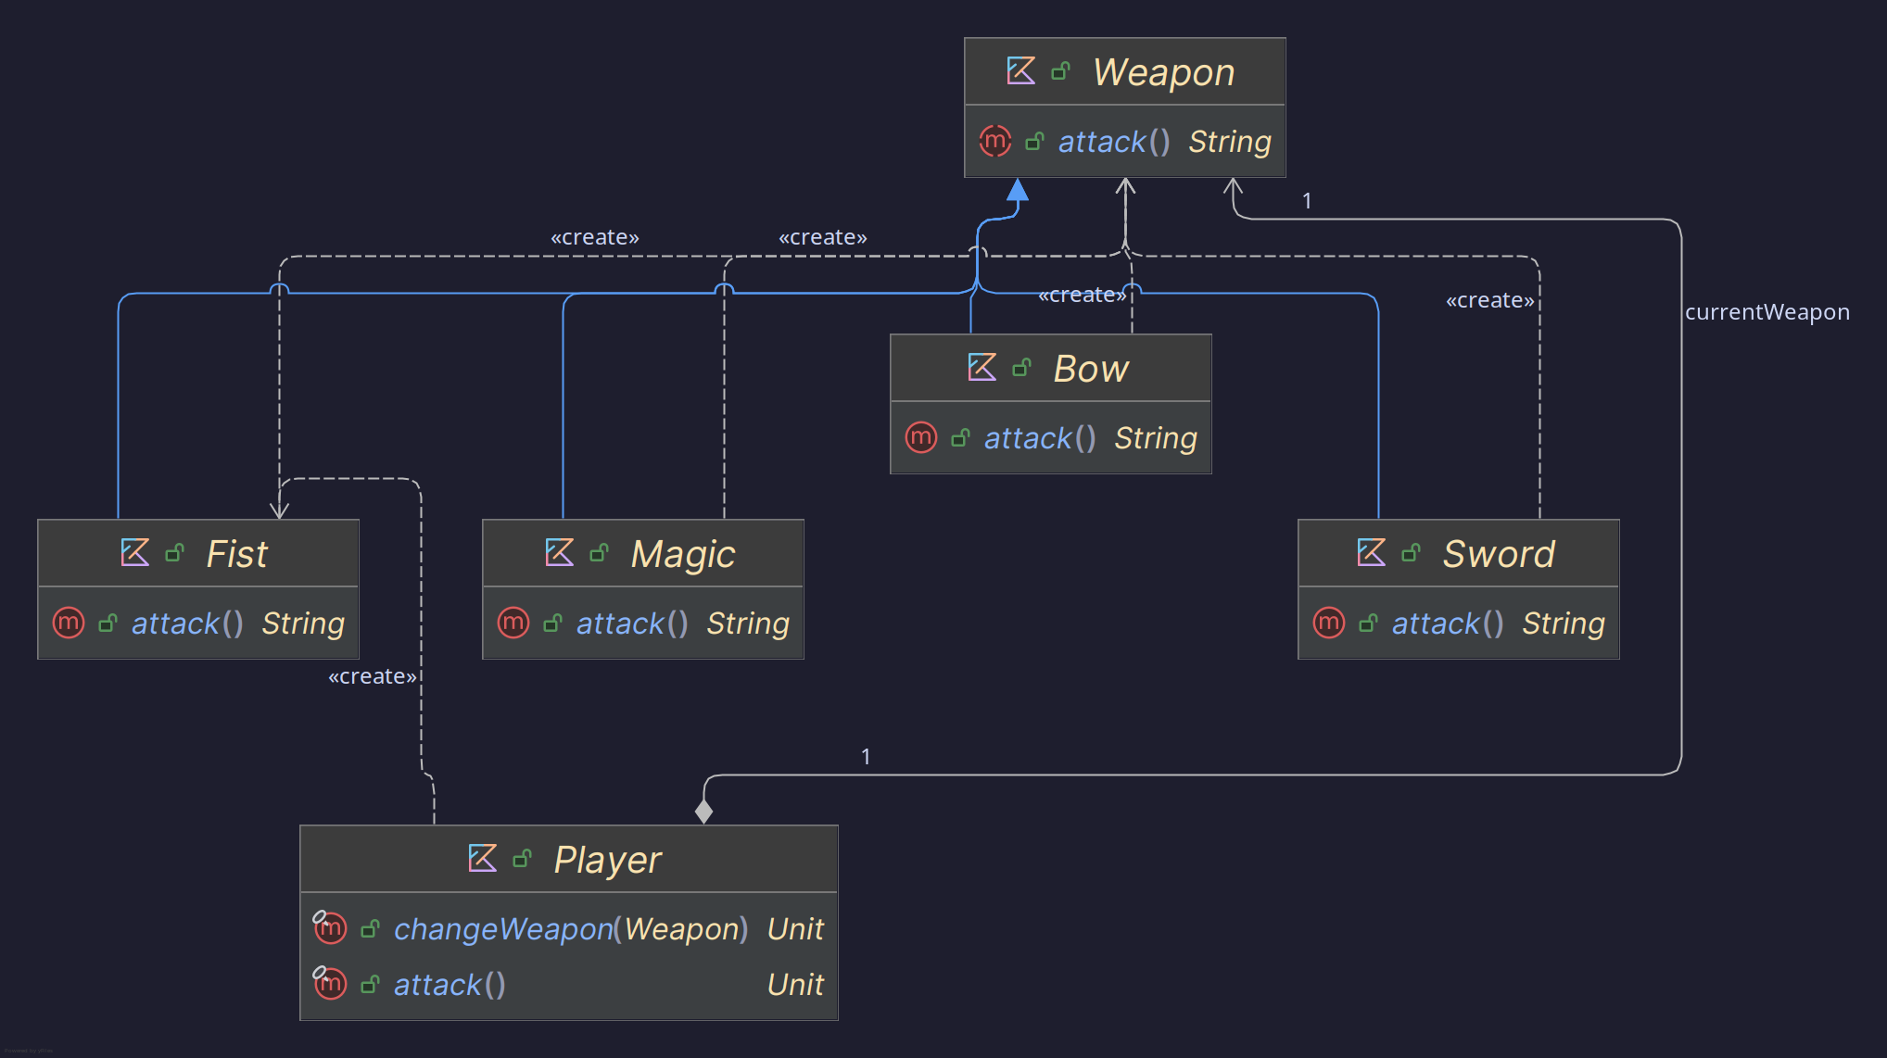
Strategy Pattern
Encapsulates interchangeable behaviors into separate classes, allowing the behavior of a class to be dynamically changed at runtime
Its key feature is the promotion of flexibility
Ideal for situation where:
Multiple algorithms exists
The system needs to choose or switch dynamically
State Pattern
Differences

Slide 7
Strategy Pattern
UML Diagram example
Strategy Pattern
State Pattern
Differences

Slide 8
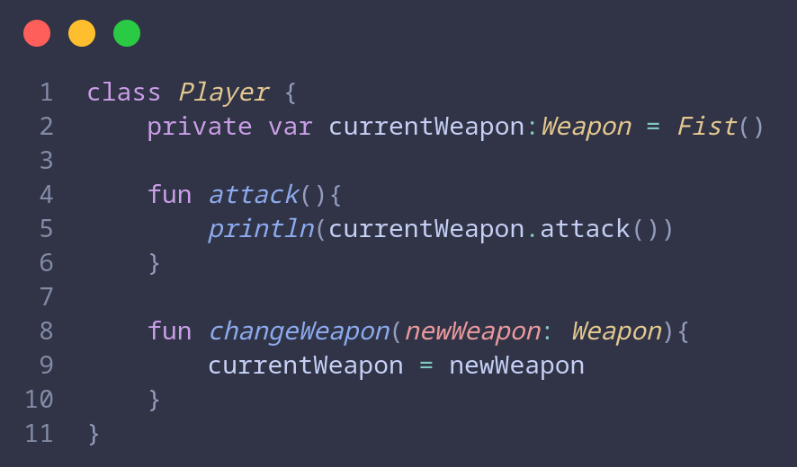
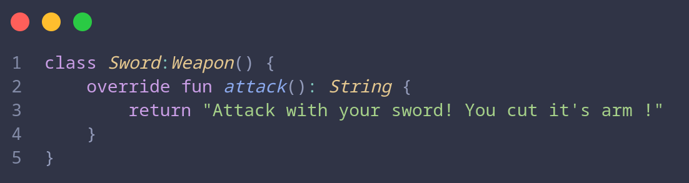
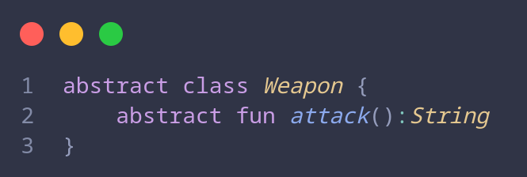
Strategy Pattern
State Pattern
Differences
Strategy Pattern

Slide 9
Summary
Allows an object to alter its behavior when its internal state changes, appearing to change its class
Strategy Pattern
State Pattern
Differences

Slide 10
State Pattern
Allows an object to alter its behavior when its internal state changes, appearing to change its class
Strategy Pattern
Differences

Slide 11
State Pattern
Allows an object to alter its behavior when its internal state changes, appearing to change its class
Key features:
Encapsulates state-specific behavior
Code easier to extend and maintain
Strategy Pattern
Differences

Slide 12
State Pattern
Allows an object to alter its behavior when its internal state changes, appearing to change its class
Key features:
Encapsulates state-specific behavior
Code easier to extend and maintain
Strategy Pattern
Useful when an object's behavior depends on its current state (Idle, Active, Paused)
Differences

Slide 13
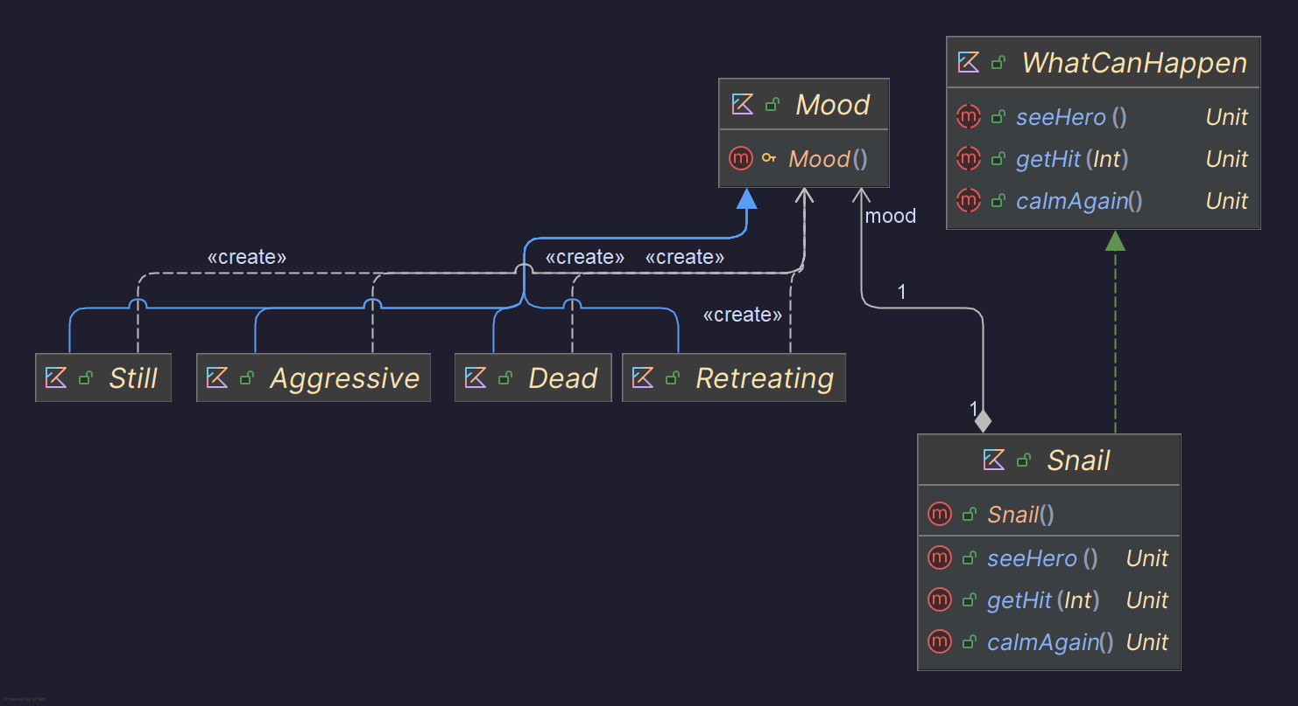
State Pattern
Strategy Pattern
Differences
UML Diagram example

Slide 14
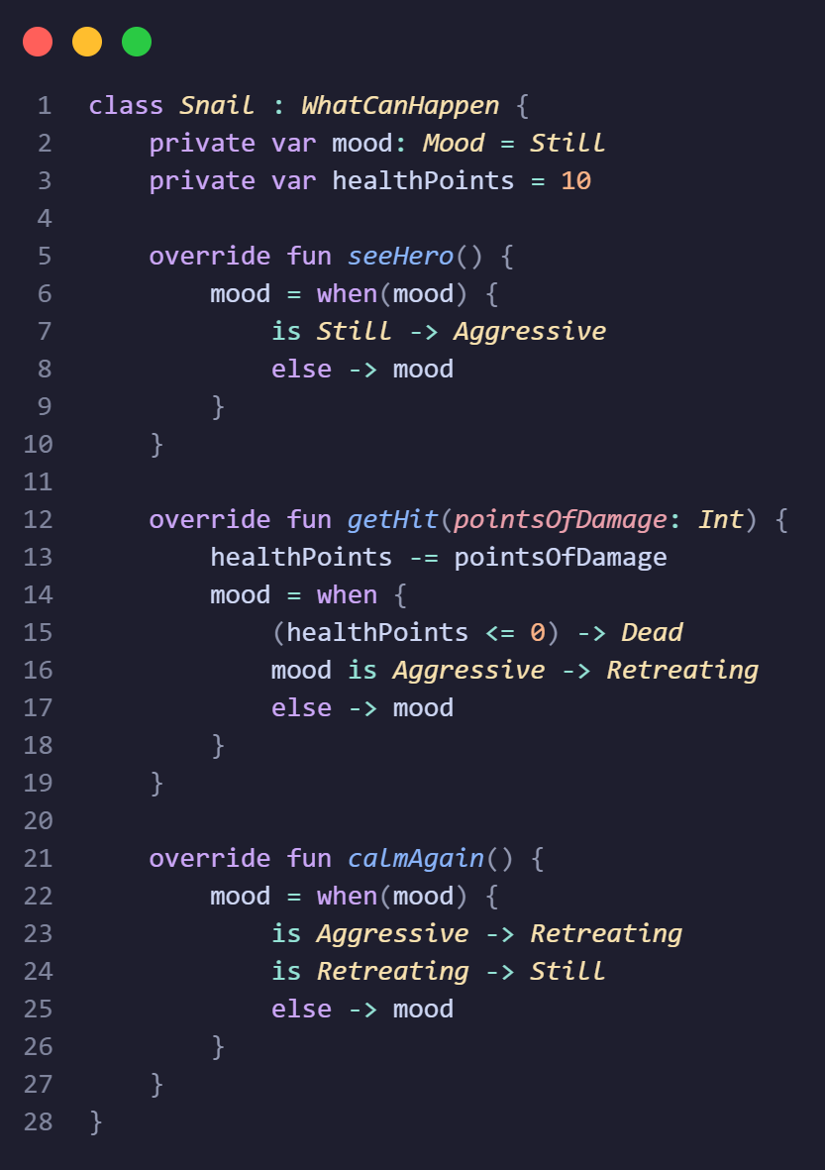
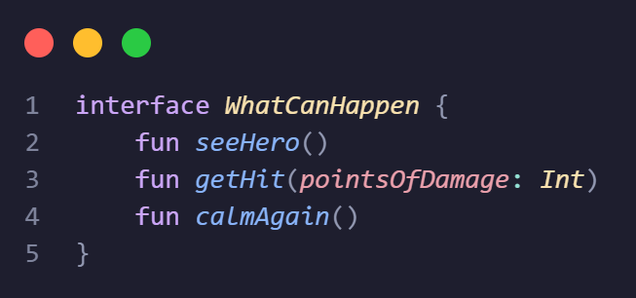
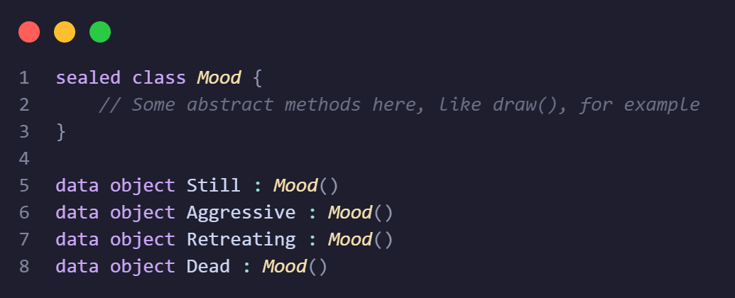
State Pattern
Strategy Pattern
State Pattern
Differences

Slide 15
Summary
Allows an object to alter its behavior when its internal state changes, appearing to change its class
Strategy Pattern
State Pattern
Differences

Slide 16
Differences
 | State | Strategy
Context relationship | Context holds a reference to the current state. | Context uses one of the strategies to perform an operation.
Implementation | State classes can transition between each other. | Strategies do not manage or know about each other.
Change Trigger | Changes occur based on the state transitions (internal logic). | Changes are determined externally, often at runtime.
Dynamic Behavior | Focuses on managing behavioral changes over time. | Focuses on behavioral selection based on input or configuration.
Strategy Pattern
State Pattern

Slide 17
Differences
 | State | Strategy
Context relationship | Context holds a reference to the current state. | Context uses one of the strategies to perform an operation.
Implementation | State classes can transition between each other. | Strategies do not manage or know about each other.
Change Trigger | Changes occur based on the state transitions (internal logic). | Changes are determined externally, often at runtime.
Dynamic Behavior | Focuses on managing behavioral changes over time. | Focuses on behavioral selection based on input or configuration.
Strategy Pattern
State Pattern

Slide 18
Differences
 | State | Strategy
Context relationship | Context holds a reference to the current state. | Context uses one of the strategies to perform an operation.
Implementation | State classes can transition between each other. | Strategies do not manage or know about each other.
Change Trigger | Changes occur based on the state transitions (internal logic). | Changes are determined externally, often at runtime.
Dynamic Behavior | Focuses on managing behavioral changes over time. | Focuses on behavioral selection based on input or configuration.
Strategy Pattern
State Pattern

Slide 19
Differences
 | State | Strategy
Context relationship | Context holds a reference to the current state. | Context uses one of the strategies to perform an operation.
Implementation | State classes can transition between each other. | Strategies do not manage or know about each other.
Change Trigger | Changes occur based on the state transitions (internal logic). | Changes are determined externally, often at runtime.
Dynamic Behavior | Focuses on managing behavioral changes over time. | Focuses on behavioral selection based on input or configuration.
Strategy Pattern
State Pattern

Slide 20
 | Strategy | State
Ease to implement | require the creation of multiple classe | very simple
Ease to maintain and upgrade | very easy to manage and re-use | become complexe the more state there is
When should you use it ? | in situation where the objects that compose the strategy will be extensively used | in situation where there is a defined amount of state which won't evolve much
Quiz time

Slide 21
 | Strategy | State
Ease to implement | require the creation of multiple classe | very simple
Ease to maintain and upgrade | very easy to manage and re-use | become complexe the more state there is
When should you use it ? | in situation where the objects that compose the strategy will be extensively used | in situation where there is a defined amount of state which won't evolve much
Quiz time
What is the type of design pattern that strategy and state pattern belong to?

Slide 22
 | Strategy | State
Ease to implement | require the creation of multiple classe | very simple
Ease to maintain and upgrade | very easy to manage and re-use | become complexe the more state there is
When should you use it ? | in situation where the objects that compose the strategy will be extensively used | in situation where there is a defined amount of state which won't evolve much
Quiz time
What is the type of design pattern that strategy and state pattern belong to?
The strategy and state pattern are behavior pattern.

Slide 23
 | Strategy | State
Ease to implement | require the creation of multiple classe | very simple
Ease to maintain and upgrade | very easy to manage and re-use | become complexe the more state there is
When should you use it ? | in situation where the objects that compose the strategy will be extensively used | in situation where there is a defined amount of state which won't evolve much
Quiz time
Which pattern have the changes determined externally, often at runtime?

Slide 24
Quiz time
Which pattern have the changes determined externally, often at runtime?
In the strategy pattern, changes are determinate externally, often at runtime.

Slide 25
Quiz time
How can the State pattern be perceived?.

Slide 26
Quiz time
How can the State pattern be perceived?.
It can be seen as an opinionated version of the Strategy pattern.

Slide 27
Thank you for your attentions
Sources :
Kotlin Design Patterns and Best Practices by Alexey Soshin
https://refactoring.guru/fr/design-patterns for the images

