Slide 1
CAPSTONE • MACHINE LEARNING FOR CONSUMER BEHAVIOR
WHEN CUSTOMERS ACT UNEXPECTEDLY
Mengurai misteri premi naik, churn tertunda, dan akuisisi yang melonjak.
Dari ANOMALI → HIPOTESIS → DATA → MODEL → INSIGHT → KEPUTUSAN
Materi + eksperimen Python + visualisasi + evaluasi bisnis
PROFESSIONAL ML WORKSHOP • SYNTHETIC DATA
01

Slide 2
INSURANCE BEHAVIOR LAB
The business paradox
01 PREMI +10%
02 CHURN MENDADAK
03 AKUISISI ANEH
Premi bulanan dinaikkan; pelanggan tidak langsung berhenti. Mengapa?
Beberapa bulan kemudian tingkat non-renewal melonjak. Apa sinyal sebelumnya?
Campaign sepi, tetapi di waktu lain pendaftaran meningkat. Faktor apa yang hilang?
Pertanyaan inti: bisa memprediksi siapa/kapankah, dan bisakah membuktikan penyebabnya?
PROFESSIONAL ML WORKSHOP • SYNTHETIC DATA
02

Slide 3
INSURANCE BEHAVIOR LAB
Learning outcomes | kemampuan peserta
•
Merumuskan masalah bisnis menjadi target supervised / unsupervised / time-series.
•
Membangun customer-month dataset dan label churn tanpa data leakage.
•
Menjalankan EDA cohort, renewal, premium sensitivity dan change-point analysis.
•
Melatih baseline dan model ML, menguji secara out-of-time, serta memilih metrik tepat.
•
Menerjemahkan probabilitas menjadi prioritas retention dan eksperimen bisnis.
PROFESSIONAL ML WORKSHOP • SYNTHETIC DATA
03

Slide 4
INSURANCE BEHAVIOR LAB
Learning path | 8 tahap end-to-end
01
02
03
04
Business framing
→
Data audit
→
EDA & cohort
→
Label & feature
01
02
03
04
Modeling
→
Validation
→
Explainability
→
Decision & monitor
Setiap tahap menghasilkan artefak yang dinilai: problem brief, dataset, visual, model, score, dan action plan.
PROFESSIONAL ML WORKSHOP • SYNTHETIC DATA
04

Slide 5
INSURANCE BEHAVIOR LAB
Rencana 4 sesi | 12 jam
SESI 1 • 3 JAM
SESI 2 • 3 JAM
Business framing, data dictionary, EDA anomaly, cohort & hypothesizing.
Target definition, time split, missing values, leakage, baseline.
SESI 3 • 3 JAM
SESI 4 • 3 JAM
Logistic Regression vs tree-based ML, PR-AUC, lift, diagnostics.
Interpretation, causal testing, retention playbook, final pitch.
PROFESSIONAL ML WORKSHOP • SYNTHETIC DATA
05

Slide 6
INSURANCE BEHAVIOR LAB
Kerangka bisnis: 3 pertanyaan ≠ 1 model
CHURN / RETENTION
ACQUISITION / DEMAND
SEGMENT / PATTERN
Unit: customer × month
Target: cancel / lapse dalam 30 atau 60 hari
Model: classification / survival
Unit: region × product × week
Target: new policies / lead conversion
Model: forecasting / count / uplift
Unit: customer atau cohort
Target: tidak ada label
Model: clustering / change point
Jangan melatih satu classifier lalu mengklaim ia menjelaskan ketiga fenomena tersebut.
PROFESSIONAL ML WORKSHOP • SYNTHETIC DATA
06

Slide 7
INSURANCE BEHAVIOR LAB
Causal map | apa yang mungkin tersembunyi?
01
02
03
04
Tekanan ekonomi
→
Kemampuan bayar
→
Late payment
→
Churn
01
02
03
04
Persepsi nilai
→
Kebutuhan proteksi
→
Word-of-mouth
→
New policies
Premi, masa kontrak, klaim, pengalaman layanan dan campaign dapat memengaruhi jalur-jalur di atas.
Korelasi / feature importance tidak membuktikan sebab-akibat. Data eksternal & eksperimen diperlukan.
PROFESSIONAL ML WORKSHOP • SYNTHETIC DATA
07

Slide 8
INSURANCE BEHAVIOR LAB
Dataset latihan | granularitas dan struktur
POLICY-MONTH FACT
ACQUISITION-MONTH FACT
customer_id · month · active
Premium · product · region · tenure
Claim · complaint · late payment
Contact · renewal_window · stress_index
Label: churn_next_30d
month · campaign_active
inbound_leads · new_policies
Ideal production add-ons:
quote, website traffic, channel, competitor price, unemployment, Google Trends
Semua data pendamping bersifat sintetis; tidak merepresentasikan nasabah atau hasil perusahaan sebenarnya.
PROFESSIONAL ML WORKSHOP • SYNTHETIC DATA
08

Slide 9
INSURANCE BEHAVIOR LAB
Time and label design | no leakage
01
02
03
04
Snapshot T
→
Features ≤ T
→
Forecast window
→
Outcome T+30d
BENAR
SALAH
Keluhan yang tercatat sebelum scoring → fitur; lapse setelah scoring → label.
Alasan berhenti di akhir periode dimasukkan sebagai fitur untuk memprediksi berhenti.
Perhatikan keterlambatan data, grace period, renewal policy, dan overlapping customer windows.
PROFESSIONAL ML WORKSHOP • SYNTHETIC DATA
09

Slide 10
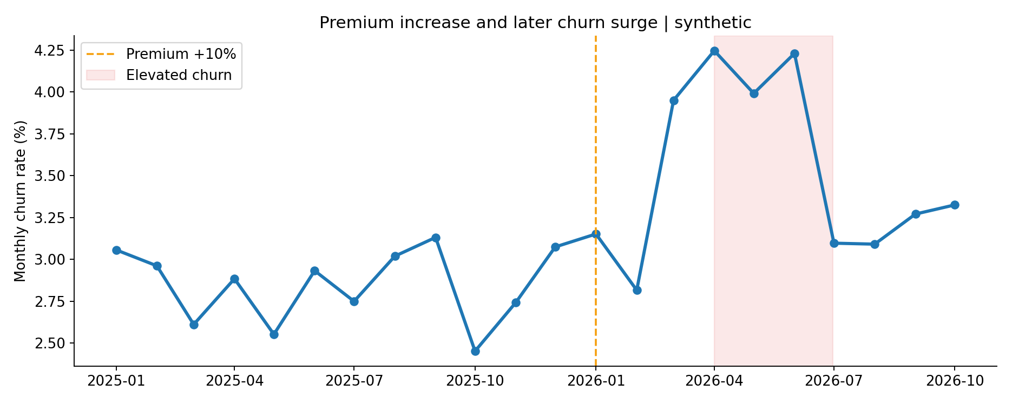
INSURANCE BEHAVIOR LAB
EDA 1 | kenaikan premi ≠ churn langsung
Interpretasi: periksa delay effect, renewal schedule, ketahanan pelanggan dan perubahan risiko ekonomi.
PROFESSIONAL ML WORKSHOP • SYNTHETIC DATA
10

Slide 11
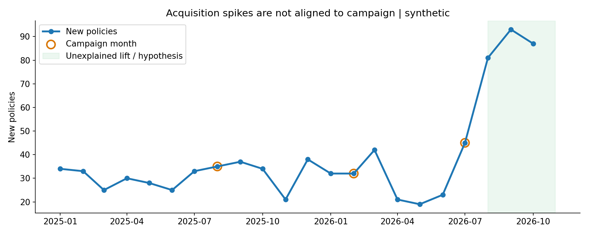
INSURANCE BEHAVIOR LAB
EDA 2 | campaign tidak selalu menjelaskan demand
Kenaikan akuisisi bisa dipengaruhi faktor yang tidak tercatat. Hindari mengklaim campaign menyebabkan spike.
PROFESSIONAL ML WORKSHOP • SYNTHETIC DATA
11

Slide 12
INSURANCE BEHAVIOR LAB
Analisis yang harus dikerjakan mahasiswa
•
Segmentasi: churn rate menurut product × income_band × tenure × region.
•
Cohort analysis: pelanggan masuk per bulan dan survival / retention-nya.
•
Event study: bandingkan trend sebelum/sesudah premi +10%, dengan kontrol jika tersedia.
•
Lag analysis: apakah complaint, pembayaran terlambat, dan renewal mendahului churn?
•
Acquisition decomposition: traffic × conversion × eligibility × product mix.
PROFESSIONAL ML WORKSHOP • SYNTHETIC DATA
12

Slide 13
INSURANCE BEHAVIOR LAB
Feature engineering | dari raw data ke sinyal
BEHAVIORAL
CONTEXT & CHANGE
late_payment_3m
complaint_90d
claim_frequency_6m
contact_recency_days
months_to_renewal
premium_change_pct
premium_to_income_ratio (jika tersedia)
macro_index_by_region
tenure_segment
rolling_churn_rate_3m
Setiap fitur harus dihitung hanya dari data yang tersedia pada waktu prediksi.
PROFESSIONAL ML WORKSHOP • SYNTHETIC DATA
13

Slide 14
INSURANCE BEHAVIOR LAB
Library dan development stack
CORE PYTHON
ADVANCED / OPTIONAL
Python 3.11+ · JupyterLab
numpy · pandas · matplotlib · seaborn
scikit-learn · scipy
pyarrow · joblib
shap · imbalanced-learn
statsmodels · lifelines
ruptures · xgboost
mlflow · evidently
Environment minimum: CPU 8 GB RAM. Tidak membutuhkan GPU untuk dataset sintetis ini.
PROFESSIONAL ML WORKSHOP • SYNTHETIC DATA
14

Slide 15
INSURANCE BEHAVIOR LAB
Pipeline modeling | simple before sophisticated
01
02
03
04
Temporal split
→
Preprocess
→
Logistic baseline
→
Random Forest
01
02
03
04
Predict proba
→
Compare PR-AUC
→
Top-decile lift
→
Decision threshold
Pilih model atas dasar data masa depan, kalibrasi, manfaat bisnis, fairness, dan kemampuan dijelaskan.
PROFESSIONAL ML WORKSHOP • SYNTHETIC DATA
15

Slide 16
INSURANCE BEHAVIOR LAB
Train / test | hindari random split
TRAIN: JAN 2025 – JAN 2026
OUT-OF-TIME: FEB – OCT 2026
Belajar dari periode lama.
Nasabah yang sama bisa memiliki banyak monthly snapshot.
Gunakan rolling backtest sebagai pengembangan.
Uji robustness setelah perubahan ekonomi dan harga.
Dalam produksi: tambah gap sesuai horizon label agar overlap tidak bocor.
Dataset demo memiliki target 30 hari yang disimulasikan; tanggal akhir dan observasi label harus dipastikan dalam data riil.
PROFESSIONAL ML WORKSHOP • SYNTHETIC DATA
16

Slide 17
INSURANCE BEHAVIOR LAB
Hasil eksperimen | kompleksitas bukan jaminan
METRIK
LOGISTIC REGRESSION
RANDOM FOREST
ROC-AUC
0.6073
0.5782
PR-AUC
0.0605
0.0520
Base churn rate
3.57%
3.57%
Data sintetis | ROC-AUC ≈ 0.6 masih lemah; model belum layak deployment tanpa improvement dan validasi.
PROFESSIONAL ML WORKSHOP • SYNTHETIC DATA
17

Slide 18
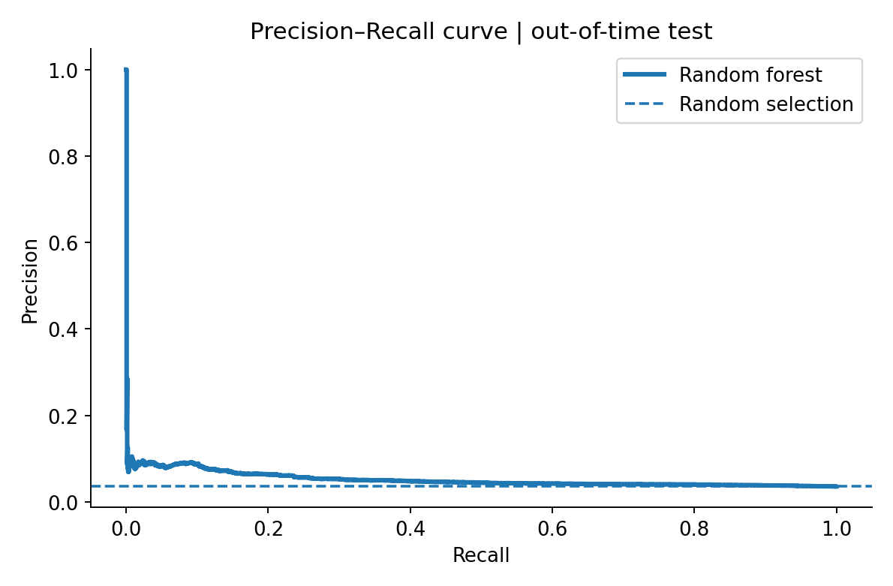
INSURANCE BEHAVIOR LAB
Precision–Recall | metrik untuk churn langka
MENGAPA PR-AUC?
Positive class hanya 3.57%.
Random baseline PR-AUC ≈ 0.0357.
Random Forest PR-AUC = 0.0520.
Evaluasi precision pada kapasitas kontak.
ROC-AUC boleh dilaporkan, namun PR-AUC, lift, calibration, dan cost-based utility lebih operasional.
PROFESSIONAL ML WORKSHOP • SYNTHETIC DATA
18

Slide 19
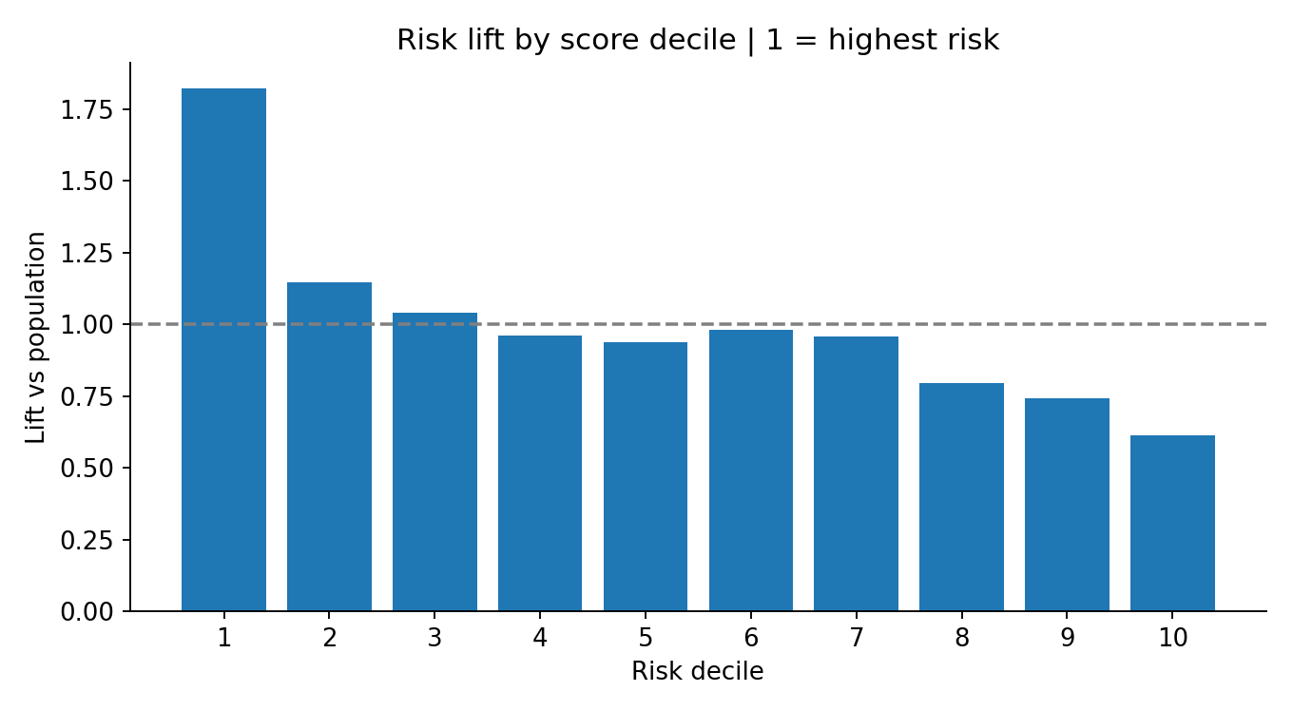
INSURANCE BEHAVIOR LAB
Decile lift | siapa yang dihubungi dulu?
TOP 10% RISIKO
Precision@10% = 6.51%
Recall@10% = 18.22%
Lift = 1.82× vs acak
Masih banyak false alarms.
Kapasitas call center, expected loss, dan biaya intervensi menentukan cutoff yang masuk akal.
PROFESSIONAL ML WORKSHOP • SYNTHETIC DATA
19

Slide 20
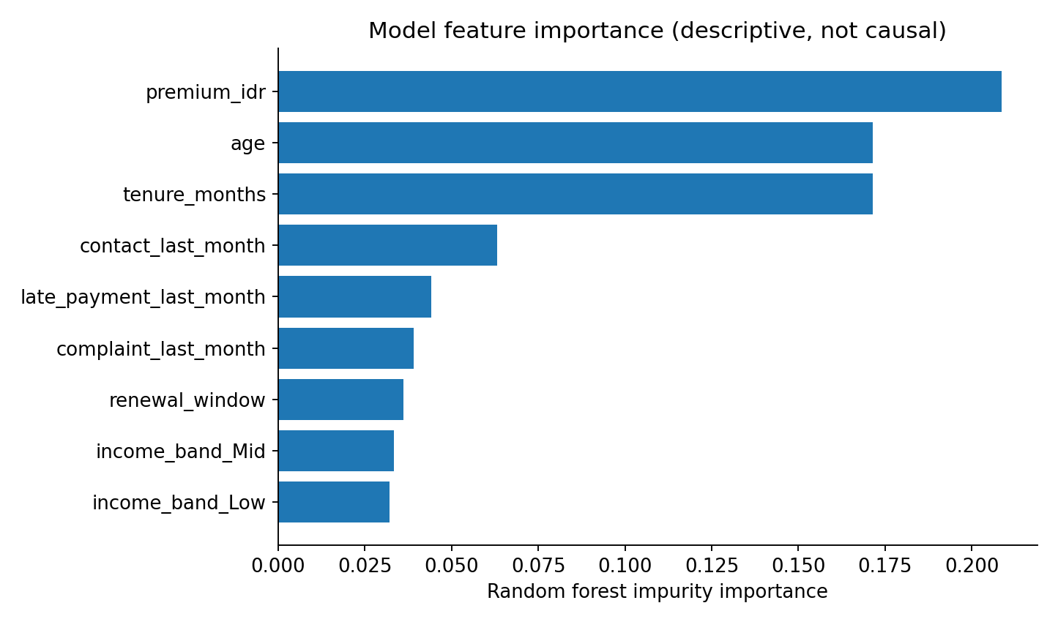
INSURANCE BEHAVIOR LAB
Model explanation | sinyal ≠ penyebab
BATAS INTERPRETASI
Importance menunjukkan variabel yang dipakai model, bukan dampak kebijakan.
Gunakan permutation importance / SHAP dan cek stability by cohort.
Feature importance jenis impurity bias terhadap variabel kontinu / high-cardinality.
PROFESSIONAL ML WORKSHOP • SYNTHETIC DATA
20

Slide 21
INSURANCE BEHAVIOR LAB
Mengapa premi +10% tidak langsung memicu churn?
•
Switching friction: proses pindah / berhenti membutuhkan usaha dan keputusan.
•
Renewal timing: harga berubah sekarang tetapi keputusan dibuat saat pembaruan.
•
Perceived value: proteksi dinilai lebih bernilai daripada kenaikan harga.
•
Delayed budget stress: dampak tekanan ekonomi baru muncul setelah beberapa bulan.
•
Survivorship / mix shift: sebagian cohort berisiko mungkin sudah keluar sebelumnya.
Semua poin adalah HIPOTESIS; perlu data tambahan dan pengujian, bukan jawaban pasti dari model.
PROFESSIONAL ML WORKSHOP • SYNTHETIC DATA
21

Slide 22
INSURANCE BEHAVIOR LAB
Mengapa churn tiba-tiba melonjak?
POTENTIAL SIGNALS
ANALYTICS TO TEST
Renewal cluster × payment difficulty
Complaint increase × unresolved cases
Income stress by geography
Channel / policy admin changes
Competitor offers
Rolling cohort retention
Segmented change-point detection
Lagged feature trends
Outlier investigation
Control group / difference-in-differences
Model hanya bisa melihat variabel yang dikumpulkan. Unknown unknowns memerlukan penelitian dan instrumentation.
PROFESSIONAL ML WORKSHOP • SYNTHETIC DATA
22

Slide 23
INSURANCE BEHAVIOR LAB
Mengapa akuisisi meningkat di luar campaign?
MODEL PREDIKSI AKUISISI
VALIDASI PENYEBAB
Weekly lead → policy funnel
Forecast by region/product/channel
Features: ad spend, search trends, seasonality, weather/event, competitor pricing
Monitor residual / anomaly
Instrument source attribution & referral
Cek organic search & word-of-mouth
Compare exposed vs holdout for campaign
Uji incrementality, jangan hanya mengaitkan waktu
Dataset acquisition demo hanya agregat bulanan; terlalu kecil untuk menyimpulkan penyebab atau membangun model andal.
PROFESSIONAL ML WORKSHOP • SYNTHETIC DATA
23

Slide 24
INSURANCE BEHAVIOR LAB
From prediction to business action
01
02
03
04
Risk score
→
Segment
→
Action policy
→
Controlled test
RETENTION
ACQUISITION
High risk + high CLV → assisted outreach; service recovery; renewal reminder.
Region with unexplained lift → investigate attribution; test incremental campaigns.
Success metric: incremental retention / net value, bukan sekadar semakin banyak orang diberi diskon.
PROFESSIONAL ML WORKSHOP • SYNTHETIC DATA
24

Slide 25
INSURANCE BEHAVIOR LAB
Economic decisioning | jangan optimasi AUC saja
NET EXPECTED BENEFIT
EXPERIMENT DESIGN
P(churn) × treatment effect × customer value
− treatment cost
− contact / operational cost
P(churn) tinggi tidak selalu berarti mudah diselamatkan.
Randomized control vs treatment
Measure incremental retention
Policy rules & compliance
Re-evaluate cost / uplift each period
Avoid protected-attribute discrimination
Prioritaskan uplift modeling setelah treatment data dan eksperimen memadai.
PROFESSIONAL ML WORKSHOP • SYNTHETIC DATA
25

Slide 26
INSURANCE BEHAVIOR LAB
Production ML | architecture
01
02
03
04
Policy & events
→
Validated features
→
Batch scoring
→
Risk table
01
02
03
04
CRM / agent
→
Controlled action
→
Observed outcomes
→
Drift monitoring
Prinsip: reproducibility, versioned model, logging, security/PII, and human approval for sensitive actions.
PROFESSIONAL ML WORKSHOP • SYNTHETIC DATA
26

Slide 27
INSURANCE BEHAVIOR LAB
Monitoring | 5 indikator wajib
•
Data quality: null rate, delayed feeds, duplicate IDs, schema changes.
•
Prediction quality: PR-AUC, precision@K, lift@K, calibration.
•
Population stability: PSI / distribution drift by month and region.
•
Business: incremental retained premium, complaint rate, conversion, action cost.
•
Governance: consent, privacy, explainability, fairness, model rollback.
PROFESSIONAL ML WORKSHOP • SYNTHETIC DATA
27

Slide 28
INSURANCE BEHAVIOR LAB
Practical lab | tugas kelompok
LAB 1 & 2
LAB 3 & 4
1. Buat data dictionary + EDA top 5 chart
2. Plot churn dan akuisisi timeline
3. Rumuskan minimal 5 hipotesis
4. Feature engineering dan audit leakage
5. Train baseline + tree classifier
6. Evaluasi temporal dan capacity@K
7. Jelaskan dua false positives
8. Usulkan 2 eksperimen bisnis
Output: notebook reproducible, model artifact, dashboard 1 halaman, dan pitch 5 menit.
PROFESSIONAL ML WORKSHOP • SYNTHETIC DATA
28

Slide 29
INSURANCE BEHAVIOR LAB
Assessment rubric | hasil akhir kelas
Business framing + hypothesis
20%
Data/label/leakage/EDA
25%
Validation + modeling
25%
Interpretation + action design
20%
Communication / reproducibility
10%
Bonus: calibration + confidence intervals + causal experiment design + survival modeling.
PROFESSIONAL ML WORKSHOP • SYNTHETIC DATA
29

Slide 30
INSURANCE BEHAVIOR LAB
Closing | 3 takeaways
PREDICT
EXPLAIN
ACT & LEARN
Siapa berpotensi churn, kapan, dan seberapa yakin?
Sinyal mana terkait risiko, dan faktor apa yang belum diobservasi?
Tindakan mana yang menciptakan manfaat incremental terbukti?
Good ML is not just accurate prediction—it is better, testable decision-making.
PROFESSIONAL ML WORKSHOP • SYNTHETIC DATA
30

