Slide 1
D. Y. Patil College of Engineering & Technology, Kolhapur.
Department of Computer Science & Engineering
Academic Year 2025-26
Elective-III (Block Chain Technology)
Topic 1-Introduction of Blockchain
Mrs.N.N.Patil(CSE)

Slide 2
Distributed database and Decentralized database
Distributed and decentralized databases are both designed to manage data across multiple locations, but they differ in architecture and control. Distributed databases coordinate data across several sites to appear as a single system, while decentralized databases remove central authority, distributing control and responsibility among all participants.
Distributed databases are common in large organizations needing unified data access with some central oversight.
Decentralized databases are favored in environments where trust, transparency, and resilience are critical, such as public blockchains or peer-to-peer networks
https://youtu.be/3ZACVZw2BXE?si=99rR1L-1t-O4swFh

Slide 3
Key Concepts and Differences
Feature | Distributed Database | Decentralized Database | Citations
Control | Managed by a central authority or coordinated system | No central authority; control is shared among nodes | 3427
Data Location | Data is spread across multiple sites, but appears unified to users | Data and control are both distributed; each node can operate independently | 3478
Fault Tolerance | Improved over centralized systems, but may still have single points of failure | High, as there is no single point of failure | 24810
Security & Trust | Relies on central coordination for security and consistency | Enhanced trust and transparency; security through consensus and distributed control | 2410
Performance & Scalability | Can be optimized for performance, but coordination overhead exists | May face scalability and performance challenges due to consensus mechanisms | 245
Example Technologies | Distributed SQL/NoSQL databases, sharded databases | Blockchain, peer-to-peer databases, DLT-based systems

Slide 4

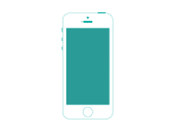
Distributed & Decentralized Network

Slide 5
Decentralized System
A decentralized system distributes control and decision-making across a network rather than relying on a single central authority
How It Works:
Each node (participant) has equal authority.
Decisions are made through consensus among participants.
Data is replicated and shared across all nodes.
Key Concepts:
No Single Point of Failure: The system keeps running even if one or more nodes fail.
Trust is Distributed: Trust is embedded in the protocol, not any one person or institution.
Data Integrity: Each node validates data independently.
Advantages:
Improved resilience and security
Censorship resistance — no one can unilaterally control the system
Enables global cooperation without intermediaries
Real-World Examples:
Blockchain (Bitcoin, Ethereum)
Peer-to-peer file sharing (BitTorrent)
Federated systems (Mastodon, Matrix)

Slide 6
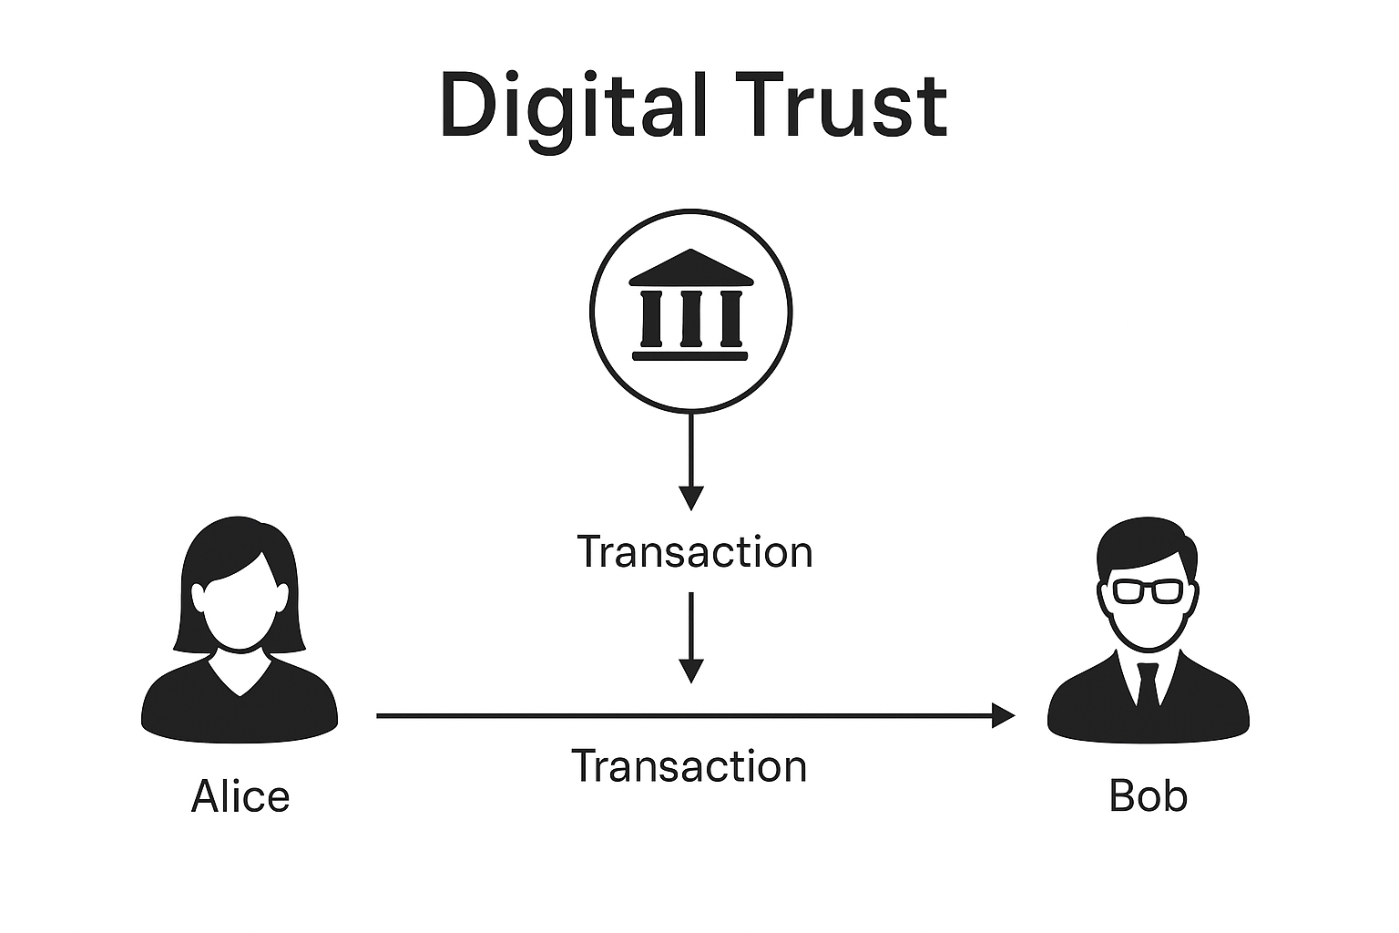

Slide 7
Removes dependency on centralized authorities
Enables peer-to-peer trust through technology
Builds trust using consensus mechanisms, not institutions
Example use case: Online transaction secured by blockchain instead of banks

Slide 8
What is Blockchain?
A blockchain is a shared ledger of data — e.g., transactions or code — that are batched into blocks, verified, and subsequently accepted as part of the blockchain by a network of distributed users through a consensus mechanism.
Because each block of verified data contains a unique signature of data from the previous block, they are inextricably linked together into a “block-chain.”
A network-based consensus mechanism is the way a blockchain protocol agrees on how its underlying technical architecture will operate.

Slide 9


Traditional Approach

Slide 10
Blockchain Approach

Slide 11
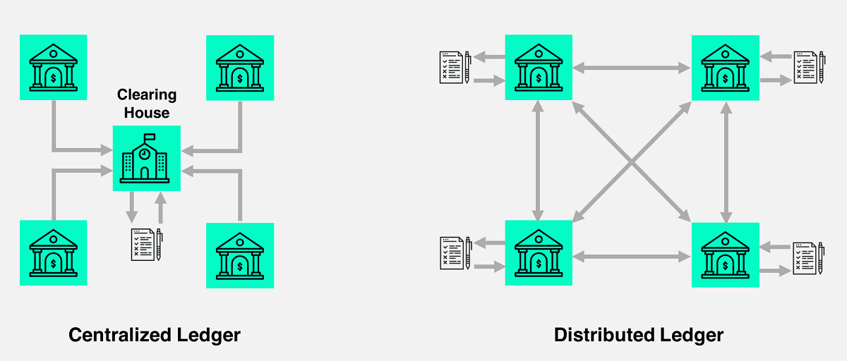

Slide 12
Why Blockchain?
Validate
Consensus
Developed Trust
Security
Immutable Record

Slide 13
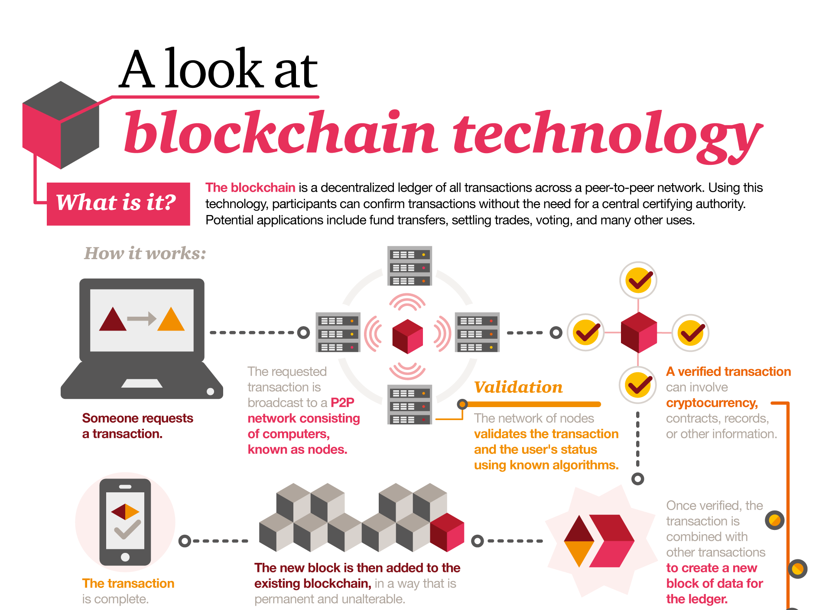

Slide 14
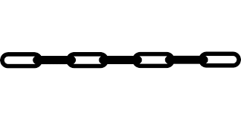
Blockchain Introduction
Basic Element is Transaction & its broadcast
Many transactions form block
Blocks will be validated before adding in chain
https://youtu.be/SSo_EIwHSd4?si=qA_vKyKLgXUNWkG_

Slide 15
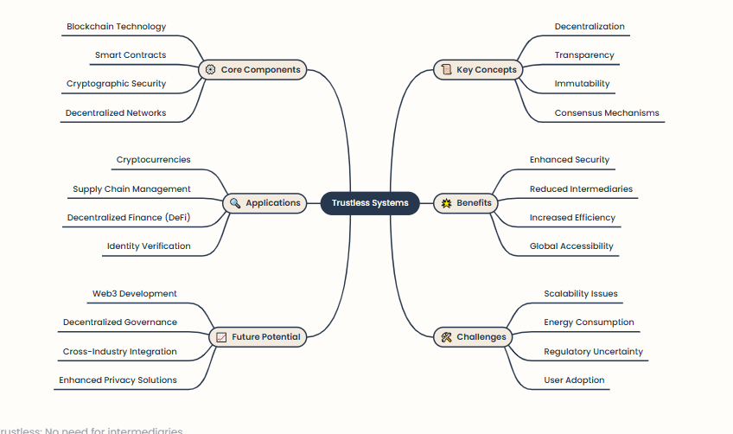

Slide 16
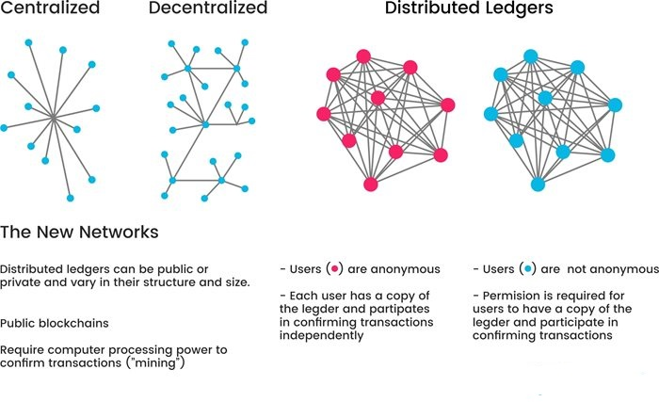
Network Types

Slide 17
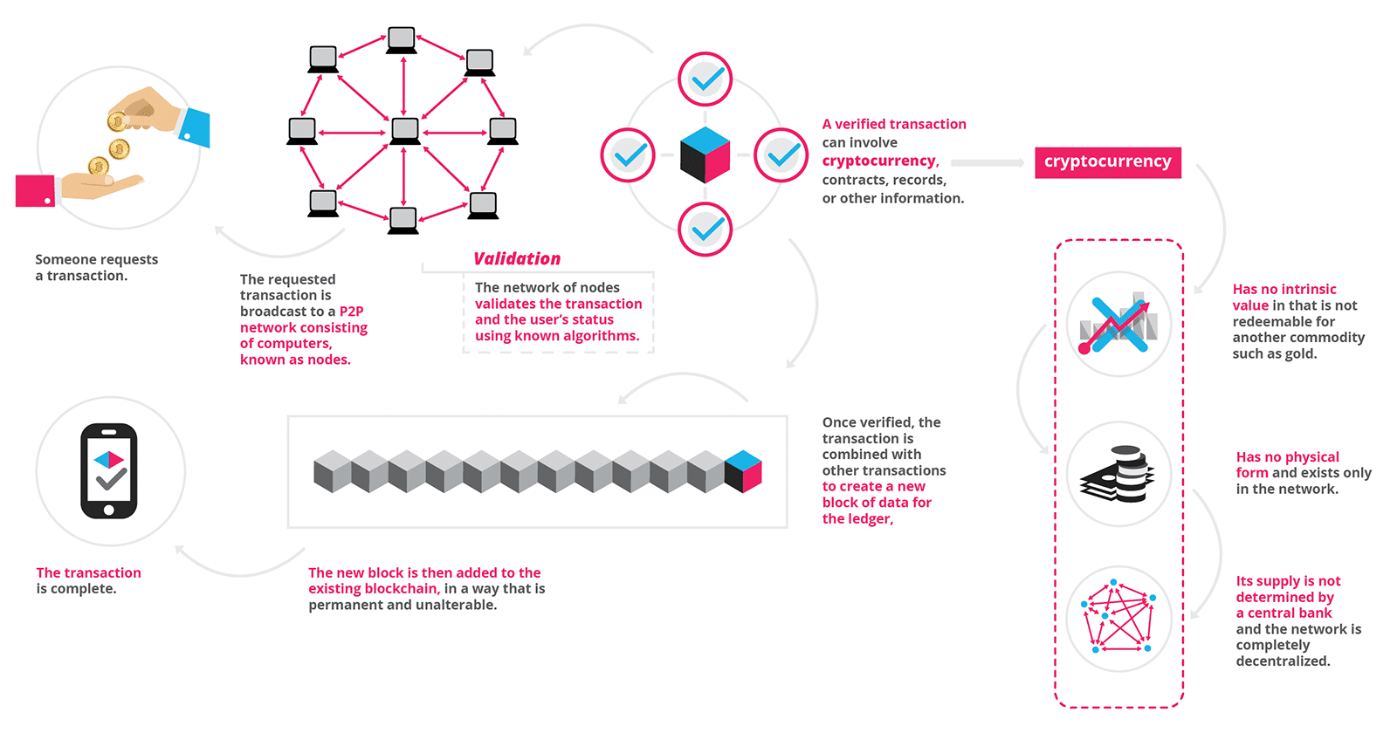
Highlights

Slide 18
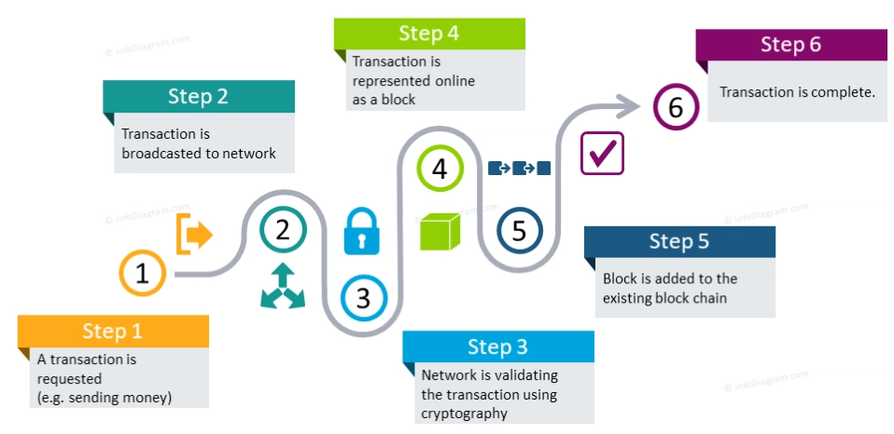
Highlights

Slide 19
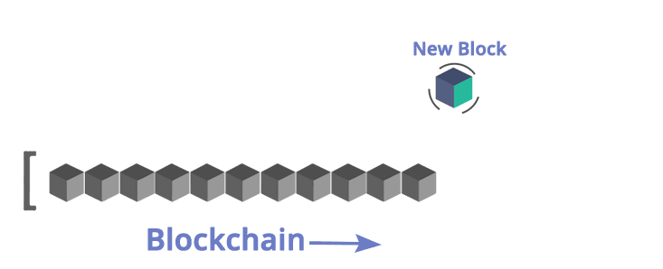
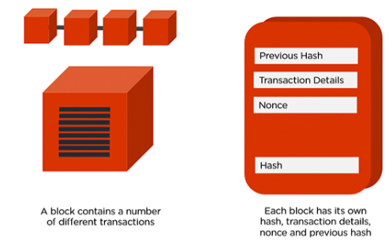
Highlights

Slide 20
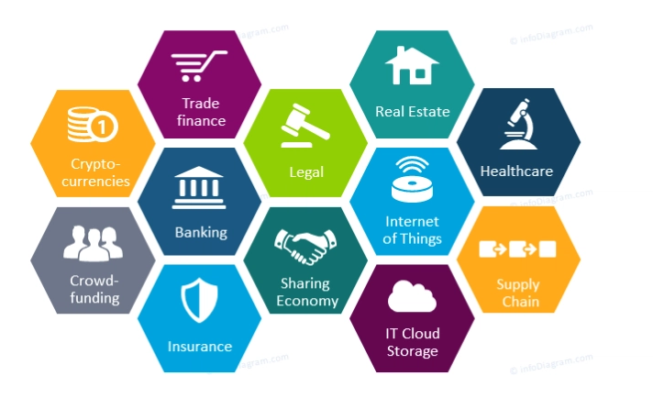
Applications

Slide 21
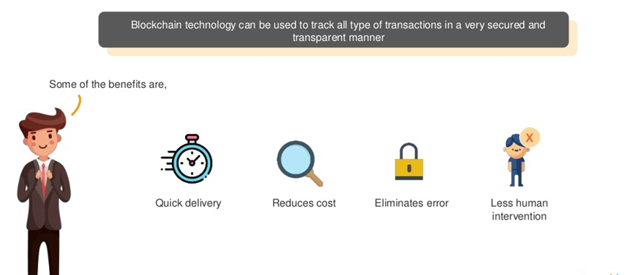
Supply Chain Management – After Blockchain

Slide 22
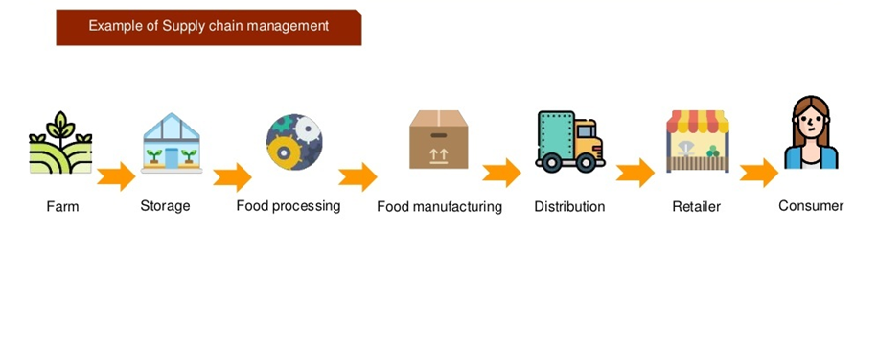
Supply Chain Management – After Blockchain

Slide 23
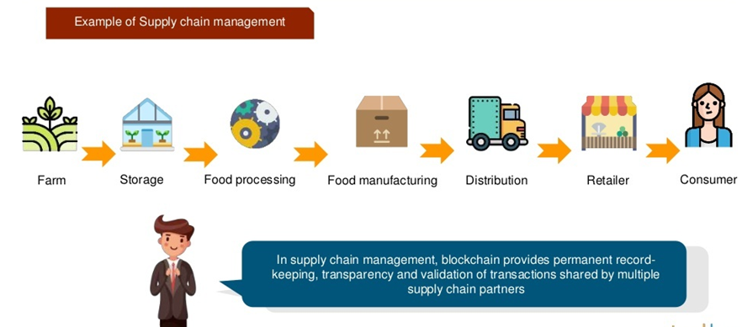
Supply Chain Management – After Blockchain

Slide 24
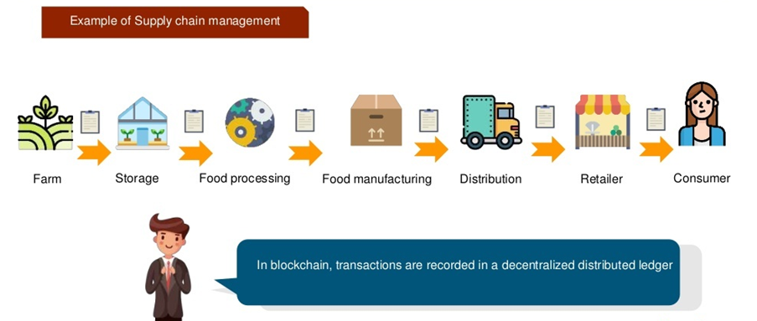
Supply Chain Management – After Blockchain

Slide 25
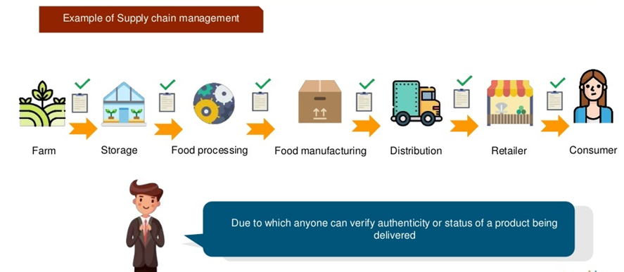
Supply Chain Management – After Blockchain

Slide 26
Supply Chain Problem
The supply chain industry has become much more complex.
The amount of time taken for a payment between a customer and a vendor, or a manufacturer and a supplier is notably long and tedious.
The products once received, are extremely hard to trace back to its supplier which in turn makes it difficult to eliminate defects in food products, consumer goods, industrial equipment or digital offerings.

Slide 27
Supply Chain Problem
The friction in this supply chain is a major problem since there are a lot of middlemen and this vast chain increases the uncertainty and stops the chain from working as desired.
A chain that is just a list of simple transactions turns into a lengthy procedure involving a high number of steps.

Slide 28
Problems in Political Systems
Elections. Democracies. Politics. It is an open secret that our political systems are imperfect.
In fact, one wouldn't hesitate to call them broken. The current system seems more and more dysfunctional and ineffective as the days pass because of the information that we receive from different sources.
With the increasing news of manipulations by the official authorities, in the process of counting votes or passing a law, the trust in the government has reached new lows in the recent times

Slide 29
Problems in Political Systems
The recent sessions of the governments in all the leading democracies have been amongst the least productive ones.
Certain news about the foreign and non-state actors with real power affecting the elections has shaken the pillars of trust the citizens had in the prevailing system of politics.
Majority of the people from all over the world are expressing their dissatisfaction and concern over the direction in which all the democracies are headed.

Slide 30
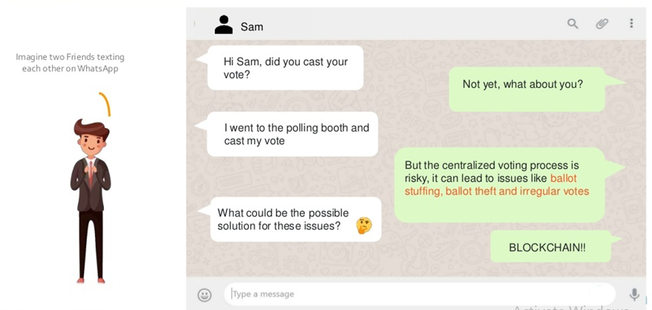
Before Blockchain –A problem in Political Systems

Slide 31
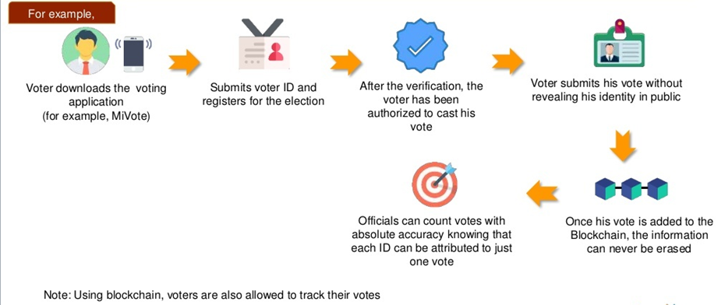
Political Systems – After Blockchain

Slide 32
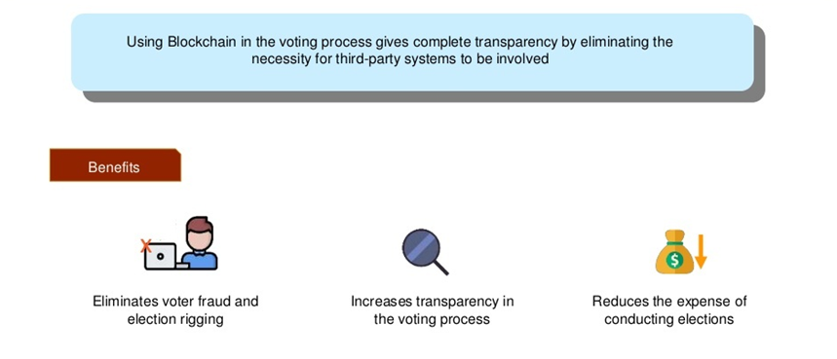
Political Systems – After Blockchain

Slide 33
Solution via Blockchain
Blockchain technology gives us a viable solution here. With its decentralized, selective and impenetrable storage of data, it also provides a perfect ledger to track the information.
With this feature, blockchain can replace anything where the humans are prone to make mistakes, and this is where the governments come to mind.
Voting could go digital with no scope of manipulation by any official authorities or foreign agents involved. All would be able to vote online, and it would be put on the blockchain ledgers on each computer in the blockchain.

Slide 34
Financial Technology Solution
The details of a user are held with the bank and an individual has no control over the security of their own information.
Authentication methods and secured transmission are the major issues faced by FinTech at the moment.
Ensuring the authenticity and identity of the person signing the documents, supervisory controls on the financial markets, transaction control, insurance claiming processes, etc. are some of the issues created due to the oversight of the Financial industry.

Slide 35
Financial Technology Solution
This is where blockchain comes in to solve all these problems.
With the application of blockchain in FinTech, all the data available will be decentralized.
All the transactions taking place will be authorized by the miners, making it immutable and unhackable.
With the help of the public ledger, all the transactions recorded will be on the chain and validate each other transaction, making it reliable and secure.

Slide 36
Financial Technology Solution
The blockchain technology will discard any third party trying to get a hold of the data and make it a peer-to-peer transaction, giving everyone complete control over their data security.
The transparency that an irreversible ledger provides would make financial operations smooth-running.
Moreover, the ability to create smart contracts would significantly decrease the possibility of defaulting on payments. This way blockchain would reinvent the way FinTech industry operates making it secure and stable than before.

