Slide 1
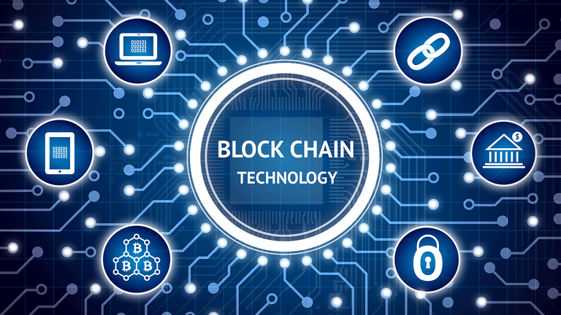
Features of Blockchain

Slide 2
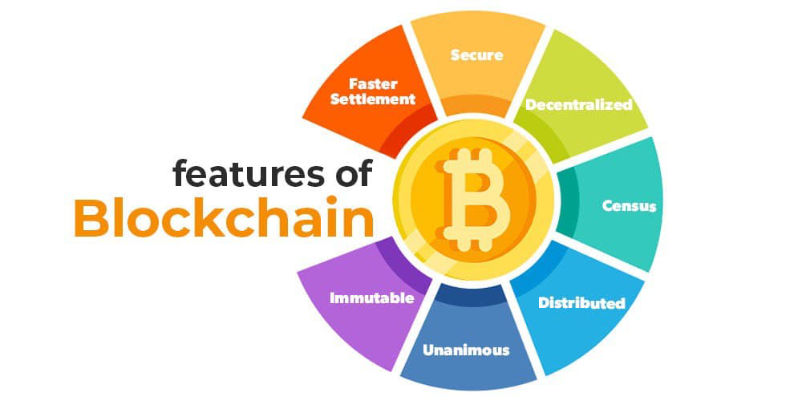
Features of blockchain

Slide 3
Immutable
Immutability means that the blockchain is a permanent and unalterable network.
Blockchain technology functions through a collection of nodes.
Once a transaction is recorded on the blockchain, it cannot be modified or deleted.
This makes the blockchain an immutable and tamper-proof ledger that provides a high degree of security and trust.
To add a transaction every node checks the validity of the transaction and if the majority of the nodes think that it is a valid transaction then it is added to the network. This means that without the approval of a majority of nodes no one can add any transaction blocks to the ledger.

Slide 4
Distributed
In distributed ledger tracking what’s happening in the ledger is easy as changes propagate really fast in a distributed ledger.
Every node on the blockchain network must maintain the ledger and participate in the validation.
Any change in the ledger will be updated in seconds or minutes and due to no involvement of intermediaries in the blockchain, the validation for the change will be done quickly.
If a user wants to add a new block then other participating nodes have to verify the transaction. For a new block to be added to the blockchain network it must be approved by a majority of the nodes on the network.
In a blockchain network, no node will get any sort of special treatment or favors from the network. Everyone will have to follow the standard procedure to add a new block to the network.

Slide 5
Decentralized
As a blockchain network does not depend on human calculations it is fully organized and fault-tolerant.
The blockchain network is less prone to failure due to the decentralized nature of the network. Attacking the system is more expensive for the hackers hence it is less likely to fail.
There is no third-party involved hence no added risk in the system.
The decentralized nature of blockchain facilitates creating a transparent profile for every participant on the network. Thus, every change is traceable, and more concreate.
Users now have control over their properties and they don’t have to rely on third-party to maintain and manage their assets.

Slide 6
Secure
All the records in the blockchain are individually encrypted.
Using encryption adds another layer of security to the entire process on the blockchain network. Since there is no central authority, it does not mean that one can simply add, update or delete data on the network.
Every information on the blockchain is hashed cryptographically which means that every piece of data has a unique identity on the network.
All the blocks contain a unique hash of their own and the hash of the previous block. Due to this property, the blocks are cryptographically linked with each other. Any attempt to modify the data means to change all the hash IDs which is quite impossible.

Slide 7
Consensus
Every blockchain has a consensus to help the network to make quick and unbiased decisions. Consensus is a decision-making algorithm for the group of nodes active on the network to reach an agreement quickly and faster and for the smooth functioning of the system.
Nodes might not trust each other but they can trust the algorithm that runs at the core of the network to make decisions. There are many consensus algorithms available each with its pros and cons.
Unanimous
All the network participants agree to the validity of the records before they can be added to the network. When a node wants to add a block to the network then it must get majority voting otherwise the block cannot be added to the network.
A node cannot simply add, update, or delete information from the network. Every record is updated simultaneously and the updations propagate quickly in the network. So it is not possible to make any change without consent from the majority of nodes in the network.
Faster Settlement
Traditional banking systems are prone to many reasons for fallout like taking days to process a transaction after finalizing all settlements, which can be corrupted easily. On the other hand, blockchain offers a faster settlement compared to traditional banking systems.

