Slide 1

Types Of Blockchain

Slide 2
Types Of Blocks
Genesis Block: First block of Blockchain
Valid Block: Already Mined by Miners and added to blockchain
Orphan Block: block that do not meet consensus

Slide 3
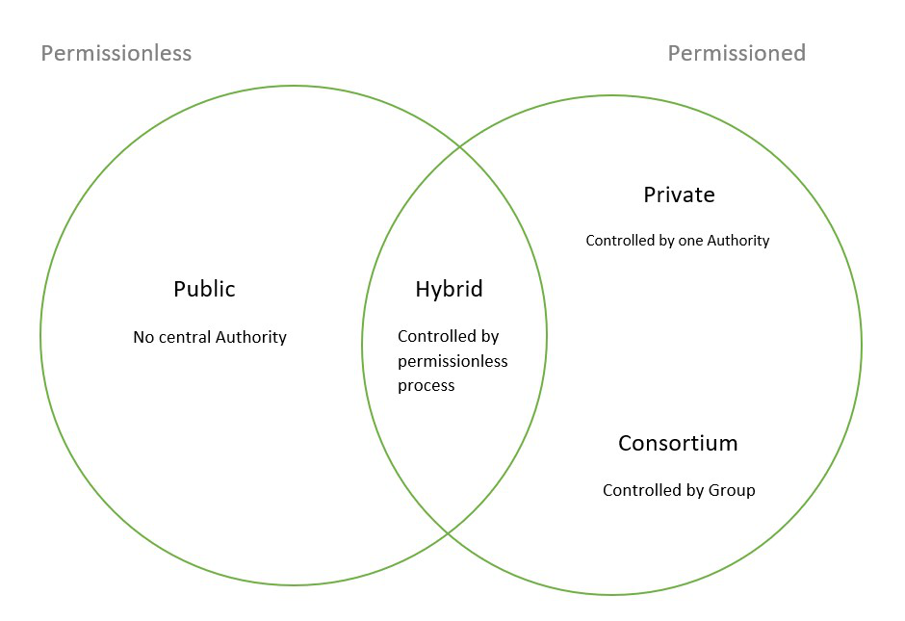
Types of Blockchain

Slide 4
Public Blockchain:
These blockchains are completely open to following the idea of decentralization.
They don’t have any restrictions, anyone having a computer and internet can participate in the network.
As the name is public this blockchain is open to the public, which means it is not owned by anyone.
Anyone having internet and a computer with good hardware can participate in this public blockchain.
All the computer in the network hold the copy of other nodes or block present in the network
In this public blockchain, we can also perform verification of transactions or records
Advantages:
Trustable: There are algorithms to detect no fraud. Participants need not worry about the other nodes in the network
Secure: This blockchain is large in size as it is open to the public. In a large size, there is greater distribution of records
Anonymous Nature: It is a secure platform to make your transaction properly at the same time, you are not required to reveal your name and identity in order to participate.
Decentralized: There is no single platform that maintains the network, instead every user has a copy of the ledger.

Slide 5
Disadvantages:
Processing: The rate of the transaction process is very slow, due to its large size. Verification of each node is a very time-consuming process.
Energy Consumption: Proof of work is high energy-consuming. It requires good computer hardware to participate in the network
Acceptance: No central authority is there so governments are facing the issue to implement the technology faster.
Use Cases: Public Blockchain is secured with proof of work or proof of stake they can be used to displace traditional financial systems. The more advanced side of this blockchain is the smart contract that enabled this blockchain to support decentralization. Examples of public blockchain are Bitcoin, Ethereum.

Slide 6
Private Blockchain:
These blockchains are not as decentralized as the public blockchain only selected nodes can participate in the process, making it more secure than the others.
These are not as open as a public blockchain.
They are open to some authorized users only.
These blockchains are operated in a closed network.
In this few people are allowed to participate in a network within a company/organization.
Advantages:
Speed: The rate of the transaction is high, due to its small size. Verification of each node is less time-consuming.
Scalability: We can modify the scalability. The size of the network can be decided manually.
Privacy: It has increased the level of privacy for confidentiality reasons as the businesses required.
Balanced: It is more balanced as only some user has the access to the transaction which improves the performance of the network.

Slide 7
Disadvantages:
Security- The number of nodes in this type is limited so chances of manipulation are there. These blockchains are more vulnerable.
Centralized- Trust building is one of the main disadvantages due to its central nature. Organizations can use this for malpractices.
Count- Since there are few nodes if nodes go offline the entire system of blockchain can be endangered.
Use Cases: With proper security and maintenance, this blockchain is a great asset to secure information without exposing it to the public eye. Therefore companies use them for internal auditing, voting, and asset management. An example of private blockchains is Hyperledger, Corda.

Slide 8
Hybrid/Consortium Blockchain
It is the mixed content of the private and public blockchain, where some part is controlled by some organization and other makes are made visible as a public blockchain.
It is a combination of both public and private blockchain.
Permission-based and permissionless systems are used.
User access information via smart contracts
Even a primary entity owns a hybrid blockchain it cannot alter the transaction
Advantages:
Ecosystem: Most advantageous thing about this blockchain is its hybrid nature. It cannot be hacked as 51% of users don’t have access to the network
Cost: Transactions are cheap as only a few nodes verify the transaction. All the nodes don’t carry the verification hence less computational cost.
Architecture: It is highly customizable and still maintains integrity, security, and transparency.
Operations: It can choose the participants in the blockchain and decide which transaction can be made public.

Slide 9
Disadvantages:
Efficiency: Not everyone is in the position to implement a hybrid Blockchain. The organization also faces some difficulty in terms of efficiency in maintenance.
Transparency: There is a possibility that someone can hide information from the user. If someone wants to get access through a hybrid blockchain it depends on the organization whether they will give or not.
Ecosystem: Due to its closed ecosystem this blockchain lacks the incentives for network participation.
Use Case: It provides a greater solution to the health care industry, government, real estate, and financial companies. It provides a remedy where data is to be accessed publicly but needs to be shielded privately. Examples of Hybrid Blockchain are Ripple network and XRP token.

Slide 10
Consortium Blockchain:
It is a creative approach that solves the needs of the organization. This blockchain validates the transaction and also initiates or receives transactions.
Also known as Federated Blockchain.
This is an innovative method to solve the organization’s needs.
Some part is public and some part is private.
In this type, more than one organization manages the blockchain.
Advantages:
Speed: A limited number of users make verification fast. The high speed makes this more usable for organizations.
Authority: Multiple organizations can take part and make it decentralized at every level. Decentralized authority, makes it more secure.
Privacy: The information of the checked blocks is unknown to the public view. but any member belonging to the blockchain can access it.
Flexible: There is much divergence in the flexibility of the blockchain. Since it is not a very large decision can be taken faster.

Slide 11
Disadvantages:
Approval: All the members approve the protocol making it less flexible. Since one or more organizations are involved there can be differences in the vision of interest.
Transparency: It can be hacked if the organization becomes corrupt. Organizations may hide information from the users.
Vulnerability: If few nodes are getting compromised there is a greater chance of vulnerability in this blockchain
Use Cases: It has high potential in businesses, banks, and other payment processors. Food tracking of the organizations frequently collaborates with their sectors making it a federated solution ideal for their use. Examples of consortium Blockchain are Tender mint and Multichain.

Slide 12
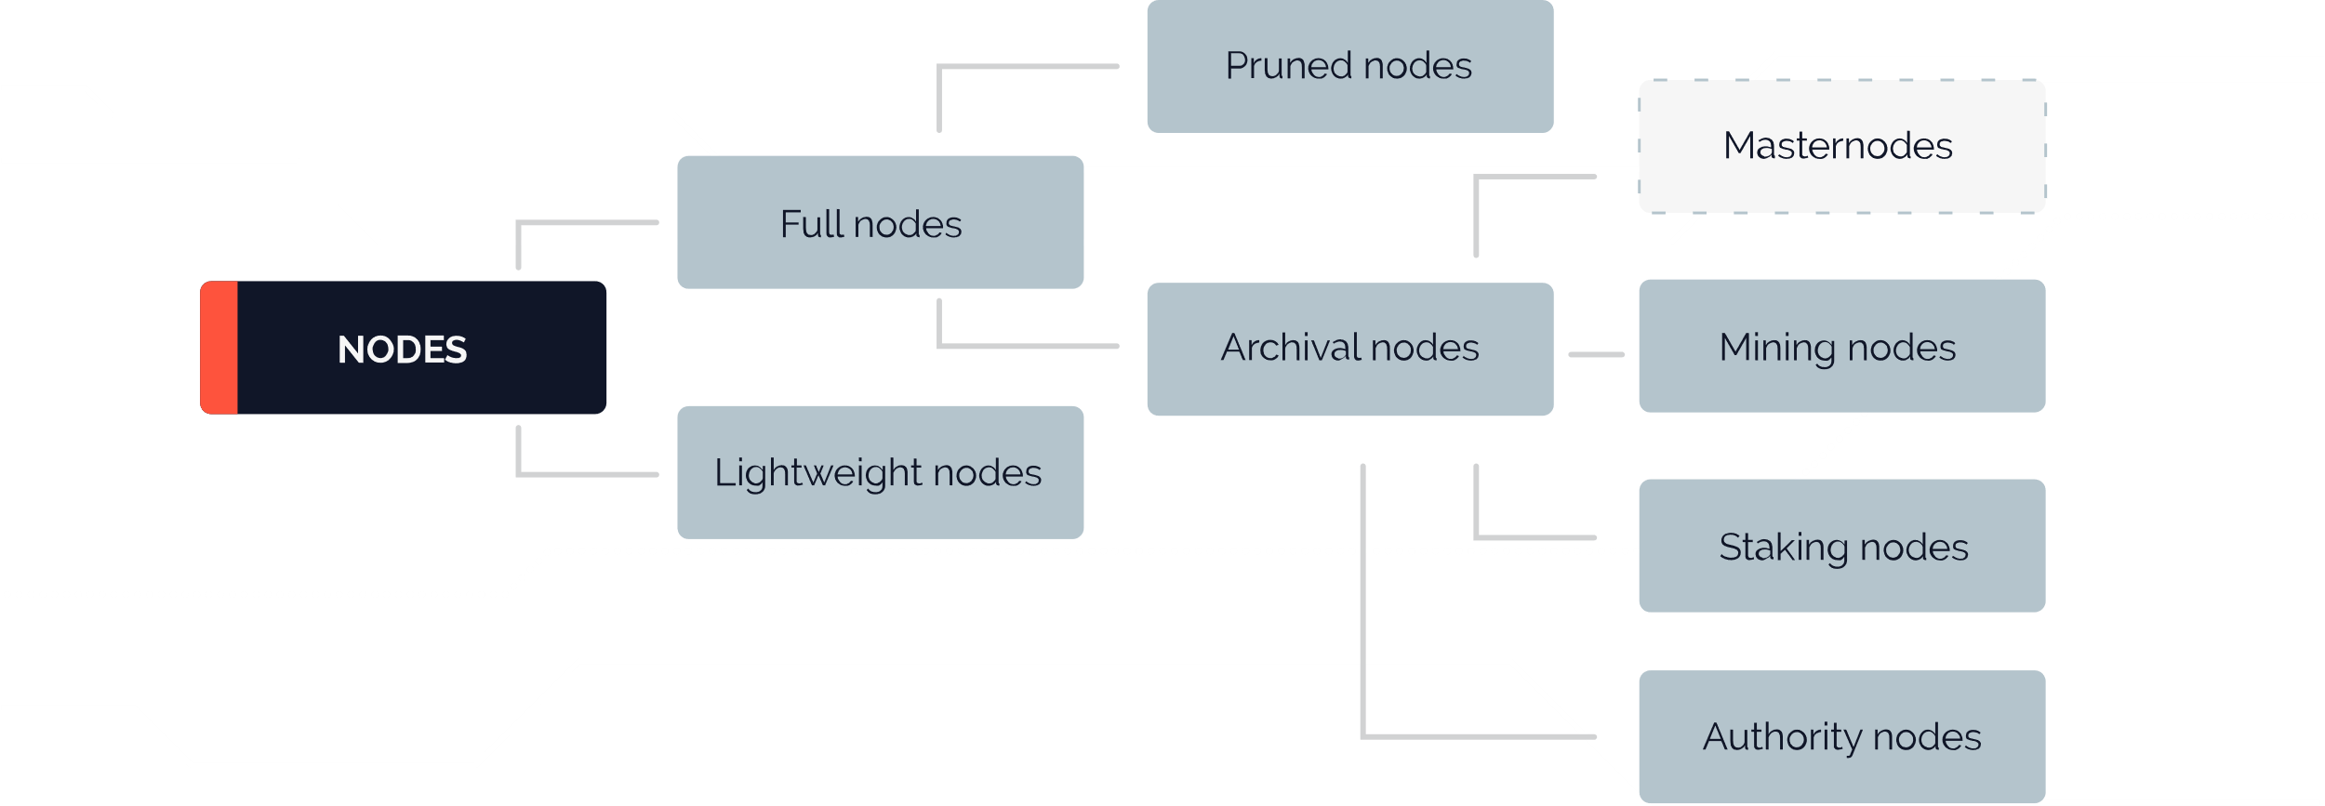
what a blockchain node?
there are two main types of nodes – Full nodes and Light nodes

Slide 13
Full Nodes
Full nodes serve as servers in decentralized networks, maintaining consensus and verifying transactions.
They store a secure blockchain copy and enable custom functions like instant send and private transactions.
If over 51% disagree, proposals are skipped,
leading to hard forks, such as the Bitcoin Cash Fork.

Slide 14
Pruned Full Node
The pruned full node downloads blocks from the beginning and deletes oldest ones after reaching a set limit, retaining only headers and chain placement.
This method requires validating previous blocks through the entire blockchain before storing the latest blocks.
Archival Full Node:
Archival full nodes are servers hosting the full blockchain, maintaining consensus and validating blocks.
They can be divided into subtypes, including those that add blocks and those that cannot.
The difference between pruned and archival nodes is their hard drive space usage.

Slide 15
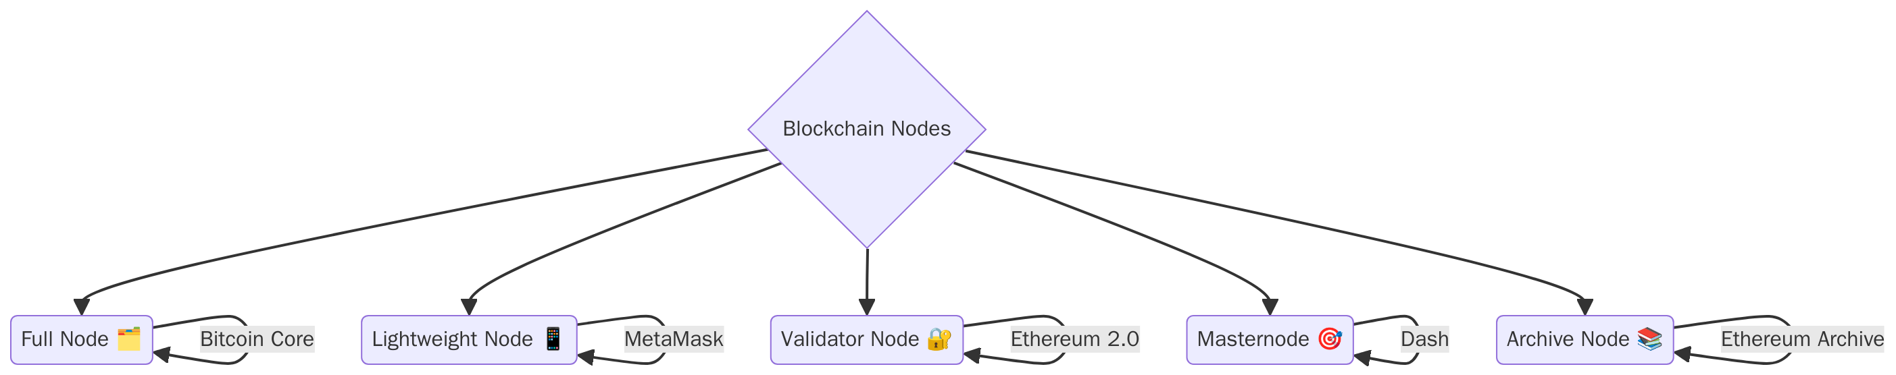
Main participants in the blockchain
Miners (Mining Nodes)
Stakers (Staking Nodes)
Authority Nodes

Slide 16
Lightweight (SPV) Nodes
Lightweight node or Simple Payment Verification (SPV) node,
These types of nodes communicate with the blockchain while relying on full nodes to provide them with the necessary information.
As they don’t store a copy of the chain, they only query the current status for which block is last, and broadcast transactions for processing.
Having in mind the above features, it’s clear to see that running SPV node doesn’t require many resources, but it does sacrifice security for the sake of convenience.

Slide 17
Master Nodes
Compared to full nodes, master nodes themselves cannot add blocks to the blockchain. Their only purpose is to keep a record of transactions and validate them.
Whether it will be miners or stakers
It Secure the network but can earn a share of the rewards for your services.

