Slide 1

Adidas Data Challenge
Raffi Sahakyan, ,Ezhilvel Malar Elangovan, Sharad Jain, Pranay Singla, Marina Makarova

Slide 2
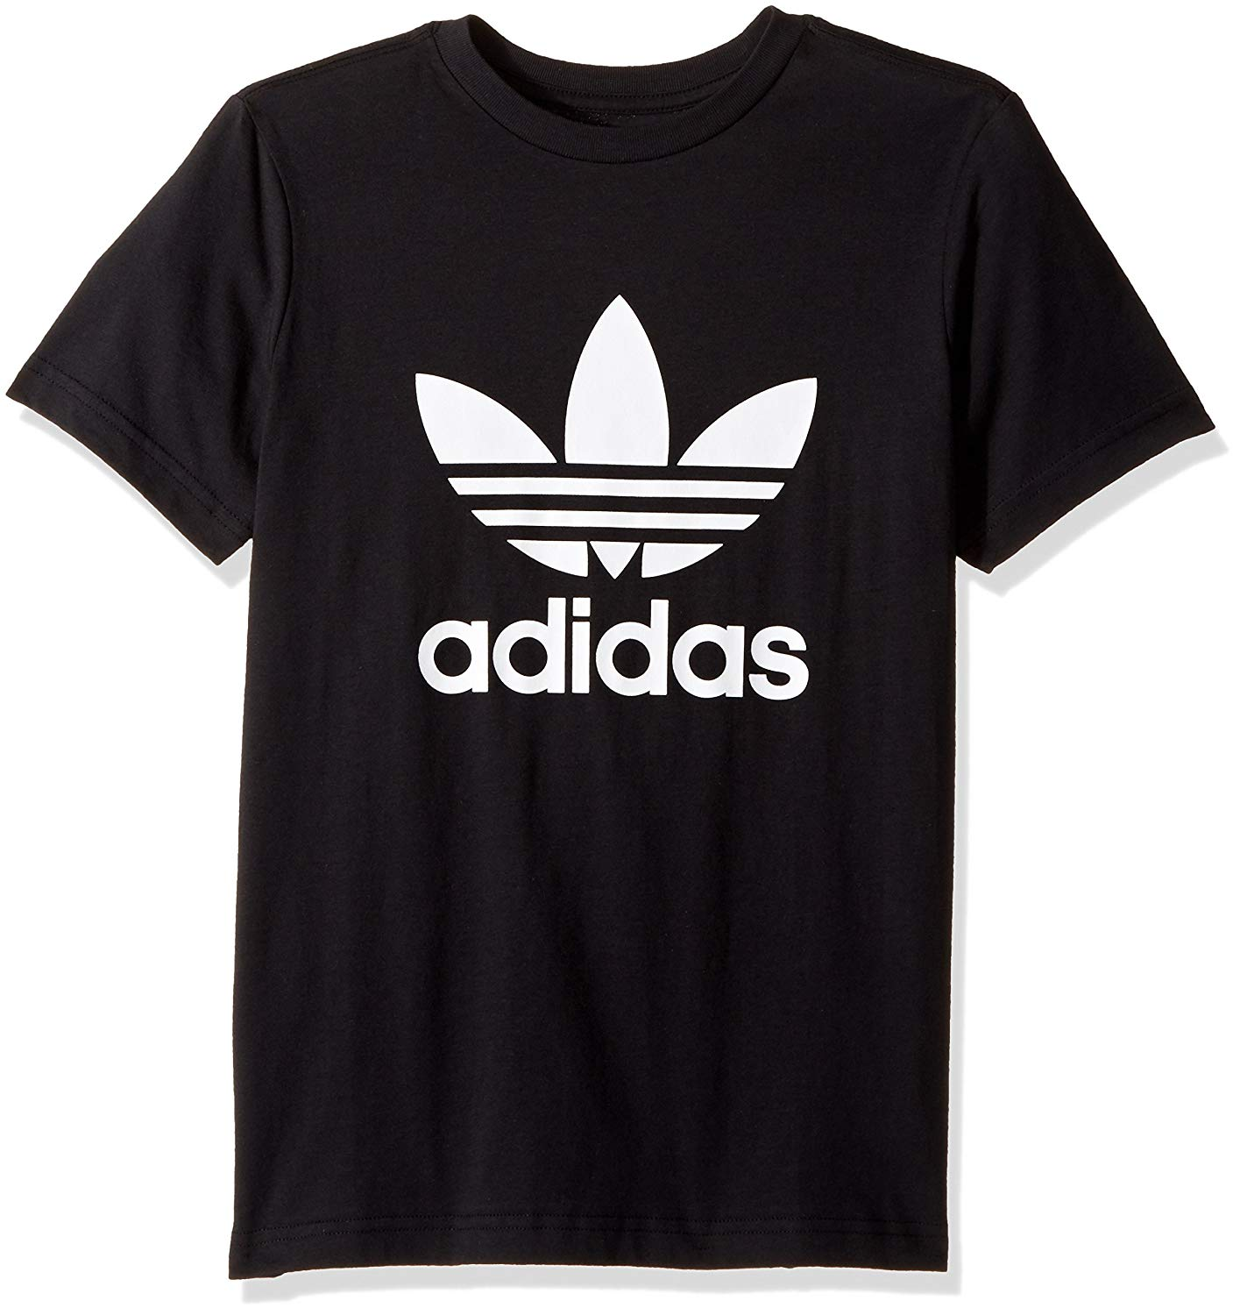


Super scale project goal
Unify the diverse sizing scales and help customers find best fit
Target product:
Adult male t-shirt
Target dimensions:
14 measurements were selected for modeling
Methodology:
Clustering and Optimization

Slide 3
Data cleaning
We selected 28 most relevant measurements and filtered out highly correlated ones
Survey measurements
Measurements related to the t-shirt size
Relevant features
Correlation < 0.85
Independent features

Slide 4
Modeling
Clustering was optimized using XXXX
Briefly describe methodology here: what clustering method, how you are optimizing (penalizing what), might be helpful to include viz

Slide 5
Results
For the male t-shirt category X sizes in super scale are optimal
Table with super scale as in the adidas presentation slides

