Slide 1


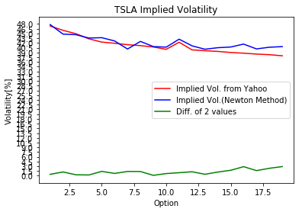
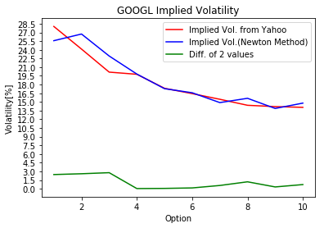
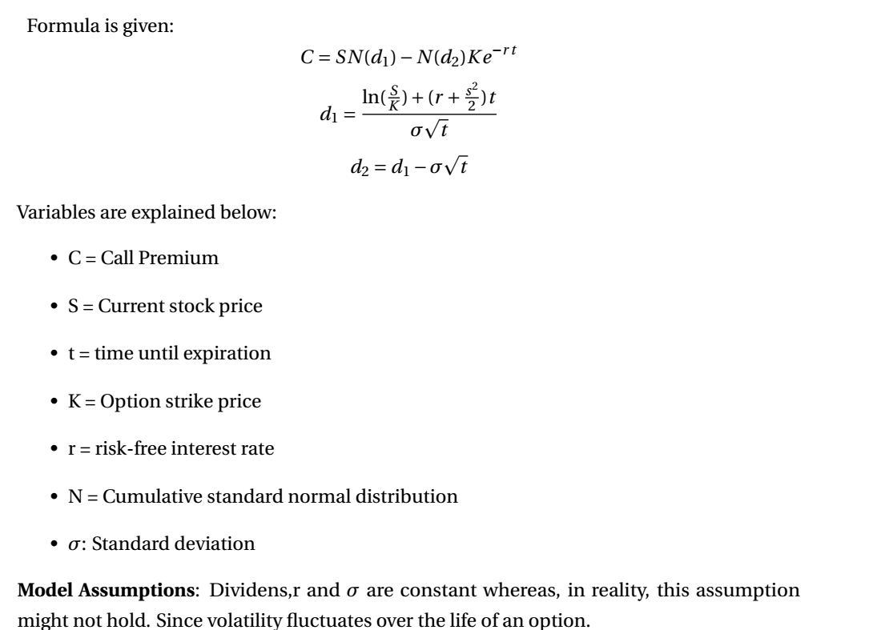
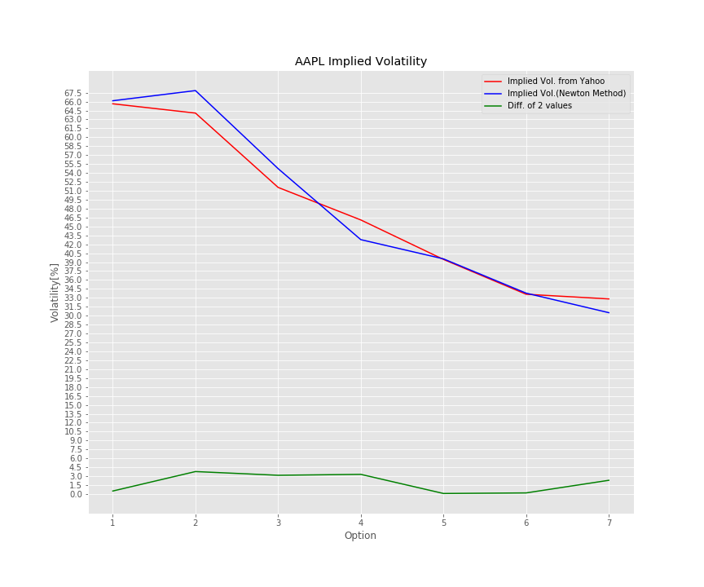
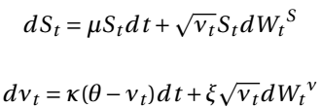
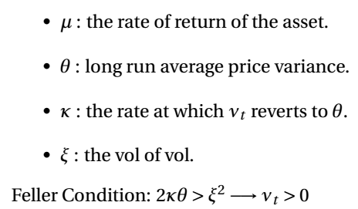
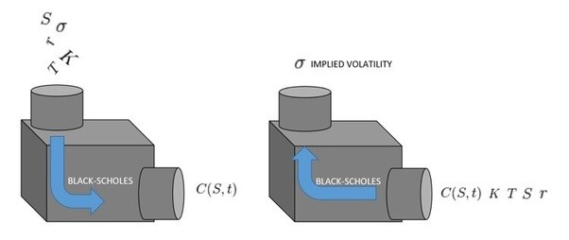
Stochastic Volatility and Options Pricing by Using Parametric Methods
Enes Özipek
Advisor: Ali Taylan Cemgil
Motivation
Methods
Results
Option is a crucial phenomenon for investors to make profitable moves in their trades. They need to know at which price they should trade stocks, i.e underlying securities.
Options are derivative contracts giving the holder the right of buying or selling shares of a stock at a price (strike or exercise) upon which both parties(writer and holder) agree.
Depending on the strategy, option trading can provide a variety of benefits, including the security of limited risk and the advantage of leverage. Another benefit is that options can protect or enhance your portfolio in rising, falling and neutral markets.
In other words, options are one step before the stock trading. They are used to minimize the loss of a prospective move an investor makes or they are used to maximize the profit of a prospective move an investor makes.
I worked with several parametric models to manage my project. I made the most of my work based on Black-Scholes which is very first, and probably, most well-known option pricing model.
Another famous method utilized by many investors is Heston Model.
It is a mathematical model describing the evolution of the volatility of an underlying asset. In this model, we don’t have a constant or deterministic volatility. It follows a random process.[1]
Objectives
Option Pricing is my first aim in this study. I started generating synthetic parameters to be used in several models. Mostly, I utilized Black-Scholes Model.
In addition to Option Pricing calculation , I also intended to estimate Implied Volatility which is a significant parameter plugged into the models. In contrast to the first part, I used the data of real stocks from Yahoo Finance.
Future Work
For the future work, ϵ-Sinsensitive Support Vector Regression can be implmeneted. My approach is to analyze the volatility of last 10 days and try to guess if tomorrow volatility would be higher than calculated volatility. [2]
Implied Volatility
Implied volatility is one of the significant parameter to price the options. Options will tend to have higher premiums with high levels of implied volatility, and vice versa.
Implied volatility tries to guess the future value of an option volatility, and, current underlying value takes this guess into consideration. Therefore, implied volatility is a very important factor to which investors pay attention.
Conclusion
In this study, fair price of an option is predicted using Black Scholes Model, Binomial Model and Heston Model. Implied volatility is predicted by using customized Newton-Raphson. The empirical results show good error rates even though I used a naive approach to calculate implied volatility.
Contact
References
Enes Özipek
Boğazici University
enes.ozipek@boun.edu.tr
+905314748998
Wim Schoutens,Lévy Processes in Finance,Katholieke Universiteit Leuven, Belgium.
Forecasting the Price of Call Option Using Support Vector Regression IOSR-JM, Dec,2014., Neetu Verma, Namita Srivastava, Sujoy Das.

