Slide 1

Exploring Healthcare Networks for Stroke Prevention and Management
By Afnan Abdullahi

Slide 2
Introduction
Strokes are serious medical conditions with lasting impacts.
Effective prevention and treatment depend on understanding risk factors and healthcare interactions.
This project analyzes healthcare networks to optimize care for stroke patients.

Slide 3
Objective
We built a network of healthcare facilities based on patient data.
Focused on key risk factors like hypertension, heart disease, and age.
Aimed to identify critical facilities and patient demographics for improved stroke management.

Slide 4
Network Analysis
Analyzed patient data to create a network of healthcare facilities.
Identified key nodes (facilities) and connections based on patient flow.
Used network metrics to find important facilities and patient groups.

Slide 5
Key Findings
Network structure reveals highly connected hubs and isolated areas.
Certain facilities play crucial roles in patient care pathways.
Age is a strong predictor of stroke risk, especially for children and seniors.

Slide 6
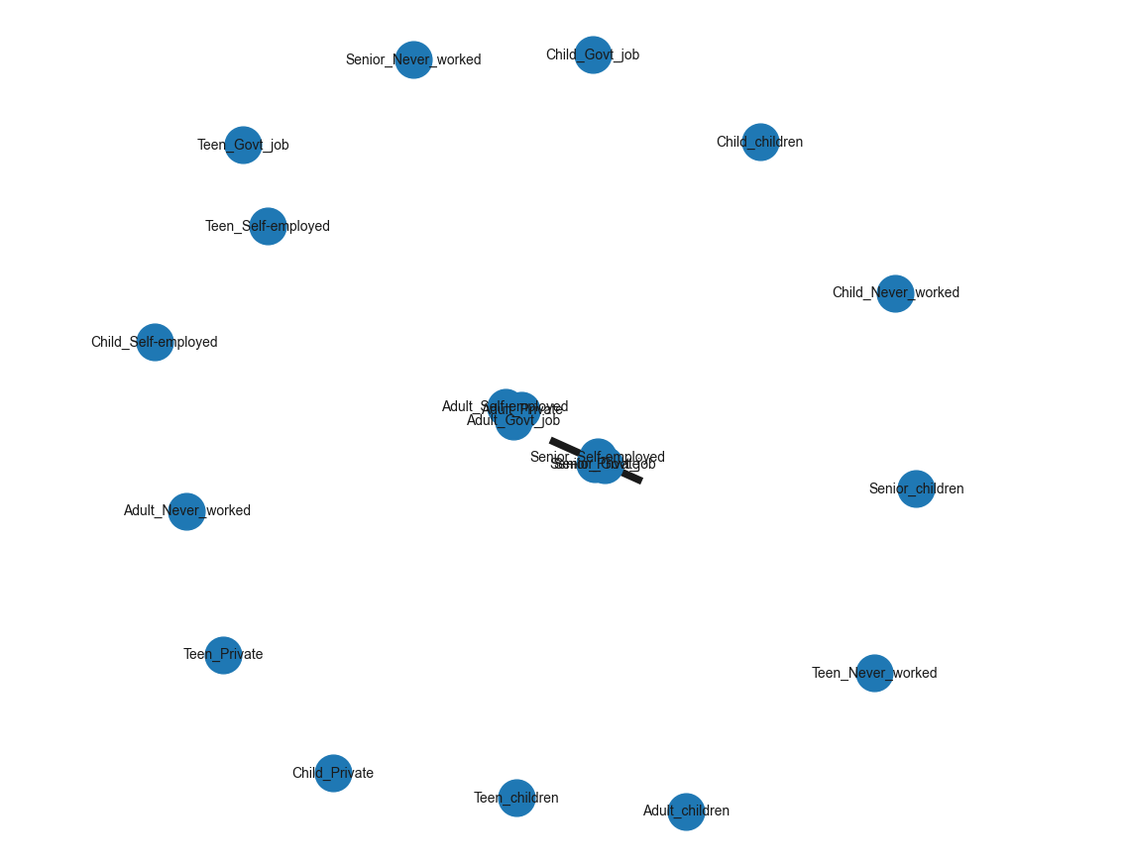

Predictive Modeling
Developed a model to predict stroke risk based on patient data and network metrics.
Achieved high overall accuracy but faced challenges due to data imbalance.
Need for further model refinement and feature selection.

Slide 7
Recommendations
Utilize advanced modeling techniques for better stroke risk prediction.
Integrate additional data like socioeconomic factors and detailed health history.
Conduct longitudinal studies to track network changes over time.

Slide 8
Conclusion
This project provides valuable insights into healthcare network utilization for stroke care.
We identified key areas for improvement in healthcare delivery.
Continued research can optimize stroke prevention and treatment strategies.

