Slide 1
Accounting Principles
Thirteenth Edition
Weygandt ● Kimmel ● Kieso
Chapter 2
The Recording Process
This slide deck contains animations. Please disable animations if they cause issues with your device.

Slide 2
Chapter Outline
  Learning Objectives
  L O 1 Describe how accounts, debits, and credits are used to record business transactions.
  L O 2 Indicate how a journal is used in the recording process.
  L O 3 Explain how a ledger and posting help in the recording process.
  L O 4 Prepare a trial balance.

Slide 3
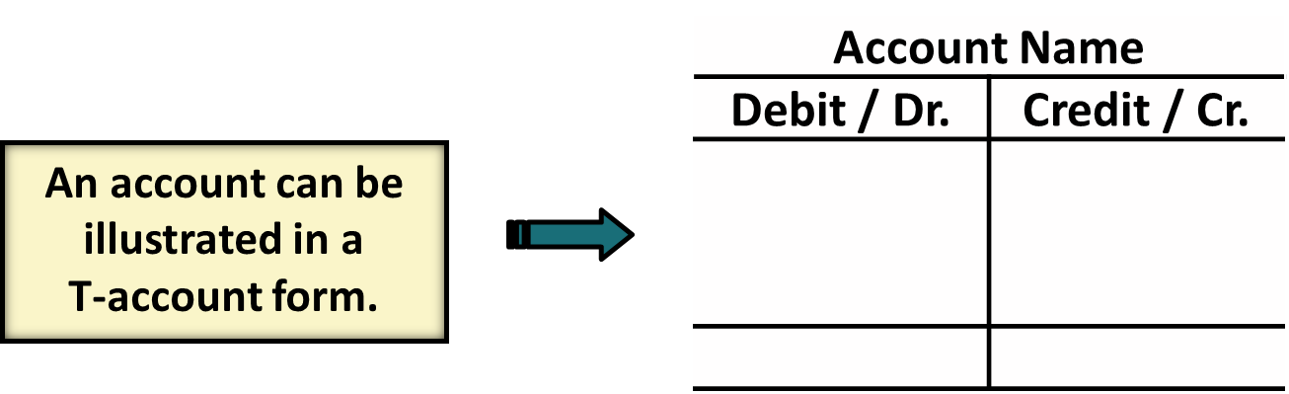
Accounts, Debits, and Credits (1 of 4)
The Account
    Record of increases and decreases in a specific asset, liability, or owner’s equity item.
    Debit = “Left”
    Credit = “Right”

Slide 4
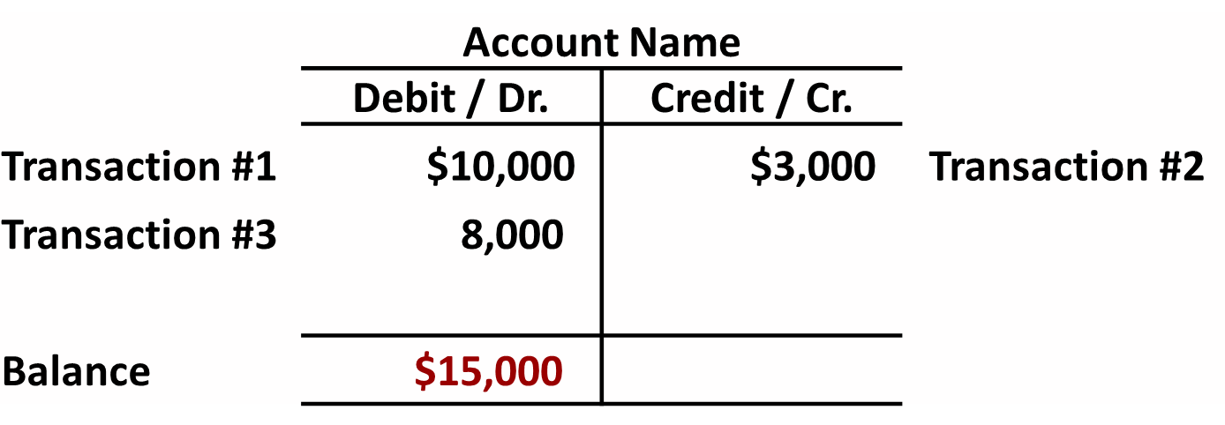
Debits and Credits (1 of 3)
If the sum of Debit entries are greater than the sum of Credit entries, the account will have a debit balance.

Slide 5
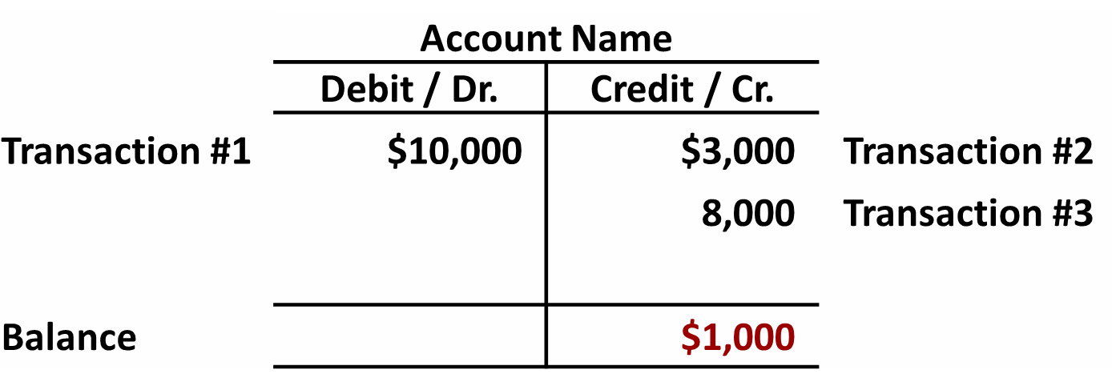
Debits and Credits (2 of 3)
If the sum of Credit entries are greater than the sum of Debit entries, the account will have a credit balance.

Slide 6
Debits and Credits (3 of 3)
Debit and Credit Procedure
Double-entry system
    Each transaction must affect two or more accounts to keep basic accounting equation in balance
    Recording done by debiting at least one account and crediting at least one other account
    DEBITS must equal CREDITS

Slide 7
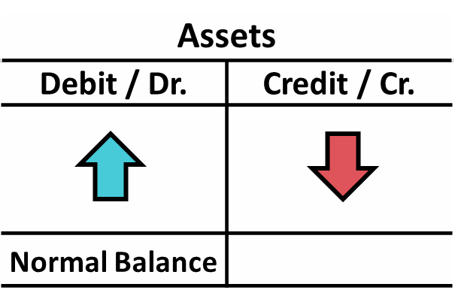
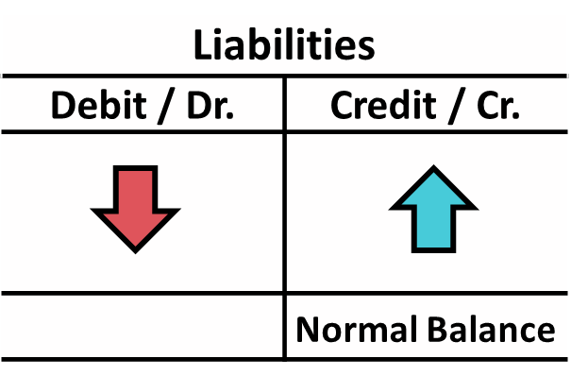
Accounts, Debits, and Credits (2 of 4)
    Asset – accounts normally show debit balances
    Liabilities – accounts normally show credit balances
    Normal balance is on the increase side

Slide 8
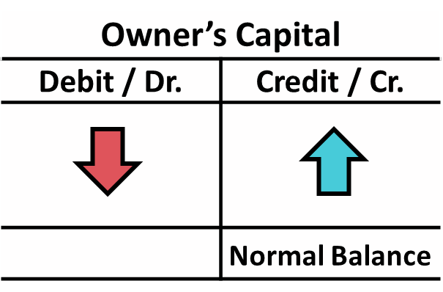
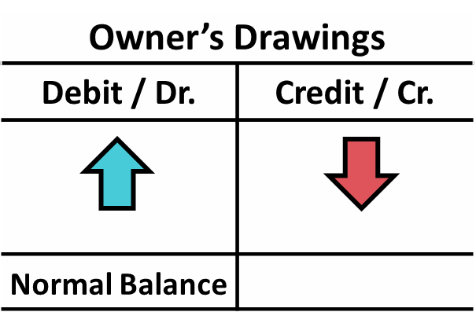
Accounts, Debits, and Credits (3 of 4)
    Owner’s investments and revenues increase owner’s equity (credit)
    Owner’s drawings and expenses decrease owner’s equity (debit)

Slide 9
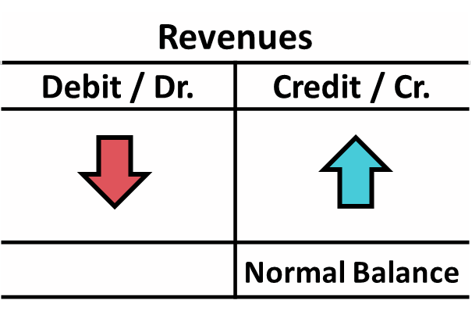
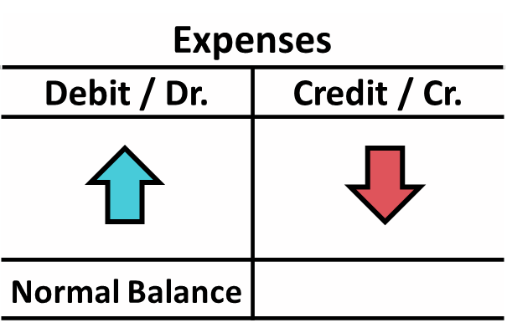
Accounts, Debits, and Credits (4 of 4)
    Earning revenues is to benefit owner(s)
    Effect of debits and credits on revenue accounts is the same as effect on Owner’s Capital
    Expenses have opposite effect

Slide 10
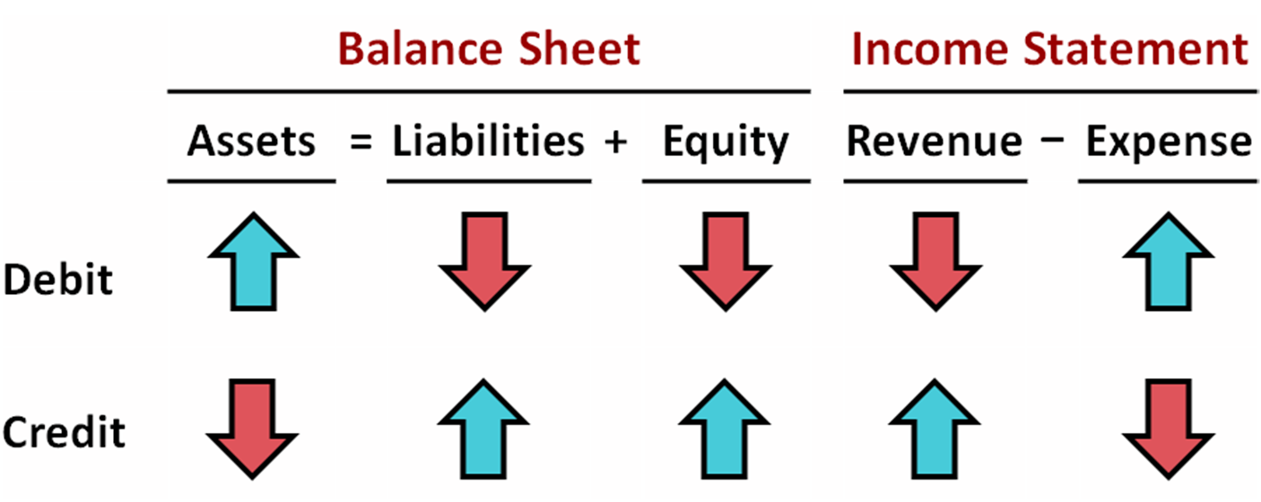
Summary of Debit / Credit Rules (1 of 2)

Slide 11
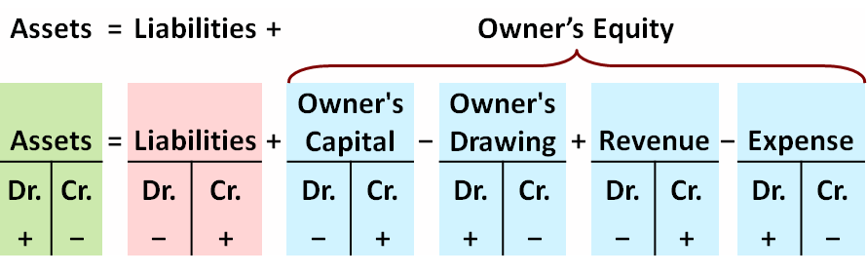
Summary of Debit / Credit Rules (2 of 2)
Debit/credit rules and effects on each type of account.
Equation must be in balance after every transaction. Total Debits must equal total Credits.

Slide 12
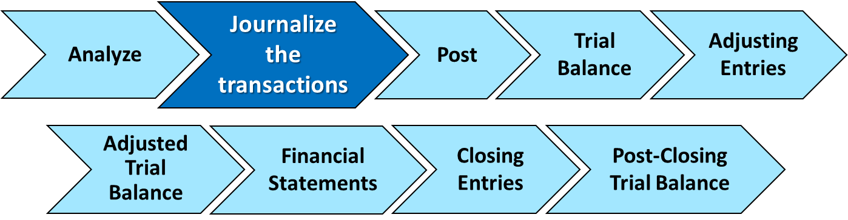
The Journal (1 of 2)
The Recording Process
  Analyze transaction
  Enter transaction in journal
  Transfer journal information to ledger accounts

Slide 13
The Journal (2 of 2)
    Book of original entry
    Transactions recorded in chronological order
    Contributions to the recording process:
  Discloses in one place the complete effects of a transaction
  Provides a chronological record of transactions
  Helps to prevent or locate errors because the debit and credit amounts for each entry can be easily compared

Slide 14
Journalizing (1 of 2)
Journalizing - Entering transaction data in the journal.
Illustration: On September 1, Ray Neal invested $15,000 cash in the business, and Softbyte purchased computer equipment for $7,000 cash.
 | General Journal |  |  | J1
Date | Account Titles and Explanation | Ref. | Debit | Credit
2020 Sept. 1 | Cash |  | 15,000
 | Owner's Capital (Owner’s investment of cash in business) |  |  | 15,000
1 | Equipment |  | 7,000
 | Cash (Purchase of equipment for cash) |  |  | 7,000

Slide 15
Journalizing (2 of 2)
Simple and Compound Entries
Illustration: On July 1, Butler Company purchases a delivery truck costing $14,000. It pays $8,000 cash now and agrees to pay the remaining $6,000 on account (to be paid later).
 | General Journal |  |  | J1
Date | Account Titles and Explanation | Ref. | Debit | Credit
2020 July 1 | Equipment |  | 14,000
 | Cash |  |  | 8,000
 | Accounts Payable (Purchased truck for cash with balance on account) |  |  | 6,000

Slide 16
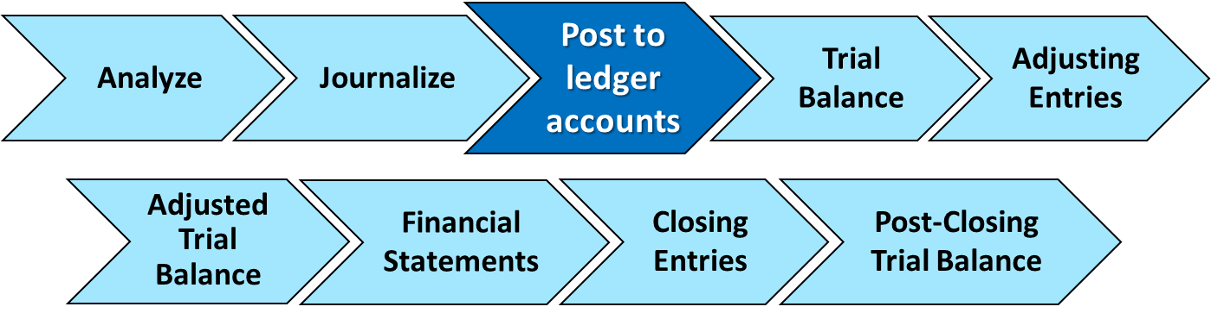
The Journal and Posting
The Ledger
  Entire group of accounts maintained by a company
  Provides the balance in each account
  Keeps track of changes in account balances

Slide 17
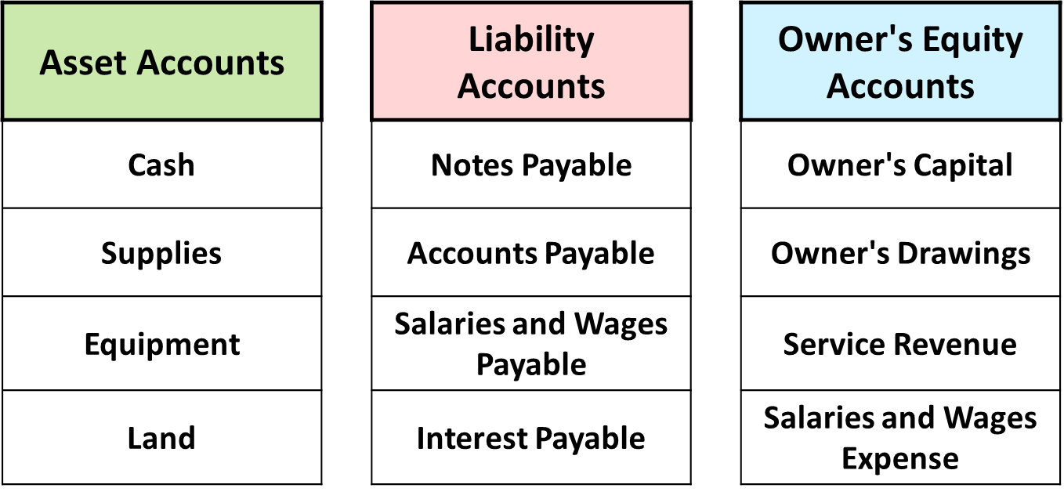
The Ledger (1 of 3)
General ledger contains all asset, liability, and owner’s equity accounts

Slide 18
The Ledger (2 of 3)
Standard Form of Account
 | Cash |  |  |  | NO. 101
Date | Explanation | Ref. | Debit | Credit | Balance
2020 June 1 | (names of opposite a/c) |  | 25,000 |  | 25,000
2 |  |  |  | 8,000 | 17,000
3 |  |  | 4,200 |  | 21,200
9 |  |  | 7,500 |  | 28,700
17 |  |  |  | 11,700 | 17,000
20 |  |  |  | 250 | 16,750
30 |  |  |  | 7,300 | 9,450

Slide 19
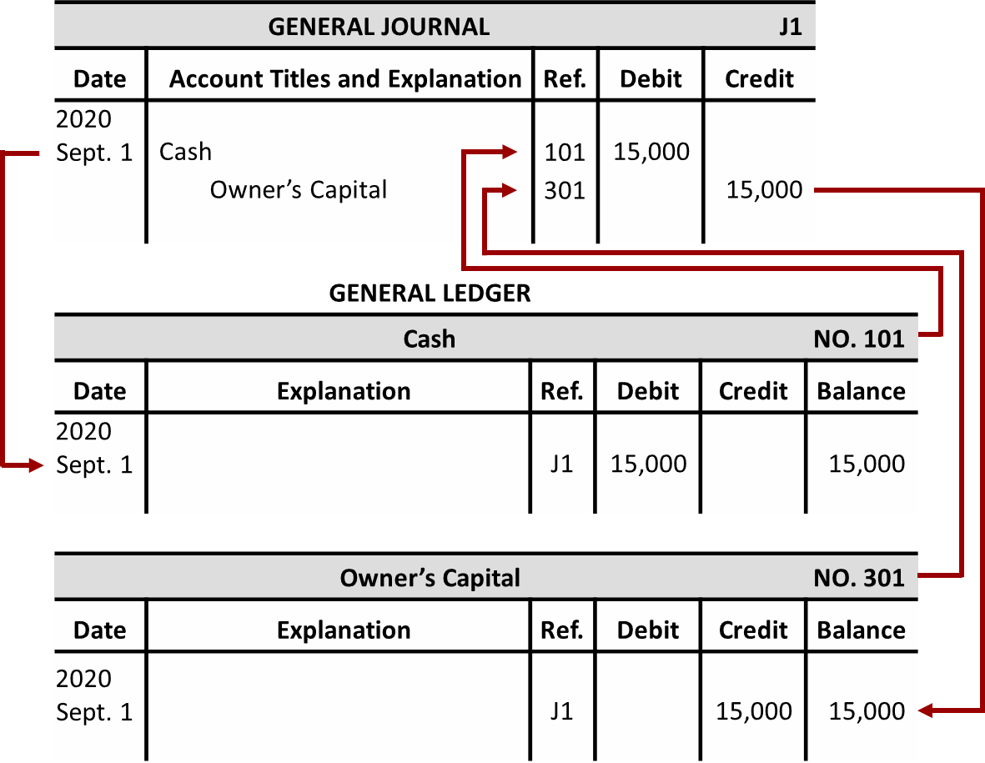
The Ledger (3 of 3)

Slide 20
The Recording Process Illustrated (1 of 10)
Follow these steps:
Determine what type of account is involved.
Determine whether the account increased or decreased and by how much.
Translate the increases and decreases into debits and credits.

Slide 21
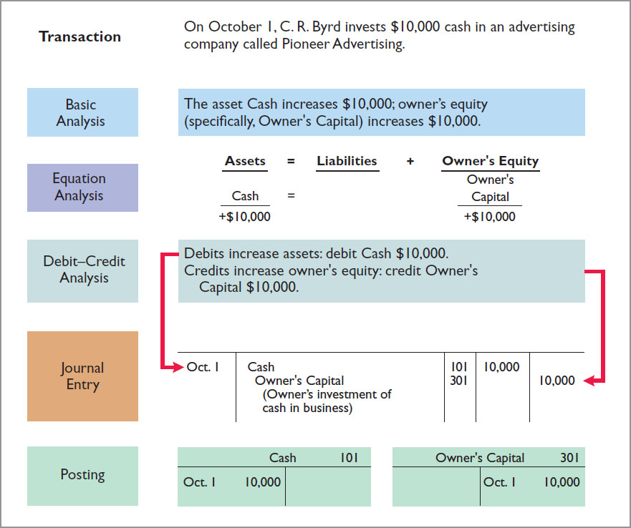
The Recording Process Illustrated (2 of 10)

Slide 22
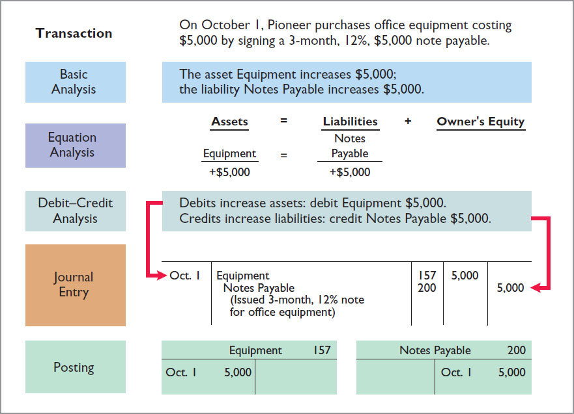
The Recording Process Illustrated (3 of 10)

Slide 23
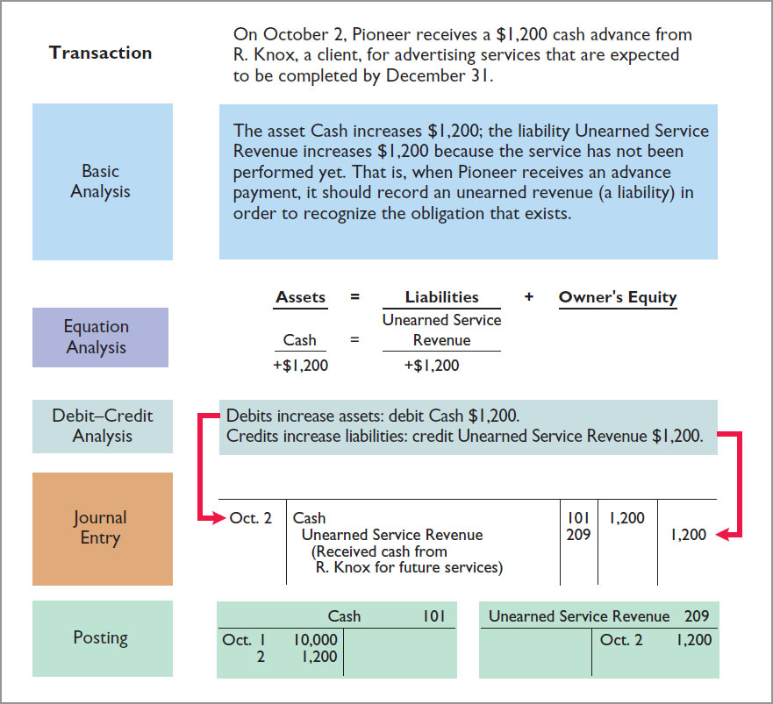
The Recording Process Illustrated (4 of 10)

Slide 24
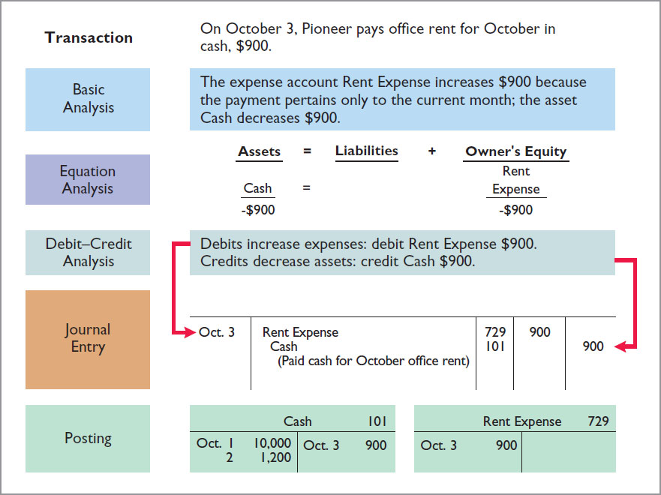
The Recording Process Illustrated (5 of 10)

Slide 25
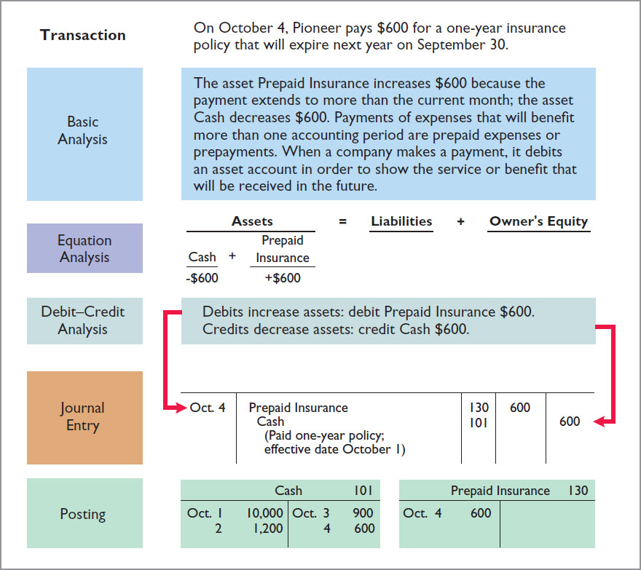
The Recording Process Illustrated (6 of 10)

Slide 26
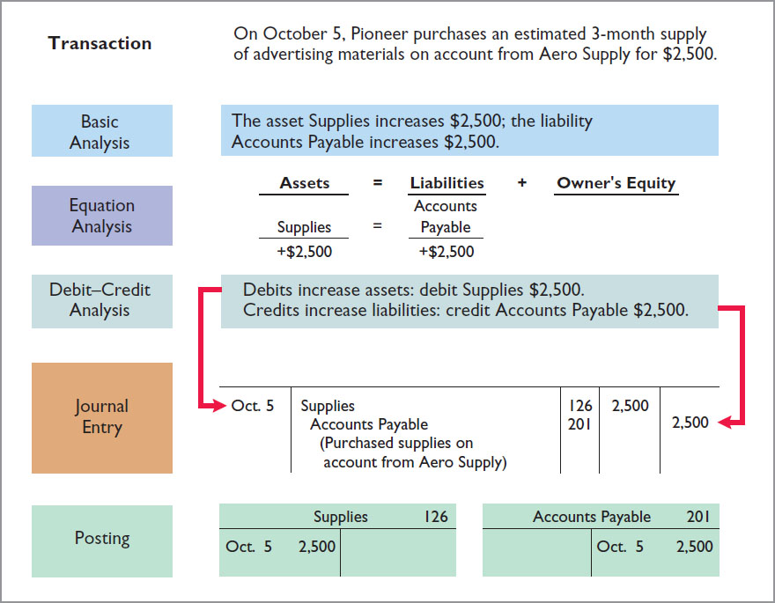
The Recording Process Illustrated (7 of 10)

Slide 27
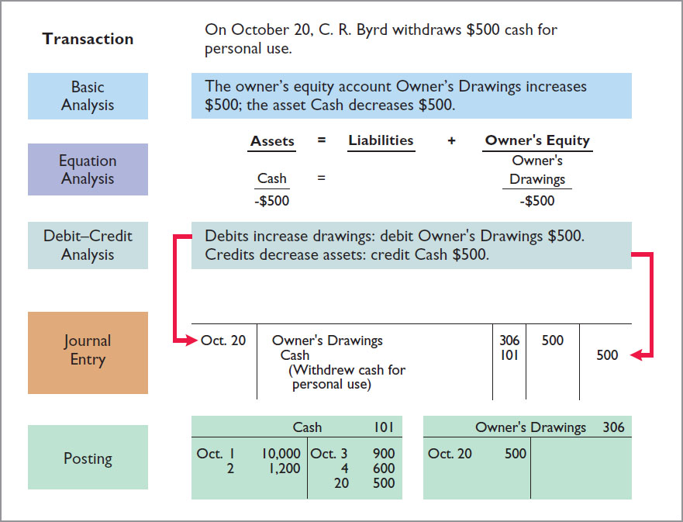
The Recording Process Illustrated (8 of 10)

Slide 28
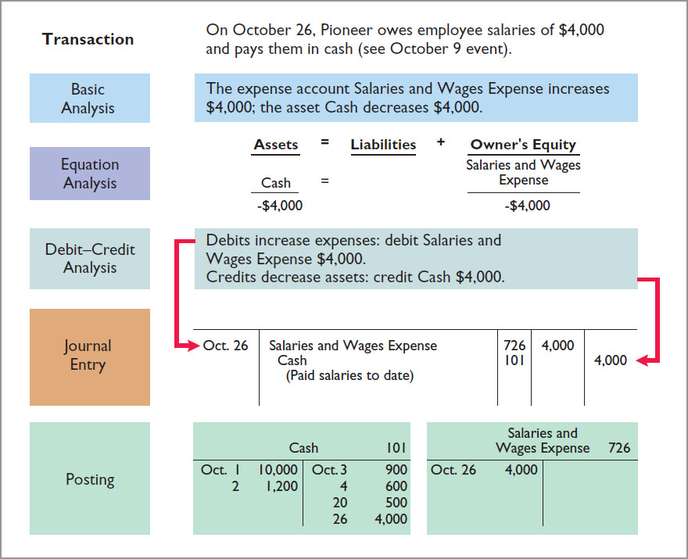
The Recording Process Illustrated (9 of 10)

Slide 29
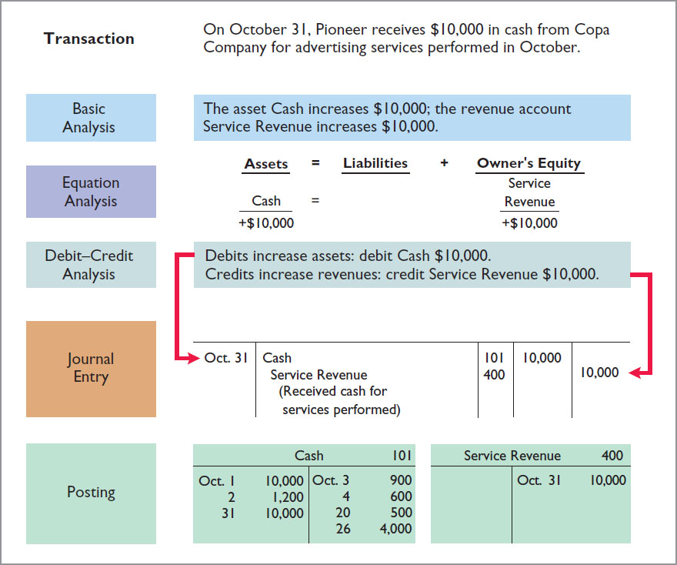
The Recording Process Illustrated (10 of 10)

Slide 30
Journalizing and Posting Summary (1 of 3)
 | General journal |  |  | Page J1
Date | Account Titles and Explanation | Ref. | Debit | Credit
2020 Oct. 1 | Cash | 101 | 10,000
 | Owners’ Capital (Owner’s investment of cash in business) | 301 |  | 10,000
1 | Equipment | 157 | 5,000
 | Notes Payable (Issued 3-month, 12% note for office equipment) | 200 |  | 5,000
2 | Cash | 101 | 1,200
 | Unearned Revenue (Received cash from R. Knox for future services) | 209 |  | 1,200
3 | Rent Expense | 729 | 900
 | Cash (Paid cash for October office rent) | 101 |  | 900

Slide 31
Journalizing and Posting Summary (2 of 3)
 | General journal |  |  | Page J1
Date | Account Titles and Explanation | Ref. | Debit | Credit
2020 Oct. 4 | Prepaid Insurance | 130 | 600
 | Cash (Paid one-year policy; effective date October 1) | 101 |  | 600
5 | Supplies | 126 | 2,500
 | Accounts Payable (Purchased supplies on account from Aero Supply) | 201 |  | 2,500
20 | Owner’s Drawings | 306 | 500
 | Cash (Withdrew cash for personal use) | 101 |  | 500
26 | Salaries and Wages Expense | 726 | 4,000
 | Cash (Paid salaries to date) | 101 |  | 4,000
31 | Cash | 101 | 10,000
 | Service Revenue (Received cash for services performed) | 400 |  | 10,000

Slide 32
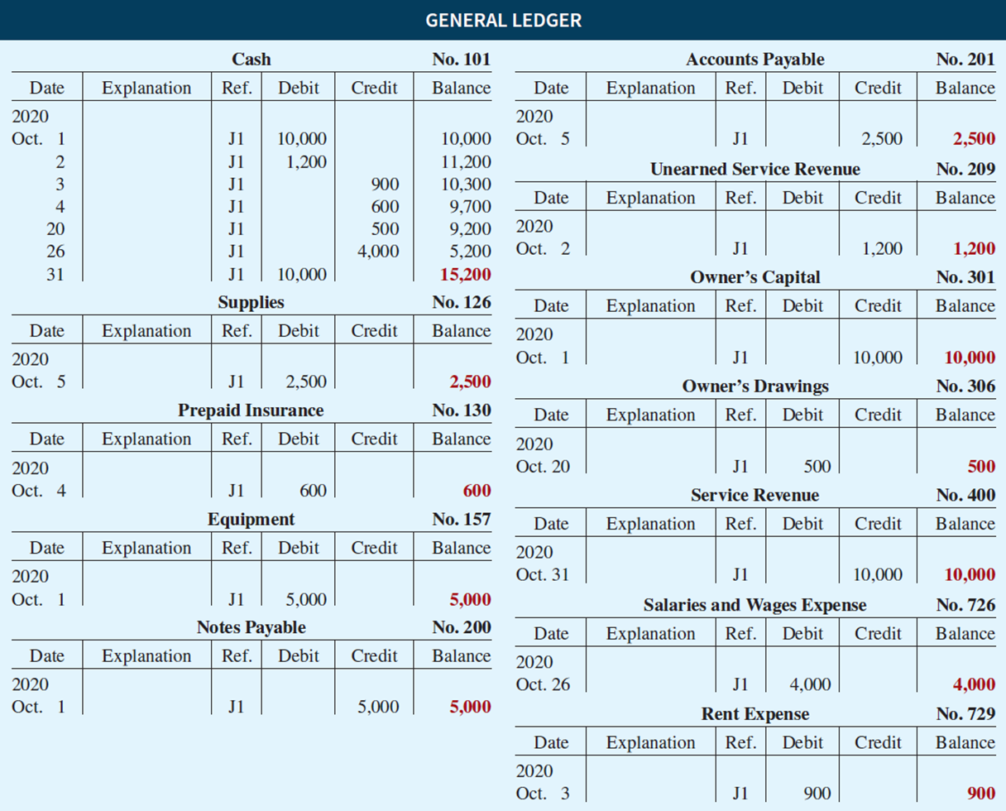
Journalizing and Posting Summary (3 of 3)
OPPOSITE
ACCOUNT
NAMES
WRITE THE OPPOSITE ACCOUNT NAME UNDER THE “EXPLANATION” COLUMN!

Slide 33

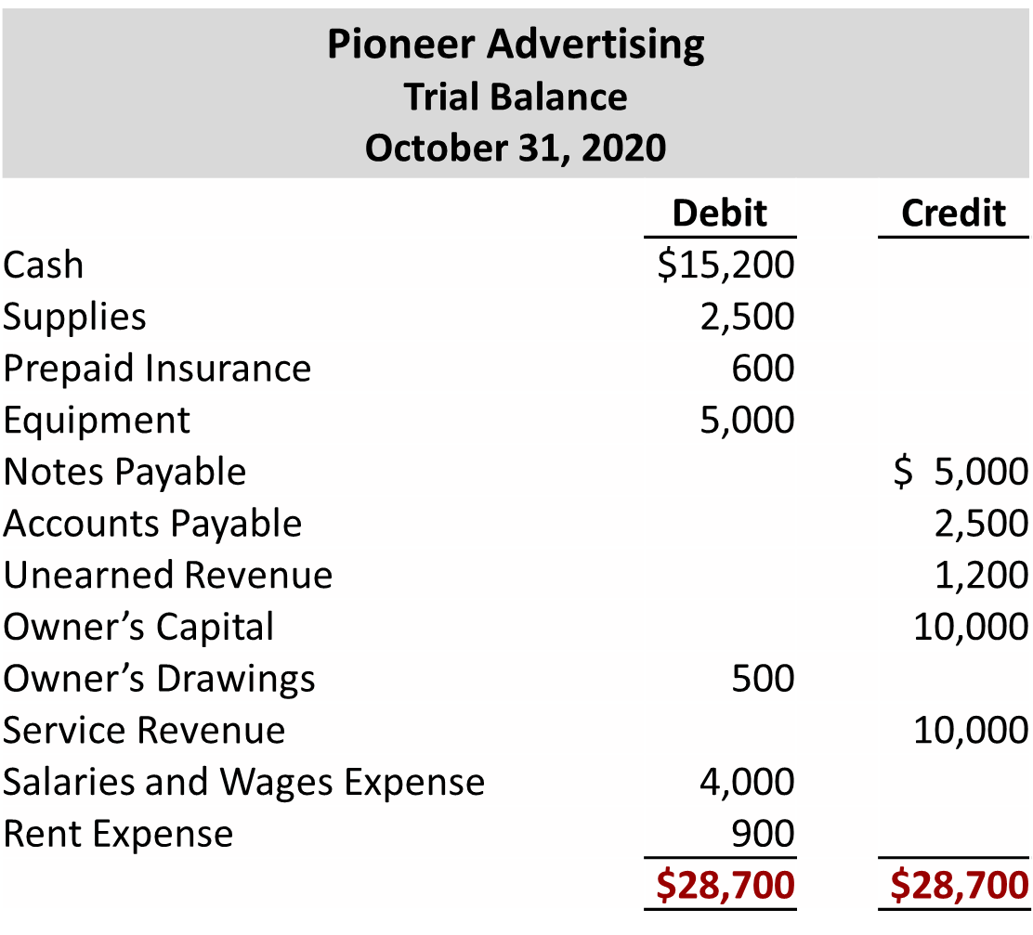
Trial Balance
The trial balance proves the mathematical equality of debits and credits after posting.
Steps:
List the account titles and their balances in the appropriate debit or credit column.
Total the debit and credit columns.
Prove the equality of the two columns.

Slide 34
Limitation of a Trial Balance
Trial balance may balance even when:
  A transaction is not journalized.
  A correct journal entry is not posted.
  A journal entry is posted twice.
  Incorrect accounts are used in journalizing or posting.
  Offsetting errors are made in recording the amount of a transaction.

Slide 35
Trial Balance
Locating Errors
Errors in a trial balance generally result from
mathematical mistakes,
incorrect postings,
or simply transcribing data incorrectly.

