Slide 1
Accounting Principles
Thirteenth Edition
Weygandt ● Kimmel ● Kieso
Chapter 13
Corporations: Organization and Capital Stock Transactions
This slide deck contains animations. Please disable animations if they cause issues with your device.

Slide 2
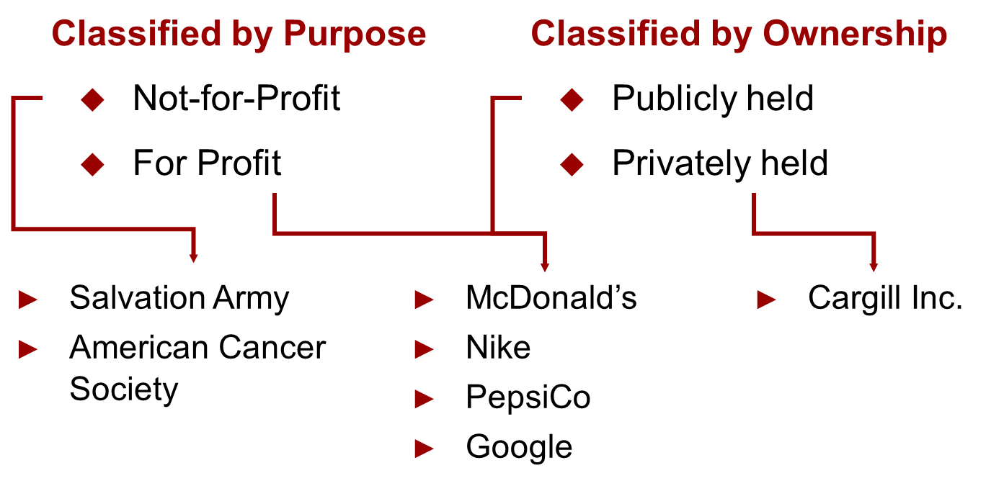
Corporate Form of Organization
An entity separate and distinct from its owners. 2 ways to classify corporations:

Slide 3
Characteristics of Corporation
Characteristics that distinguish corporations from proprietorships and partnerships.
Advantages
Separate Legal Existence
Limited Liability of Stockholders
Transferable Ownership Rights
Ability to Acquire Capital
Continuous Life
Corporate Management
Disadvantages
Corporate Management
Government Regulations
Additional Taxes

Slide 4
Characteristics of Corporation
Characteristics that distinguish corporations from proprietorships and partnerships.
Separate Legal Existence → Corporation acts under its own name rather than in the name of its stockholders.
Limited Liability of Stockholders → Limited to their investment.
Transferable Ownership → Stockholders may sell their stock.
Ability to Acquire Capital → Corporation can obtain capital through the issuance of stock.

Slide 5
Characteristics of Corporation
Characteristics that distinguish corporations from proprietorships and partnerships.
Continuous Life → Continuance as a going concern is not affected by the withdrawal, death, or incapacity of a stockholder, employee, or officer.
Corporate Management →
  Advantage: The organizational structure of a corporation enables a company to hire professional managers to run the business.
  Disadvantage: Separation of ownership and management often reduces an owner’s ability to actively manage the company.
Government Regulations → A corporation is subject to numerous state and federal regulations.
Additional Taxes → Corporations pay income taxes as a separate legal entity and in addition, stockholders pay taxes on cash dividends.

Slide 6
Forming a Corporation
Initial Steps:
File application with the Secretary of State
State grants charter
Corporation develops by-laws
Companies generally incorporate in a state whose laws are favorable to the corporate form of business.
Corporations engaged in interstate commerce must obtain a license from each state in which they do business.
Costs incurred in the formation of a corporation are called organization costs/organizational expense. These costs include legal and state fees, and promotional expenditures involved in the organization of the business. Corporations expense organization costs as incurred.

Slide 7
(Common) Stockholder Rights
Vote in election of board of directors at annual meeting and vote on actions that require stockholder approval.
Share the corporate earnings through receipt of dividends.
Keep the same percentage ownership when new shares of stock are issued (preemptive right).
Share in assets upon liquidation in proportion to their holdings. This is called a residual claim.

Slide 8
Stock Issue Considerations
When a corporation decides to issue stock, it must resolve a number of basic questions:
How many shares should it authorize for sale?
How should it issue the stock?
What value should the corporation assign to the stock?

Slide 9
Stock Issue Considerations
Authorized Stock
Charter indicates amount of stock that a corporation is authorized to sell
Number of authorized shares is often reported in stockholders’ equity section
No formal accounting entry

Slide 10
Stock Issue Considerations
Issuance of Stock
Companies issue common stock directly to investors or indirectly through an investment banking firm
Factors in setting price for a new issue of stock:
  Company’s anticipated future earnings
  Expected dividend rate per share
  Current financial position
  Current state of economy
  Current state of securities market

Slide 11
Stock Issue Considerations
Par and No-Par Value Stocks
Years ago, par value determined legal capital per share that a company must retain in business for protection of corporate creditors
Today many states do not require a par value
No-par value stock is fairly common today
In many states, the board of directors assigns a stated value to no-par shares

Slide 12
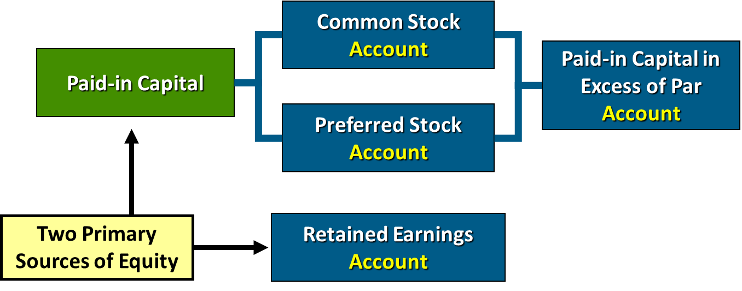
Corporate Capital
Paid-in capital is the total amount of cash and other assets paid in to the corporation by stockholders in exchange for capital stock.

Slide 13
Corporate Capital
Retained earnings is net income that a corporation retains for future use.

Slide 14
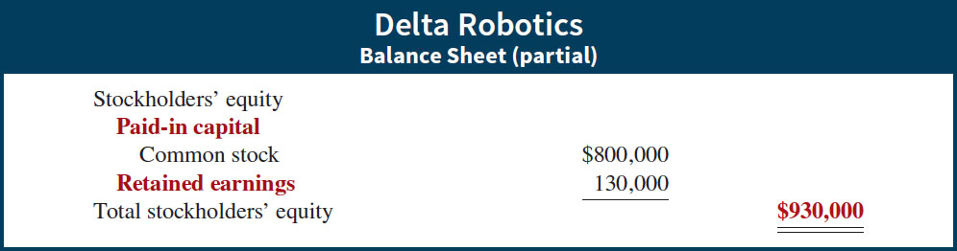
Retained Earnings
If Delta Robotics has a balance of $800,000 in common stock and $130,000 in retained earnings at the end of its first year, its stockholders’ equity section is as follows.

Slide 15
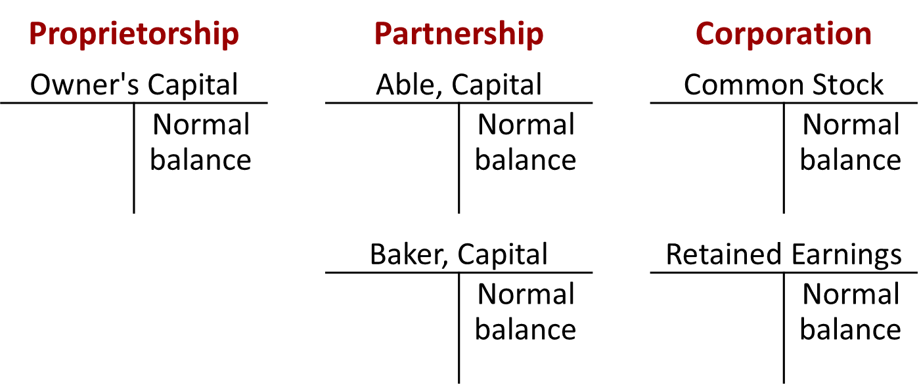
Corporate Capital
Comparison of the owners’ equity (stockholders’ equity) accounts reported on a balance sheet.

Slide 16
Do It! 1b: Corporate Capital
Illustration: At the end of its first year of operation, Doral Corporation has $750,000 of common stock and net income of $122,000. Prepare (a) the closing entry for net income and (b) the stockholders’ equity section at year-end.
(a)
Income Summary
122,000
Retained Earnings
(To close Income Summary and transfer net income to Retained Earnings)
122,000
(b)
Stockholders’ equity
Paid-in capital
Common stock
$750,000
Retained earnings
Total stockholders’ equity

Slide 17
Accounting for Stock Transactions
Accounting for Common Stock
Primary Objectives:
  Identify the specific sources of paid-in capital.
  Maintain the distinction between paid-in capital and retained earnings.
  Other than consideration received, the issuance of common stock affects only paid-in capital accounts.

Slide 18
Issuing Common Stock for Cash
Illustration: Assume that Hydro-Slide, Inc. issues 1,000 shares of $1 par value common stock. Prepare Hydro-Slide’s journal entry if (a) 1,000 share are issued for $1 per share, and (b) 1,000 shares are issued for $5 per share.
(a)
Cash
1,000
Common Stock (1,000 × $1)
(To record issuance of 1,000 shares of $1 par common stock at par)
1,000
(b)
Cash
5,000
Common Stock (1,000 × $1)
1,000
Paid-in Capital in Excess of Par—Common Stock
(To record issuance of 1,000 shares of $1 par common stock)
4,000

Slide 19
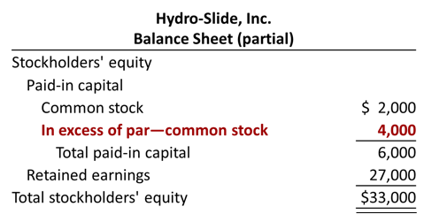
Accounting for Stock Transactions

Slide 20
Issuing No-Par Common Stock for Cash
Illustration: Assume that instead of $1 par value stock, Hydro-Slide, Inc. has $5 stated value no-par stock and the company issues 5,000 shares at $8 per share for cash.
Cash
40,000
Common Stock (5,000 × $5)
25,000
Paid-in Capital in Excess of Stated Value—Common Stock
(To record issue of 5,000 shares of $5 stated value no-par stock)
15,000

Slide 21
Issuing No-Par Common Stock for Cash
Illustration: Assume further that the no-par stock does not have a stated value and the company issues 5,000 shares at $8 per share for cash.
Cash
40,000
Common Stock
(To record issue of 5,000 shares of no-par stock)
40,000

Slide 22
Issuing Common Stock for Services or Noncash Assets
Corporations also may issue stock for:
Services (attorneys or consultants)
Noncash assets (land, buildings, and equipment)
Cost is either the fair market value of the consideration given up, or the fair market value of the consideration received, whichever is more clearly determinable.

Slide 23
Common Stock for Services
Illustration: Attorneys have helped Jordan Company incorporate. They have billed the company $5,000 for their services. They agree to accept 4,000 shares of $1 par value common stock in payment of their bill. At the time of the exchange, there is no established market price for the stock. Prepare the journal entry for this transaction.
Organizational Expense
5,000
Common Stock (4,000 × $1)
4,000
Paid-in Capital in Excess of Par Value—Common Stock
(To record issuance of 4,000 shares of $1 par value stock to attorneys)
1,000

Slide 24
Common Stock for Noncash Assets
Illustration: Athletic Research Inc. is an existing publicly held corporation. Its $5 par value stock is actively traded at $8 per share. The company issues 10,000 shares of stock to acquire land recently advertised for sale at $90,000. Prepare the journal entry for this transaction.
Land
80,000
Common Stock (10,000 × $5)
50,000
Paid-in Capital in Excess of Par Value—Common Stock
(To record issuance of 10,000 shares of $5 par value stock for land)
30,000

Slide 25
Accounting for Preferred Stock
Typically, preferred stockholders have a priority as to:
Distributions of earnings (dividends).
Assets in event of liquidation.
Generally do not have voting rights.
Accounting for preferred stock at issuance is similar to that for common stock.

Slide 26
Accounting for Preferred Stock
Illustration: Stine Corporation issues 10,000 shares of $10 par value preferred stock for $12 cash per share. The journal entry to record the issuance is:
Cash
120,000
Preferred Stock (10,000 × $10)
100,000
Paid-in Capital in Excess of Par Value—Preferred Stock
(To record the issuance of 10,000 shares of $10 par value preferred stock)
20,000
Preferred stock may have a par value or no-par value.

Slide 27
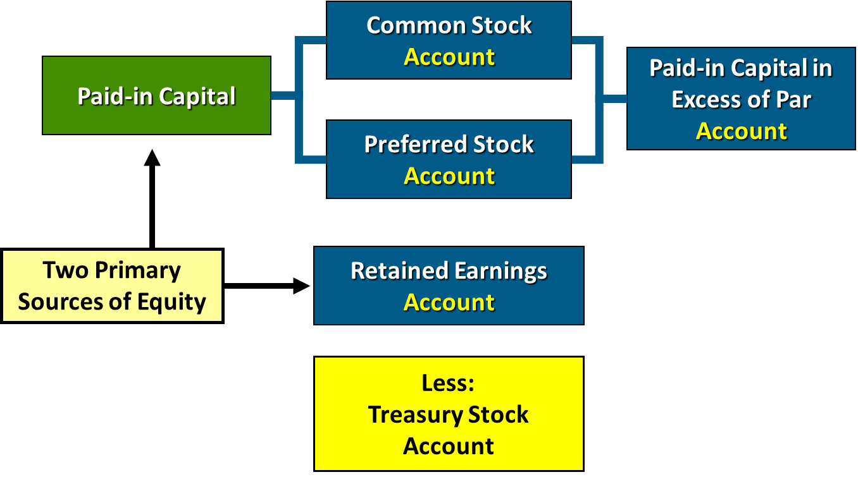
Accounting for Treasury Stock (1 of 5)

Slide 28
Accounting for Treasury Stock (2 of 5)
Treasury stock is a corporation’s own stock that it has issued and subsequently reacquired from shareholders but not retired.
Corporations acquire treasury stock for various reasons:
  To reissue the shares to officers and employees under bonus and stock compensation plans.
  To enhance the stock’s market value.
  To have additional shares available for use in the acquisition of other companies.
  To increase earnings per share.

Slide 29
Accounting for Treasury Stock (3 of 5)
Companies generally use cost method
Debit Treasury Stock for price paid to reacquire shares
Treasury stock is a contra stockholders’ equity account
Reduces stockholders’ equity

Slide 30
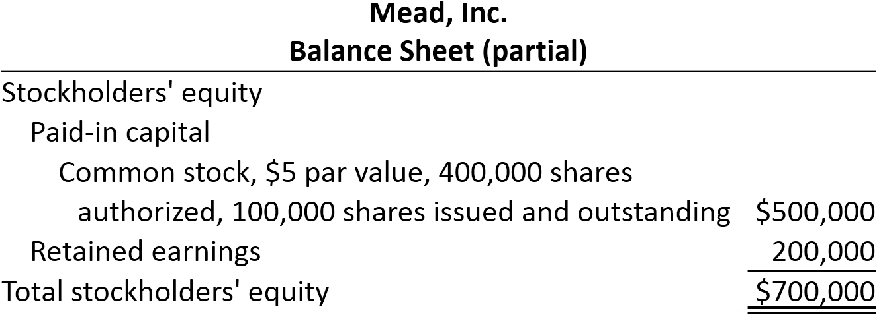
Accounting for Treasury Stock (4 of 5)
Illustration: On February 1, 2020, Mead acquires 4,000 shares of its stock at $8 per share. The entry is as follows.
Feb. 1 Treasury Stock (4,000 × $8)
32,000
Cash
(To record purchase of 4,000 shares of treasury stock at $8 per share)
32,000

Slide 31
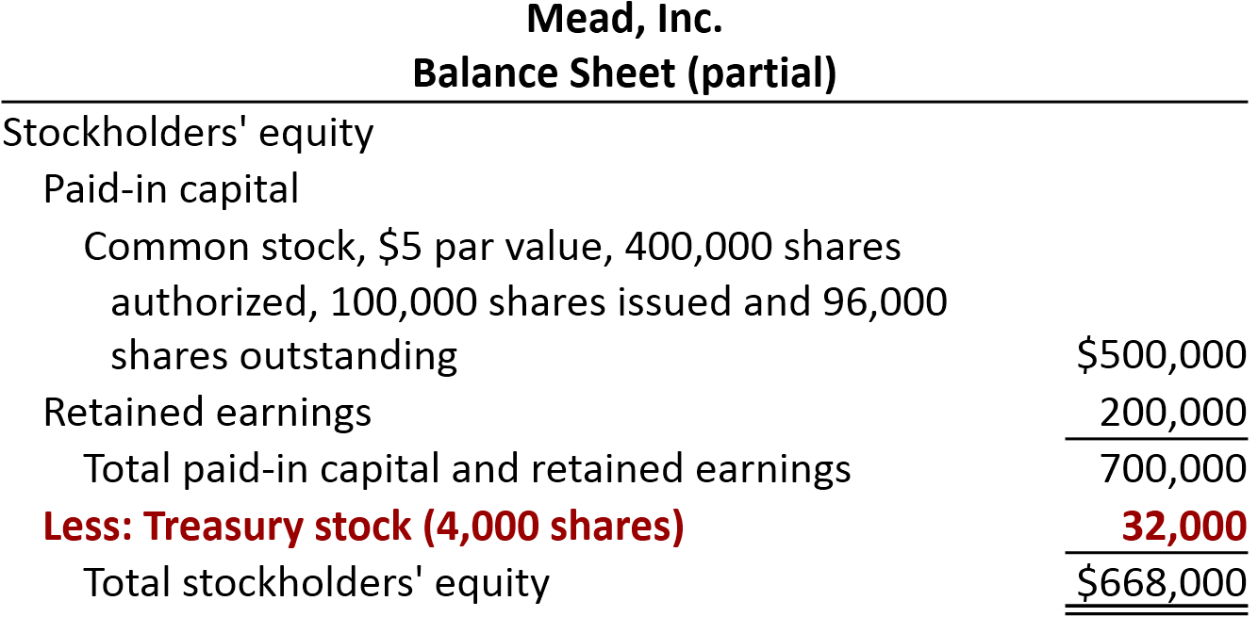
Accounting for Treasury Stock (5 of 5)
Both the number of shares issued (100,000) and the number of shares held as treasury (4,000) are disclosed.

Slide 32
Sale of Treasury Stock Above Cost
Illustration: On July 1, Mead, Inc. sells for $10 per share 1,000 of the 4,000 shares of its treasury stock previously acquired at $8 per share. The entry is as follows.
Jul. 1 Cash
10,000
Treasury Stock (1,000 × $8)
8,000
Paid-in Capital from Treasury Stock
(To record sale of 1,000 shares of treasury stock above cost)
2,000
A corporation does not realize a gain or suffer a loss from stock transactions with its own stockholders.

Slide 33
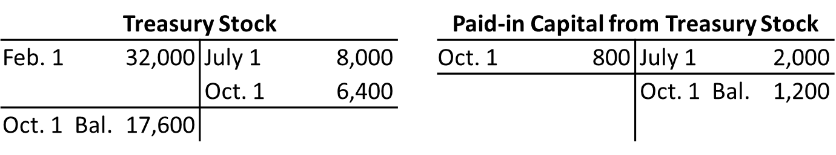
Sale of Treasury Stock Below Cost (1 of 2)
If Mead, Inc. sells an additional 800 shares of treasury stock on October 1 at $7 per share, it makes the following entry.
Cash (800 × $7)
5,600
Paid-in Capital from Treasury Stock
800
Treasury Stock (800 × $8)
(To record sale of 800 shares of treasury stock below cost)
6,400

Slide 34
Sale of Treasury Stock Below Cost (2 of 2)
On December 1, assume that Mead, Inc. sells its remaining 2,200 shares at $7 per share and makes the following entry.
Cash (2,200 × $7)
15,400
Limited to balance on hand
Paid-in Capital from Treasury Stock
1,200
Retained Earnings
1,000
Treasury Stock (2,200 × $8)
(To record sale of 2,200 shares of treasury stock at $7 per share)
17,600

Slide 35
Do It! 2b: Treasury Stock
Santa Anita Inc. purchases 3,000 shares of its $50 par value common stock for $180,000 cash on July 1. It will hold the shares in the treasury until resold. On November 1, the corporation sells 1,000 shares of treasury stock for cash at $70 per share. Journalize the treasury stock transactions.
July 1
Treasury Stock
180,000
Cash
(To record the purchase of 3,000 shares at $60 per share)
180,000
Nov. 1
Cash
70,000
Treasury Stock
60,000
Paid-in Capital from Treasury Stock
(To record the sale of 1,000 shares at $70 per share)
10,000

Slide 36
(for the following topics in this slide deck, focus on slides only; no book needed)
Explain the Accounting and Reporting Issues Related to Dividends

Slide 37
Dividend and Dividend Policy
A dividend is a distribution of a company’s profits to stockholders.
A dividend policy is essentially a company's strategic approach to deciding how much of its profits to distribute to shareholders in the form of dividends, and how often to do so.

Slide 38
Dividend Policy
Companies that grow dividends (companies that have a consistent history of increasing the amount of money they pay out as dividends) are signaling confidence about future earnings.
However, most companies do not distribute all of their retained earnings (accumulated profits) as dividends. Why?
Maintain agreements with creditors.
Meet state incorporation requirements.
To finance growth or expansion.
To smooth out dividend payments.
To build up a cushion against possible losses.
  LO 3
Notes:
Supplementary notes by TBR:
Maintain agreements with creditors - Creditors want to ensure that the company has enough cash flow to repay its debts, so they may impose limits on dividend payouts. These agreements are legal contracts that the company must abide by.
Meet state incorporation requirements - Some states have laws that restrict the amount of dividends a company can pay. These laws are designed to protect creditors and ensure that the company remains solvent.
To finance growth or expansion - Retained earnings are a primary source of funding for capital expenditures, research and development, and other growth initiatives.
To smooth out dividend payments - Many companies aim to provide stable and predictable dividend payments to their shareholders. To do this, they may retain earnings during periods of high profitability to ensure they can maintain dividend payouts during periods of lower earnings.
To build up a cushion against possible losses - Companies need to have a financial buffer to protect themselves against unexpected losses or economic downturns. Retaining earnings allows them to build up a cash reserve that can be used to weather financial storms. This protects the company, and therefore the investors, from unexpected events.

Slide 39
Dividend Policy
Financial Condition and Dividend Distributions
A company should not pay a dividend unless both the present and future financial position warrant the distribution.
The Securities and Exchange Commission (S E C) encourages companies to disclose their dividend policy in their annual report, especially those that
have earnings but fail to pay dividends, or
do not expect to pay dividends in the foreseeable future.
The S E C encourages companies that consistently pay dividends to indicate whether they intend to continue this practice in the future.
  LO 3
Notes:
Supplementary notes by TBR:
Present Financial Position: The company must have sufficient current cash flow and profitability to cover the dividend payment without jeopardizing its short-term financial stability. This means having enough cash to meet its immediate obligations.
Future Financial Position: The company must also consider its long-term financial prospects. It should only pay dividends if it anticipates generating enough future profits to sustain those payments and continue its operations.
“have earnings but fail to pay dividends”: When a company generates profits but doesn't pay dividends, investors may be curious or concerned about the reasons. This allows investors to understand if the company is choosing to reinvest all profits, or if there is a more concerning reason that dividends are not being paid.
“do not expect to pay dividends in the foreseeable future”: It's crucial for investors to know if a company has no plans to pay dividends, especially if they are seeking income from their investments. This disclosure helps investors avoid investing in companies that don't align with their investment goals.
“The S E C encourages companies that consistently pay dividends to indicate whether they intend to continue this practice in the future”: Knowing a company's intention to continue its dividend practice provides predictability and stability for investors.

Slide 40
Types of dividends
Cash dividends
Property dividends (dividends in kind)
Liquidating dividends
Stock dividends

Slide 41
Cash Dividends
Board of directors vote on the declaration of cash dividends.
A declared cash dividend is a (current) liability.
Companies do not declare or pay cash dividends on treasury stock.
Three dates are important in connection with dividends:
declaration date: the board of directors formally declares (authorizes) the cash dividend and announces it to stockholders
record date: in the interval between the declaration date and the record date, the corporation updates its stock ownership records to identify the persons or entities that will receive the dividend
payment date: the company makes cash dividend payments to the stockholders and records the payment of the dividend
  LO 3

Slide 42
Cash Dividends
Illustration: On December 1, the directors of Media General declare a 50 cents per share cash dividend on 100,000 shares of $10 par value common stock. The dividend is payable on January 20 to shareholders of record on December 22.
Dec. 1
Retained Earnings
50,000
Dividends Payable
(To record declaration of cash dividend)
50,000
Dec. 22
No entry (on record date)
Jan. 20
Dividends Payable
50,000
Cash
(To record payment of cash dividend)
50,000

Slide 43
Property Dividends
Dividends payable in assets other than cash.
Restate at fair value the property it will distribute, recognizing any gain or loss.
Three dates are important:
declaration date
record date
payment date
  LO 3

Slide 44
Property Dividends
Illustration: Trendler, Inc. transferred to stockholders some of its equity investments costing $1,250,000 by declaring a property dividend on December 28, 2019, to be distributed on January 30, 2020, to stockholders of record on January 15, 2020. At the date of declaration, the securities have a market value of $2,000,000. Trendler makes the following entries.
Dec 28
Equity Investments
750,000
Unrealized Holding Gain or Loss—Income
750,000
Retained Earnings
2,000,000
Property Dividends Payable
(To record declaration of property dividend)
2,000,000
Jan 15
No entry (on record date)
Jan 30
Property Dividends Payable
2,000,000
Equity Investments
(To record payment of property dividend)
2,000,000
  LO 3

Slide 45
Liquidating Dividends
Cash dividends are paid from retained earnings (company's earned profits).
Liquidating dividends are declared out of paid-in capital (which represents the money shareholders invested when they purchased the company's stock).
  If a company pays out dividends that are greater than its earned profits, it means that some of the dividend payment is not coming from these profits.
  In this situation, the excess portion of the dividend is considered a return of the shareholder's original investment, which is drawn from the paid-in capital.
  The most common reason is when a company is winding down its operations. After selling assets and paying off liabilities, any remaining funds are distributed to shareholders.
  LO 3

Slide 46
Liquidating Dividends
Illustration: McChesney Mines, Inc. declared a “dividend” to its common stockholders of $1,200,000 on December 28, 2019 , to be distributed on January 30, 2020, to stockholders of record on January 15, 2020. The announcement noted stockholders should consider $900,000 as income and the remainder a return of capital. McChesney Mines records the dividend as follows.
Dec 28
Retained Earnings
900,000
Paid-in Capital in Excess of Par—Common Stock
300,000
Dividends Payable
(To record declaration of property dividend)
1,200,000
Jan 15
No entry (on record date)
Jan 30
Dividends Payable
1,200,000
Cash
(To record payment of property dividend)
1,200,000
  LO 3
Notes:
Supplementary notes by TBR:
Why debit "Paid-in Capital in Excess of Par—Common Stock”?
In many cases, especially in modern accounting, the par value of stock is very low.
"Excess of par" represents the premium investors paid for the stock beyond its par value.
Because liquidating dividends are returning a portion of the investors' original investment, it's logical that this "excess" amount would be affected.
Therefore, in the journal entry we will debit "Paid-in Capital in Excess of Par—Common Stock” for $300,000.

Slide 47
Stock Dividends
A stock dividend is a pro rata (proportional to ownership) distribution of the corporation’s own stock to stockholders.
Whereas a company pays cash in a cash dividend, a company issues shares of stock in a stock dividend.
A stock dividend results in a decrease in retained earnings and an increase in paid-in capital. Used when management wishes to “capitalize” part of earnings.
Unlike other dividends, a stock dividend does not decrease total stockholders’ equity.
Helps increase the marketability of the corporation’s stock. When the number of shares outstanding increases, the market price per share decreases.
To illustrate, assume that you have a 2% ownership interest in Cetus Inc. That is, you own 20 of its 1,000 shares of common stock. If Cetus declares a 10% stock dividend, it would issue 100 shares (1,000 × 10%) of stock. You would receive two shares (2% × 100). Would your ownership interest change? No, it would remain at 2% (22 ÷ 1,100). You now own more shares of stock, but your ownership interest has not changed.
  LO 3
Notes:
Supplementary notes by TBR:
(continuation of above example)
Cetus has disbursed no cash and has assumed no liabilities. What, then, are the purposes and benefits of a stock dividend? Corporations issue stock dividends generally for one or more of the following reasons.
To satisfy stockholders’ dividend expectations without spending cash.
To increase the marketability of the corporation’s stock. When the number of shares outstanding increases (and because the company's value stays the same), the market price per share decreases. (Imagine a pizza. If you cut that pizza into more slices, each slice will have a smaller size/value.) Decreasing the market price of the stock makes it easier for smaller investors to purchase the shares.
To emphasize that a company has permanently reinvested in the business a portion of stockholders’ equity, which therefore is unavailable for cash dividends.
“Used when management wishes to “capitalize” part of earnings.”; it means:
When a company issues a stock dividend, it increases the number of outstanding shares.
To properly account for this, the company transfers an amount from retained earnings to paid-in capital.
This transfer "capitalizes" a portion of the earnings, meaning it converts a portion of the earnings into permanent capital.

Slide 48
Stock Dividends - small stock dividend
If the company issues a small stock dividend (less than 20–25% of the corporation’s issued stock), the value assigned to the dividend is the fair value (market price) per share.
Illustration: Vine Corporation has outstanding 1,000 shares of $100 par value common stock and retained earnings of $50,000. If Vine declares a 10 percent stock dividend, it issues 100 additional shares to current stockholders. If the fair value of the stock at the time of the stock dividend is $130 per share, the entry is:
At date of declaration
Retained Earnings
13,000
Common Stock Dividend Distributable
10,000
Paid-in Capital in Excess of Par—Common Stock
3,000
At date of record: no entry
At date of distribution
Common Stock Dividend Distributable
10,000
Common Stock
10,000
  LO 3
Notes:
Supplementary notes by TBR:
Understanding the Scenario
Outstanding Shares: 1,000 shares
Par Value: $100 per share
Retained Earnings: $50,000
Stock Dividend: 10%
Fair Value: $130 per share
Calculations
Number of New Shares: 1,000 shares × 10% = 100 shares
Total Par Value of New Shares: 100 shares × $100 par value = $10,000
Total Fair Value of New Shares: 100 shares × $130 fair value = $13,000
Paid-in Capital in Excess of Par—Common Stock: $13,000 (fair value) - $10,000 (par value) = $3,000
Explanation
Date of Declaration:
Retained Earnings (Debit $13,000): This reduces the retained earnings by the fair market value of the shares being distributed. This is the amount of the company's equity that is now being moved to the common stock accounts.
Common Stock Dividend Distributable (Credit $10,000): This is a temporary equity account that represents the par value of the shares to be distributed.
Paid-in Capital in Excess of Par—Common Stock (Credit $3,000): This account captures the excess of the fair market value over the par value of the shares.
Date of Distribution:
Common Stock Dividend Distributable (Debit $10,000): This closes out the temporary account.
Common Stock (Credit $10,000): This increases the common stock account by the par value of the shares issued.

Slide 49
Stock Dividends - large stock dividend
If a company issues a large stock dividend (greater than 20–25%), the price assigned to the dividend is the par or stated value.
Illustration: Rockland Steel, Inc. declared a 30 percent stock dividend on November 20, payable December 29 to stockholders of record December 12. At the date of declaration, 1,000,000 shares, par value $10, are outstanding and with a fair value of $200 per share. The entry is:
At date of declaration
Retained Earnings (1,000,000 shares x 30% x $10 par value)
3,000,000
Common Stock Dividend Distributable
3,000,000
At date of record: no entry
At date of distribution
Common Stock Dividend Distributable
3,000,000
Common Stock
3,000,000

Slide 50
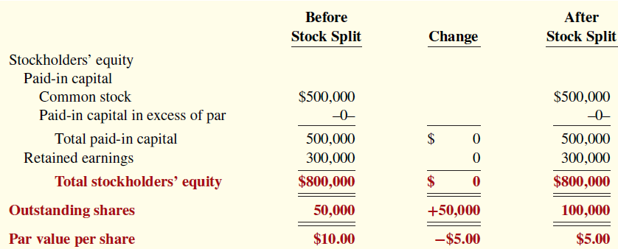
Stock Splits
A stock split, like a stock dividend, involves issuance of additional shares to stockholders according to their percentage ownership.
Each old share is split into a number of new shares with a reduced par value/stated value.
The company increases the number of shares in the same proportion that par or stated value per share decreases. For example, in a 2-for-1 split, the company exchanges one share of $10 par value stock for two shares of $5 par value stock. This does not have any effect on total paid-in capital, retained earnings, or total stockholders’ equity (see below illustration). Therefore, a company does not need to journalize a stock split.
The purpose is to increase the marketability of the stock by lowering its market price per share. This, in turn, makes it easier for the corporation to issue additional stock.
Medland Corporation split its 50,000 shares of common stock on a 2-for-1 basis. Illustration shows the effects of the split.
  LO 3
Notes:
Supplementary notes by TBR:
The decrease in the market price of a stock after a stock split is a direct result of increasing the number of outstanding shares without changing the company's overall market capitalization.
Market Capitalization: This is the total value of a company's outstanding shares. It's calculated by multiplying the current share price by the total number of outstanding shares.
Stock Split's Goal: A stock split aims to increase the number of shares while keeping the company's market capitalization constant.
Example: 2-for-1 Split: If you own one share of stock before a 2-for-1 split, you'll own two shares after the split. To maintain the same market capitalization, the price of each individual share must be halved. So, if the stock was trading at $100 per share before the split, it will trade at $50 per share after the split.
The Logic: The company is essentially dividing its existing ownership into more, smaller pieces. Since the company's overall value hasn't changed, the value of each individual piece must decrease proportionally. Imagine a pizza. If you cut that pizza into twice as many slices, each slice will be half the size (or have half the value).

Slide 51
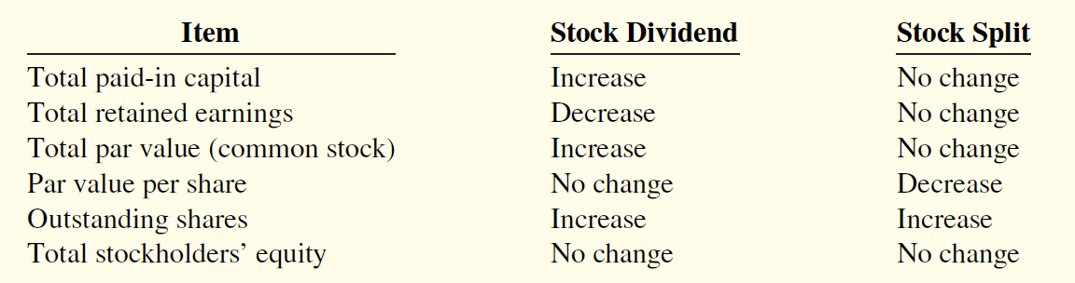
DO IT AT HOME: Stock Dividend & Stock Split Differentiated
Illustration below summarizes the differences between stock dividends and stock splits:
  LO 3

Slide 52
Statement Presentation of Stockholders’ Equity (1 of 2)
Companies report paid-in capital and retained earnings in the stockholders’ equity section of the balance sheet. Paid-in capital includes:
Capital stock. Preferred stock appears before common stock because of its preferential rights. Companies report par value, shares authorized, shares issued, and shares outstanding for each class of stock.
Additional paid-in capital. Excess amounts paid in over par or stated value and paid-in capital from treasury stock.

Slide 53
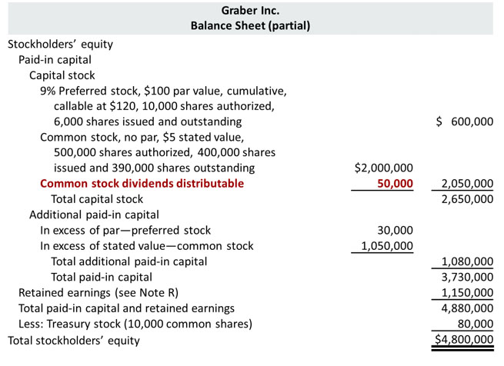
Statement Presentation of Stockholders’ Equity (2 of 2)
Notes:
Supplementary notes by TBR:
Under Stockholders' equity:
Paid-in capital
Capital stock (at par/stated value)
Preferred stock: 9% = fixed annual dividend of $9 per share {9% of $100 par value}; cumulative = if corporation cannot pay dividend in year 1 due to losses, they will pay in year 2, and so on, meaning any unpaid dividend will be carried forward to the following year; callable at $120 = the corporation has the right, but not the obligation, to repurchase or "call back" the preferred stock from its shareholders at a price of $120 per share ; 6000 shares issued and outstanding meaning no preferred shares was bought back by the company
Common stock: 400,000 shares issued, and 390,000 outstanding meaning 10,000 common shares bought back by the company (treasury stock)
Issued shares are the shares that a company issues/sells. Its shareholders hold these shares. The company issues these to the people in the company or the general public and some large investment institutions.
Outstanding shares are Issued shares minus the stock in the treasury. When a company buys back its shares and does not retire them, they are said to place in the treasury. Thus, after subtracting such shares in the treasury, the remaining are said to be outstanding shares.
Total capital stock (summation of i and ii)
Additional paid-in capital
mention "Preferred stock“
mention "Common stock“
Total additional paid-in capital (summation of a and b)
Total paid-in capital (summation of 1 and 2)
Retained Earnings
Total paid-in capital and retained earnings (summation of 3 and 4)
Treasury stock [has to be deducted] (when corporation issues shares of common stock, sometimes it buys back certain portion of the issue in order to keep it with the corporation because they want to keep some stock in their hand so that they can pay for other transactions such as employee bonus/attorney fees, and sometimes these stocks are retained in order to have higher demand in the stock market)
Total stockholders' equity (5 - 7)

Slide 54
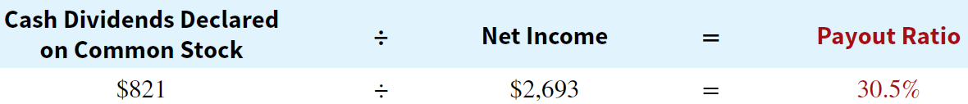
Analysis of Stockholders’ Equity
  Payout Ratio
  One way that companies reward stock investors for their investment is to pay them dividends.
  The payout ratio measures the percentage of earnings (net income) a company distributes in the form of cash dividends to common stockholders.
  It is computed by dividing total cash dividends declared to common shareholders by net income.
  To illustrate, Nike’s dividends were recently $821 million and net income was $2,693 million.
Notes:
Supplementary notes by TBR:
Companies attempt to set their dividend rate at a level that will be sustainable. Companies that have high growth rates are characterized by low payout ratios because they reinvest most of their net income in the business. Thus, a low payout ratio is not necessarily bad news. Companies that believe they have many good opportunities for growth, such as Facebook, will reinvest those funds in the company rather than pay dividends. However, low dividend payments,
or a cut in dividend payments, might signal that a company has liquidity or solvency problems and is trying to conserve cash by not paying dividends. Thus, investors and analysts should investigate the reason for low dividend payments.

Slide 55
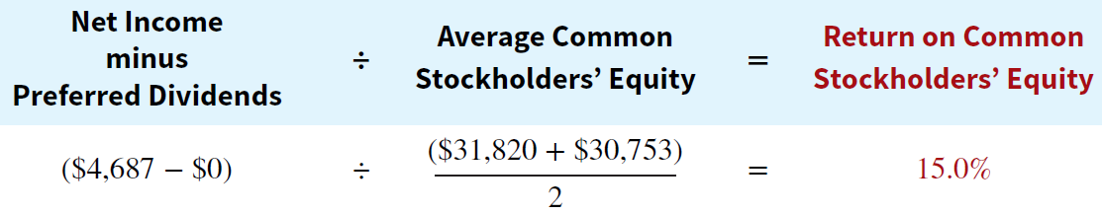
Analysis of Stockholders’ Equity
  Return on Common Stockholders’ Equity
  Investors and analysts can measure profitability from the viewpoint of the common stockholder by the return on common stockholders’ equity.
  This ratio indicates how many dollars of net income the company earned for each dollar invested by the common stockholders.
  It is computed by dividing net income available to common stockholders (i.e. net income minus preferred stock dividends) by average common stockholders’ equity (i.e. average of beginning and ending common stockholders’ equity).
  To illustrate, Walt Disney Company’s beginning and ending common stockholders’ equity were $31,820 and $30,753 million, respectively. Net income was $4,687 million, no preferred stock.

Slide 56
DO IT AT HOME: Rate of Return on Common Stockholders’ Equity
Illustration: Gerbers Inc. had net income of $360,000, declared and paid preferred dividends of $54,000, and average common stockholders’ equity of $2,550,000.
  LO 4

Slide 57
Do It AT HOME! 2: Analyzing Stockholders’ Equity (1 of 3)
On January 1, 2020, Siena Corporation purchased 2,000 shares of treasury stock. Other information regarding Siena Corporation is provided below.
 | 2019 | 2020
Net income | $110,000 | $110,000
Dividends on preferred stock | 10,000 | 10,000
Dividends on common stock | 2,000 | 1,600
Common stockholders’ equity, beginning of year | 500,000 | 400,000*
Common stockholders’ equity, ending of year | 500,000 | 400,000
*Adjusted for purchase of treasury stock.
(a) Compute return on common stockholders’ equity for each year, and (b) discuss its change from 2019 to 2020.

Slide 58
Do It AT HOME! 2: Analyzing Stockholders’ Equity (2 of 3)
 | 2019 | 2020
Net income | $110,000 | $110,000
Dividends on preferred stock | 10,000 | 10,000
Dividends on common stock | 2,000 | 1,600
Common stockholders’ equity, beginning of year | 500,000 | 400,000*
Common stockholders’ equity, ending of year | 500,000 | 400,000
*Adjusted for purchase of treasury stock.
(a) Compute return on common stockholders’ equity for each year.
2019
2020

Slide 59
Do It AT HOME! 2: Analyzing Stockholders’ Equity (3 of 3)
(b) Discuss its change from 2019 to 2020.
Between 2019 and 2020, return on common stockholders’ equity improved from 20% to 25%. While this would appear to be good news for the company’s common stockholders, this increase should be carefully evaluated. It is important to note that net income did not change during this period. The increase in the ratio was due to the purchase of treasury shares, which reduced the denominator of the ratio. As the company repurchases its own shares, it becomes more reliant on debt and thus increases its risk.

Slide 60
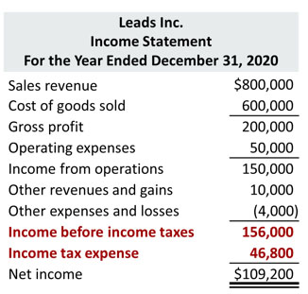
Income Statement Presentation
On the income statement, corporations report “income before income taxes” first, from which they subtract “income tax expense”, which results in “net income”.
Companies record income tax expense and the related liability for income taxes payable as part of the adjusting process.
Using the data for Leads Inc., the adjusting entry for income tax expense at December 31, 2020, is as follows.:
Income Tax Expense
46,800
Income Taxes Payable
(To record income taxes for 2020)
46,800

Slide 61
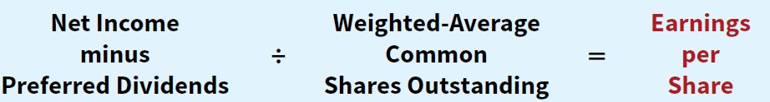
Income Statement Analysis
  E P S and Preferred Dividends: Stockholders and potential investors use earnings data of companies to evaluate their profitability. A convenient measure of earnings is earnings per share (EPS), which indicates the net income earned by each share of outstanding common stock.
  To illustrate, assume that Rally Inc. reports net income of $211,000 on its 102,500 weighted-average common shares. During the year, it also declares a $6,000 dividend on its preferred stock. Therefore, the amount Rally has available for common stock dividends is $205,000 ($211,000 − $6,000). Earnings per share is calculated as follows.

Slide 62
Do It AT HOME! 3: E P S (1 of 3)
On January 1, 2020, Siena Corporation purchased 2,000 shares of treasury stock. Other information regarding Siena Corporation is provided below.
 | 2019 | 2020
Net income | $110,000 | $110,000
Dividends on preferred stock | 10,000 | 10,000
Dividends on common stock | 2,000 | 1,600
Weighted-average number of shares outstanding | 10,000 | 8,000*
Common stockholders’ equity, beginning of year | 500,000 | 400,000*
Common stockholders’ equity, ending of year | 500,000 | 400,000
*Adjusted for purchase of treasury stock.
(a) Compute earnings per share for each year, and (b) discuss the change from 2019 to 2020.

Slide 63
Do It AT HOME! 3: E P S (2 of 3)
 | 2019 | 2020
Net income | $110,000 | $110,000
Dividends on preferred stock | 10,000 | 10,000
Dividends on common stock | 2,000 | 1,600
Weighted-average number of shares outstanding | 10,000 | 8,000*
Common stockholders’ equity, beginning of year | 500,000 | 400,000*
Common stockholders’ equity, ending of year | 500,000 | 400,000
*Adjusted for purchase of treasury stock.
(a) Compute earnings per share for each year.
2019
2020

Slide 64
Do It AT HOME! 3: E P S (3 of 3)
(b) Discuss the change from 2019 to 2020.
Between 2019 and 2020, earnings per share increased from $10 to $12.50. While this would appear to be good news for the company’s common stockholders, this increase should be carefully evaluated. It is important to note that net income did not change during this period. The increase was due to the purchase of treasury shares, which reduced the denominator of the ratio. As the company repurchases its own shares, it becomes more reliant on debt and thus increases its risk.

