Slide 1
Decision Tree Construction using Information Gain

Slide 2
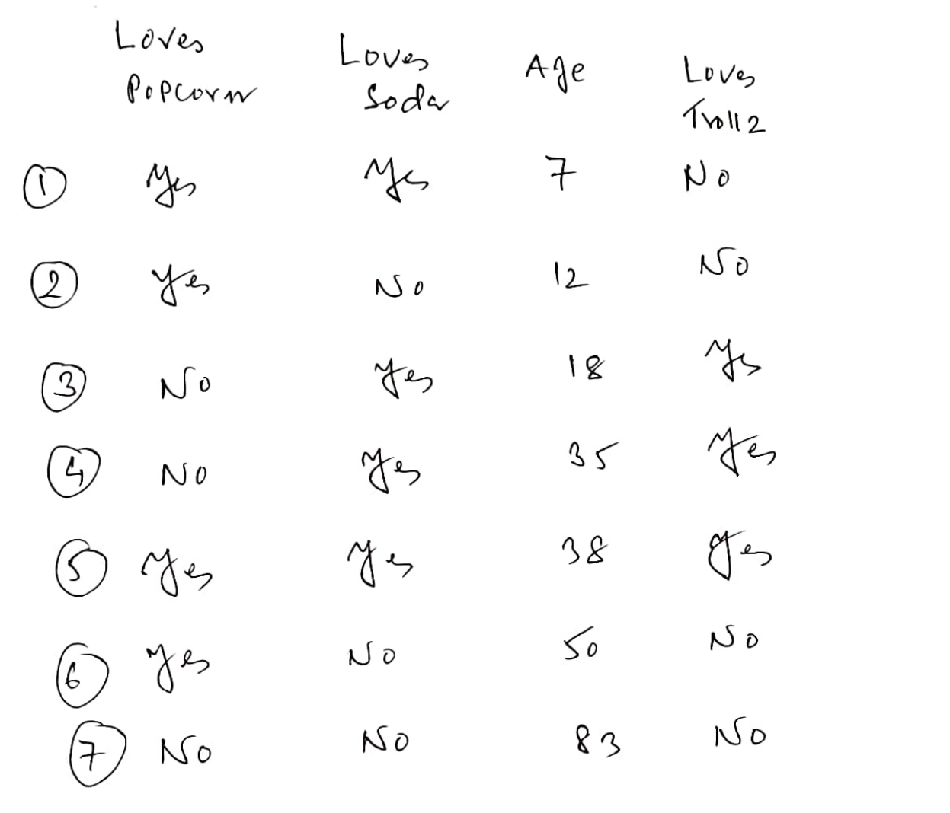

Slide 3
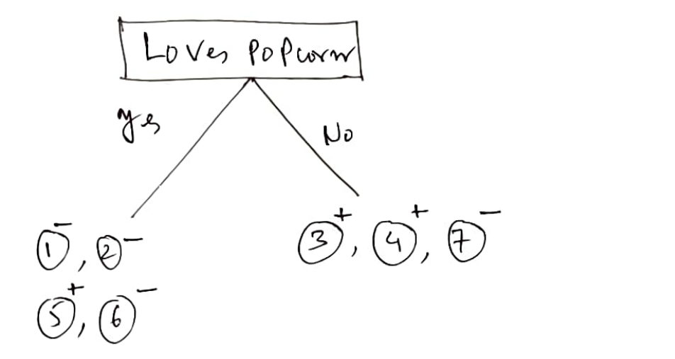
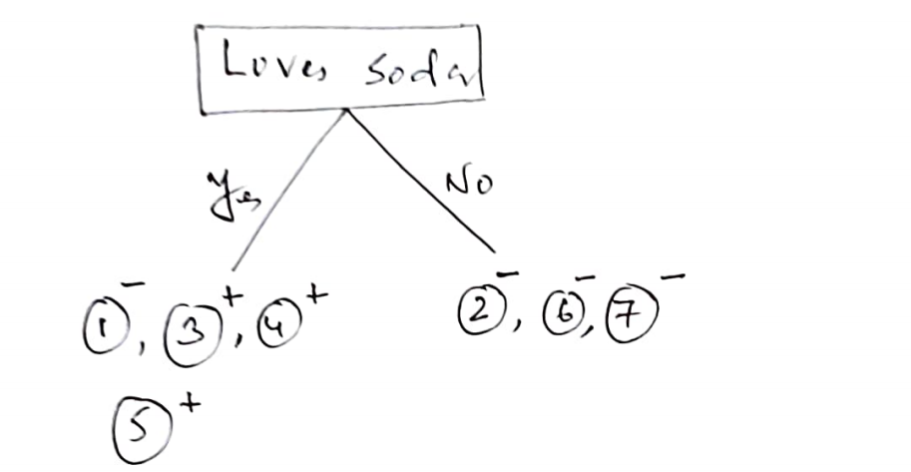

Slide 4
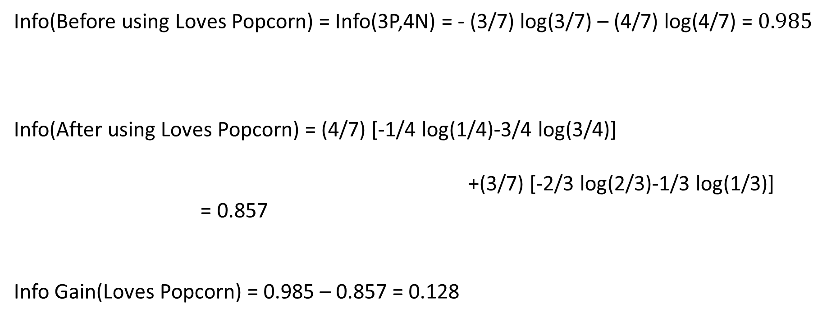
Info(Before using Loves Popcorn) = Info(3P,4N) = - (3/7) log(3/7) – (4/7) log(4/7) = $0.985$
Info(After using Loves Popcorn) = (4/7) [-1/4 log(1/4)-3/4 log(3/4)]
+(3/7) [-2/3 log(2/3)-1/3 log(1/3)]
= 0.857
Info Gain(Loves Popcorn) = 0.985 – 0.857 = 0.128

Slide 5
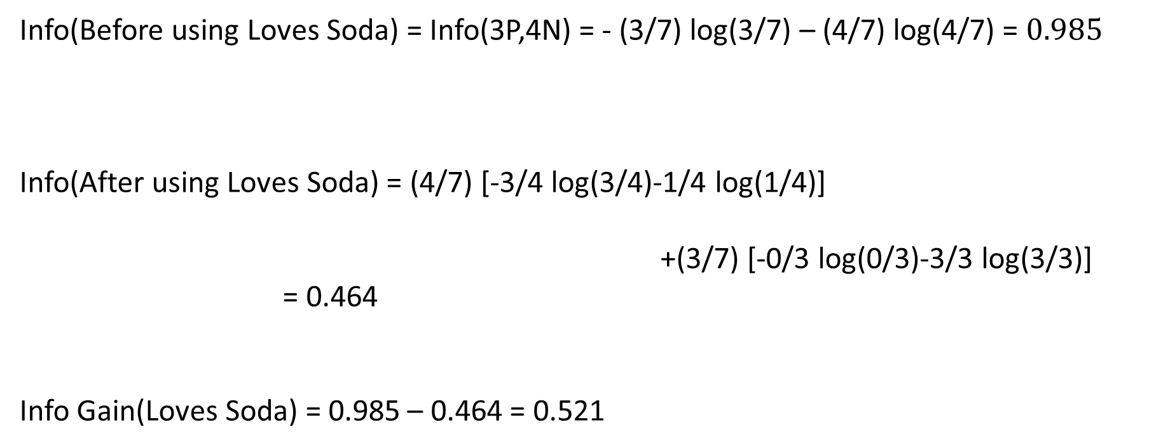
Info(Before using Loves Soda) = Info(3P,4N) = - (3/7) log(3/7) – (4/7) log(4/7) = $0.985$
Info(After using Loves Soda) = (4/7) [-3/4 log(3/4)-1/4 log(1/4)]
+(3/7) [-0/3 log(0/3)-3/3 log(3/3)]
= 0.464
Info Gain(Loves Soda) = 0.985 – 0.464 = 0.521

Slide 6
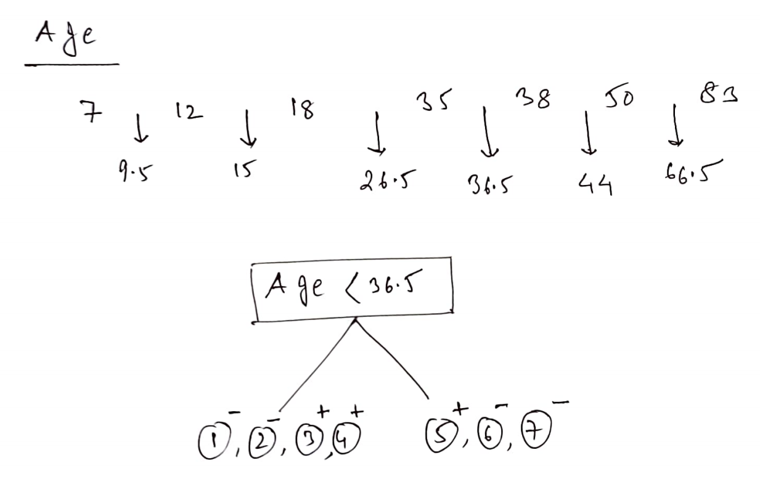

Slide 7
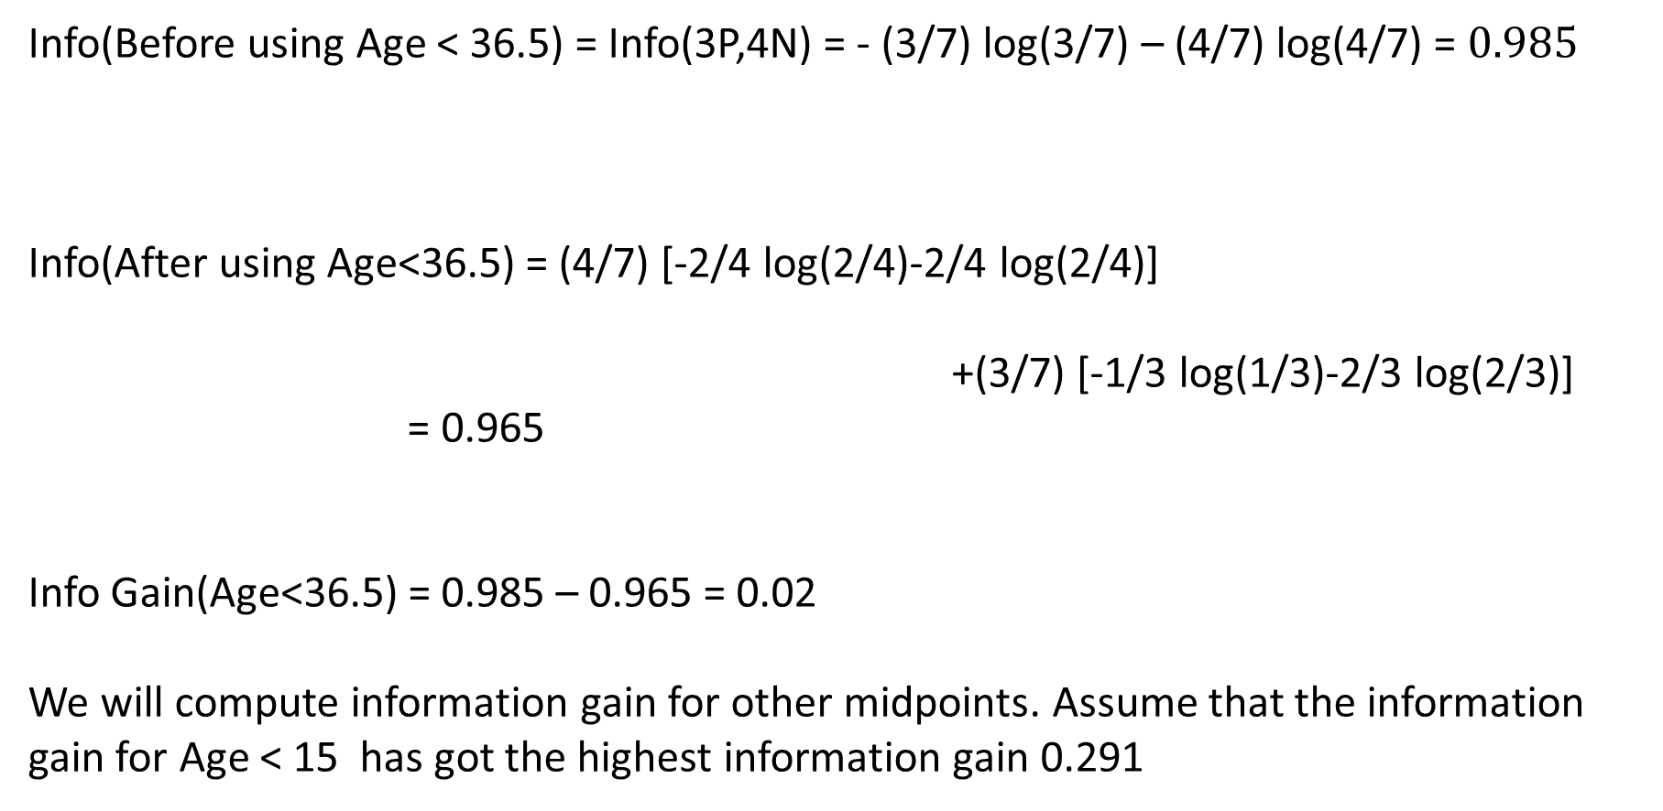
Info(Before using Age < 36.5) = Info(3P,4N) = - (3/7) log(3/7) – (4/7) log(4/7) = $0.985$
Info(After using Age<36.5) = (4/7) [-2/4 log(2/4)-2/4 log(2/4)]
+(3/7) [-1/3 log(1/3)-2/3 log(2/3)]
= 0.965
Info Gain(Age<36.5) = 0.985 – 0.965 = 0.02
We will compute information gain for other midpoints. Assume that the information gain for Age < 15 has got the highest information gain 0.291

Slide 8
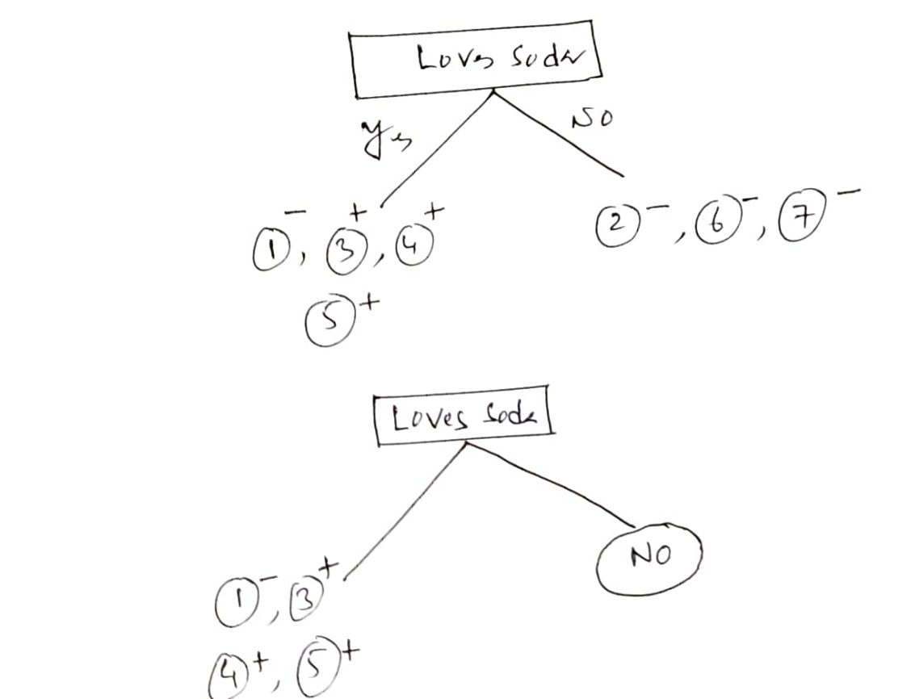
Info Gain(Loves Popcorn) = 0.128
Info Gain (Loves Soda) =0.521
Info Gain (Age <15) = 0.291

Slide 9
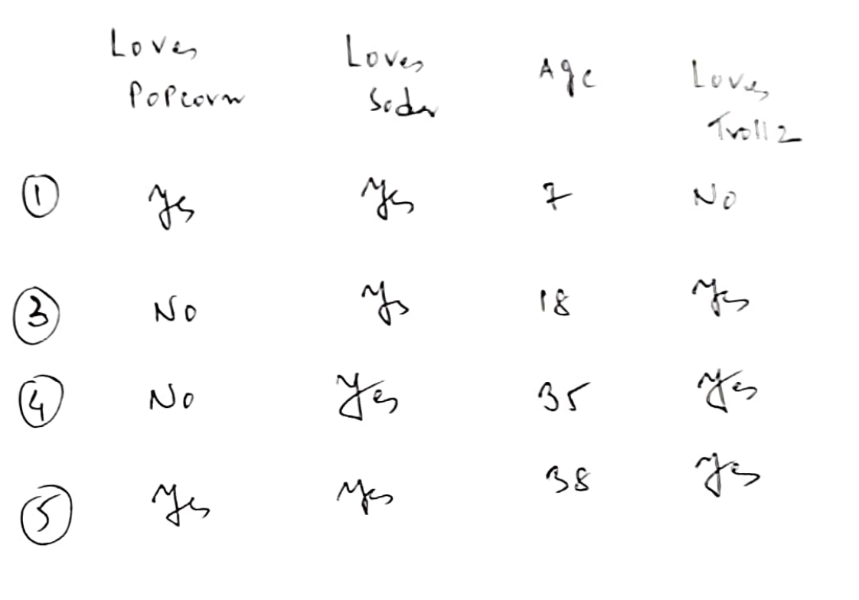
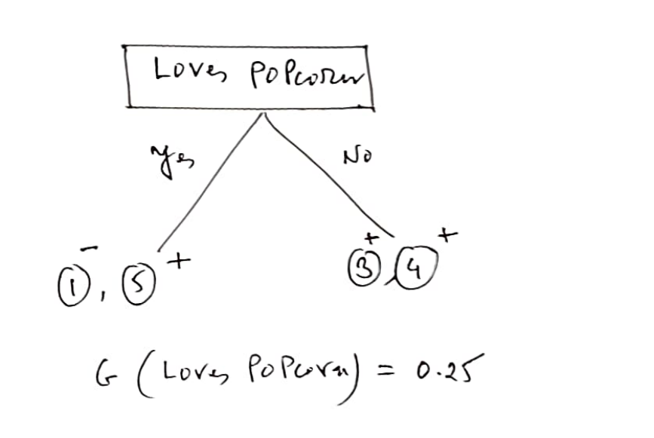

Slide 10
Info(Before using Loves Popcorn) = Info(3P,1N) = - (3/4) log(3/4) – (1/4) log(1/4) = 0.811
Info(After using Loves Popcorn) = (2/4) [-1/2 log(1/2)-1/2 log(1/2)]
+(2/4) [-2/2 log(2/2)-0/2 log(0/2)]
= 0.50
Info Gain(Loves Popcorn) = 0.811 – 0.50 = 0.311

Slide 11
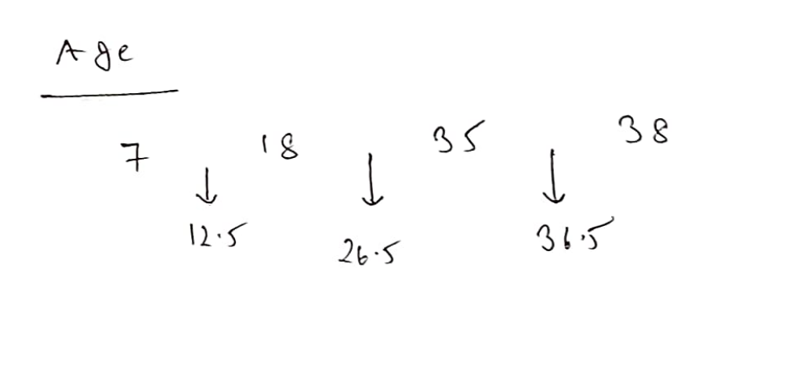
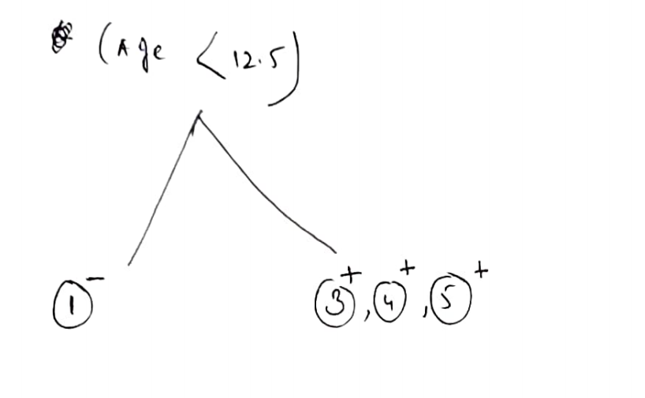

Slide 12
Info(Before using Age <12.5) = Info(3P,1N) = - (3/4) log(3/4) – (1/4) log(1/4) = 0.811
Info(After using Age<12.5) = (1/4) [-0/1 log(0/1)-1/1 log(1/1)]
+(3/4) [-3/3 log(3/3)-0/3 log(0/3)]
= 0.00
Info Gain(Age<12.5) = 0.811 – 0.00 = 0.811
Info gain of other mid points are less than 0.811
Info Gain(Loves Popcorn) = 0.811 – 0.50 = 0.311
Age<12.5 is the winner

Slide 13
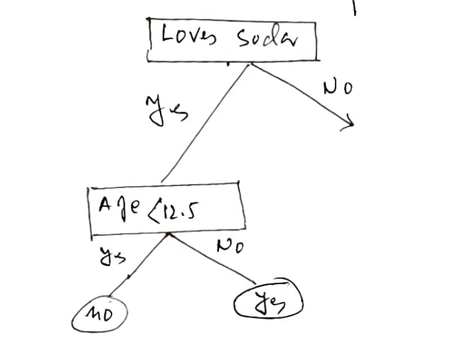

Slide 14
