Slide 1
Tracing

Slide 2
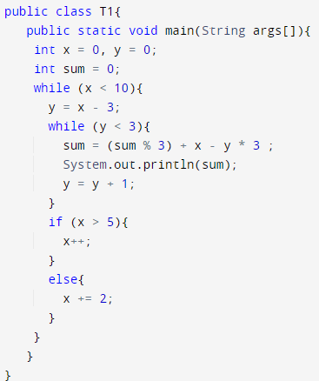
Example Code
Output:
9
6
3
0
-3
-6
5
4
0
-4
0
-2

