Slide 1
Data Communication
Data Communication is the exchange of information from one entity to the other using a Transmission Medium.
‹#›

Slide 2
Data Communication
1883: Samuel Morse & Alfred Veil invent Morse Code Telegraph System
1876: Alexander Graham Bell invented Telephone
1930: Development of ASCII Transmission Code
1950: IBM releases its first computer IBM 710
1960: IBM releases the First Commercial Computer IBM 360
‹#›

Slide 3
Data Communication Definition (Modified)
Data Communication is the exchange of data (in the form of 0’s and 1’s) between two devices (computers) via some form of the transmission medium.
‹#›

Slide 4
DATA COMMUNICATIONs
The term telecommunication means communication at a distance. The word data refers to information presented in whatever form is agreed upon by the parties creating and using the data. Data communications are the exchange of data between two devices via some form of transmission medium such as a wire cable.
1.‹#›

Slide 5



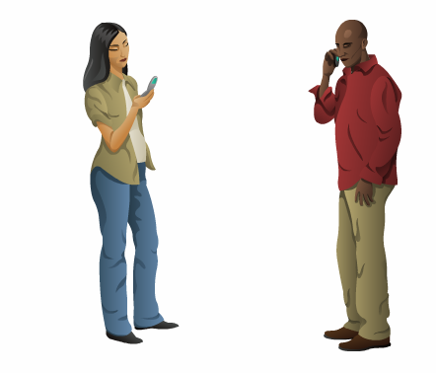
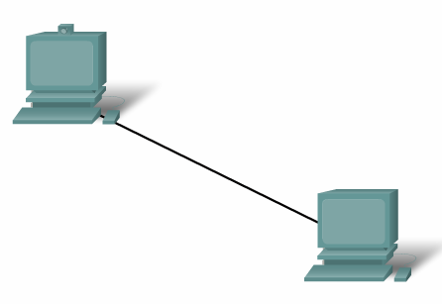

Elements of Communication
‹#›

Slide 6
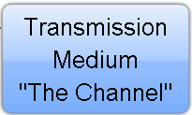




Elements of Communication
What are the elements?
‹#›

Slide 7
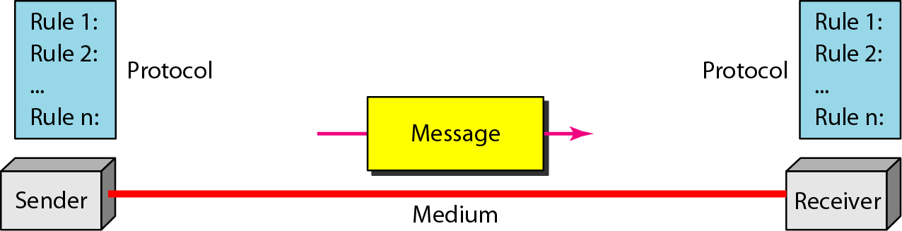
Five elements/components of data communication
1.‹#›

Slide 8
Elements of Communication over Networks
Devices (Sender/Receiver)
These are used to communicate with one another
Medium
This is how the devices are connected together
Messages
Information that travels over the medium
Rules/Protocols
Governs how messages flow across network
‹#›

Slide 9
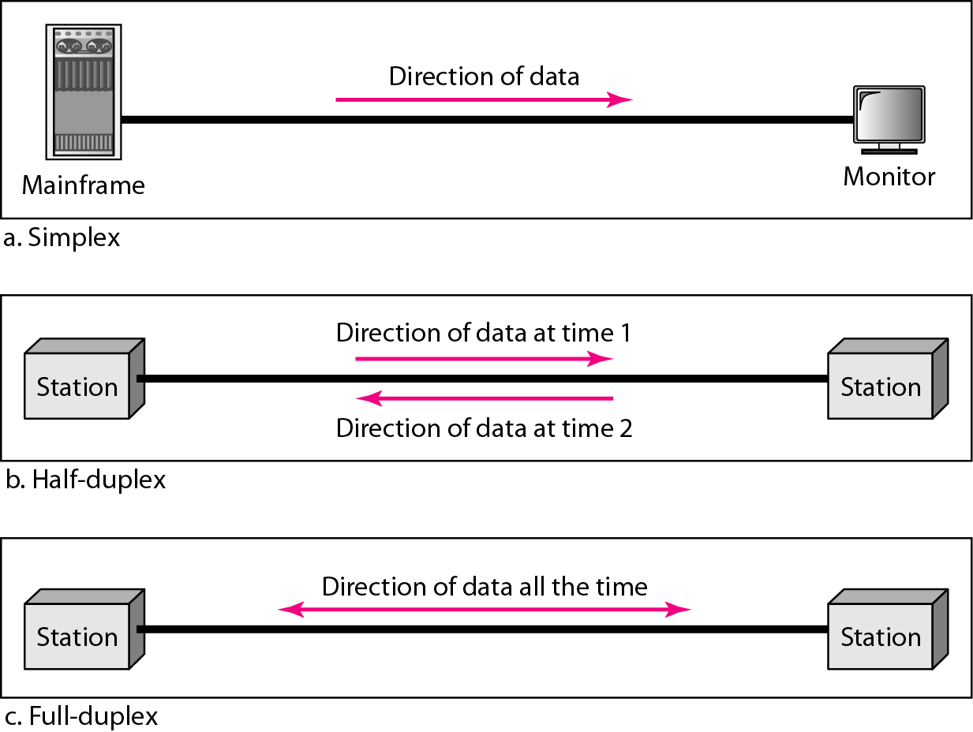
Transmission Mode / Data flow (simplex, half-duplex, and full-duplex)
1.‹#›

Slide 10
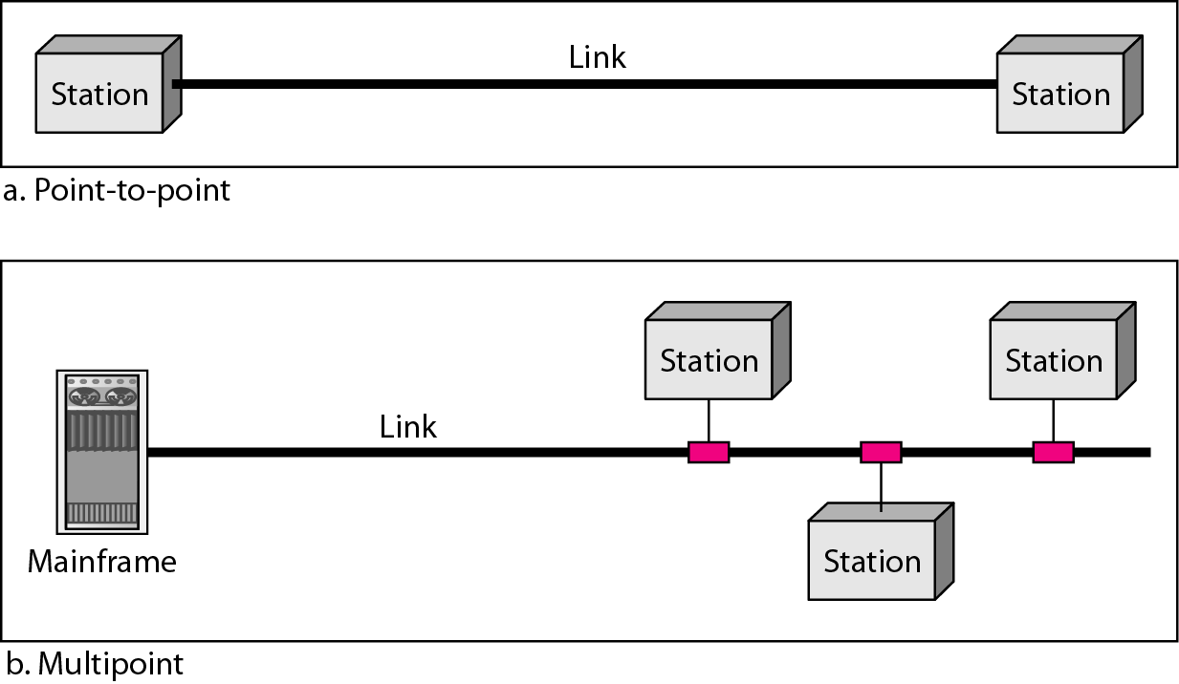
Figure 1.3 Types of connections: point-to-point and multipoint
1.‹#›

Slide 11
NETWORKS
A network is a set of devices (often referred to as nodes) connected by communication links. A node can be a computer, printer, or any other device capable of sending and/or receiving data generated by other nodes on the network.
Topics discussed in this section:
Distributed Processing Physical Structures Categories of Networks Interconnection of Networks: Internetwork

Slide 12
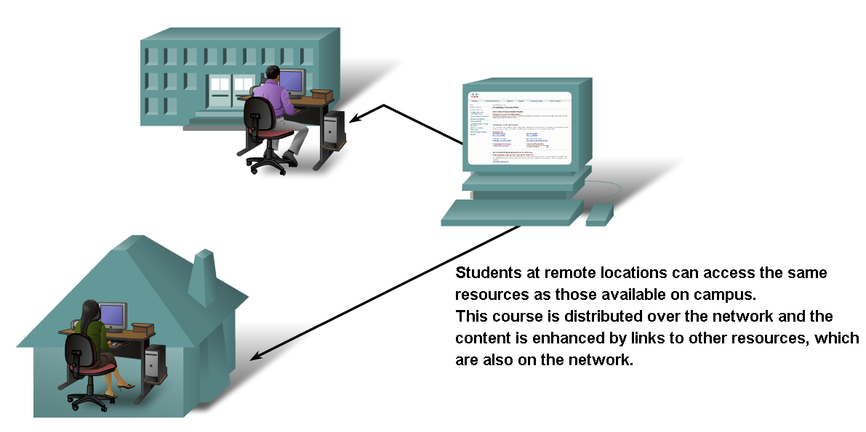
Networks supporting the way we learn.
‹#›

Slide 13
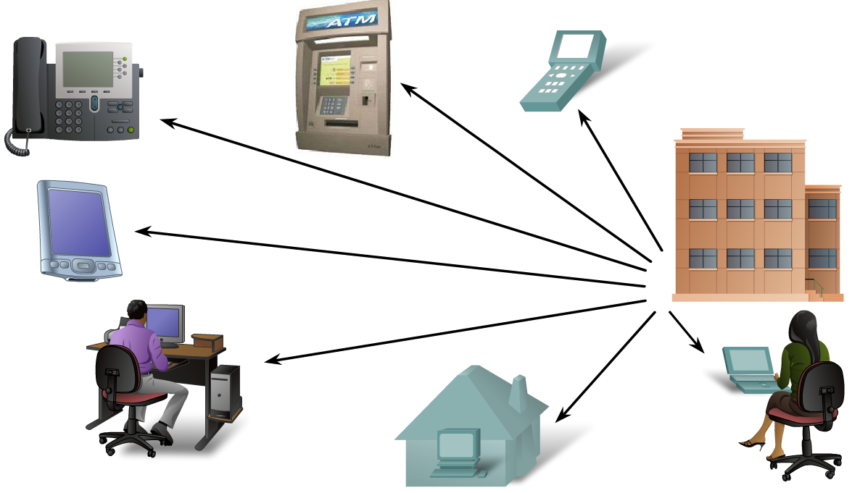
Networks supporting the way we work.
‹#›

Slide 14
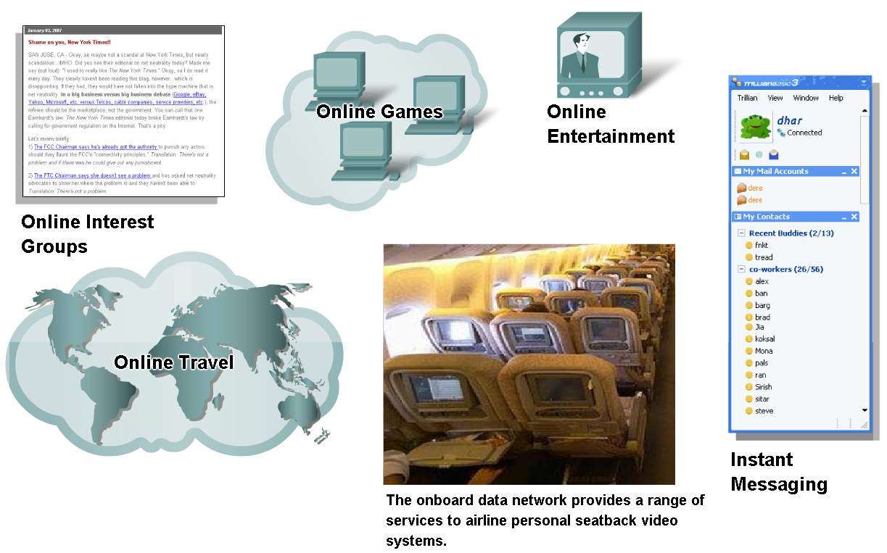
Networks supporting the way we play.
‹#›

Slide 15
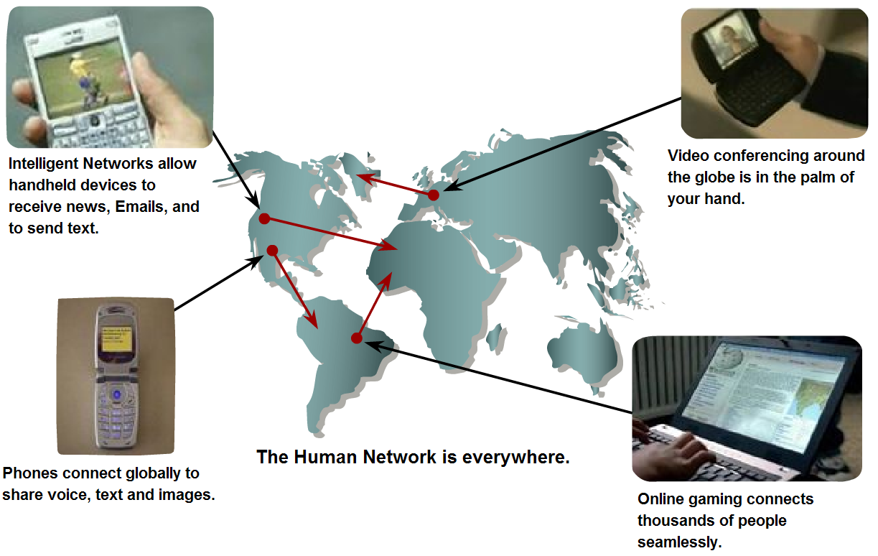
Networks- Purpose???
Communication.
‹#›

Slide 16
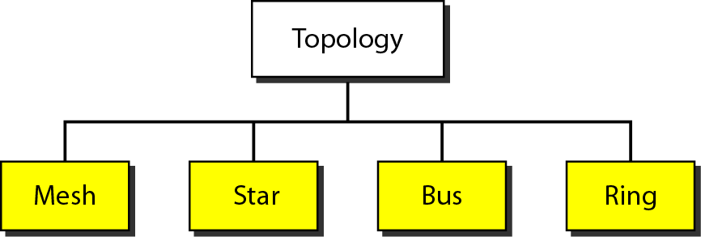
Figure 1.4 Categories of topology
1.‹#›

Slide 17
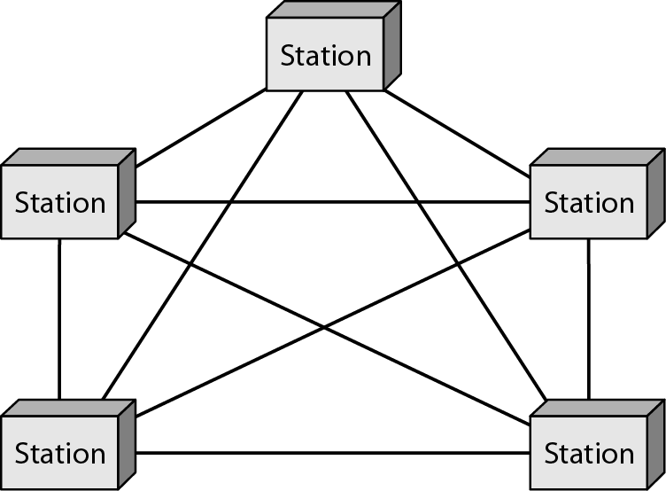
Figure 1.5 A fully connected mesh topology (five devices)
1.‹#›

Slide 18
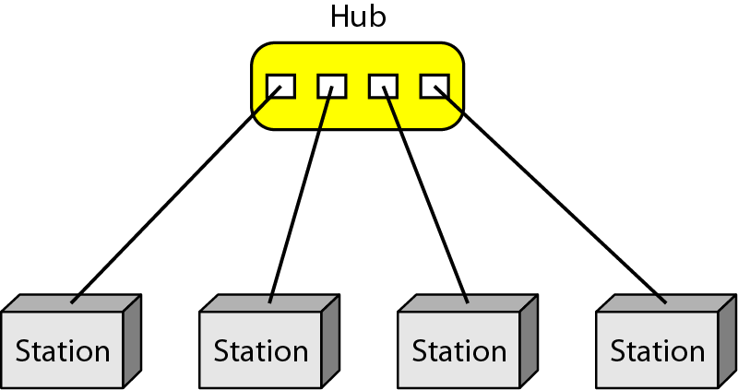
Figure 1.6 A star topology connecting four stations
1.‹#›

Slide 19
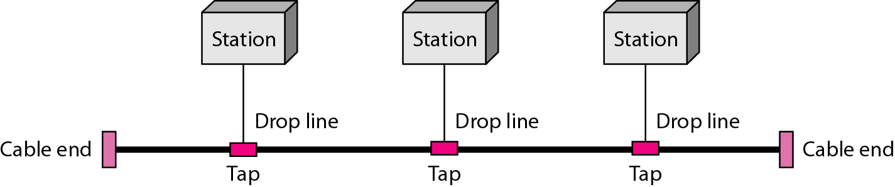
Figure 1.7 A bus topology connecting three stations
1.‹#›

Slide 20
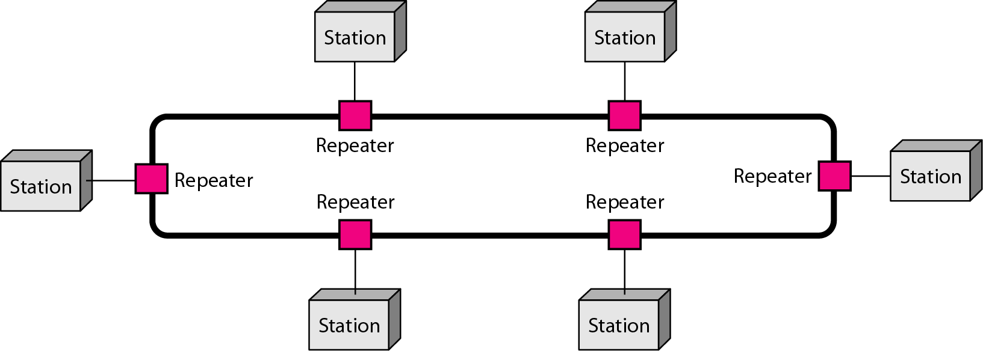
Figure 1.8 A ring topology connecting six stations
1.‹#›

Slide 21
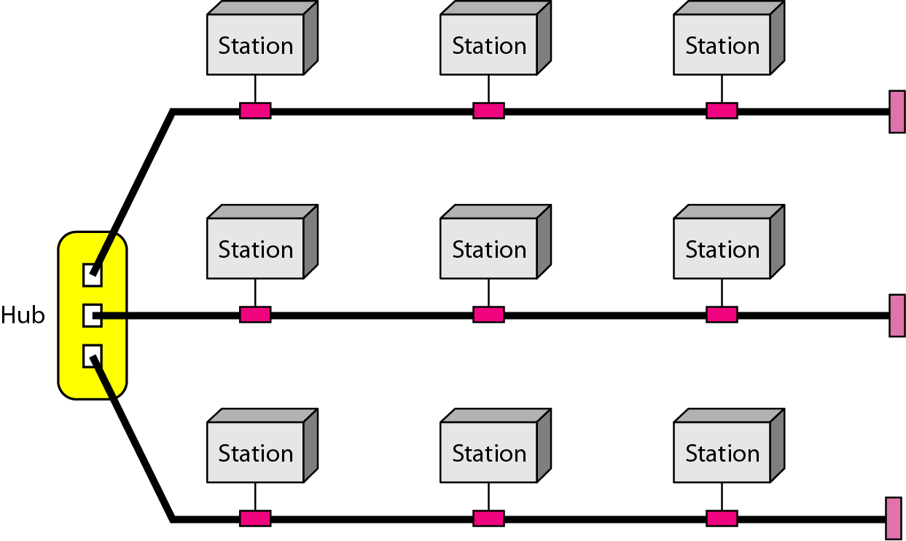
Figure 1.9 A hybrid topology: a star backbone with three bus networks
1.‹#›

Slide 22
Advantages/disadvantages of Topologies
Topology | Advantages | Disadvantages
Mesh | Fast, no traffic problem No single point of failure Privacy / security | Expensive, lots of wires and ports needed New connection setup difficult
Star | Less expensive than mesh Easy to setup and add/remove nodes | Single point of failure Traffic congestion
Bus | Cheap Easy installation Suitable for broadcasting scenarios | Signal degradation with distance, limiting the number of taps Single point of failure (bus backbone) No privacy / security [design choice, not exactly a limitation]
Ring | Easy installation No collision, stable performance | Multi points of failure No privacy / security
‹#›

Slide 23
Topology: Practice problem
Let’s consider the network setting for the following university campus with FOUR departments.
Each department has a faculty area and a student area
Each area can communicate with each other as they are connected centrally using a switch
There are THREE devices in each area that are connected using multipoint connections only
Each department has connection with all other departments
Based on this, IDENTIFY the topologies used in the university network, DRAW the hybrid structure, and CALCULATE the total number of links used.
‹#›

Slide 24
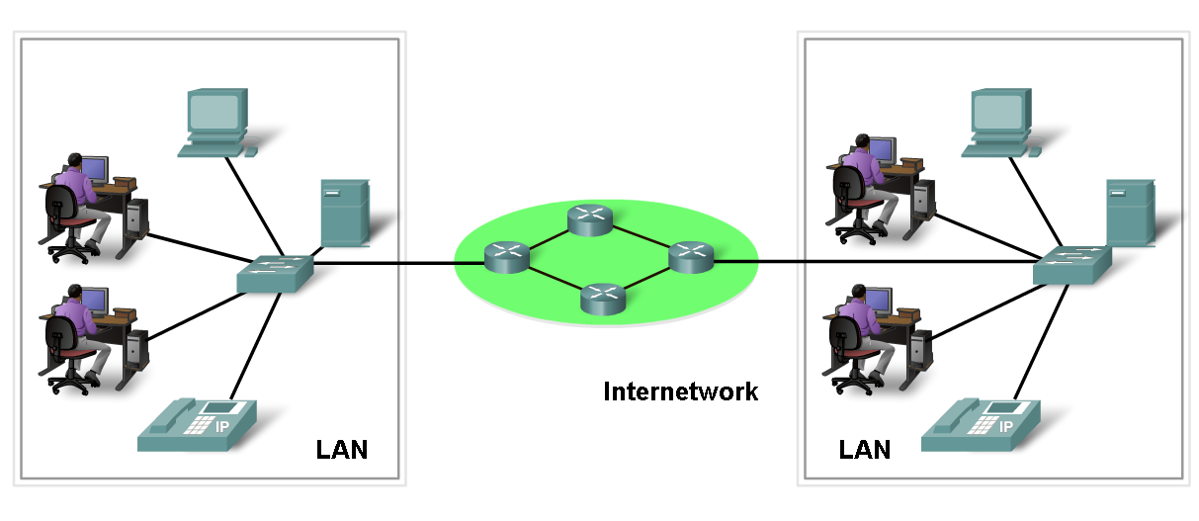
Network Elements/Components
Network Devices
Hardware (Devices and Media)
Software (Services and Processes)
‹#›

Slide 25
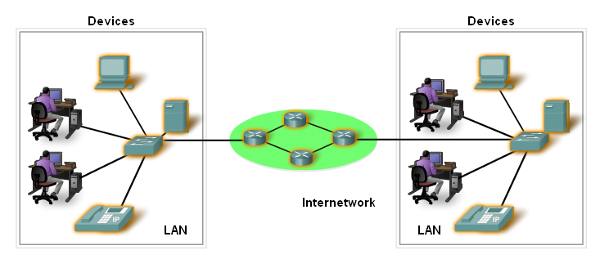
Devices
Two Types:
End Devices
Intermediary Devices
‹#›

Slide 26
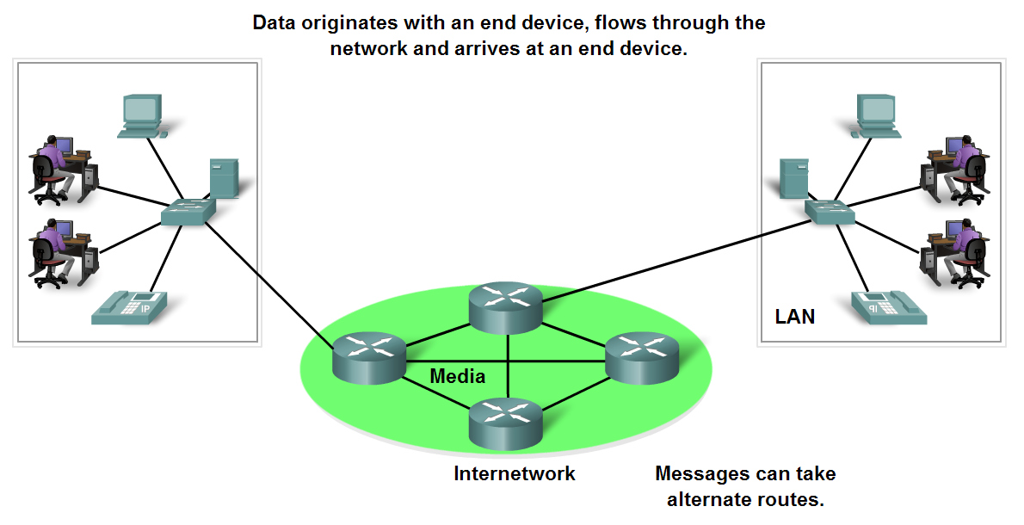
End Devices
Sits at the edge of a network and interacts directly with users
Sends, receives, stores data
Example: PCs, servers, smartphones, IoT devices, printers
‹#›

Slide 27
Intermediary devices
Connects end devices to form a network
Connects multiple networks to form an internetwork
Manages data as it flows through the network
Example: Hub, switch, router, firewall, etc
Routers
Switches
‹#›

Slide 28
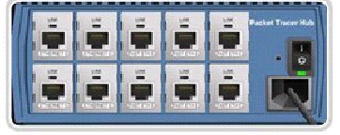
HUB
Connects multiple end devices within a network, allowing them to communicate with one another
When a device (like a computer) sends data to the hub, the hub broadcasts the data to all devices connected to it
Every connected device receives the data, but only the intended recipient processes it. All other devices ignore it
Half-duplex communication
Simple, inexpensive, easy setup, no intelligence
‹#›

Slide 29

SWITCH
Intelligent version of HUB
Instead of broadcasting data to all connected devices, the switch forwards data only to the intended recipient
Maintains a MAC address table of the devices connected to each of its port
Full-duplex communication
Intelligent forwarding, expensive, requires configuration
‹#›

Slide 30
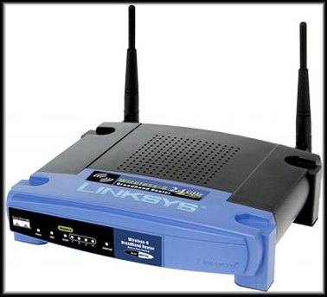
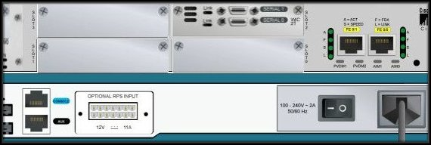
ROUTER
A gateway between networks; connects local networks with the internet
LAN ports (for local devices) and WAN port (for connecting to the internet)
Built-in security features
Supports wireless connectivity
Complex, expensive, requires configuration
‹#›

Slide 31
Software
Services
Software-driven functionalities that enable communication and resource sharing within a network
Example: file sharing and storage services, web services, email services
Processes
Standardized rules that define how devices on a network should interact
Example: authentication (logging in to a wifi network), routing procedures, error detection and connection
‹#›

Slide 32
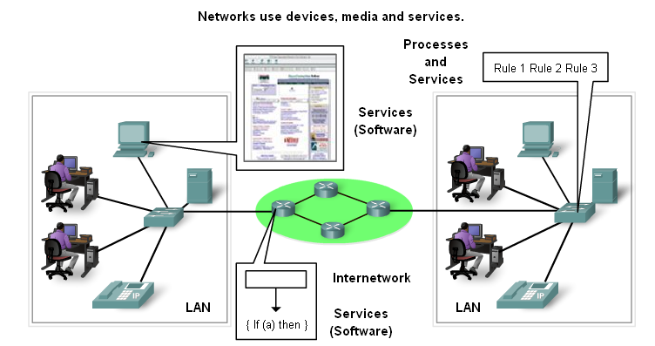
Processes and Services
‹#›

Slide 33
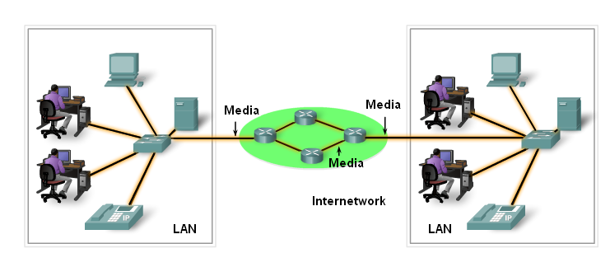
Network Media (Transmission Media)
Provides the pathway for data transmission between devices
‹#›

Slide 34
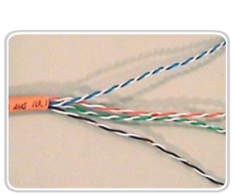
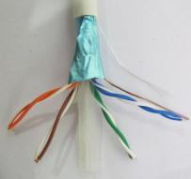
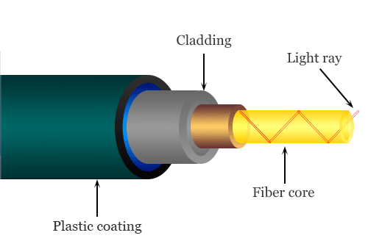

Wired Transmission Media
Unshielded Twisted Pair (UTP) Cable
Shielded Twisted Pair (STP) Cable
Coaxial cable
Fiber optic cable
‹#›

Slide 35
Wireless Transmission Media
Radio-wave (WiFi, bluetooth, FM radio)
Satellite (Star-link)
‹#›

Slide 36
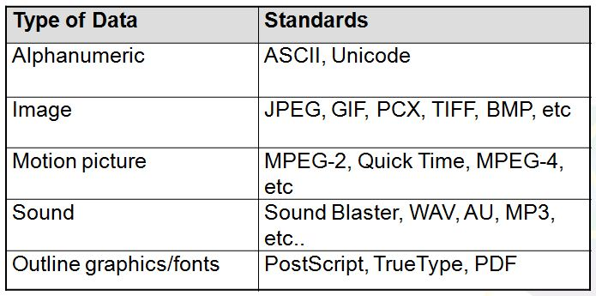
Messages- Data Representation
Information today comes in different forms such as
text, numbers, images, audio, and video.
‹#›

Slide 37
Data Representation - Text
Text : Different sets of bit patterns are designed to represent text symbols. Each set is called a code.
ASCII
American Standard Code for Information Interchange: 7-bit code/char, 1 bit for parity.
Unicode - 16 bit codes to represent a symbol.
‹#›

Slide 38
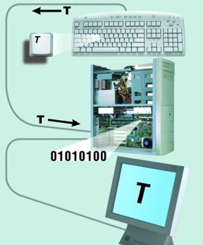
Data Representation - Text
‹#›

Slide 39
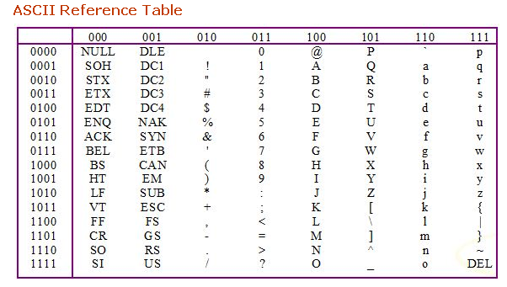
Data Representation - Text
‹#›

Slide 40
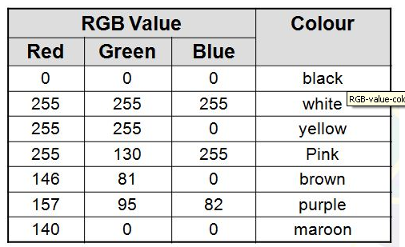
Data Representation - Image
Images –
Also represented by bit patterns.
Mechanism different. Matrix of Pixels used. Each pixel is assigned to a bit pattern.
Color images uses RGB or YCM methods.
‹#›

Slide 41
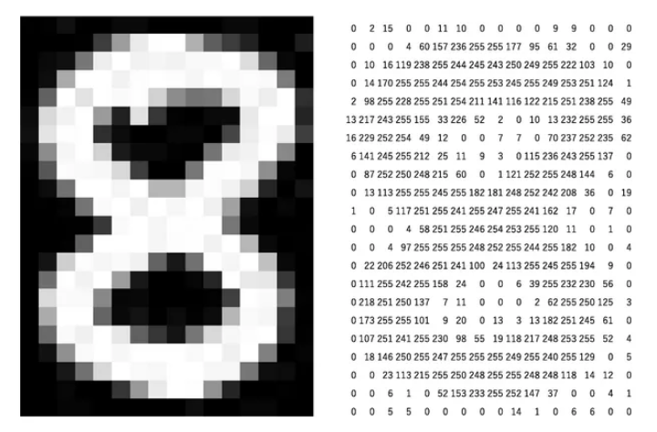
Data Representation - Image
‹#›

Slide 42
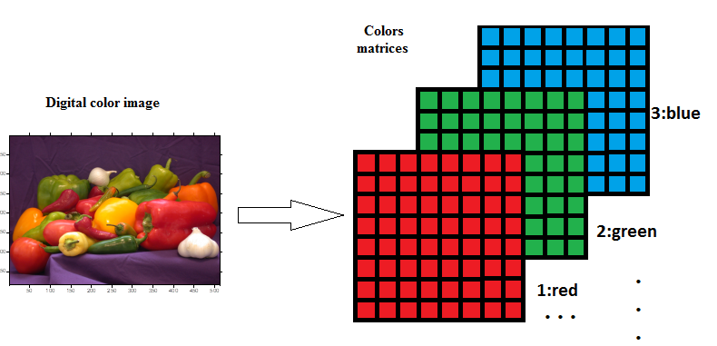
Data Representation - Image
‹#›

Slide 43
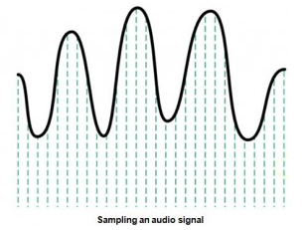
Data Representation - Audio
Audio- Continuous, not discrete. Converted to digital or analog signal.
‹#›

Slide 44
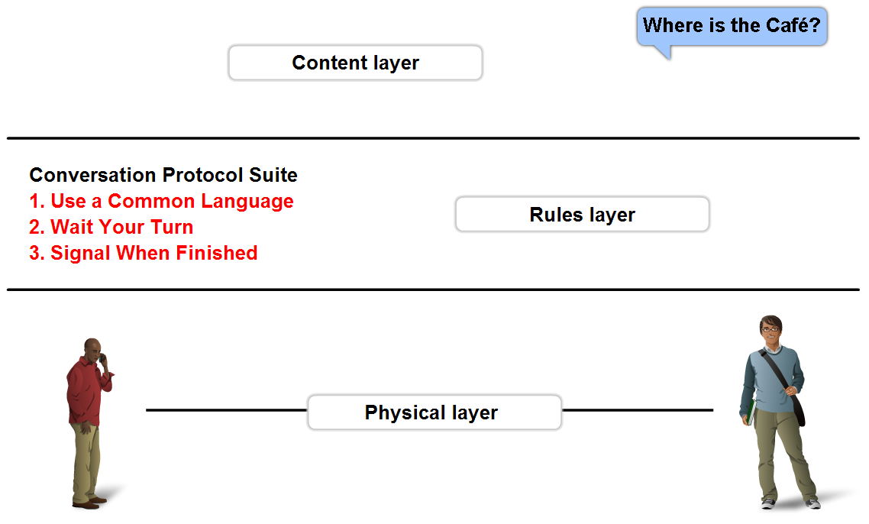
Rules - Protocols
A set of predetermined rules that govern communication.
Defines:
What is communicated??
How it is communicated??
When it is communicated??
‹#›

Slide 45
Network Types
PAN
LAN
MAN
WAN
‹#›

Slide 46
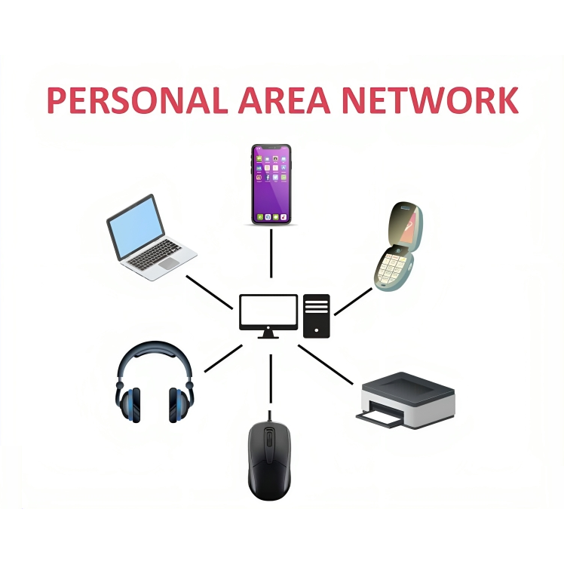
Personal Area Networks (PAN)
A small network that connects computers, peripherals and other devices for personal use through bluetooth or USB
Range: Short, typically a few meters
‹#›

Slide 47
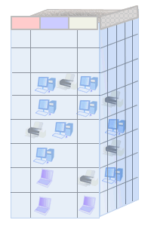
Local Area Networks (LAN)
Connects computers, peripherals and other devices within a building (e.g. varsity campus, office) or in a limited area
Range: Typically 50 to 300 meters
Example: Ethernet, Wireless LANs
‹#›
http://www.conniq.com

Slide 48
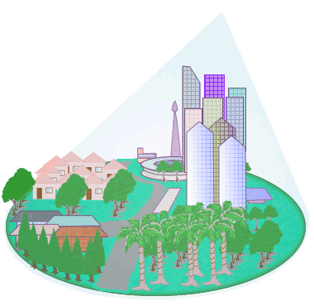
Metropolitan Area Network (MAN)
Covers larger area than LAN, e.g. a city, suburb, or large campus
Connects multiple LANs within the area to create a larger network
Example: University network connecting multiple campuses or buildings
‹#›

Slide 49
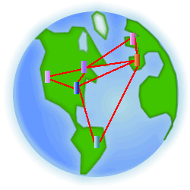
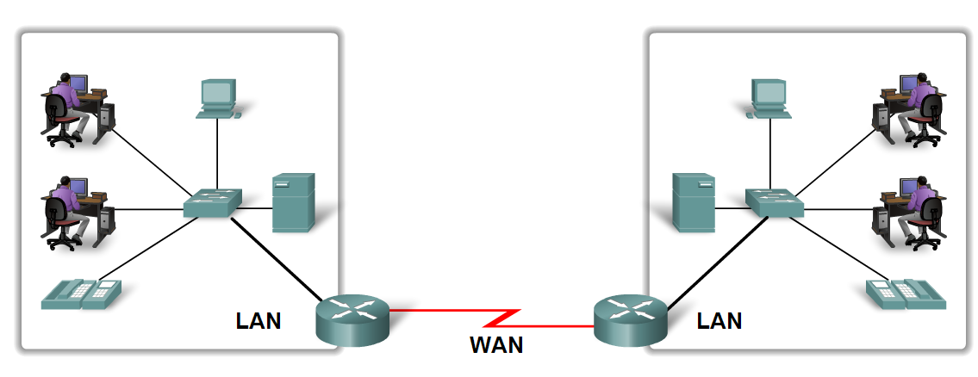
Wide Area Network (WAN)
Spans large geographical areas like countries, continents, or even the entire world
Connects multiple LANs and MANs separated by geographic distance, to form a global network
Example: Cellular Networks (GSM etc), corporate WANs (Amazon, Microsoft), Internet
‹#›

Slide 50
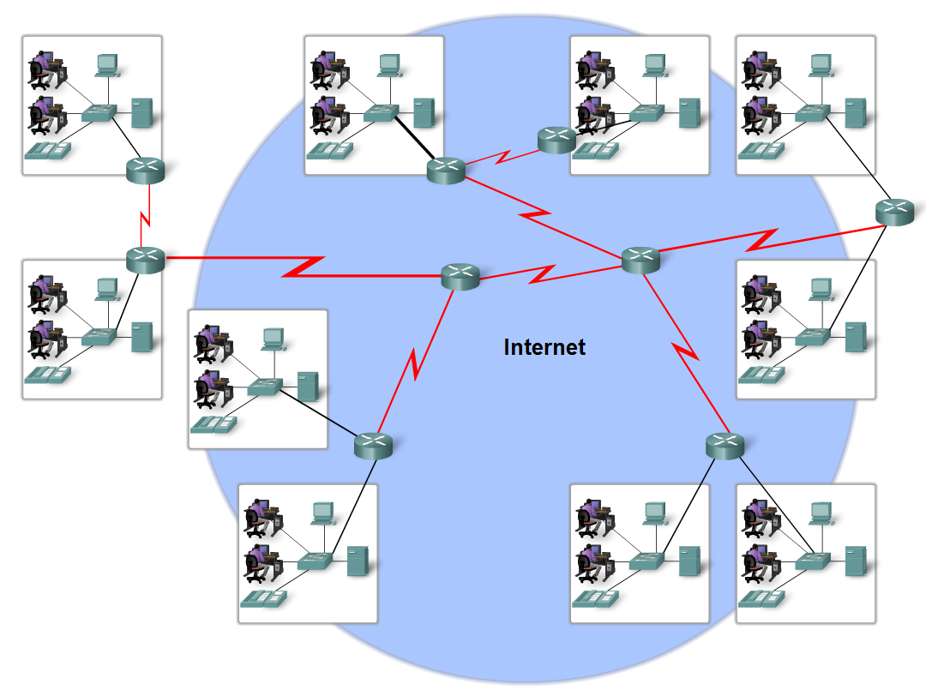
Internet
The internet is defined as a global mesh of interconnected networks.
‹#›

Slide 51
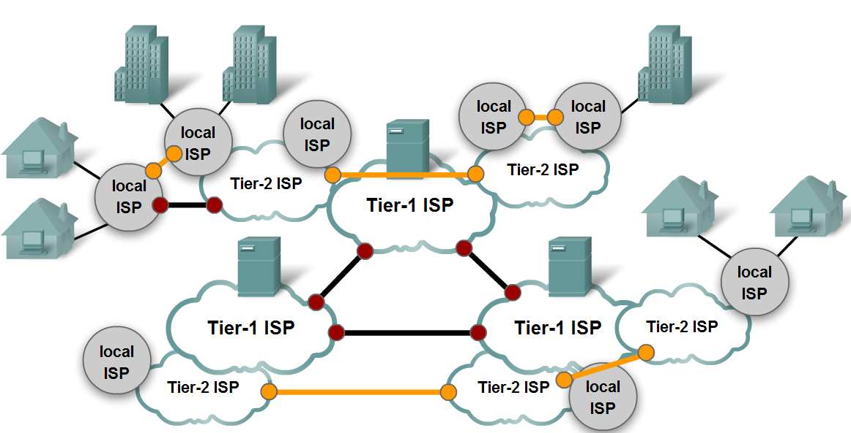
Internet
‹#›

Slide 52
Effectiveness of a system depends upon:
Delivery
Accuracy
Timeliness
Jitter

Slide 53
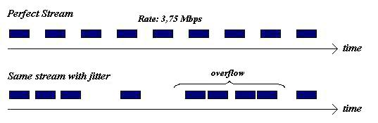

Slide 54
