Slide 1

Chapter 4
Digital Transmission
4.‹#›
Copyright © The McGraw-Hill Companies, Inc. Permission required for reproduction or display.
Notes:
‹#›

Slide 2
4-2 ANALOG-TO-DIGITAL CONVERSION
A digital signal is superior to an analog signal because it is more robust to noise and can easily be recovered, corrected and amplified. For this reason, the tendency today is to change an analog signal to digital data. In this section we describe two techniques, pulse code modulation and delta modulation.
Topics discussed in this section:
Pulse Code Modulation (PCM)
Delta Modulation (DM)
4.‹#›
Notes:
‹#›

Slide 3
PCM
PCM consists of three steps to digitize an analog signal:
Sampling
Quantization
Binary encoding
Before we sample, we have to filter the signal to limit the maximum frequency of the signal as it affects the sampling rate.
Filtering should ensure that we do not distort the signal, ie remove high frequency components that affect the signal shape.
4.‹#›

Slide 4
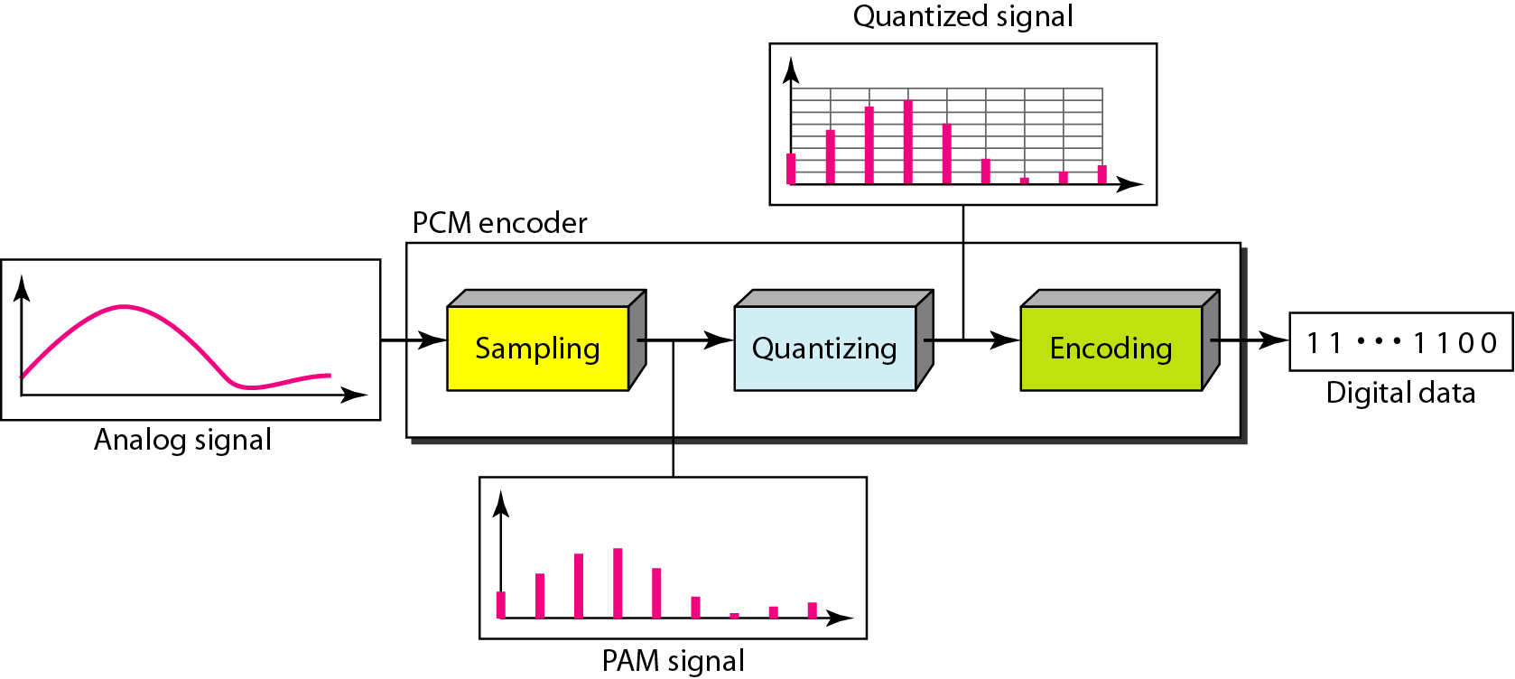
Figure 4.21 Components of PCM encoder
4.‹#›
Notes:
‹#›

Slide 5
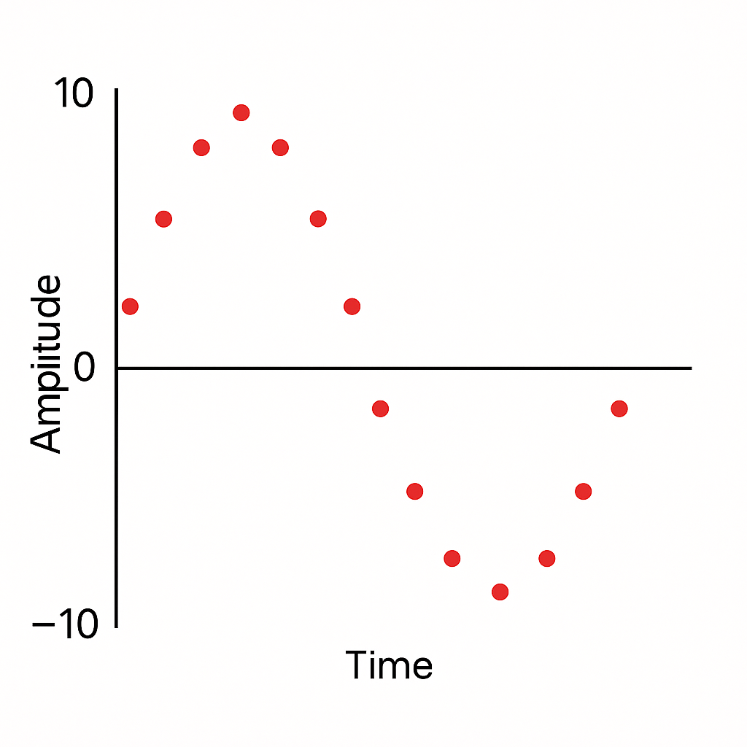
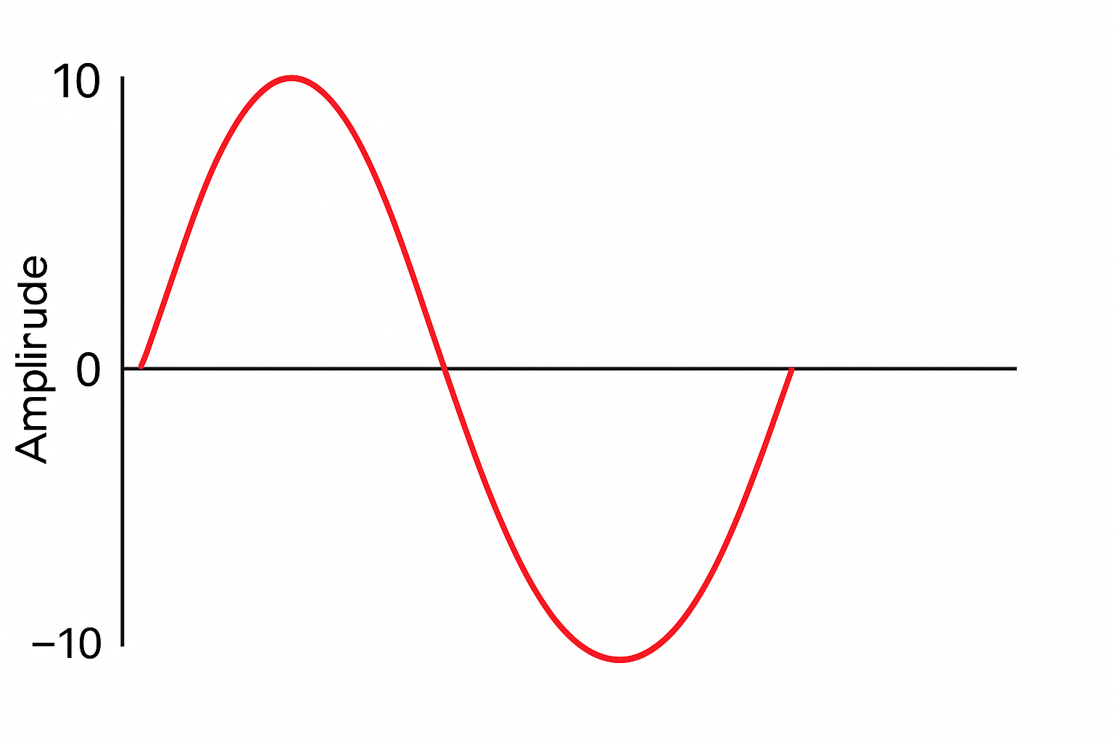
Sampling

Slide 6
Sampling
Analog signal is sampled every T_{S} secs.
T_{s} is referred to as the sampling interval.
f_{s} = 1/T_{s} is called the sampling rate or sampling frequency.
There are 3 sampling methods:
Ideal - an impulse at each sampling instant
Natural - a pulse of short width with varying amplitude
Flattop - sample and hold, like natural but with single amplitude value
The process is referred to as pulse amplitude modulation PAM and the outcome is a signal with analog (non integer) values
4.‹#›

Slide 7

Note
According to the Nyquist theorem, the sampling rate must be
at least 2 times the highest frequency contained in the signal.
4.‹#›
Notes:
‹#›

Slide 8
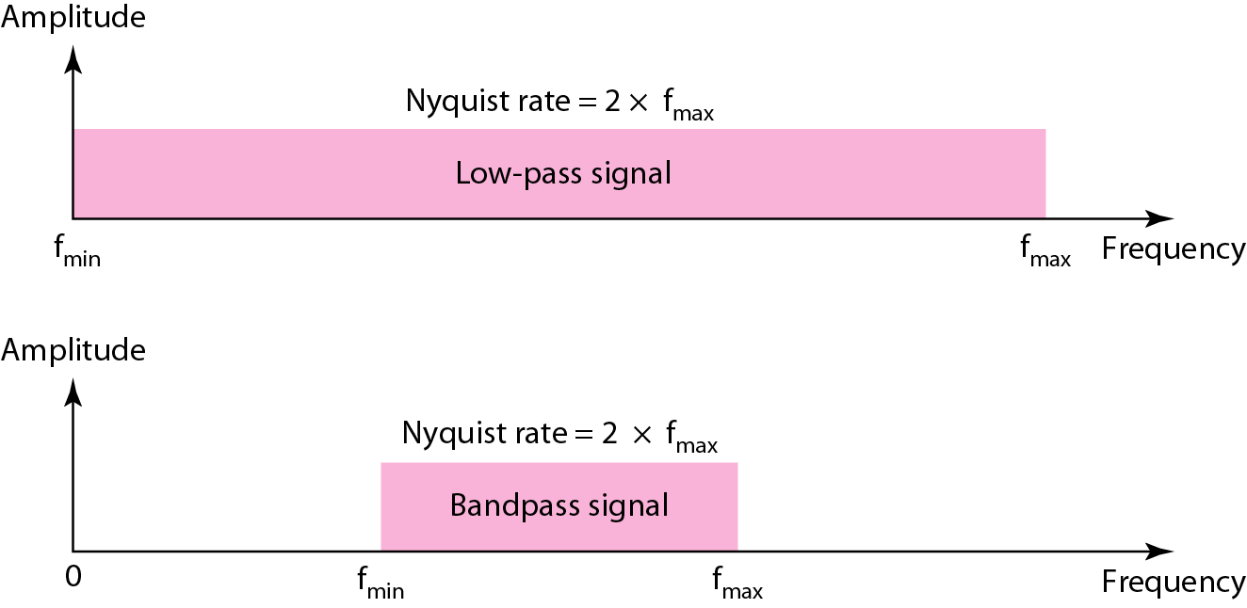
Figure 4.23 Nyquist sampling rate for low-pass and bandpass signals
4.‹#›
Notes:
‹#›

Slide 9
Example 4.6
For an intuitive example of the Nyquist theorem, let us sample a simple sine wave at three sampling rates: f_{s} = 4f (2 times the Nyquist rate), f_{s} = 2f (Nyquist rate), and f_{s} = f (one-half the Nyquist rate). Figure 4.24 shows the sampling and the subsequent recovery of the signal.
It can be seen that sampling at the Nyquist rate can create a good approximation of the original sine wave (part a). Oversampling in part b can also create the same approximation, but it is redundant and unnecessary. Sampling below the Nyquist rate (part c) does not produce a signal that looks like the original sine wave.
4.‹#›
Notes:
‹#›

Slide 10
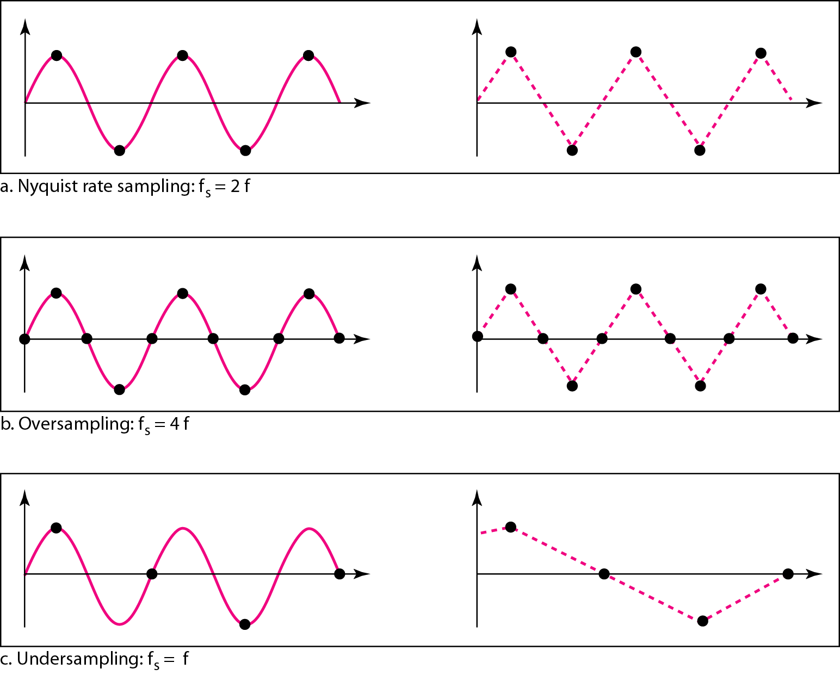
Figure 4.24 Recovery of a sampled sine wave for different sampling rates
4.‹#›
Notes:
‹#›

Slide 11
Example 4.7
Consider the revolution of a hand of a clock. The second hand of a clock has a period of 60 s. According to the Nyquist theorem, we need to sample the hand every 30 s (T_{s} = T or f_{s} = 2f ). In Figure 4.25a, the sample points, in order, are 12, 6, 12, 6, 12, and 6. The receiver of the samples cannot tell if the clock is moving forward or backward. In part b, we sample at double the Nyquist rate (every 15 s). The sample points are 12, 3, 6, 9, and 12. The clock is moving forward. In part c, we sample below the Nyquist rate (T_{s} = T or f_{s} = f ). The sample points are 12, 9, 6, 3, and 12. Although the clock is moving forward, the receiver thinks that the clock is moving backward.
4.‹#›
Notes:
‹#›

Slide 12
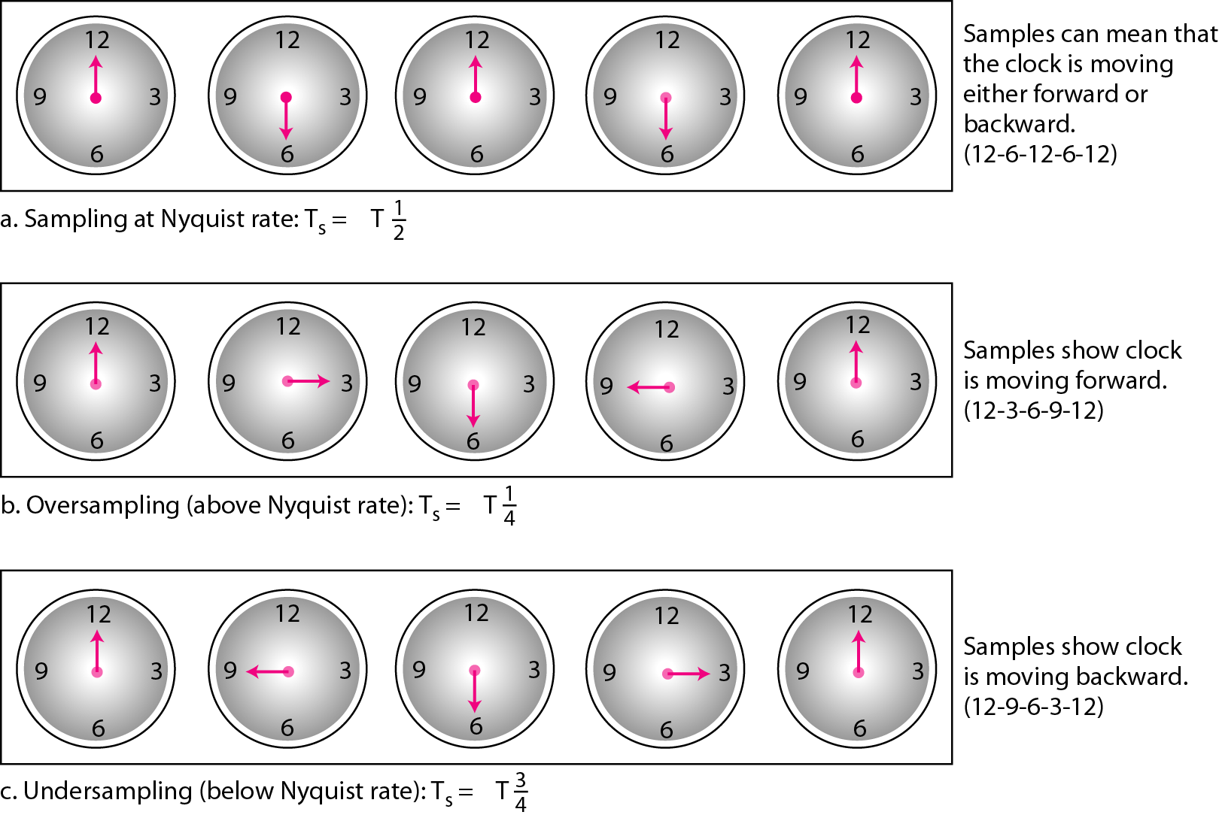
Figure 4.25 Sampling of a clock with only one hand
4.‹#›
Notes:
‹#›

Slide 13
Example 4.9
Telephone companies digitize voice by assuming a maximum frequency of 4000 Hz. The sampling rate therefore is 8000 samples per second.
4.‹#›
Notes:
‹#›

Slide 14
Example 4.10
A complex low-pass signal has a bandwidth of 200 kHz. What is the minimum sampling rate for this signal?
Solution
The bandwidth of a low-pass signal is between 0 and f, where f is the maximum frequency in the signal. Therefore, we can sample this signal at 2 times the highest frequency (200 kHz). The sampling rate is therefore 400,000 samples per second.
4.‹#›
Notes:
‹#›

Slide 15
Example 4.11
A complex bandpass signal has a bandwidth of 200 kHz. What is the minimum sampling rate for this signal?
Solution
We cannot find the minimum sampling rate in this case because we do not know where the bandwidth starts or ends. We do not know the maximum frequency in the signal.
4.‹#›
Notes:
‹#›

Slide 16
Quantization
Sampling results in a series of pulses of varying amplitude values ranging between two limits: a min and a max.
The amplitude values are infinite between the two limits.
We need to map the infinite amplitude values onto a finite set of known values.
This is achieved by dividing the distance between min and max into L zones, each of height Δ.
Δ = (max - min)/L
4.‹#›

Slide 17
Quantization Levels
The midpoint of each zone is assigned a value from 0 to L-1 (resulting in L values)
Each sample falling in a zone is then approximated to the value of the midpoint.
4.‹#›

Slide 18
Quantization Zones
Assume we have a voltage signal with amplitudes V_{min}=-20V and V_{max}=+20V.
We want to use L=8 quantization levels.
Zone width Δ = (20 - -20)/8 = 5
The 8 zones are: -20 to -15, -15 to -10, -10 to -5, -5 to 0, 0 to +5, +5 to +10, +10 to +15, +15 to +20
The midpoints are: -17.5, -12.5, -7.5, -2.5, 2.5, 7.5, 12.5, 17.5
4.‹#›

Slide 19
Assigning Codes to Zones
Each zone is then assigned a binary code.
The number of bits required to encode the zones, or the number of bits per sample as it is commonly referred to, is obtained as follows:
n_{b} = log₂ L
Given our example, n_{b} = 3
The 8 zone (or level) codes are therefore: 000, 001, 010, 011, 100, 101, 110, and 111
Assigning codes to zones:
000 will refer to zone -20 to -15
001 to zone -15 to -10, etc.
4.‹#›

Slide 20
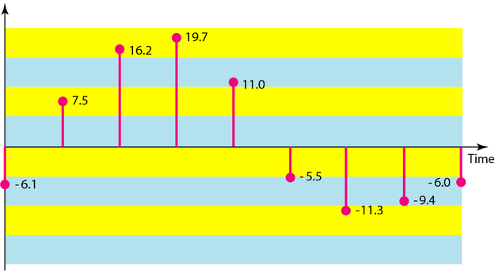
Figure 4.26 Quantization and encoding of a sampled signal
The following figure shows a sampled analog signal. Convert it to a digital signal using Pulse Code Modulation.
Assume there will be 3-bit code words for each sampled amplitude.
Assume that the sampling amplitudes are between -20V to +20V.
4.‹#›
Notes:
‹#›

Slide 21
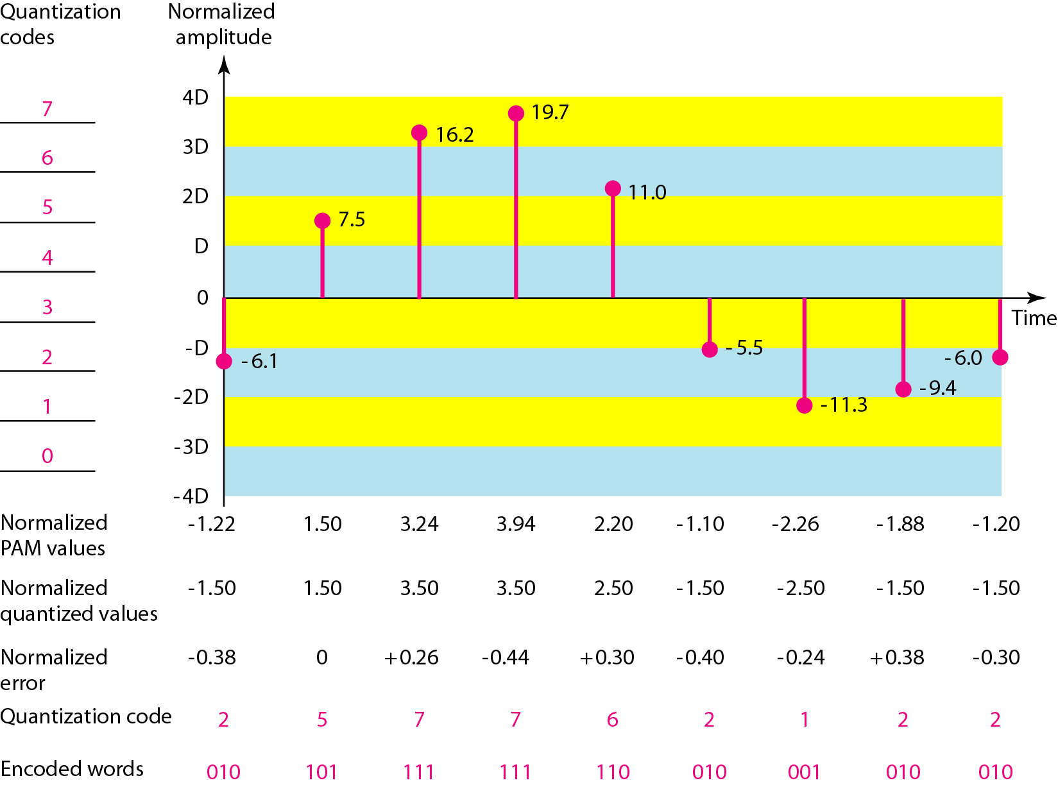
Figure 4.26 Quantization and encoding of a sampled signal
4.‹#›
Notes:
‹#›

Slide 22
Bit rate and bandwidth requirements of PCM
The bit rate of a PCM signal can be calculated form the number of bits per sample x the sampling rate
Bit rate = n_{b} x f_{s}
The bandwidth required to transmit this signal depends on the type of line encoding used. Refer to previous section for discussion and formulas.
A digitized signal will always need more bandwidth than the original analog signal. Price we pay for robustness and other features of digital transmission.
4.‹#›

Slide 23
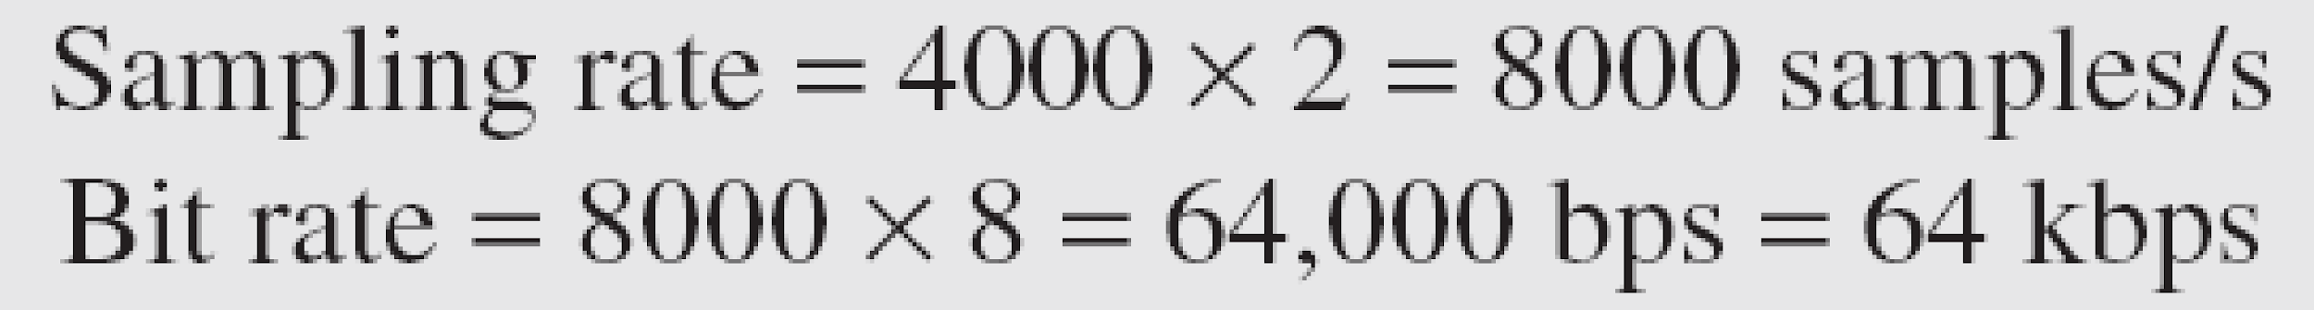
Example 4.14
We want to digitize the human voice. What is the bit rate, assuming 8 bits per sample?
Solution
The human voice normally contains frequencies from 0 to 4000 Hz. So the sampling rate and bit rate are calculated as follows:
4.‹#›
Notes:
‹#›

