Slide 1

COVID-19 World Vaccination Progress EAD
•Afnan Alshehri

Slide 2
• Table of contents
01
02
03
Methodology
Findings
Conclusion

Slide 3
Methodology
Problem understanding
Exploratory
Data preparation
Findings and Insights

Slide 4

• Problem understanding
those days all the world is interested in covid-19 vaccines , does it works ? does people show interest in it ? which country showed most on interest in vaccine , does the information we have about vaccine is trusted ? using the dataset i have from kaggle i am trying to answer those questions using an EDA for the datase

Slide 5
•Dataset
5664k
15
Rows
Columns

Slide 6
Data Preparation
-Delete unnecessary columns
-Deal With Null Values
-Convert Columns Type
-Remove Duplicates
-Update inconsistent data

Slide 7

Findings

Slide 8
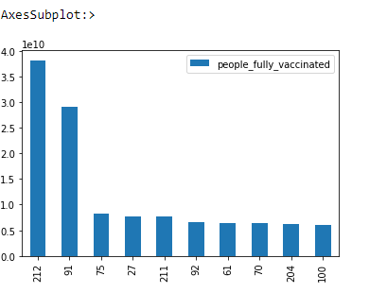
01
• •
america is the most country showed an interest in vaccine then india most of the data comes from government of jersey then public health most of the data comes from government of jersey then public health

Slide 9
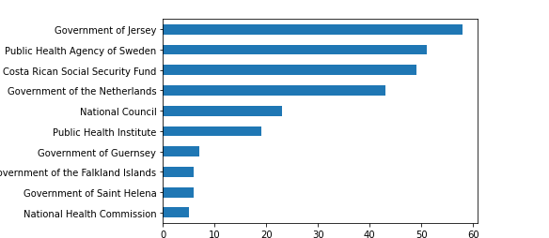
02
• •
most of the data comes from government of jersey then public health agency of sweeden

Slide 10
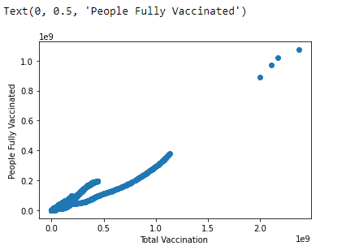
03
• •
most of the people are getting vaccine

Slide 11
Conclusions

Slide 12
Conclusions
america is the most country showed an interest in vaccine then india
most of the data comes from government of jersey then public health agency of sweeden
most of the people are getting vaccine

Slide 13
Thank you for listening
•Afnan Alshehri

