Slide 1
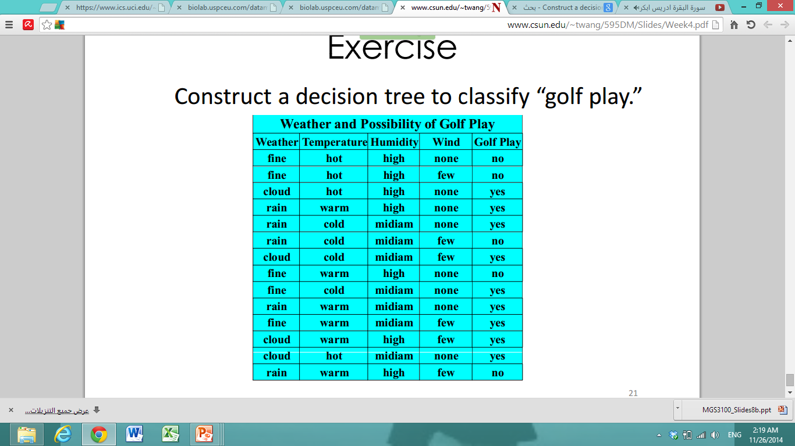
Decision tree
Construct a decision tree to classify “golf play.

Slide 2
Answer
First : we calculate the entropy for the data set class
Info (D)= - 5/14 log₂ (5/14) – 9/14 log₂ (9/14) =0.530 +0.409 =0.939

Slide 3
Then : we calculate the entropy for the Attributes .
info_{weather} (D) = 5/14 ( -2/5 log₂ (2/5) - 3/5 log₂ (3/5) ) + 4/14 (-4/4 log₂ (4/4) ) + 5/14 ( -2/5 log₂ (2/5) - 3/5 log₂ (3/5) )= 0.346 +0+0.346 = 0.692
info_{temp} (D) = 4/14 ( -2/4 log₂ (2/4) - 2/4 log₂ (2/4) ) + 6/14 (-4/6 log₂ (4/6) - 2/6 log₂ (2/6) ) + 4/14 ( -3/4 log₂ (3/4) - 1/4 log₂ (1/4) )= 0.285 + 0.393 + 0.231 = 0.909
info_{humidty} (D) = 7/14 ( -4/7 log₂ (4/7) - 3/7 log₂ (3/7) ) + 7/14 (-6/7 log₂ (6/7) - 1/7 log₂ (1/7) ) = 0.492+ 0.295= 0.787
info_{wind} (D) = 8/14 ( -6/8 log₂ (6/8) - 2/8 log₂ (2/8) ) + 6/14 (-3/6 log₂ (3/6) - 3/6 log₂ (3/6) ) = 0.463 + 0.428 = 0.891

Slide 4
Third : calculate the information Gain for each attributes .
Gain (Weather)= 0.939 – 0.692 = 0.247
Gain (Temp)= 0.939 – 0.909 = 0.03
Gain (Humidity)= 0.939 – 0.787 = 0.152
Gain (Wind)= 0.939 – 0.891 = 0.048
The Weather is the higher information gain , then it will be the Root of the Tree.
Weather
Fain
Rain
Cloud
Select
Attributes ??
Select
Attributes ??
Yes

Slide 5
Then : Same previous steps but with just Rain rows
So, Find the gain for the Rain branch ..
The D will be 5.
Info(D)= - 3/5 log₂ (3/5) – 2/5 log₂ (2/5) =0.442+ 0.528 =0.97
info_{temp} (D) = 3/5 ( -2/3 log₂ (2/3) - 1/3 log₂ (1/3) ) + 2/5 (-1/2 log₂ (1/2) - 1/2 log₂ (1/2) =0.595+ 0.4= 0.95
info_{humidty} (D) = 2/5 (-1/2 log₂ (1/2) - 1/2 log₂ (1/2) + 3/5 ( -2/3 log₂ (3/3) - 1/3 log₂ (1/3) ) =0.95
info_{wind} (D) = = 2/5 (-2/2 log₂ (2/2) )+ 3/5 ( -3/3 log₂ (3/3)) =0

Slide 7
Gain (Temp)= 0.97– 0.95 = 0.02
Gain (Humidity)= 0.97 – 0.95 = 0.02
Gain (Wind)= 0.97 – 0 = 0.97
The Wind is the higher information gain , then it will be the internal node of the Rain brache.
Weather
Fain
Rain
Cloud
Select
Attributes ??
Wind
Yes
none
Few
Yes
No

Slide 9
Next : Find the gain for the fain branch ..
The D will be 5.
Info(D)= - 3/5 log₂ (3/5) – 2/5 log₂ (2/5) =0.442+ 0.528 =0.97
info_{temp} (D) = 2/5 ( -1/2 log₂ (1/2) - 1/2 log₂ (1/2) ) + 2/5 (-2/2 log₂ (2/2))+1/5 (-1/1 log₂ (1/1 ) ) =0.4
info_{humidty} (D) = 3/5 (-3/3 log₂ (3/3)) + 2/5 ( -2/2 log₂ (2/2)) = 0
Gain (Temp)= 0.97– 0.4 =0.57
Gain (Humidity)= 0.97 – 0 = 0.97
The Humidity is the higher information gain , then it will be the internal node of the fain brache.

Slide 10
Weather
Fain
Rain
Cloud
Humidity
Wind
Yes
Medium
High
none
Few
Yes
No
Yes
Yes

Slide 11
Naïve Bayes
What is the class of :
X=((Weather=rain), (temperature=cold), (humidity=high) and (windy=few))

Slide 12
P(Yes) = 9/14 =0.642 , P(NO)= 5/14 = 0.357
P(Rain | Yes) = 3/9 , P(Rain | No) = 2/5
P(Cold | Yes) = 3/9 , P(Cold | No) = 1/5
P(High | Yes) = 3/9 , P(High | No) = 4/5
P(Few | Yes) = 3/9 , P(Few | No) = 3/5
P(X | Yes) = 3/9* 3/9* 3/9* 3/9 =0.012
P(X | No) = 2/5* 1/5* 4/5* 3/5 =0.038
P(Yes | X ) = P(X | Yes) * P(Yes) = 0.012*0.642= 0.077
P(No | X ) = P(X | No) * P(No) = 0.038*0.357 =0.013
So, the X will be in class Yes

Slide 13
Rule based
Based on the following decision tree of play golf or not , extract set of rules.

Slide 14
Weather
Fine
Rain
Cloud
Humidity
Wind
Yes
Medium
High
none
Few
Yes
No
No
Yes

Slide 16
Answer
If (Weather= Rain) ^ (wind=few)->Golf play=yes
If (Weather= Rain) ^ (wind=none)->Golf play=No
If (Weather=Cloud)->Golf play=yes
If (Weather=fine) ^ (Humidity=High)->Golf play=No
If (Weather=fine) ^ (Humidity=Medium)->Golf play=yes

Slide 17
Find the class of the following records:
( the default class is Yes):
(Weather= Rain) ^ (wind=few)->yes
(Weather= Cloud) ^ (wind=few)->yes
(Weather= Fine) ^ (Humidity=High)->No
(Weather= Fine) ^ (Humidity=Low)-> deafult class= yes

