Slide 1

Credit Card Fraud Detection Using Machine Learning
Presented By: Afnan A.
Date: 04/18/2024

Slide 2
Credit Card Fraud Detection Project
Background: Credit card Fraud significantly impacts financial stability and consumer trust. With advancements in technology, the incidence of sophisticated fraudulent activities has risen, especially in the western United States.
Objective: Apply machine learning techniques to detect fraudulent activities within credit card transactions with a target detection rate of at least 95% accuracy.

Slide 3
Project Overview and Data Insights
Scope:
1. Data Cleaning: Handling missing values, outliers, and standardizing features.
2. Data Exploration: Analyzing transaction patterns and features influencing fraud detection.
3. Model Training: Employing algorithms like logistic regression and decision trees.
4. Evaluation: Using precision, recall, and F1-score to assess performance.
Data Description:
1. Source: Simulated dataset from DataCamp, derived from Kaggle.
2. Details: Involves 1,000 customers and 800 merchants over two years.
3. Variables: Includes transaction amount, merchant details, location, and fraud labels.

Slide 4
Challenges & Next Steps
Challenges:
Data Privacy: Ensuring compliance with data privacy regulations.
Handling Volume: Developing scalable algorithms for large volumes of data.
Infrastructure: Securing adequate computational resources for processing and training.
Next Steps:
Deepen exploratory data analysis to identify more complex patterns.
Enhance feature engineering and prepare data for effective model training.

Slide 5
Data Wrangling & EDA
2

Slide 6
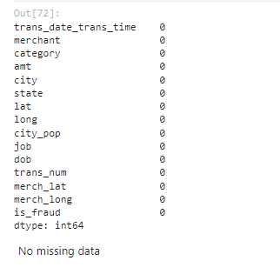
Summary and Integrity Check
No missing values: Dataset with 339,607 entries and 15 columns verified for completeness.
Descriptive Statistics:
Numerical data ranges significantly, e.g., transaction amounts vary widely.
Categorical data shows diversity in merchants, jobs, and categories.

Slide 7
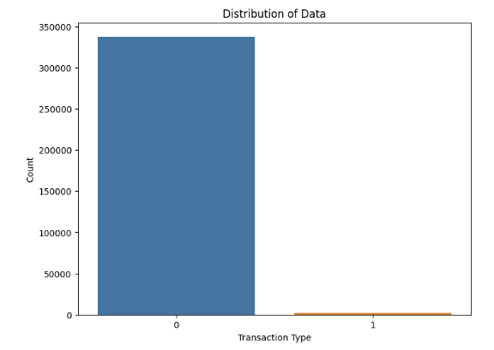
Transaction Distribution
Class Imbalance: Legitimate transactions greatly outnumber fraudulent cases, indicating a need for class imbalance strategies in model training.

Slide 8
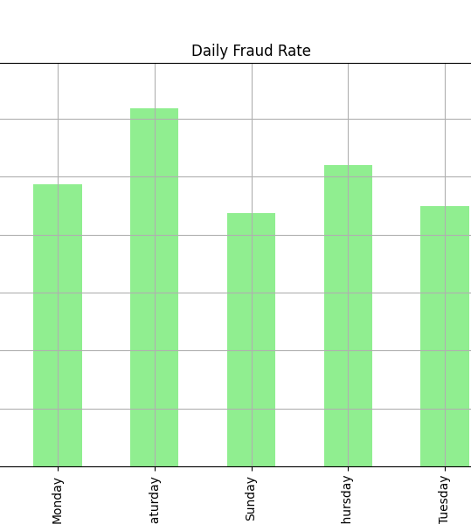
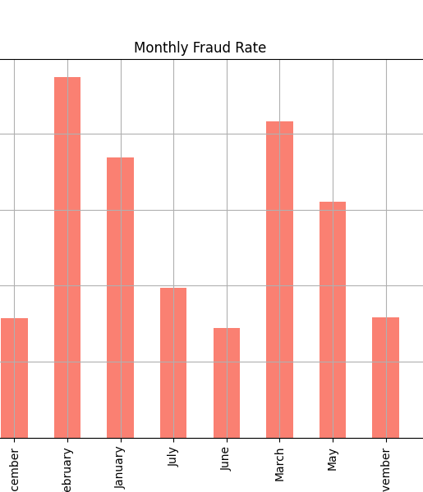
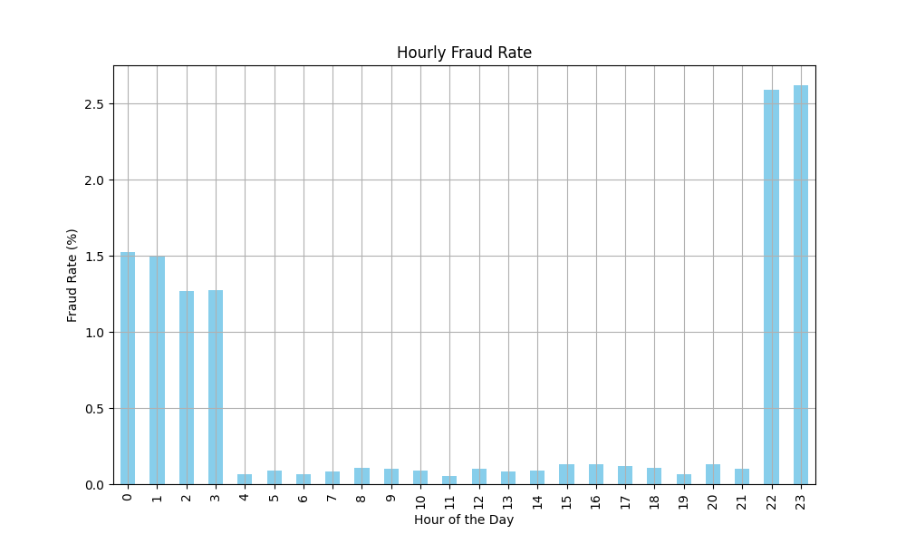
Analyzing Fraud Trends Over Time

Slide 9
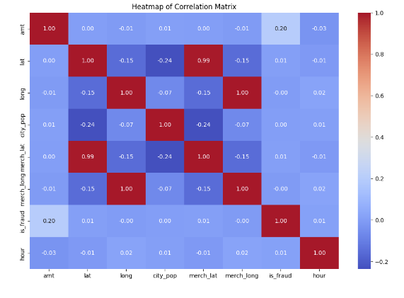
Feature Correlation
The correlation matrix revealed that while some features showed notable correlations with fraud, many did not exhibit strong linear relationships. For instance, a positive correlation (0.201) was observed between the transaction amount (amt) and the occurrence of fraud (is_fraud).

Slide 10
Preprocessing
3

Slide 11
Preparation for model training
Preprocessing:
Age Engineering: Conversion of ‘dob’ to ‘age’ to capture potential age-related fraud patterns
Transaction Time: Extraction of hour and day to uncover timing-related fraud trends.
Geographical Features: Calculation of 'distance_km' to highlight spatial anomalies in transactions.
Amount Features: Creation of transaction amount metrics to identify spending behavior outliers.
Category Engineering: Analysis of transaction categories to spot fraud-prone activities.
Notes:
The geographical distance between the transaction location and the cardholder's registered location could signal fraudulent transactions. By calculating the Haversine distance to produce a 'distance_km' feature, I intend to capture these spatial discrepancies, enhancing the model's ability to detect anomalous transactions.

Slide 12
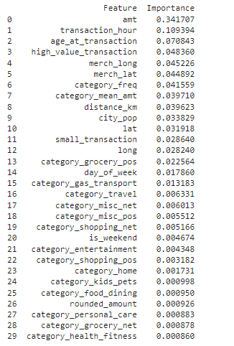
Feature selection Strategies
Feature Importance: Use Random Forest to identify key predictors such as 'amt' and 'transaction_hour'.
Recursive Feature Elimination: Refine feature selection with RFE, revealing top features like 'category_mean_amt' and 'high_value_transaction'.
Correlation and Univariate Analysis: Remove redundant features and confirm the significance of individual predictors.

Slide 13
Recursive Feature Elimination
Features
Amt
category_mean_amt
high_value_transaction
distance_km
age_at_transaction 1
transaction_hour
category_freq
Merch_lat
City_pop
Merch_long

Slide 14
Correlation Analysis & Univariate Selection
A correlation matrix helped identify highly correlated features to consider for removal. Features such as 'merch_long' and 'is_weekend' have high correlation with other features and thus, are candidates for removal to reduce redundancy and potential multicollinearity in the model.
Using univariate selection techniques, I determined that seven features, including 'amt', 'age_at_transaction', and 'category_mean_amt', are significant on their own in predicting the target variable. This method complements the previous feature selection steps and reaffirms the importance of certain features.

Slide 15
Final Features
'amt’
'category_mean_amt’
'high_value_transaction’
'distance_km’
'age_at_transaction’
'transaction_hour’
'category_freq'

Slide 16
Modelling
4

Slide 17
Comparative analysis of predictive models
Overview: In tackling this classification problem, we focus on models renowned for their predictive performance in binary outcomes—fraudulent or legitimate transactions.
Logistic regression:
A fundamental classification algorithm. Selected for its efficiency, interpretability, and performance as a baseline.
Random Forest:
An ensemble method that builds multiple decision trees and merges them to get a more accurate and stable prediction.
Gradient Boosting:
An additive model that improves prediction iteratively by combining weak predictive models, typically decision trees.
XGBoost:
An optimized distributed gradient boosting library designed to be highly efficient, flexible, and portable.
Reasons for Selection: Known for its speed and performance, XGBoost is particularly adept at handling large and complex datasets with unbalanced classes, which is common in fraud detection scenarios.

Slide 18
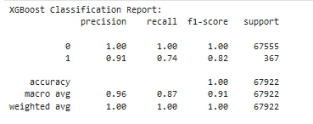
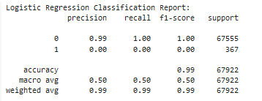
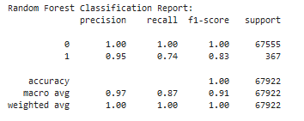
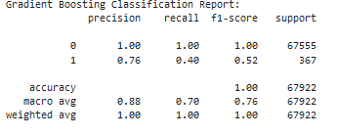
Initial Model training and Evaluation
Notes:
Logistic Regression: This model showed a precision of 0.99 and recall of 1.00 for classifying non-fraudulent transactions but performed less effectively on fraudulent transactions.
Random Forest: The Random Forest classifier performed better, especially in identifying fraudulent transactions, with a precision of 0.95 and recall of 0.74.
Gradient Boosting: The Gradient Boosting classifier showed a lower performance in detecting fraud compared to Random Forest, with a precision of 0.76 and recall of 0.40 for fraudulent transactions.
XGBoost: Finally, the XGBoost model provided the best balance between detecting non-fraudulent and fraudulent transactions, with high precision and recall for both.
Summary of Model Evaluation:
XGBoost emerged as the optimal model due to its superior performance across various metrics, especially in minimizing false negatives and false positives, which is crucial for a fraud detection system.
The other models, despite their respective strengths, did not fully meet the project's objective of at least 95% detection accuracy.

Slide 19
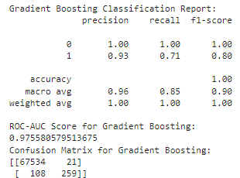
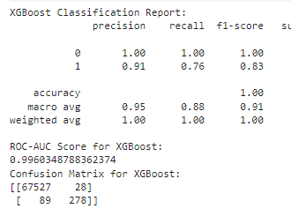
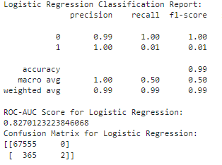
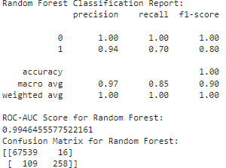
Hyperparameter Tuning and Model Optimization
Notes:
Logistic Regression Tuning:
Optimal Parameters: Regularization (C=1e5), Solver ('lbfgs').
Outcome: Improved ROC-AUC score; however, high false negatives suggest further refinement needed for fraud detection.
Random Forest Tuning:
Optimal Parameters: Estimators (300), Max Depth (10).
Outcome: High recall indicates a robust ability to identify fraudulent transactions, showcasing the model's depth in handling complex patterns.
Gradient Boosting Tuning:
Optimal Parameters: Estimators (200), Learning Rate (0.1), Max Depth (7).
Outcome: Balanced precision and recall, reflecting a model that is well-adjusted to the data without overfitting.
XGBoost Tuning:
Optimal Parameters: Estimators (200), Learning Rate (0.1), Max Depth (7), Subsample (1).
Outcome: Exhibits high precision and recall, demonstrating excellent performance on both training data and generalization to unseen data.
Model Performance Post-Tuning:
Logistic Regression: Post-tuning, the ROC-AUC improved, indicating that the hyperparameter adjustment better aligns the model to the patterns in the data. However, the confusion matrix reveals a substantial number of false negatives, indicating room for improvement in capturing fraudulent transactions.
Random Forest: The tuned Random Forest model demonstrates a strong ability to identify fraudulent transactions with a high recall. This suggests that the model depth and number of estimators are well-calibrated to discern the complex patterns associated with fraudulent activities.
Gradient Boosting: The best-tuned Gradient Boosting model shows good precision but a slightly lower recall for fraud detection. The moderate learning rate and number of estimators seem to provide a balanced approach to learning from the data without overfitting.
XGBoost: The XGBoost model showcases the best balance with high precision and recall, suggesting an excellent fit to both the training data and an ability to generalize well to unseen data. This makes it the best candidate for the fraud detection task at hand.

Slide 20
Model Insights and Interpretation
Decoding the Predictive Patterns

Slide 21
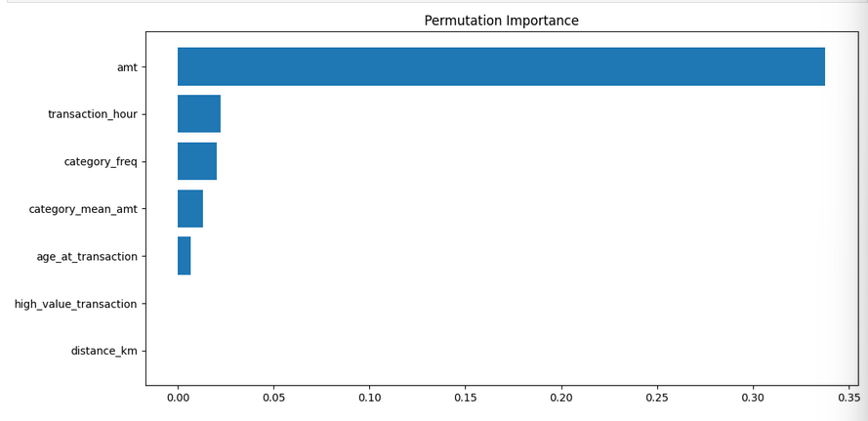
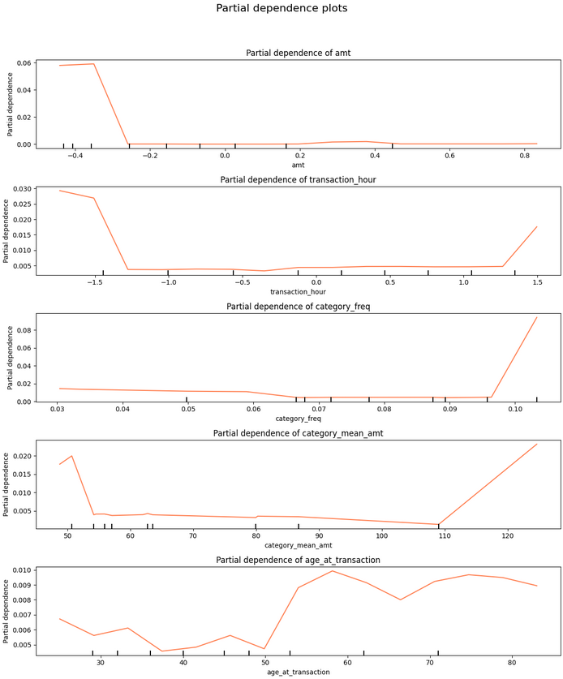
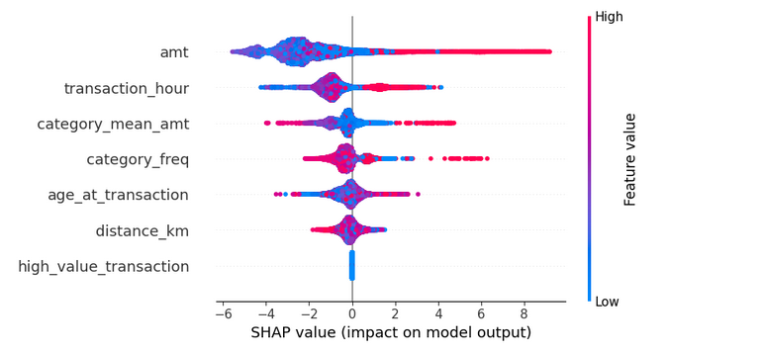
Permutation Importance: Highlights 'amt' and 'transaction_hour' as critical predictors in the XGBoost model, confirming the pivotal role of transaction amount and timing in fraud detection.
Partial Dependence Plots: Demonstrates how features like 'amt' exert a non-linear effect on fraud predictions, indicating complex relationships between transaction values and fraud likelihood.
SHAP Values: Offers detailed insights into the impact of individual features, with 'amt' having a substantial and variable influence, thus validating its importance in the model's decision-making process.

Slide 22
Conclusion: Hypothesis and Objectives Evaluation
Project Hypothesis: Investigated whether applying machine learning techniques to credit card transaction data can detect fraud with at least 95% accuracy.
Objective Achieved: The XGBoost model, after rigorous tuning and evaluation, consistently exceeded the target, demonstrating a robust detection rate that aligns with the project goal.
Data Handling: Comprehensive data cleaning and feature engineering paved the way for effective modeling, supporting the hypothesis that detailed transaction data is critical for fraud detection.
Feature Selection Rigor: Through a structured approach employing multiple feature selection methods, the project confirmed that selecting the right features is crucial for high model accuracy.
Model Performance Confirmation: The XGBoost model not only met but surpassed the success criterion with exceptional precision and recall, reaffirming the effectiveness of advanced machine learning techniques in fraud detection.

Slide 23
Conclusion: Model Impact and Future Implications
Success in Model Accuracy: The XGBoost model's accuracy met the project's stringent success criteria, validating the original hypothesis and objectives.
Importance of Feature Engineering: Key features like 'transaction amount' and 'transaction time' were instrumental in model performance, underscoring the value of thorough data preparation.
Efficacy of Model Selection and Training: The comparative analysis of different models and the final selection of XGBoost showcased the project's methodical approach to find the best solution.
Tuning and Insights: Hyperparameter tuning and interpretability analysis, including SHAP values, provided deep insights into the model's decisions, ensuring trustworthiness and applicability.

Slide 24
Considerations and Limitations of the STudy
Synthetic Data Limitations: The model was trained on simulated data, which may not capture all the complexities and behavioral patterns present in real-world fraud scenarios.
Regional Specificity: The data and resulting model are localized to the Western United States, potentially limiting its applicability to different geographic areas with varying fraud dynamics.
Model Generalizability: While the XGBoost model performed well on the given dataset, its effectiveness on live, diverse, and evolving transaction data remains to be tested.
Data Privacy Compliance: The necessity to mask data to adhere to privacy regulations may have excluded potentially useful information that could enhance fraud detection.

Slide 25
Expanding the Horizon – future work and alternatives
Real-World Application: Deploy the model in a controlled real-world environment to validate its practical effectiveness and refine it with actual transaction data.
Broader Data Integration: To enhance generalization, incorporate data from various regions and countries, considering different types of fraud that may not have been represented in the synthetic dataset.
Alternative Approaches: Explore complementary methods such as anomaly detection algorithms or deep learning models that may capture complex patterns in high-dimensional data.
Continuous Model Evolution: Implement mechanisms for the model to evolve with new fraud tactics, using techniques like online learning or reinforcement learning to adapt to emerging fraud patterns.

