Slide 1

Credit Card Fraud Detection Using Machine Learning
Presented By: Afnan A.
Date: 04/18/2024

Slide 2
Credit Card Fraud Detection Project
Background: Credit card Fraud significantly impacts financial stability and consumer trust. With advancements in technology, the incidence of sophisticated fraudulent activities has risen, especially in the western United States.
Objective: Apply machine learning techniques to detect fraudulent activities within credit card transactions with a target detection rate of at least 95% accuracy.

Slide 3
Project Overview and Data Insights
Scope:
1. Data Cleaning: Handling missing values, outliers, and standardizing features.
2. Data Exploration: Analyzing transaction patterns and features influencing fraud detection.
3. Model Training: Utilized advanced machine learning techniques to develop the fraud detection model.
4. Evaluation: Assessed the model's performance to ensure it meets our accuracy targets.
Results:
Successfully developed a fraud detection system that meets our goal of 95% accuracy.

Slide 4
Data Wrangling & EDA
2

Slide 5
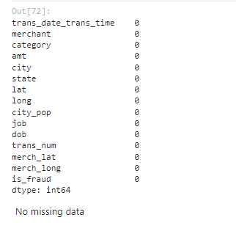
Summary and Integrity Check
No missing values: Dataset with 339,607 entries and 15 columns verified for completeness.
Descriptive Statistics:
Numerical data ranges significantly, e.g., transaction amounts vary widely.
Categorical data shows diversity in merchants, jobs, and categories.

Slide 6
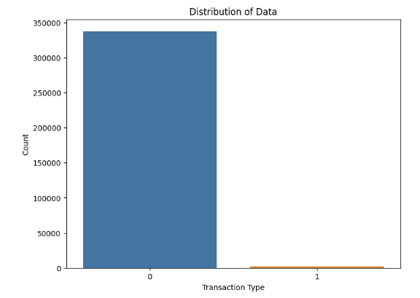
Transaction Distribution
Class Imbalance: Legitimate transactions greatly outnumber fraudulent cases, indicating a need for class imbalance strategies in model training.

Slide 7
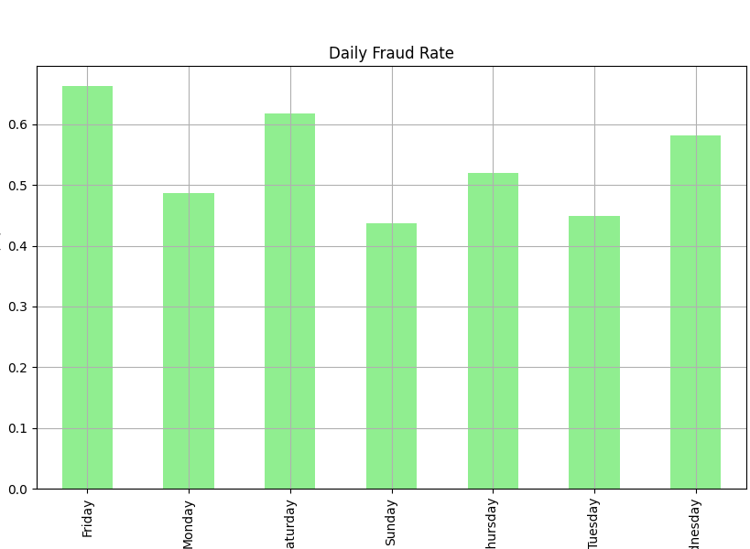
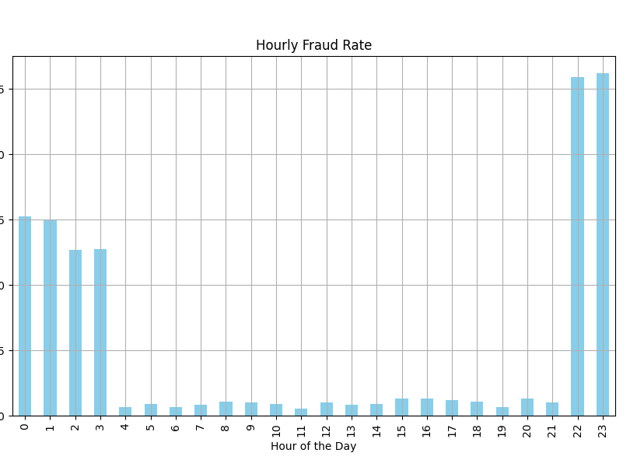
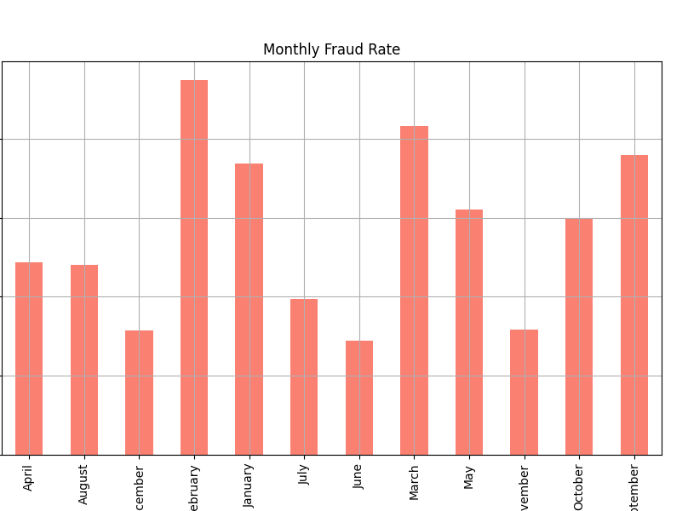
Analyzing Fraud Trends Over Time

Slide 8
Modelling
3

Slide 9
Model Performance and Business Impact
Model Choice
Selected XGBoost due to its excellent balance of speed and accuracy, proving to be highly effective in handling unbalanced datasets typical of fraud detection scenarios.
Business Impact:
Enhanced Security: The improved detection rate minimizes potential financial losses from fraud, protecting both the company's assets and customer transactions.
Increased Trust: High accuracy in fraud detection boosts customer confidence, reinforcing our reputation as a safe and trustworthy service provider.
Operational Efficiency: Streamlining fraud detection processes reduces the need for manual review, allowing resources to be allocated to other critical areas of operation.

Slide 10
Model Insights and Interpretation
4
Decoding the Predictive Patterns

Slide 11
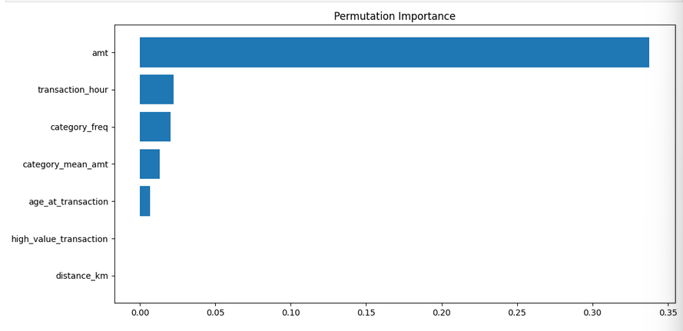
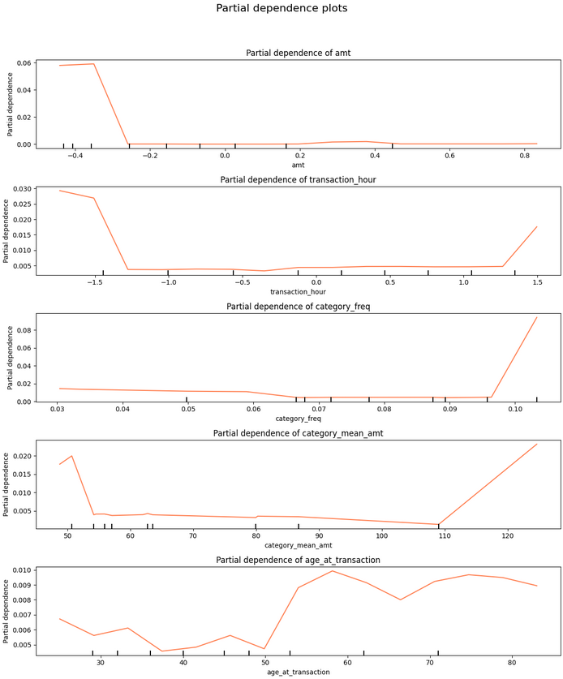
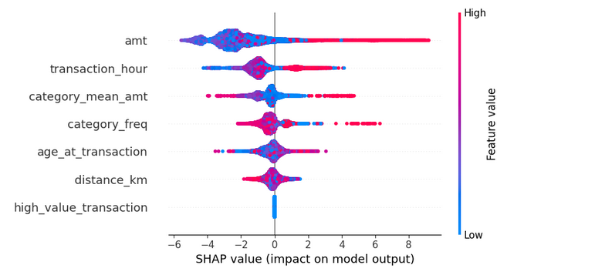
Permutation Importance: Highlights 'amt' and 'transaction_hour' as critical predictors in the XGBoost model, confirming the pivotal role of transaction amount and timing in fraud detection.
Partial Dependence Plots: Demonstrates how features like 'amt' exert a non-linear effect on fraud predictions, indicating complex relationships between transaction values and fraud likelihood.
SHAP Values: Offers detailed insights into the impact of individual features, with 'amt' having a substantial and variable influence, thus validating its importance in the model's decision-making process.

Slide 12
5 Conclusion

Slide 13
Considerations
Synthetic Data Limitations: The current model is based on simulated data, which might not capture all real-world complexities and behavioral patterns.
Regional Specificity: The data and model are localized to the Western United States, which could limit applicability to different geographic areas with varying fraud dynamics.
Data Privacy Compliance: Continuous monitoring and updating of data privacy measures to ensure compliance while utilizing data effectively for fraud detection.

Slide 14
Future Directions
Real-World Application: Plan to deploy the model in a controlled real-world environment to validate its practical effectiveness and refine it based on actual transaction data.
Broader Data Integration: To enhance generalization, consider incorporating data from various regions and countries, taking into account different types of fraud that may not have been represented in the synthetic dataset.
Continuous Model Evolution: Implement mechanisms for the model to evolve with new fraud tactics using techniques like online learning or reinforcement learning to adapt to emerging fraud patterns.

Slide 15
Conclusion
Achievements:
Objective Achieved: The project successfully met its goal of detecting fraudulent transactions with at least 95% accuracy using the XGBoost model.
Impactful Data Handling: Comprehensive data cleaning and feature engineering laid a solid foundation for effective modeling, demonstrating the critical role of detailed transaction data in fraud detection.
Strategic Feature Selection: A structured approach to feature selection ensured the model's high accuracy, proving the importance of choosing the right features.
Future Outlook:
Commitment to Excellence: We remain dedicated to enhancing our fraud detection capabilities, continuing to invest in technology and processes that protect our customers and business.
Adaptive and Responsive: The project will continue to evolve in response to new fraud tactics and changing market conditions, ensuring it remains at the forefront of fraud detection technology.

Slide 16

Any Questions?

