Slide 1
CSS
Team 3

Slide 2
CSS
CSS stands for Cascading Style Sheets. It is the language for describing the presentation of Web pages, including colours, layout, and fonts, thus making our web pages presentable to the users.CSS is designed to make style sheets for the web. It is independent of HTML and can be used with any XML-based markup language.

Slide 3
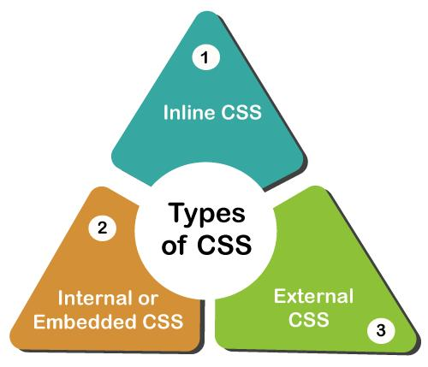

Slide 4
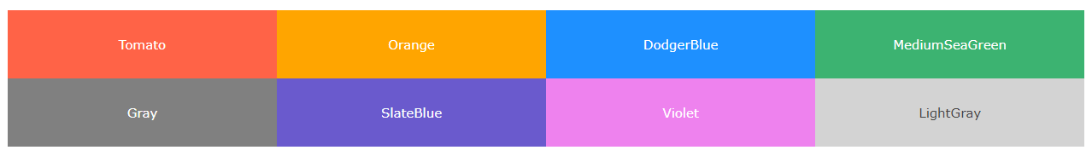
CSS Color Names
In CSS, a color can be specified by using a predefined color name:

Slide 5
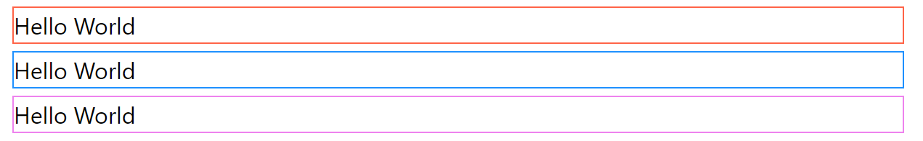
Example CSS Border Color
<h1 style="border:2px solid Tomato;">Hello World</h1> <h1 style="border:2px solid DodgerBlue;">Hello World</h1> <h1 style="border:2px solid Violet;">Hello World</h1>

Slide 6
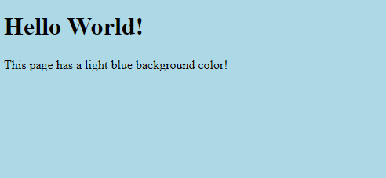
CSS Backgrounds
<!DOCTYPE html>
<html>
<head>
<style>
body {
background-color: lightblue;
}
</style>
</head>
<body>
<h1>Hello World!</h1>
<p>This page has a light blue background color!</p>
</body>
</html>

Slide 7
CSS Margins
The CSS margin properties are used to create space around elements, outside of any defined borders.
With CSS, you have full control over the margins. There are properties for setting the margin for each side of an element (top, right, bottom, and left).

Slide 8
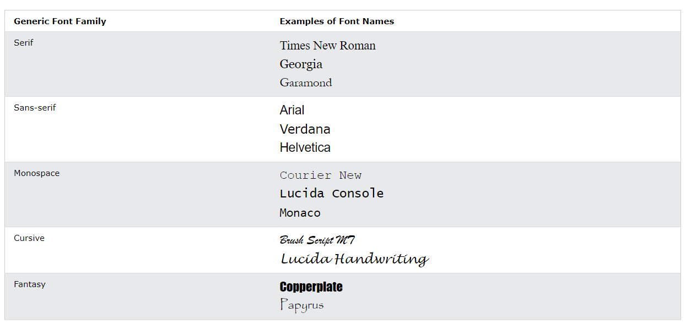
CSS Fonts

Slide 9
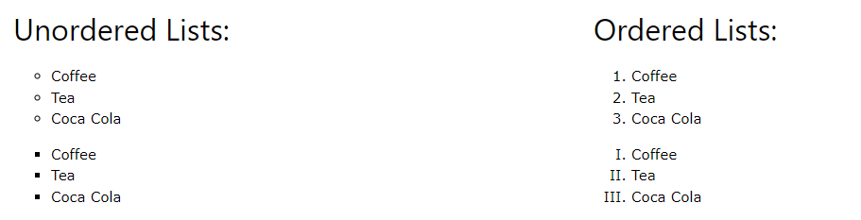
CSS Lists

Slide 10
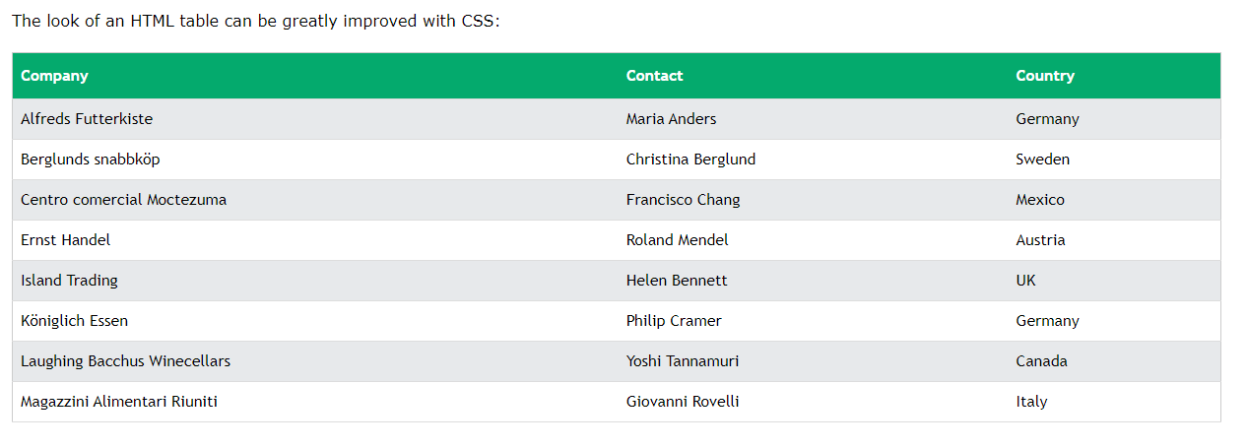
CSS Tables

Slide 11
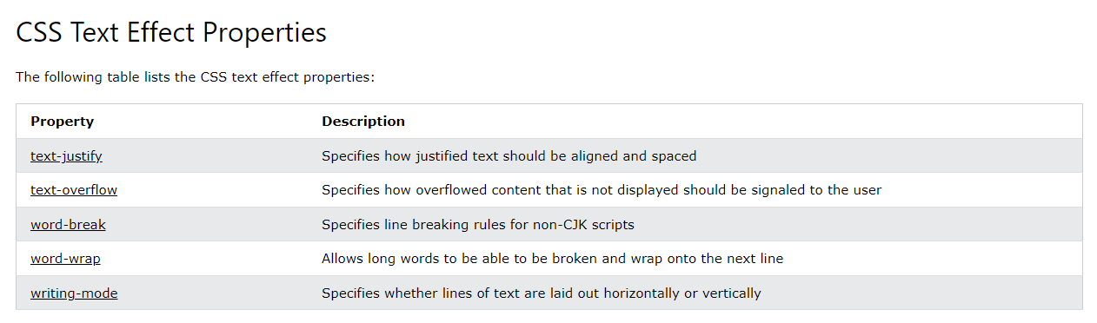
Text Effects
Text effect properties in CSS allow us to apply different formatting styles to the text within an HTML document. These styles can include splitting up words when a sentence is too long to fit within a line, changing its orientation, and applying any patterns that a programmer needs to add.

Slide 12
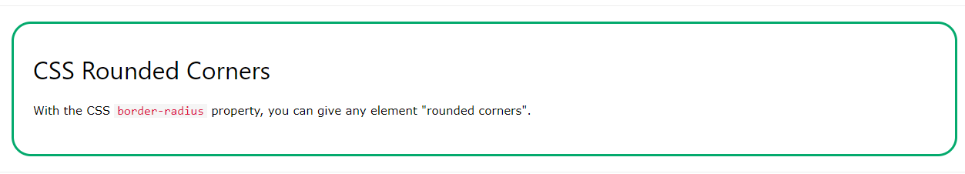
Rounded Corners

Slide 13
CSS class
What is a CSS class? A CSS class is an attribute used to define a group of HTML elements in order to apply unique styling and formatting to those elements with CSS.

Slide 14

ID
ID is used to identify a single element. A class selector is therefore used to style multiple HTML elements of the same class, while an ID selector is used to style one HTML element.

Slide 15
Padding
An element's padding area is the space between its content and its border. Note: Padding creates extra space within an element. In contrast, margin creates extra space around an element.

