Slide 1





AI-Powered Fresh Food Demand & Inventory Optimization
PANDA Team · EWA · InnovatiCS · Group 10
Notes:
Phase 1 (business understanding) is approved, so we go straight to the data. Three questions for the next three minutes: can we trust the data, what does it tell us about Panda's fresh-food business, and what is it worth.
1

Slide 2













Stakeholders Definition
Trainee Coordinator
Business Experts
Business Experts
Data Expert
Developer
Marwan Al-haj
Mohamed Al Shirshabi
Tarek Elnagdy
Ahmed Batwa
Shaik Zaheeruddin
Sara Alshamrani
Afnan Aljohani
Team Lead
Khalid Alhrabi
Sahad Marwi
Rahaf Alhadhrami
AI Engineer & Data Science
AI Engineer & Data Science
AI Engineer & Data Science
AI Engineer & Data Science
AI Engineer & Data Science
Notes:
1.7.2013
3
‹#›

Slide 3

AGENDA
What we will cover today
THREE STEPS
Business understanding — the problem statement and the objectives
1
Data understanding — what is data tell us about stockouts, shelf life and waste
2
Data preparation — what we found in the raw data and how we fixed it without losing real signals
3
4

Slide 4
BUSINESS UNDERSTANDING PHASE 1
Industry-Specific Problem Statement
BUSINESS OBJECTIVES
PROBLEM STATEMENT
Forecast store-level demand (units sold) for fresh products with Saudi calendar and promotion effects, reducing forecast error (MAPE) from 25–30% to below 15% for high-velocity products
1
Panda Retail's supply-chain roles focus on store/DC replenishment, product availability, overstock, and aged and near-expiry inventory. This project will forecast SKU-store demand and optimize replenishment for fresh and short-shelf-life products, where excess stock creates markdown/expiry waste while insufficient stock causes lost sales.
For the academic dataset, assume a fresh-food forecast MAPE of 25–30%, an 8–12% stockout rate for high-velocity fresh SKUs during promotion/peak periods, and 5–8% of fresh inventory units entering markdown, expiry, or disposal status.
Predict stockout and near-expiry risk, achieving at least 85% recall for near-expiry risk and cutting promo stockouts on fresh products by 25–30% (from a baseline of 8–12%)
2
Optimize DC/store replenishment and allocation under shelf-life constraints, improving on-shelf availability by 3–5 percentage points
3
Quantify lost sales, markdown, expiry waste and working-capital improvement, cutting fresh stock going to markdown or expiry by 20–25% (from a baseline of 5–8%)
4
5

Slide 5
DATA AT A GLANCE
Two years of Panda fresh-food data: big enough and clean enough to build on
1M
730
1,000
150K
inventory & sales records
days · Jan 2025 – Dec 2026
stores · 30 distribution centres
products (SKUs) · 12,000 suppliers
83.8%
0
0
3 of 26
records fully complete
duplicate rows or IDs
invalid dates or flags
columns with gaps (4–8%)
SO WHAT
The data covers every store and two full years, so the patterns on the next slide are reliable. The few gaps are small and are fixed in Phase 3 before any model is built.
6
Notes:
Big numbers only. One million records over two years, all 1,000 stores, 150 thousand products. The data is clean on its keys: no duplicates, no invalid dates. Only three of 26 columns have gaps, at 4 to 8 percent, and those are handled in Phase 3. Message: we can trust what comes next.
6

Slide 6
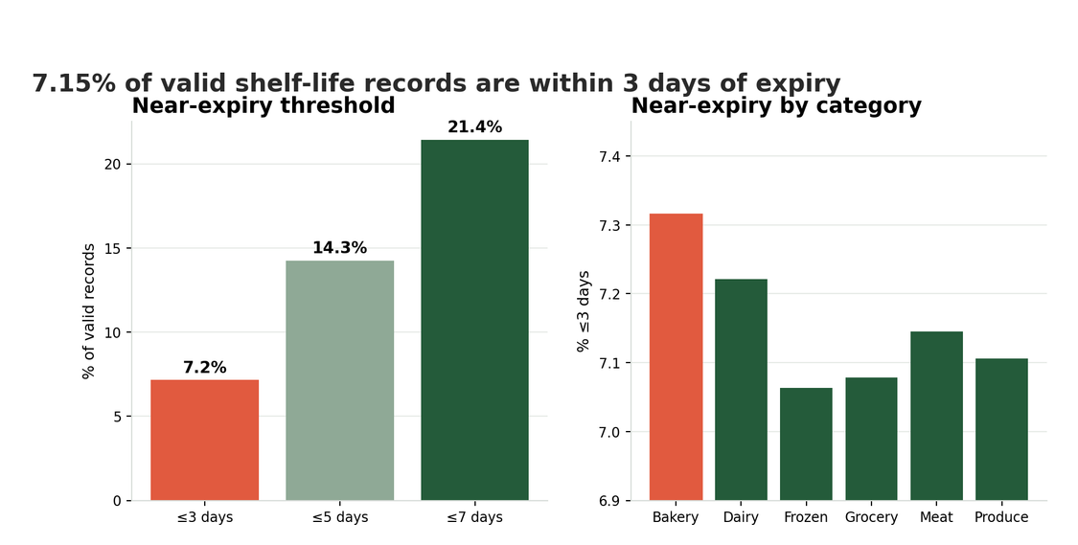
DESCRIPTIVE QUESTION · DQ4
Remaining Shelf Life and Near-Expiry Share
7.15%
of valid shelf-life records are within 3 days of expiry
67,950
of 949,813 valid shelf-life records
≤ 3 days
exploratory threshold, to be confirmed with the business team in Phase 3
QUESTION
What is the distribution of remaining shelf life across product categories and stores, and what proportion of inventory records is near expiry?
8

Slide 7
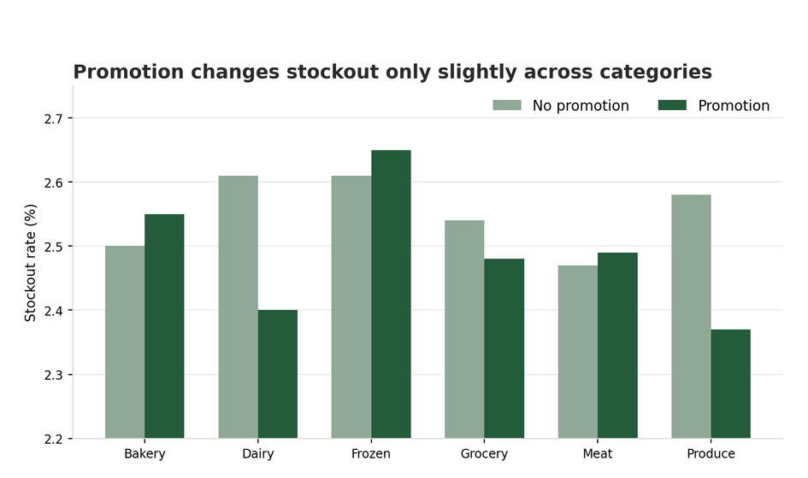
DESCRIPTIVE QUESTION · DQ2
Stockout Rates: Promotion vs Non-Promotion
2.55%
pooled stockout rate without promotion
2.49%
pooled stockout rate during promotion
−0.06 pts
promotions raise mean sales, but not the pooled stockout rate
QUESTION
What differences exist in stockout rates between promotional and non-promotional periods across stores and product categories?
7

Slide 8
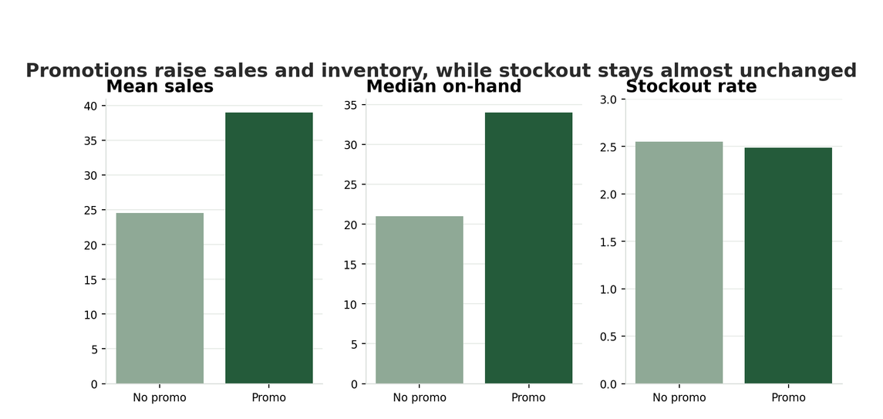
DIAGNOSTIC QUESTION · GQ3
Why Stockout Differs Between Promotion and Non-Promotion
24.55 → 38.98
Mean Sale: no promotion vs promotion (+59%)
2.55% vs 2.49%
stockout rate without vs with promotion: keep stable
QUESTION
Why do stockout rates differ between promotional and non-promotional periods, considering sales volumes, on-hand inventory, and supplier lead times?
9

Slide 9
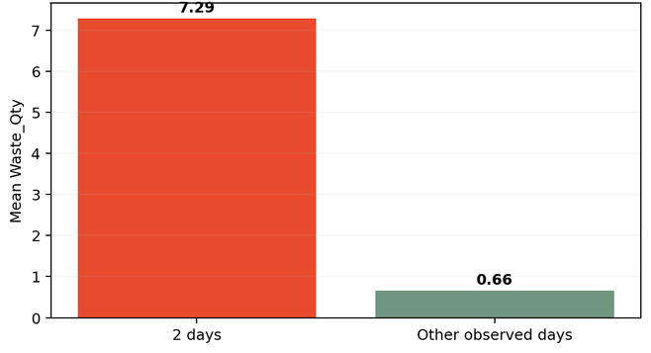
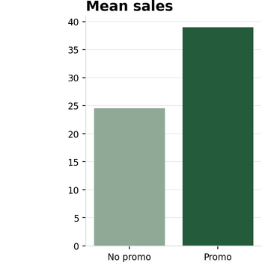
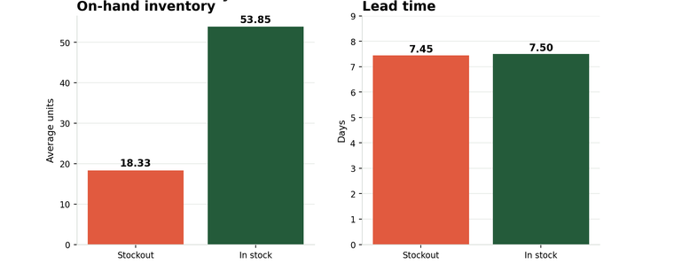
WHAT THE DATA TELLS US
Three findings Panda can act on
1 · WASTE
2 · DEMAND
3 · STOCKOUTS
27.8%
+59%
−66%
of all waste comes from the 3.6% of stock with 2 days left
more units sold on promotion, and ≈3× more in the busiest stores
less stock on hand when shelves run short; supplier lead time is the same
Mean waste per record: 7.29 at 2 days vs 0.66
Mean sales: 24.55 → 38.98 on promotion
During promotions: on hand 18.33 vs 53.85
So what: mark down or transfer 2–3 days before expiry
So what: forecast with the promotion calendar and store traffic
So what: fix how much is replenished, not which supplier
10
Notes:
One slide, three findings, each with a number, a picture and a business meaning.
Waste: a quarter of all waste sits in stock with only 2 days left. Mean waste jumps from 0.66 to 7.29 units. Acting 2 to 3 days before expiry targets that quarter.
Demand: promotions lift mean units sold from 24.55 to 38.98 (+59%), and the busiest stores sell about three times more than the quietest. Price alone shows no link. So the forecast must read the promo calendar and traffic.
Stockouts: during promotions, records that ran short held 18 units on average versus 54 for in-stock records, while lead time is the same (7.49 vs 7.50 days). The lever is replenishment quantity, which is exactly what our model optimises.
10

Slide 10
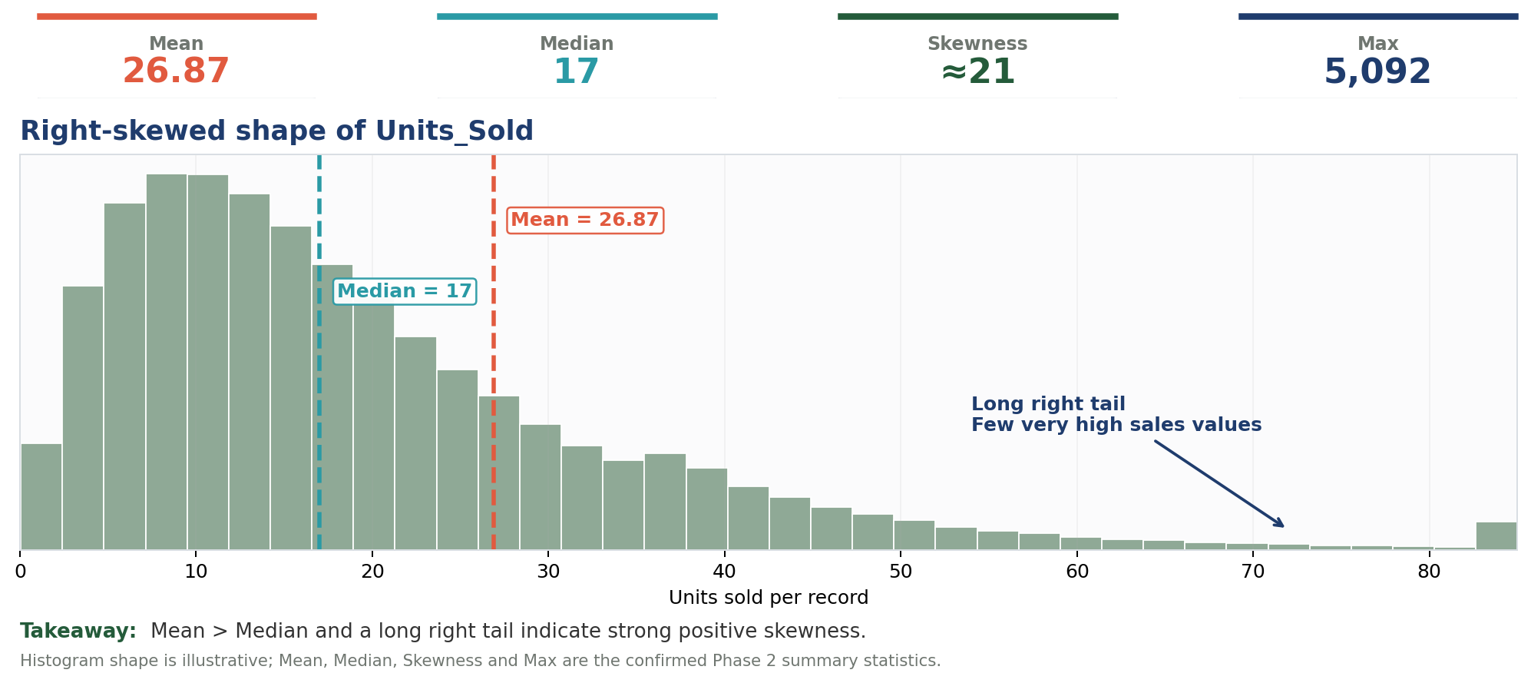
26
APPENDIX
Skewness of Units_Sold
Click a metric during Slide Show to explore it
Mean
Median
Skewness
Right Tail
PowerPoint interactivity works in Slide Show mode.

Slide 11



PHASE 3 · DATA PREPARATION
Data Preparation & Modeling Readiness
AI-Powered Fresh Food Demand & Inventory Optimization
PANDA Team · EWA · InnovatiCS · Group 10
Notes:
Phase 3 turns the raw PANDA file into two modeling-ready tables. Every number in this deck is produced by the Phase 3 notebook on PANDA.csv.
46

Slide 12


WHAT WE FOUND IN THE DATA
From 1,000,000 raw records to 871,314 we can trust
128,686
9,825
964
Records from the future
Inflated sales records
Hidden stockouts
Dated after 27 Sep 2026, so no real sales exist yet. Excluded.
Units sold were far higher than the money collected implies. Corrected.
Shelf stock was zero but no stockout was recorded. Relabelled.
Why it matters Left uncleaned, the model would over-forecast demand, we would over-order, and fresh food waste would go up.
Source: PANDA.csv (1,000,000 records × 26 columns) · Phase 3 notebook · synthetic academic dataset
47
Notes:
Two tables, because Dr. Moha's Store × SKU × Day unit has no history for forecasting (slide 8): ABT-A aggregates to Store × Category × Week for the time-series forecast; ABT-B keeps batch detail for the stockout and near-expiry classifiers.
47

Slide 13

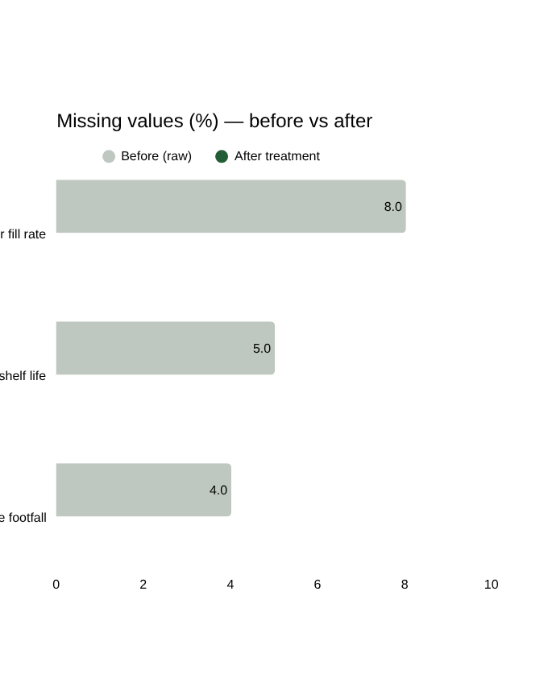
HOW WE FIXED IT
We fixed three data problems without throwing away real business signals
Missing values
8%
→
0%
BEFORE
AFTER
of supplier fill-rate values were empty
WHAT WE DID
Filled with the typical value for the same supplier, plus a “was missing” flag.
WHY
Deleting rows would lose data in 3 columns, and a missing value can itself signal a supply problem.
Source: PANDA.csv (1,000,000 records x 26 columns) · Phase 3 notebook · synthetic academic dataset
48
Notes:
Why we imputed instead of deleting: three columns are missing 4-8% each, so deleting would remove a large share of rows. We kept a flag so the model can still learn from the missingness. Outliers: peaks are real demand (promotions, large stores), so we capped predictors but never the target. One-hot is used only for fields with few options (category, temperature zone, region, DC, weekday).
48

Slide 14
HOW WE FIXED IT
We fixed three data problems without throwing away real business signals
Extreme values
Text categories
4.04
→
0.02
→
7
6
BEFORE
AFTER
BEFORE
AFTER
skew of weekly sales (how lopsided it is)
category labels (“ produce ” vs Produce)
WHAT WE DID
WHAT WE DID
Kept real peaks. Capped predictors at the 99.9th percentile and log-transformed sales.
Cleaned labels and one-hot encoded small fields. IDs are encoded by frequency instead.
WHY
WHY
Promotions and big stores create real demand. Deleting them would hide the busiest days.
A product spelled two ways counts twice. One-hot on 149,827 SKU IDs would explode the table.
Source: PANDA.csv (1,000,000 records x 26 columns) · Phase 3 notebook · synthetic academic dataset
49
Notes:
Why we imputed instead of deleting: three columns are missing 4-8% each, so deleting would remove a large share of rows. We kept a flag so the model can still learn from the missingness. Outliers: peaks are real demand (promotions, large stores), so we capped predictors but never the target. One-hot is used only for fields with few options (category, temperature zone, region, DC, weekday).
49

Slide 15
HOW WE WILL ANALYSE IT
Three business questions drive our analysis
79.8%
How much will each store sell next week?
Weekly demand forecast
DECISION IT SUPPORTS
Order the right quantity from suppliers
of store-category weeks have sales history
2.5%
Which items will run out today?
Stockout alert
DECISION IT SUPPORTS
Refill the right shelves first
of batch records are stockouts (rare events)
7.2%
Which batches are close to expiring?
Near-expiry risk
DECISION IT SUPPORTS
Discount early, before it becomes waste
of batch records are within 3 days of expiry
Goal waste −20–25% · stockouts −25–30%. Next: Phase 4 trains and tests models on weeks they have never seen.
Source: PANDA.csv (1,000,000 records x 26 columns) · Phase 3 notebook · synthetic academic dataset
50
Notes:
Each model answers one business question. Stockouts and near-expiry are rare, so accuracy alone would be misleading: we will measure how many real cases we catch (recall) and how many alerts are correct (precision).
50

Slide 16
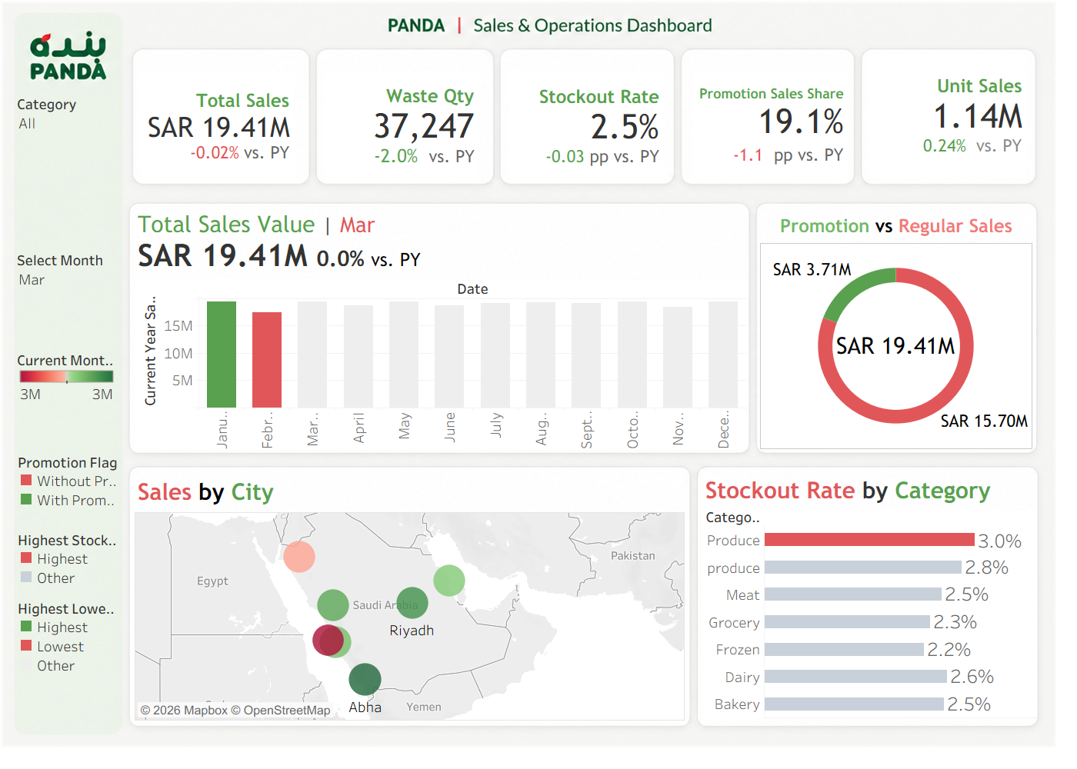

Slide 17

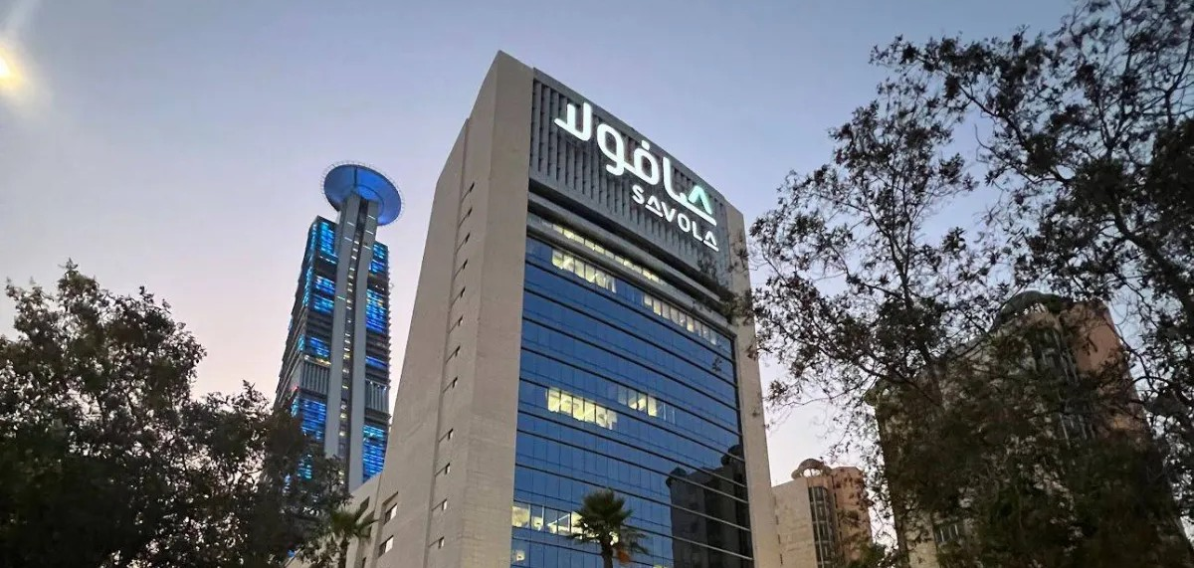

Panda Visit
زيارة شركة بنده
Savola Group HQ · Jeddah
EWA AI & Data Science Program × Panda Retail Company (Savola)

Slide 18




Inside the Visit
معك تفرق
Better Together
Panda offices · Ocean-view workspace · Meeting session

Slide 19
THANK YOU
Notes:
51

