Slide 1
Real-Time Multi-Task Skin Lesion Classification
and Segmentation Using Swin Transformer
Afnan Bin Islam Nahin • Aman Ullah • Shakila Rahman
American International University–Bangladesh (AIUB), Dhaka, Bangladesh
Presented by: Afnan Bin Islam Nahin
2026 IEEE International Conference on Biomedical Engineering, Computer and Information Technology for Health (BECITHCON)
04-05 September 2026 | IUBAT, Dhaka, Bangladesh

Slide 2
Content
Presentation roadmap
01
Background & Problem
08
Comparison with Baselines
02
Research Objective
09
Class-wise Performance
03
Literature Review & Research Gap
10
Real-Time Performance & Model Complexity
04
Methodology
11
Conclusion & Future Work
05
Dataset & Preprocessing
12
References
06
Proposed Multi-Task Framework
07
Experimental Setup

Slide 3
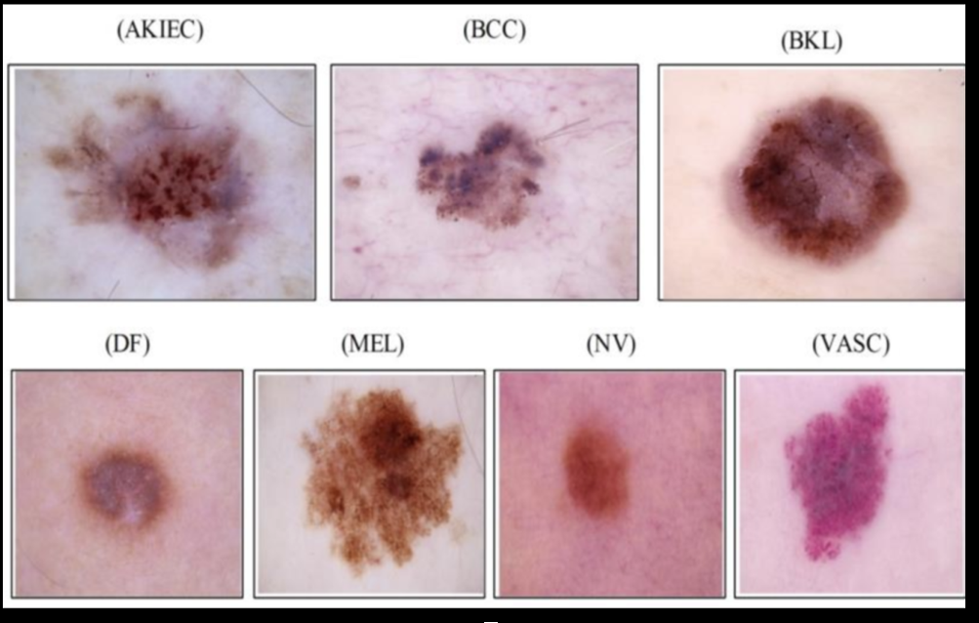
Background & Problem
Why joint skin lesion analysis matters
• Skin lesion categories can look visually very similar in dermoscopic images.
• Skin lesion analysis is challenging due to similarities in color, texture, and lesion boundaries across classes.
• Classification identifies the lesion type, while segmentation locates the lesion area.
• A practical framework should perform both tasks jointly while maintaining fast inference.
Core challenge : Predict what the lesion is — and where it is.

Slide 4
Research Objective
What this study aims to achieve
01
02
03
04
7-Class Classification
Lesion Segmentation
Single Multi-Task Model
Real-Time Capability
Predict AKIEC, BCC, BKL, DF, MEL, NV, or VASC.
Generate a pixel-level mask of the lesion region.
Perform classification and segmentation using shared features.
Measure FPS and latency under a defined hardware setup.
Main objective
Develop a unified Swin Transformer + U-Net framework for joint lesion classification and segmentation while maintaining practical inference speed.

Slide 5
Literature Review & Research Gap
From local features to unified real-time-capable analysis
CNNs [8]
U-Net [1], [5]
ViT / Transformers [13], [14]
Research Gap [3], [6]
Strong local feature extraction and widely used for lesion classification.
Effective encoder–decoder design for pixel-level lesion segmentation.
Capture long-range and global contextual relationships in images.
Limited studies jointly evaluate classification, segmentation, and real-time inference in a single framework.
Our response to the gap
• Swin Transformer for hierarchical shared feature extraction
• Classification head + U-Net decoder for joint prediction
• Comprehensive evaluation using accuracy, Dice, IoU, FPS, latency, and model complexity

Slide 6
Methodology
End-to-end research workflow
shared hierarchical features
Classification Head
Output: lesion class
HAM10000
Dataset
Preprocessing
Swin Transformer
Encoder
Evaluation
U-Net Decoder
Output: lesion mask
Workflow in one line
Dermoscopic images → preprocessing → shared feature extraction → lesion class + lesion mask → performance evaluation
Two outputs are produced in parallel from one shared encoder.

Slide 7
Dataset & Preprocessing
HAM10000 Class Distribution
HAM10000 Dataset
10,015 dermoscopic images • 7 lesion classes
Class | Samples
AKIEC | 327
BCC | 514
BKL | 1,099
DF | 115
MEL | 1,113
NV | 6,705
VASC | 142
Total | 10,015
Images + Masks + Metadata
Dermoscopic image, lesion mask, diagnosis label
Image–Mask–Label Matching & Cleaning
Match by image ID; remove incomplete samples
Resize Images & Masks
Preprocessing
224 × 224
Normalization + Tensor Conversion
Resize images and masks to 224 × 224
Normalize input images
Train-time augmentation: horizontal flipping, vertical flipping, random rotation, scaling, and brightness–contrast adjustment.
Convert images and masks to tensors
Prepare inputs for model training
Training Data Augmentation
Stratified split: 70% train | 15% validation | 15% test
Horizontal/vertical flipping, random rotation, scaling, and brightness–contrast adjustment
Class imbalance: NV = 6,705 samples, while DF = 115 and VASC = 142.
Training handling: Weighted Random Sampler + Weighted Cross-Entropy.
Label Encoding
7 lesion classes
Stratified Dataset Split
Train 70% | Validation 15% | Test 15%
Final Dataset
Ready for model training

Slide 8
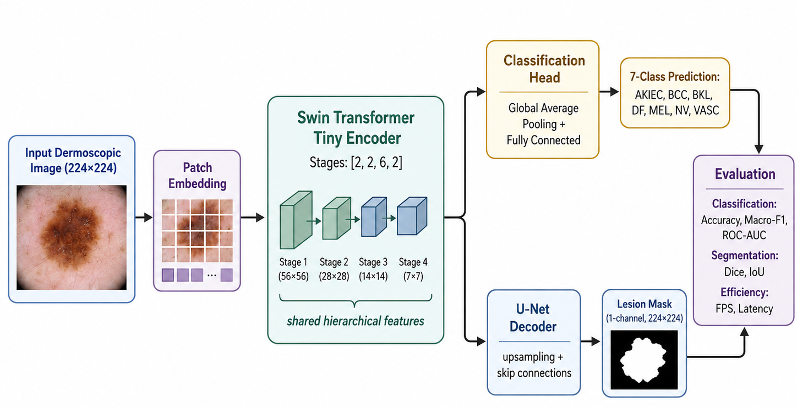
Proposed Multi-Task Framework
Shared Swin Transformer features for two related tasks
Swin Transformer → hierarchical shared features
Classification branch → 7-class lesion prediction
U-Net decoder → pixel-level lesion mask
Multi-task loss = 0.5 × classification + 0.5 × segmentation
One forward pass produces both outputs
Key idea: shared representations reduce redundant feature extraction.

Slide 9
Experimental Setup
Training configuration and evaluation metrics
Training setup
Baselines
Evaluation metrics
Input size
224 × 224
ResNet18 + U-Net
EfficientNet-B0 + U-Net
Classification: Accuracy, Macro-F1, ROC-AUC
Segmentation: Dice, IoU
Efficiency: FPS, latency, parameters, model size
Batch size
8
Epochs
10
Same dataset split, preprocessing, training configuration, and evaluation protocol for fair comparison.
Optimizer
AdamW
Learning rate
1 × 10⁻⁴
Inference benchmark
Classification loss
Weighted Cross-Entropy
Segmentation loss
BCE + Dice
Hardware
Apple M4 • 16 GB unified memory • MPS
Input / batch
224 × 224 • batch size 1
Total loss
0.5 Lcls + 0.5 Lseg
Runtime mode
Evaluation mode • gradients disabled
Sampler
Weighted Random Sampler
Timing
10 warm-up passes + 50 timed iterations
Per timed pass
Classification + segmentation together
This setup supports an interpretable real-time-capable model-level inference claim.

Slide 10
Comparison with Baselines
Predictive performance across three multi-task models
Model | Accuracy | Macro-F1 | ROC-AUC | Dice | IoU
ResNet18 + U-Net | 0.6048 | 0.5921 | 0.9326 | 0.9353 | 0.8874
EfficientNet-B0 + U-Net | 0.5988 | 0.6613 | 0.9372 | 0.9358 | 0.8874
Proposed Swin + U-Net | 0.6585 | 0.6820 | 0.9397 | 0.9398 | 0.8936
Proposed model
Takeaway
Highest performance across all evaluated metrics
Best overall balance of classification and segmentation performance

Slide 11
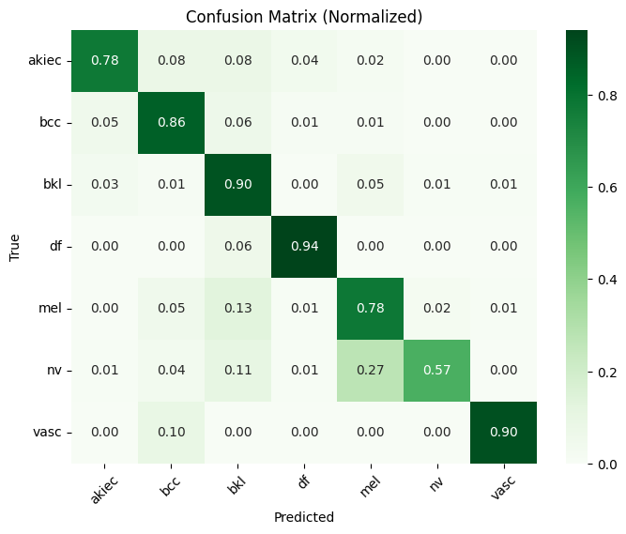
Class-wise performance of the proposed Swin Transformer + U-Net
Where the classifier performs well — and where it still struggles
Key observations
DF achieved the highest recognition rate: 0.94.
BKL and VASC each reached 0.90; BCC reached 0.86.
NV was the most challenging class, with a diagonal value of 0.57.
Major confusion: NV → MEL = 0.27, NV → BKL = 0.11, and MEL → BKL = 0.13.
The largest errors occur among MEL, NV, and BKL due to similar pigmentation, texture, and border appearance.
Severe class imbalance in HAM10000, together with visual similarity among MEL, NV, and BKL, may contribute to the moderate overall classification accuracy of 65.85%.
Limitation: Single-dataset evaluation, class imbalance, and no external or multi-center validation.

Slide 12
Real-Time Performance & Model Complexity
Proposed Swin Transformer + U-Net under the tested hardware configuration
72.58 FPS
13.77 ms
37.06 M
142.43 MB
Throughput
Average latency
Parameters
Model size
Complete multi-task forward pass.
Average inference time per image.
Trainable parameters in the proposed model.
Larger than both CNN baselines.
Benchmark setup
Trade-off
Apple M4 • 16 GB unified memory • MPS backend
Batch size 1 • evaluation mode • gradients disabled
10 warm-up passes + 50 timed iterations
Classification and segmentation executed together
The proposed model is slower and larger than the CNN baselines, but it still exceeds 72 FPS while performing both tasks in one forward pass.
Therefore, the claim is real-time-capable model-level inference under this tested setup — not a deployed clinical system.

Slide 13
Conclusion & Future Work
Main takeaway, limitations, and next steps
Conclusion
Future Work
A unified Swin Transformer + U-Net multi-task framework was developed.
Classification and segmentation are performed together from shared features.
The proposed model achieved the highest Accuracy, Macro-F1, ROC-AUC, Dice, and IoU among the evaluated models.
Segmentation performance is strong, while classification accuracy remains moderate.
72.58 FPS and 13.77 ms latency demonstrate real-time-capable inference under the tested setup.
Evaluate on larger and multi-center datasets.
Improve minority-class discrimination, especially MEL/NV/BKL.
Explore lighter Transformer architectures to reduce model size and latency.
Measure end-to-end clinical-system latency, including preprocessing and interface overhead.
Perform external validation to assess generalization.
Main limitations: single dataset, class imbalance, visually similar classes, and no external/multi-center validation.
Goal: improve classification performance, generalizability, and computational efficiency without sacrificing segmentation quality.

Slide 14
References
Selected studies cited in the Literature Review & Research Gap slide
[1]
Y. Gulzar and S. A. Khan, “Skin lesion segmentation based on vision transformers and convolutional neural networks—A comparative study,” Appl. Sci., vol. 12, no. 12, Art. no. 5990, 2022, doi: 10.3390/app12125990.
[8]
T. M. Alam et al., “An efficient deep learning-based skin cancer classifier for an imbalanced dataset,” Diagnostics, vol. 12, no. 9, Art. no. 2115, 2022, doi: 10.3390/diagnostics12092115.
[3]
J. S. ThangaPurni and M. Braveen, “Unified ARP-ViT-CNN system: Hybrid deep learning approach for segmenting and classifying multiple skin cancer lesions,” Array, vol. 28, Art. no. 100515, 2025, doi: 10.1016/j.array.2025.100515.
[13]
C. Xin et al., “An improved transformer network for skin cancer classification,” Comput. Biol. Med., vol. 149, Art. no. 105939, 2022, doi: 10.1016/j.compbiomed.2022.105939.
[5]
A. Ahmed et al., “Precision and efficiency in skin cancer segmentation through a dual encoder deep learning model,” Sci. Rep., vol. 15, Art. no. 4815, 2025, doi: 10.1038/s41598-025-88753-3.
[14]
R. P. Desale and P. S. Patil, “An efficient multi-class classification of skin cancer using optimized vision transformer,” Med. Biol. Eng. Comput., vol. 62, no. 3, pp. 773–789, 2024, doi: 10.1007/s11517-023-02969-x.
[6]
I. Paçal et al., “A novel CNN-ViT-based deep learning model for early skin cancer diagnosis,” Biomed. Signal Process. Control, vol. 104, Art. no. 107627, 2025, doi: 10.1016/j.bspc.2025.107627.

Slide 15
Thank You
Real-Time Multi-Task Skin Lesion Classification and Segmentation Using Swin Transformer
Afnan Bin Islam Nahin • Aman Ullah • Shakila Rahman
American International University–Bangladesh (AIUB)

