Slide 1
LAB
Course Code:
Course Title:
Dept. of Computer Science
Faculty of Science and Technology
Lecturer No: | 1 | Week No: | 1 | Semester: | Summer24-25
Lecturer: | Syma Kamal Chaity, chaity@aiub.edu

Slide 2
Lecture Outline
Understand the computer Architecture, and the relation between the architecture on the software.
Understand the vision in understanding programs behavior on the computing systems.
Understand the abstract topics more precisely by using some simulators to simulate different models of processors and emulators to practice Assembly Language Programs.
Understand the basic systems principles of pipelining and caching, and requires writing and understanding programs at multiple levels.

Slide 3

IDE
An integrated development environment (IDE) is a software application that provides comprehensive facilities to computer programmers for software development. An IDE normally consists of a source code editor, build automation tools and a debugger. IDEs are designed to maximize programmers’ productivity. IDEs present a single program in which all development is done. This program typically provides many features for authoring, modifying, compiling, deploying and debugging software. An advantage of IDE is that code can be continuously parsed while it is being edited, providing instant feedback when syntax errors are introduced. That can speed learning a new programming language and its associated libraries.
Microsoft Visual Studio, Net-beans, CodeBlocks, Emu8086 Eclipse are some popular IDEs

Slide 4
:
EMU8086 IDE:
“An Integrated Development Environment (IDE) provides a convenient environment to write a source file, assemble and link it to a -.COM or -.EXE file, and trace it in both source file, and machine code. Emu86 is an educational IDE for assembly program development. You can download the latest student version of EMU86 from the web page www.emu8086.com. It is a Windows program, and will run by dragging an -.ASM, -.OBJ, -.LST, -.EXE , or -.COM file into the emu86 shortcut icon. By this action, asm or lst files will start the 8086 assembler source editor, while obj and exe files starts the disassembler and debugger units.

Slide 5
EMU8086 Source Editor
The source editor of EMU86 is a special purpose editor which identifies the 8086 mnemonics, hexadecimal numbers and labels by different colors as seen in Figure 1.
The compile button on the taskbar starts assembling and linking of the source file. A report window is opened after the assembling process is completed. Figure 2 shows the emulator of 8086 which gets opened by clicking on emulate button
Emu8086 environment contains templates to generate command and executable files. Another benefit of Emul8086 is its emulation of a complete system, including the floppy disk, memory, CPU, and I/O ports, which raises opportunity to write custom bios and boot programs together with all other coding of a system. Moreover, its help is quite useful even for a beginner of asm programming.”

Slide 6
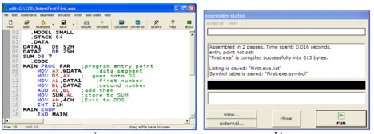
EMU8086 Source Editor (Cont)
Figure 1. a) EMU8086 Source Editor, and b) assembler status report windows.

Slide 7
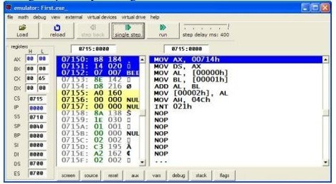
EMU8086 Source Editor (Cont)
Figure 2 first.exe in the emulator window of EMU8086 debugging environment

Slide 8
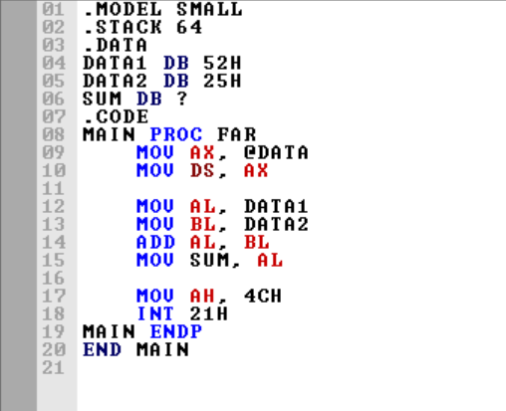

Slide 9
PDF EXPLAIN

Slide 10
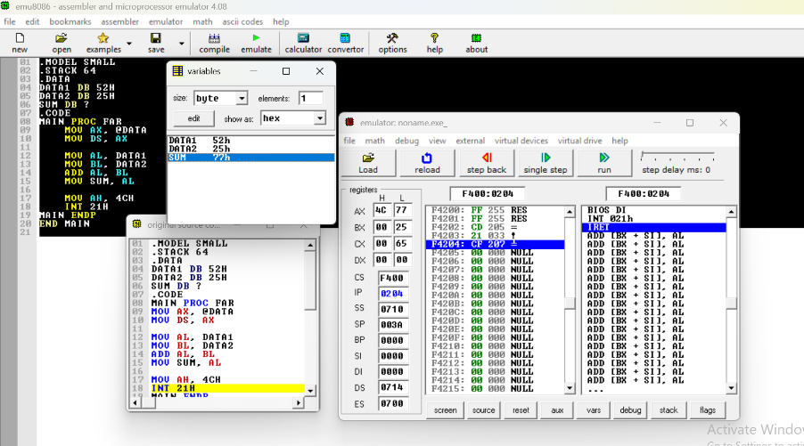

Slide 11
Opt-in Examples in Emu8086
Look at “Code Examples”
After opening one of the code samples, then press ‘emulate’, then ‘run’. Also try these :
a) add
b) subtract
c) mov
d) exchange

Slide 12
Assemble and execute instructions in Emu8086
Step 1: Use emu8086 to make the calculations following
10100101b = ?(10)
1234h = ?(10)
39 = ? h

Slide 13
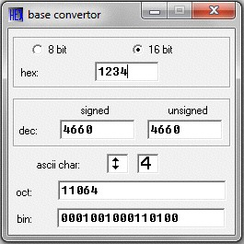
Procedure
First , do whole calculations manually.
Choose “Math” and specify “Base Convertor” in emu8086.
Enter one of the numbers like in the Figure 3.
compare your results with the results “base convertor” produced.
Figure 3: Base Convertor window

Slide 14
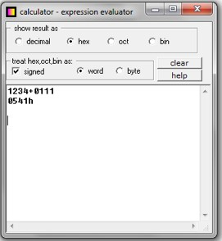
Use EMU8086 to evaluate an expressions Evaluate : OFFFFh *10h +OFFFFh
First , do whole calculations manually.
Choose “Math” and specify “Multi Base Calculator” in emu8086.
Enter the expression like in the Figure 4.
Compare your results with the results “base convertor” produced. Is it same or not ? Please explain clearly.
Figure 4: Multi Base Calculator window with a sample expression

Slide 15
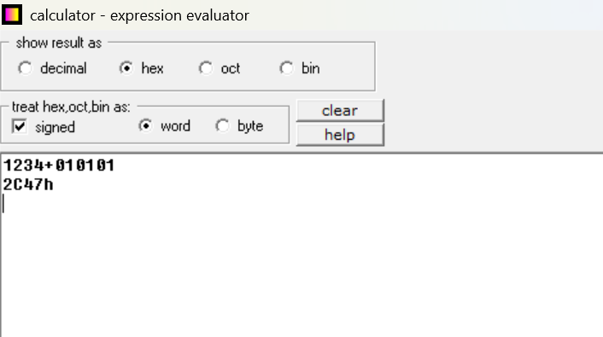

Slide 16
Initialize the internal registers of the 80x86 as follows:
(AX) = 0000H
(BX) = 0001H
(CX) = 0002H
(DX) = 0003H
(SI) = 0010H
(DI) = 0020H
(BP) = 0030H
(DS) = 0B60H
Then , verify the initialization by displaying the new content of register. Please put a check if you can verify it.

Slide 17
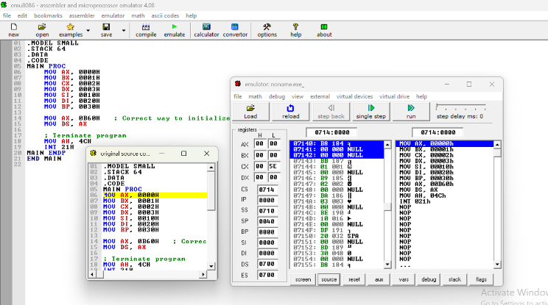

Slide 18
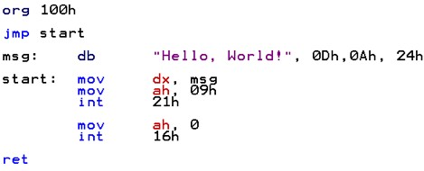
Writing and Running Assembly Code in Emu8086
In this part, we are entering Assembly language world. Let‟s say „hello‟

Slide 19
References
Assembly Language Programming and Organization of the IBM PC, Ytha Yu and Charles Marut, McGraw Hill, 1992. (ISBN: 0-07-072692-2).
https://www.tutorialspoint.com/assembly_programming/index.htm

Slide 20
Books
Assembly Language Programming and Organization of the IBM PC, Ytha Yu and Charles Marut, McGraw Hill, 1992. (ISBN: 0-07-072692-2).
Essentials of Computer Organization and Architecture, (Third Edition), Linda Null and Julia Lobur
W. Stallings, “Computer Organization and Architecture: Designing for performance”, 67h Edition, Prentice Hall of India, 2003, ISBN 81 – 203 – 2962 – 7
Computer Organization and Architecture by John P. Haynes.

