Slide 1

PROXIMITY BASED PROFESSIONAL LOCATOR
Ayush Mayekar Nitish Jha Afnan Pathan

Slide 2
Implementation so far
User Registration
User Authentication
Professional Search (Proximity-based)
Basic UI of the App
Chatbot Backend
Community Backend

Slide 3
Features to be Implemented
Overall Integration
User to Professional Contact (Messaging and Mails)
Assistance for Less Educated/Illiterate People
Feedback Logic
Other Basic Adjustments

Slide 4
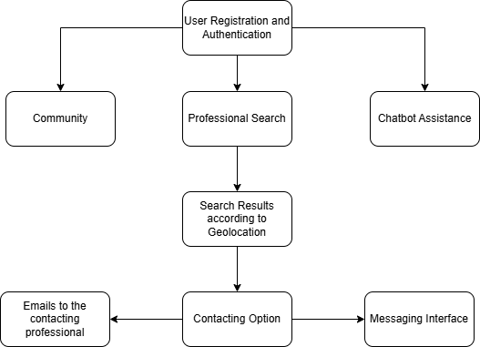
Architecture Flow

Slide 5
Thank you!

