Slide 1
TypeScript and tools to use
David Karolyi
Nyíregyháza – 2024/03/19

Slide 2
Agenda
01
HTTP
02
Swagger
03
Utilities
04
Node
05
Exercises

Slide 3
HTTP
How the web works

Slide 4
HyperText Transfer Protocol
HTTP
Application protocol for distributed, collaborative and hypermedia information systems
Based on request-response protocol in client-server computing model
Stateless communication – no stored data
History:
Timer Berners Lee & CERN
1991: v0.9
1996: v1.0 (RFC 1945)
1997: v1.1 (RFC 2068) – most widely known and used
2015: v2.0 (HTTP/2 – RFC 7540) – multiplexing, content pushing
2022: v3.0 (QUIC – RFC 9114) – based on UDP instead of TCP

Slide 5
HTTP Request
HTTP
Client to server communication
Contains header information and body (if needed)
Structure:
POST /create-user HTTP/1.1
Host: localhost:3000
Content-type: application/json
{ “name”: ”John”, ”age”: 35 }
GET: retrieve information from the server using the given URI, expected to retrieve only and should have no effect on the data
POST: send data to server – usually to store new information, upload data via HTML forms
PUT: replace already existing information on the server; usually for update
PATCH: partial modification; update for some elements within an item
DELETE: remove already existing data from the server
Others:
HEAD – almost same as GET, but no body is expected in the response
CONNECT – establish a tunnel to the server
OPTIONS – describe the communication options for the target resource
TRACE – for debugging
Method
URI
Version
Headers
Body

Slide 6
HTTP Response
HTTP
Status codes categories:
1: information responses – hold on
2: Successful responses – here you go
200: OK
202: Accepted
3: Redirection messages – go away
301: Moved permanently
302: Found (temporary changed)
4: Client error responses – you f***d messed up
400: Bad request
401: Unauthorized
404: Not Found
418: I’m a teapot
5: Server error responses – I f***d messed up
500: Internal server error
503: Service unavailable
Server to client communication
Structure:
HTTP/1.1 201 Created
Date: Mon, 27 Jul 2009 12:28:53 GMT
Server: Apache/2.2.14 (Win32)
Last-Modified: Wed, 22 Jul 2009 19:15:56 GMT
Content-Length: 88
Content-Type: text/html
Connection: Closed
Version
Status code
Headers

Slide 7
Headers
HTTP
HTTP headers let the client and the server pass additional information within an HTTP request or response.
A HTTP header consist of a name followed by a colon, then by its value (key-value pairs)
Some common headers are:
Content-Type: Indicates the media type of the resource.
Host: Specifies the domain name
Cookie: Contains stored HTTP cookies previously sent by the server with the Set-Cookie header.
Set-Cookie: Send cookies from the server to the user-agent.
For example:
”Content-Type”: ”text/html”
Mime type
https://developer.mozilla.org/en-US/docs/Web/HTTP/Headers
https://developer.mozilla.org/en-US/docs/Web/HTTP/Basics_of_HTTP/MIME_types

Slide 8
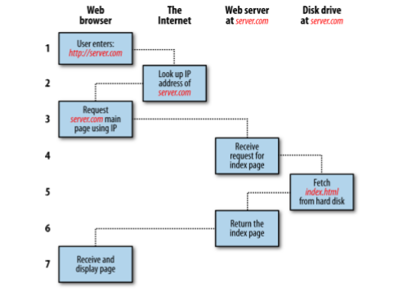
How the web works through HTTP
HTTP
You enter http://server.com into your browser’s address bar.
Your browser looks up the IP address for server.com.
Your browser issues a request for the home page at server.com.
The request crosses the Internet and arrives at the server.com web server.
The web server, having received the request, looks for the web page on its disk.
The web page is retrieved by the server and returned to the browser.
Your browser displays the web page.

Slide 9
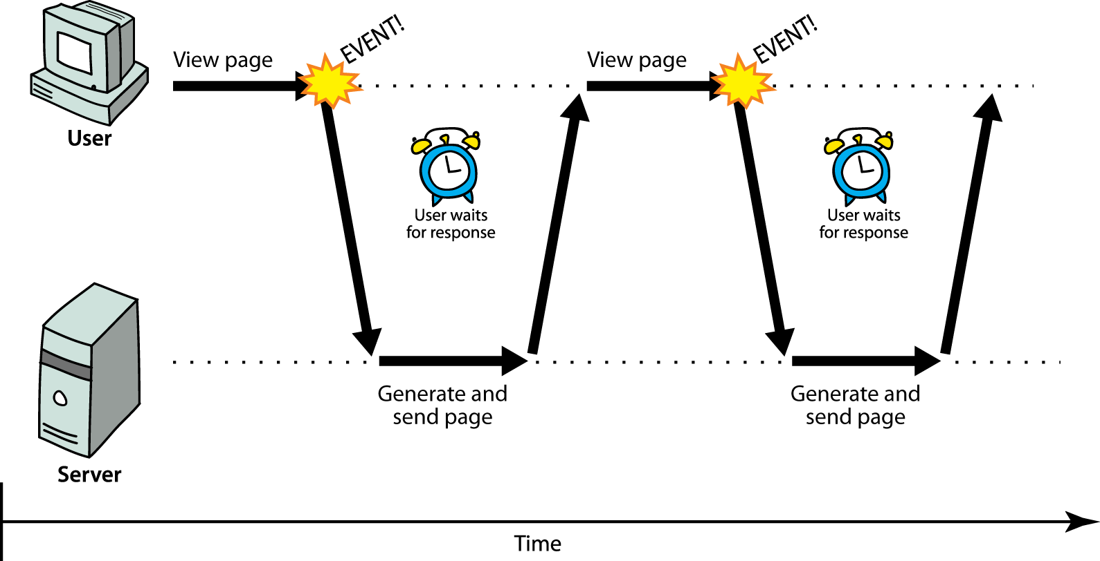
The old school
HTTP
Synchronous way
The user must wait while full content loads
Standard way of communication in web pages (click – wait – refresh)
One request – one response
Organize your HTML code external resources (scripts images, stylesheets)
Focus on server side – serve the client once
Mostly independent from the client
Each page requires full content load
Slow
Terrible user experince

Slide 10
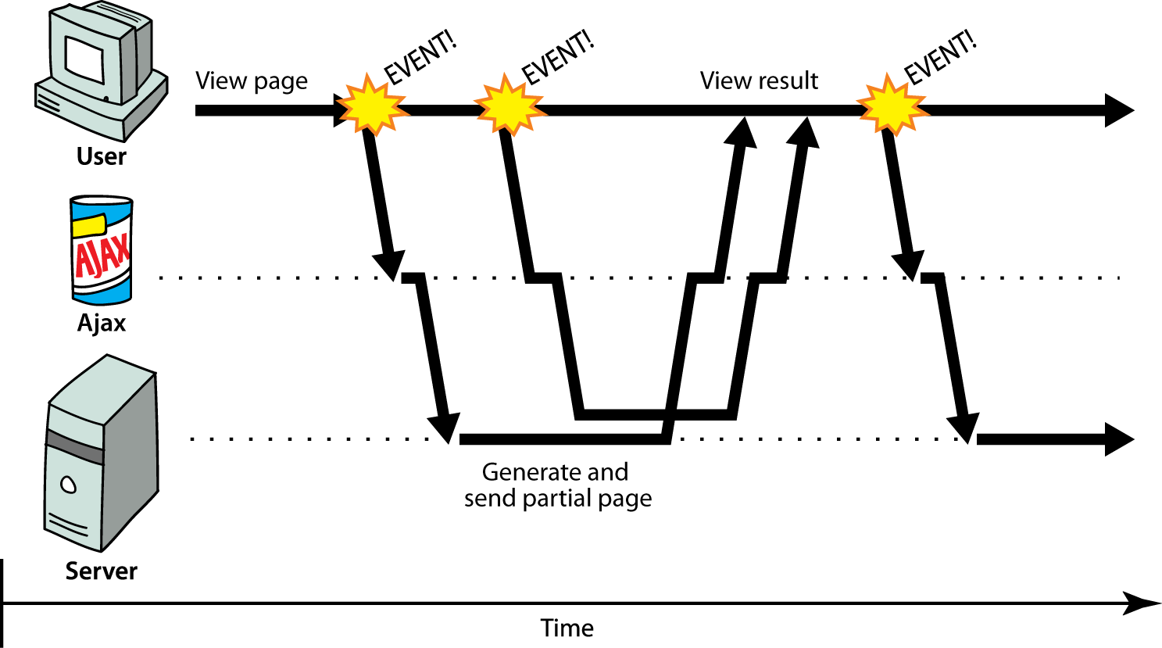
The asynchronous way
HTTP
Rich (heavy/fat/thick) client
Client-server communication in the backround
Dynamically update page without reloading
Transparent to the user
Content of fetched file can be put into the current web page using DOM manipulation

Slide 11
Async pros & cons
HTTP
Async limitations
Fast – not everything is needed at the first load
User friendly – dynamically added new items
Requires different kind of thinking on both side:
Service Oriented Architecture
Microservices
REST API
Heavily based on JavaScript – client-dependent
Client error might disable a functionality and/or a complete page
Hell of loading indicators
Same Origin Request Policy - can only load from the same domain via the same protocol
Cross Origin Resource Sharing (CORS)
Hard to handle manually loaded scripts
SEO can cause difficulties
Disabled JavaScript equals unusable webpage

Slide 12
Swagger
API Documentation & Design Tools for Teams

Slide 13
REST
Swagger
Framework for evaluating the maturity of web service
Main factors:
URI
HTTP Methods
HATEOAS (Hypermedia as The Engine of Application State)
RESTful principles:
Uniform interface
Stateless
Layered system
Cacheability
Code on demand
The client sends a request to the server. The client follows the API documentation to format the request in a way that the server understands
The server authenticates the client and confirms that the client has the right to make that request.
The server receives the request and processes it internally.
The server returns a response to the client. The response contains information that tells the client whether the request was successful. The response also includes any information that the client requested.
https://aws.amazon.com/what-is/restful-api/
https://yuminlee2.medium.com/rest-in-a-nutshell-ff7e85a7559b
Notes:
Uniform interface:
- Requests should identify resources
- Clients have enough information in the representation to modify or delete the resource if they want. The server sends additional metadata to describe the resource further
- Clients receives self-descriptive messages
- Clients receives hyperlinks letting them dynamically discover more resources
Stateless
- Every request a client makes is always a new request to the server
- The server has no memory carried over from the previous requests
Layered system
- Client communicates with one server
- Servers can pass requests to the other server
- Can run on several servers with multiple layer, e.g. security, application, business logic
- These layers remain invisible to client
Cacheability
- Server provides information if the response is cacheable or not
- Same request – same response strategy for rarely updated resources (-> versioning)
- Eliminates redundant client-server interactions
Code on demand
- Transfer programming code / executables to the client
- E.g.: the server highlights mistakes made in a registration form

Slide 14
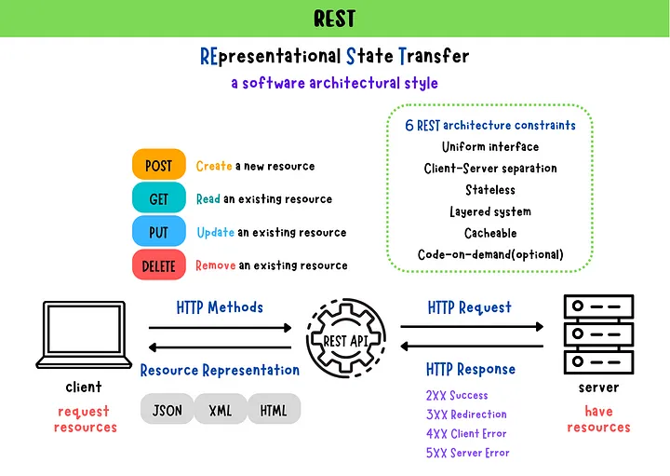
REST API
Swagger
Representational State Transfer
Software architectural style and resource oriented
Resources identified by URI’s
Client and server are independent
Stateless communication (-> immutability)
Commonly implemented on top of HTTP

Slide 15
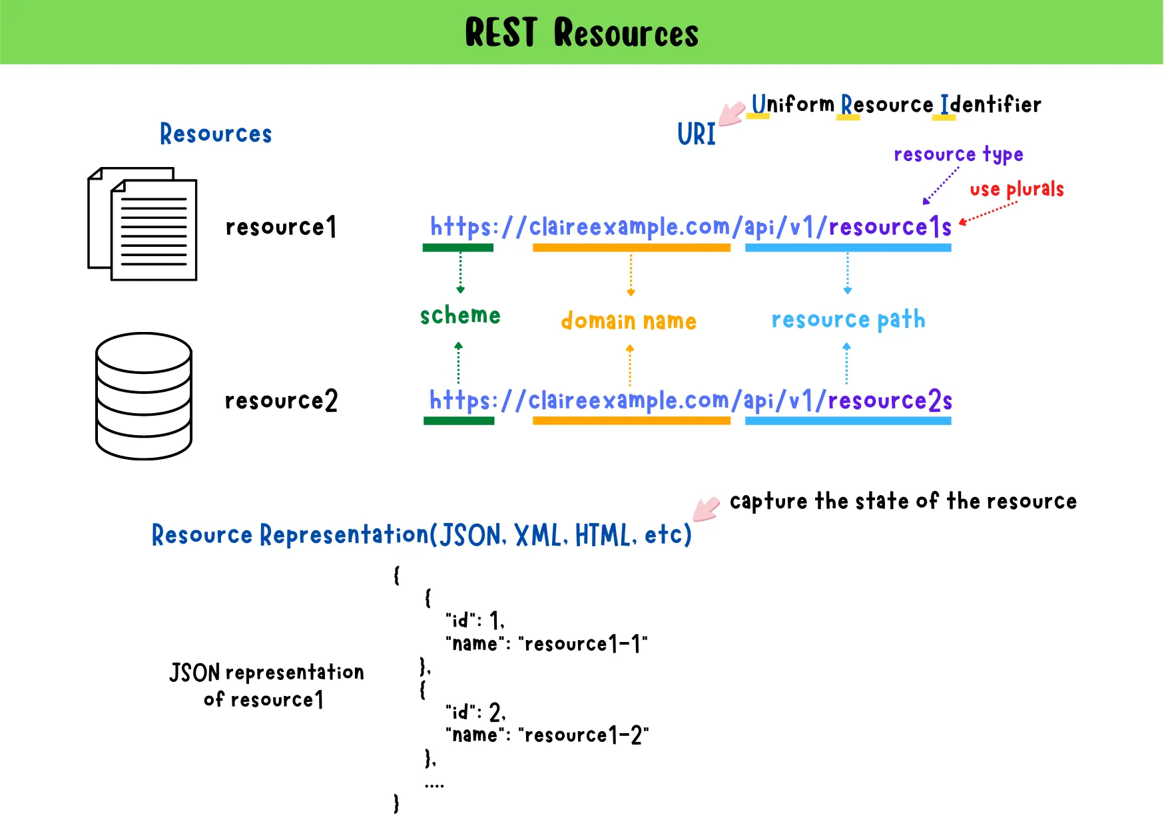
REST Resources
SWAGGER
Every content is considered as a resource
Uniform Resource Identifier (URI)
Popular representations (of raw data):
XML
JSON
Clients send requests to retrieve and manipulate resources through representations

Slide 16
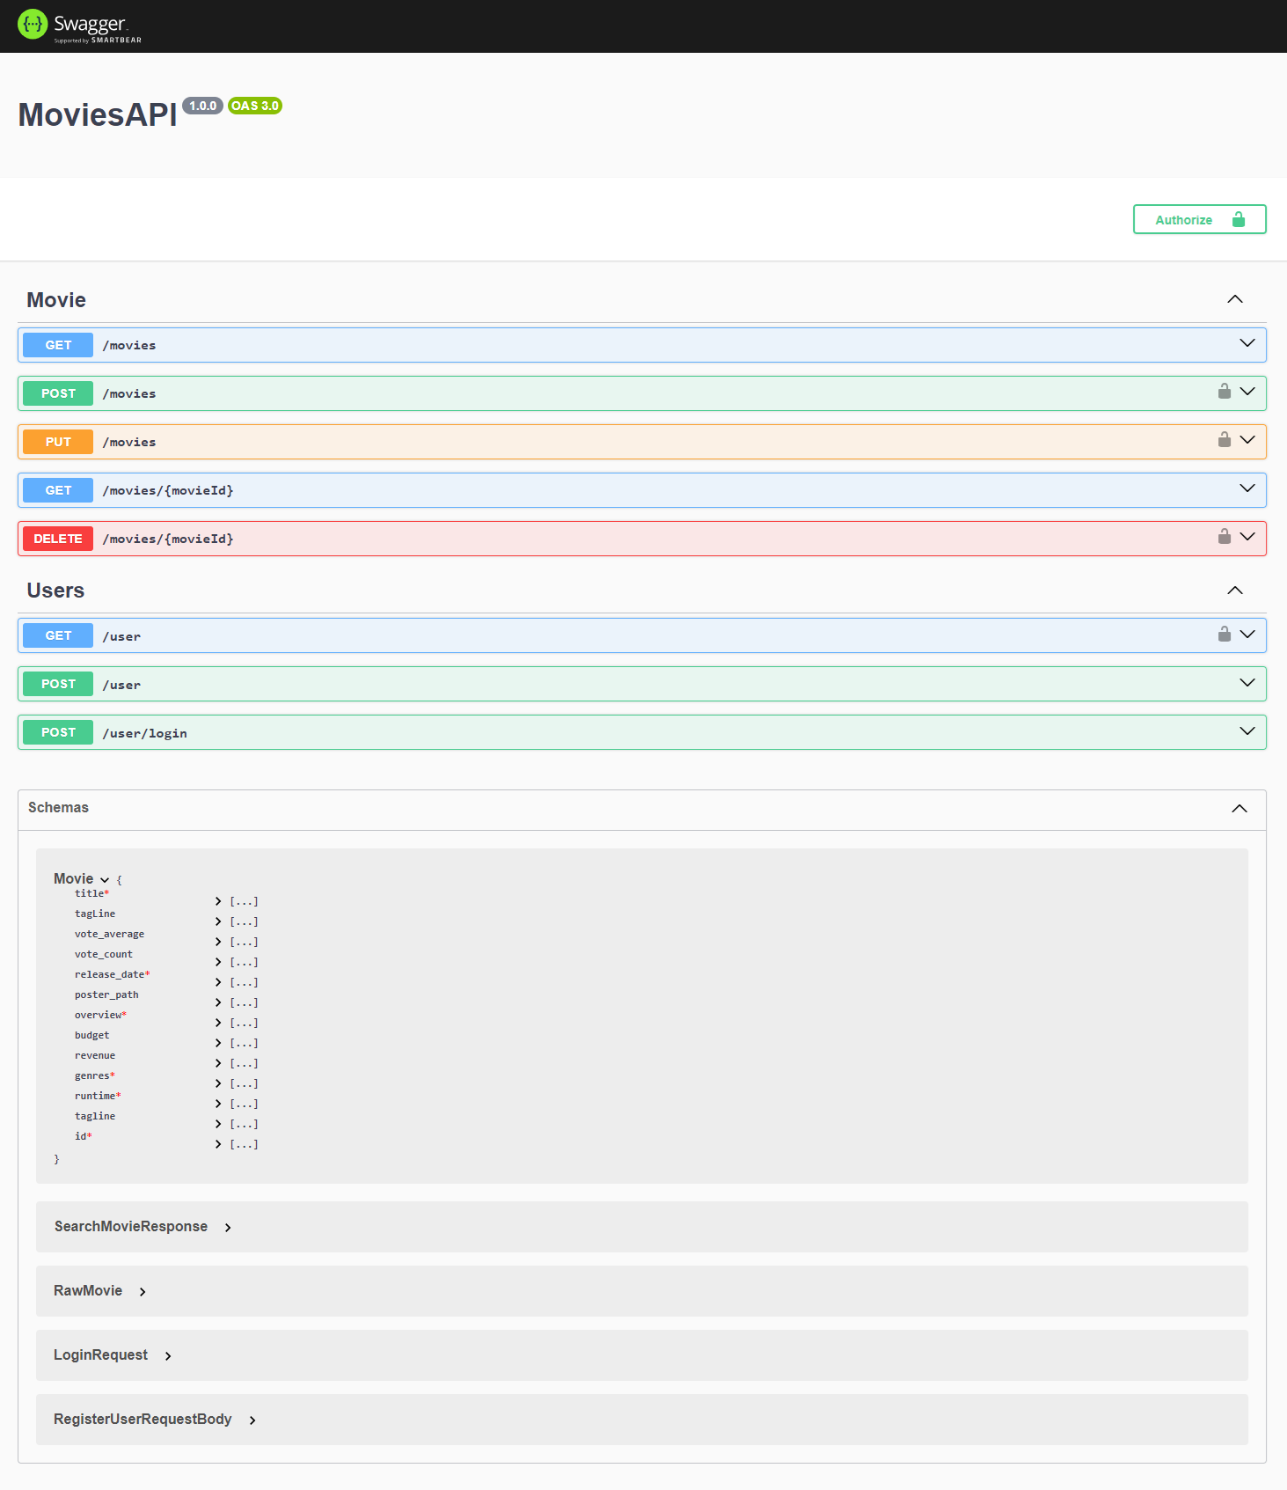
Swagger
Swagger
A framework for describing API’s
Comprehensible for developers and non-developers
Human and machine readable
Adjustable
Well organized and easily understandable documentation through UI
Notes:
http://localhost:5000/api-doc

Slide 17
Swagger -> Open API Initiative
Swagger
Originally known as the Swagger Specification – de facto API design
OpenAPI Specification (OAS) is a format to describe RESTful web services:
Produce
Consume
Visualize
Programming language agnostic – identify and understand service capabilities for both computers and users
Automatic documentation for a server interface
Endpoints: availability and allowed operations
Authentication methods
Operation input and output parameters (query, path, header, cookies, request and response body)
https://www.openapis.org/?ref=blog.readme.com

Slide 18
Utilities
Commonly used libraries and development tools

Slide 19
ECMAScript
Utilities
Commonly used for client-side scripting on World Wide Web
JavaScript standard to ensure the interoperability of web pages across different browsers
Always Up-to-date version: ESNext
Make your work much easier if you know the standards for the different browsers
Downgrade is possible between different versions using additional tools and polyfills
Solves most of the problems with browser differencies
Does not replace testing!

Slide 20
Package managers
Utilities
NPM
Worlds largest software registry
Standard usage of JavaScript libraries and utilities
Supported by most of the IDE’s
Online repository for open-source Node.js projects
Command-line utility for interaction with the repo
Aids package installation, version and dependency management
YARN
Also uses the NPM repository
Project management utility
Creates a more lightweight dependency tree than NPM
Usually a bit faster (in large repositories)

Slide 21
Package.json
Utilities
Entry point for each package manager
Store version of the software, depencies for development and for the working application
Describes what is necessary to run the created module
Initialize your project with:
yarn init or
npm init
{
"name": "test",
"version": "0.0.1",
"description": "little bit of description",
"main": "index.js",
"license": "MIT",
"dependencies": {
"express": "4.17.3"
},
"devDependencies": {
"@types/express": "4.17.13"
}
}

Slide 22
TypeScript
Utilities
Pros:
Better readibility
Reduce the number of possible typos
Self-documented results, possible replacement of JSDoc
Clean and simple code results
Cons:
Does not run in browsers (and it is not supposed to)
Hard to configure for beginners
Typed JavaScript at any scale
Superlative for JavaScript
Add ability for static type definitions
Provide a way to describe your application and lets you validate your code during development
Transformed into JavaScript with TypeScript compiler or Babel
@types package usually have support for older/not TS libs

Slide 23
Linting – ESLint
Utilities
Static code analysis tool
Indentify problematic patterns found in ES/JS code
Covers code quality and coding style issues
Makes code more consistent to avoid bugs
Impose the coding standard using a certain set of standalone rules
Lets your project use the same writing style, e.g.:
variable naming conventions
tabs or space usage
Single/double quotes for string
Function styles
limitations

Slide 24
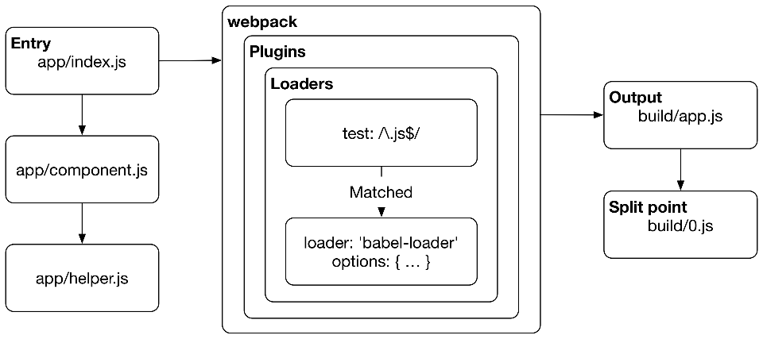
Webpack
Utilities
Webpack is module bundler
Can take care of bundling alongside a separate runner
From an entry point it:
Traverses the module imports (import / require)
Construct a dependency graph of the project
Generates output based on the configuration
Can handle different formats via loaders
TypeScript
(S)CSS
Simple JavaScript
Can be used in other environments as well (e.g Ruby on Rails)

Slide 25

Node.JS
JavaScript runtime environment for backend

Slide 26
What is Node.JS?
Node.JS
Open source server environment
Runs on all major platforms (e.g. Windows, Linux, Unix, Mac OS)
JavaScript on the server side
Node is a single threaded, non-blocking asynchronous server
What it can do in an efficient way:
Display dynamic page content
CRUD operations on server side files
Database communication
Socket handling: direct connection between clients through a server (e.g chats, P2P)
Proxy

Slide 27
Comparison: PHP vs Node.JS
Node.JS
PHP file handling
Sends the task to the computer’s file system
Waits until the file system opens and reads the file
Return the content to the client
Ready to handle next request
Cons:
Multiple, but independent database requests can thake a while
Not enough responsive on many cases
Node request handling
Sends the task the computers’s file system
Ready to handle next request
When the file system finished the operation the server will send the response content to the client (streaming)
Cons:
Not much differences in response time on single operation
Sometimes hard to reconcile the independent queries
Usage of promises / callbacks are essential

Slide 28
Express
Node.JS
Fast and minimalist web framework for Node.js
Let’s you create a RESTful JSON Webservice through HTTP
Flexible and pluggable
Ability to route
Ability to write middlewear
Supports MVC architecture
Supports templating engines
What is a HTTP RESTful API:
Supports CRUD operations through HTTP requests:
(C) POST to push new items
(R) GET requests for request data
(U) PUT to update existing items
(D) DELETE to remove data
Response tells if it was successful or not:
HTTP Status codes (e.g. 200 – OK, 404 – Not found, 500 – error)
Response body contains a JSON object with the result of the operation

Slide 29
Thank you!
For more information, contact
Jozsef Gal
Senior Software Engineer
jozsef_gal@epam.com
EPAM Debrecen
Tüzér street 4.
HU-4028 Debrecen

