Slide 1
Advanced JavaScript
Janos Stefan
Nyíregyháza – 2024/03/12

Slide 2
Agenda
01
Asynchronous model
02
Callbacks, Promises
03
AJAX, Fetch API
04
Exercises

Slide 3
Callbacks & Promises

Slide 4
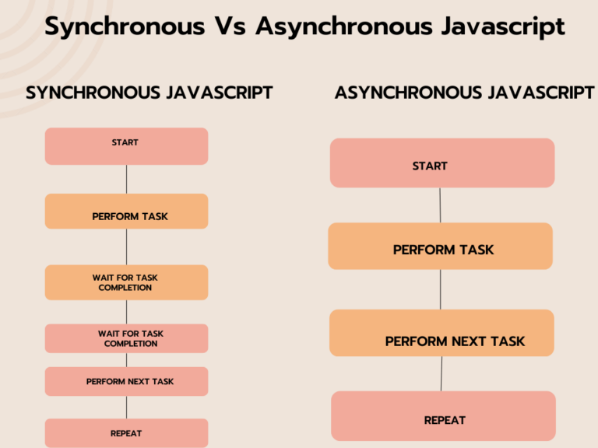
Asynchronous JavaScript in a nutshell
Callbacks & Promises
Asynchronous programming is a way for a computer program to handle multiple tasks simultaneously rather than executing them one after the other
Allows a program to continue working on other tasks while waiting for external events
Improve performance and responsiveness
Events (wait for user to click…?)
Timers (e.g. do nothing for X seconds…?)
HTTP requests (e.g. XHR or Fetch – block everything till data arrives…?)
JS is single-threaded – it carries out async operations via callback queue and event loop
JS is synchronous and has a single call stack
Coed is executed in last-in first out (LIFO)
https://semaphoreci.com/blog/asynchronous-javascript
https://www.freecodecamp.org/news/asynchronous-programming-in-javascript/

Slide 5
JavaScript concurrency model
Callbacks & Promises
JavaScript has a concurrency model based on „event loop”
Three main parts: heap, stack and message queue.
At some time during the event loop, the JS runtime starts processing the messages on the message queue
Event handlers, XMLHttpRequest and timers can push messages to the message queue
Each message has a callback associated with it, which will be invoked upon processing.

Slide 6
Asynchronous functions
Callbacks & Promises
const printNumber = (num) => {
setTimeout(() => {
console.log("Your number is: ", num);
}, Math.floor(Math.random() * 100) + 1);
};
const countToThree = () => {
printNumber(1);
printNumber(2);
printNumber(3);
};
countToThree(); // What is the result of this? Why?
Notes:
Check code section: 3a-async-timer.html

Slide 7
Callbacks
Callbacks & Promises
const printNumber = (num, callBackFn) => {
setTimeout(() => {
console.log("Your number is: ", num);
callBackFn();
}, Math.floor(Math.random() * 100) + 1);
};
const countToThree = () => {
printNumber(1, () => {
printNumber(2, () => {
printNumber(3, () => {});
});
});
};
countToThree(); // Is this better?
Functions are first class citizens in JavaScript
That means we can use them as function parameters
A callback is basically a function that is passed to another function
The first function will call the callback
So let’s see our printNumber function with callbacks
Notes:
Check code section: 3b-async-timer.html

Slide 8
The Promise
Callbacks & Promises
A promise is an object representing the eventual completion or failure of an asychronous operation.
A Promise is in one of these states:
pending: initial state, neither fulfilled nor rejected.
resolved: meaning that the operation completed successfully.
rejected: meaning that the operation failed.
Until ES6 JavaScript did not have native implementation for promises
Pre ES6, the concept Promise was more like a design pattern, if you wanted to use it you had to use third-party libraries like jQuery or Q, frameworks that had the implementation (like AngularJS) or implement it yourself.
https://developer.mozilla.org/en-US/docs/Web/JavaScript/Reference/Global_Objects/Promise

Slide 9
The Promise object
Callbacks & Promises
With the standardisation of ECMAScript2015 (more commonly known as ES6), native support for promises was introduced for JavaScript
The promise constructor takes a function with two functions as parameters for happy and sad cases – this function is called the executor
The executor is called immediately (even before creating the new promise object), does some asynchronous work then calls resolve if everything went fine, or reject if some error occured.
The Promise prototype has the well known then, catch and finally methods for handling the result of the Promise
const proxy = new Promise(
(resolve, reject) => {}
);

Slide 10
How to work with promises?
Callbacks & Promises
In async calls you have to work with data you don’t have yet – so: Simple variable assignment is not working!
You have to WAIT until the data arrives – it can be done via the THEN method
It’s also possible an error occurs and it has to be handled too – never forget it, a promise has to be accepted or rejected within a time
You can store data within promises too e.g. no other request has to be sent out which can increase performance
JS Decorator for promise: async + await pairing
const proxy = new Promise(
(resolve, reject) => {}
);
proxy
.then((param) => {
console.log("done", param);
})
.catch((error) => {
console.error("error", error);
});
(async () => {
try {
const param = await proxy;
console.log("done", param);
} catch (error) {
console.error("error", error);
}
})();

Slide 11
Counting with Promises
Callbacks & Promises
const printNumber = (num) =>
new Promise((resolve, reject) => {
setTimeout(() => {
console.log("Your number:", num);
resolve();
}, Math.floor(Math.random() * 100) + 1);
});
const countToThree = () => {
printNumber(1)
.then(() => printNumber(2))
.then(() => printNumber(3));
};
countToThree();
const countToThree = async () => {
await printNumber(1);
await printNumber(2);
await printNumber(3);
};
/** We successfully created a promise chain that will print the numbers in order */
Notes:
3c-async-timer-with-promise.html

Slide 12
Sync the async
Callbacks & Promises
const printNumber = (num) =>
new Promise((resolve, reject) => {
const wait = Math.floor(Math.random() * 100) + 1;
setTimeout(() => {
console.log("Your number:", num);
resolve({ wait, num });
}, wait);
});
const count = () => {
return Promise.all([
printNumber(1), printNumber(2), printNumber(3)
]);
};
(async () => {
try {
const [number1, number2, number3] = await count();
console.log(
"all done",
{ number1, number2, number3 }
);
} catch (error) {
console.error("error", error);
}
})();
What the actual …? Why …?
A little multi-threaded thinking is needed
E.g. transactions (database or multiple requests)
We want to know when all the async methods are finished, failed or just settled (-> Promise.allSettled)
We want the fastest result (-> Promise.race)
How to stop the unstoppable?
-> don’t – just accept it and move on

Slide 13
AJAX & Fetch API
Asynchronouse JavaScript and XML
Execute requests from client side to a server

Slide 14
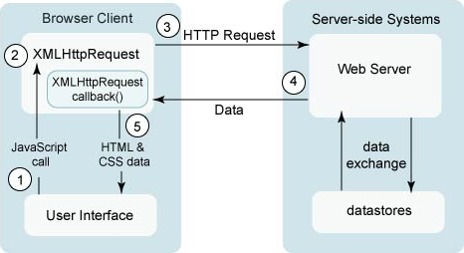
A typical AJAX request
Ajax & Fetch API
Click event handler
Create a request, register callback
Call a service
Server is answering…
Event – answer arrived; run callback function
Remember:
Your callback is what really process the data
Can’t work with a value you don’t have yet
https://developer.mozilla.org/en-US/docs/Web/Guide/AJAX

Slide 15
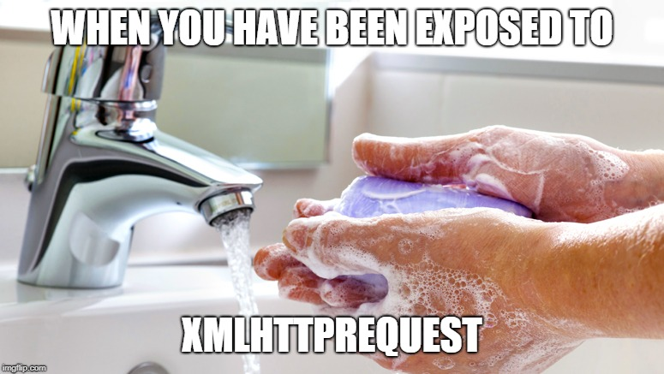
Old-school JS – XMLHttpRequest (XHR)
AJAX & Fetch API
Don’t Panic
and carry a towel
const ajax = new XMLHttpRequest();
ajax.onreadystatechange = () => {
if (ajax.readyState === 4 && ajax.status === 200) {
const response = JSON.parse(ajax.responseText);
ShoppingCart.updateQuantity(response.quantity);
} else if (ajax.status != 200) {
Notification.error("Unexpected error");
}
};
ajax.open("post", "/api/cart", true);
ajax.send(
JSON.stringify({
productId: 5,
quantity: 1,
userId: 1,
})
);
This would be the code if you would like to handle the response only in native JavaScript
Frameworks and JS tools helps a lot in this – so don’t worry, you won’t meet this if you’re using one.

Slide 16
The Fetch API
AJAX & Fetch API
(async () => {
const response = await fetch("/api/cart", {
method: "POST",
headers: {
"Content-Type": "application/json",
},
body: JSON.stringify({
productId: 5,
quantity: 1,
userId: 1,
}),
});
if (response.status === 200) {
const { quantity } = await response.json();
ShoppingCart.updateQuantity(quantity);
} else {
throw new Error("Unexpected error");
}
})();
The Fetch API provides a JavaScript interface to create HTTP requests.
Follows the Promise pattern solution
Standard way to request data from server and handle the responses
Example:
(async function() {
const res = await fetch("https://yesno.wtf/api");
const data = await res.json();
console.dir(data);
return data;
})();
https://developer.mozilla.org/en-US/docs/Web/API/Fetch_API
Notes:
4a-fetch.html

Slide 17
Exercises
Dynamically update HTML page

Slide 18
Create a simple HTML page
Exercises
Title: Was it good enough?
Add a button with text: let’s ask
Add a placeholder for an image (no content yet)
Add a placeholder for an answer
Define 3 CSS classes:
.ok with green color
.no with red color
.dunno with color gray
<!DOCTYPE html>
<html>
<head>
<title>Was it good enough?</title>
<style type="text/css">
body { text-align: center; }
.ok { color: green; }
.no { color: red; }
.dunno { color: gray; }
</style>
</head>
<body>
<h1>Was it good enough?</h1>
<button>Let’s ask</button>
<p>I don’t know yet...</p>
<figure></figure>
</body>
</html>

Slide 19
Let’s code something
Exercises
Add an event-listener to button for click event handler
Create a service MyService with one method: question
When the button is clicked:
Execute a request to "https://yesno.wtf/api"
(the handler should be placed within MyService)
const MyService = (() => {
return {
question: async () => {
const res = await fetch("https://yesno.wtf/api");
return res.json();
}
};
})();
const clickHandler = (event) => {
event.preventDefault();
MyService.question();
};
const button = document.querySelector("button");
button.addEventListener("click", clickHandler);

Slide 20
Still coding...
Exercises
While waiting for response, change the paragraph text to „Wait for it...” and change it to gray color („dunno” class)
Create a function that replace the items; depending on the answer param:
In case of „yes”:
Change paragraph text to „YES”
Change the paragraph’s color to green using the CSS classes (use „ok”)
In case of „no”:
Change the text of paragraph to „NO”
Change the paragraph’s color to red using the CSS classes (use „no”)
const getTextItem = () =>
document.querySelector("p");
const updateText = (answer) => {
const textItem = getTextItem();
textItem.className = "";
textItem.classList.add(
answer === "no" ? "no" : "ok"
);
textItem.innerText = answer;
};
....
const clickHandler = (event) => {
event.preventDefault();
const textItem = getTextItem();
textItem.innerText = "Wait for it...";
if (!textItem.classList.contains("dunno")) {
textItem.classList.add("dunno");
}
....
}

Slide 21
Almost there...
Exercises
Create a function that replace or create the image within the placeholder
If the image already placed, update the source of it
If it has not been added yet, create it and append to the placeholder with set url
const setImage = (url) => {
const container = document.querySelector("figure");
let image = container.querySelector("img");
if (!image) {
image = document.createElement("img");
container.appendChild(image);
}
image.setAttribute("src", url);
};

Slide 22
Finish it
Exercises
Connect the service call with update phase
Update/create image from the response’s „image” field
Set the text based on the response’s „answer” field
const clickHandler = (event) => {
...
MyService.question().then(data => {
updateText(data.answer);
setImage(data.image);
});
};
Notes:
Check exercise.html & exercise.js

Slide 23
Thank you!
For more information, contact
Jozsef Gal
Senior Software Engineer
jozsef_gal@epam.com
EPAM Debrecen
Tüzér street 4.
HU-4028 Debrecen

